Slide 1
Customer Churn Analysis – Bank Churners
Visualization & Documentation
EDA & Modeling Results

Slide 2
Project Overview
Objective: Predict customer churn and identify key drivers
Dataset: Bank Churners (demographic, behavioral, financial data)
Approach: EDA, feature engineering, machine learning modeling

Slide 3
Dataset Summary
Target variable: Attrition_Flag (Existing vs Attrited Customer)
Behavioral features dominate churn prediction
Class imbalance present in churn outcome

Slide 4
Data Cleaning Steps
Handled data consistency and encoding
Prepared numerical and categorical features
Validated dataset for EDA and modeling

Slide 5
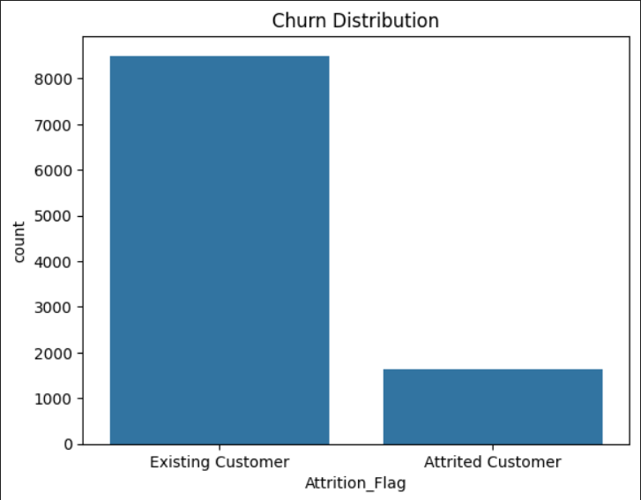
Churn Comparison
Existing customers dominate the dataset, highlighting class imbalance.

Slide 6
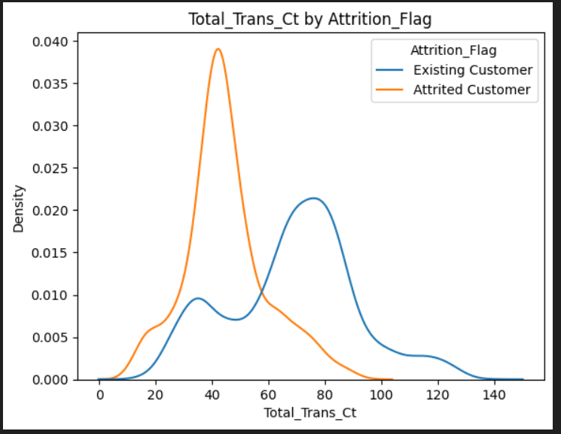
Churn vs Transaction Behavior
Attrited customers show significantly lower transaction counts.

Slide 7
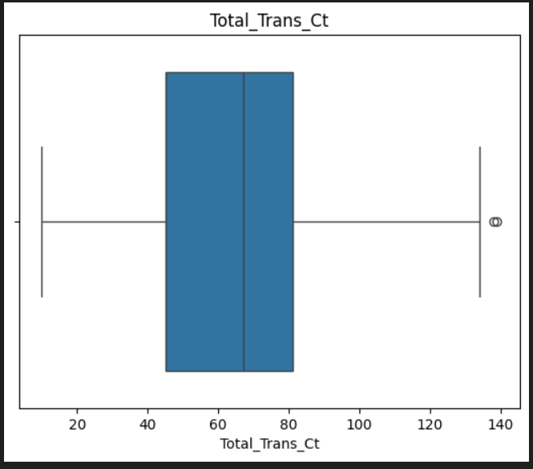
Transaction Distribution (Boxplot)
Wide variability in transaction behavior with high-engagement outliers.

Slide 8
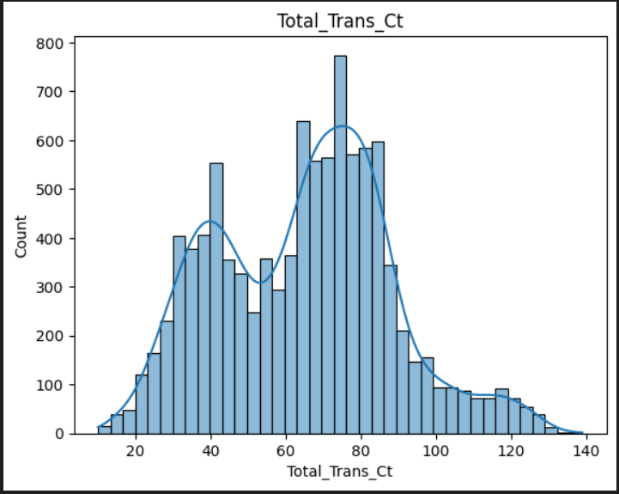
Transaction Distribution (Histogram)
Non-normal distribution supports tree-based modeling.

Slide 9
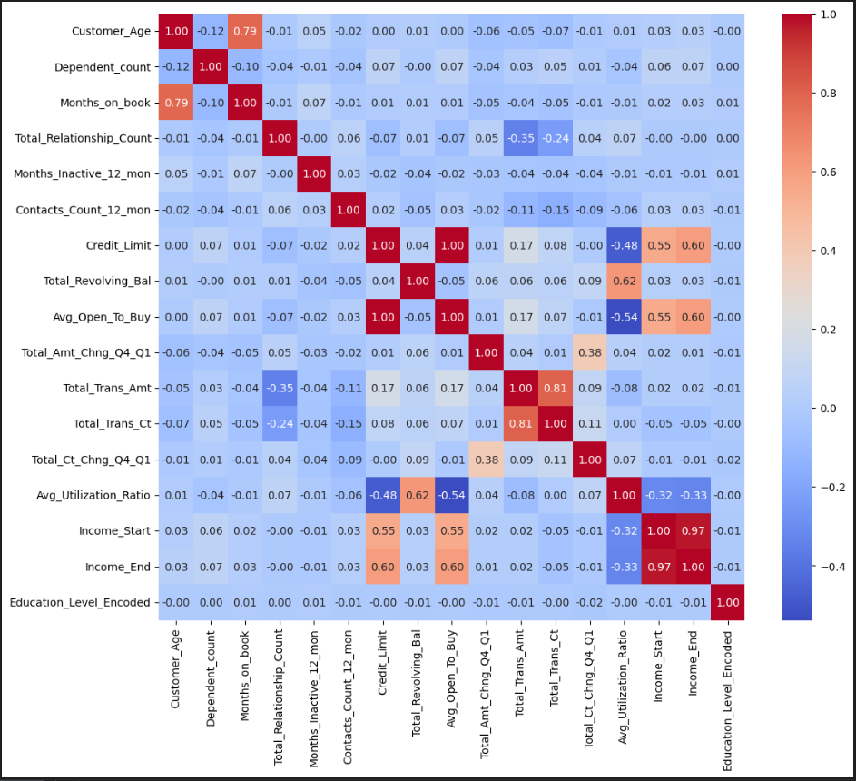
Correlation Analysis
Strong correlations among behavioral features; demographics weaker.

Slide 10
Feature Engineering
Activity_Ratio = Total_Trans_Amt / Total_Trans_Ct
Engagement_Score combines tenure, contacts, and transactions
Tenure and transaction frequency groupings created

Slide 11
Modeling Results
Models evaluated: Logistic Regression, Decision Tree, Random Forest
Best model: Random Forest
Accuracy: 96.19%,
F1-score: 87.39%,
ROC-AUC: 0.988

Slide 12
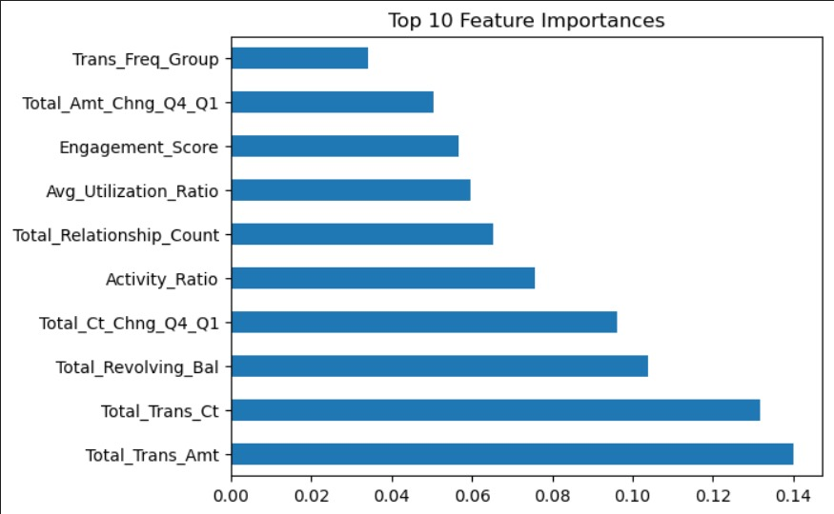
Feature Importance

Slide 13
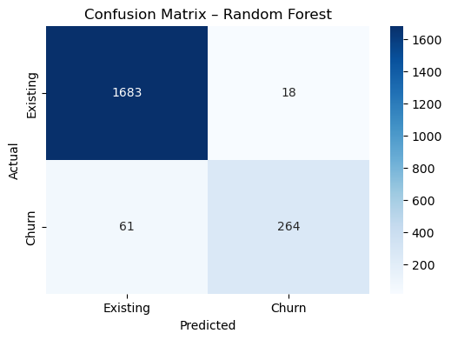
Model Evaluation – Confusion Matrix
Random Forest correctly identifies most churned customers.

Slide 14
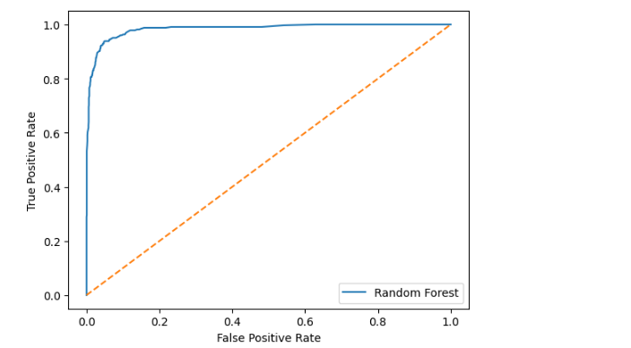
Model Evaluation – ROC Curve
High AUC indicates excellent discrimination between churned and retained customers.

Slide 15
Key Drivers, Insights & Recommendations
Low engagement and transaction frequency are primary churn drivers
Behavioral signals outperform demographic variables
Use model to proactively target at-risk customers with retention strategies

Slide 16
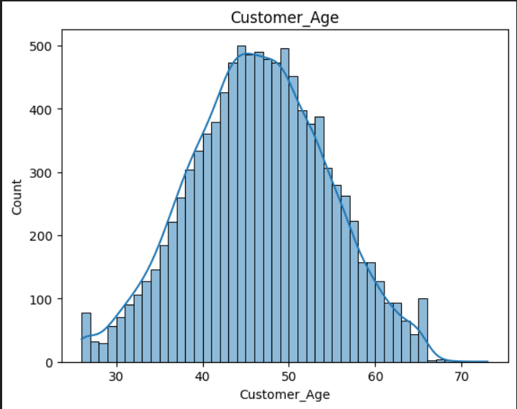
Customer Demographics – Age Distribution
Customer ages are approximately normally distributed, concentrated between 35 and 60 years.

Slide 17
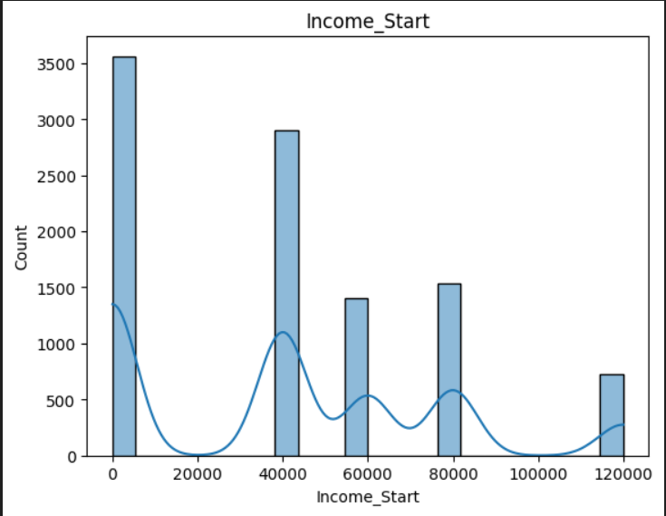
Customer Demographics – Income Distribution
Income levels are clustered into discrete bands, indicating distinct customer income segments.

Slide 18
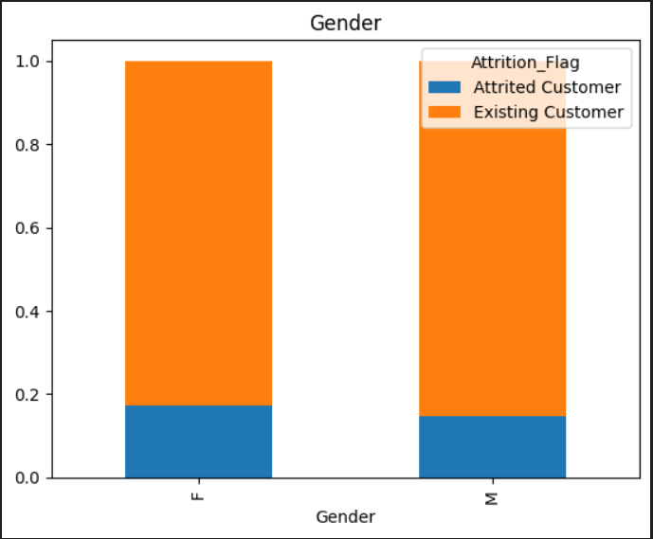
Customer Demographics – Gender
Churn proportions are similar across genders, indicating gender is not a primary churn driver.

Slide 19
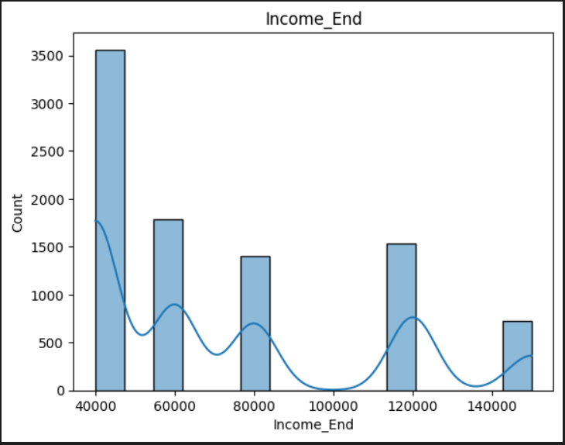
Customer Demographics – Income (Upper Bound)
Customers are grouped into income bands, with no sharp churn separation across income levels.

