Slide 1


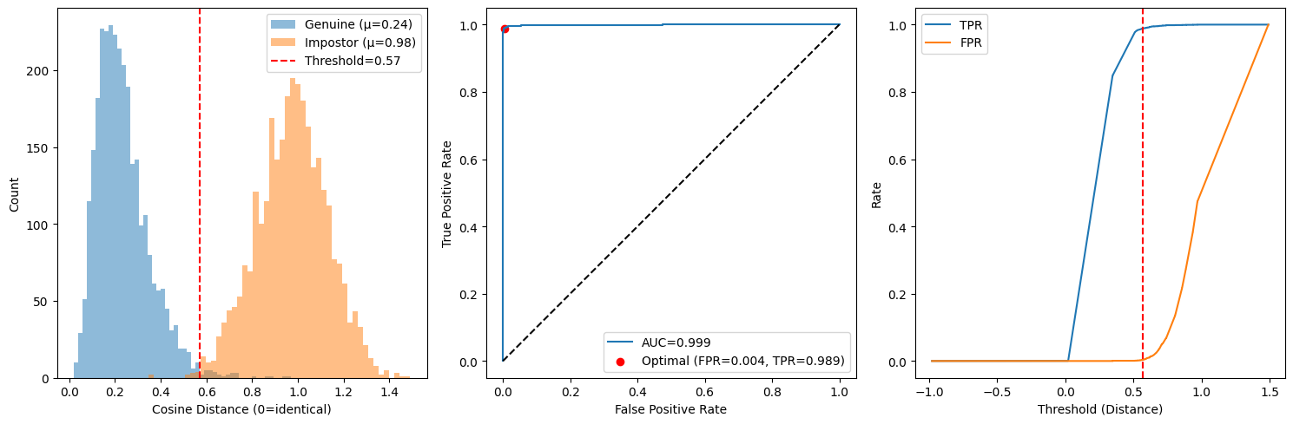
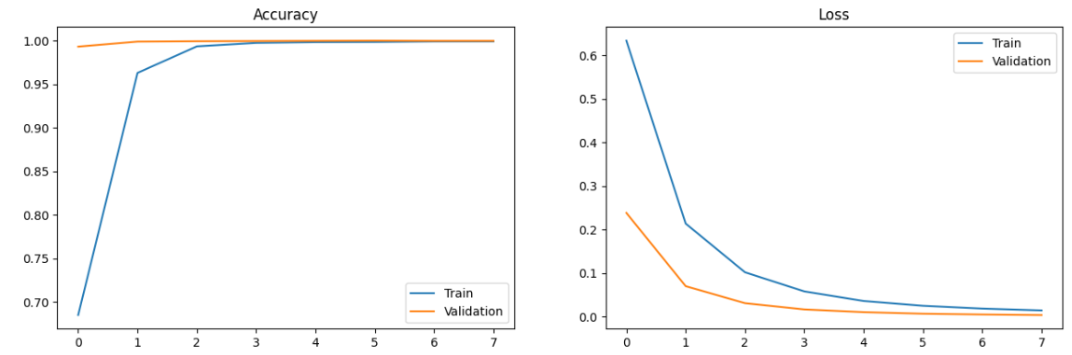
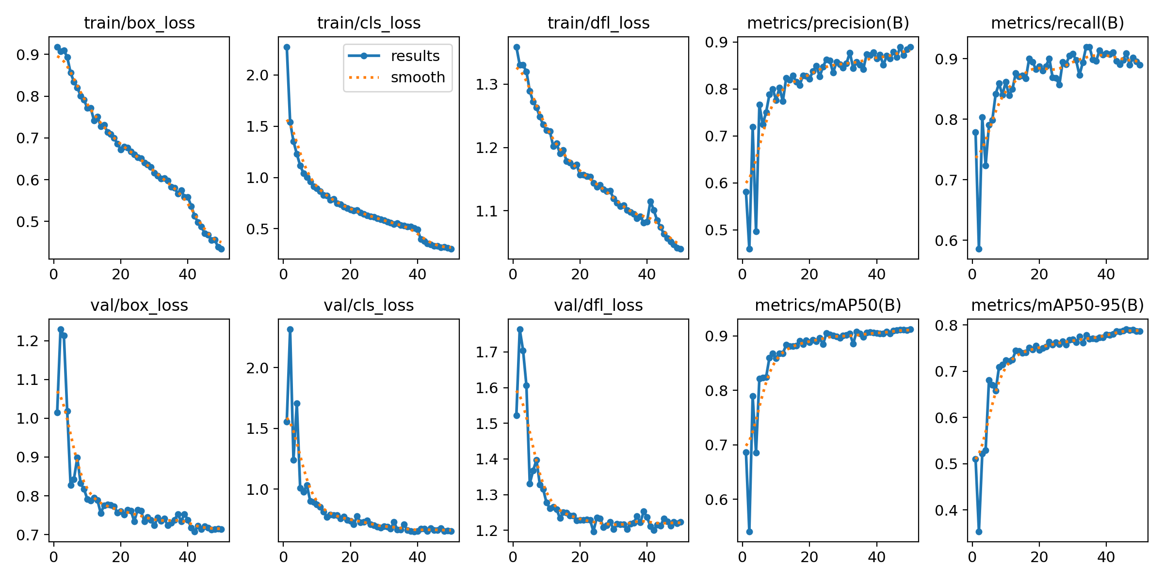
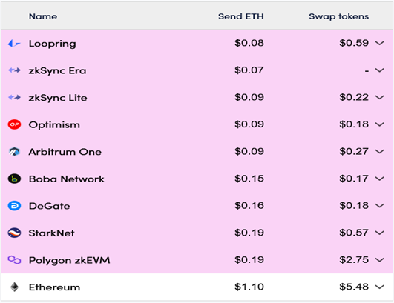
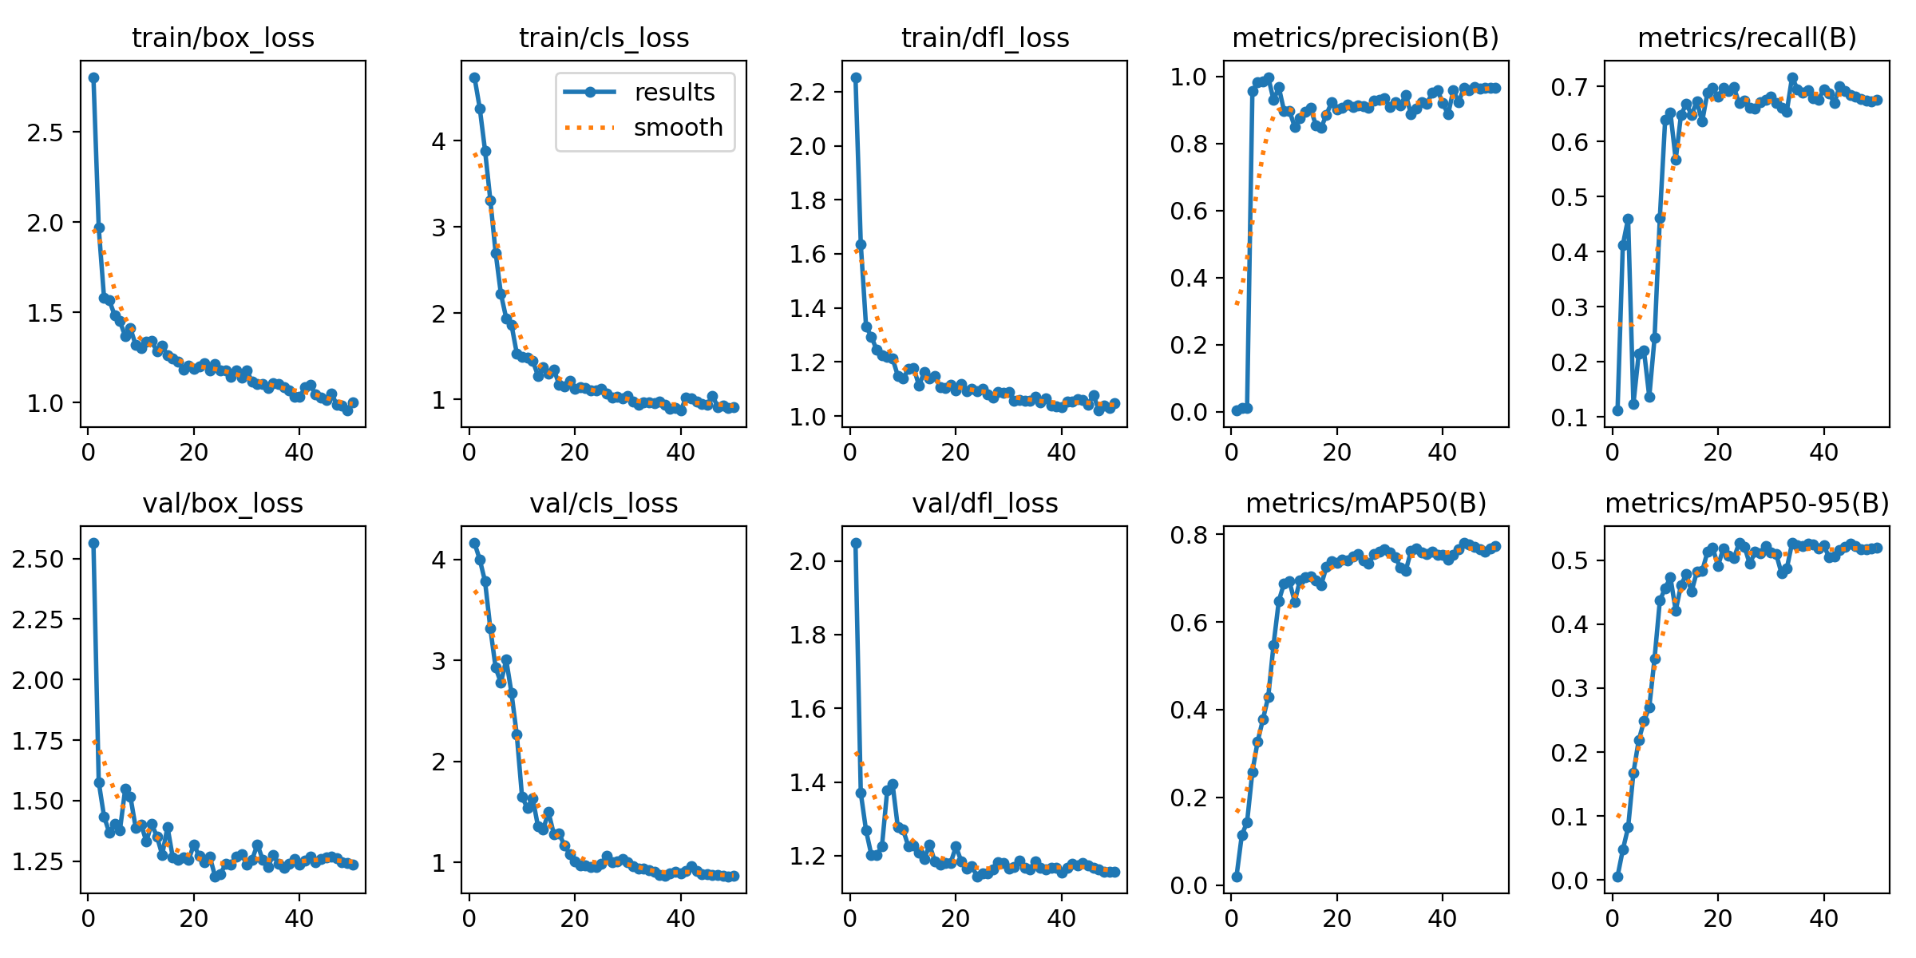

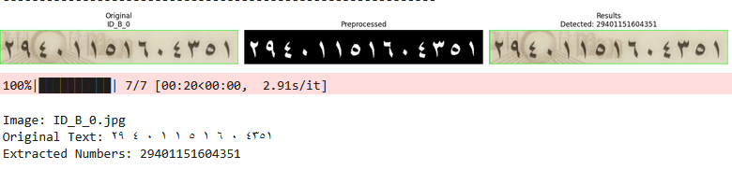

Blockchain Based E-Voting System
By: Abdelrahman Hamdi, Abdelrahman Osama, Rana Ahmed,
Habiba Ahmed, Suhail Mahmoud, Heba Shaaban
Supervised by: Dr. Dina Elsayad, T.A. Manar Sultan
Faculty of Computer and Information Sciences - Ain Shams University
Introduction
(Figure 4: Training and Validation Curves for ID Detection Model using YOLOv8)​
Results
The blockchain-based e-voting system aims to provide a secure solution for the voting process by integrating blockchain technology to provide instant, auditable, and transparent end-to-end voting records. It also ensures a decentralized infrastructure, AI-powered identity verification using facial recognition for biometric authentication, national identity verification to detect fraud, and eligibility checks (linked to national IDs) ensuring: "One voter, one account" (to eliminate fraud), equal access for all participants, and user-friendly features and an elegant user interface.
The blockchain-based e-voting system enables users to vote with complete confidence that the votes are theirs without any doubt.
Face Verification Model: Utilizes advanced Deep Neural Network to Create a Numerical Embedding representation for any face, Computes Similarity (Cosine or Euclidean) Between two Embeddings, Detects whether the face faces is for the same person or not.
Fake ID Detection Model:
find and detect any Pattern that can identify this id as a fake, Using some Technique like ELA and LBP Algorithm.
ID Detection Model:
The goal is to detect the Egyptian national ID card within a larger image and crop the ID card from the original image.
Field Detection Model:
Trying to find and detect all fields (name, address, national id number, ….) in National Egyptian ID image, Crop all finding fields from ID Image.
OCR Model:
Trying to convert fields images (name, address, national id number, ….) into Text, Handle any Problem with convert Arabic to English Text.
zkSync Blockchain:
Using new Blockchain as zkSync which is A Layer 2 Ethereum scaling solution, zkSync has Transaction Throughput (Transactions per second) about ~ 2000 TPS vs 15-30 TPS for Ethereum L1, With Cost-Efficiency can reach up to 95 – 98% from Ethereum L1, making it suitable for high-volume voting scenarios, This appear also in Scalability With less Confirmation Time and Deployment Time, Using zkSync’s Account Abstraction feature to hide the complexity of blockchain public/private key management from users, making the system more user-friendly and accessible, especially for those unfamiliar with blockchain technology.
(Figure 1: Transaction Fees zkSync VS Ethereum)
The Result for each model shown in Figures:
Face Verification Model:
(Figure 2: Test InceptionResNet-V1 on LFW Dataset)
With Accuracy 99.3 – 99.6% on LFW Dataset
Fake ID Detection Model:
(Figure 3: Training and validation for Fake id detection model)
ID Detection Model:
(Figure 4: Training and Validation Curves for ID Detection Model using YOLOv8)
Field Detection Model:
(Figure 5: Training and Validation Curves for Field Detection Model using YOLOv8)
OCR Model:
Methods
Our system architecture consists of multiple components, each one with its own distinct purpose and contribution to the overall functionality of the system.
(Figure 6: OCR Model Sample results preprocessing and postprocessing)​
Face Verification Model:
Using VggFace2 Dataset with Preprocessing (Detect face With MTCNN, Resize (160 x160), Augmentation), then for the model we use InceptionResNet-V1 Pretrained.
ID Detection Model:
We have been used Roboflow for labelling and splitting dataset we collected from different resources then we fin-tune YOLOv8 then use the model to detect the ID card even if it’s rotated.
Conclusion
Our blockchain-based e-voting system integrates AI-powered identity verification—using facial recognition, OCR, and field detection—with zkSync blockchain to ensure secure, scalable, and transparent voting. By combining all these technologies for the first time, along with a dynamic, user-friendly website, our solution greatly improves efficiency and accessibility. This innovation sets a new benchmark in modernizing elections while enhancing trust, usability, and fraud prevention in democratic participation.
Fake ID Detection Model:
New dataset collected for Egyptian national IDs with preprocessing (grayscale, resize 128×128, augmentation),Model: Three-branch input (Original/MobileNetV2, ELA, LBP) → Combined → Dense layers for classification.
Field Detection Model:
We used Roboflow to label and split the cropped ID images. Then we fine-tuned YOLOv8 to detect and localize key fields inside the card such as Name, Address, Birth Date, and National ID number.
Bibliography
- Gaddam Harsha Vardhan, Swapnil Shah, Vanshika Gupta, Rohithreddy B. C., Tanya Bisht, "Voting System Using Blockchain (Face Recognition)", International Journal of Engineering Research & Technology (IJERT), NCET - 2022 Conference Proceedings, June 2022, Volume 11, Issue 06, pp. 1-6.
- V. Sathya Preiya, V. D. Ambeth Kumar, R. Vijay, Vijay K., N. Kirubakaran, “Blockchain-Based E-Voting System with Face Recognition”, International Journal of Intelligent Systems and Applications in Engineering, ISSN: 2147-6799, April 2024, Vol. 12, No. 15s, pp. 240–250.
OCR Model:
We developed an OCR module to extract the National ID Number (NID) from Egyptian ID cards. The system uses EasyOCR to recognize Arabic digits after detecting and cropping the ID field. Preprocessing and postprocessing steps ensure clean and accurate text extraction for secure identity verification.

