Slide 1
Overview
Gate Circuits and Boolean Equations
- Binary Logic and Gates
- Boolean Algebra
- Standard Forms
Additional Gates and Circuits
- Other Gate Types
- Exclusive-OR Operator and Gates
- High-Impedance Outputs

Slide 2
Binary Logic and Gates
Digital circuits are hardware components (based on transistors) that manipulate binary information
We model the transistor-based electronic circuits as logic gates.

Slide 3
Binary Logic
Binary variables take on one of two values.
Logical operators operate on binary values and binary variables.
Basic logical operators are the logic functions AND, OR and NOT.
Logic gates implement logic functions.
Boolean Algebra: a useful mathematical system for specifying and transforming logic functions.

Slide 4
Binary Variables
Recall that the two binary values have different names:
True/False
On/Off
Yes/No
1/0
We use 1 and 0 to denote the two values.

Slide 5
Conclusion
Computers are implementations of Boolean logic.
Boolean functions are completely described by truth tables.
Logic gates are small circuits that implement Boolean operators.
The basic gates are AND, OR, and NOT.
The XOR gate is very useful in parity checkers and adders.
The “universal gates” are NOR, and NAND.

Slide 6
Logical Operations
The three basic logical operations are:
AND
OR
NOT
AND is denoted by a dot (·).
OR is denoted by a plus (+).
NOT is denoted by an overbar ( ¯ ), a single quote mark (') after, or (~) before the variable.

Slide 7
Notation Examples
Examples:
is read “Y is equal to A AND B.”
is read “z is equal to x OR y.”
is read “X is equal to NOT A.”
Y
=
A
⋅
B
z
=
x
+
y
X
=
A
Note: The statement:
1 + 1 = 2 (read “one plus one equals two”)
is not the same as
1 + 1 = 1 (read “1 or 1 equals 1”).

Slide 8
Operator Definitions
Operations are defined on the values "0" and "1" for each operator:
AND
OR
NOT
0 · 0 = 0
0 + 0 = 0
=
0
1
0 · 1 = 0
0 + 1 = 1
=
1
0
1 · 0 = 0
1 + 0 = 1
1 · 1 = 1
1 + 1 = 1

Slide 9
Truth Tables
Truth table - a tabular listing of the values of a function for all possible combinations of values on its arguments
Example: Truth tables for the basic logic operations:
AND
OR
X | Y | Z = X+Y
0 | 0 | 0
0 | 1 | 1
1 | 0 | 1
1 | 1 | 1
NOT
X
Y
Z = X·Y
X
Z
=
X
0
0
0
0
1
0
1
0
1
0
1
0
0
1
1
1

Slide 10
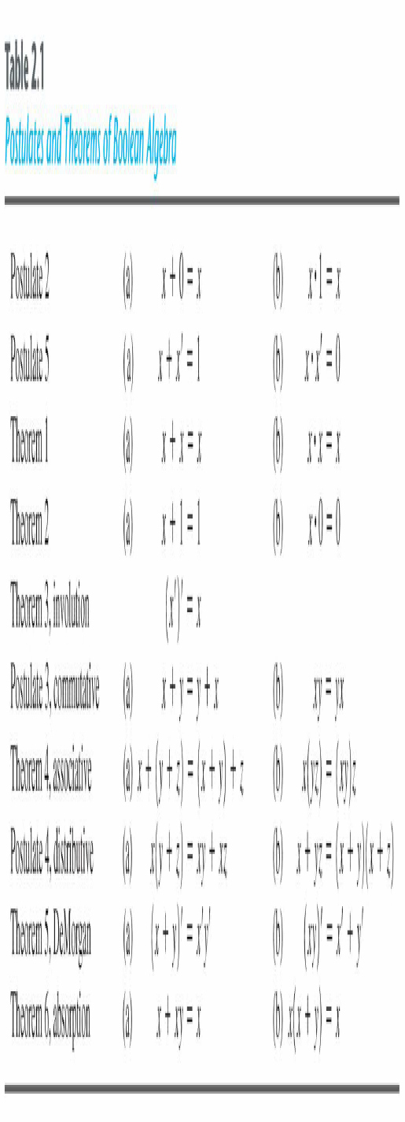
Basic Theorems

Slide 11
Logic Function Implementation
Using Switches
For inputs:
logic 1 is switch closed
logic 0 is switch open
For outputs:
logic 1 is light on
logic 0 is light off.
NOT uses a switch such
that:
logic 1 is switch open
logic 0 is switch closed
Switches in parallel => OR
Switches in series => AND
Normally-closed switch => NOT
C

Slide 12
Review of Boolean algebra
Not is a horizontal bar above the number
0 = 1
1 = 0
Or is a plus
0+0 = 0
0+1 = 1
1+0 = 1
1+1 = 1
And is multiplication
0*0 = 0
0*1 = 0
1*0 = 0
1*1 = 1
_
_

Slide 13
Logic Gate

Slide 14
Logic Gate
A gate is an digital circuit which operates on one or more signals and produce single output.
Gates are digital circuits because the input and output signals are denoted by either 1(high voltage) or 0(low voltage).
There are three basic gates and are:
1. AND gate
2. OR gate
3. NOT gate

Slide 15

AND gate
The AND gate is an electronic circuit that gives a high output (1) only if all its inputs are high.
AND gate takes two or more input signals and produce only one output signal.
Input A | Input B | Output AB
0 | 0 | 0
0 | 1 | 0
1 | 0 | 0
1 | 1 | 1

Slide 16

OR gate
The OR gate is an electronic circuit that gives a high output (1) if one or more of its inputs are high.
OR gate also takes two or more input signals and produce only one output signal.
Input A | Input B | Output A+B
0 | 0 | 0
0 | 1 | 1
1 | 0 | 1
1 | 1 | 1

Slide 17

NOT gate
The NOT gate is an electronic circuit that gives a high output (1) if its input is low .
NOT gate takes only one input signal and produce only one output signal.
The output of NOT gate is complement of its input.
It is also called inverter.
Input A | Output A
0 | 1
1 | 0

Slide 18
DeMorgan’s Theorem
(x + y)’ = x’y’ ,(xy)’ = x’ + y’
By means of truth table
x | y | x’ | y’ | x+y | (x+y)’ | x’y’ | xy | x’+y' | (xy)’
0 | 0 | 1 | 1 | 0 | 1 | 1 | 0 | 1 | 1
0 | 1 | 1 | 0 | 1 | 0 | 0 | 0 | 1 | 1
1 | 0 | 0 | 1 | 1 | 0 | 0 | 0 | 1 | 1
1 | 1 | 0 | 0 | 1 | 0 | 0 | 1 | 0 | 0

Slide 19
NAND Gate
Known as a “universal” gate because ANY digital circuit can be implemented with NAND gates alone.

Slide 20
NAND Gate
NAND
X Y Z
0 0 1
0 1 1
1 0 1
1 1 0
X
Z
Y
Z = ~(X & Y)
Nand(Z,X,Y)

Slide 21
NAND Gate
F = (X•X)’
= X’+X’
= X’
X
F = X’
X
X
X
F X•Y
F = ((X•Y)’)’
= (X’+Y’)’
= X’’•Y’’
= X•Y
Y
Y
X
X
F = (X’•Y’)’
= X’’+Y’’
= X+Y
F = X+Y
Y
Y

Slide 22
NOR Gate
NOR
X Y Z
0 0 1
0 1 0
1 0 0
1 1 0
X
Z
Y
Z = ~(X | Y)
nor(Z,X,Y)

Slide 23
Exclusive-OR Gate
XOR
X Y Z
X
Z
0 0 0
Y
0 1 1
1 0 1
Z = X ^ Y
xor(Z,X,Y)
1 1 0

Slide 24
Exclusive-NOR Gate
XNOR
X Y Z
X
Z
0 0 1
Y
0 1 0
Z = ~ (X ^ Y)
Z = X ~ ^ Y
Xnor (Z,X,Y)
1 0 0
1 1 1

Slide 25
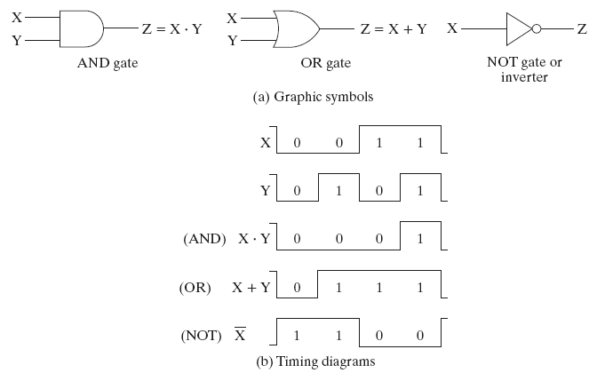
Logic Gate Symbols and Behavior
Logic gates have special symbols:

Slide 26
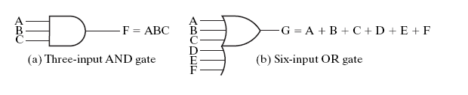
AND and OR gates with more than two inputs

Slide 27
Boolean Algebra
Boolean expression: a expression formed by binary variables, for example,
Boolean function: a binary variable identifying the function followed by an equal sign and a Boolean expression for example

Slide 28
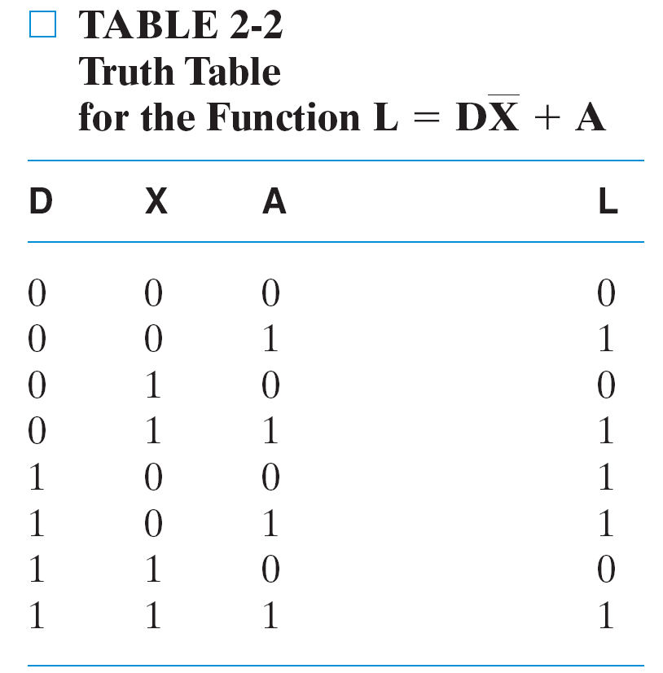
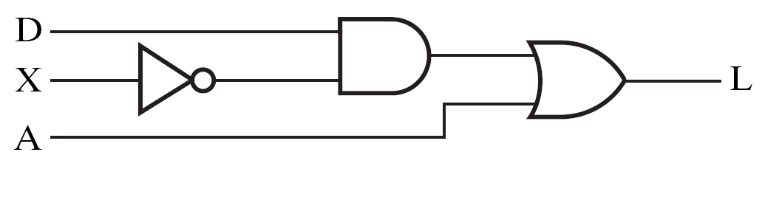

Truth table and Logic circuit
For the Boolean function
$$L(D, X, A)=D\bar{X}+A$$
Logic Circuit Diagram

Slide 29
Basic identities of Boolean Algebra
An algebraic structure defined on a set of at least two elements together with three binary operators (denoted +, · and - ) that satisfies the following basic identities:
1.
X
+ 0
=
X
2.
X
. 1
=
X
3.
X
1
1
4.
X
. 0
0
+
=
=
5.
X + X
=
X
6.
X . X
=
X
7.
X + X
=
1
8.
X . X
=
0
9.
X = X
10.
X + Y
=
Y + X
11.
XY
=
YX
Commutative
12.
(X + Y)
+
Z
=
X + (Y
+
Z)
13.
(XY)
Z
=
X(Y
Z)
Associative
14.
X(Y +
Z)
=
XY
+
XZ
15.
X
+ YZ
=
(X + Y)
(X + Z)
Distributive
DeMorgan
’
16.
X + Y
=
X . Y
17.
X . Y
=
X + Y
s

Slide 30
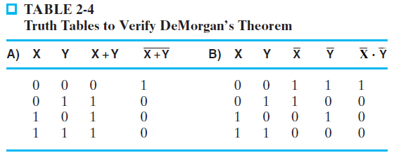
Truth Table to Verify DeMorgan’s Theorem
Extension of DeMorgan’s Theorem:

Slide 31
Boolean Operator Precedence
The order of evaluation in a Boolean expression is:
1.
Parentheses
2.
NOT
3.
AND
4.
OR
Example: F = A (B + C) (C + D)

Slide 32
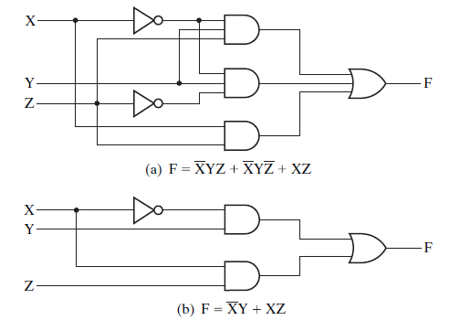
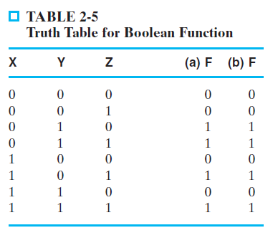
Boolean Algebraic Manipulation

Slide 33
Boolean Algebraic Manipulation
AB + AC + BC = AB + AC (Consensus Theorem)
Proof Steps Justification (identity or theorem)
AB + AC + BC
= AB + AC + 1 · BC
= AB +AC + (A + A) · BC
=
Notes:
Justification 1: 1 . X = X
Justification 2: X + X’ = 1
= AB + A’C + ABC + A’BC X(Y + Z) = XY + XZ (Distributive Law)
= AB + ABC + A’C + A’BC X + Y = Y + X (Commutative Law)
= AB . 1 + ABC + A’C . 1 + A’C . B X . 1 = X, X . Y = Y . X (Commutative Law)
= AB (1 + C) + A’C (1 + B) X(Y + Z) = XY +XZ (Distributive Law)
= AB . 1 + A’C . 1 = AB + A’C X . 1 = X

Slide 34
Example: Complementing Function
By DeMorgan’s Theorem (Example 2-2)
By duality (Example 2-3)
Notes:
= X’ Y’ Z + X Y’ (A + B)’ = A’ . B’ (DeMorgan’s Law)
= Y’ X’ Z + Y’ X A . B = B . A (Commutative Law)
= Y’ (X’ Z + X) A(B + C) = AB + AC (Distributive Law)
= Y’ (X’ + X)(Z + X) A + BC = (A + B)(A + C) (Distributive Law)
= Y’ . 1 . (Z + X) A + A’ = 1
= Y’ (X + Z) 1 . A = A, A + B = B + A (Commutative Law)

Slide 35
Canonical Forms
It is useful to specify Boolean functions in a form that:
Allows comparison for equality.
Has a correspondence to the truth tables
Canonical Forms in common usage:
Sum of Minterms (SOM)
Product of Maxterms (POM)

Slide 36
Maxterms and Minterms
Examples: Two variable minterms and maxterms.
The index above is important for describing which variables in the terms are true and which are complemented.
Index | Minterm | Maxterm
0 | x y | x + y
1 | x y | x + y
2 | x y | x + y
3 | x y | x + y

Slide 37
Minterms
Minterms are AND terms with every variable present in either true or complemented form.
Given that each binary variable may appear normal (e.g., x) or complemented (e.g., ), there are 2^{n} minterms for n variables.
Example: Two variables (X and Y)produce 2 x 2 = 4 combinations:
x

Slide 38
(both normal)
(X normal, Y complemented)
(X complemented, Y normal)
X (both complemented)
Thus there are four minterms of two variables.
XY
X
Y
X
Y
Y

Slide 39
Maxterms
Maxterms are OR terms with every variable in true or complemented form.
Given that each binary variable may appear normal (e.g., x) or complemented (e.g., x), there are 2^{n} maxterms for n variables.
Example: Two variables (X and Y) produce 2 x 2 = 4 combinations:
(both normal)
(x normal, y complemented)
(x complemented, y normal)
(both complemented)
X
+
Y
X
+
Y
X
+
Y
X
+
Y

Slide 40
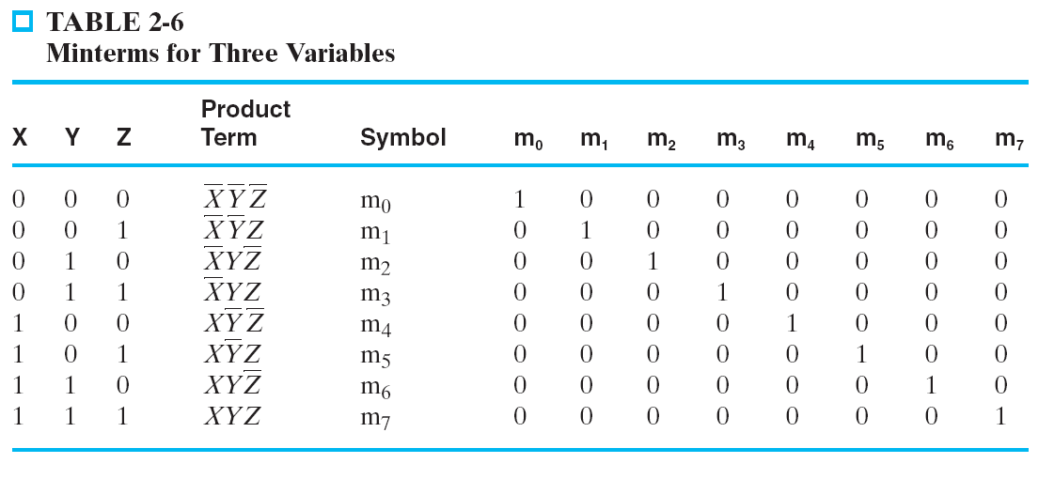
Minterms for three variables

Slide 41
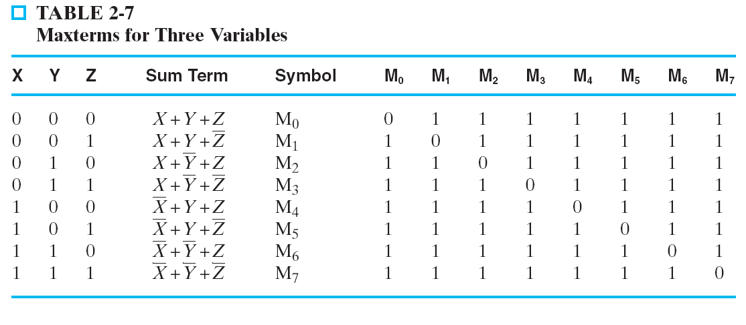
Maxterms for three variables

Slide 42
Minterm and Maxterm Relationship
Review: DeMorgan's Theorem
and
Two-variable example:
and
Thus M₂ is the complement of m₂ and vice-versa.
Since DeMorgan's Theorem holds for n variables, the above holds for terms of n variables
giving:
and
Thus M_{i} is the complement of m_{i}.
x
·
y
=
x
+
y
x
+
y
=
x
⋅
y
M
=
x
+
y
m
=
x·
y
2
2
M
=
m
m
=
M
i
i
i
i

Slide 43
Function Tables for Both
Minterms of 2 variables Maxterms of 2 variables
Each column in the maxterm function table is the complement of the column in the minterm function table since M_{i} is the complement of m_{i}.
x y
m
m
m
m
x y
M
M
M
M
0
1
2
3
0
1
2
3
0 0
1
0
0
0
0 0
0
1
1
1
0 1
0
1
0
0
0 1
1
0
1
1
1 0
0
0
1
0
1 0
1
1
0
1
1 1
0
0
0
1
1 1
1
1
1
0

Slide 44
Observations
In the function tables:
Each minterm has one and only one 1 present in the 2^{n} terms (a minimum of 1s). All other entries are 0.
Each maxterm has one and only one 0 present in the 2^{n} terms All other entries are 1 (a maximum of 1s).
We can implement any function by "ORing" the minterms corresponding to "1" entries in the function table. These are called the minterms of the function.

Slide 45
We can implement any function by "ANDing" the maxterms corresponding to "0" entries in the function table. These are called the maxterms of the function.
This gives us two canonical forms:
Sum of Minterms (SOM)
Product of Maxterms (POM)
for stating any Boolean function.

Slide 46
Conversion of Minterm and Maxterm

Slide 47
Conversion of Minterm and Maxterm

Slide 48
Canonical Sum of Minterms
Any Boolean function can be expressed as a Sum of Minterms.
For the function table, the minterms used are the terms corresponding to the 1's
For expressions, expand all terms first to explicitly list all minterms. Do this by “ANDing” any term missing a variable v with a term ( ).
Example: Implement as a sum of minterms.
First expand terms:
Then distribute terms:
Express as sum of minterms: f = m₃ + m₂ + m₀
v
+
v
f
=
x
+
x
y
f
=
x
(
y
+
y
)
+
x
y
f
=
xy
+
x
y
+
x
y

Slide 49
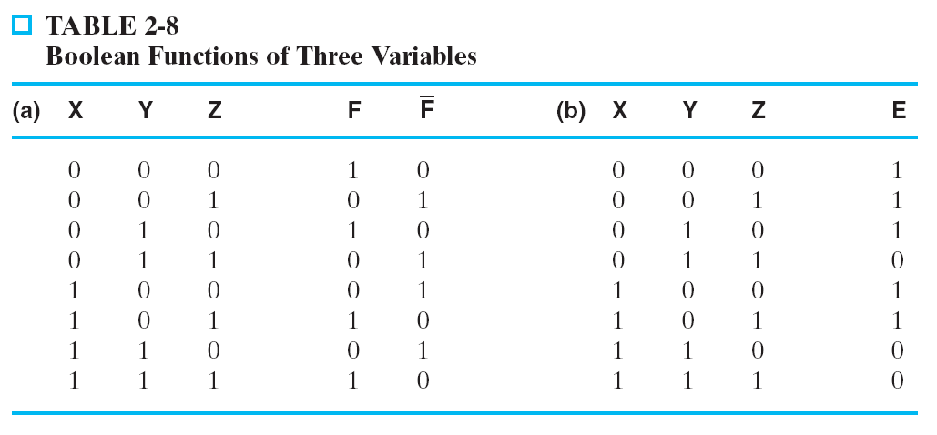
Another SOM Example
Expand by using truth table
According to truth table Table 2-8,
Notes:
F = A(B + B’)(C + C’) + (A + A’) B’ C
= ABC + ABC’ + AB’C + AB’C’ + AB’C + A’B’C
= ABC + ABC’ + AB’C + AB’C’ + A’B’C
= m7 + m6 + m5 + m4 + m1 = m1 + m4 + m5 + m6 + m7

Slide 50
Standard Sum-of-Products (SOP)
A sum of minterms form for n variables can be written down directly from a truth table.
Implementation of this form is a two-level network of gates such that:
The first level consists of n-input AND gates, and
The second level is a single OR gate (with fewer than 2^{n} inputs).
This form often can be simplified so that the corresponding circuit is simpler.

Slide 51
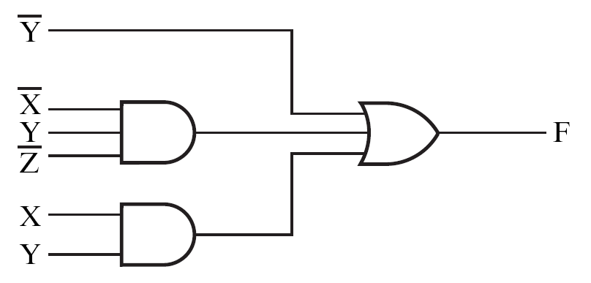
Standard Sum-of-Products (SOP)
Example:
Fig. 2-5
a two-level implementation/two-level circuit
Product-of-Sums (POS):
What’s the implementation?
Notes:
F = A’ B’ C + A (B’ C’ + B C’ + B’ C + B C)
= A’ B’ C + A (B’ + B) (C’ + C)
= A’ B’ C + A.1.1
= A’ B’ C + A
= B’C + A

Slide 52
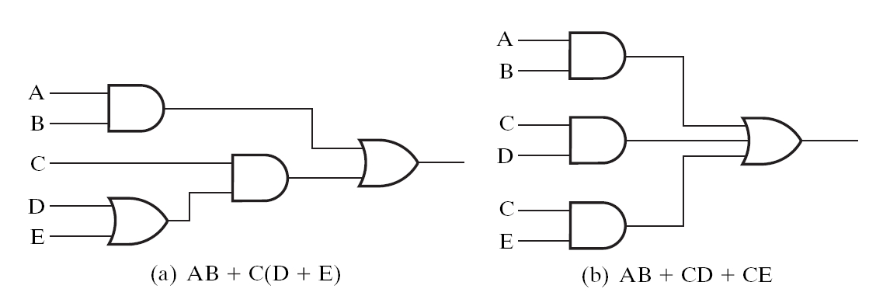
Convert non-SOP expression to SOP expression
The decision whether to use a two-level or multiple-level implementation is complex.
no. of gates
No. of gate inputs
amount of time delay

Slide 53
Simplification of two-level implementation of SOP expression
The two implementations for F are shown below – it is quite apparent which is simpler!

Slide 54
SOP and POS Observations
The previous examples show that:
Canonical Forms (Sum-of-minterms, Product-of-Maxterms), or other standard forms (SOP, POS) differ in complexity
Boolean algebra can be used to manipulate equations into simpler forms.
Simpler equations lead to simpler two-level implementations
Questions:
How can we attain a “simplest” expression?
Is there only one minimum cost circuit?
The next part will deal with these issues.

Slide 55
POWER CONSUMPTION OF SYSTEM

Slide 56
Basic Theorem of Boolean Algebra
T1 : Properties of 0
(a) 0 + A = A (b) 0 A = 0
T2 : Properties of 1
(a) 1 + A = 1 (b) 1 A = A

Slide 57
Basic Theorem of Boolean Algebra
T3 : Commutative Law
(a) A + B = B + A (b) A B = B A
T4 : Associate Law
(a) (A + B) + C = A + (B + C) (b) (A B) C = A (B C)
T5 : Distributive Law
(a) A (B + C) = A B + A C (b) A + (B C) = (A + B) (A + C)
(c) A+A’B = A+B

Slide 58
Basic Theorem of Boolean Algebra
T6 : Indempotence (Identity ) Law
(a) A + A = A (b) A A = A
T7 : Absorption (Redundance) Law
(a) A + A B = A (b) A (A + B) = A

Slide 59
Basic Theorem of Boolean Algebra
T8 : Complementary Law
(a) X+X’=1
(b) X.X’=0
T9 : Involution
(a) x’’ = x
T10 : De Morgan's Theorem
(a) (X+Y)’=X’.Y’
(b) (X.Y)’=X’+Y’

Slide 60

De Morgan's Theorem 1
Theorem 1 A . B = A + B

Slide 61
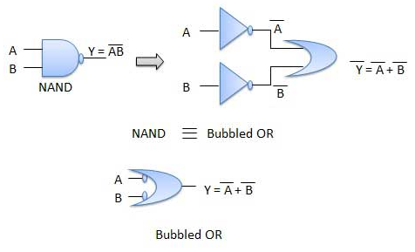
De Morgan's Theorem 1
Theorem 1 A . B = A + B

Slide 62
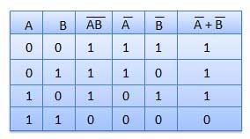
De Morgan's Theorem 1
Theorem 1 A . B = A + B

Slide 63
De Morgan's Theorem 2
Theorem 1 A + B = A . B

Slide 64

De Morgan's Theorem 2
Theorem 2 A + B = A . B

Slide 65
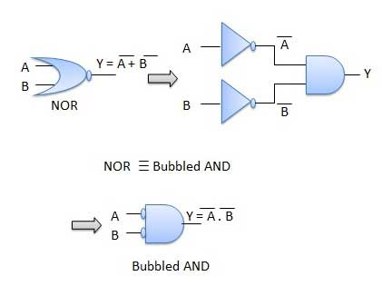
De Morgan's Theorem 2
Theorem 2 A + B = A . B

Slide 66
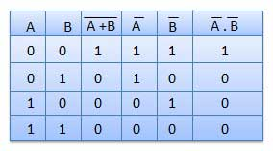
De Morgan's Theorem 2
Theorem 2 A + B = A . B

