Slide 1
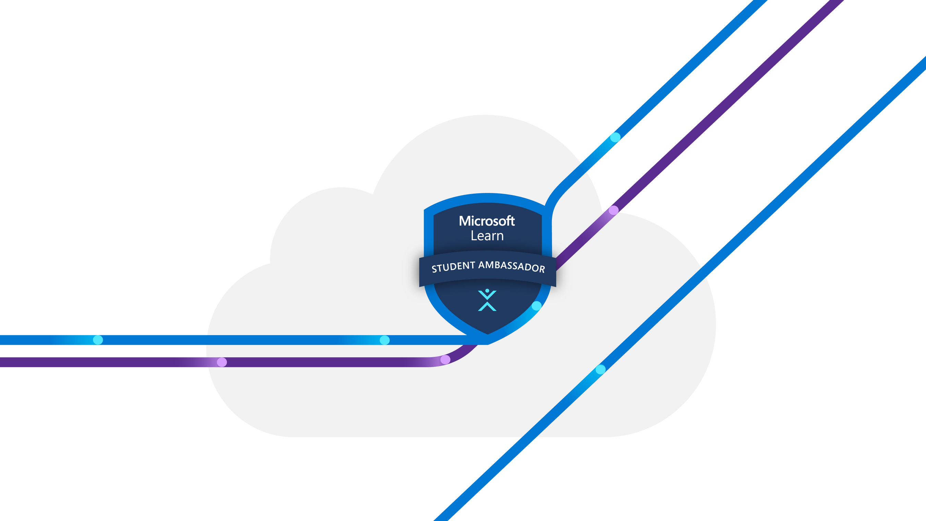
Customer Churn Prediction
using Machine Learning

Slide 2


What’s the Problem..?
What is Customer Churn?
Churn happens when customers stop doing business with a company.
High churn = revenue loss
Goal: Predict and prevent churn using data and ML!

Slide 3


Dataset Overview

Slide 4
Understanding the Features Used in Modeling
Column | Description
gender | Male / Female
SeniorCitizen | 1 = Yes, 0 = No
Partner, Dependents | Whether the customer has a partner or dependents
tenure | Number of months with the company
InternetService | DSL / Fiber optic / No
Contract | Contract type: Monthly / 1yr / 2yr
PaymentMethod | Electronic check, Bank transfer, etc.
TotalCharges | Total charges over time (float stored as string)
Churn (Target) | Yes = Customer left, No = Stayed

Slide 5
Data Engineering

Slide 6
Data Engineering
Preprocessing Steps
Handled missing/invalid values
Applied Label Encoding to categorical features
Created derived features like:
AvgChargesPerMonth = TotalCharges / Tenure

Slide 7
Modeling

Slide 8


Two models tested:
Logistic Regression (baseline)
Random Forest Classifier
Used Scikit-learn with cross-validation
Evaluated on Accuracy & F1-Score

Slide 9
Results Visualization

Slide 10
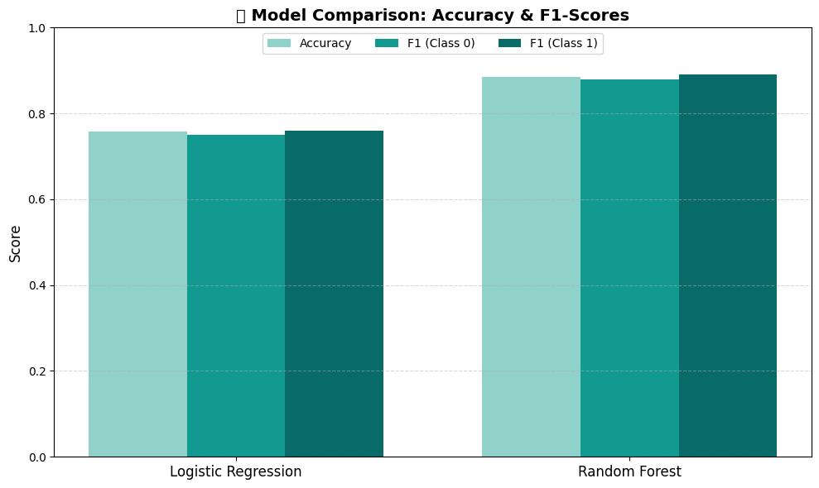
📊 Model Performance

Slide 11
Flask Web App

Slide 12
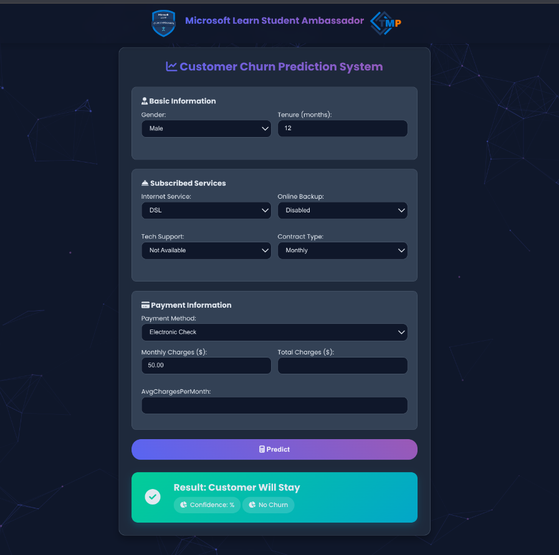

Slide 13
Real Business Value

Slide 14
Why does this matter?
Companies can identify high-risk customers
Take action early: offers, discounts, support
Reduce churn = Increase revenue

Slide 15
What’s Next..?

Slide 16
🔮 Future Enhancements
Add more advanced models (e.g., XGBoost, LSTM)
Integrate sentiment analysis of support chats like this project i have worked on https://nlp.pixion.tech/
Connect to live CRM data

Slide 17
Thank You
Microsoft Learn Student Ambassadors

