Slide 1


Sales Analysis
Adventure Works Dataset

Slide 2


Agenda
Overview of Presentation:
1. Data Overview
2. Data Cleaning and Transformation
3. Data Model
4. Sales Overview & Performance
5. Detailed Sales Analysis
6. Key Insights and Conclusions

Slide 3
Data Overview
Sales (Fact Table):
SalesOrderNumber
OrderDate
ProductKey
ResellerKey
EmployeeKey
SalesTerritoryKey
Quantity
Unit Price
Sales
Cost
Region:
SalesTerritoryKey
Region
Country
Group
Product:
ProductKey
Product
Standard Cost
Color
Subcategory
Category
Category Key
Subcategory Key
Category ID
Subcategory ID
Sales Person:
EmployeeKey
EmployeeID
Salesperson
Title
UPN

Slide 4

Data Cleaning & Transformation
Tools Used: Excel and Power Query
Key Steps:
Removing duplicates
Standardizing formats (dates, text)
Handling missing values
Data type conversion
Remove Null Values

Slide 5
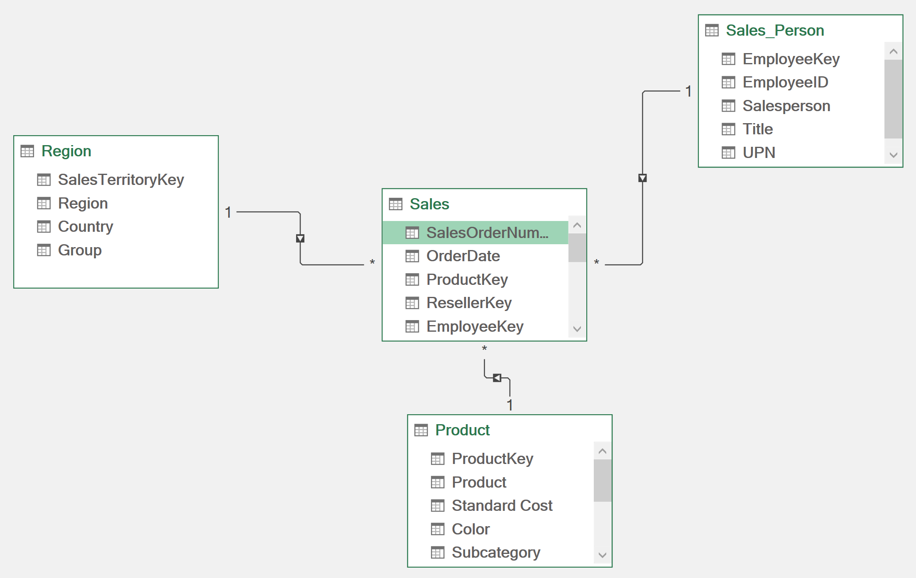
Data Model
Relationships:
Sales connected to Region, Product, and Salesperson using their respective keys.
1. Sales to Region (SalesTerritoryKey)
2. Sales to Product (ProductKey)
3. Sales to SalesPerson (EmployeeKey)

Slide 6
Question ??
1.T-Sales & T-Profit by Year
2.Total Profit & Sales by Months
3. Bottom 10 Products by Profit
4. Top 10 Products by Sales
5. Total Sales Per Region
6. Sales and profit by country
7. Top / Bottom 5 Sub Category by Profit
8. Sales by category
9. Top 5 Sales Person by Sales
10. Total Profit By Category

Slide 7
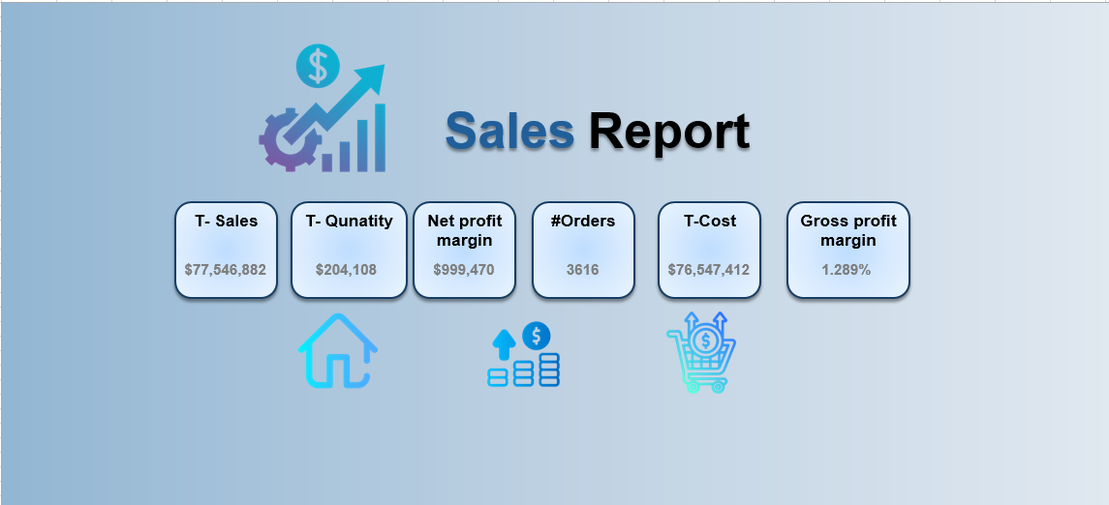
Home

Slide 8


Sales Overview Report

Slide 9
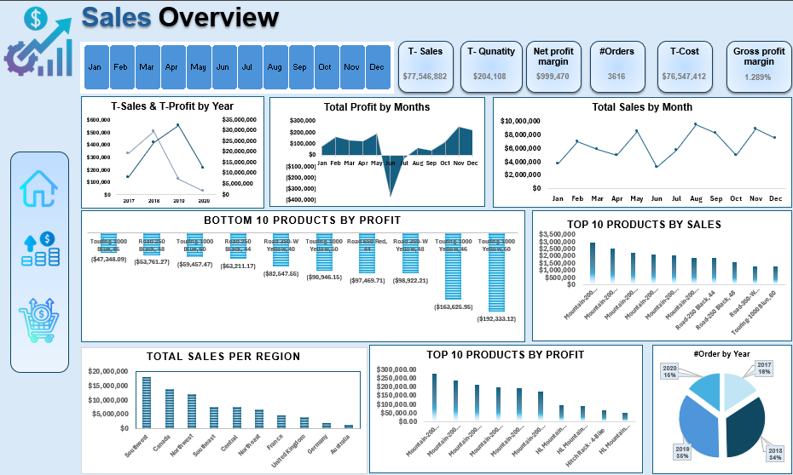

Slide 10
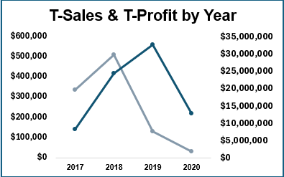
T-Sales &T-Profit by year
This chart shows the trend of Sales and profit over year
The profit decreases a lot in last 2 year even when the Sales increases

Slide 11
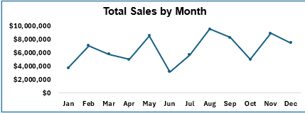
T-Sales by month
The Sales decreases a lot during in June and July
The Sales peak was in August

Slide 12
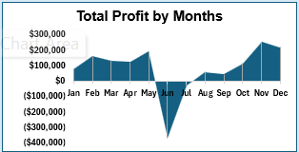
T-Profit by month
This chart shows the trend profit over months
The profit is negative in the summer

Slide 13
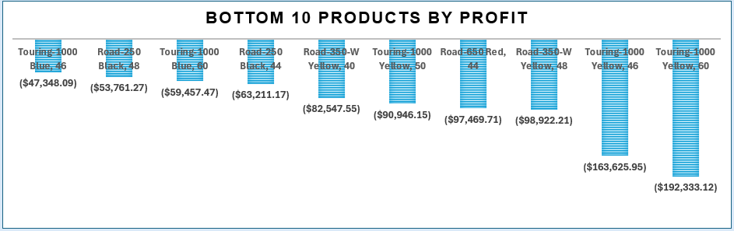
Bottom 10 products by Profit
We have more than 10 products with a high negative profit
All the bottom 10 product was from Bikes category especially touring subcategory

Slide 14
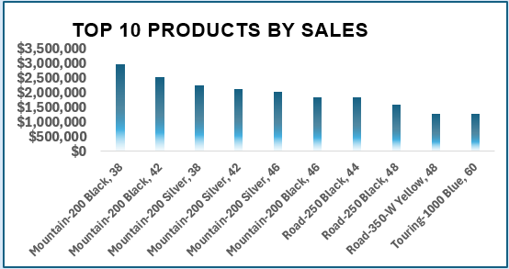
Top 10 products by sales
most of the 10 belongs to mountain bikes subcategory

Slide 15
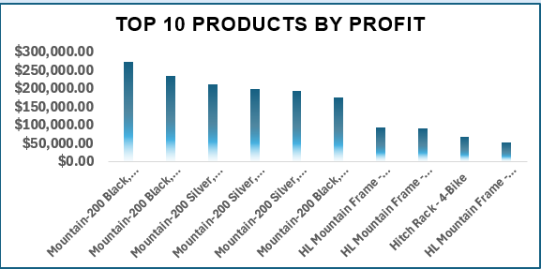
Top 10 products by Profit
Most of the 10 belongs to the Mountain bikes subcategory
Mountain product (either bikes or accessories) are generating high profit

Slide 16
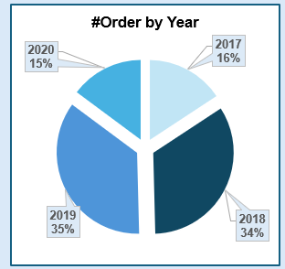
#Orders by year
We get high orders in 2018 and 2019 more than 2017 and 2020

Slide 17
Sales Details Report

Slide 18
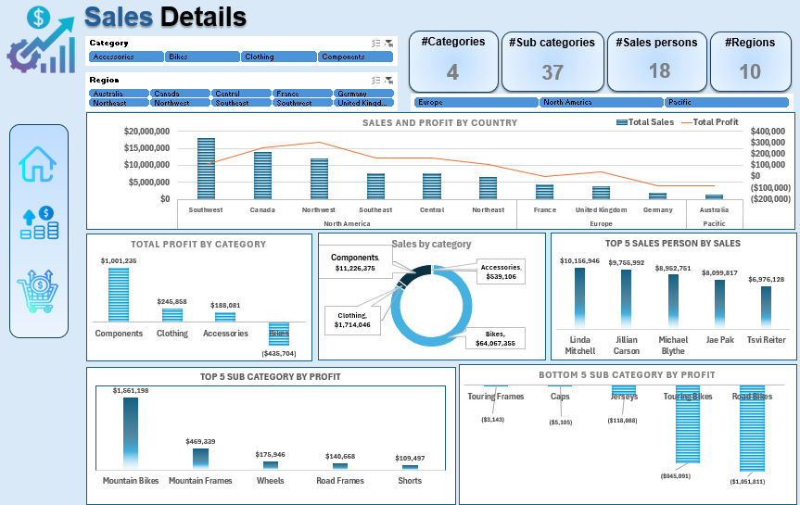

Slide 19
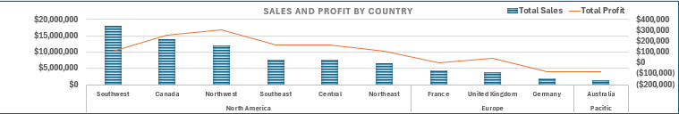
Sales and Profit by Country
North America regions has the highest Sales and Profit
The profit is too low in Europe and Pacific , we are losing in Germany and Australia
We must track the cost and price for Europe and pacific Groups and act

Slide 20
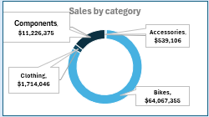
Total Sales by Category
Although bikes is the top category by Sales , but We are losing

Slide 21
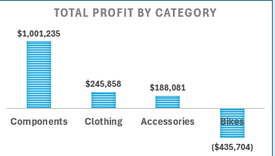
Total Profit by Category
We must rethink about the bikes cost and price because we are losing
The components generates the most profit

Slide 22
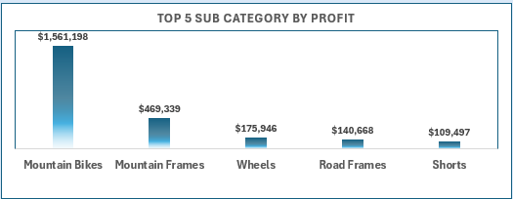
Top 5 subcategories by profit
Mountain Bikes the most subcategory by profit even when bikes has negative profit
The big gap between mountain bikes and other subcategories explained by the different between Bikes sales and other categories

Slide 23
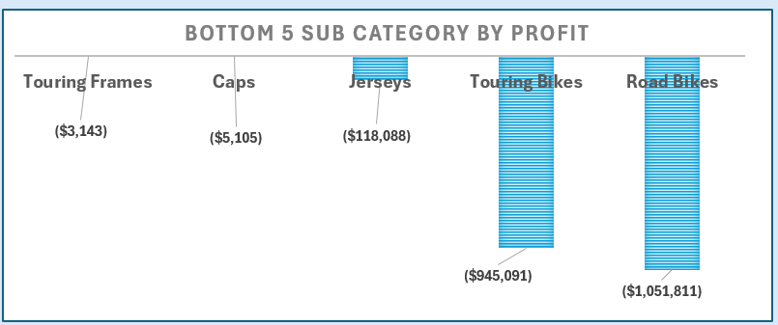
Bottom 5 subcategories by profit
Road and Touring bikes are the worst subcategories by profit which leads to a negative profit in bikes category

Slide 24

Conclusion

