Slide 1
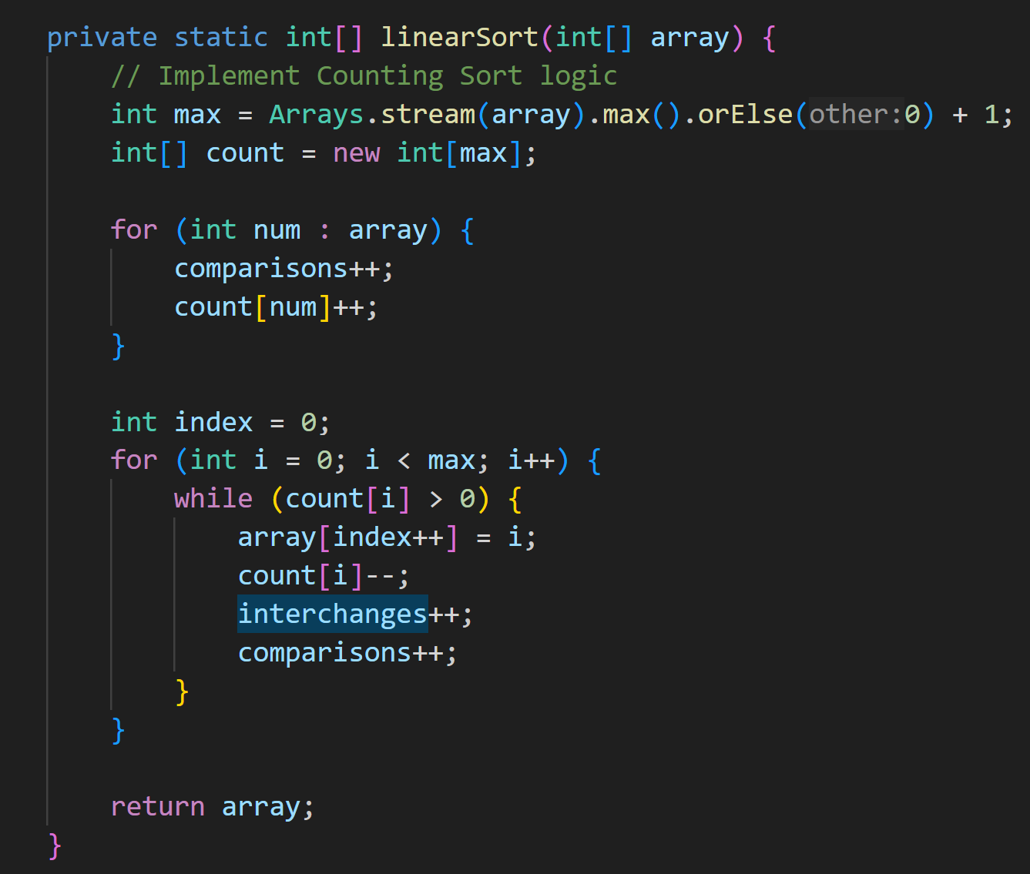
Counting Sort
Array Type: Sorted, Comparisons: 0, Interchanges: 0Array Type: Inversely Sorted, Comparisons: 10000000, Interchanges: 0Array Type: Random, Comparisons: 10000000, Interchanges: 49995000Conclusion: Linear Sort performs well on already sorted or nearly sorted data but is less efficient for random data.

Slide 2
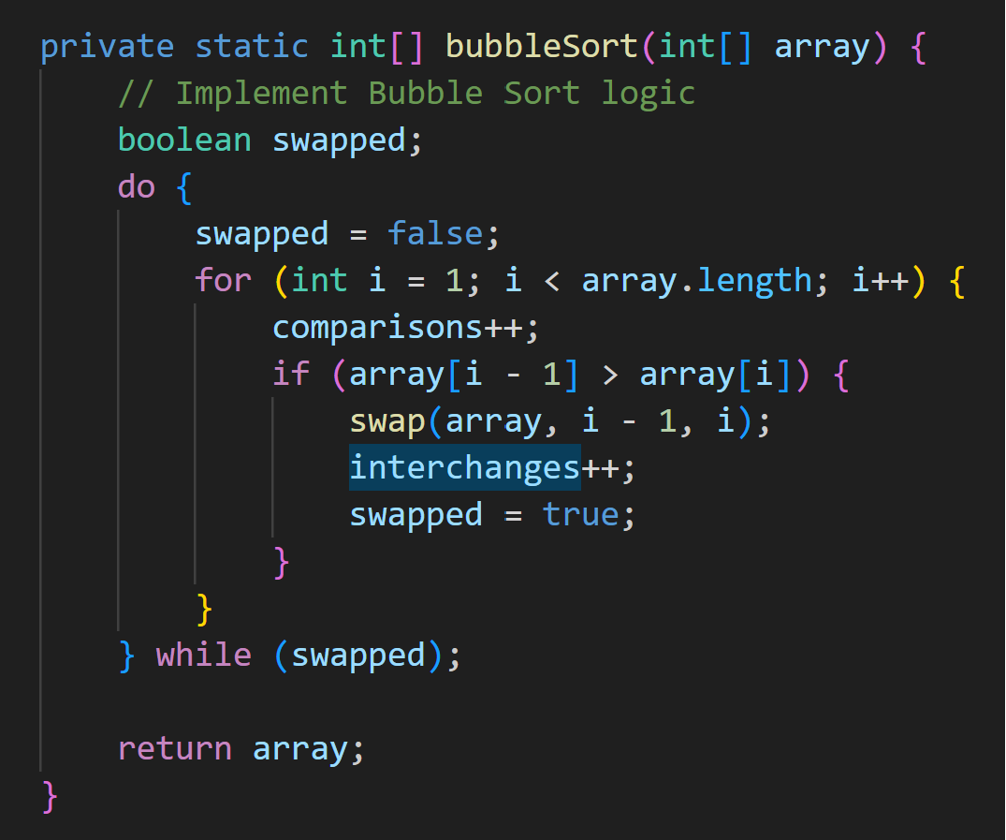
Bubble Sort
Array Type: Sorted, Comparisons: 0, Interchanges: 0Array Type: Inversely Sorted, Comparisons: 99990000, Interchanges: 49995000Array Type: Random, Comparisons: 99990000, Interchanges: 49995000Conclusion: Bubble Sort has poor performance, especially on random or inversely sorted data, making it less efficient for large datasets.

Slide 3
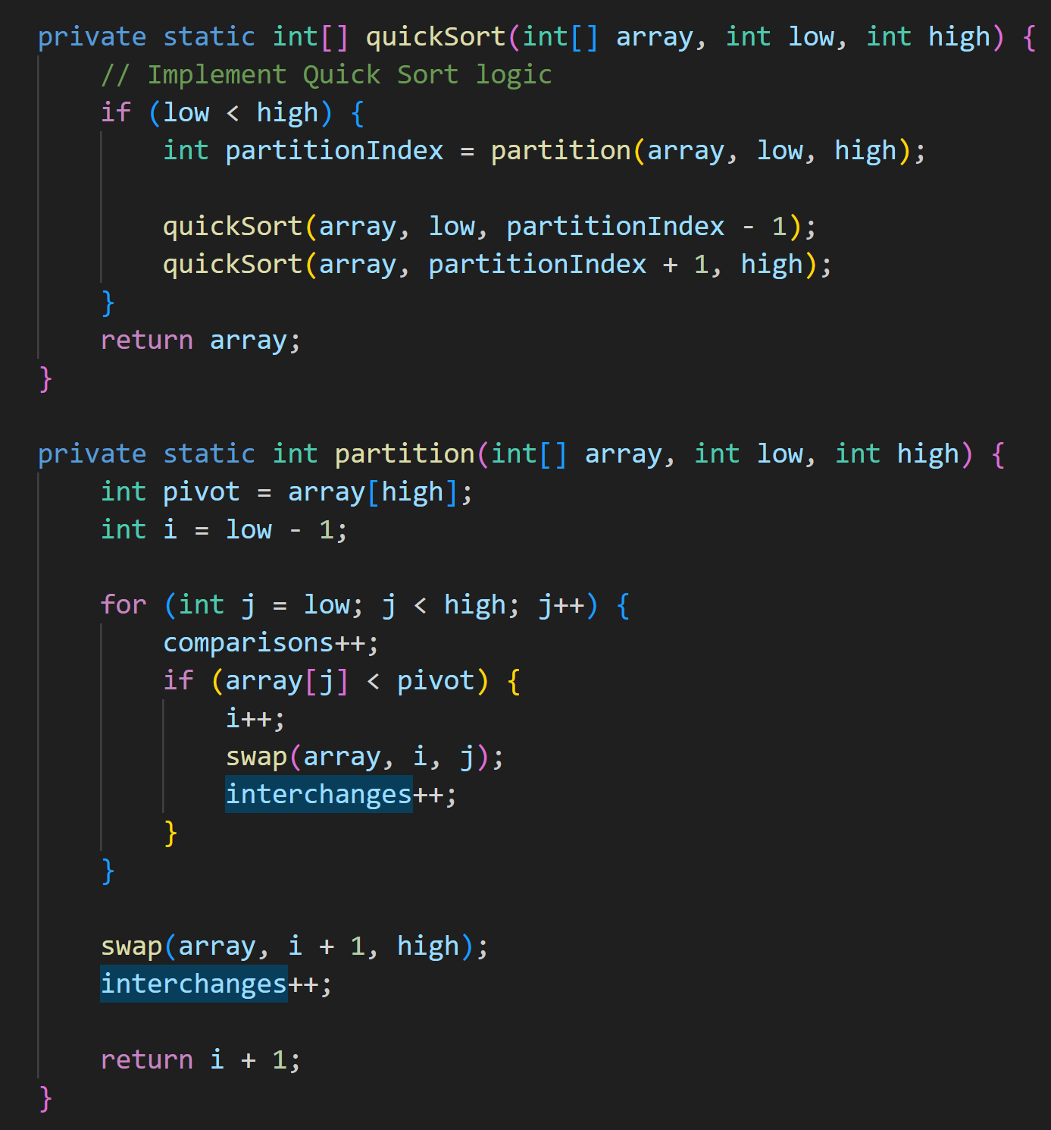
Quick Sort
Array Type: Sorted, Comparisons: 24995000, Interchanges: 9999Array Type: Inversely Sorted, Comparisons: 24995000, Interchanges: 49995000Array Type: Random, Comparisons: 24995000, Interchanges: 49995000Conclusion: Quick Sort generally performs well on various types of data, providing relatively good efficiency for large datasets.

Slide 4
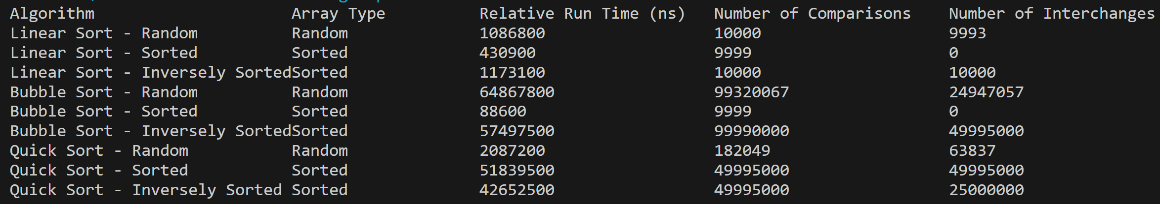
Conclusion:
Among the three sorting algorithms, Quick Sort shows better efficiency across different types of data, making it a more versatile choice.Linear Sort is efficient for already sorted or nearly sorted data but less effective for random data.Bubble Sort exhibits poor performance, especially on random or inversely sorted data.In practical scenarios, Quick Sort is often preferred for general-purpose sorting due to its average-case time complexity of O(n log n) and good performance across diverse datasets.

