Slide 1
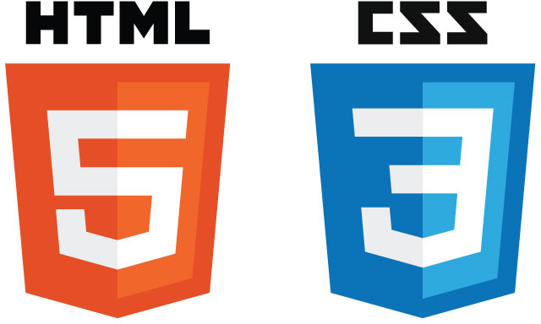
Menna Shata

Slide 2


HTML Hyper Text Markup Language
The standard markup language for creating web pages and web applications.
Notes:
What is HTML?
HTML is the standard markup language for creating Web pages.
HTML stands for Hyper Text Markup Language
HTML describes the structure of Web pages using markup
HTML elements are the building blocks of HTML pages
HTML elements are represented by tags
HTML tags label pieces of content such as "heading", "paragraph", "table", and so on
Browsers do not display the HTML tags, but use them to render the content of the page

Slide 3
What is HTML5 ?
HTML5 is the latest evolution of the standard that defines HTML.
The term represents two different concepts. It is a new version of the language HTML, with new elements, attributes, and behaviors, and a larger set of technologies that allows the building of more diverse and powerful Web sites and applications.

Slide 4
How Did HTML5 Get Started?
HTML5 is a cooperation between the world wide web consortium (W3C) and the Web Hypertext Application Technology Working Group (WHATWG).
(WHATWG) was working with web forms and applications and W3C was working with XHTML 2.0 in 2006, they decided to cooperate and create a new version of HTML.

Slide 5
How Did HTML5 Get Started?(cont`d)
Some rules for HTML5 were established:
New features should be based on HTML, CSS, DOM, and JavaScript
Reduce the need for external plugins (like Flash).
More markup to replace scripting
HTML5 should be device independent.

Slide 6
What is HTML5 ?
HTML
[NEW] Tags
JavaScript
APIS
HTML5

Slide 7

HTML5 – New Features
Some of the most interesting new features in HTML5
The <canvas> element for 2D drawing
The <video> and <audio> elements for media playback
Support for local storage
New content-specific elements, like <footer>, <header>.
New form controls, date, number, email.

Slide 8
Browser Support For HTML5
Some of the most interesting new features in HTML5
HTML5 is not yet an official standard, and no browser have full HTML5 support
But all major browsers (Chrome, Safari, Firefox, Internet Explorer, Opera) continue to add new HTML5 features to their latest versions

Slide 9

HTML5 Detection Library
Is an open source JavaScript library that detects support for many HTML5 and CSS3 features
<script src="modernizr.min.js"> </script>

Slide 10
HTML5 New Elements
HTML5 includes new elements for better structure, better form handling, drawing, and for media content
New Semantic/ Structural Elements.
<article> <aside> <details> <figcaption>
<figure> <footer> <header>
<main> <mark> <nav>
<section> <summary> <time>

Slide 11
HTML5 New Elements
HTML5 includes new elements for better structure, better form handling, drawing, and for media content
New Media Elements.
<video> <audio> <source> <track>
New Form Elements.
<datalist> <output>

Slide 12
HTML5 New Elements
Plan the page: in very simple term it offers you very clean code
Google bot: easier for Google bot to crawl and index due to it`s clean markup

Slide 13
HTML5 FORMS
date
number
range
email
url
search
tel
color
datetime
month
week
Datetime-local
Notes:
•Input type= datetime global date-and-time input control
•input type = datetime-local local date-and-time input control
•input type = date date input control
•input type = month year-and-month input control
•input type = time time input control
•input type = week year-and-week input control
•input type = number number input control
•input type = range imprecise number-input control
•input type = email e-mail address input control
•input type = url URL input control
•input type = search search field
•input type = tel telephone-number-input field
•input type = color color-well control

Slide 14
HTML5 Forms
Input number
<input type="number" min="0" max="10" step="2" value="6” />
JavaScript Methods
Input.stepUp(n)
Input.stepDown(n)
Input.valueAsNumber()

Slide 15
HTML5 Forms
Input number as slider: the only difference is the user interface
<input type=“range" min="0" max="10" step="2" value="6” />
JavaScript Methods
Input.stepUp( )
Input.stepDown( )
Input.valueAsNumber( )

Slide 16
HTML5 Forms
Input email
<input type=“email" />
Input url
<input type=“url" />
Input search
<input type=“search" />

Slide 17
HTML5 Forms
Input tel
<input type=“tel" />
Input color
<input type=“color" />

Slide 18
HTML5 FORMS
Attributes and functions
placeholder
required
autocomplete
pattern
autofocus
Notes:
•Input type= datetime global date-and-time input control
•input type = datetime-local local date-and-time input control
•input type = date date input control
•input type = month year-and-month input control
•input type = time time input control
•input type = week year-and-week input control
•input type = number number input control
•input type = range imprecise number-input control
•input type = email e-mail address input control
•input type = url URL input control
•input type = search search field
•input type = tel telephone-number-input field
•input type = color color-well control

Slide 19
Questions ???

Slide 20

Canvas
Let`s call it
a drawing surface
<canvas width =“300” height=“150” ></canvas>
Notes:
ctx.fillStyle = "red";
ctx.fillRect(x,y,width,height);
Ctx.strokestyle=“red”
ctx.lineWidth = 5;
ctx.moveTo(50, 50);
ctx.lineTo(100, 100);
ctx.stroke();

