Slide 1
LIBRARY MANAGEMENT SYSTEM

Slide 2
TABLE OF CONTENTS
01
02
03
04
05
06
INTRODUCTION
PURPOSE
FEATURES
SYSTEM DESIGN
ARCHITECTURE
IMPLEMENTATION
07
TESTING
08
CONCLUTION

Slide 3
01
INTRODUCTION
This system aims to streamline and automate various library operations to improve efficiency and the user experience.

Slide 4

INTRODUCTION
A Library Management System (LMS) is a software application designed to handle the fundamental operations and processes of a library. It allows libraries to manage book inventories, transactions (borrowing, returning, etc.), user memberships, and other related services in a digital environment.

Slide 5
02
PURPOSE

Slide 6
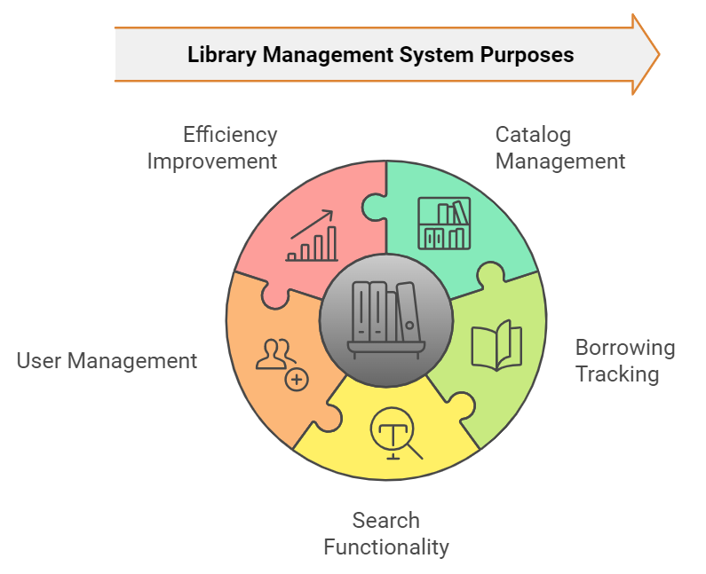

Slide 7
03
FEATURES
1-Book Management
2-User Management
3-Borrowing and Returning Management
4-Search Functionality
5-Reporting

Slide 8
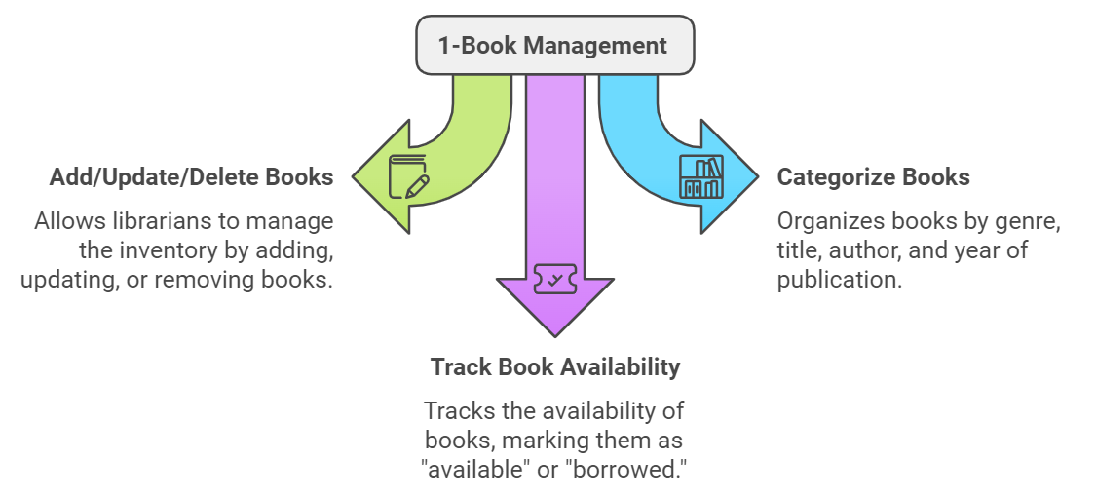

Slide 9
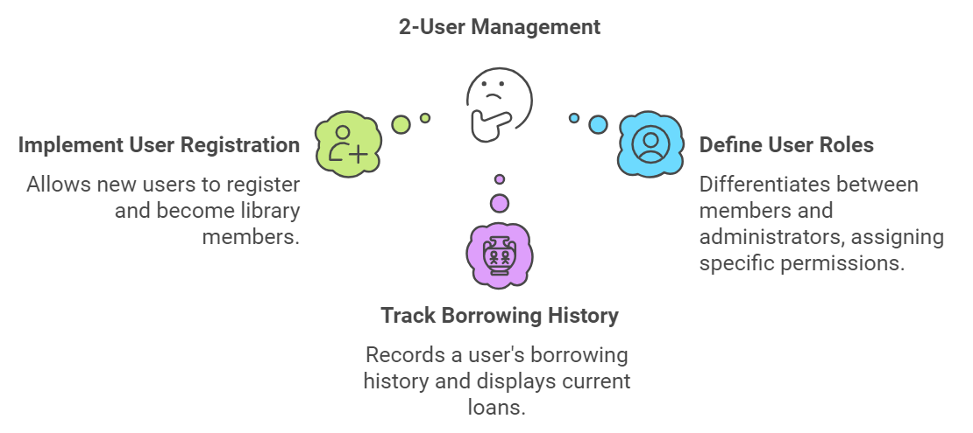

Slide 10
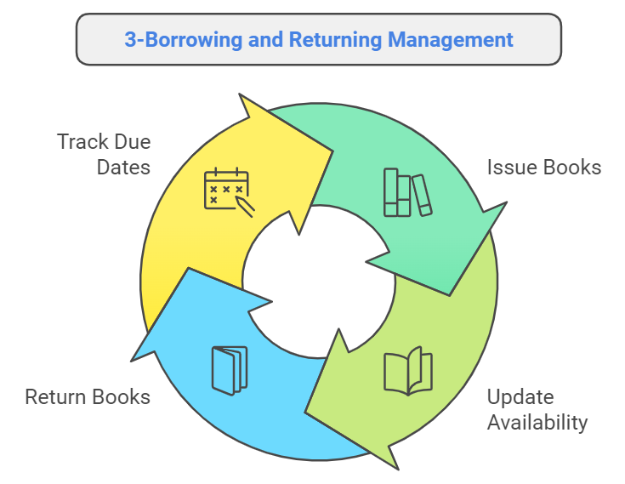

Slide 11
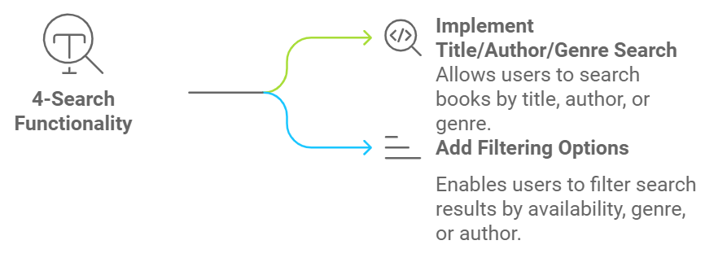

Slide 12
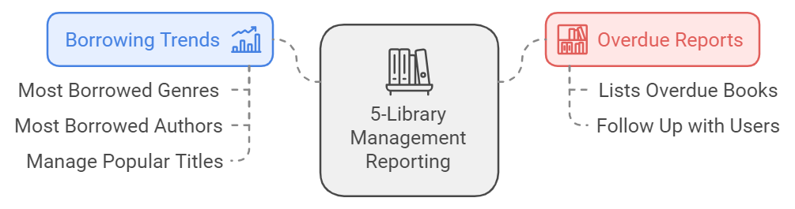

Slide 13
04
SYSTEM DESIGN

Slide 14
3. System Design:
3.1. Data Models
3.1.1. Book Model
3.1.2. Author Model
3.1.4. AppUser Model
3.1.5. Publisher Model
3.1.6. BookUser Model

Slide 15
05
ARCHITECTURE

Slide 16
Architecture
The system architecture is based on the MVC (Model-View-Controller) design pattern.
Model: Handles data representation, including the Book, Author, AppUser, and BookUser models.
View: Provides the user interface for librarians and users, allowing them to search for books, view borrowing history, and more.
Controller: Handles the interactions between the views and models, performing actions like borrowing a book or searching for titles.

Slide 17
06
IMPLEMENTATION

Slide 18
4.1. Tools and Technologies
Language: C# (ASP.NET Core)
Database: SQL Server and Cloudinary MediaDB and MonsterAsp.net
Frontend: Razor Views (HTML, CSS, Bootstrap,Js)
Development Environment: Visual Studio 2022
Framework: ASP.NET Core MVC

Slide 19
07
TESTING

Slide 20
7. Testing
Testing of the LMS can include the following test cases:
Book Search Test: Ensure that searching by title, author, and genre retrieves the correct results.
Borrowing Test: Ensure that users can borrow books, and the system updates the availability status.
Return Test: Ensure that returning a book updates the availability status.
Overdue Test: Verify that the system correctly flags overdue books .
User Registration Test: Ensure that users can register and manage their borrowing history.

Slide 21
08
CONCLUTION

Slide 22
6. Conclusion
A Library Management System is an essential tool for managing library resources effectively and improving the user experience. By automating tasks such as book search, borrowing, returning, and reporting, the system significantly reduces the manual workload for librarians and provides users with a seamless experience. This system is highly adaptable and can be extended to include features such as e-book Borrowing.

Slide 23
OUR TEAM
Abdelrhman Hamdy Tawfic
Mohammed Ahmed Abdelrazik
Ashraf AbuElrai Attia
Abdelrhman Hassan
Kareem helkan fathi
Amr Ali

Slide 24
THANKS!
DO YOU HAVE ANY QUESTIONS?

