Slide 1

Stack-Overflow (EDA)
By Abdulrhman Ahmed Mohammed Hussein
Exploratory Data Analysis
01

Slide 2
Today's agenda
Executive summary
Project overview
Problem
Solution and recommendations
Contact for more

Slide 3
03
Executive summary
This report analyzes data professionals on Stack Overflow, a massive online developer Q&A platform. By examining this data, we aim to uncover valuable insights into current trends within the Data Professional field. This information will be crucial for understanding the challenges, sought-after skills, and evolving technologies shaping this critical workforce.
Stack-Overflow (EDA)

Slide 4
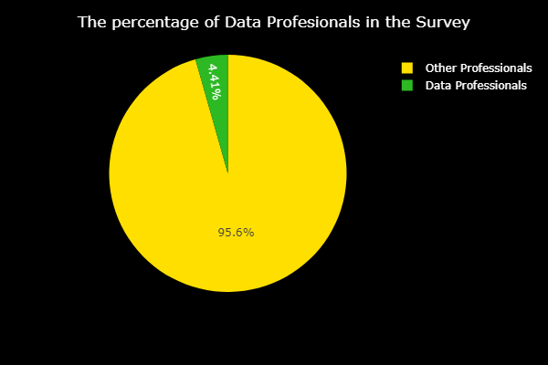
Project overview
04
This project analyzed a survey with a total of 89,184 respondents. However, only 3,686 of the respondents identified as data professionals. This represents a relatively small percentage of the overall sample. This finding suggests that the survey results may not be fully representative of the data professional population. Further analysis may be required to determine if additional data collection is necessary to obtain a more representative sample

Slide 5
The EDA Questions
05
1- what are the types of data professionals included in this survey ?
2- what are the to 10 Countries having ?
3- what are the Top 10 Countries having Data analysts ?
4- which industries having higher number of Data Professionals ?
5- what is the percentage of each Data Professionals per industry ?
6- what are the top 10 programming language used by data professionals ?
7- what are the top 10 Programming language desired by Data Professionals ?
8- what are the top 10 Databases used by data professionals ?
9- what are the top 10 Databases desired by data professionals ?

Slide 6
The EDA Questions
06
10- what are the top 10 Technologies / frameworks used by data professionals ?
11- what are the top 10 Technologies / frameworks desired by data professionals ?
12- which data professional having the highest income ?
13- is there a relationship between the Coding experience years and Annual income ?
14- is there a relationship between the Working experience years and Annual income ?
15- which industry having the highest paying average for data professionals ?
16- which frameworks (TensorFlow or pytorch ) user having a higher salary ?

Slide 7
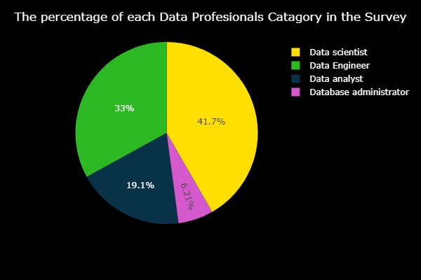
What are the types of data professionals included in this survey ?
07
According to the Pie chart, It shows the distribution of data professionals according to the survey. Data scientists are the largest group, making up 41.7% of those surveyed. Data engineers come in second at 33%, followed by data analysts at 19.1%. Database administrators are the smallest group, at 6.21%.
Note: this unequal distribution will affect on some interoperations

Slide 8
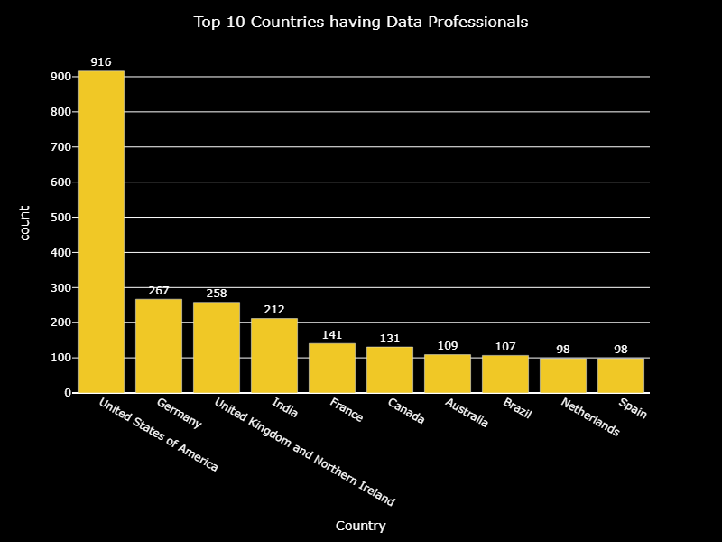
What are the top 10 Countries having ?
08
This bar chart shows the top 10 countries having data professionals. The United States of America has the most data professionals. According to the Stack-overflow survey

Slide 9
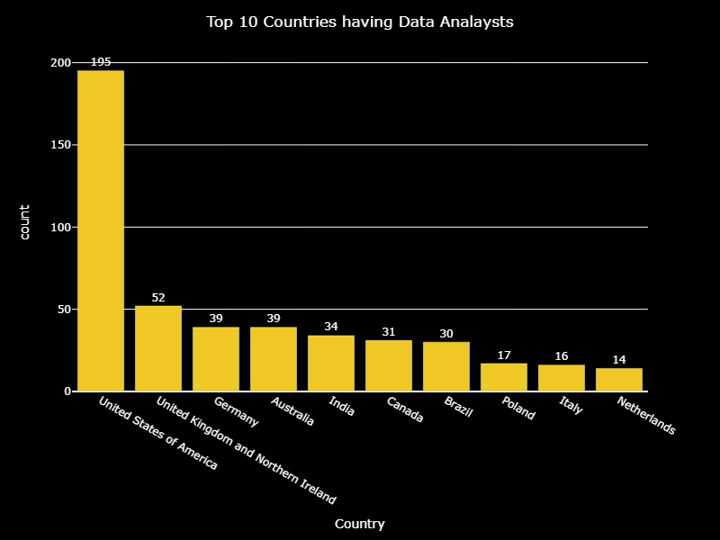
What are the Top 10 Countries having Data analysts ?
09
This bar chart shows the top 10 countries having data professionals. The United States of America has the most data Analysts. According to the Stack-overflow survey

Slide 10
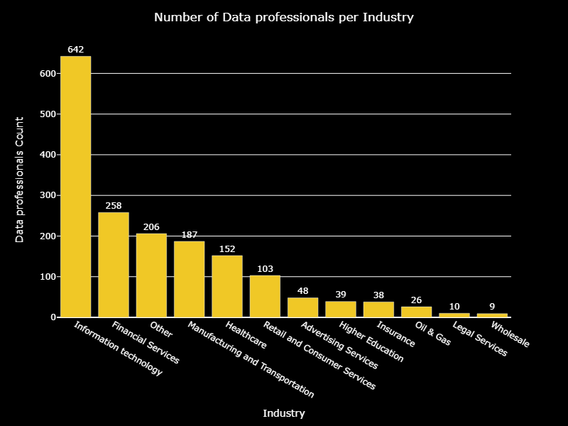
which industries having higher number of Data Professionals ?
10
According to this bar chart, shows the Information Technology industry has the highest number of data professionals, at 642. The Finance industry follows with 206 data professionals.

Slide 11
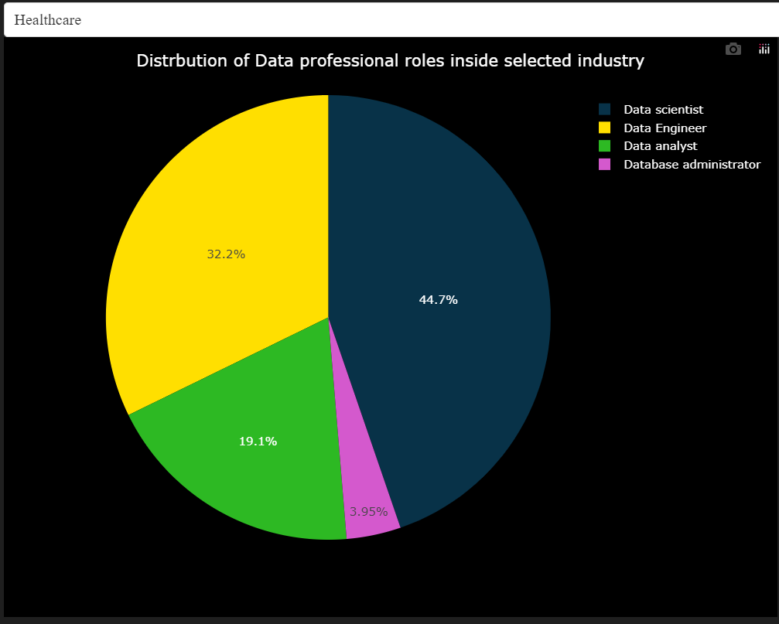
what is the percentage of each Data Professionals per industry ?
11
According to this interactive chart (built with Dash) ,it shows the distribution of data professionals in health care industry.
In which data scientists have the highest portion with about 45% of data professionals, and 32% are data engineer , 19% data analysts, and only about 4% database administrator

Slide 12
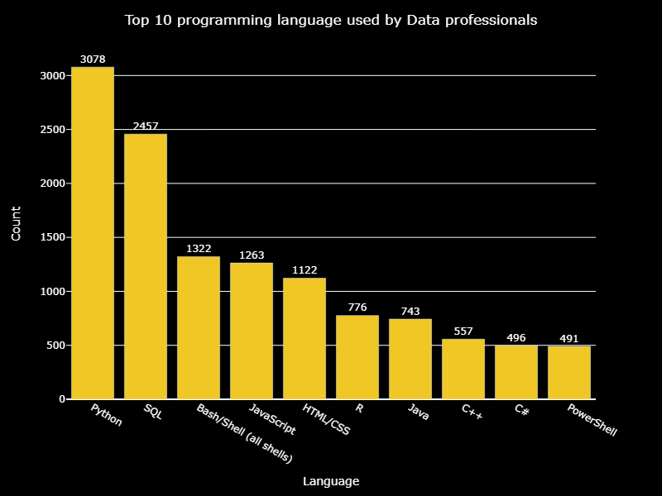
what are the top 10 programming language used by data professionals ?
12
According to this bar chart, shows number of users who used these programming languages, it shows that Python taking the first place and the difference between Python and R in term of number of users is very high

Slide 13
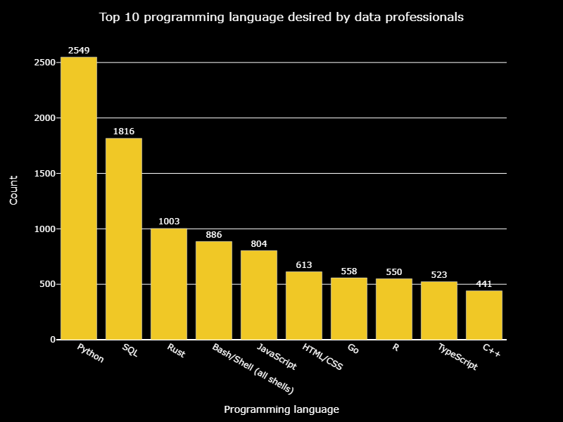
What are the top 10 Programming language desired by Data Professionals ?
13
According to this bar chart, shows number of users who used these programming languages, it shows that Python taking the first place and the difference between Python and R in term of number of data professionals who want to use it . And Rust is taking a higher attention

Slide 14
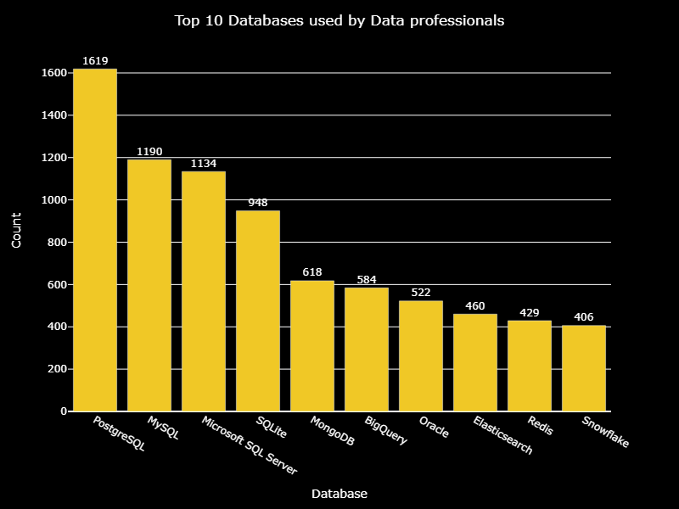
What are the top 10 Databases used by data professionals ?
14
According to this bar chart, shows number of users who used these Databases, it shows that PostgreSQL is most used database overall and the most used among SQL-based databases, while MongoDB is the most used No-SQL database.

Slide 15
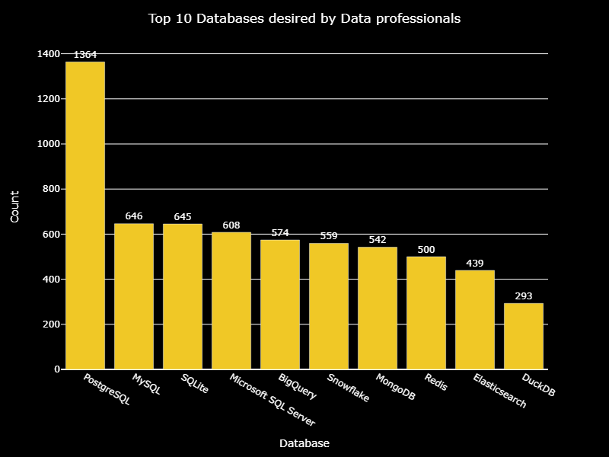
what are the top 10 Databases desired by data professionals ?
15
According to this bar chart, it shows the PostgreSQL still having the highest place as the most desired database and MongoDB still keeping its place as the most NoSQL database wanted.
But we see a new player(snowflake) coming to the scene that transferred from 10th place as the most used to 6th place in the most desired databases.

Slide 16
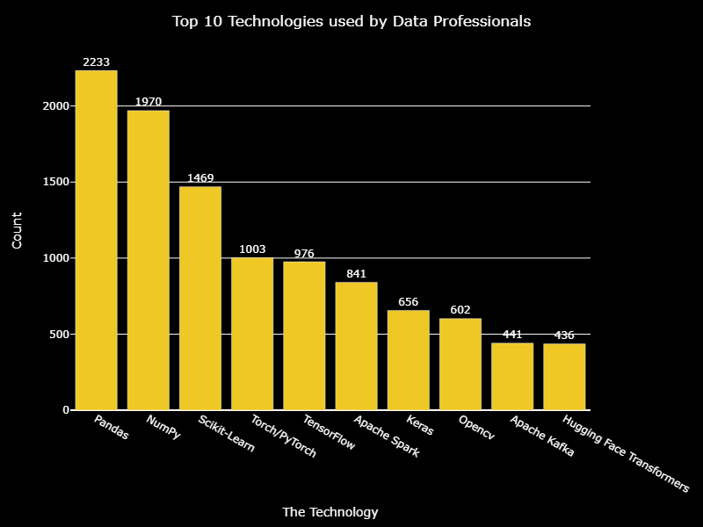
what are the top 10 Technologies / frameworks used by data professionals ?
16
According to this bar chart, pandas is taking the highest place as the most used technology. And scikit-learn as the most used machine-learning technology

Slide 17
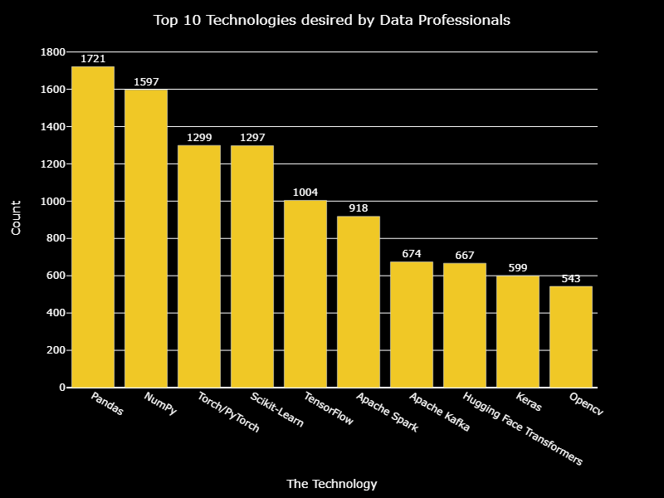
what are the top 10 Technologies desired by data professionals ?
17
According to this bar chart, pandas keeping its place as the most desired and used technology, but Pytorch is now the most desired technology in Machine-learning technologies

Slide 18
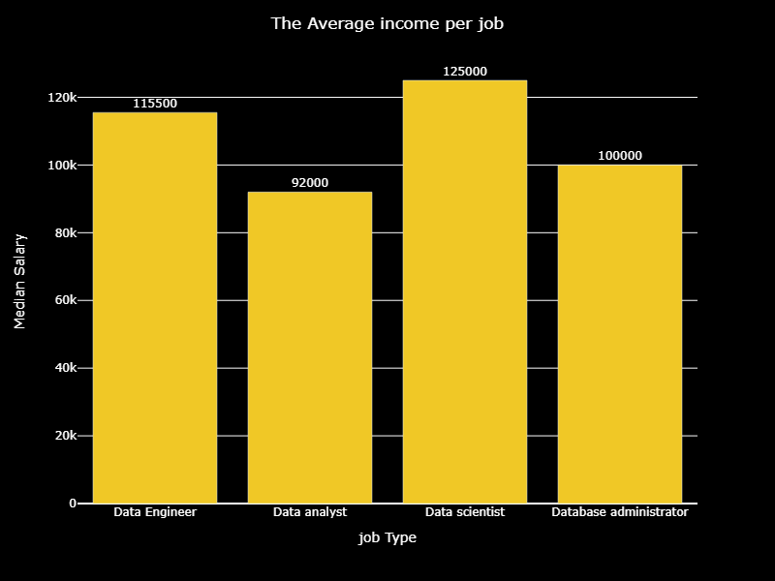
which data professional having the highest income ?
18
According to this bar chart, the data scientists have the highest average of income in comparison to other data professional role

Slide 19
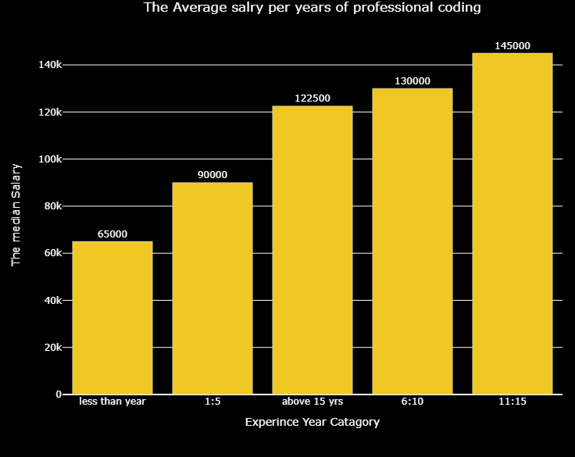
is there a relationship between the Coding experience years and Annual income ?
19
According to this bar chart, the more you get of professional coding experience years the more higher average income
Note: the problem with (above 15yrs) age category will be answer next slide

Slide 20
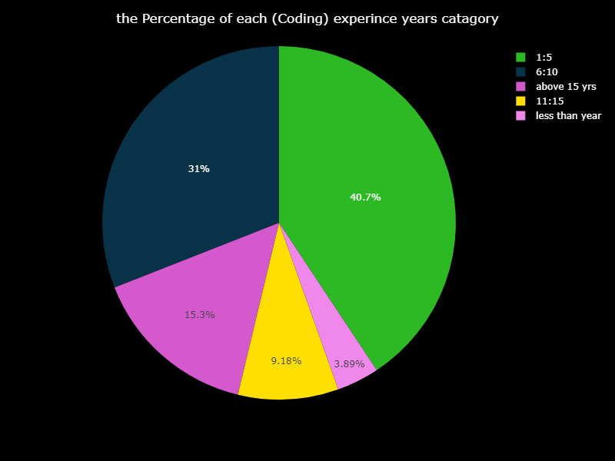
The distribution of each Coding experience years category
20
According to this pie chart, the above 15yrs is relatively low in comparison to the respondents were between 1:5 and 6:10 and even the respondents that are less than year are the smallest percentage , thus the 15yrs category is mis represented

Slide 21
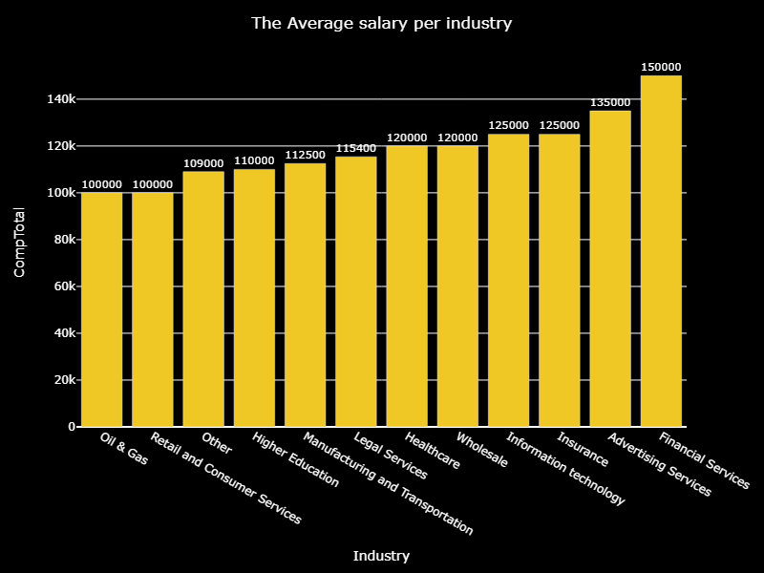
which industry having the highest paying average for data professionals
21
According to this bar chart, the financial services and Advertising services both are having the highest average income.

Slide 22
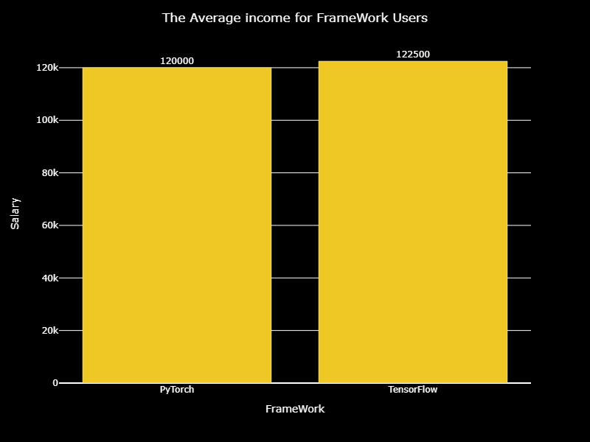
which frameworks (TensorFlow or pytorch ) user having a higher salary ?
22
After taking a sample of 100 users of each framework exclusively (used only one), we ended to “there is no big difference between total income for data professionals who use PyTorch or TensorFlow”

Slide 23

Problem 1
23
Problems in the data
The data isn’t collected for data professionals
Problem 2
Some categories of data professionals aren’t well represented
Problem 3
The data professional distributions were not equal there for it was affecting some interpretations

Slide 24
24
Solution
RECOMMENDATION 1
RECOMMENDATION 2
RECOMMENDATION31
Collect a data with a focus on data professionals
Taking a random equal samples from data collected for each data professional category
Re-do the EDA with the new Data

Slide 25
25
EMAIL ADDRESS
Abd.ahme1998@gmail.com
Contact me for more
PHONE NUMBER
+20 1123488354.

