Slide 1


Slide 2



Layout is an essential aspect of web design that involves positioning and arranging elements on a web page in a meaningful and visually appealing way. A well-designed layout can enhance the user experience by making it easier for users to navigate, understand the content, and interact with the website. There are several layout techniques and tools available in web design, and each has its own benefits and drawbacks.
CSS Grid Layout is a powerful and flexible layout system that enables developers to create complex and dynamic layouts with ease. It uses a grid-based approach to layout design, where elements are placed within rows and columns, allowing for precise control over the position and size of each element. CSS Grid Layout provides a wide range of features, including the ability to create responsive designs, handle dynamic content, and create intricate layouts that would be difficult or impossible with other layout techniques.

Slide 3

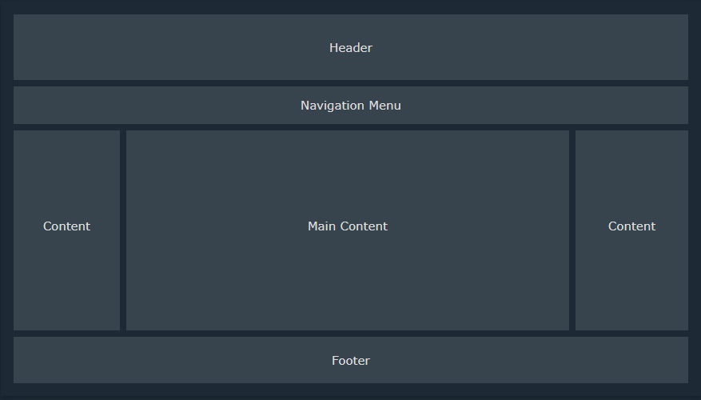
This an example for most popular layout used in web sites:

Slide 4
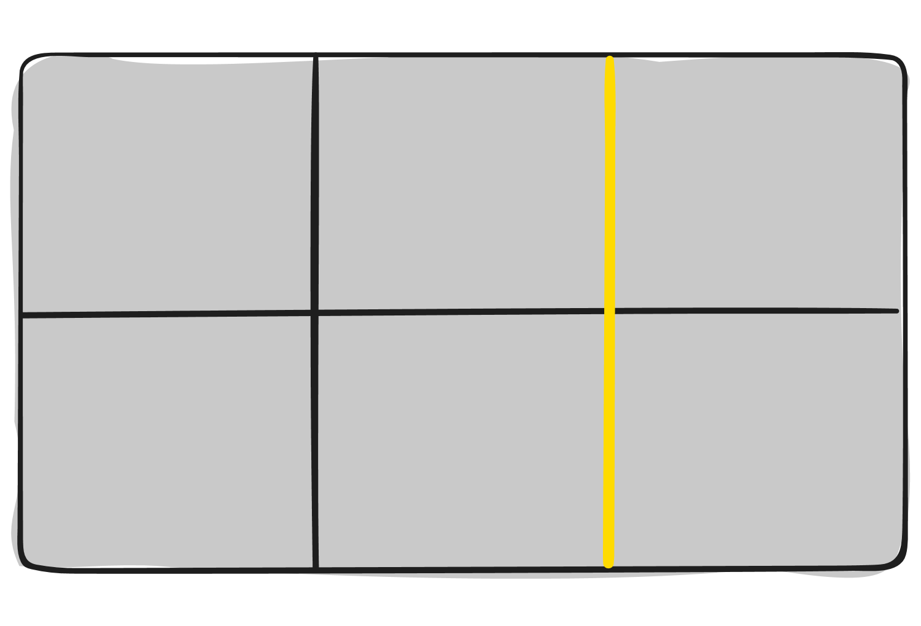
Before diving into the concepts of Grid it’s important to understand the terminology. Since the terms involved here are all kind conceptually similar.
Grid Container:
Grid Line:
Is the element on which display: grid is applied, and is the direct parent of all the grid items.
The dividing lines that make up the structure of the grid. They can be either vertical (“column grid lines”) or horizontal (“row grid lines”) and reside on either side of a row or column.
In this example container is the grid container:
<div class="container">
<div class="item item-1"></div>
<div class="item item-2"></div>
<div class="item item-3"></div>
</div>
Here the yellow line is an example of a column grid line:

Slide 5
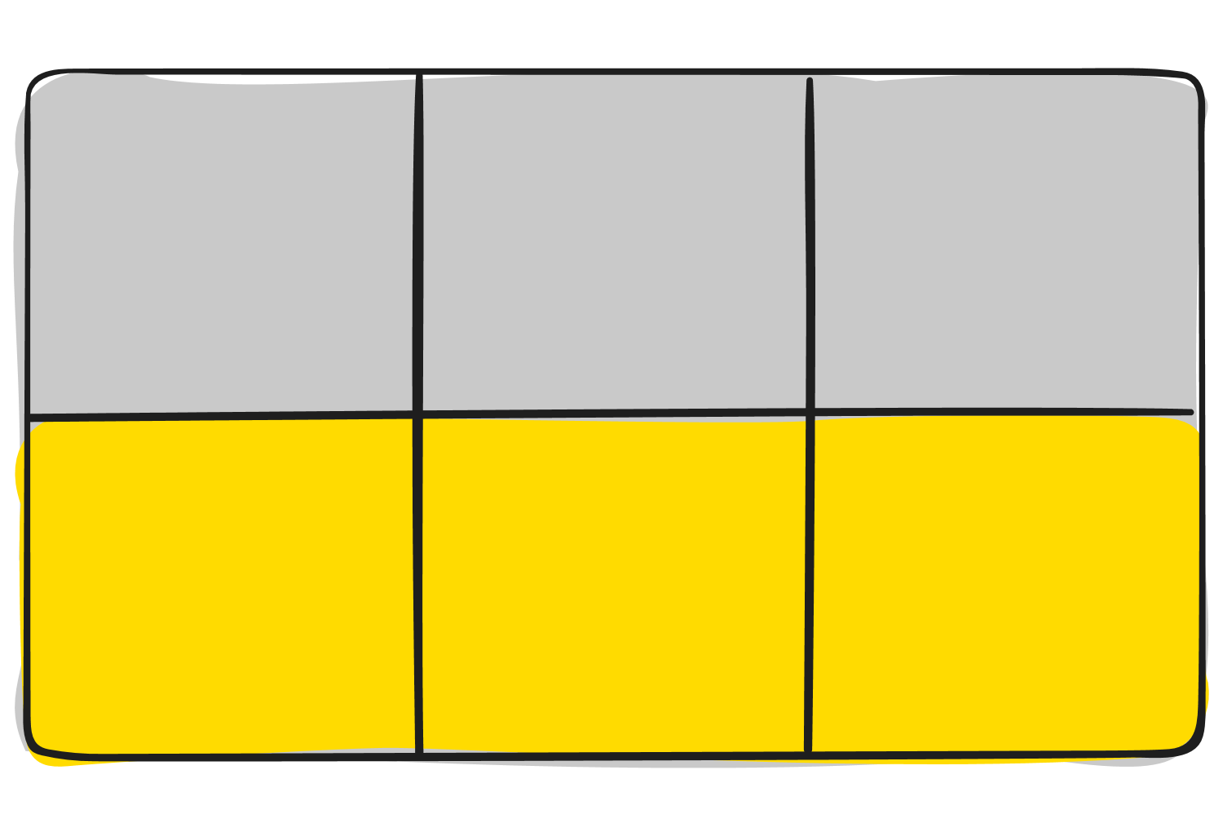
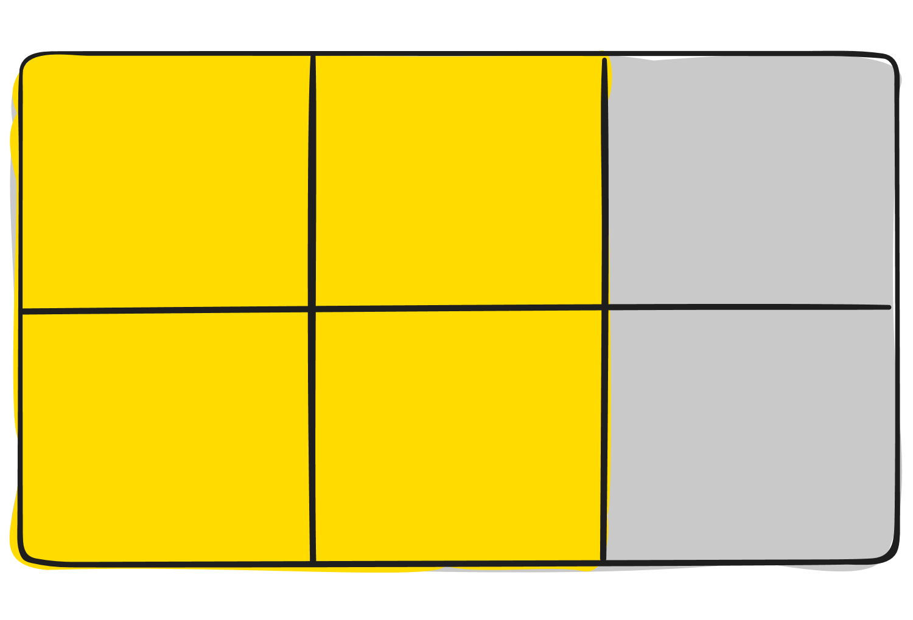
Grid Track:
Grid Area:
The space between two adjacent grid lines. You can think of them as the columns or rows of the grid.
The total space surrounded by four grid lines. A grid area may be composed of any number of grid cells.
Here’s the grid area between row grid lines 1 and 3, and column grid lines 1 and 3:
Here’s the grid track between the second and third-row grid lines:

Slide 6
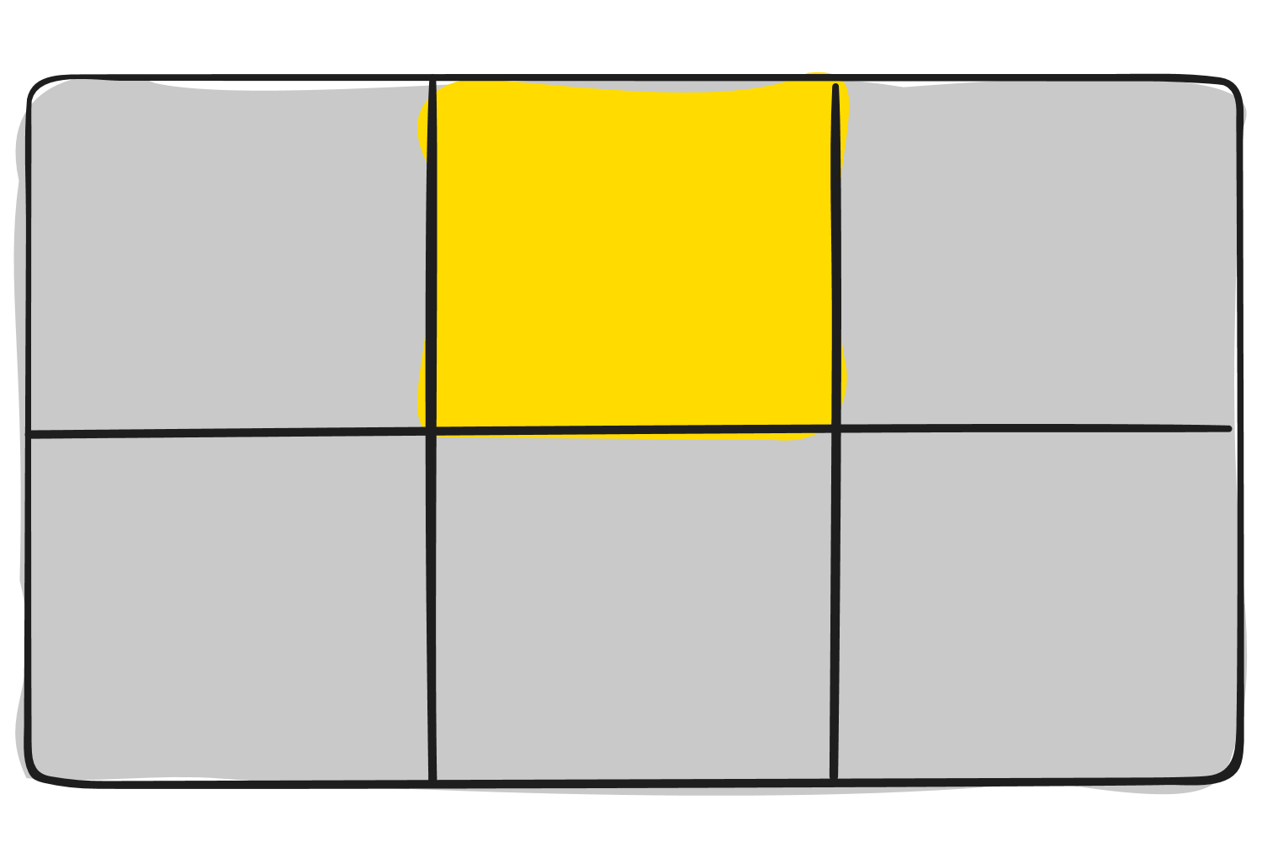
Grid Item:
Grid Cell:
The children (i.e. direct descendants) of the grid container.
The space between two adjacent row and two adjacent column grid lines. It’s a single "unit" of the grid.
Here the item elements are grid items, but sub-item isn’t:
Here’s the grid cell between row grid lines 1 and 2, and column grid lines 2 and 3.
<div class="container">
<div class="item"></div>
<div class="item">
<p class=“sub-item"></p>
</div>
<div class="item"></div>
</div>

Slide 7

To layout your grid there are two methods (parent or child), and both have their pros and cons, generally used as needed
  Parent:
  Display: Defines the element as a grid container and establishes a new grid formatting context for its contents.
    grid: Generates a block-level grid.
    Inline-grid: Generates an inline-level grid
.container {
display: grid | inline-grid;
}
  grid-template-rows and grid-template-columns: Defines the columns and rows of the grid with a space-separated list of values. The values represent the track size, and the space between them represents the grid line.
  grid-template-columns: sets the size and number of columns in a grid container.
  grid-template-rows: sets the size and number of rows in the grid container.
You can use a combination of length values, percentages, and other CSS units to define the size of the grid columns and rows.
.container {
grid-template-columns: ... ...;
/* e.g.
1fr 1fr
minmax(10px, 1fr) 3fr
repeat(5, 1fr)
50px auto 100px 1fr
*/
grid-template-rows: ... ...;
/* e.g.
min-content 1fr min-content
100px 1fr max-content
*/
}

Slide 8

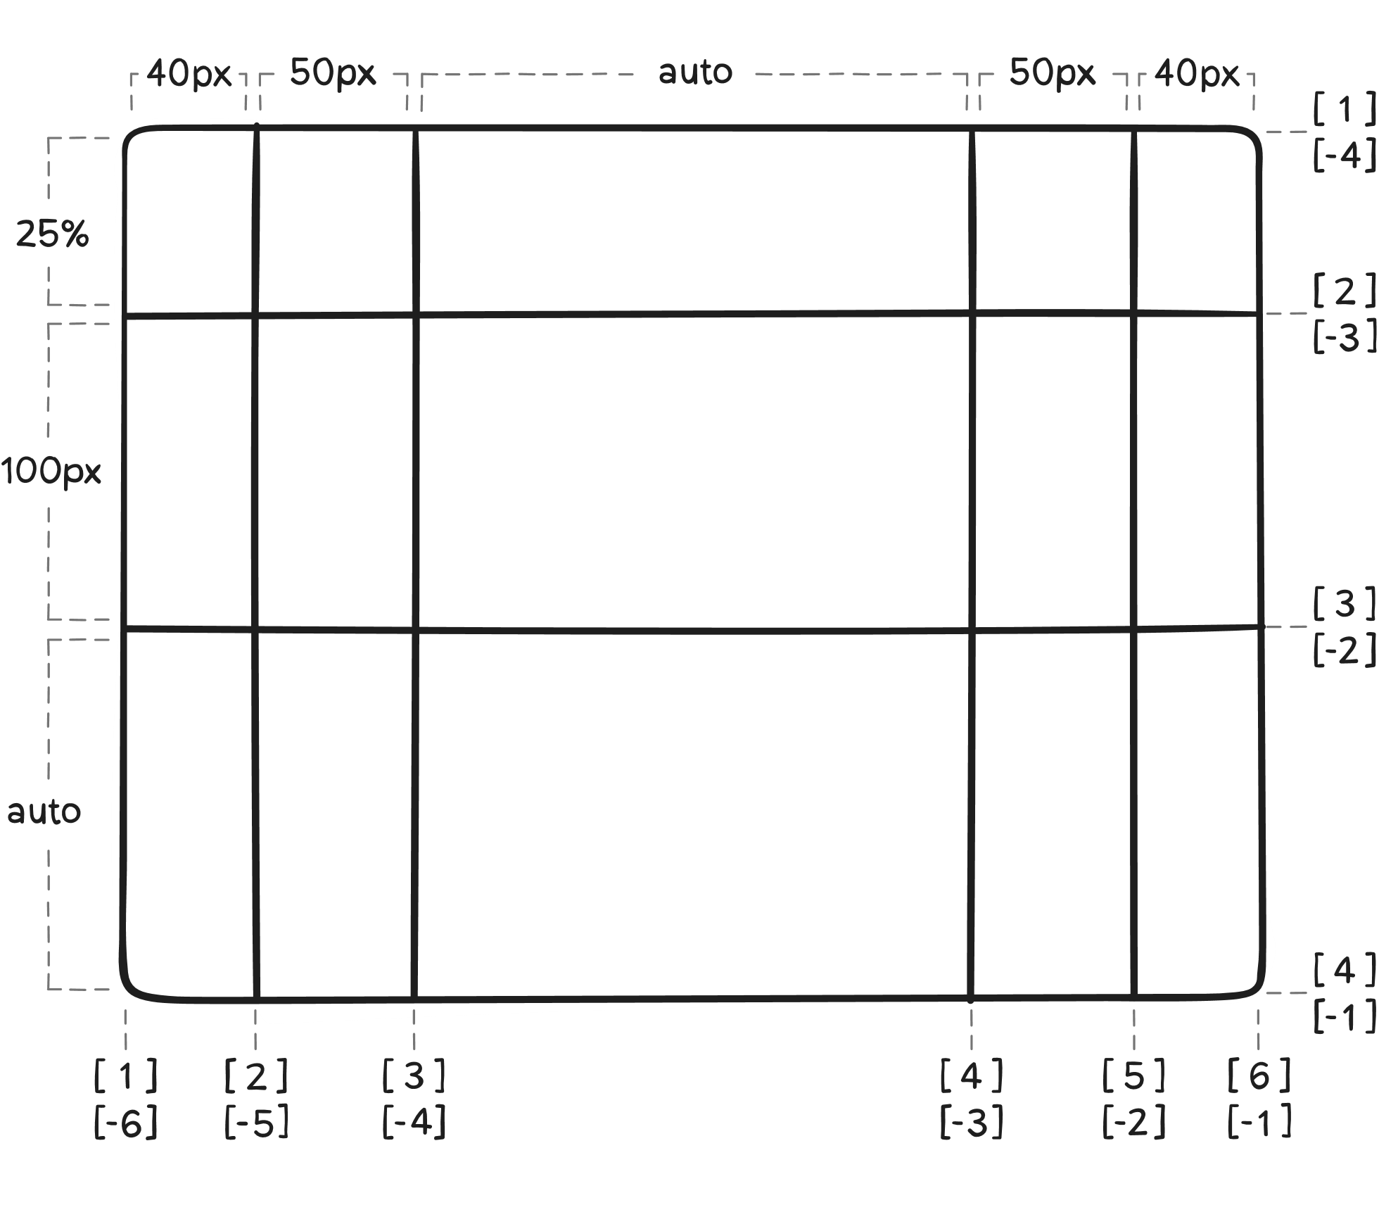
Grid lines are automatically assigned positive numbers from these assignments (-1 being an alternate for the very last row).

Slide 9
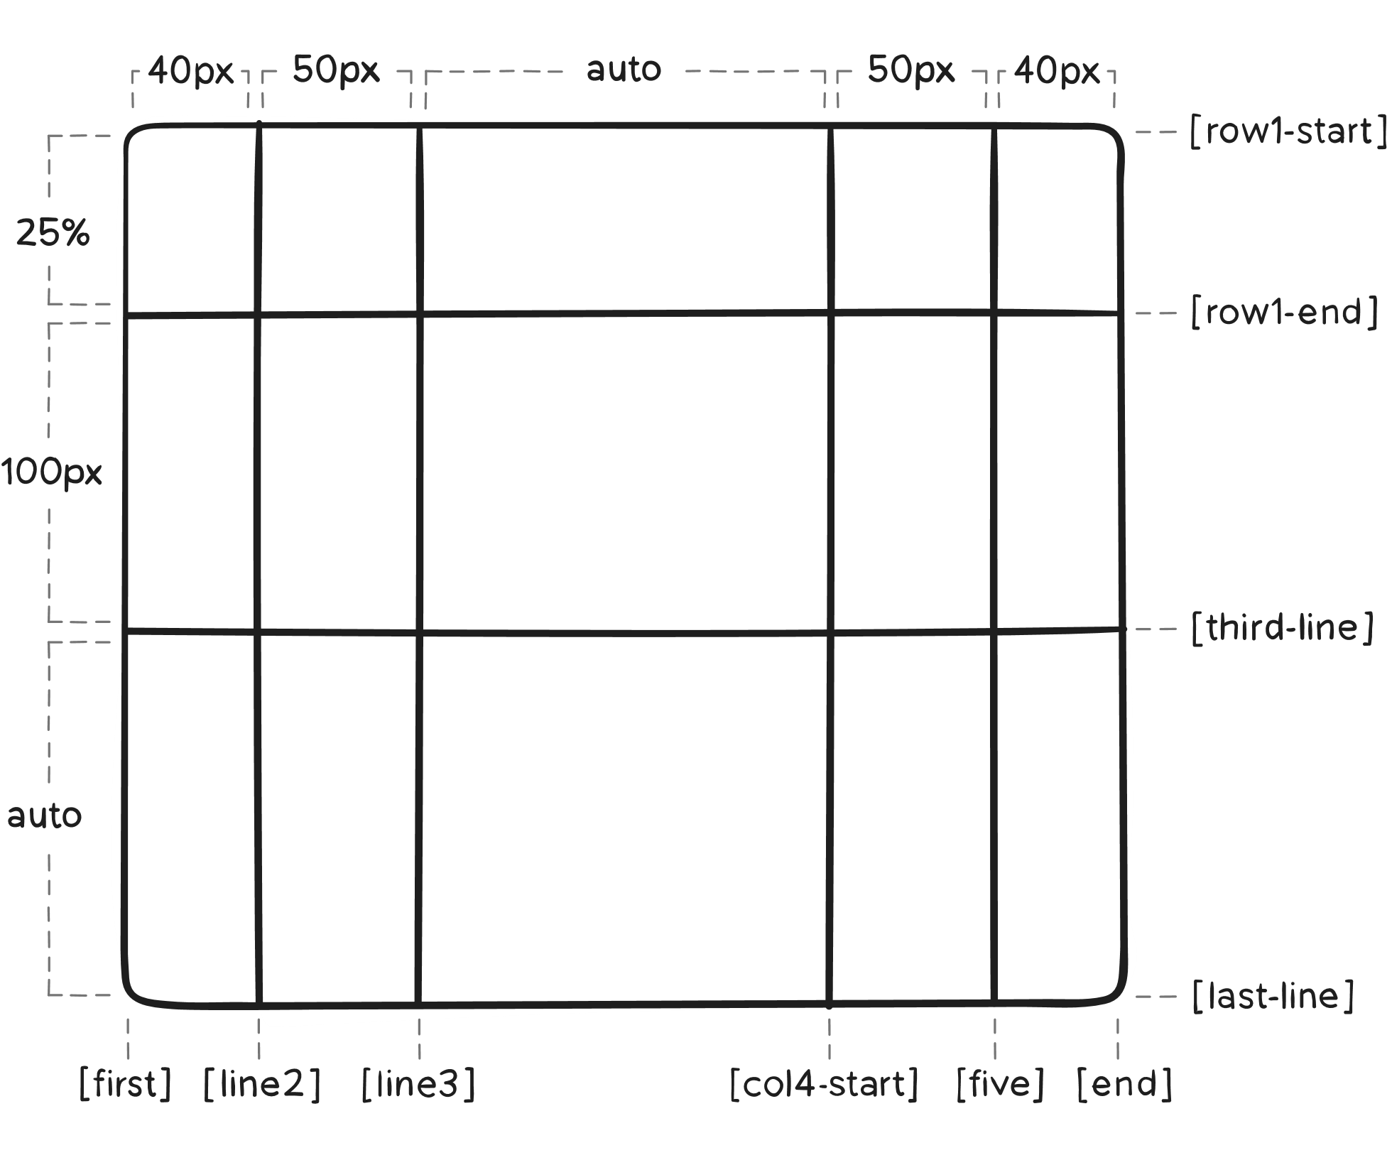
But you can choose to explicitly name the lines. Note the bracket syntax for the line names:
.container {
grid-template-columns: [first] 40px [line2] 50px
[line3] auto [col4-start]
50px [five] 40px [end];
grid-template-rows: [row1-start] 25%
[row1-end] 100px
[third-line] auto [last-line];
}

Slide 10
.container {
grid-template-rows: [row1-start] 25%
[row1-end row2-start]
25% [row2-end];
}
Note that a line can have more than one name.
For example, here the second line will have two names: row1-end and row2-start:
If your definition contains repeating parts, you can use the repeat() notation to streamline things:
.container {
grid-template-columns: repeat(3, 20px [col-start]);
}
If multiple lines share the same name, they can be referenced by their line name and count:
.item {
grid-template-columns: col-start 20px;
}
The fr unit allows you to set the size of a track as a fraction of the free space of the grid container.
For example, this will set each item to one third the width of the grid container
.item {
grid-template-columns: 1fr 1fr 1fr;
}
The free space is calculated after any non-flexible items. In this example the total amount of free space available to the fr units doesn’t include the 50px:
.item {
grid-template-columns: 1fr 50px 1fr 1fr;
}

Slide 11



For example, to create a simple 3-column grid with equal width columns, you can use the following code:
<div class="container">
<aside class="side-right"></aside>
<main class="main-content"></main>
<aside class="side-left"></aside>
</div>
.container {
display: grid;
height: 97vh;
grid-template-columns: repeat(3, 1fr);
}
.side-right { background-color: red; }
.main-content { background-color: green; }
.side-right { background-color: whitesmoke; }
This code sets the container's display to grid, and then uses grid-template-columns to create three equal-width columns.
The repeat() function is used to repeat the value 1fr (which stands for "one fraction") three times.

Slide 12


To create a 2-row grid with a fixed height for the first row and a flexible height for the second row, you can use the following code:
<div class="container">
<aside class=“side"></aside>
<main class="main-content"></main>
</div>
.container {
display: grid;
height: 97vh;
grid-template-columns: 250px, auto;
}
.side { background-color: red; }
.main-content { background-color: green; }
This code sets the container's display to grid, and then uses grid-template-rows to create two rows. The first row has a fixed height of 100px, while the second row has a flexible height (auto) that will expand to fill the remaining space in the container.
These are just a few examples of how grid-template-columns and grid-template-rows can be used to create different grid layouts.

Slide 13
  grid-template-areas: Defines a grid template by referencing the names of the grid areas which are specified with the grid-area property.
  Repeating the name of a grid area causes the content to span those cells.
  A period signifies an empty cell. The syntax itself provides a visualization of the structure of the grid.
.container {
grid-template-areas: "<grid-area-name> | . | ... "
"...";
}
  grid-area-name: the name of a grid area specified with grid-area.
  .: a period signifies an empty grid cell.
  none: no grid areas are defined.

Slide 14
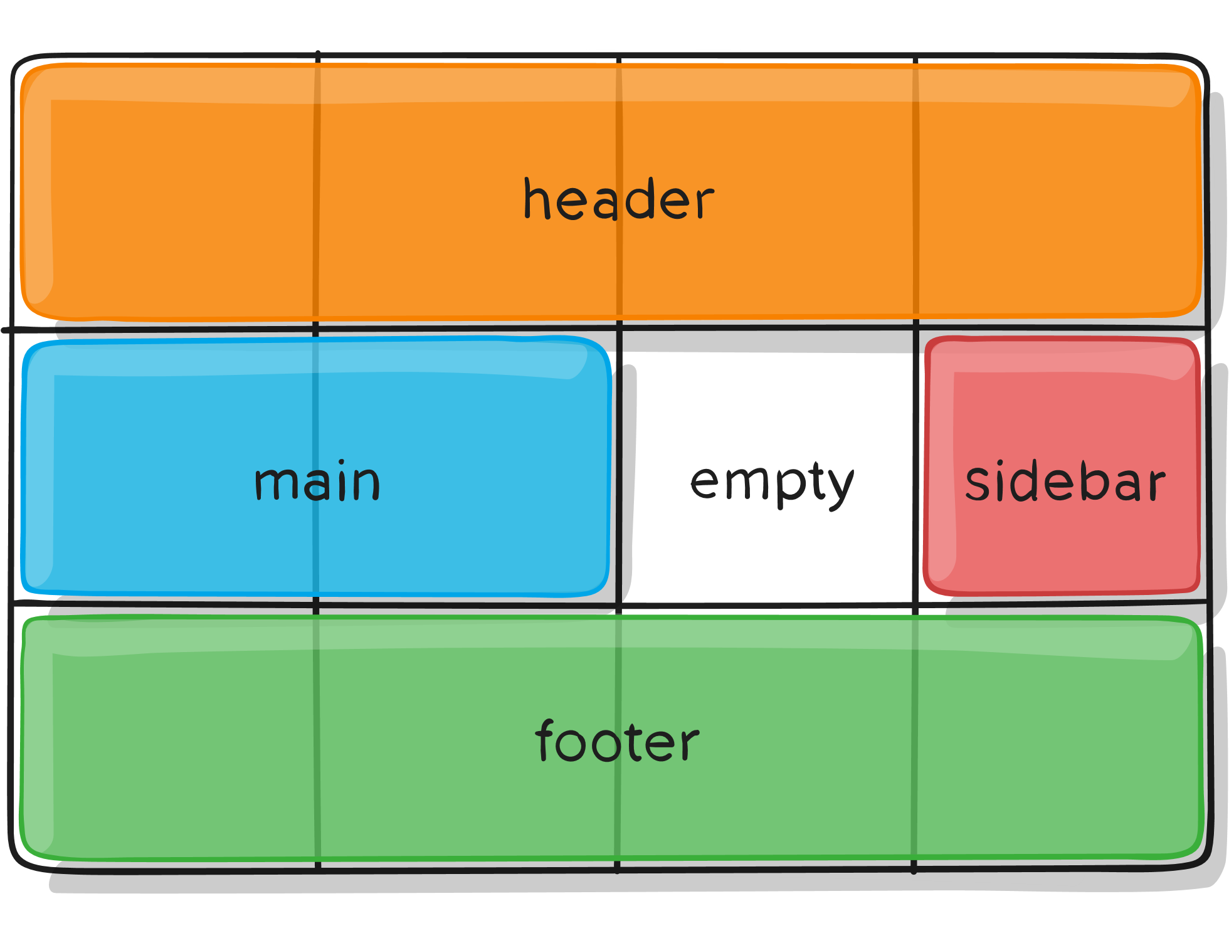
Example:
That’ll create a grid that’s four columns wide by three rows tall. The entire top row will be composed of the header area. The middle row will be composed of two main areas, one empty cell, and one sidebar area. The last row is all footer.
.item-a {
grid-area: header;
}
.item-b {
grid-area: main;
}
.item-c {
grid-area: sidebar;
}
.item-d {
grid-area: footer;
}
.container {
display: grid;
grid-template-columns: repeat(4, 50px);
grid-template-rows: auto;
grid-template-areas:
"header header header header"
"main main . sidebar"
"footer footer footer footer";
}
Each row in your declaration needs to have the same number of cells.
You can use any number of adjacent periods to declare a single empty cell. As long as the periods have no spaces between them they represent a single cell.
Notice that you’re not naming lines with this syntax, just areas. When you use this syntax the lines on either end of the areas are actually getting named automatically. If the name of your grid area is foo, the name of the area’s starting row line and starting column line will be foo-start, and the name of its last row line and last column line will be foo-end. This means that some lines might have multiple names, such as the far left line in the above example, which will have three names: header-start, main-start, and footer-start.

Slide 15
  grid-template: A shorthand for setting grid-template-rows, grid-template-columns, and grid-template-areas in a single declaration.
.container {
grid-template: none |
<grid-template-rows> / <grid-template-columns>;
}
  none: sets all three properties to their initial values.
  <grid-template-rows> / <grid-template-columns>: sets grid-template-columns and grid-template-rows to the specified values, respectively, and sets grid-template-areas to none.
  It also accepts a more complex but quite handy syntax for specifying all three. Here’s an example:
.container {
grid-template:
[row1-start] "header header header" 25px [row1-end];
[row2-start] "footer footer footer" 25px [row2-end] / auto 50px auto;
}

Slide 16
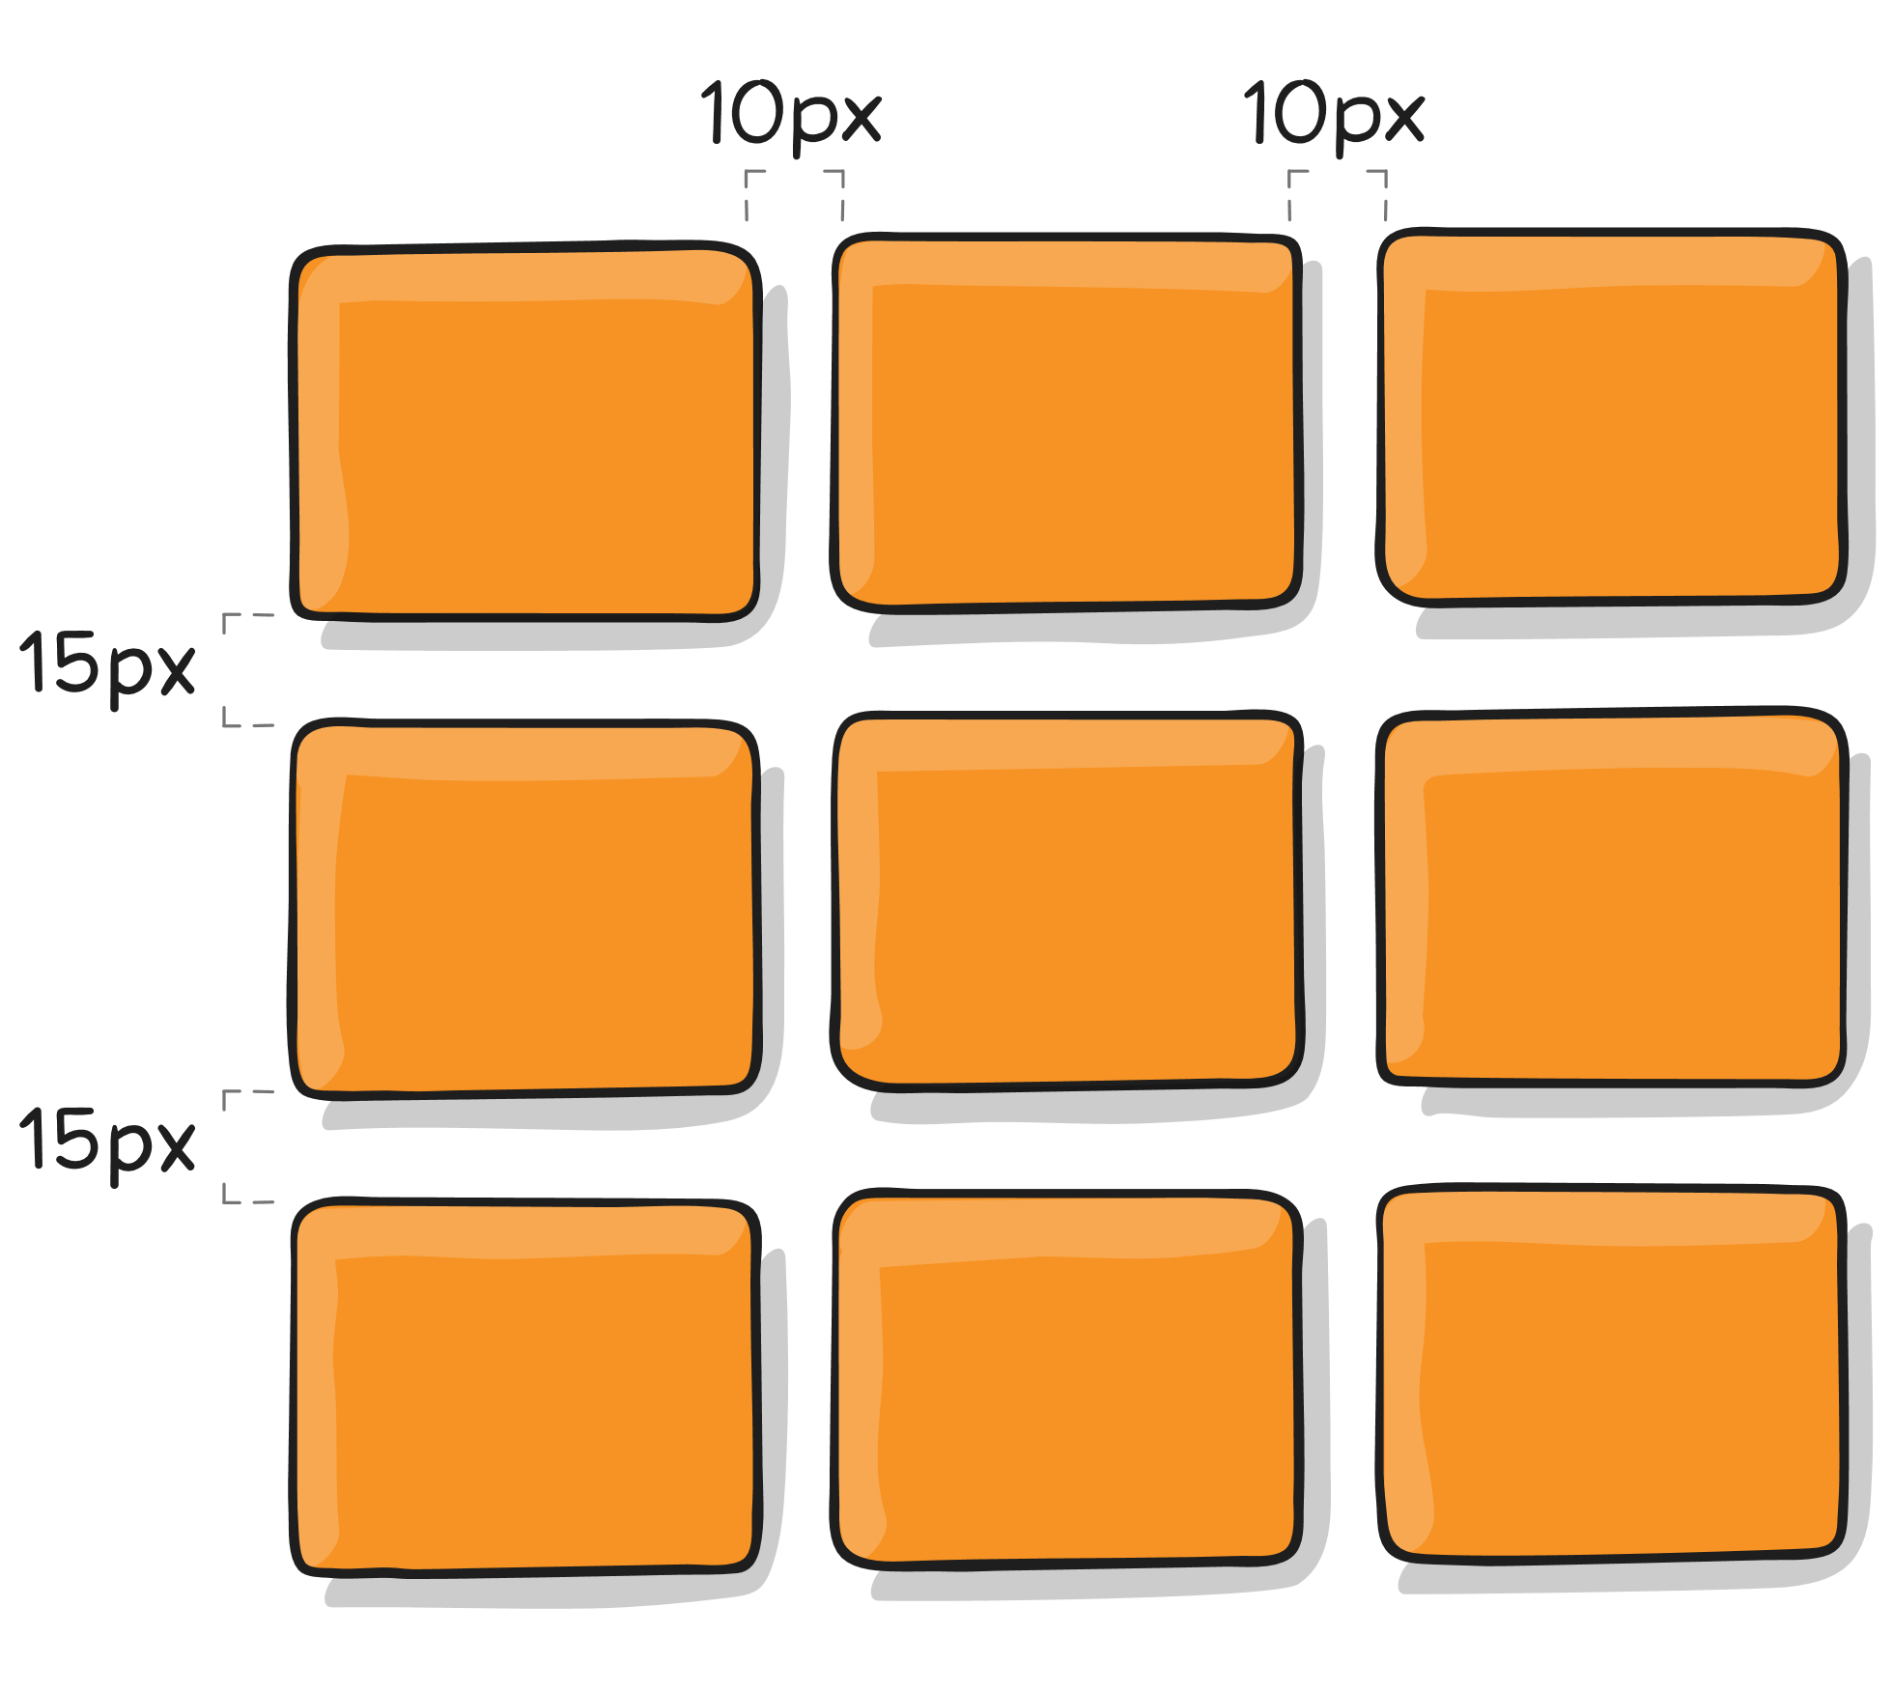
.container {
/* standard */
column-gap: <line-size>;
row-gap: <line-size>;
/* old */
grid-column-gap: <line-size>;
grid-row-gap: <line-size>;
}
  column-gap, row-gap, grid-column-gap, grid-row-gap: Specifies the size of the grid lines. You can think of it like setting the width of the gutters between the columns/rows.
    <line-size>: a length value.
  Example:
.container {
grid-template-columns: 100px 50px 100px;
grid-template-rows: 80px auto 80px;
column-gap: 10px;
row-gap: 15px;
}
  The gutters are only created between the columns/rows, not on the outer edges.
  Note: The grid- prefix will be removed and grid-column-gap and grid-row-gap renamed to column-gap and row-gap.
  The unprefixed properties are already supported in Chrome 68+, Safari 11.2 Release 50+, and Opera 54+.

Slide 17
.container {
/* standard */
gap: <grid-row-gap> <grid-column-gap>;
/* old */
grid-gap: <grid-row-gap> <grid-column-gap>;
}
  gap, grid-gap: A shorthand for row-gap and column-gap.
    <grid-row-gap> <grid-column-gap>: a length value.
  Example:
.container {
grid-template-columns: 100px 50px 100px;
grid-template-rows: 80px auto 80px;
gap: 10px;
}
  If no row-gap is specified, it’s set to the same value as column-gap.
  Note: The grid- prefix is deprecated (but who knows, may never actually be removed from browsers). Essentially grid-gap renamed to gap.

Slide 18

<div class="container">
<div class="header"></div>
<nav class="menu"></nav>
<main class=“main-content"></main>
<aside class="side"></aside>
<footer class="footer"></footer>
</div>
.container {
display: grid;
height: 97vh;
}
.header {
grid-row: 1 / 2;
grid-column: 1 / 3;
}
.menu {
grid-row: 2 / 3;
grid-column: 1 / 3;
}
.main-content {
grid-row: 3 / 4;
grid-column: 1 / 2;
}
.side {
grid-row: 3 / 4;
grid-column: 2 / 3;
}
.footer {
grid-row: 4 / 5;
grid-column: 1 / 3;
}

Slide 19
<div class="container">
<div class="header"></div>
<nav class="menu"></nav>
<main class=“main-content"></main>
<aside class="side"></aside>
<footer class="footer"></footer>
</div>
.container {
display: grid;
height: 97vh;
}
.header {
grid-row: 1 / 2;
grid-column: 1 / 3;
}
.menu {
grid-row: 2 / 3;
grid-column: 1 / 3;
}
.main-content {
grid-row: 3 / 4;
grid-column: 1 / 2;
}
.side {
grid-row: 3 / 4;
grid-column: 2 / 3;
}
.footer {
grid-row: 4 / 5;
grid-column: 1 / 3;
}

Slide 20
<div class="container">
<div class="header"></div>
<nav class="menu"></nav>
<main class=“main-content"></main>
<aside class="side"></aside>
<footer class="footer"></footer>
</div>
.container {
display: grid;
height: 97vh;
}
.header {
grid-row: 1 / 2;
grid-column: 1 / 3;
}
.menu {
grid-row: 2 / 3;
grid-column: 1 / 3;
}
.main-content {
grid-row: 3 / 4;
grid-column: 1 / 2;
}
.side {
grid-row: 3 / 4;
grid-column: 2 / 3;
}
.footer {
grid-row: 4 / 5;
grid-column: 1 / 3;
}

Slide 21
<div class="container">
<div class="header"></div>
<nav class="menu"></nav>
<main class=“main-content"></main>
<aside class="side"></aside>
<footer class="footer"></footer>
</div>
.container {
display: grid;
height: 97vh;
}
.header {
grid-row: 1 / 2;
grid-column: 1 / 3;
}
.menu {
grid-row: 2 / 3;
grid-column: 1 / 3;
}
.main-content {
grid-row: 3 / 4;
grid-column: 1 / 2;
}
.side {
grid-row: 3 / 4;
grid-column: 2 / 3;
}
.footer {
grid-row: 4 / 5;
grid-column: 1 / 3;
}

Slide 22
<div class="container">
<div class="header"></div>
<nav class="menu"></nav>
<main class=“main-content"></main>
<aside class="side"></aside>
<footer class="footer"></footer>
</div>
.container {
display: grid;
height: 97vh;
}
.header {
grid-row: 1 / 2;
grid-column: 1 / 3;
}
.menu {
grid-row: 2 / 3;
grid-column: 1 / 3;
}
.main-content {
grid-row: 3 / 4;
grid-column: 1 / 2;
}
.side {
grid-row: 3 / 4;
grid-column: 2 / 3;
}
.footer {
grid-row: 4 / 5;
grid-column: 1 / 3;
}

Slide 23
<div class="container">
<div class="header"></div>
<nav class="menu"></nav>
<main class=“main-content"></main>
<aside class="side"></aside>
<footer class="footer"></footer>
</div>
.container {
display: grid;
height: 97vh;
}
.header {
grid-row: 1 / 2;
grid-column: 1 / 3;
}
.menu {
grid-row: 2 / 3;
grid-column: 1 / 3;
}
.main-content {
grid-row: 3 / 4;
grid-column: 1 / 2;
}
.side {
grid-row: 3 / 4;
grid-column: 2 / 3;
}
.footer {
grid-row: 4 / 5;
grid-column: 1 / 3;
}

Slide 24

<div class="container">
<div class="header"></div>
<nav class="menu"></nav>
<main class=“main-content"></main>
<aside class="side"></aside>
<footer class="footer"></footer>
</div>
.container {
display: grid;
height: 97vh;
}
.header {
grid-row: 1 / 2;
grid-column: 1 / 3;
}
.menu {
grid-row: 2 / 3;
grid-column: 1 / 3;
}
.main-content {
grid-row: 3 / 4;
grid-column: 1 / 2;
}
.side {
grid-row: 3 / 4;
grid-column: 2 / 3;
}
.footer {
grid-row: 4 / 5;
grid-column: 1 / 3;
}

