Slide 1
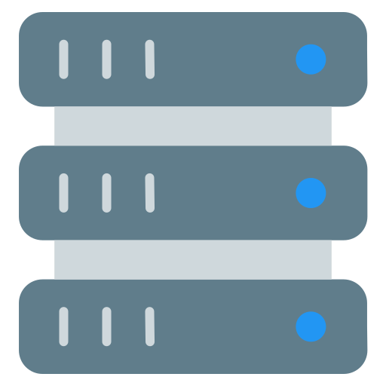




Server
App Server
The Internet
HTTP Response
Database
Source Code
HTTP Request
Web Server
Client
LAMP
DNS Server Record:
foobar.com IN A 8.8.8.8
www IN CNAME foobar.com

Slide 2
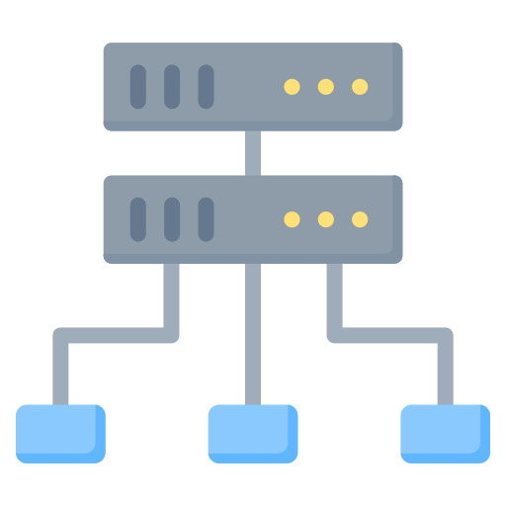
Load Balancer
(HAPROXY)
The Internet
HTTP Response
Active/Passive
HTTP Request
Client
Server
Server
App Server
App Server
Database
Database
Source Code
Source Code
Web Server
Web Server
Replica
LAMP
Master
LAMP

Slide 3



Firewall
Load Balancer
(HAPROXY)
The Internet
HTTP Response
Active/Passive
HTTP Request
DATADOG Monitoring Service
Client
SSl HTTPS
Firewall
Firewall
Server
App Server
Server
App Server
Database
Database
Source Code
Source Code
Web Server
Web Server
Replica
LAMP
Master
LAMP

Slide 4
Firewall
Load Balancer
(HAPROXY)
Load Balancer
(HAPROXY)
The Internet
HTTP Response
Active/Passive
HTTP Request
DATADOG Monitoring Service
Client
SSl HTTPS
Firewall
Firewall
Firewall
App Server
App Server
Server
App Server
Server
Server
Database
Database
Database
Source Code
Source Code
Source Code
Web Server
Web Server
Web Server
Replica
Replica
Master
LAMP
LAMP
LAMP

