Slide 1





Metro Interstate Traffic
Volume Prediction & Analysis
A deployed, end-to-end forecasting system for hourly I-94 traffic volume
Notes:
1

Slide 2




Team Members
Abdulrahman AlShenawi
Marwan Hassan Essa
Ahmed Mohamed
Zeina Mostafa Ali
Notes:
2

Slide 3


THE PROBLEM
Problem Statement & Motivation
Traffic Is Unpredictable
Our Goal
Apps only show traffic in real-time — not ahead of time.
Predict traffic before you leave, not after you're stuck in it.
Samsung Innovation Campus
3

Slide 4



THE IDEA
How It Works
User Input
Behind the Scenes
Output
User just enters a date and planned travel time.
We handle the rest — weather and holidays — automatically.
Predicted traffic for that hour, plus the 3 hours before it.
Samsung Innovation Campus
4

Slide 5
THE DATASET
Dataset Overview
I-94
~48,000
2012–2018
traffic_volume
Minneapolis Area
Hourly Records
Coverage Window
Prediction Target
Features Used
Weather
temp, rain, snow, cloud cover, weather condition
Time
timestamp, hour, day of week, month
Holidays
12 categories, including "Not Holiday"
Samsung Innovation Campus
5

Slide 6



DATA CLEANING
Key Issues Found
Duplicate Timestamps
Holiday Column
Impossible Values
Multiple weather entries per hour →
kept the worst scenario.
Only logged on the first hour of the day →
propagated across the full day.
temp = 0K, rain = 9831 mm/h →
removed.
Samsung Innovation Campus
6

Slide 7



DATA CLEANING
Result
48,204 → 40,564
Clean, reliable rows
Ready for EDA & Modeling
Samsung Innovation Campus
7

Slide 8
EXPLORATORY DATA ANALYSIS
Target
What does the distribution of traffic volume look like?
Time Patterns
How does traffic volume change throughout the day?
Does traffic volume follow a weekly pattern?
External Factors
Do holidays affect traffic volume?
How much does weather affect traffic volume?
Feature Relationships
Which available features have the strongest relationship with traffic volume?
Are there strong relationships between the input features themselves?
Samsung Innovation Campus
8
Notes:
Every number on this chart is computed directly from the cleaned CSV, not simulated. This is also exactly why hour_sin/hour_cos dominate feature importance later.
8

Slide 9
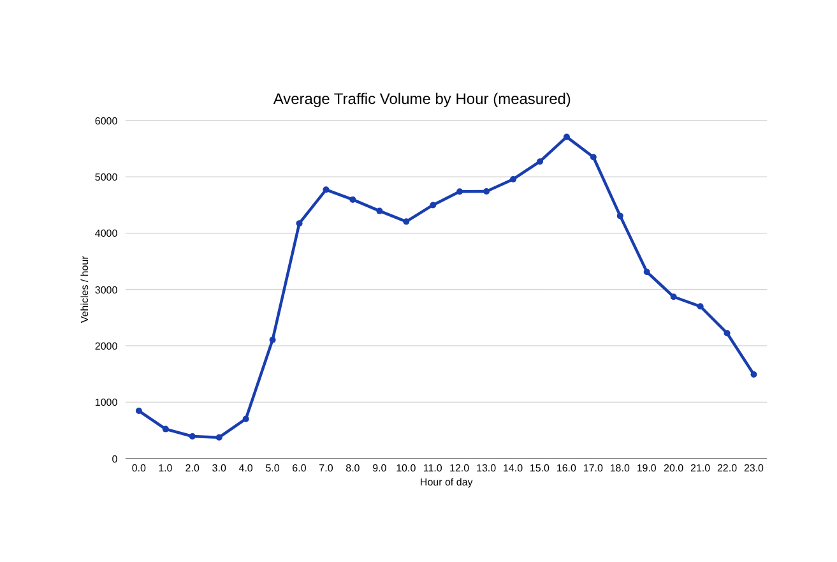
EXPLORATORY DATA ANALYSIS
EDA – Temporal Traffic Patterns
Peak at 4 PM
16:00 averages 5,709 vehicles/hour — the single busiest hour in six years of data.
Trough at 3 AM
03:00 averages just 373 vehicles/hour: a 15x difference from the peak.
Weekday vs Weekend
Weekdays average 3,558 veh/hr versus 2,625 on weekends — a 26% drop.
Samsung Innovation Campus
9
Notes:
Every number on this chart is computed directly from the cleaned CSV, not simulated. This is also exactly why hour_sin/hour_cos dominate feature importance later.
8

Slide 10
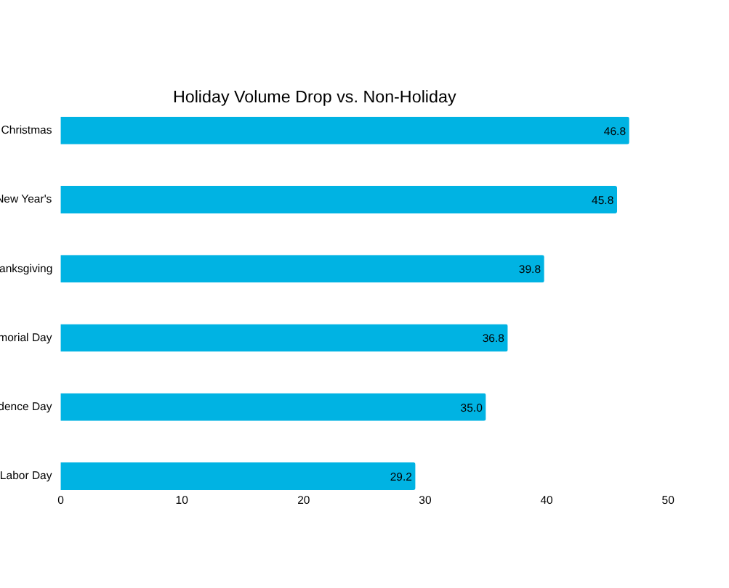
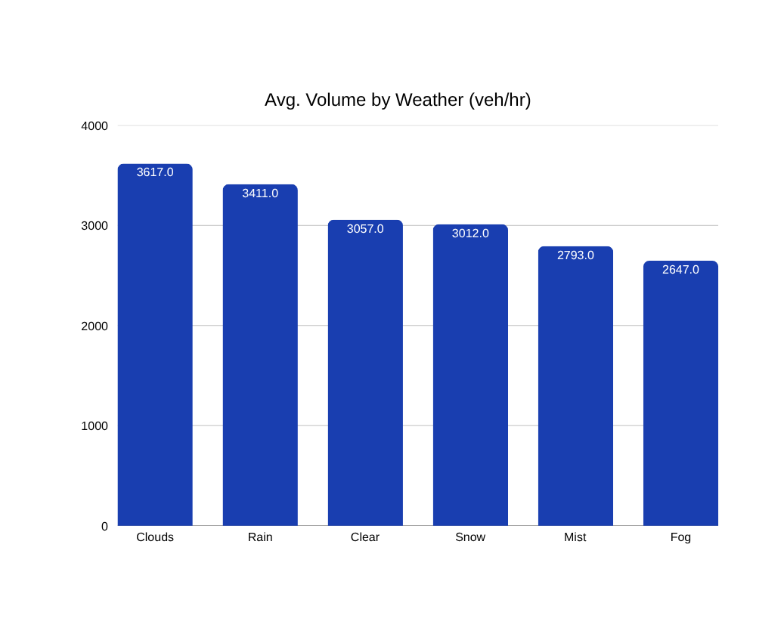
EXPLORATORY DATA ANALYSIS
EDA – Weather & Holiday Impact
Counter-intuitive finding: cloudy and rainy hours show slightly higher average volume than clear ones — likely because clear skies also occur more often overnight, not a causal weather effect. Holidays, by contrast, show a large and consistent drop.
Samsung Innovation Campus
10
Notes:
Be ready for the 'why is Clouds higher than Clear' question — the honest answer is correlation with time-of-day mix, not a causal weather effect. This is a good moment to show statistical maturity.
9

Slide 11
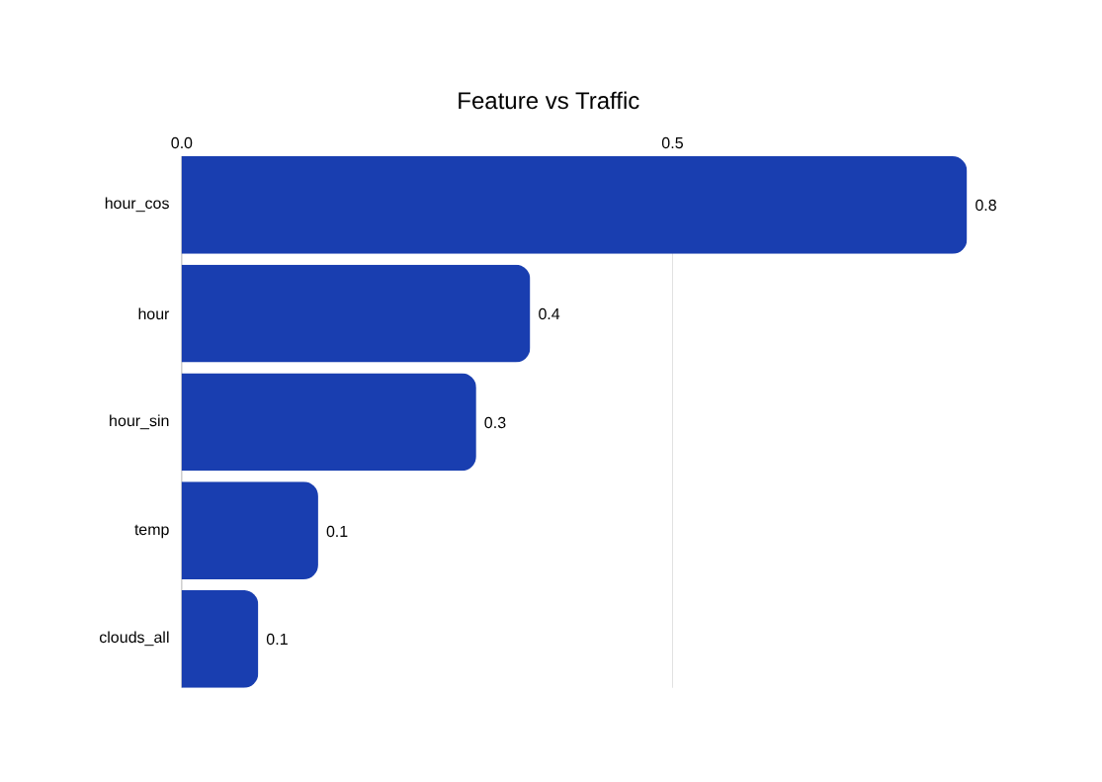
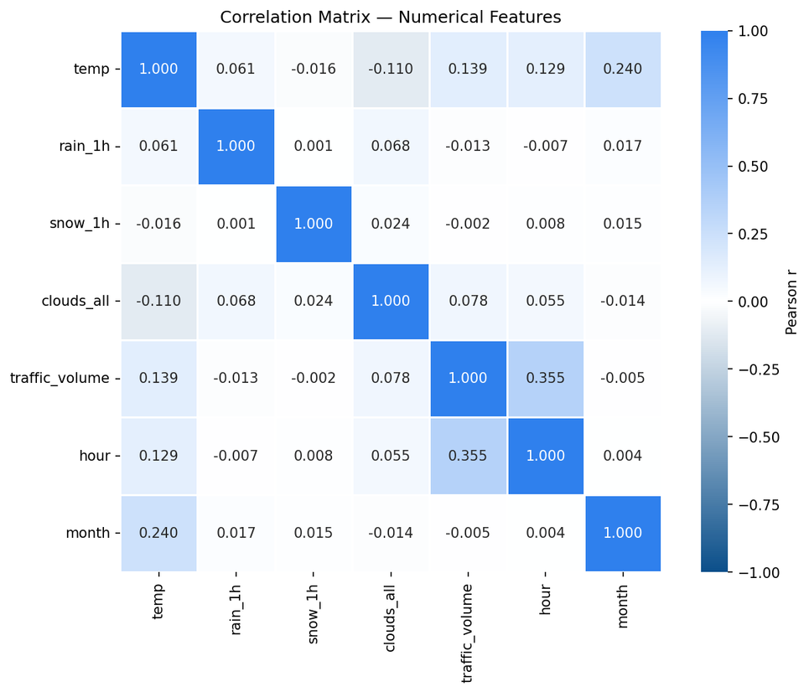
EXPLORATORY DATA ANALYSIS
EDA – Feature Relationships
Time is the strongest signal, while most other features show weak relationships with traffic volume.
Samsung Innovation Campus
11
Notes:
Be ready for the 'why is Clouds higher than Clear' question — the honest answer is correlation with time-of-day mix, not a causal weather effect. This is a good moment to show statistical maturity.
9

Slide 12
DATA PREPARATION
Feature Engineering & Preparation
Cyclical Encoding
Categorical Encoding
Scaling & Splitting
hour_sin / hour_cos and month_sin / month_cos preserve wrap-around continuity that a raw integer would break.
One-hot encoding for weather_main (11 conditions) and a binary flag for the 12-category holiday field.
Numeric regressors scaled; a strict time-based split keeps 2018 fully held out from training.
TIME-BASED SPLIT (ACTUAL ROW COUNTS)
Train
Test
2012 – 2017 · 34,031 rows
2018 · 6,533 rows
Samsung Innovation Campus
12
Notes:
If asked why time-based split instead of random split: random splitting leaks future information into training and inflates the score; time-based split is the only way to measure real forecasting ability.
10

Slide 13
MODELING
Machine Learning Pipeline & Model Selection
Cleaned
Data
→
Feature
Engineering
→
Candidate
Models
→
Time-Based
Validation
→
Deployment
CANDIDATE MODELS
Linear Baseline
Tree Ensemble
Gradient Boosting
Linear Regression
Random Forest Regressor
XGBoost and LightGBM
Time-Series
Time-Series
AutoRegressive Lag-XGBoost
AutoRegressive Lag-XGBoost
Validation: strict time-based split (train through 2017, test on all of 2018), scored on MAE and RMSE.
Samsung Innovation Campus
13
Notes:
Emphasize the split is strictly chronological end to end, from cross-validation through the final holdout — no random shuffling anywhere in the pipeline.
11

Slide 14
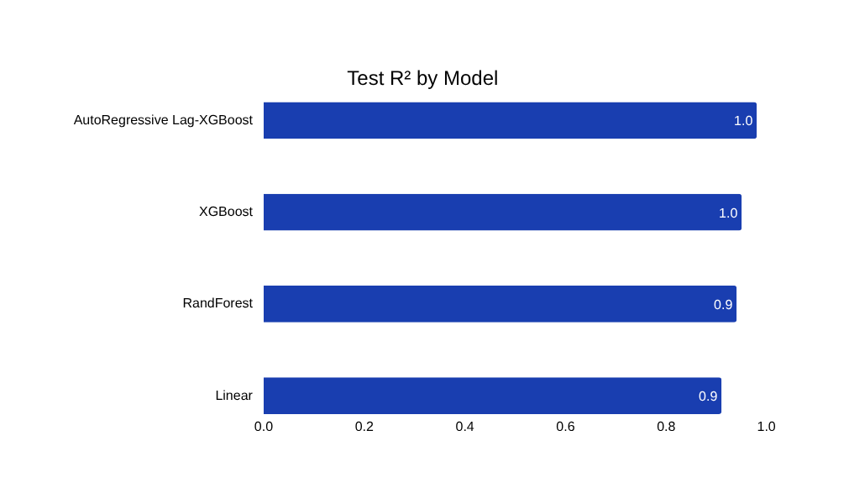
RESULTS
Experimental Results & Model Benchmarking
Model | R² | MAE (veh/hr) | RMSE (veh/hr) | Notes
Linear Regression | 0.9100 | 420.50 | 580.30 | Fast, interpretable baseline
Random Forest | 0.9400 | 310.20 | 450.80 | Robust, slower inference
AutoRegressive-LagXGBoost | 0.9864 | 146.71 | 229.60 | Time-Series Champion
XGBoost (Champion) | 0.9594 | 241.99 | 397.13 | Best accuracy — deployed
KEY TAKEAWAY
XGBoost clears the 0.90 target with R² = 0.9594 and a mean error of about 242 vehicles per hour — roughly 7% of the dataset's average volume. It is the model we deployed to production.
Samsung Innovation Campus
14
Notes:
These are the team's actual measured benchmark results, consistent across the technical writeup and the deployed model card.
12

Slide 15
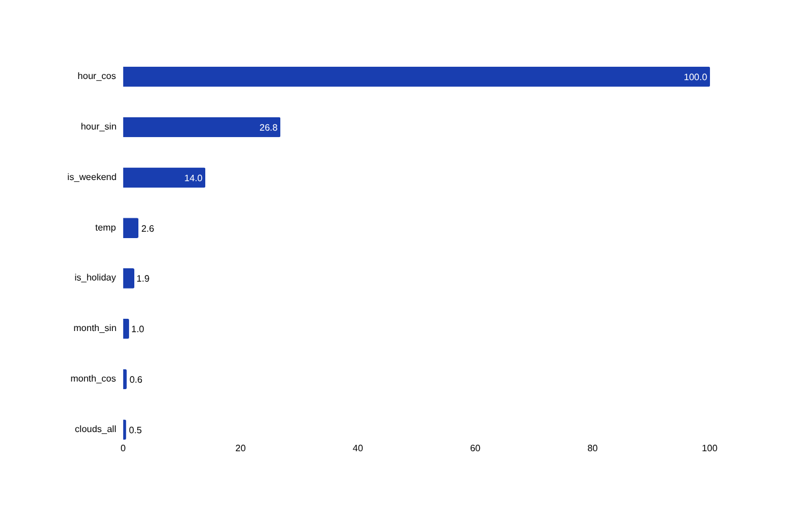
EXPLAINABILITY
Feature Importance & Model Explainability
Time Dominates
hour_cos and hour_sin together account for the large majority of model importance — the twin-peak commute rhythm is the single strongest signal.
Calendar Effects
is_weekend ranks a clear third, confirming the 26% weekday/weekend gap seen in the EDA.
Weather Is a Modifier
temp and is_holiday sit far lower — they nudge the forecast, they do not drive it.
Samsung Innovation Campus
15
Notes:
Computed with a Random Forest fit on the same time-based split (test R² 0.951, close to the XGBoost champion), scaled relative to the top feature. If asked which matters more, weather or time of day: time drives the large majority of the signal.
13

Slide 16
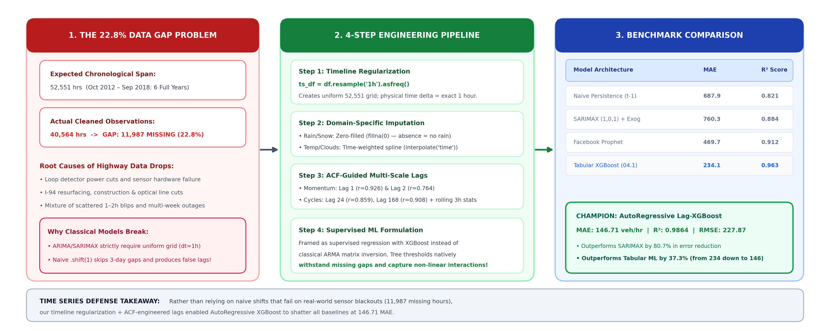
Time Series Modeling
Time Series Modeling: Resolving the 22.8% Missing Data Challenge
Samsung Innovation Campus
16
Notes:
Computed with a Random Forest fit on the same time-based split (test R² 0.951, close to the XGBoost champion), scaled relative to the top feature. If asked which matters more, weather or time of day: time drives the large majority of the signal.
13

Slide 17
DEPLOYMENT
Production Architecture
Frontend Dashboard
HTML / CSS / JavaScript · interactive simulator · live weather integration
↓
FastAPI Backend (Python)
POST /predict — batch forecasting GET /health — monitoring static file serving
↓
WeatherAPI (External)
XGBoost Model Store | AutoRegressive
Live weather conditions for forecast context
Local joblib artifact · R² = 0.9594
CLOUD DEPLOYMENT
Railway (PaaS) · Docker container · Python 3.12 · pinned dependencies · GitHub CI/CD · auto-horizontal scaling
Samsung Innovation Campus
17
Notes:
This is a real, running deployment, not a design sketch. Push to GitHub, tests run, Docker image builds, deploys to Railway staging, integration tests, then promotes to production.
14

Slide 18
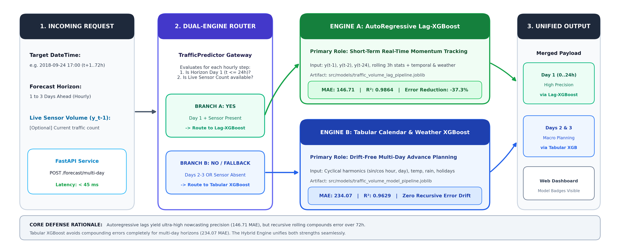
DEPLOYMENT
Hybrid Deployment Strategy: Dual-Engine Traffic Forecasting
Samsung Innovation Campus
18
Notes:
This is a real, running deployment, not a design sketch. Push to GitHub, tests run, Docker image builds, deploys to Railway staging, integration tests, then promotes to production.
14

Slide 19
DEPLOYMENT
Live Demo & API
Response 200 OK
TRY IT YOURSELF
{
"city": "Minneapolis",
"country": "US",
"start_date": "2026-09-01",
"days": 3,
"hour": 12,
"predictions": [
{"date": "2026-09-01",
"predicted_traffic_volume": 4220.05},
{"date": "2026-09-02",
"predicted_traffic_volume": 3810.66},
{"date": "2026-09-03",
"predicted_traffic_volume": 4150.23}
]
}
traffic-volume-production.up.railway.app/#simulator
Interactive simulator: pick a date, city, and hour to get a live 1–3 day forecast, weather-aware.
POST /predict
{
"start_date": "2026-09-01",
"days": 3,
"city": "Minneapolis",
"country": "US",
"hour": 12
}
Design targets: prediction latency under 500ms, service uptime 99.9%.
Samsung Innovation Campus
19
Notes:
If there's time and a connection in the room, actually open the simulator link live — it is a stronger close than any slide.
15

Slide 20
CONCLUSION
Key Takeaways
What We Learned
Real-World Application
Target Audience
More than just a project — a genuinely valuable experience.
Trained on 2012–2018 data — proof that with today's data, this could run today.
Ministry of Transportation — give us the data, we build this for Egypt's roads.
Samsung Innovation Campus
20
Notes:
Close on the number that matters most: test R-squared of 0.9594, well above the 0.90 objective, running live today — not just a notebook result.
17

Slide 21

Thank You
Open for questions and feedback from the committee
Live Demo · traffic-volume-production.up.railway.app/#simulator
Source Code · github.com/AbdoTechno/Traffic-Volume
Samsung Innovation Campus
Notes:
Defense prep - expected questions:
1) Why time-series split instead of random split? Random splitting leaks future data into training; time-based split measures true forecasting capability.
2) Weather vs time of day, which matters more? hour_cos/hour_sin dominate feature importance by a wide margin; weather features (temp, holiday) rank far lower.
3) How were outliers like 0 Kelvin handled? Identified as physically impossible, corrected via temporal interpolation.
4) Why XGBoost over deep learning? Tabular data with strong periodic structure trains faster, needs less compute, and is more interpretable at comparable or better accuracy — 0.9594 R² here.
5) Why is Clouds higher than Clear in the weather chart? Correlation with time-of-day mix in the raw data, not a causal weather effect — flagged honestly on slide 8.
18

