Slide 1

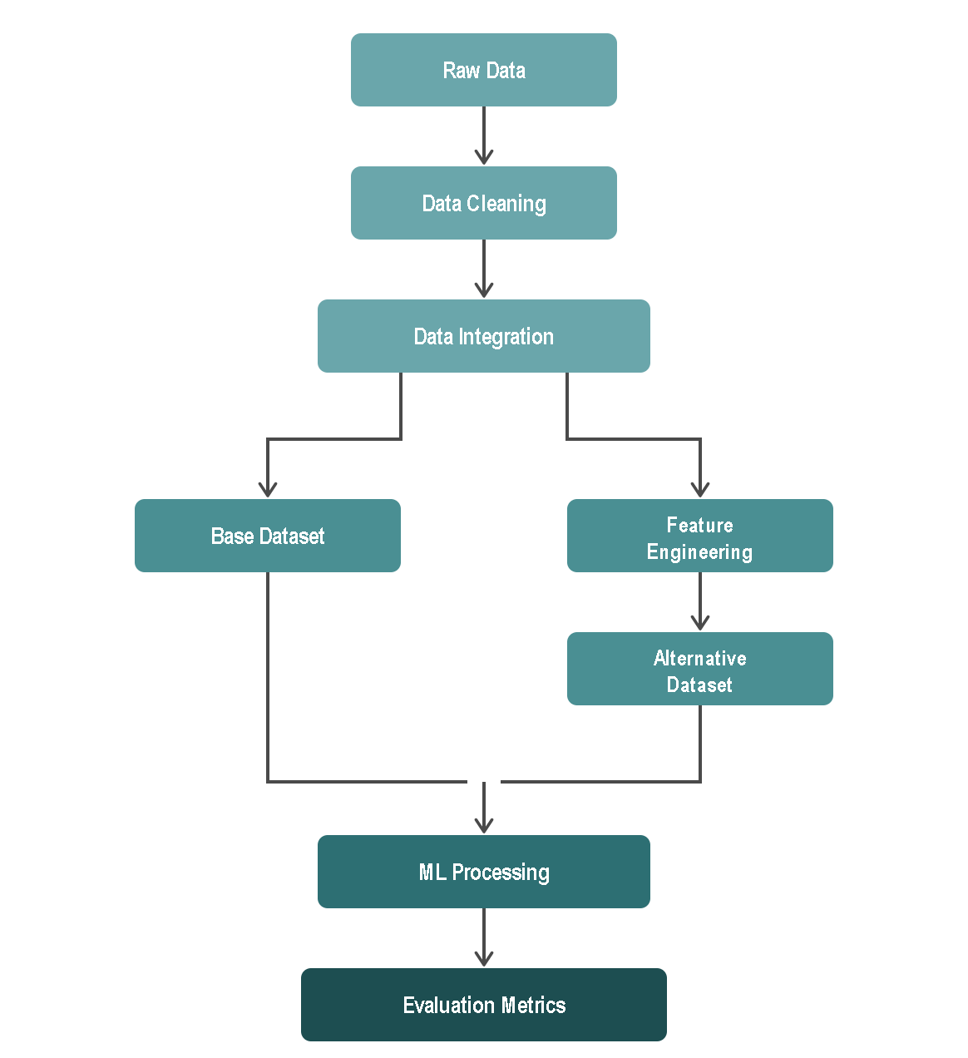
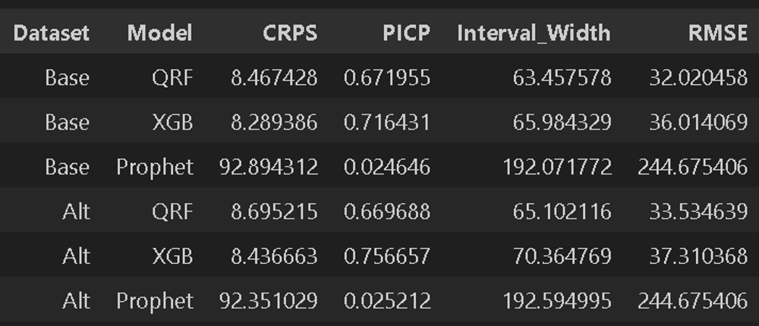
Forecasting Gold Price Movements Using Alternative Data and Machine Learning Techniques
Abdelrahman Zewin
Master of Business Administration in Data Analytics and Project Management
Master’s Thesis, Spring 2026
Introduction
Gold has been used as a store of value and hedge against inflation throughout history, making accurate price forecasting valuable to investors, institutions, and national economies alike. However, gold prices are difficult to predict due to their sensitivity to investor sentiment, geopolitical events, and macroeconomic signals
This thesis investigates whether alternative datasets, when processed through machine learning models, can meaningfully improve short-term gold price forecasting.
Research Questions
Which ML models perform best when incorporating alternative data for predicting gold price movements?
Which types of alternative data have the strongest predictive relationship with gold price movements?
Does the inclusion of alternative data improve forecasting accuracy, even marginally?
Data Description & Processing
Five datasets were collected for the period Jan. 2008 to Dec. 2017:
Gold Historical Data, Google Trends, News Sentiment, VIX, DXY
Data was cleaned, consolidated, and features were engineered before introduction to ML models (Figure 1)
Figure 1. Pipeline DAG
Forecasting Framework
Two feature configurations were compared:
Base model: technical features only (price-based features, VIX, DXY)
Alternative model: base features + Google Trends + news sentiment data
An 80/20 chronological train-test split was used with an 80% prediction interval.
Three ML models were implemented; Prophet (baseline), QRF, XGBoost
Evaluation Metrics
Metrics were chosen to measure three aspects of probabilistic forecasting quality:
CRPS (primary): forecast accuracy. Lower is better.
PICP: proportion of actual values falling within predicted intervals.
Interval Width: measures sharpness. Narrower is better (with adequate coverage).
RMSE (secondary): measures deviation from actual values.
Results
Prophet performed poorly, QRF noticeably better, XGBoost achieved the strongest performance: average PICP of 71.6% (base) with tighter intervals than QRF, and marginally similar results with the alternative dataset.
Interestingly, using alternative data resulted in an approximate 2% increase (worsening) in average CRPS scores across all models, compared to using the base dataset alone. (Figure 2)
Figure 2. Evaluation metrics’ results
Conclusion
Tree-based ML models (QRF, XGBoost) are significantly more effective than linear time series models for short-term gold price forecasting.
Alternative data (Google Trends, news sentiment) does not provide a statistically meaningful improvement in short-term gold price forecasting accuracy within this study's scope.
References
Alharbi (2024) | Cohen & Aiche (2023) | Gu, Kelly & Xiu (2020) | Masud et al. (2025) | Preis, Moat & Stanley (2013) Trivedi et al. (2022)
Date of Publication: Spring 2026
Instructor: Jari Kiiskinen

