Slide 1

DocBot
A Healthcare Chatbot.
By
Abdullah Naseef

Slide 2
Introduction
Chatbots are widely used and in great popularity today.They allow interaction between a user and a machine conveniently without any delay.
Hence ,my project is a chatbot integrated with Dialogflow API in a cross platform enviornment.
Our chatbot will be capable of taking in user inputs to realize their issues and deal with their stress and problems.

Slide 3
Objectives
The prime objective of this project is to help users solve on understand their issues remotely and freely without the need to travel or check in.
Created in a multiplatform mobile enviornment for greater degree of availability of the product.
Free of cost.

Slide 4
Relevance of this Project!
Associated with Health care access and facilitation.
Free to use and access to know what troubles you are facing without any financial charges.
A more developed version of this project could not only understand your diseases but also give the necessary steps of treatment.

Slide 5
Platform
Platform :Native(IOS,Android and so on)
Development framework:React native
Developing language: Java,JSX

Slide 6
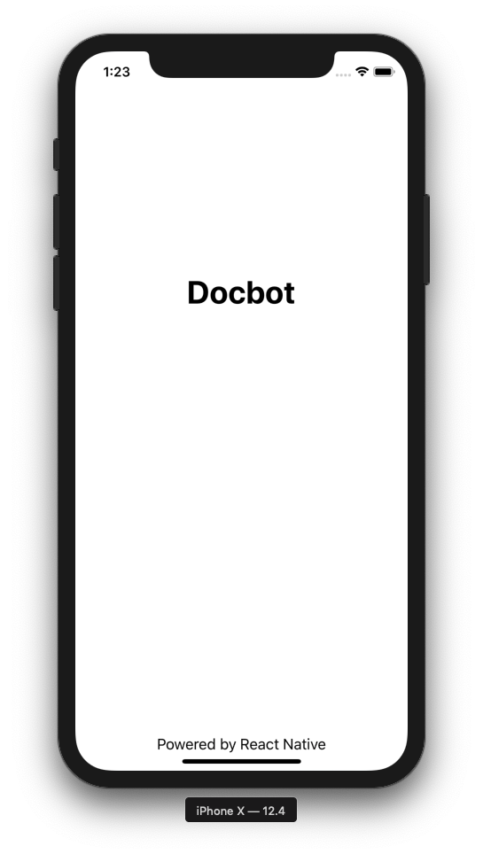
The Basics of the Code and Tools used

Slide 7
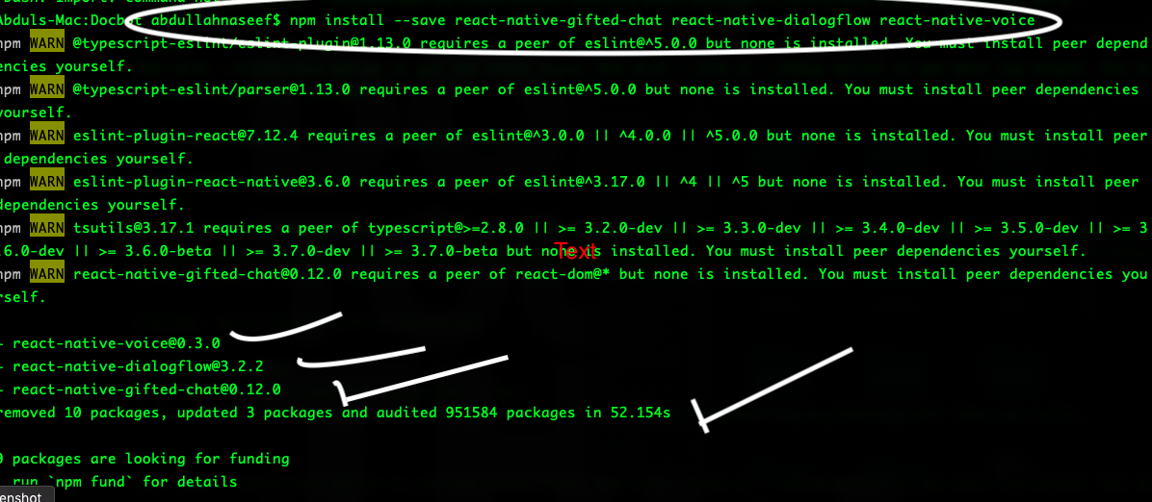
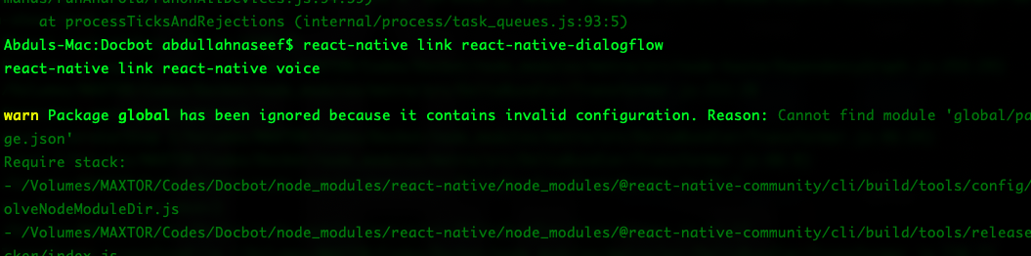
Downloading the dependencies

Slide 8
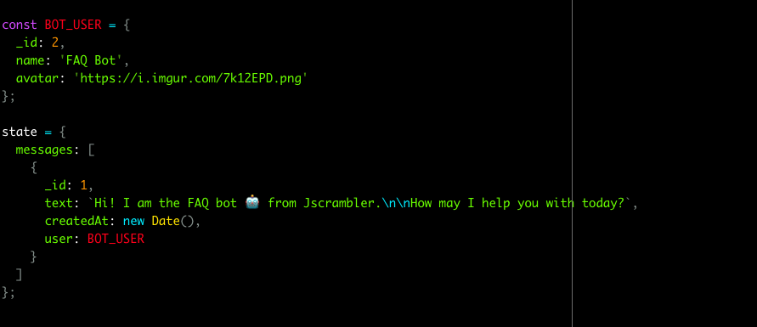
Giving States.

Slide 9
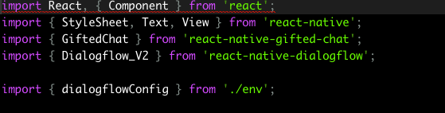
The imported Files
What they do?

Slide 10
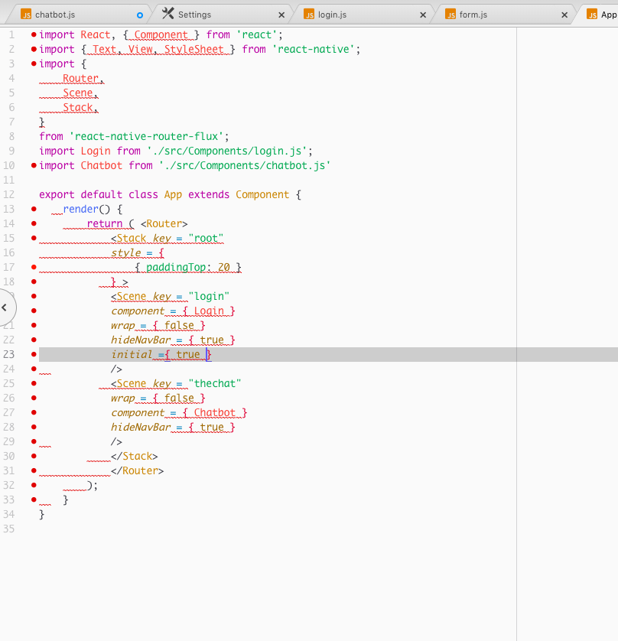
App.js(Where the applications modules are set)

Slide 11
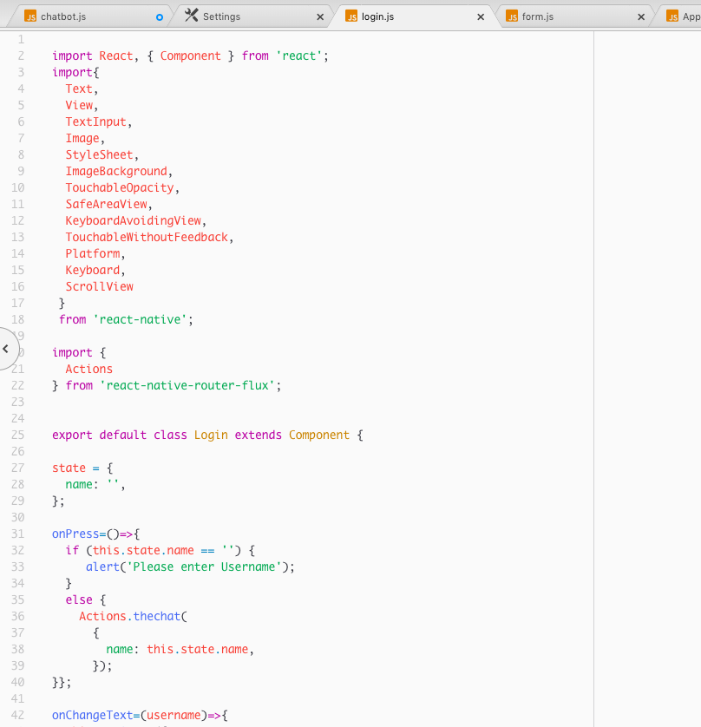
Opening Scene Codes

Slide 12
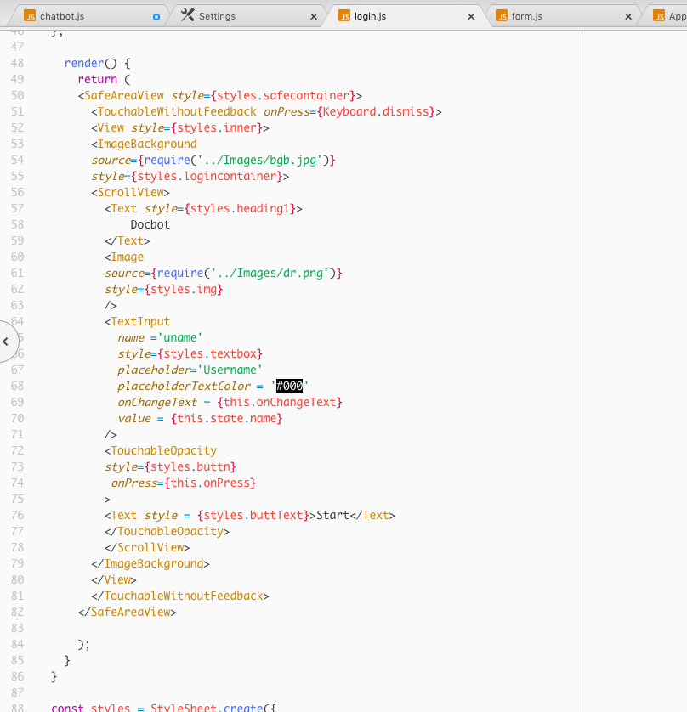
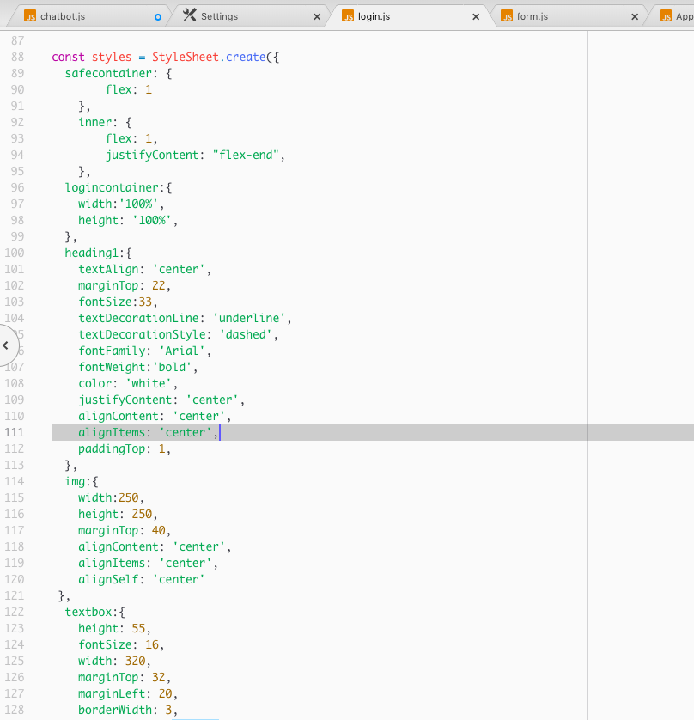

Slide 13
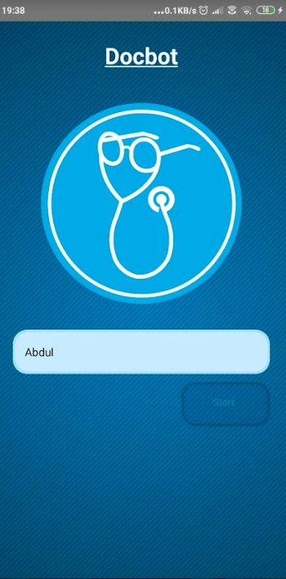

Slide 14
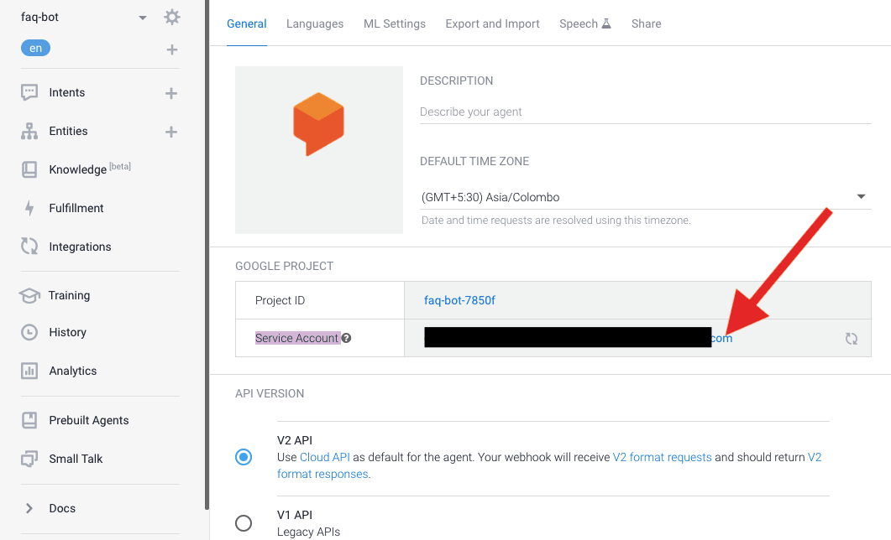
Now we need to go to Connect our
program with Dialogflow
After making an Account we create Intents where we train phrases as User expressions and replies for our BOT and we save it.

Slide 15
Steps we have to Follow then…
After creating out user expressions and replies we save them.
Dialogflow will parse our user expressions using ML.
After that we go to our intents settings to the Service Account.
Here we can create our ‘Key’ to Integrate out app with DialogFlow.
The key will be in JSon file which we need to copy and paste into our react-native file.
Once saved in the file we import the file into our App code as the configuration file.

Slide 16
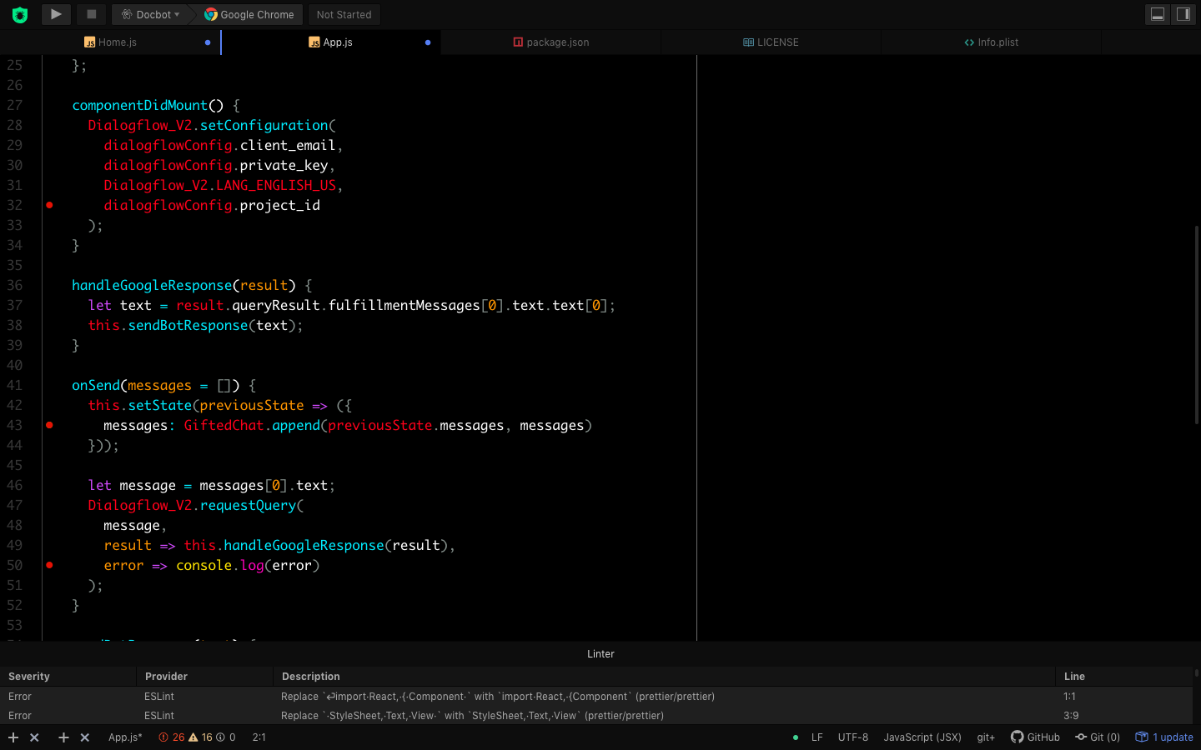
Integrating DF components in our code.

Slide 17
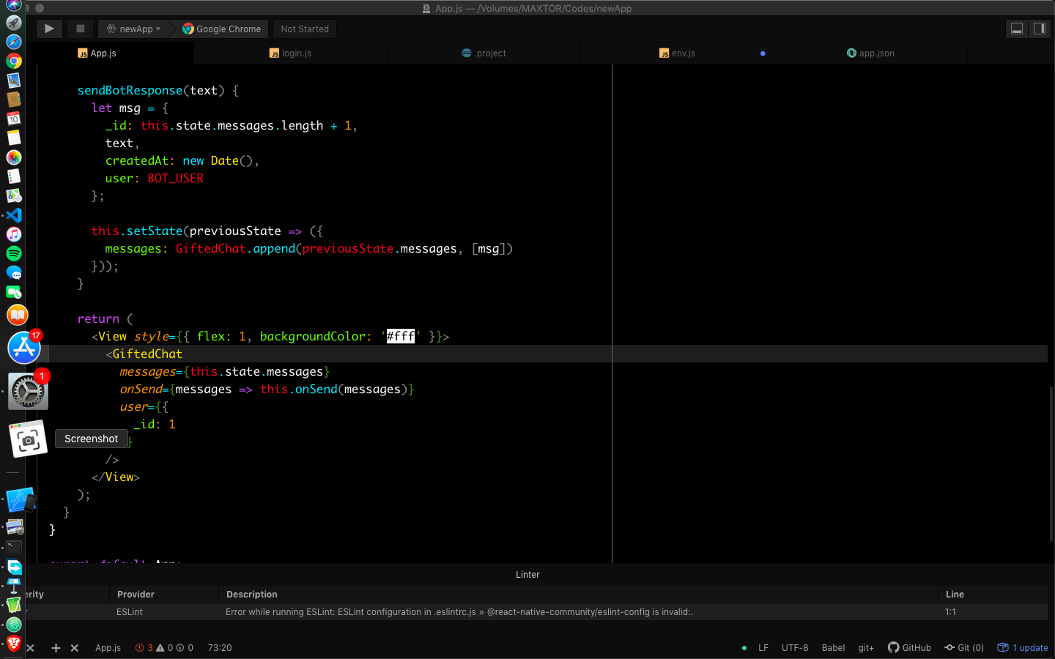

Slide 18
The Gifted Chat Library
Gifted chat is an inbuilt react Native library written in Typescript that build a convenient user interface for us.
We can use the library by using a CLI command “npm install --save react-native-gifted-chat” or from Facebook’s Github library.
We can manipulate the UI into our Specific style and need from the script as we like.

Slide 19
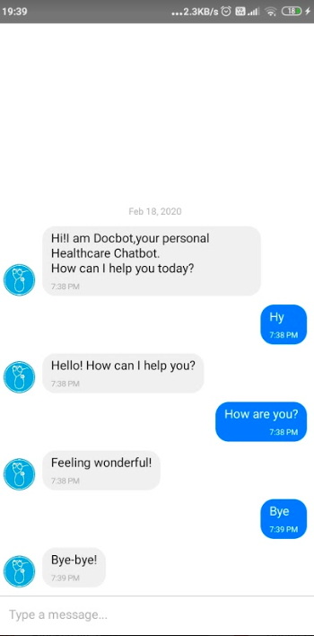
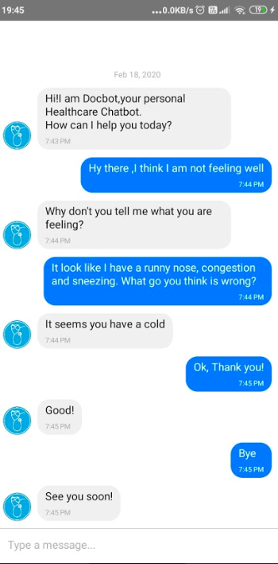

Slide 20
Testing
Had to make sure that the message sent receives the Bot .
Also make sure that the Bot sends back the appropriate reply to the question asked.
Does the text we send and receive display accordingly in the interface!

Slide 21
Thank You..!

