Slide 1
Saving and Controlling Electricity
This project demonstrates the importance of saving electricity and the modern methods used by programming an application that allows us to control electrical appliances in our home.

Slide 3
The application allows the user to control in turn on and turn off of remote devices and the consumption of each device of electricity
And you can put a limit time to turn off all devices, by this way you can assure that all devices will turn off after this time. We collect the
necessary information about the electrical devices, then we give it to the programmer to create the necessary program for this project, then we determine the necessary sources and tools and determine the cost

Slide 4
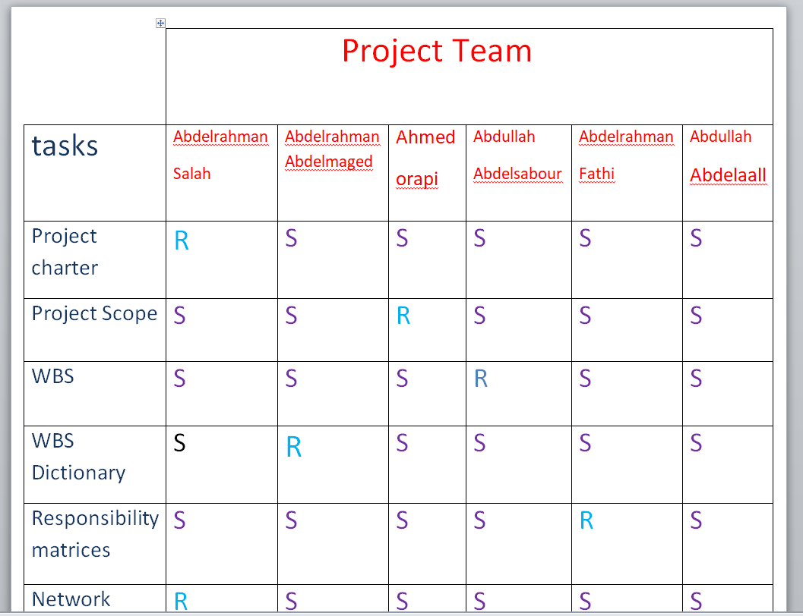
In this project, we defined the objectives of the project and defined the responsibilities through the responsibilities matrix

Slide 5
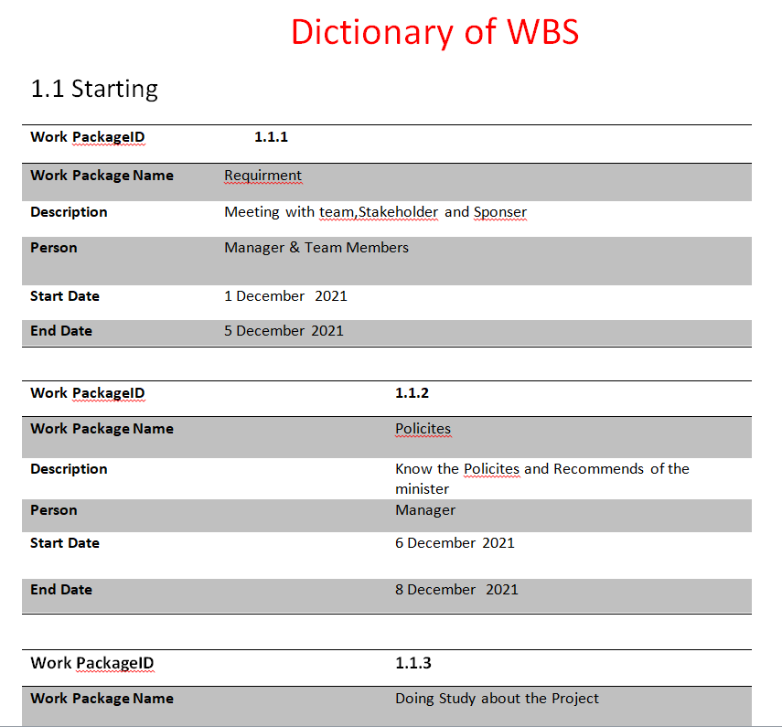
We also created a wps of dictionary. We divided the project into parts and specified the id of each part

Slide 6
One of the advantages of this project is that it will save money for all its users and maintain the provision of electricity, which will be beneficial for the whole country
This application work The IOS and
Android and windows operating system
But there are also risks such as
The lack of efficiency sufficient in the
receiver or the teams.
Damage in the receivers.
-Increase in the cost.

