Slide 1

Social Media Crisis Analytics
DEPI Graduation Project – Data Analytics Track
Progect Team by: Omar Khaled & Abdalrahman Maher & Rekfa Maged
Supervisor: Eng. Mohamed Alemam

Slide 2
Project Idea
The Problem
During a crisis, misinformation and panic spread across social platforms faster than officials can respond, making it hard to separate credible signals from noise in real time.
Our Solution
A full Medallion Architecture pipeline (Bronze → Silver → Gold) that cleans 50,000 crisis-related posts, models them into a Star Schema, and powers a 5-page Power BI dashboard tracking sentiment, credibility, and engagement.
Why It Stands Out
Goes beyond a simple dashboard by scoring every post for misinformation probability, credibility, toxicity, and cascade depth – turning raw chatter into an early-warning system.
1- The Problem
2- Our Solution
3- The Solution

Slide 3
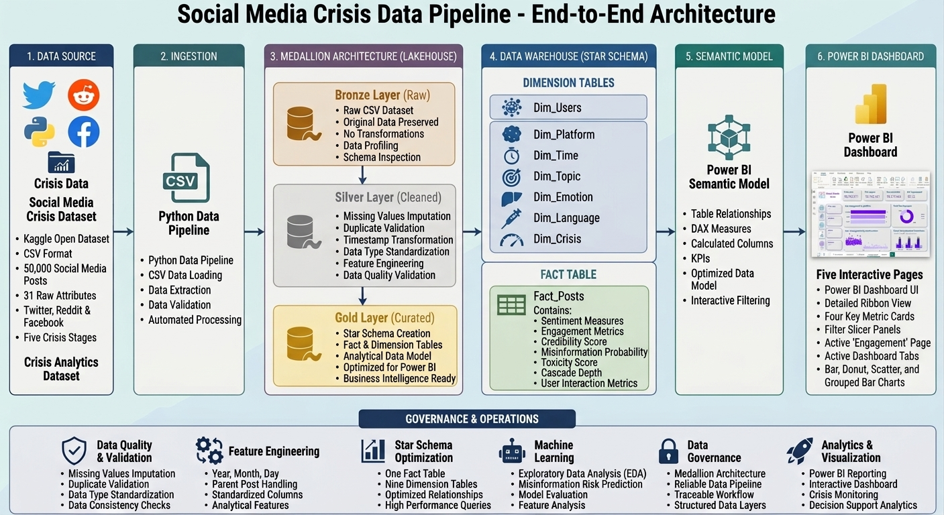

Slide 4
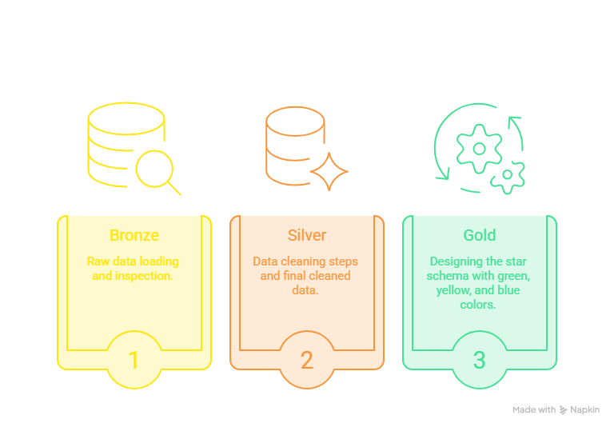
Medallion Architecture
Bronze – Raw Data
Load data.csv as-is; inspect schema, types, and describe() to profile 50,000 raw posts.
Silver – Cleaned Data
Handle missing data, standardize and rename columns, and remove duplication.
Gold – Star Schema
Build 1 fact table (fact_posts) and 9 dimension tables, then feed EDA, Power BI, and the planned AI model.

Slide 5
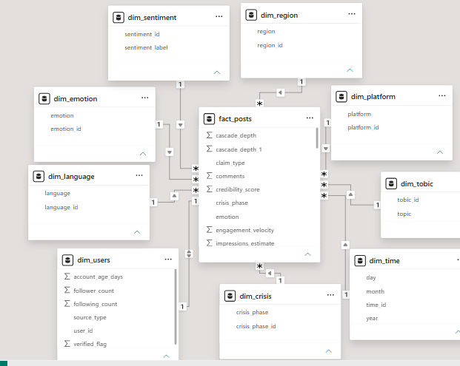
Data Structure
Source & Shape
Single CSV – 50,000 posts × 32 raw columns (platform, sentiment, engagement, credibility, misinformation, region, language.).
Cleaning Techniques
Missing-value handling, column standardization/renaming, and duplicate removal (Bronze → Silver).
Star Schema
1 fact table (fact_posts) linked to 9 dimension tables – users,
platform, time, topic, region, sentiment, emotion, language, crisis phase.
Class Balance:
Skewed – 22,249 negative vs. 9,270 positive posts, reflecting real crisis-chatter negativity.

Slide 6
Analysis Requirements and KPIs
Post Volume:
Total Posts, Total Platforms, Total Topics, Total Source Types, posts by crisis phase and source type.
Sentiment:
Positive/Negative Post counts, Average Sentiment Score, sentiment and emotion distribution.
Credibility :
Average Credibility, Average Toxicity, Average Misinformation, High-Risk Post count.
Engagement & Behavior:
Total Likes/Shares/Comments, Average Engagement, Peak Month/Day, Average Cascade Depth.

Slide 7
AI Models
Forecast
RandomForest
Prophet
Cluster
KMeans-Clustering
R2
99.9%
RSME
0.0038
MAE
0.0026
Anomaly Detection
IsolationForest
Tune-models
RandomizedSearchCV

Slide 8
Programming Languages & Frameworks
Python (Pandas, NumPy)
Core language for data cleaning and pipeline logic across all three notebook layers.
Jupyter Notebook
Interactive development environment for the Bronze, Silver, and Gold notebooks.
Power BI + DAX
5-page dashboard with KPI measures written in DEFINE/MEASURE/EVALUATE format.
Power Query (M)
Data type fixes and transformations feeding the Gold star-schema model.
Figma (planned)
UI/UX design for the analysis and AI-model result presentation layer.
Python ML (planned)
Upcoming model to classify misinformation risk from the Gold layer.

Slide 9
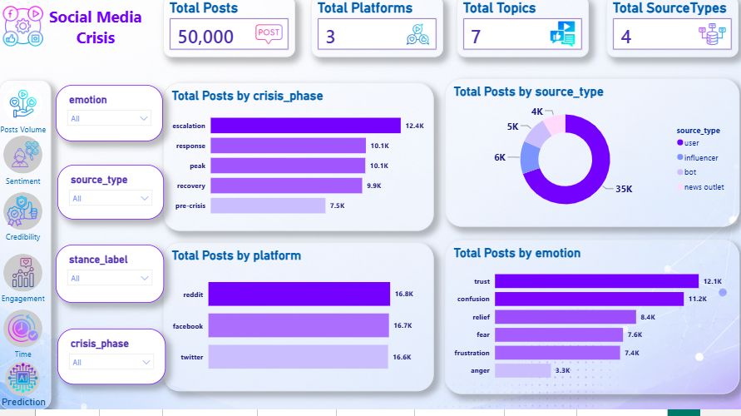
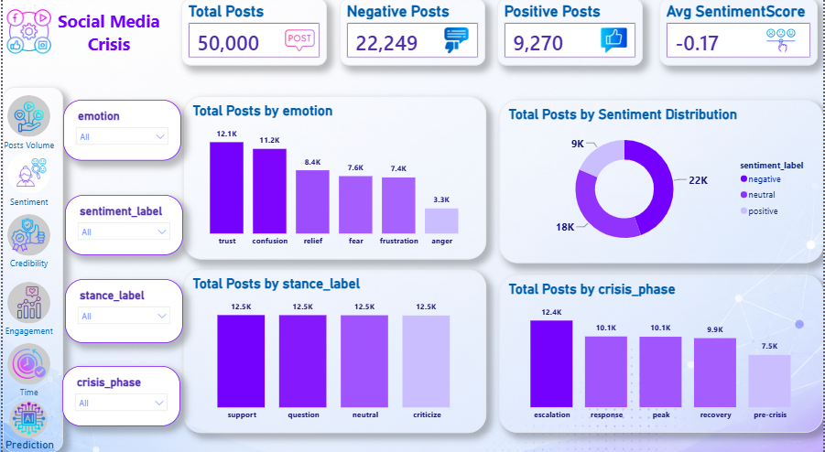
Dashboard Demo & Validation
Data Quality Checks
Verified every dimension merge preserved the original row count – no fan-out across 9 joins.

Slide 10
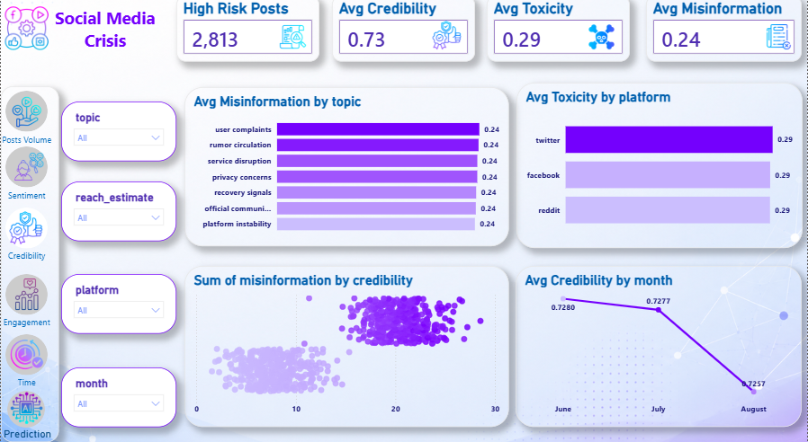
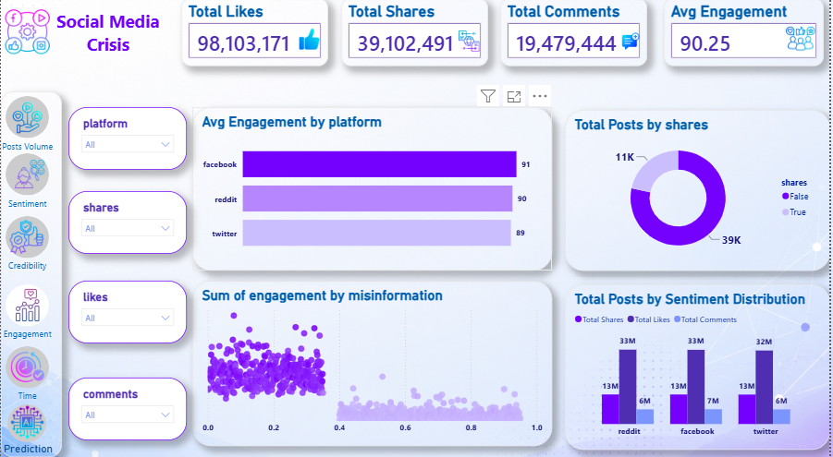
Dashboard Demo & Validation
Measure Validation
DAX measures tested in Query View (DEFINE/MEASURE/EVALUATE) against manual Pandas aggregates.
10

Slide 11
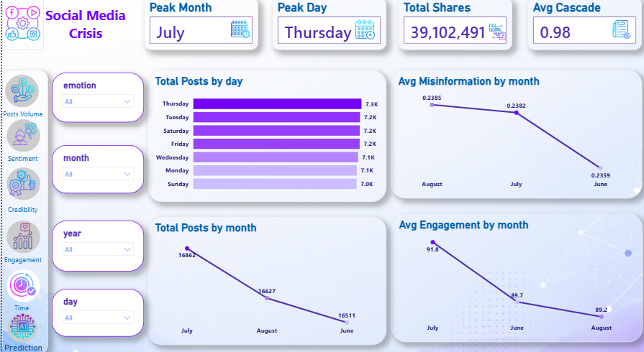
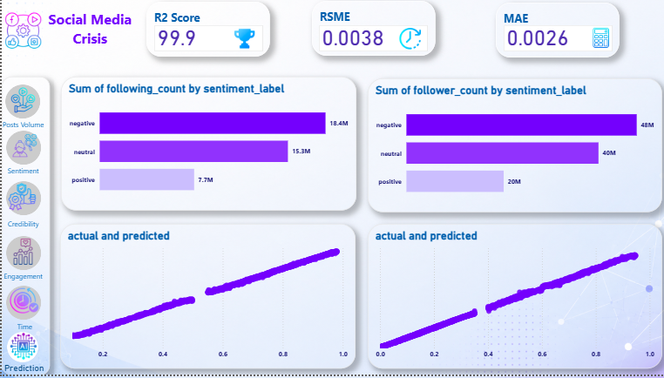
Dashboard Demo & Validation
Cross-Filter Testing
Slicers (platform, month, day, emotion) return consistent totals across all 5 dashboard pages.
11

Slide 12
Deliverables
Three Jupyter notebooks – Bronze, Silver, and Gold layers with full transformation logic.
Star-schema CSV exports – fact_posts plus 9 dimension tables, ready for BI tools.
5-page interactive Power BI dashboard (.pbix) with DAX measures and drill-through filters.
Final project report and this presentation, documenting the pipeline end to end.
1- Notebooks & Data
2- Power BI Dashboard
3- Report & Slides

Slide 13
Project Team & Roles
Omar Khaled Data Analytics Specialist Built the full pipeline (Bronze/Silver/Gold) and the Power BI dashboard.
Abdalrahman Maher Data Analytics Specialist Led the EDA and built the AI misinformation-risk model.
Refka Maged UI/UX Designer Designed the dashboard's UI/UX using Figma.
Each team member led a distinct phase of the project – from pipeline engineering, to analysis and modeling, to the final design experience.

Slide 14
Thank You!
Questions & Feedback Welcome
Social Media Crisis Analytics – DEPI Graduation Project

