Slide 1
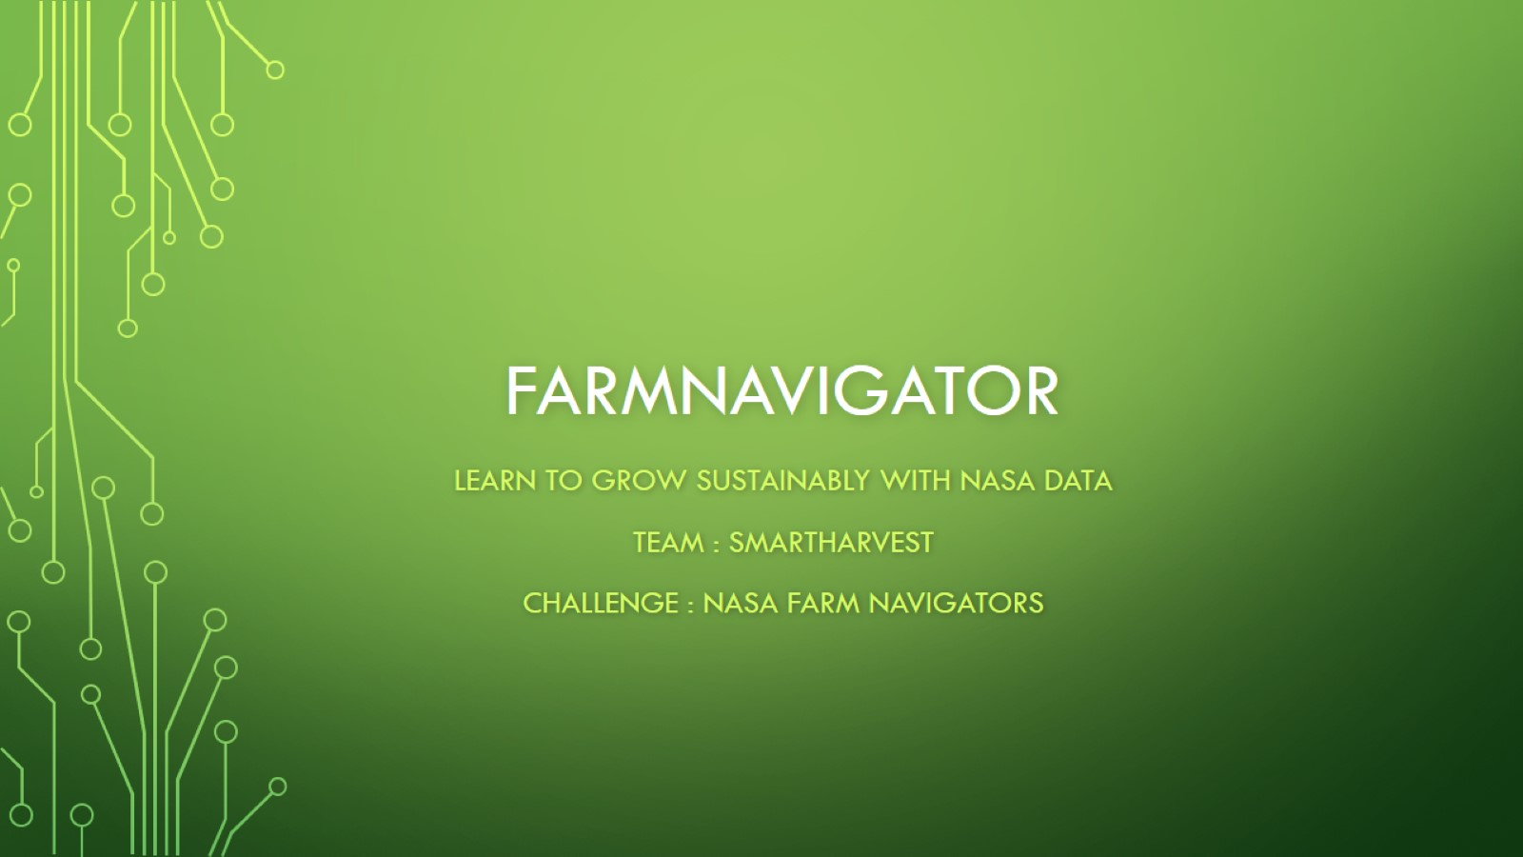
FarmNavigator

Slide 2
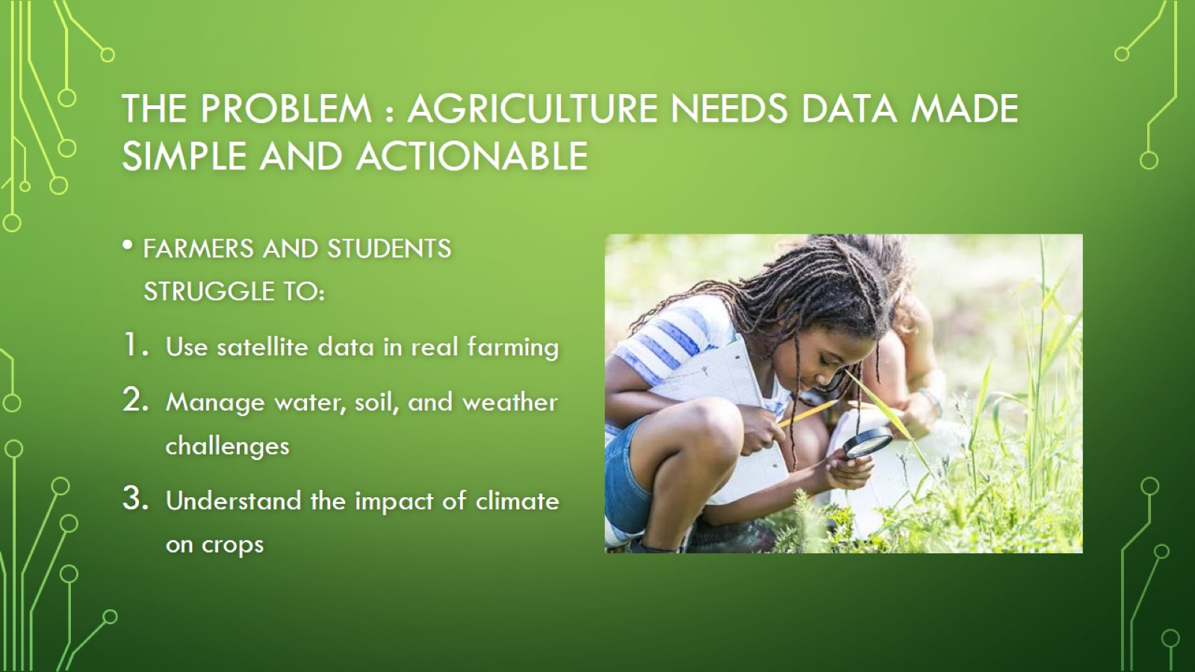
THE PROBLEM : Agriculture needs data made simple and actionable

Slide 3
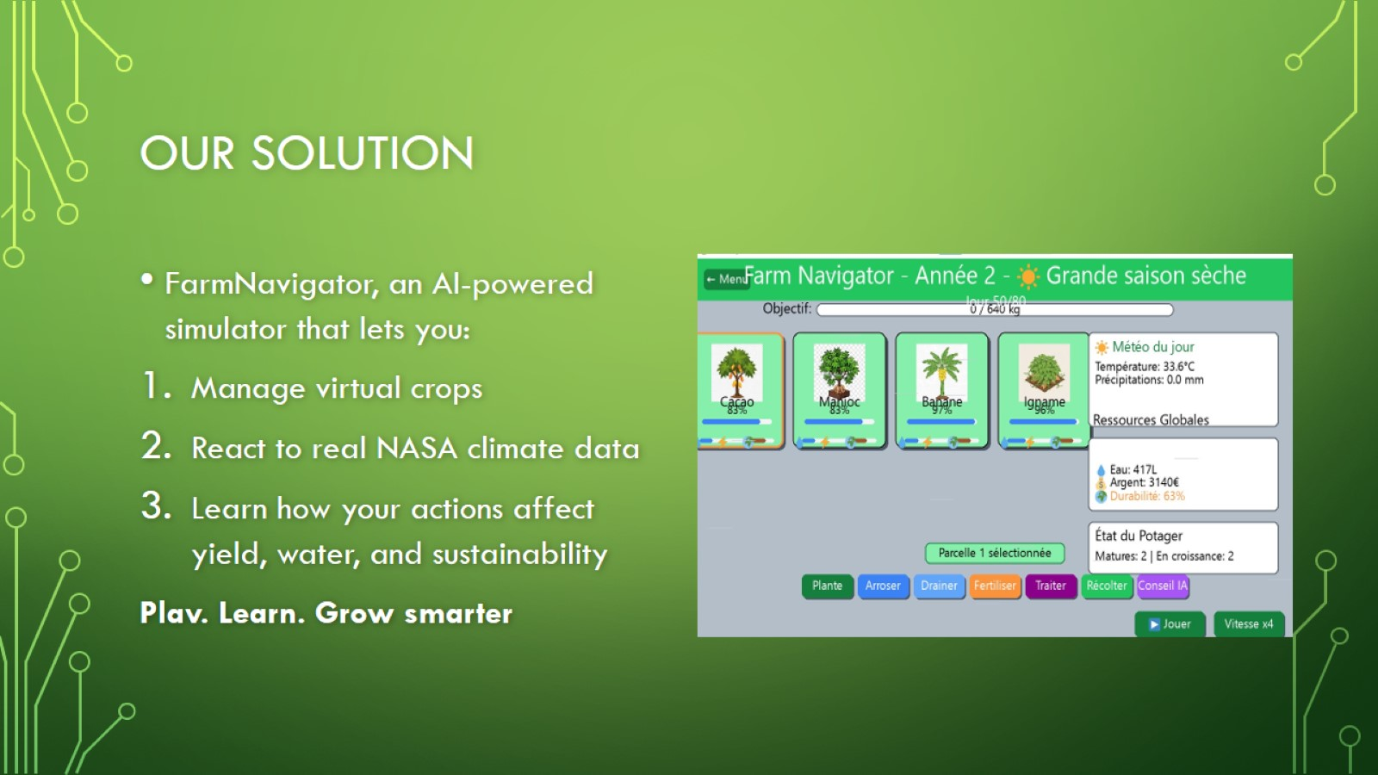
OUR SOLUTION

Slide 4
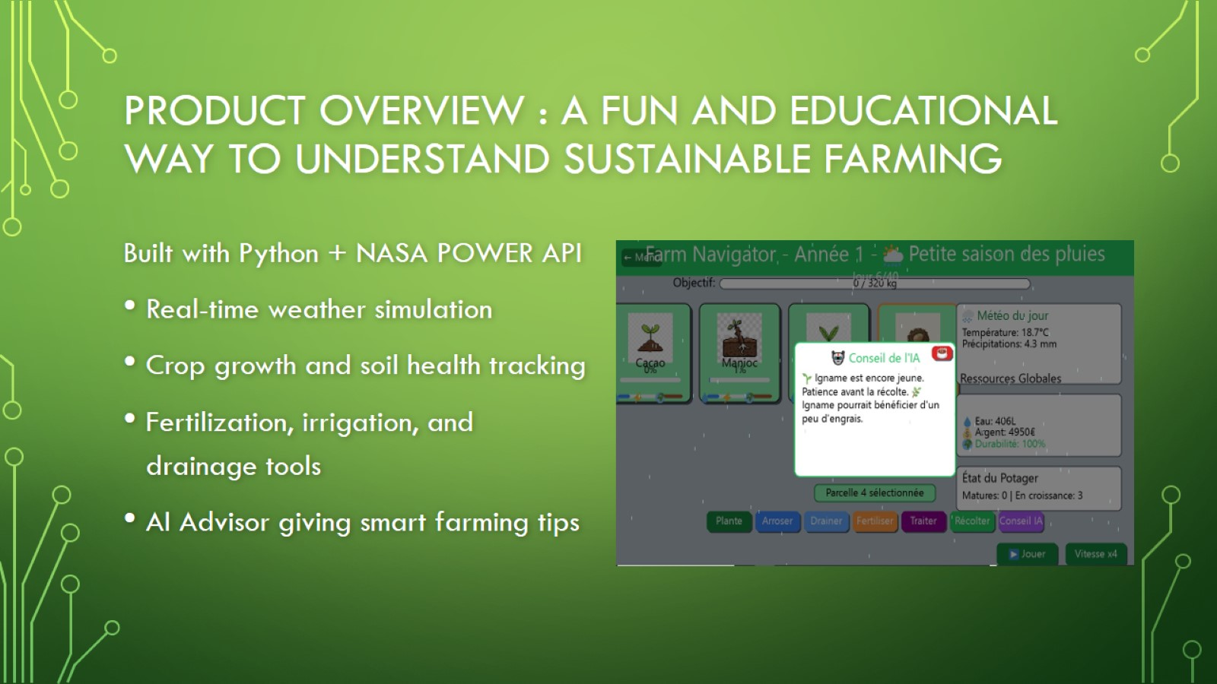
Product OVERVIEW : a fun and educational way to understand sustainable farming

Slide 5

MARKET & IMPACT

Slide 6
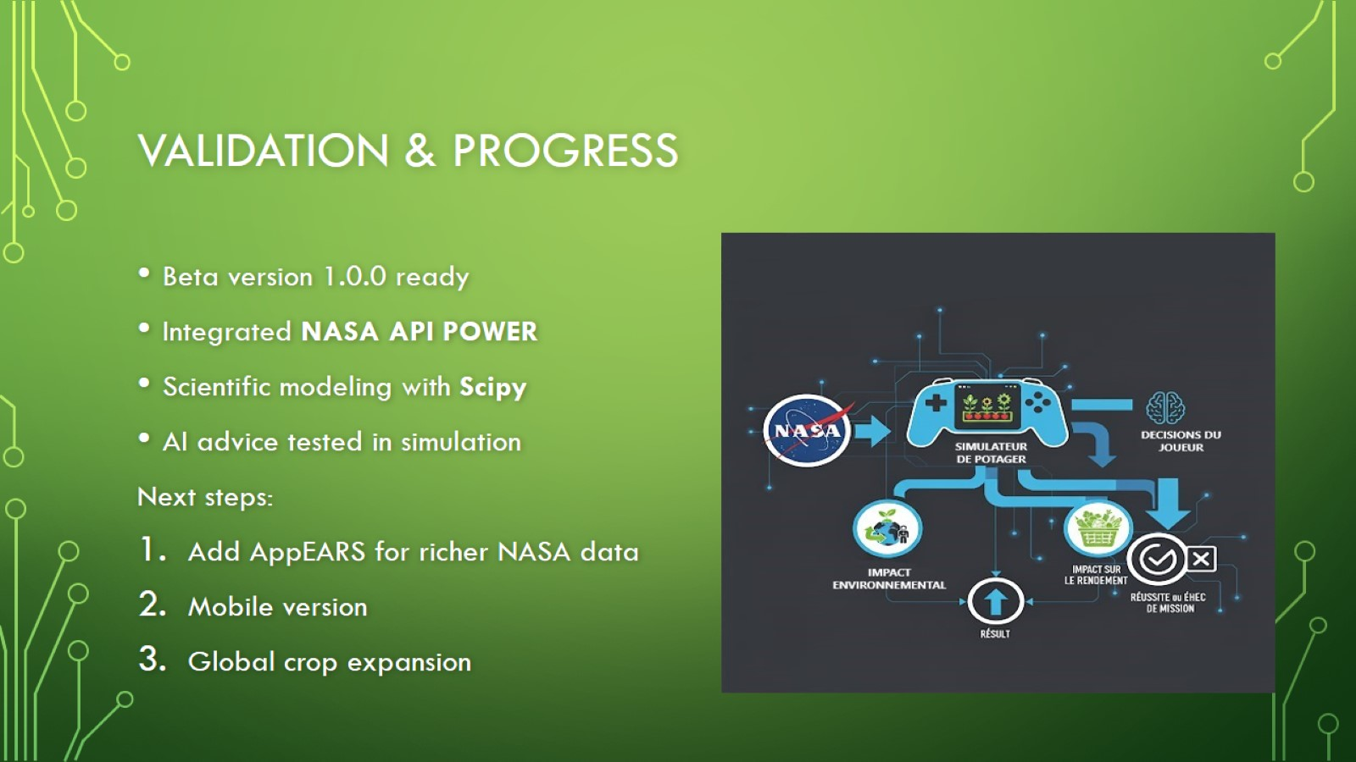
Validation & Progress

Slide 7

Team & vision

