Slide 1
FarmNavigator
LEARN TO GROW SUSTAINABLY WITH NASA DATA
TEAM : GAIATECH
CHALLENGE : NASA FARM NAVIGATORS

Slide 2

THE PROBLEM : Agriculture needs data made simple and actionable
FARMERS AND STUDENTS STRUGGLE TO:
Use satellite data in real farming
Manage water, soil, and weather challenges
Understand the impact of climate on crops

Slide 3
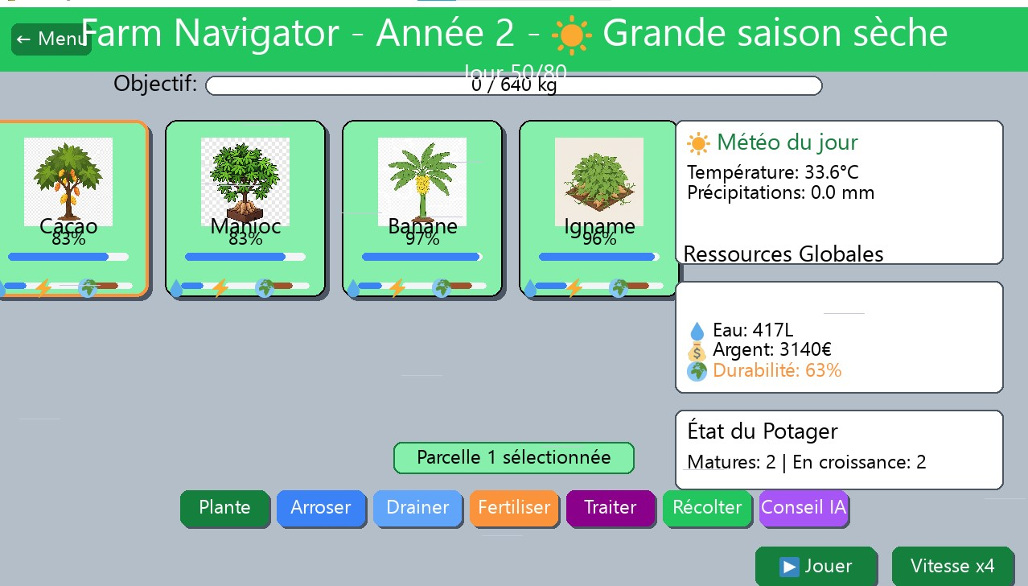
OUR SOLUTION
FarmNavigator, an AI-powered simulator that lets you:
Manage virtual crops
React to real NASA climate data
Learn how your actions affect yield, water, and sustainability
Plav. Learn. Grow smarter

Slide 4
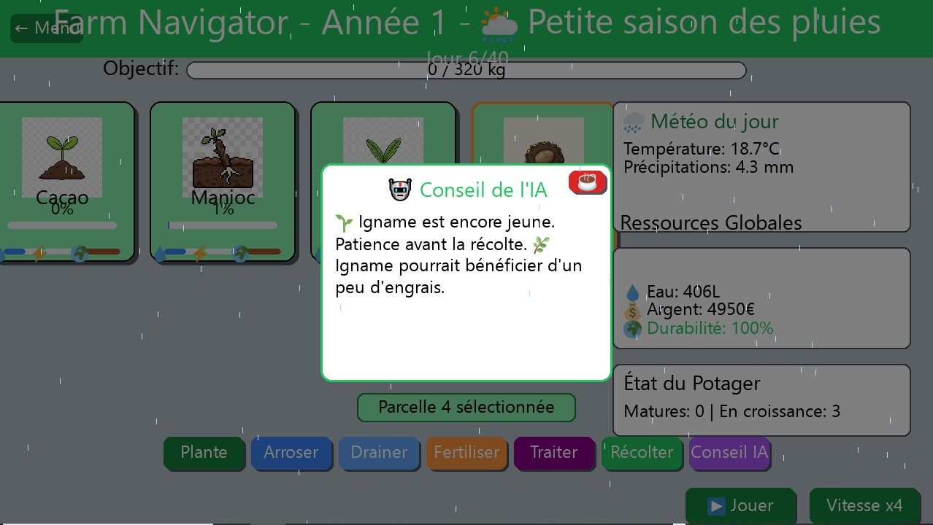
Product OVERVIEW : a fun and educational way to understand sustainable farming
Built with Python + NASA POWER API
Real-time weather simulation
Crop growth and soil health tracking
Fertilization, irrigation, and drainage tools
AI Advisor giving smart farming tips

Slide 5
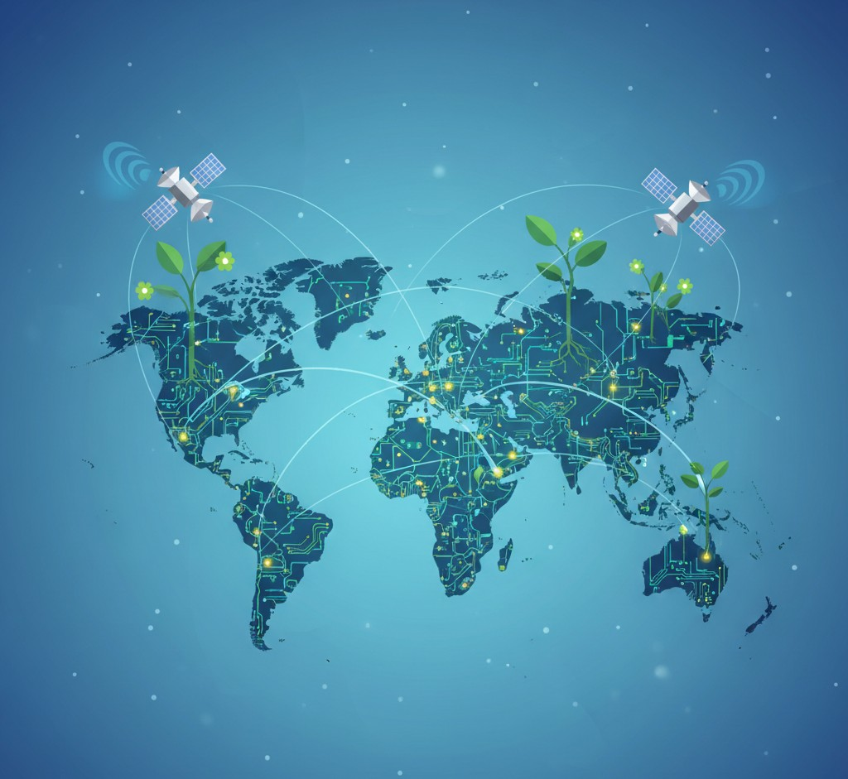
MARKET & IMPACT
Education: agricultural schools and training centers
Farmers: test and improve decisions safely
Public: awareness of sustainability and NASA data use
Empowering the next generation of data-driven farmers

Slide 6
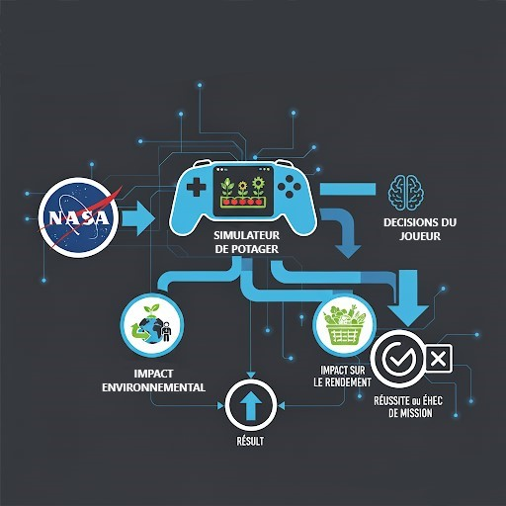
Validation & Progress
Beta version 1.0.0 ready
Integrated NASA API POWER
Scientific modeling with Scipy
AI advice tested in simulation
Next steps:
Add AppEARS for richer NASA data
Mobile version
Global crop expansion

Slide 7
Team & vision
NJIMONGBA FOCHIVE MAMA ABDOURAHIM
HADJA BEBBE HASSIMATOU BAH
LEKANE KOUNLAG BRIAND DURRANDE
Développeur principal
Designer UI/UX
Chef de Projet
Responsable Documentation
Tests
Ingénieur IA
Modélisation rule-based

