Slide 1
E-Commerce Website Analysis
Dataset Interview Abderrahim Namouh

Slide 2
Content
Dataset description
Revenue Analysis
Device Usage
Android App vs. Mobile Browsing
Business recommendation

Slide 3
Dataset Description

Slide 4
Dataset description
Dataset: User traffic on an e-commerce website.
Timeframe: Events span from March 28, 2016, to April 16, 2017.
Rows: Each row represents a single user event (e.g., browsing, purchasing).
Main Features:
Timestamp: Unix time for event occurrence.
User ID: Cookie-based user identifier.
Cross-device User ID: Common ID across devices for the same user.
Existing Client: Binary (1 if returning customer, 0 if new).
Event Type: Four types: Listing, Product, Basket, Sales.
Product ID, Price, Quantity: Details for the products involved in events.
Product Category: Classifies products as Small, Medium, Large, or Packages.
Environment: Web or Android app.
Device Type: Device used (Desktop, Mobile, etc.).
Browser Family: Type of browser (Chrome, Safari, etc.).
User Location: Inland, Outside, or Unknown
We’ll keep data from 01/04/2016 to 31/03/2017 to have a well-defined analysis over a single year.

Slide 5
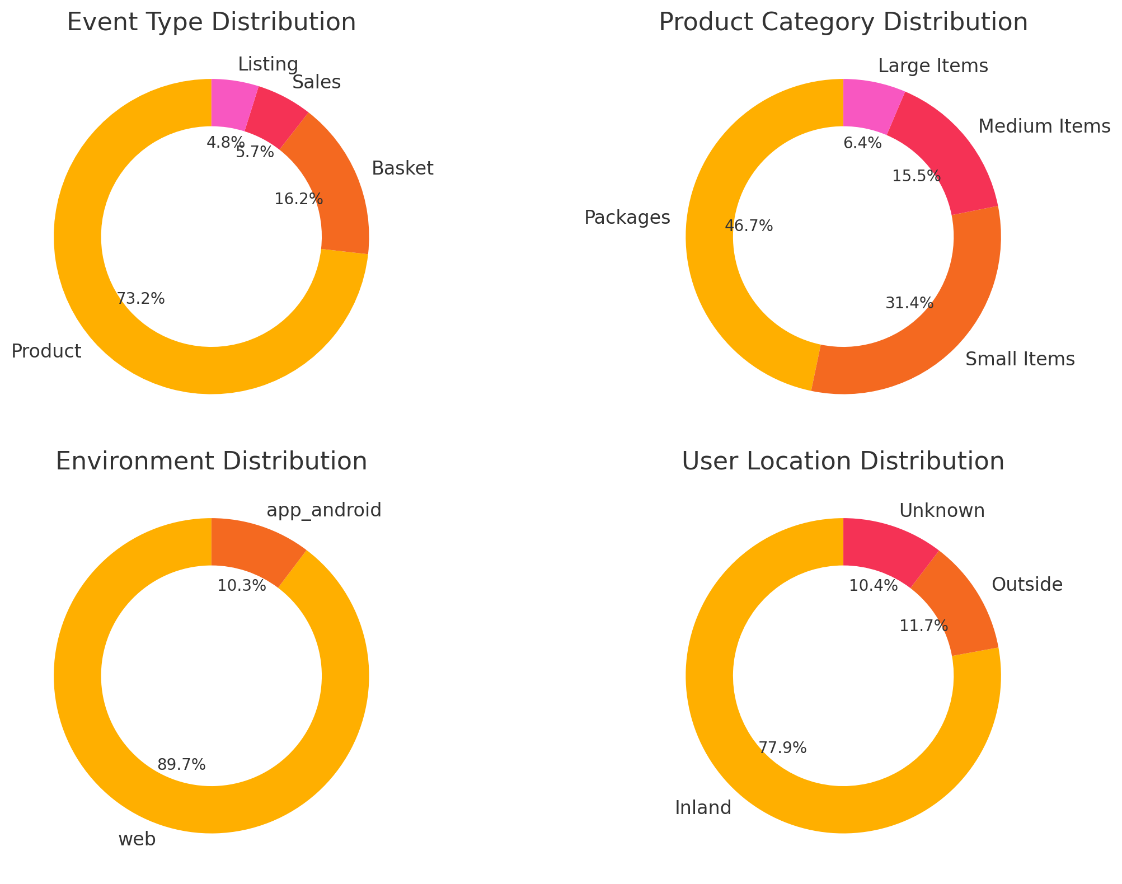
Early Insights
Events are mainly Product events.
Packages are the most recorded.
Majority of records come from web browsing.
Inland users represent the greater share of the dataset.

Slide 6
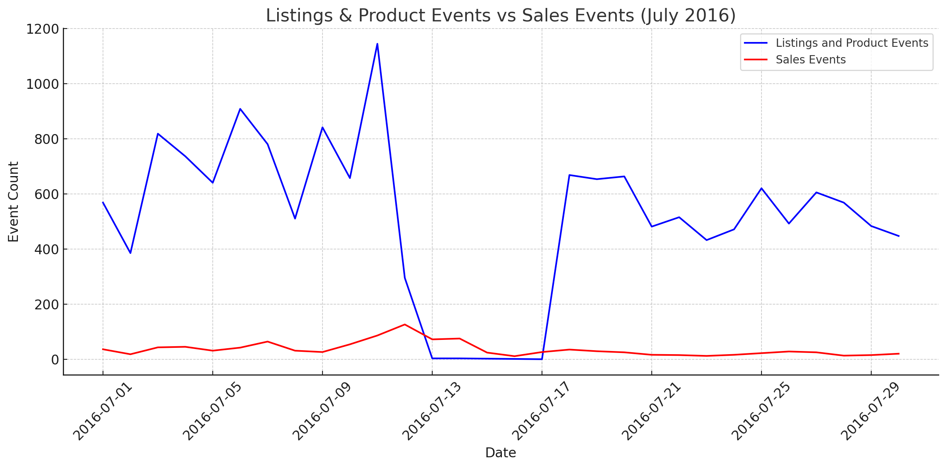
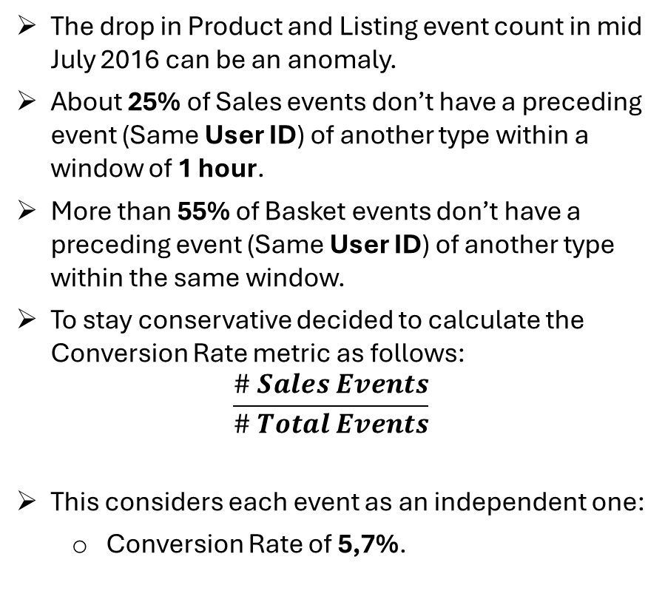
Assumptions should be carefully chosen
The drop in Product and Listing event count in mid July 2016 can be an anomaly.
About 25% of Sales events don’t have a preceding event (Same User ID) of another type within a window of 1 hour.
More than 55% of Basket events don’t have a preceding event (Same User ID) of another type within the same window.
To stay conservative decided to calculate the Conversion Rate metric as follows:
$$\frac{\# Sales Events}{\# Total Events}$$
This considers each event as an independent one:
Conversion Rate of 5,7%.
Notes:
This is wrong, it is an anomaly in the data
You need to see if the drop is associated to specific products (Desktop for sure)

Slide 7
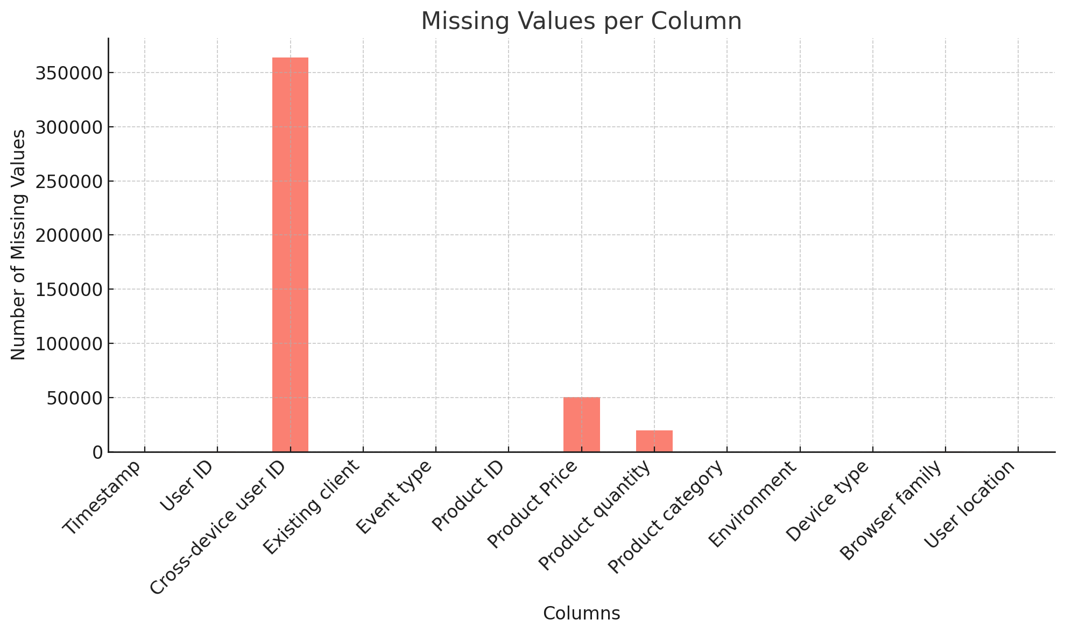
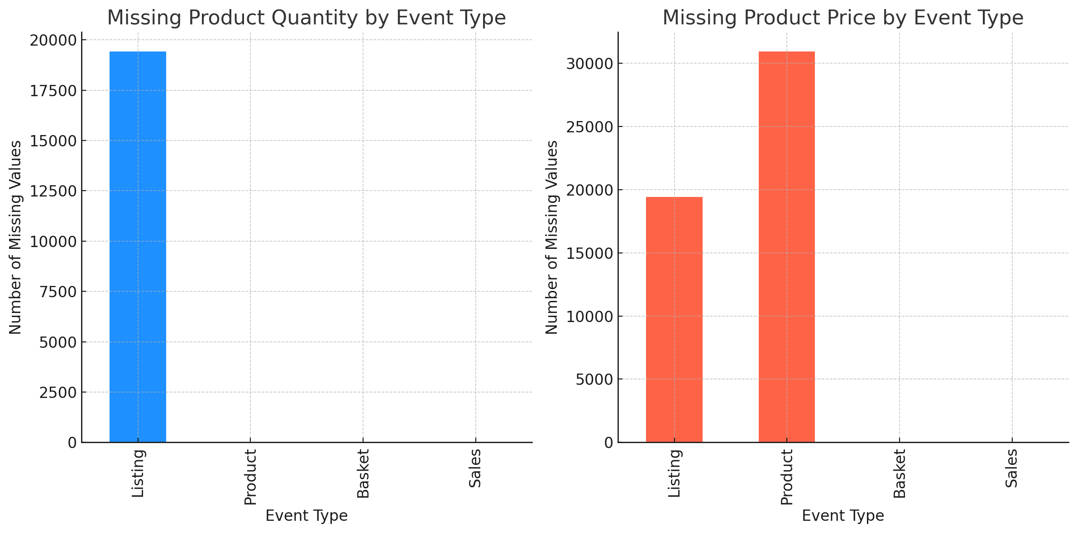
Understanding Missing Data
Missing values are spotted in Cross-device user ID, Product quantity and Product price.
Product quantity’s missing values are relevant since they only exist for Listing events.
Listing events do not have Product price values neither since there is no product associated to the event.

Slide 8
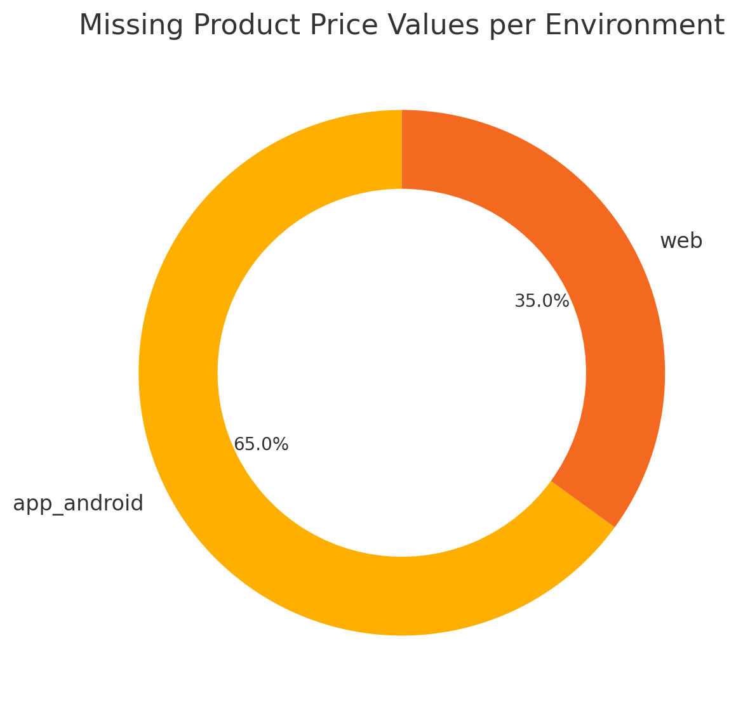
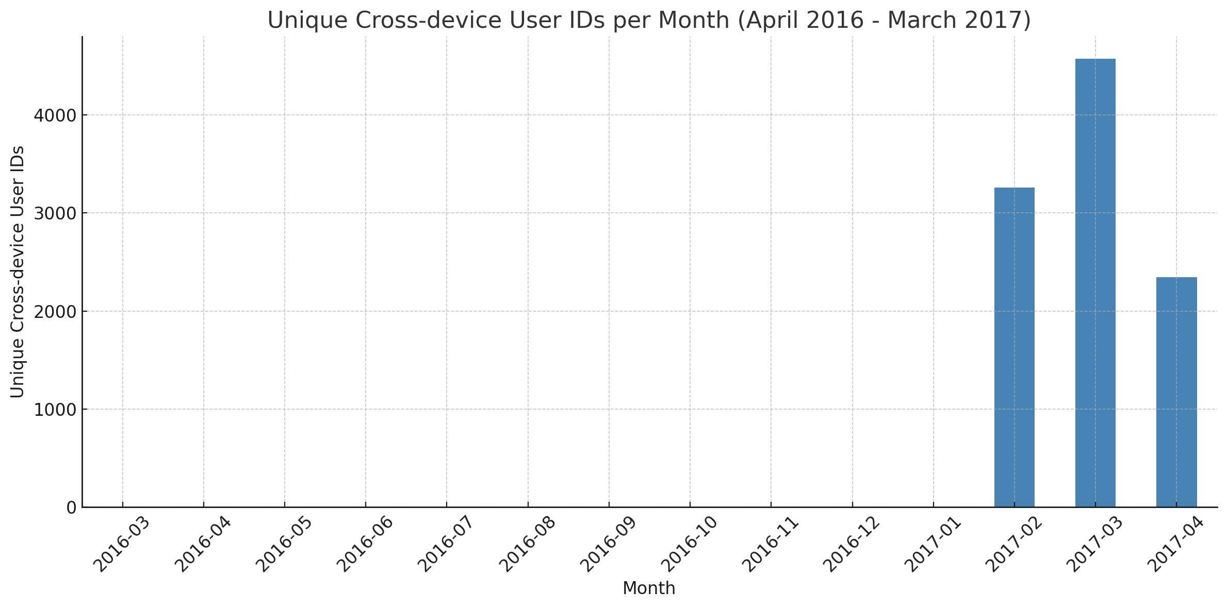
Understanding Missing Data
Product event also have missing values on Product price likely due to restrictions or other errors, especially on the Android App.
Cross-device user ID have only few records starting from Feb 2017.
Using these records, we may fill the previous records by a Cross-device user ID if we have a match on User ID.
“Unknown” records in Device Type correspond to Android App environment.
Those in Location are associated with the Android App too.
This was doubled checked using row indexes
Notes:
In location 289 rows are in web env

Slide 9
Revenue Analysis

Slide 10
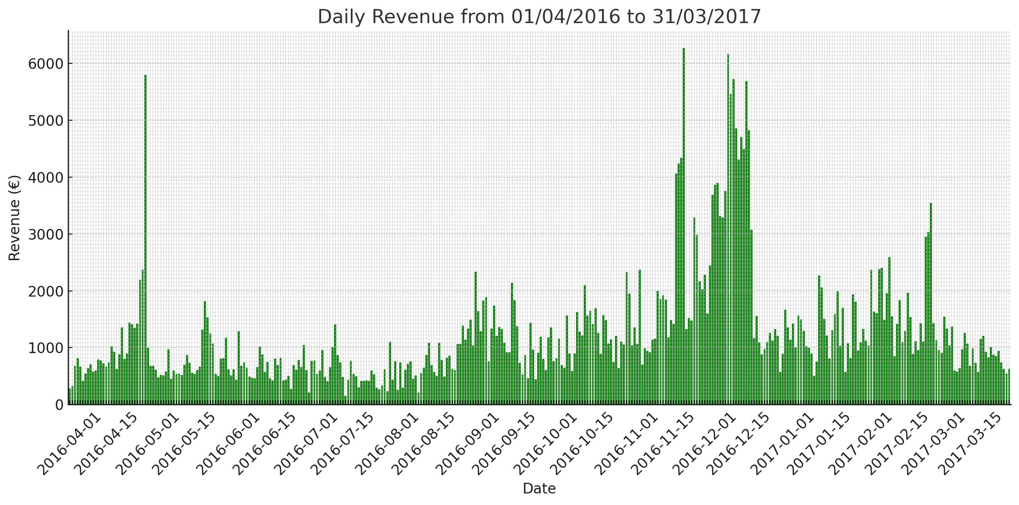
Revenue Spikes on special occasions
Significant and steady revenue growth driven by Black Friday, Cyber Monday, and Christmas promotions.
Other revenue spikes likely due to Valentine’s Day, Spring holidays or specific marketing campaigns.
Additional year of data could help uncover seasonal trends for better analysis.
Notes:
Scholar year debut for late august, or the marketing related to the launch of the app ?

Slide 11
Device Usage

Slide 12
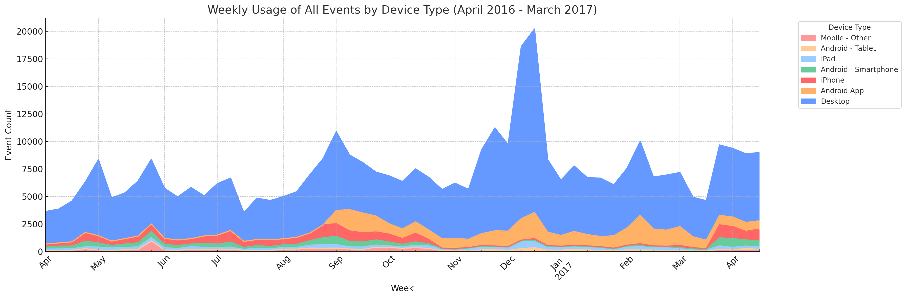
Dominance of the Desktop web browsing
Optional Appendix
A clear dominance of Desktop Web Browsing.
Android App launched around Sep 2016.
Desktop slight drop after Android App launch (Sep 2016): Some regular desktop users switched to the app for convenience.
Notes:
The app gained popularity very quickly, which is one of two things :
We either did not log the app correctly (truth)
We made an insane marketing campaign

Slide 13
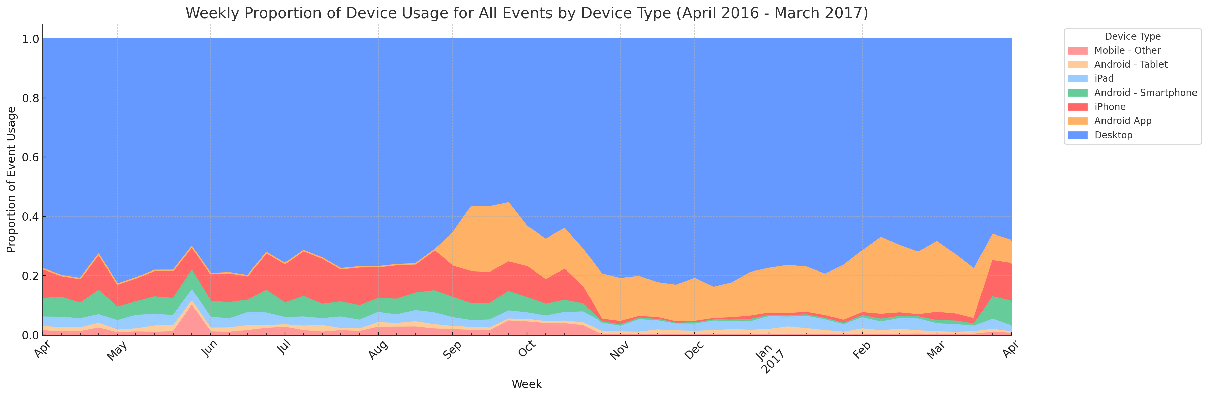
Significant Impact from the Android App launch
Mobile web browsing dropped in Nov-Feb, giving more room to the Android App, suggesting more convenient choices in special occasions, or data inconsistency (Late recovery in mid March).
iPhone and Android Smartphone usage appear to challenge the Android App starting from mid March 2017. It also may be a sign of disengagement after an intense shopping period (Lack of special event/Deals).
The significant increase of Desktop usage (Nov-Dec) can be related to occasional users.
Notes:
An app allows for an easier access, with notifications of potential deals.
The user experience is generally better when sharing products and allowing for favourite lists etc.

Slide 14
Android App vs. Mobile Browsing

Slide 15
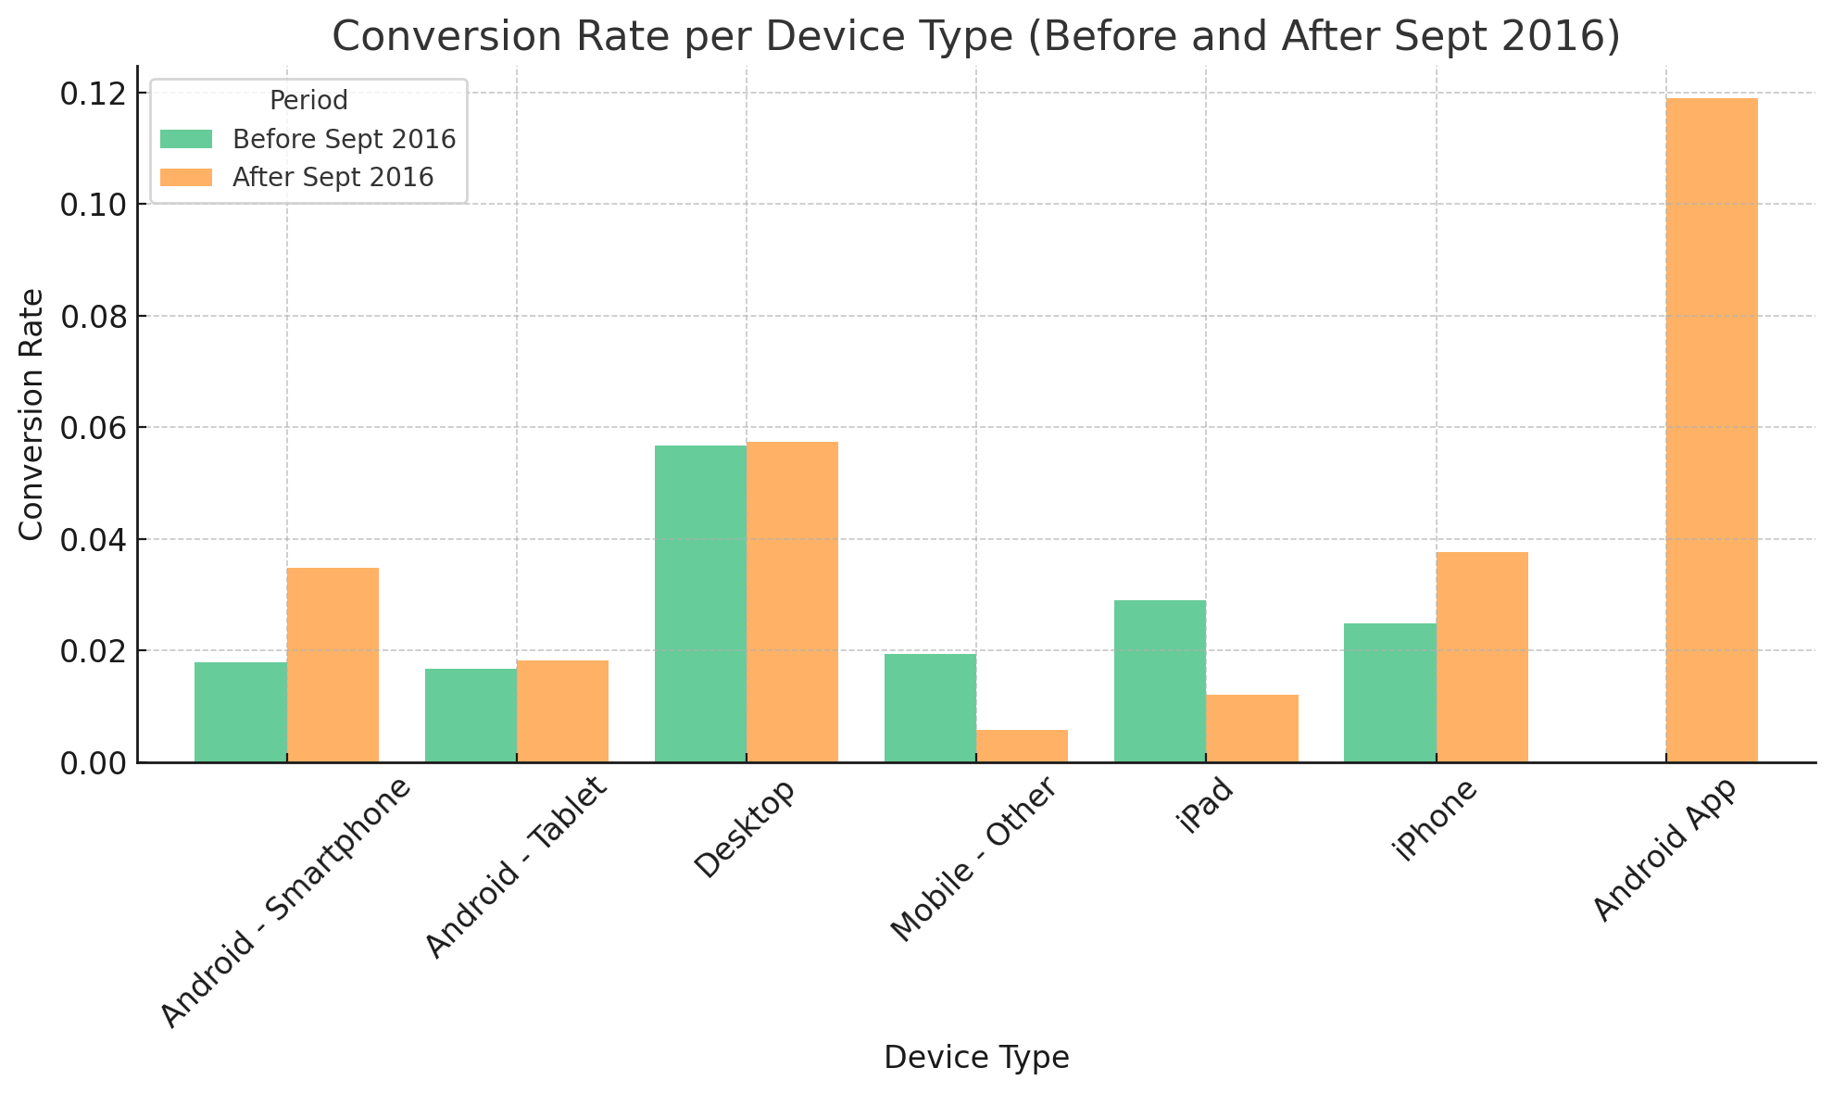
The Android App offers the best Conversion Rate
The Android App outperforms mobile browsers and even desktops in terms of converting visits into sales.
Even though some mobile browsing devices saw their CR improve after Sept 2016, the Android App had significantly better outcomes.
Even if users convert from desktop browsing, the website benefit from the high CR of the Android App.
This can be explained by:
More ergonomic design.
Easier access.
Better user retention (Notifications).
Notes:
An app allows for an easier access, with notifications of potential deals.
The user experience is generally better when sharing products and allowing for favourite lists etc.
Conversion rate

Slide 16
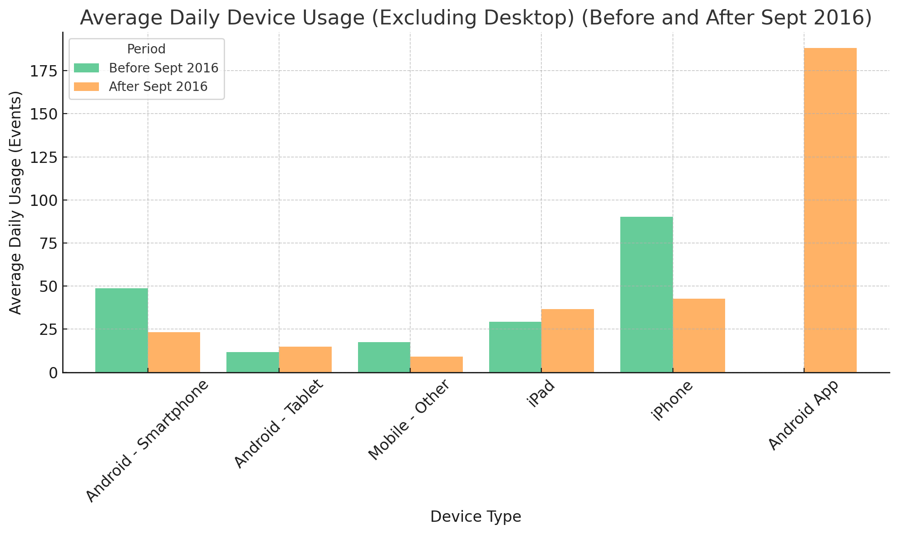
The Android App is the most attractive choice among mobile users
The Android App is by far the go to choice among mobile users.
Mobile web browsing declines after Sept 2016, compared to before the launch of the App:
Due to the decline observed during Nov-Feb.
Switch to more convenient alternatives.
Some of the App’s traffic may come from Desktop users.
Some of the lost mobile browsing traffic may benefit Desktop web browsing in addition to the Android App.
Notes:
An app allows for an easier access, with notifications of potential deals.
The user experience is generally better when sharing products and allowing for favourite lists etc.
Conversion rate

Slide 17
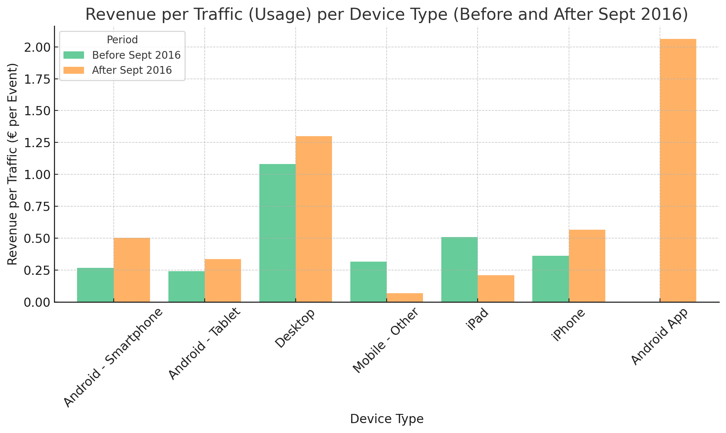
The Android App has by far the best revenue for the same amount of traffic
The Android App surpassed all other web browsing alternatives in converting traffic into revenue.
Another proof of the importance of the engagement offered by Apps.
The results indicate that app expansion and development could significantly boost overall revenue.
Notes:
An app allows for an easier access, with notifications of potential deals.
The user experience is generally better when sharing products and allowing for favourite lists etc.
Conversion rate

Slide 18
Business Recommendation

Slide 19
Business Recommendation
App Expansion
Product Analysis
Location

Slide 20
App Expansion

Slide 21
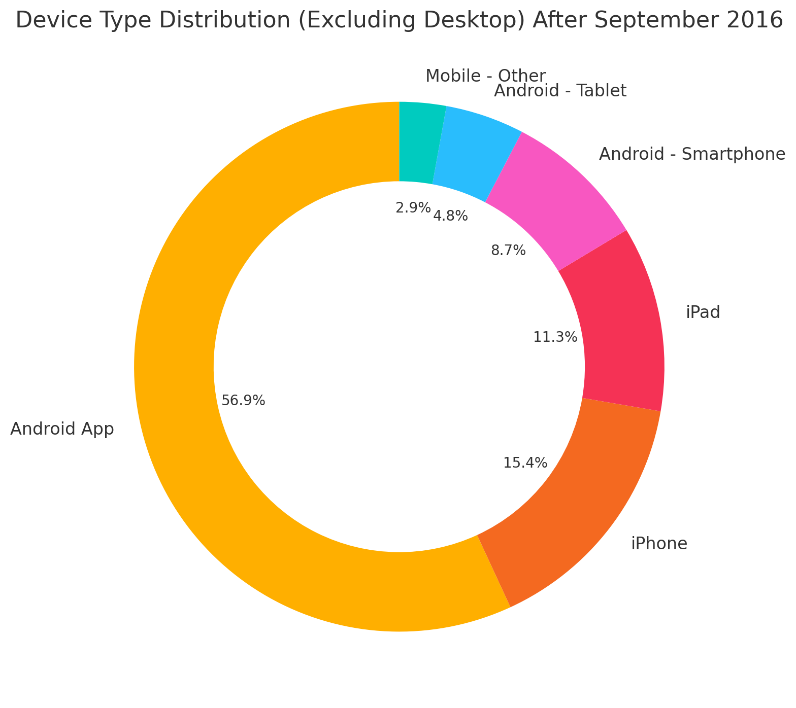
Still 43% of mobile traffic to convert
43% of mobile/tablet traffic still go through web browsing.
14% is coming from android devices web browsing.
More than the quarter of the traffic comes from IOS users, still without a suitable App.
We suppose that IOS users do not convert to Android.

Slide 22
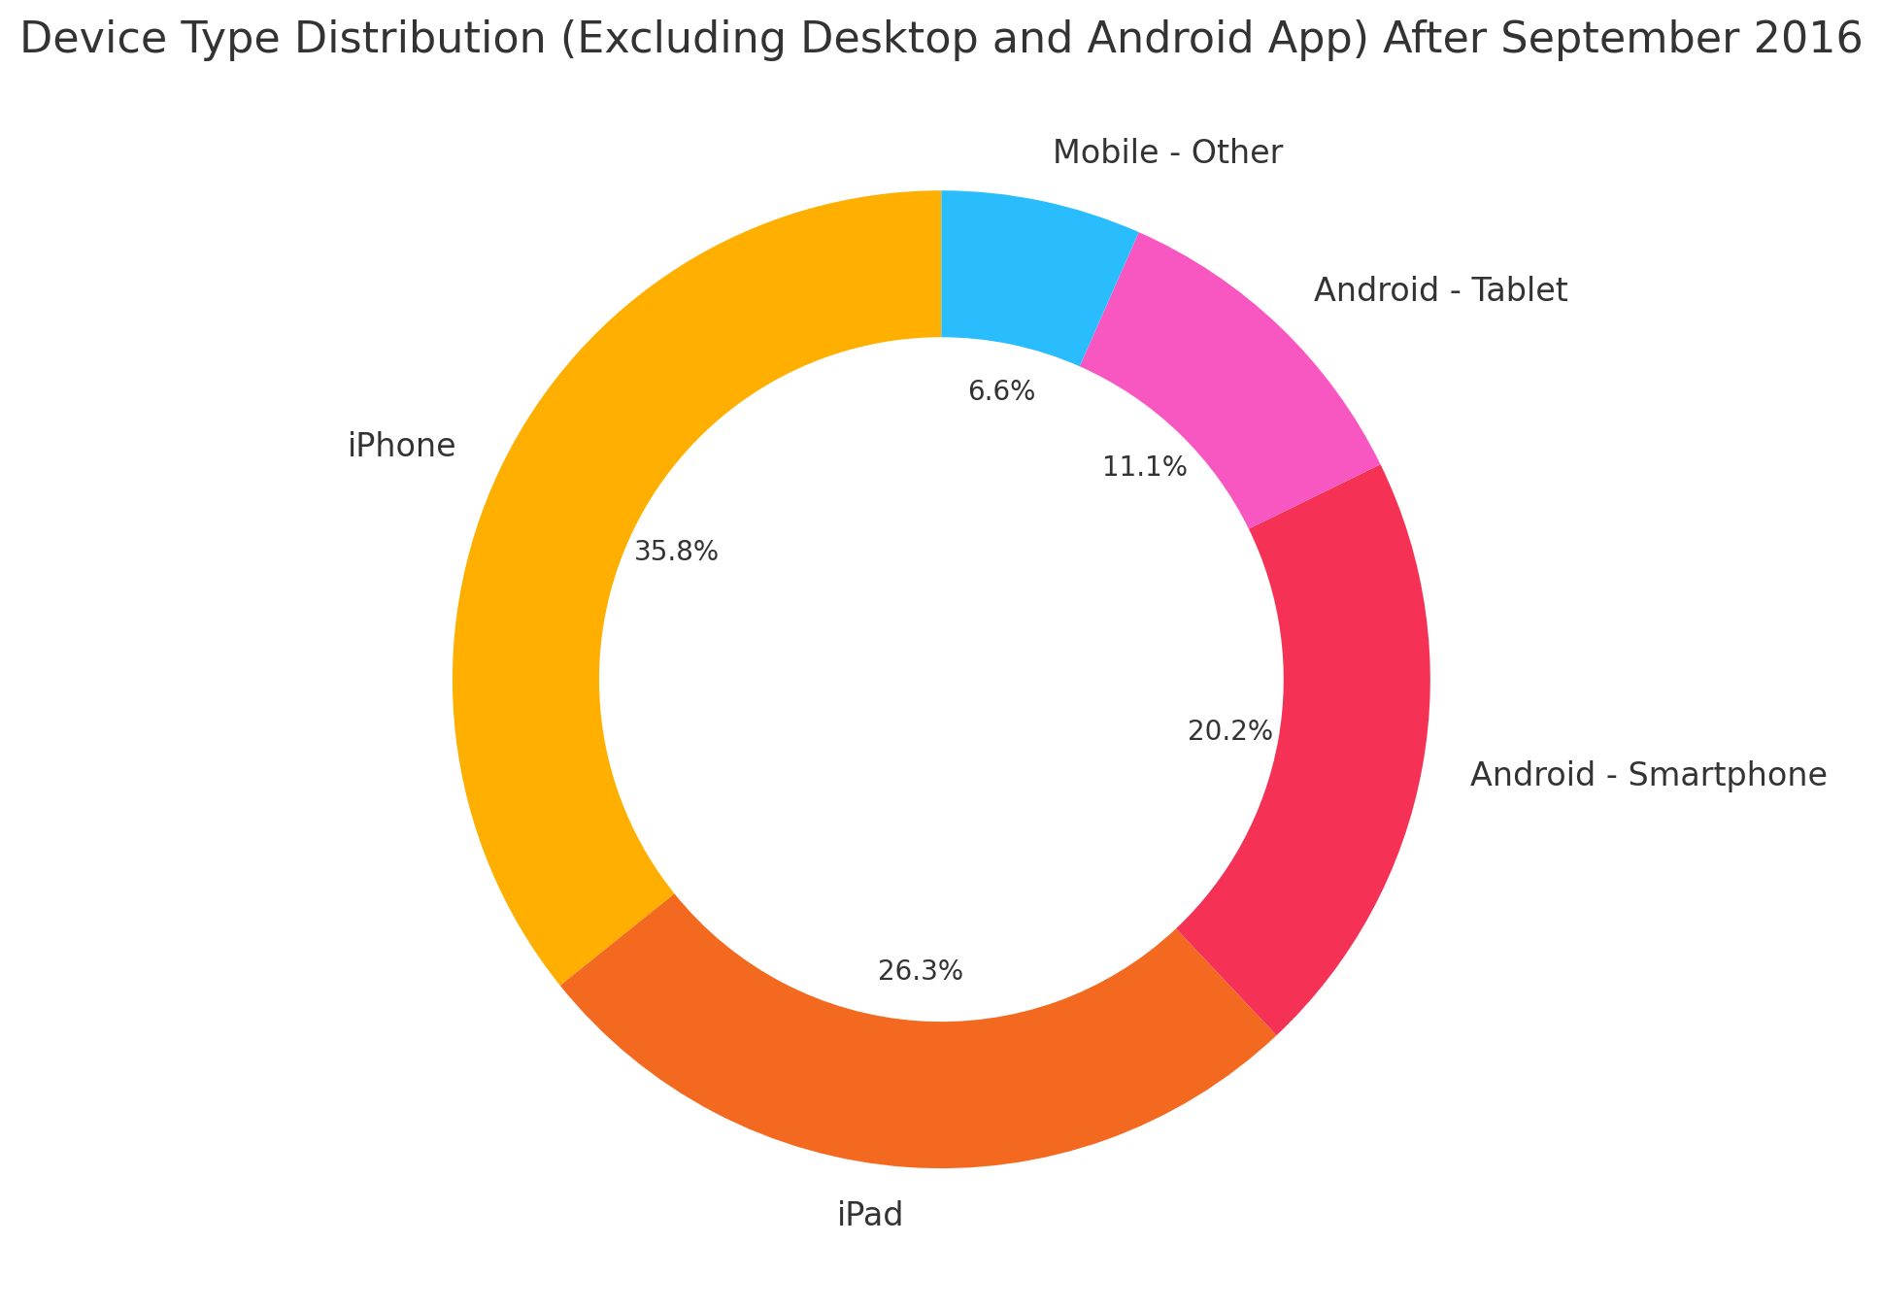
Two different approaches for the two OS
Develop an App for IOS users to up their conversion rate and revenues.
Marketing of both Android and IOS apps.
Work on incentives like Apps exclusive deals.
Think about long-term user retention, adding features like blogs, tips etc.

Slide 23
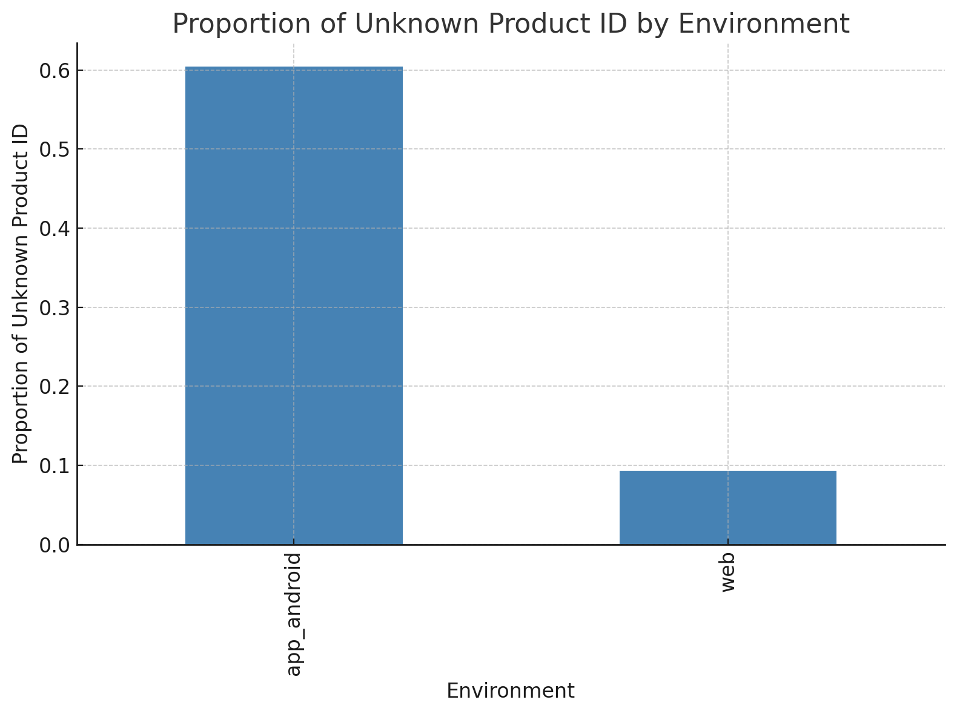
Tackle tracking problems
Multiple missing and unknown labels are associated with the android app mainly even though it only represent 10% of the dataset.
It is necessary to investigate the root of the problem to have access to valuable information.

Slide 24
Product Analysis

Slide 25
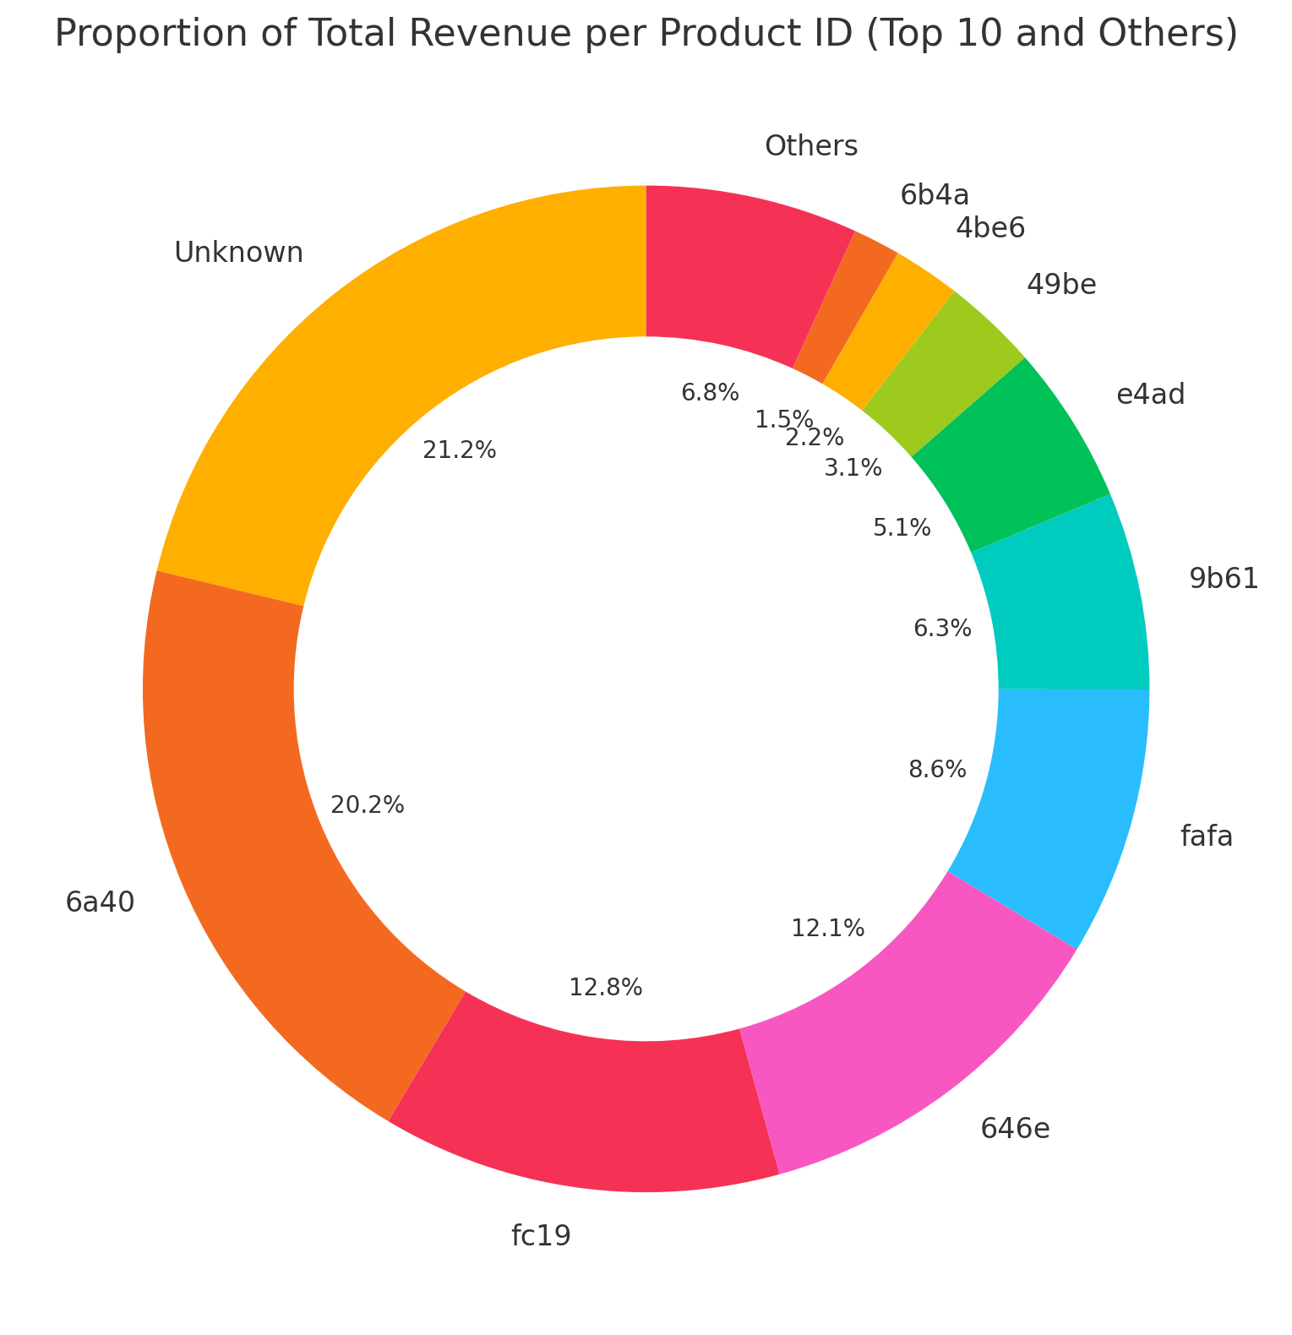
More than half of revenues come from 4 products
Excluding Unknown products, we have 17 different ones, with 16 that have been sold.
Unknown Product ID has over the fifth of revenues, showing the necessity to tackle the tracking problem.

Slide 26
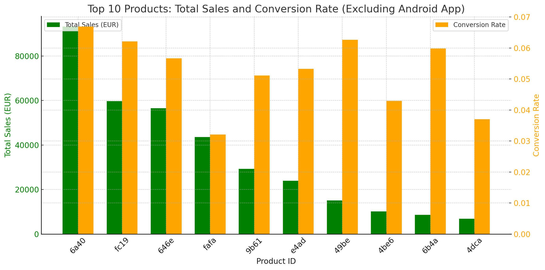
Conversion Rate as a leverage to boost sales
For a fair comparison, we compare the products only on the Web.
Top 3 products have good conversion rates.
We can rely on the high conversion rates to improve revenues on less popular products (9b61:Package / e4ad:Large Item / 49be: Small Item).
Relying on CR needs to be validated by a large sample to have confidence in CR values.
Optional Appendix

Slide 27
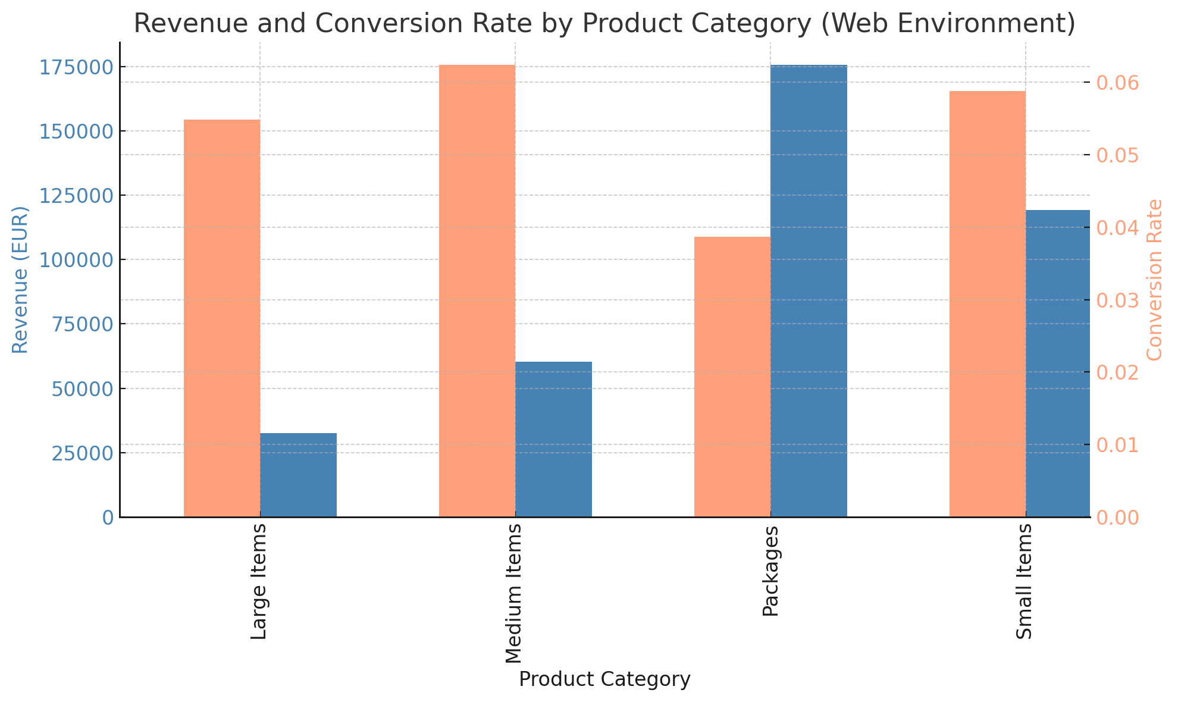
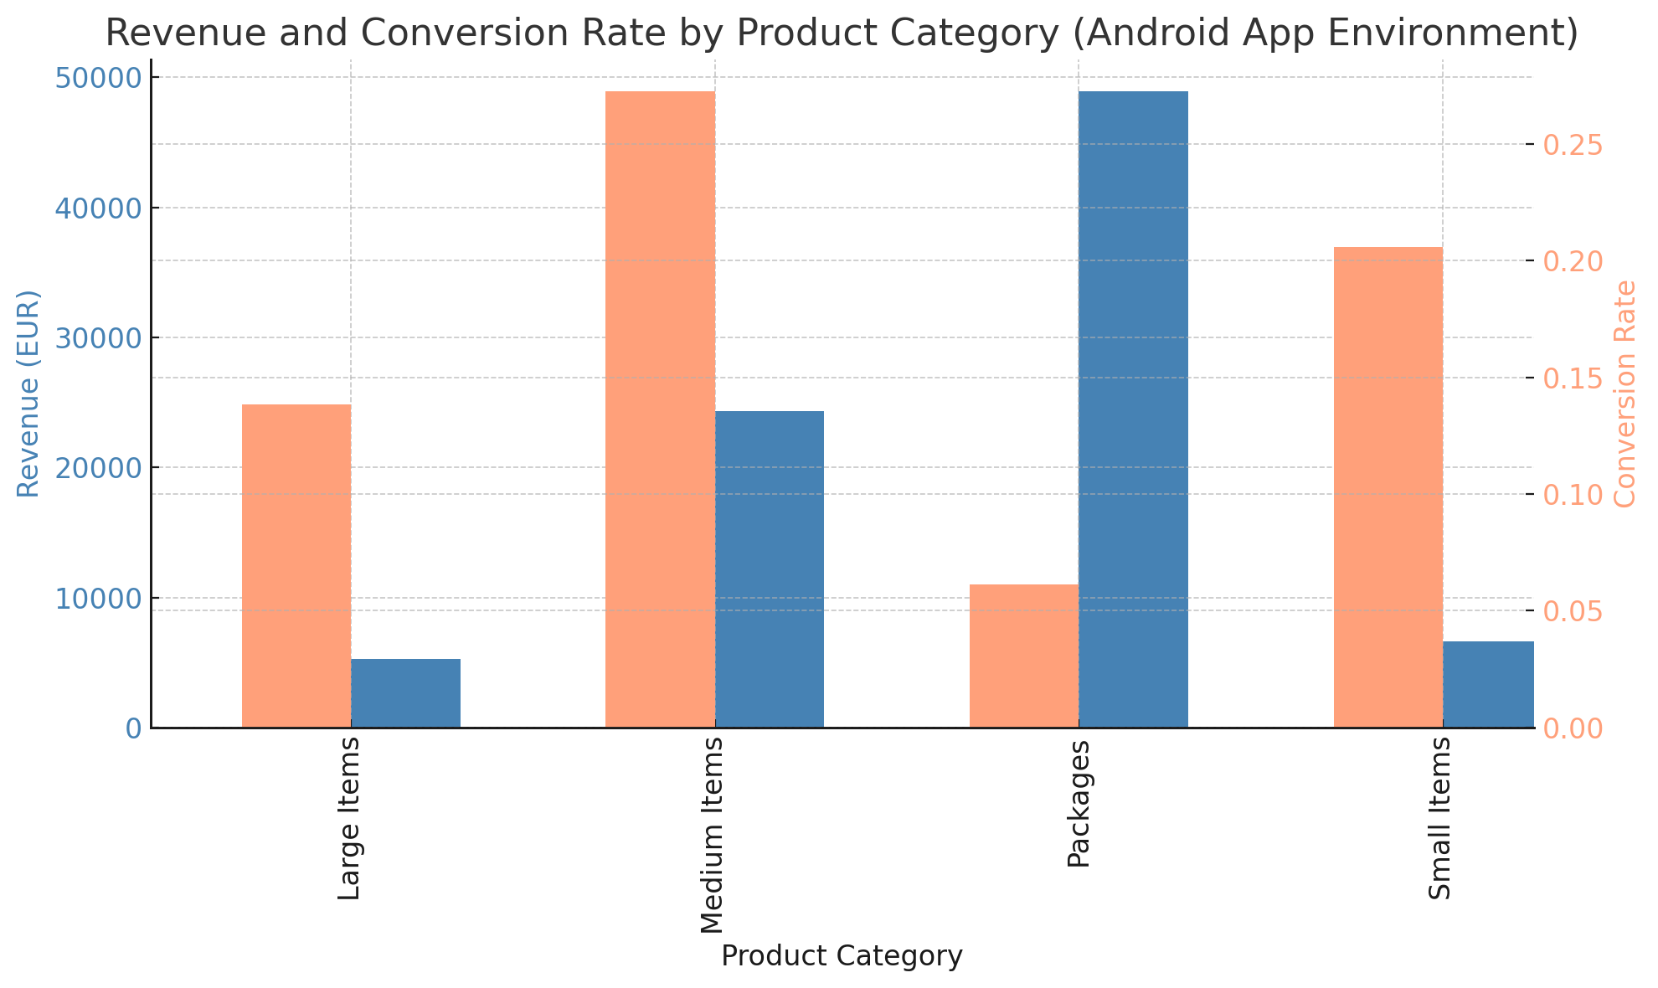
Medium items offer a reliable Conversion Rate
The fc19 medium item has the highest conversion rate over both environments.
The shy revenue suggests an opportunity to boost traffic on this product, taking advantage of its CR.
Small items are also a viable choice, especially on the Android App (CR to be validated).

Slide 28
Location

Slide 29
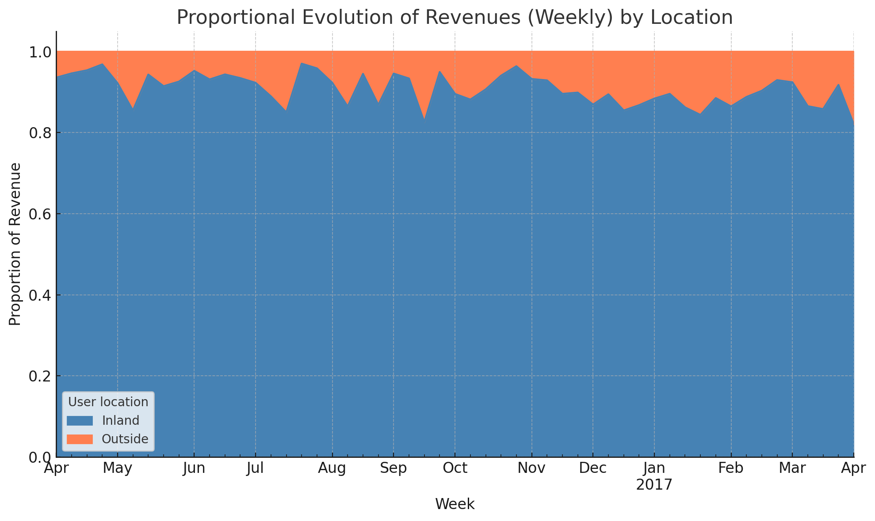
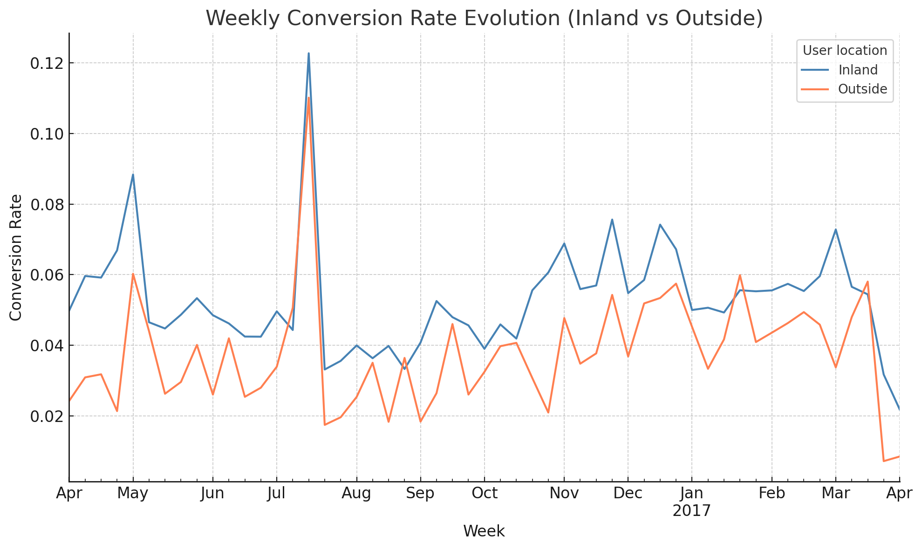
Domestic sales constitutes the majority
Domestic sales represents the overwhelming majority.
Domestic users have the better CR overall.
It is suggested that we first focus on domestic sales, applying the previously proposed measures before moving toward an expansion into foreign markets.
In this case, it would be important to improve the conversion rate with communication and ads tailored to the foreign market.

Slide 30
Summary

Slide 31
Summary
Special events and periods are where the focus should rely to capture more revenue.
Android App proved its superiority in boosting revenue and CR.
Apps are an important leverage, thus the need to expand to IOS and promote properly.
Handling tracking errors is crucial to leverage collected data (especially from Apps)
Carefully choosing promising products to promote (Revenue & CR)
Improving foreign sales might be a choice, but careful consideration on improving its CR is mandatory.

Slide 32
Questions ?

Slide 33
Appendix

Slide 34
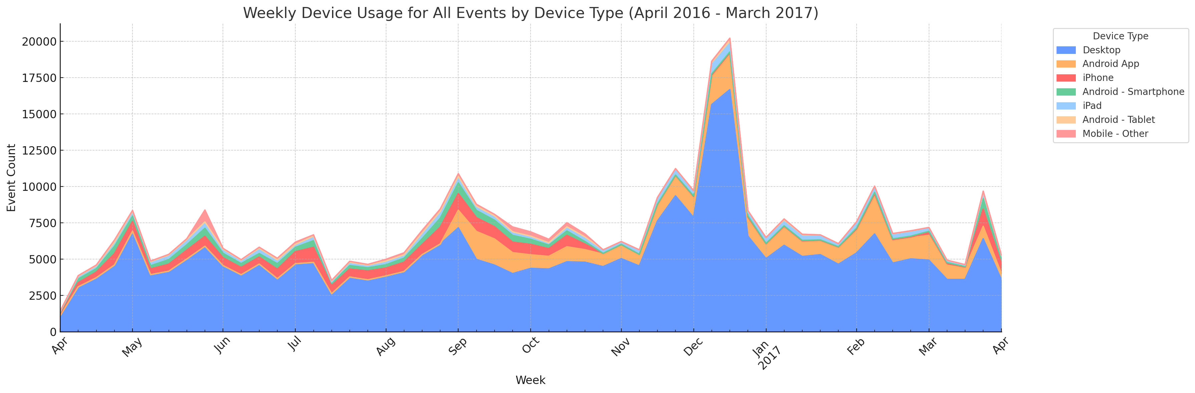
Device Usage Evolution
Go back
Notes:
An app allows for an easier access, with notifications of potential deals.
The user experience is generally better when sharing products and allowing for favourite lists etc.

Slide 35
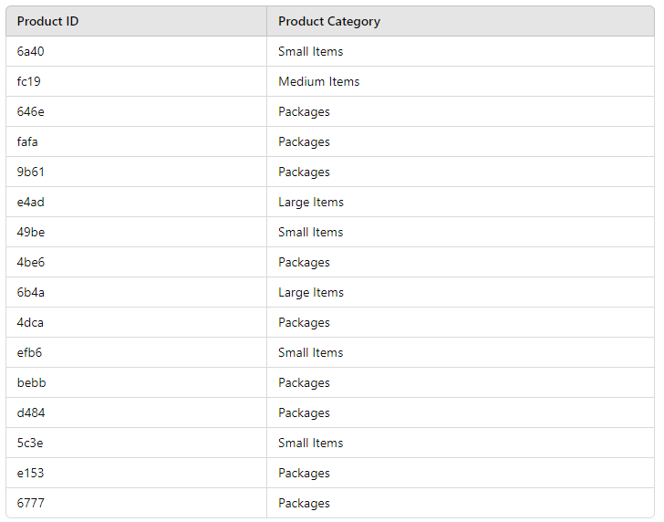
Categories of the different products
Go back
Notes:
An app allows for an easier access, with notifications of potential deals.
The user experience is generally better when sharing products and allowing for favourite lists etc.

