Slide 1

E-Commerce Dataset Analysis & Report
Dataset Interview
Ayoub Targaoui
Notes:
Raphael

Slide 2
Summary
Introduction
Dataset Overview
Shoppers Devices Analysis
Applications vs Mobile Web Browsing
Location Impact
Product Section
Conclusion
Revenue Evolution
Notes:
Raphael

Slide 3
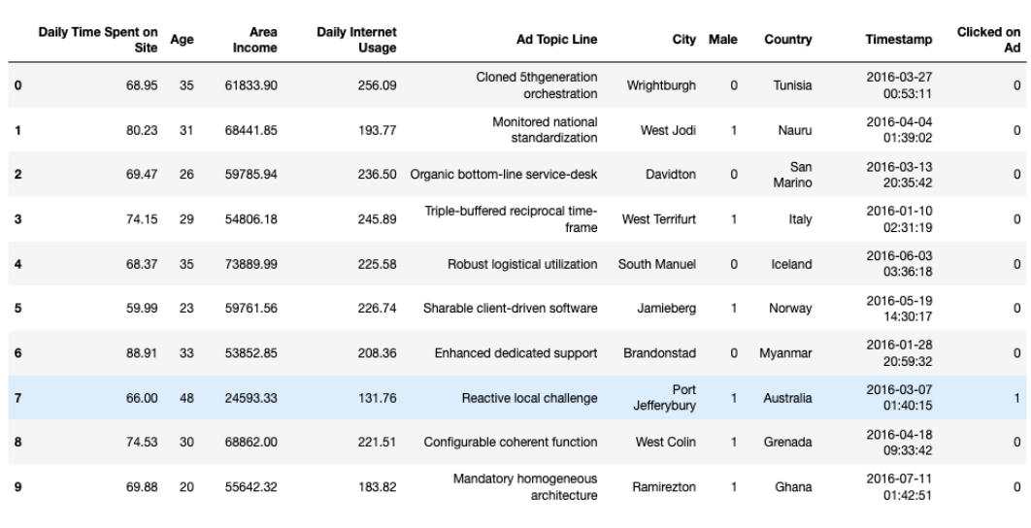
Introduction
Using Data helps us to:
Better understand customers
Predict consumers trends
Target efficiently through ads campagn
→ GOAL : Generate more Revenue
Notes:
Raphael

Slide 4
Dataset Overview
Client
User ID
Cross-device user ID
Product
Product ID
Product category
Existing client
Client Action
Timestamp
Event type
Product price
Product quantity
Traffic
Environment
Device type
Browser family
User location
Notes:
Ayoub

Slide 5
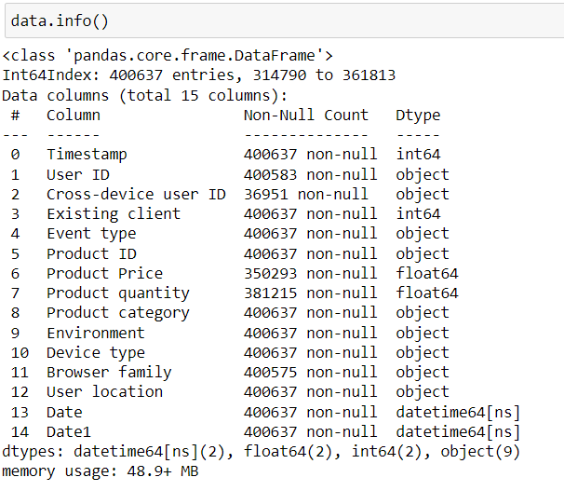
400637 entries
Preprocessing on Timestamp
Created Date and Date1 features
Date : Y/M/D HH:MM:SS
Date1 : Y/M/D
Some Users used different devices

Slide 6
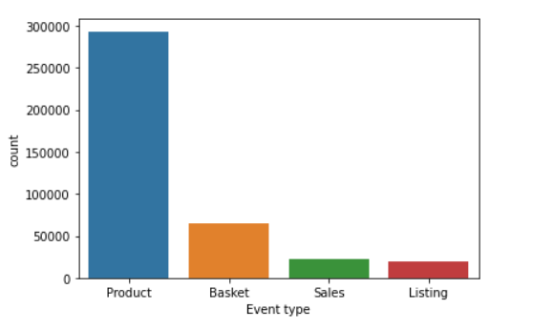
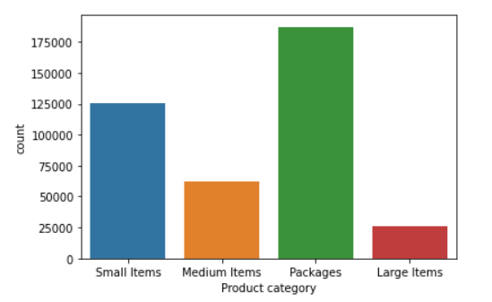
Introduction
Most Users targeted a specific product ( Targeted Traffic )
CR around 6%
Packages and Large Items most viewed through ads
Notes:
Raphael

Slide 7
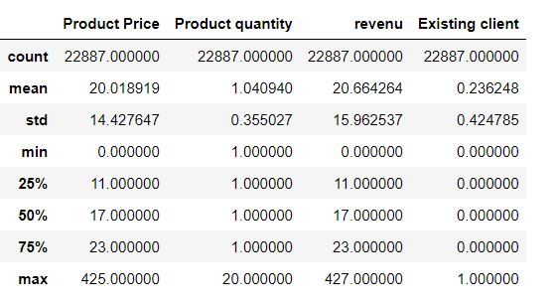
Revenue Evolution
Retrieved Sales events and sorted the dataset by Timestamp
Created Revenue feature
Grouped the result by Date1
Notes:
Mattéo

Slide 8
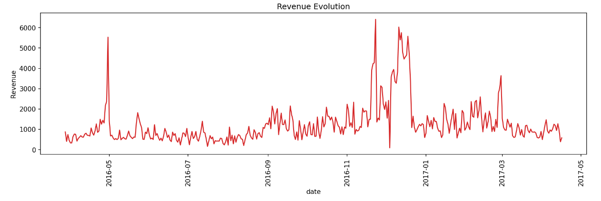
Revenue Evolution
Periodic Evolution
Highest Revenue months : November/December
Highest peaks around Christmas/Black Friday/New Year/Spring Holiday Period
For September, peaks due to the launch of the android application
Peaks for Valentine’s Day
Highest revenues around 5500 euros
Big Fall before the beginning of December offers

Slide 9
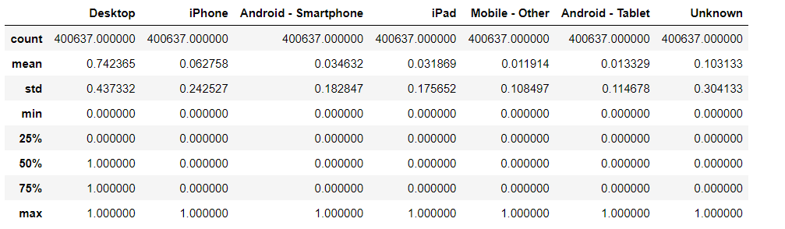
Shoppers Devices Analysis
Retrieved Timestamp, Date, Date 1 and Device type from the dataset
One Hot Encoding for Device type feature
Grouped the result by Date1 to count devices used by shoppers.
Created Percentage feature per device
Notes:
Raphael

Slide 10
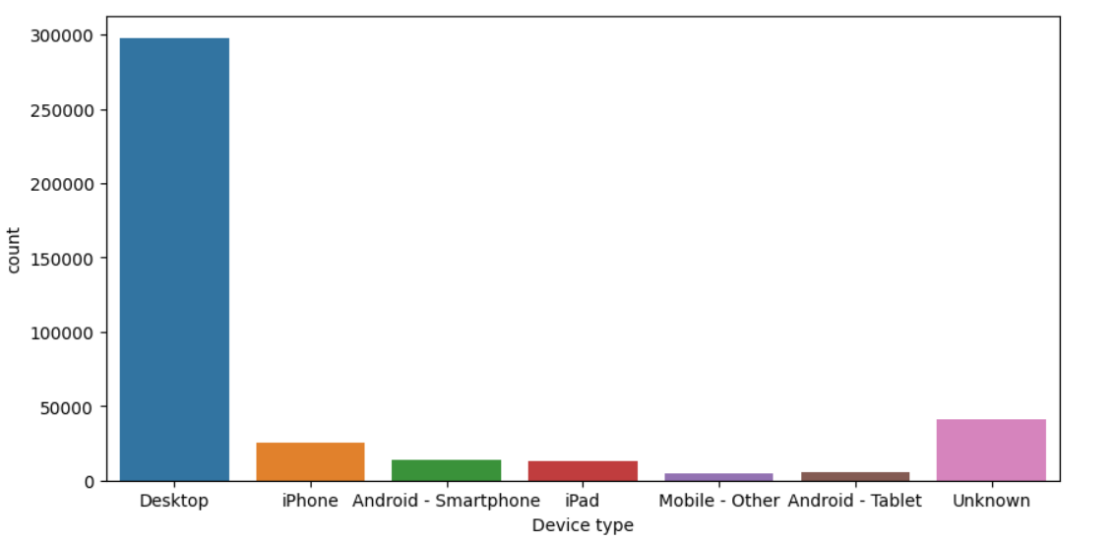

Slide 11
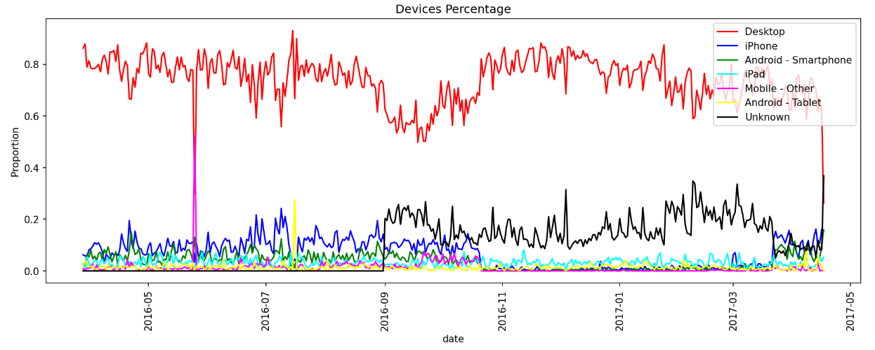
Desktop dominant device
Android Application launch around september
Android users moved from web browsing to application
Big Fall for iPhone after the application launch then resurrection around april 2017
Notes:
Ayoub

Slide 12
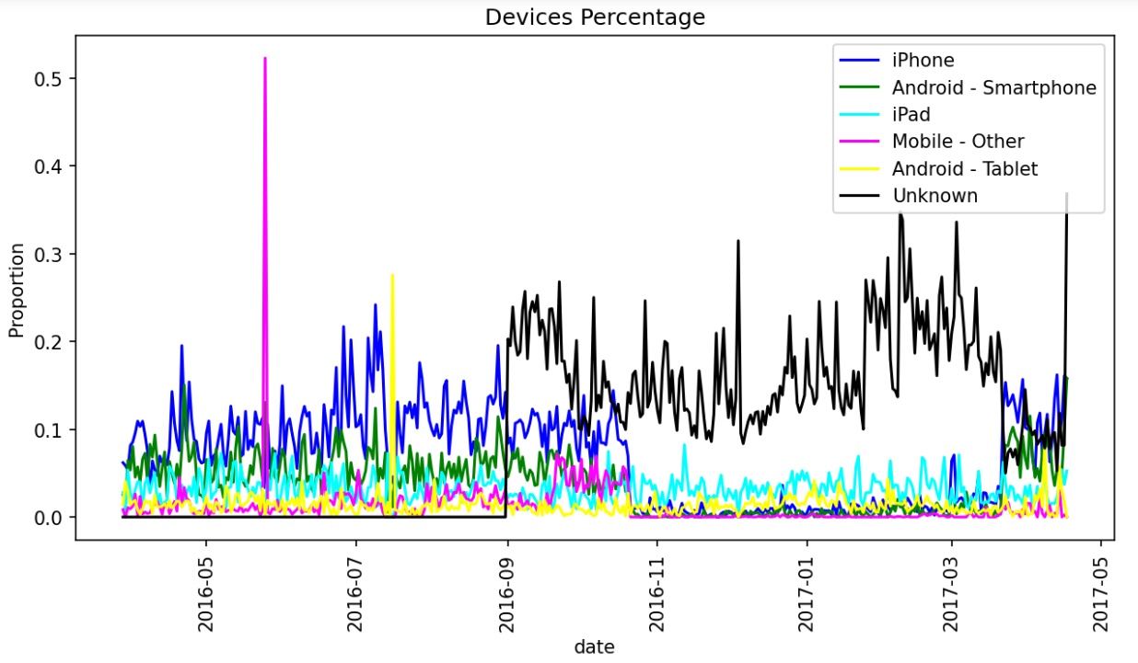

Slide 13
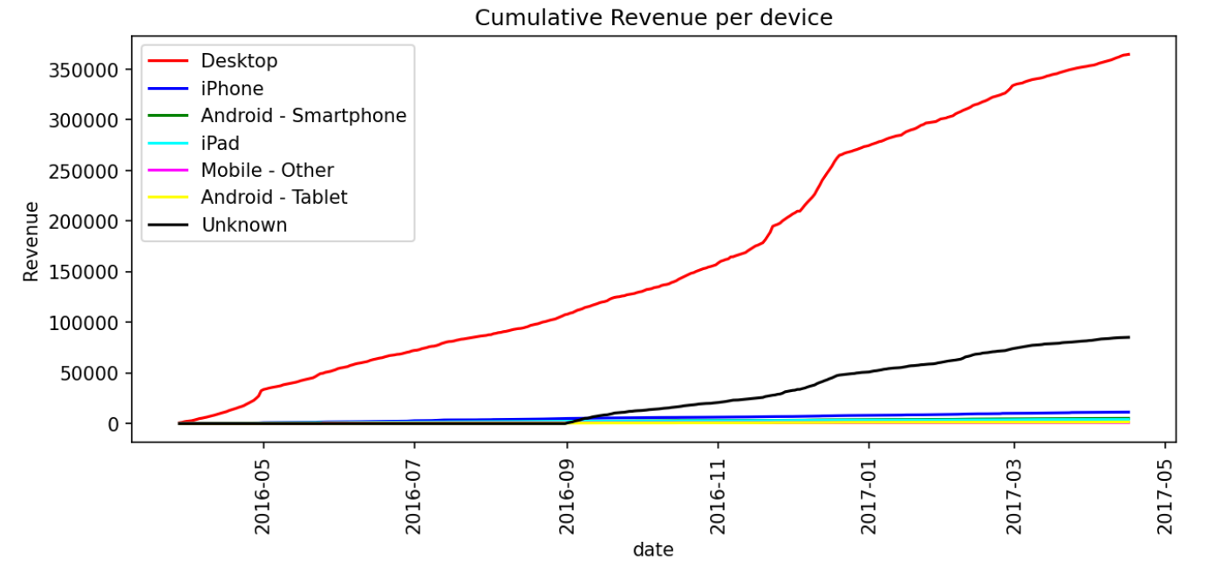

Slide 14

Applications vs Mobile Web Browsing

Slide 15
Data Extraction and KPIs
Mobile Web Users Extraction :
Environment : Web
Device type : iPhone , Android smartphone and tablets, iPad, Mobile Other
Applications Users :
Environment : App_Android
Created functions to extract Applications Users and Mobile Web Users
Calculated revenues for each type
How do we define KPIs ?
Notes:
Molka

Slide 16
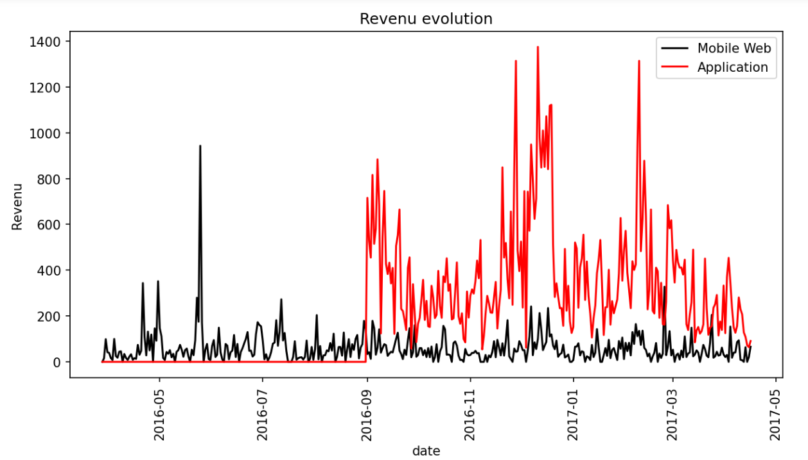
KPI : Revenue
Android Application launch around september
Better revenues for app_android since the launch
Notes:
Ayoub

Slide 17
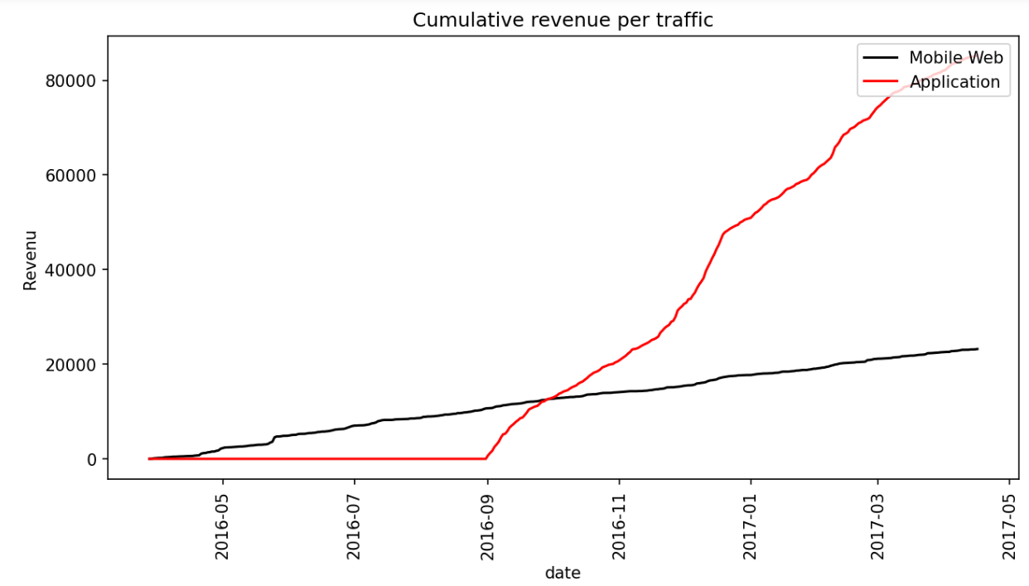
Is it a fair way to judge performance ?

Slide 18
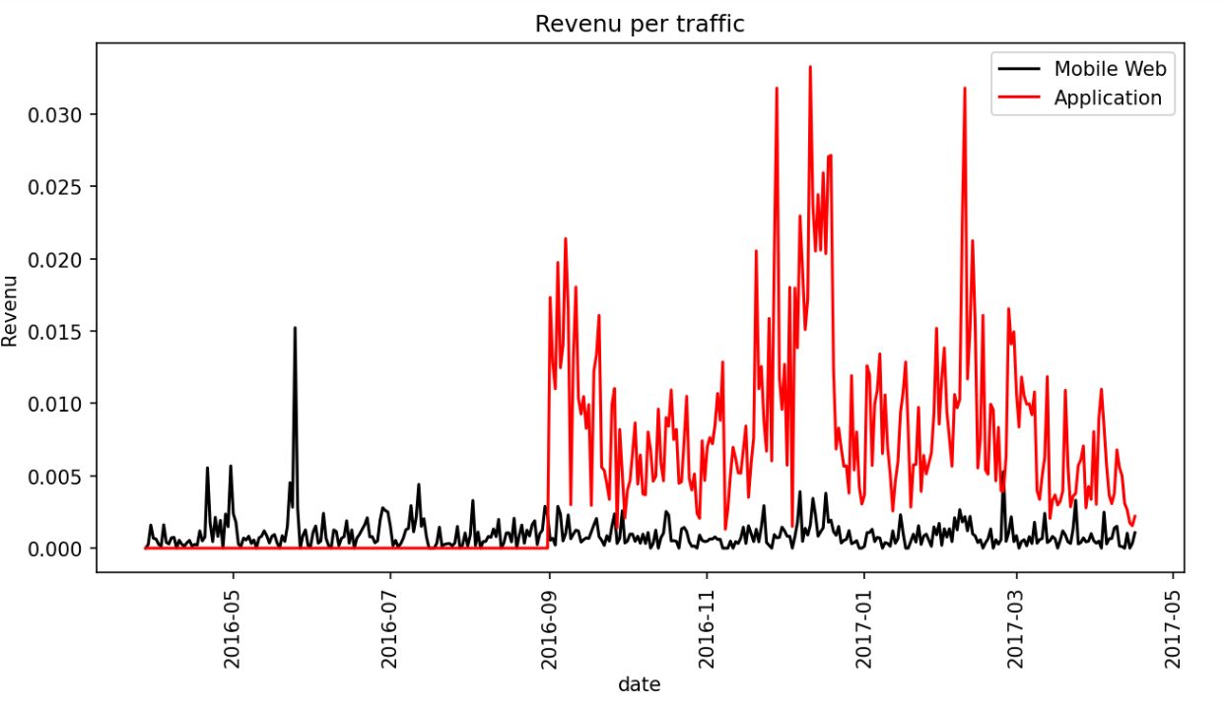
KPI : Revenue per traffic
Better performance for app_android since the launch
Notes:
Ayoub

Slide 19
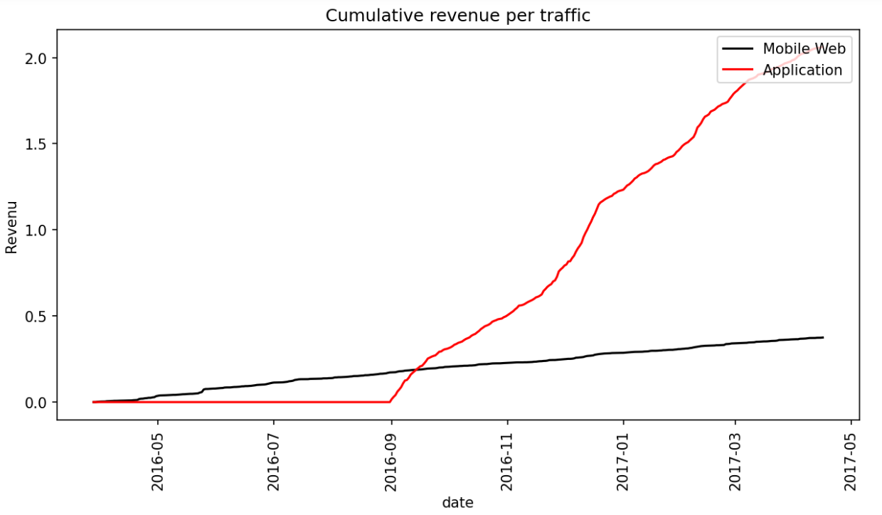
254 sales made by existing clients on Mobile Web
38/313 android clients still use Mobile Web → Promote Android application

Slide 20
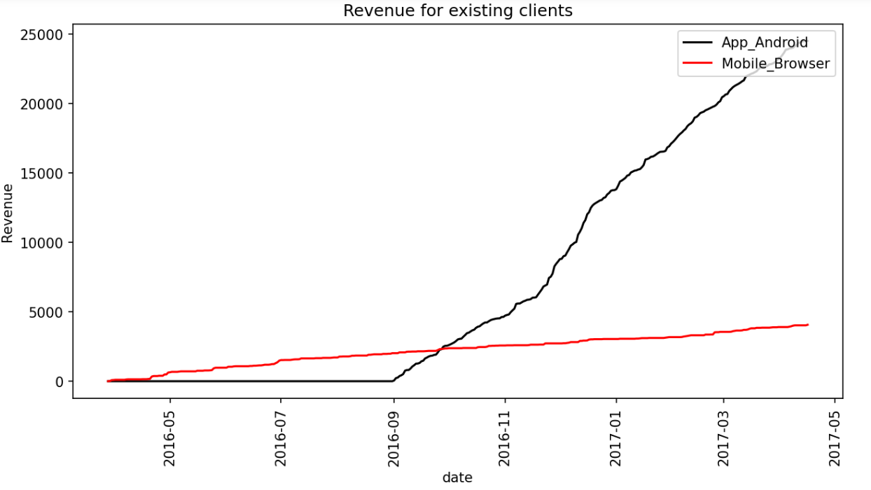
118/163 (72%) Mobile Users are from iOs
→ Create and Promote App IOS for iOS Existing clients

Slide 21
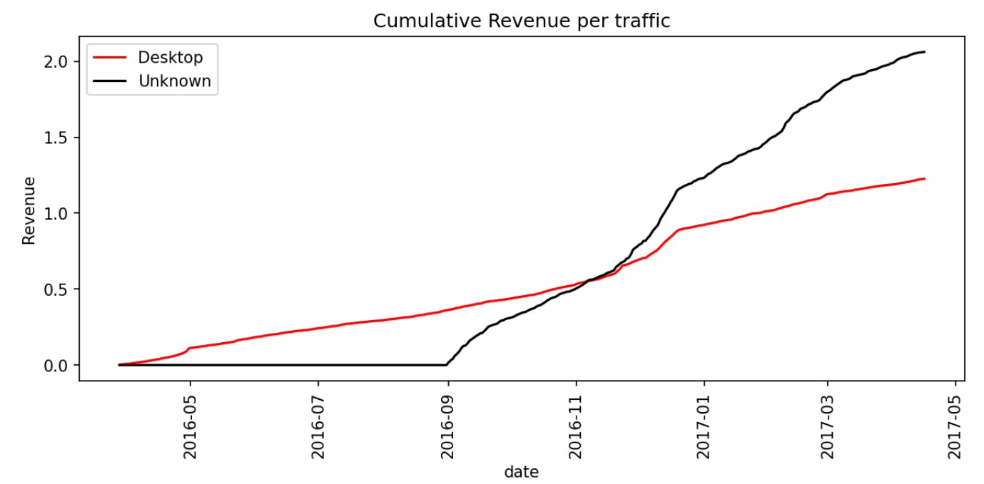

Slide 22
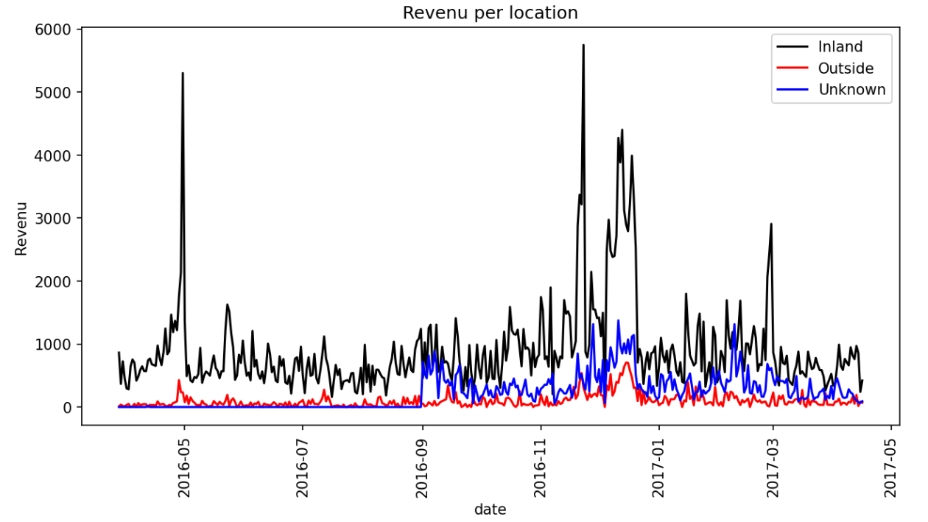

Revenue Evolution
Location Impact
Unknown are mostly App_Android Users (Localisation Permission).
Inland revenues are higher → Ads target Inland users
Let’s see the cumulative revenues

Slide 23
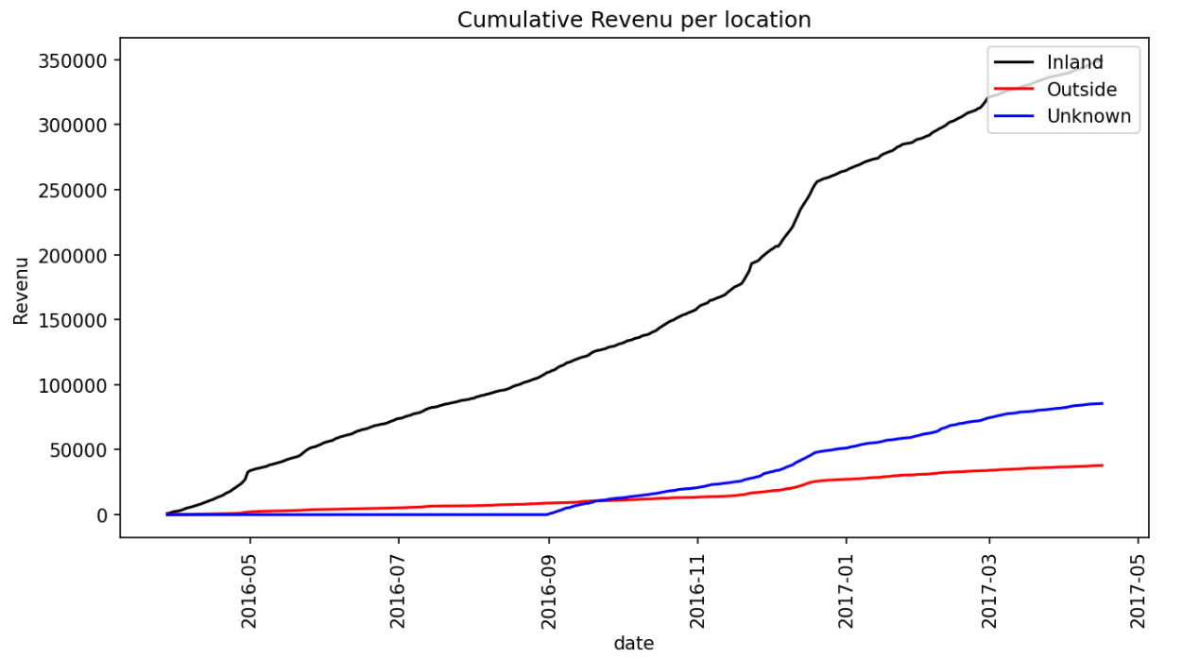
Same comments and suggestions

Slide 24
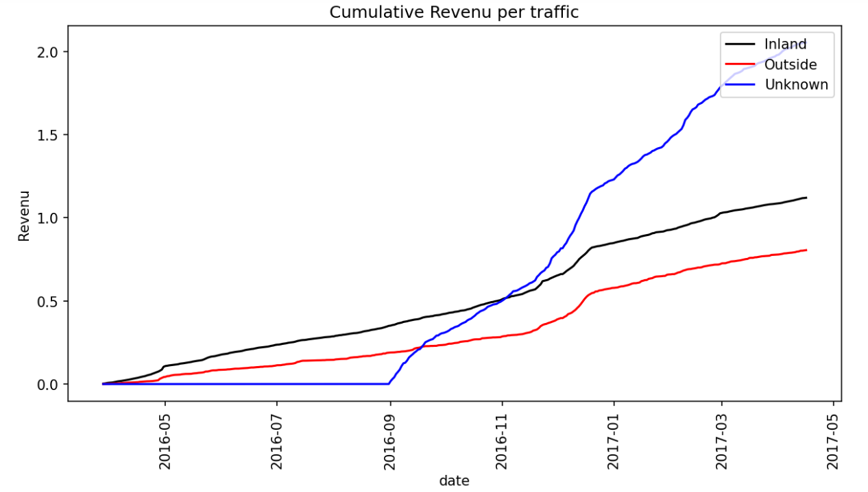
Unknown Revenues are higher (App_android performance)
Inland perform better

Slide 25
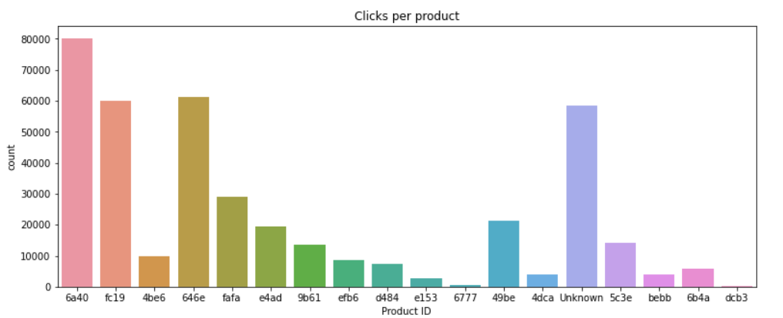
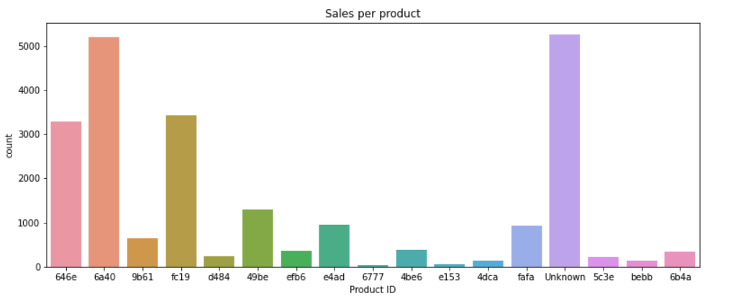
Product Section
6a40 , 646e, fc19 and Unknown category are the most viewed.
Most bought ones
646e is a package, 6a40 a small item, fc19 a medium item
Notes:
Ayoub

Slide 26
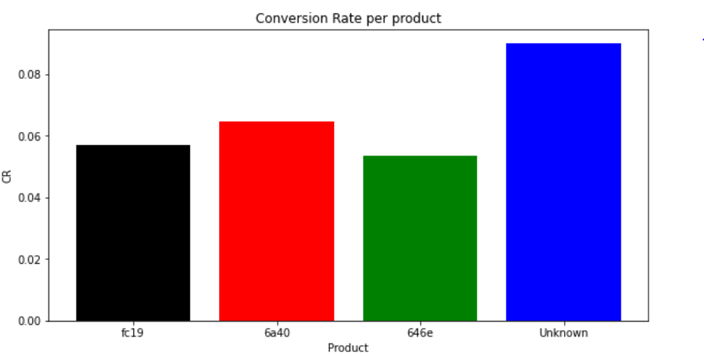

Slide 27
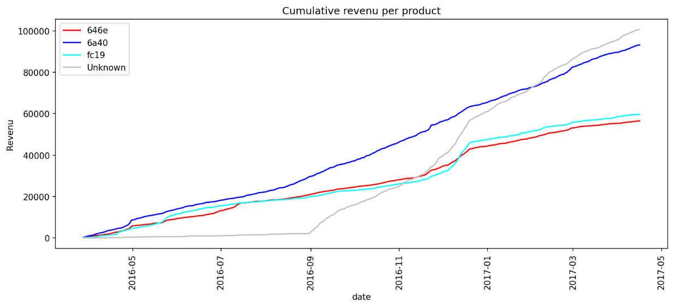

Slide 28
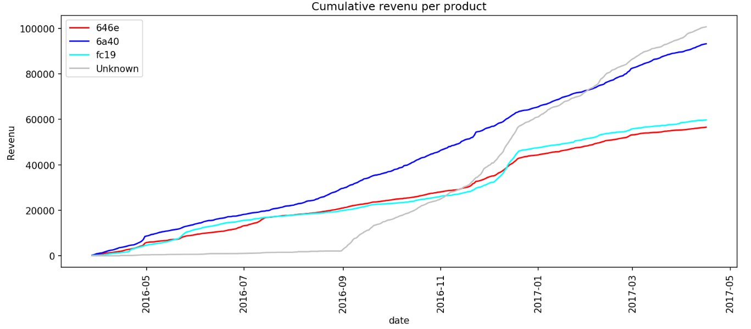
Unknown Revenues are higher due mainly to a classification problem in the android application

Slide 29
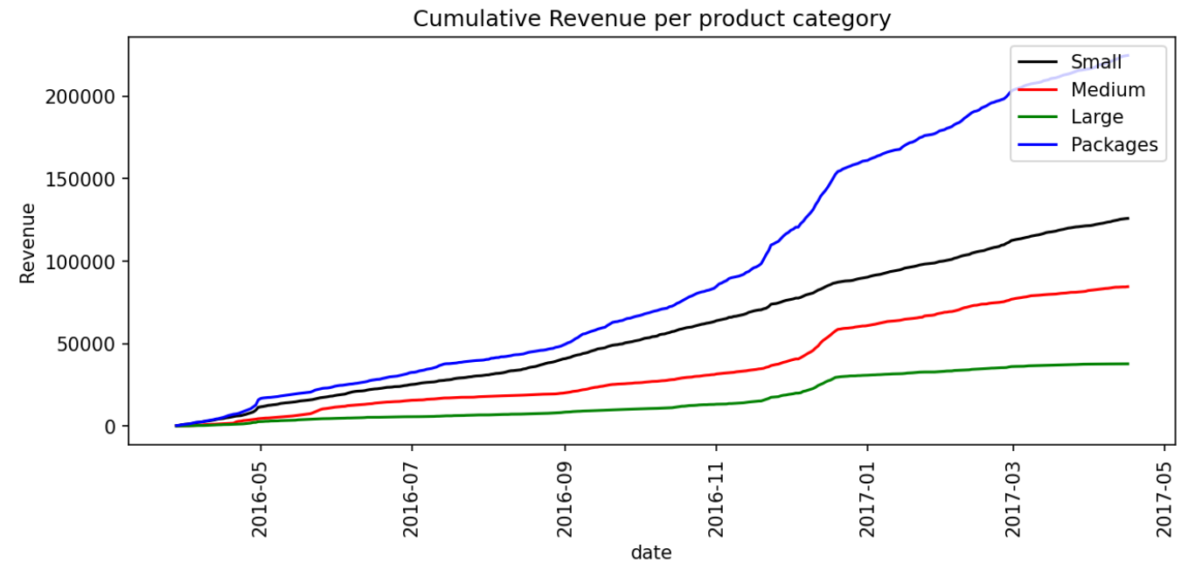
Product categories
Packages are the most viewed products
Small Items are the most bought ones/Large Items the least bought ones
Packages revenues are high
→ Regroup Small Items and Large Items into packages for example
Notes:
Raph

Slide 30
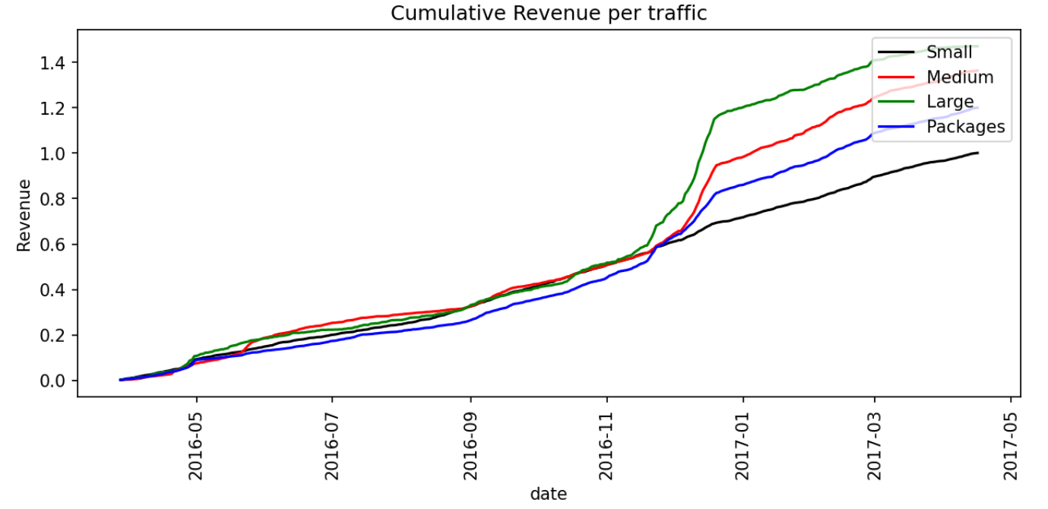

Slide 31
Conclusion

Slide 32
Conclusion and Recommendations
3 main high sales period : we should carry out more ads campagn during these periods.
Desktop remains the dominant device.
Since its launch, Android application performed better than mobile web browsing.
→We should redirect our android existing client to android app usage.
The remaining mobile web browser are mainly from IOS.
→We recommend to create an IOS app dedicated for IOS user.
Revenue from Inland traffic higher than the outside one. Our ads campagn should take this into consideration.
4 Product ID highest in term of sales, among them unknown ID product
→ Needs to be precised for a better ad campagn, and also solve the application problem.
Package generates more revenue. Large Items are the least bought ones.
→ We need to present more offer on them by regrouping them into packages with other categories

