Slide 1



The Last Mile Logistics Auditor
Auditing Delivery Performance & Customer Experience to Drive Operational Excellence
Project: Delivery Performance Analysis Prepared for: Veridi Logistics Strategic Review
Presented By : NIYIGENA Abdoul Razak
“Scan QR Code”
To access all files

Slide 2



VERIDI LOGISTICS FACES A CRITICAL TRUST DEFICIT
The Current Crisis
The CEO's Hypothesis
Veridi Logistics is experiencing a significant surge in negative customer reviews and declining satisfaction scores. The marketplace ecosystem is threatened by a growing wave of consumer dissatisfaction.
The issue extends beyond simple delays; it is driven by a systemic failure in delivery promises—over-promising and under-delivering. The gap between expectation and reality is the true problem.
Are delivery failures isolated regional anomalies or indicative of a widespread breakdown?
Customer sentiment is at an all-time low, primarily driven by logistics failures.

Slide 3




OBJECTIVE: LINKING LOGISTICS DATA TO CUSTOMER SENTIMENT
AUDIT PERFORMANCE
IDENTIFY ROOT CAUSE
RESTORE TRUST
Conduct a comprehensive audit of delivery performance to identify systemic failures across the network.
Link granular logistics timelines with customer review scores to quantify the impact of operational failures.
Provide data-driven recommendations to stabilize the delivery network and restore customer confidence.
The ultimate goal is to bridge the gap between operational performance and customer expectations.

Slide 4






DATA OVERVIEW: THE OLIST E-COMMERCE ECOSYSTEM
Primary Source
Orders
Reviews
Detailed delivery timelines including estimated vs. actual dates for 99,992 unique orders.
Direct customer sentiment and rating scores linked to specific logistics outcomes.
Analysis is based on the Olist E-Commerce Dataset, a comprehensive record of a major Brazilian marketplace. This data provides a holistic view of the customer journey from order to delivery and review.
Customers
Products
Geographic location data enabling regional performance tracking and state-level auditing.
Category-specific handling requirements and performance metrics across the marketplace.
TOTAL AUDIT SCOPE: 99,992 UNIQUE MARKETPLACE ORDERS

Slide 5

DATA ENGINEERING: BUILDING THE UNIFIED AUDIT SCHEMA
STAGE 01
STAGE 02
STAGE 03
Multi-Source Ingestion
Relational Joining
Integrity Validation
Extracted raw data from four primary tables: Orders, Reviews, Customers, and Products. This multi-dimensional approach ensures a 360-degree view of the delivery lifecycle.
Datasets were joined into a master audit table using unique order_id and customer_id keys. This process linked logistics timelines directly with customer sentiment scores.
Rigorous cleaning was performed to remove duplicate order IDs and handle missing delivery dates, ensuring the final dataset is statistically sound and reliable.
99,992
UNIQUE ORDERS IN MASTER SCHEMA

Slide 6

DEFINING THE METRIC: THE "DELIVERY DELAY" FRAMEWORK
Days Difference = Estimated Delivery Date — Actual Delivery Date
On Time
Late
Super Late
PERFORMANCE TIER 01
PERFORMANCE TIER 02
PERFORMANCE TIER 03
Orders delivered on or before the promised date. This represents the baseline for customer satisfaction and operational success.
Orders delivered after the promised date, with a delay of up to 5 days. These represent minor inconveniences that begin to erode trust.
Orders delivered more than 5 days after the promised date. These are critical service failures that drive the majority of negative sentiment.
*This framework allows for the distinction between minor operational friction and systemic service breakdowns.

Slide 7

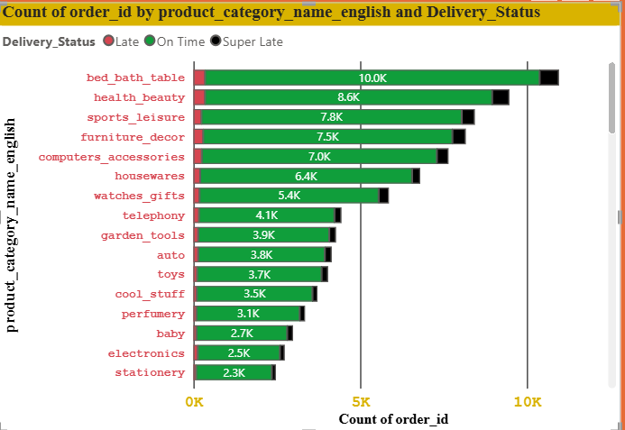
GEOGRAPHIC ANALYSIS: IDENTIFYING REGIONAL HOTSPOTS
Regional Disparities
Delivery performance is not uniform across Brazil. Northern and Northeastern states exhibit significantly higher failure rates.
Critical Failure Point
Alagoas (AL) leads with a 23.9% late delivery rate, followed by Maranhão (MA) at 19.7%. These regions require immediate logistics partner audits.

Slide 8

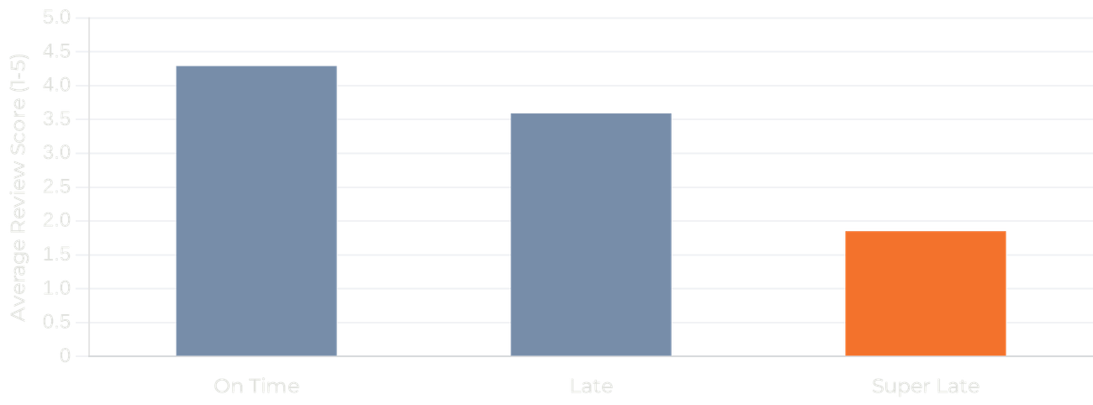
THE SENTIMENT LINK: DELAYS DIRECTLY CORRELATE TO RATINGS
The Satisfaction Gradient
Satisfaction stays high (4.29) for on-time deliveries but drops quickly with any delay - even slight lateness moves scores to 3.59.
The "Point of No Return"
"Super Late" orders (>5 days) are a critical failure: review scores fall to 1.85, signaling lost trust.
Strategic Impact
These extreme negatives drive most 1-star reviews and disproportionately harm brand reputation.

Slide 9

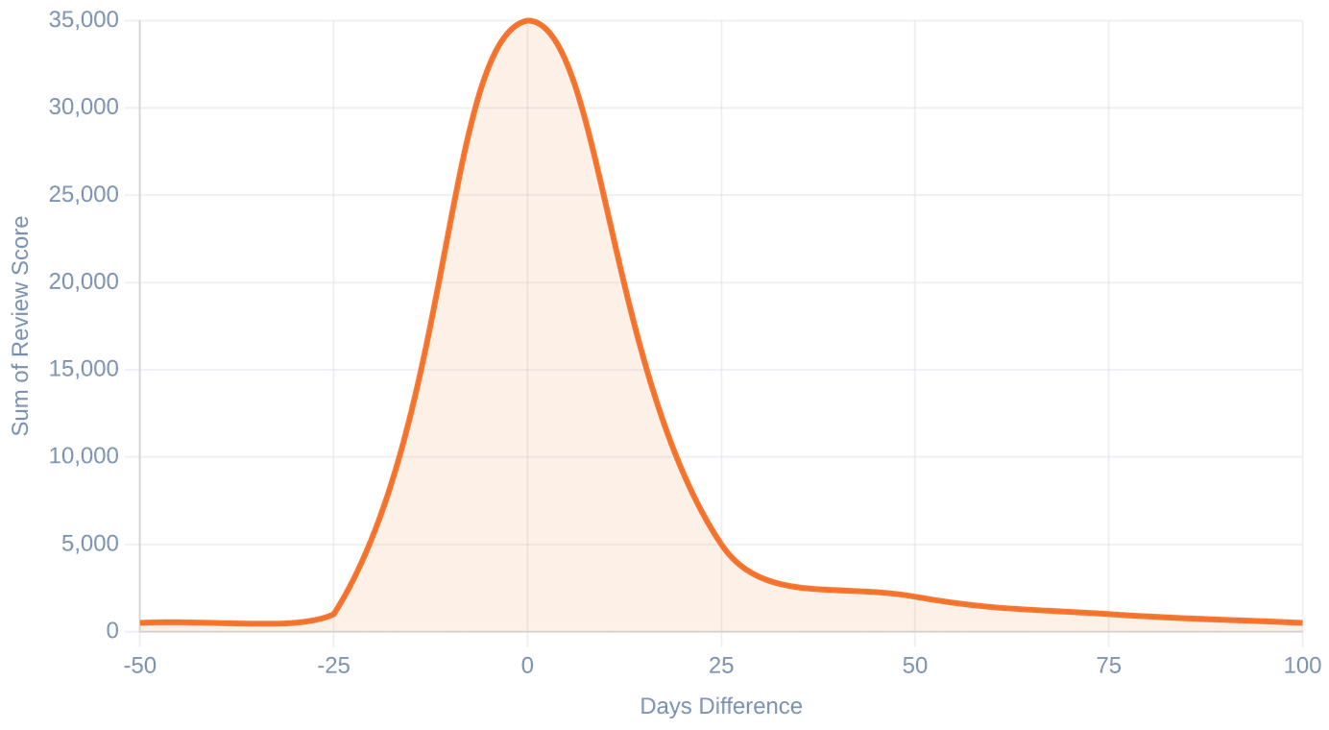
DASHBOARD INSIGHTS: DELIVERY DYNAMICS
NETWORK AVERAGE
Review Score Distribution by Days Difference
4.08
Overall customer satisfaction remains high but is sensitive to delivery accuracy.
PEAK PERFORMANCE
0 Days
Most of the positive sentiment is concentrated at the zero-day difference (On-Time delivery).
THE LONG TAIL
Super Late
Sentiment decays rapidly as the 'Days Difference' moves into the negative (late) zone.

Slide 10

ROOT CAUSE: UNRELIABLE ESTIMATES DRIVE DISSATISFACTION
The primary issue is not just the delay itself, but the unreliability of delivery promises.
THE EXPECTATION GAP
OPERATIONAL FAILURE
Inaccurate Estimates
Model Inaccuracy
Customers receive unrealistic delivery dates that fail to account for regional complexities. This creates a psychological breach of contract even when actual delays are minor.
Current prediction models are too optimistic. They ignore the high-risk variables associated with specific product categories and underperforming geographic regions.

Slide 11




BUSINESS IMPACT: THE COST OF LOGISTICS FAILURE
EROSION OF TRUST
BRAND CONTAGION
ECOSYSTEM INSTABILITY
Inaccurate delivery promises erode the core value proposition of Veridi Logistics. When expectations are consistently missed, customer loyalty evaporates, leading to high churn rates.
A surge in negative reviews creates a "Brand Contagion" effect. Prospective buyers are discouraged by public 1-star ratings, increasing customer acquisition costs (CAC).
Chronic delivery failures risk losing high-quality sellers who fear for their own ratings. This destabilizes the entire marketplace ecosystem for both buyers and sellers.
PRIMARY RISK
PRIMARY RISK
PRIMARY RISK
Long-term decline in Customer Lifetime Value (CLV).
Systemic damage to marketplace reputation and growth.
Loss of competitive edge to more reliable logistics networks.

Slide 12





RECOMMENDATIONS: RESTORING DELIVERY INTEGRITY
PREDICTIVE ACCURACY
REALISTIC PROMISING
Revise delivery-time models with regional and category inputs to produce dynamic, data-driven forecasts.
Set more conservative EDDs and prioritize under-promise, over-deliver to manage expectations.
TARGET: 25% REDUCTION IN ESTIMATION ERROR
GOAL: INCREASE EDD RELIABILITY BY 40%
REGIONAL FOCUS
RISK MONITORING
Target high-risk states with partner audits and last-mile routing optimizations.
Add real-time monitoring and early warnings for high-risk categories to prevent "Super Late" orders.
FOCUS: TOP 5 UNDERPERFORMING STATES
IMPACT: MITIGATE 1-STAR REVIEW DRIVERS
Restoring trust requires operational precision and honest communication.

Slide 13

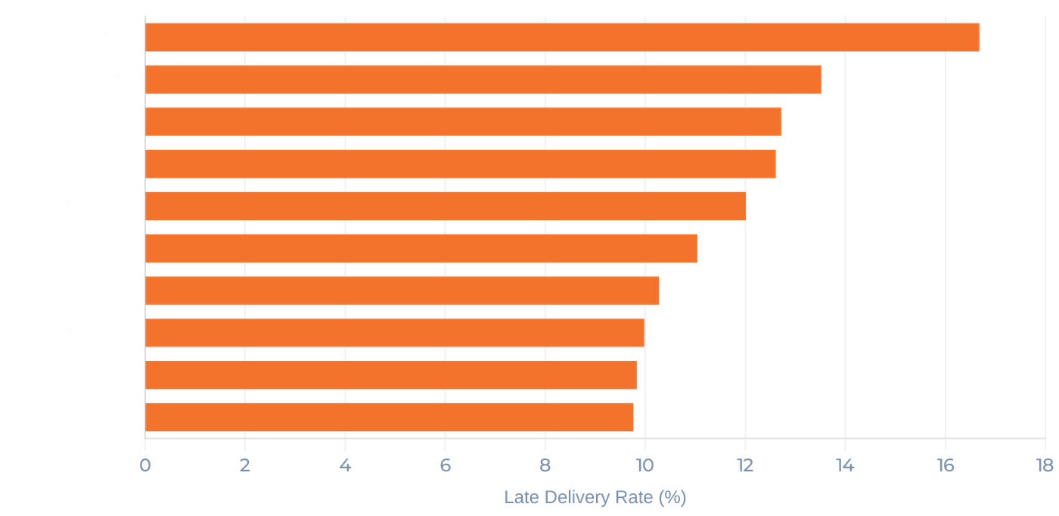
BONUS INSIGHT: CATEGORY IMPACT ON DELIVERY PERFORMANCE
Operational Complexity
Product category influences timelines; bulky items need specialized handling.
High-Risk Segments
Home Comfort and Furniture show the highest late rates (>13%).
Strategic Prioritization
Prioritize logistics for these categories to reduce customer impact.

Slide 14

Conclusion: Accuracy is the Key to Customer Experience
Systemic Expectation Gap: Delivery delays, combined with inaccurate expectations, are the primary drivers of Veridi Logistics' current trust crisis.
Operational Imperative: Fixing prediction accuracy and addressing regional logistics bottlenecks in high-risk states like AL and MA is non-negotiable.
Strategic Shift: Moving from optimistic to realistic promising will stabilize customer sentiment and protect long-term brand equity.
"In the last mile, a realistic promise is more valuable than an optimistic one."

