Slide 1



Blue Ocean Market Gap Analysis
Identifying High-Protein Low-Sugar Opportunities in the Global Food Market
Project: Business Analytics Strategy Prepared for: Strategic Growth Division
Presented by : NIYIGENA Abdoul Razak
“Scan QR Code“
To access All Files

Slide 2





THE MODERN FOOD MARKET FACES A "SUGAR TRAP"
The "Red Ocean" Reality
Our Strategic Goal
Market Saturation
Blue Ocean Identification
The contemporary snack market is flooded with high-sugar, low-protein products. Most accessible consumer goods prioritize flavor and shelf-life over nutritional density.
Identify underserved "Blue Ocean" segments—areas where high-protein and low-sugar products can thrive without the intense competition of traditional snack categories.
Health Implications
Data-Driven Growth
Saturated markets contribute to poor health outcomes. There is a structural mismatch between consumer health trends and available product nutritional profiles.
Utilize global food data to map nutritional gaps and pinpoint specific categories ripe for innovation and healthy product development.

Slide 3


LEVERAGING THE OPEN FOOD FACTS GLOBAL DATABASE
Primary Source: Open Food Facts
Data was extracted from the Open Food Facts dataset, a collaborative global database of food products. Unfortunately to extracting > 50,000 rows for me, it was challenge Because Google Colab keep crashing in the extracting Process.
10,000
Global
INITIAL PRODUCT SUBSET
GEOGRAPHIC COVERAGE

Slide 4

RIGOROUS DATA CLEANING ENSURES ANALYTICAL INTEGRITY
PHASE 01
PHASE 02
PHASE 03
Initial Filtration
Standardization
Anomaly Detection
Started with a raw subset of 10,000 product entries from the Open Food Facts database. Removed all records with missing protein or sugar values to ensure a complete nutritional profile for every data point.
Converted all nutritional metrics into standardized numeric formats. Applied rigorous type conversion to handle inconsistent data entries and localized decimal variations across the global dataset.
Filtered out unrealistic values (e.g., nutritional content exceeding 100g per 100g). This step eliminated data entry errors that would otherwise skew the statistical percentiles.
3,050
REFINED VALID PRODUCTS

Slide 5


METHODOLOGY: DEFINING THE "BLUE OCEAN" SEGMENT
HIGH PROTEIN THRESHOLD
LOW SUGAR THRESHOLD
> 18.56g
< 1.0g
Per 100g of product
Per 100g of product
This value represents the 75th percentile of the analyzed dataset, ensuring the segment targets the top tier of protein density.
This value represents the 25th percentile, identifying products with minimal added or natural sugars for a healthy profile.
Analysis includes category grouping: Meat, Snacks, Protein Products, Dairy, and Seafood.

Slide 6

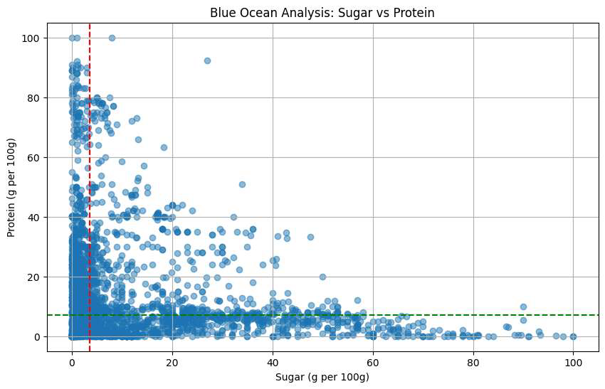
VISUALIZING THE GAP: PROTEINS VS. SUGAR DISTRIBUTION
Correlation Analysis
The data reveals a clear inverse relationship: as sugar content increases, protein density typically drops, leaving the top-left quadrant underserved.
Market Structural Gap
The density of products in the bottom-right highlights a saturated market competing on sugar-driven palatability rather than nutritional value.
Blue Ocean Segment
Market Saturation (Red Ocean)

Slide 7


DASHBOARD INSIGHTS: THE BLUE OCEAN BY THE NUMBERS
TOTAL BLUE OCEAN PRODUCTS
AVERAGE OF PROTEINS
AVERAGE OF SUGARS
252
13.78g
0.46g
Specific product count meeting the strict high-protein (>18g) and low-sugar (<1g) criteria.
Mean protein content across the validated dataset, indicating a lean towards nutritional density.
Extremely low average sugar content, confirming the "Blue Ocean" status of these products.
VERIFIED METRICS: Analysis conducted using refined dataset from the Sugar Trap Market Gap Dashboard.

Slide 8

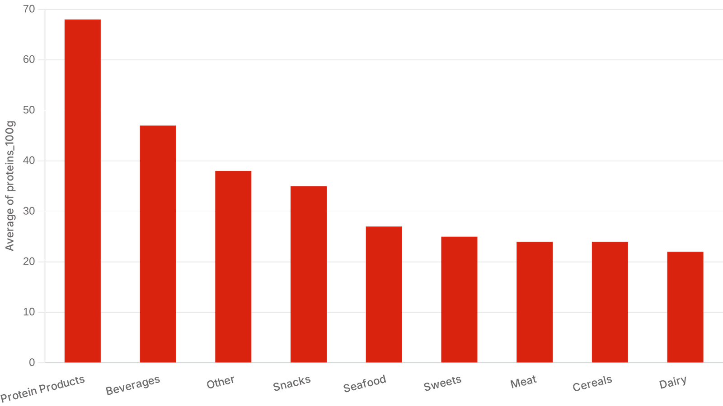
CATEGORY PROFILE: AVERAGE PROTEIN CONTENT BY SEGMENT
Protein Leadership
Specialized Protein Products lead with an average of ~68g per 100g, setting the benchmark for nutritional density in the market.
Emerging Categories
Beverages and Snacks show significant protein potential, but currently lack the low-sugar profiles required for the Blue Ocean segment.

Slide 9

THE BIGGEST OPPORTUNITY LIES IN FUNCTIONAL HEALTHY SNACKS
While meat products naturally fulfill high-protein criteria, there is a massive void in the functional snack category.
CURRENT MARKET DOMINANCE
STRATEGIC GAP
Savory & Specialized
On-the-Go Nutrition
High-protein, low-sugar profiles are currently synonymous with Meat Products and Specialized Supplements. These categories are reaching saturation with established players.
Consumer demand for "healthy snacks" is rising, yet only 9 products in our dataset meet the Blue Ocean criteria. This represents the most viable path for mass-market innovation.

Slide 10



STRATEGIC RECOMMENDATIONS FOR PRODUCT DEVELOPMENT
Functional Food Innovation
Healthy Snack Transformation
Develop high-protein, low-sugar functional foods that bridge the gap between specialized medical supplements and everyday consumer snacks. Focus on nutrient density without compromising on taste profiles.
Innovate within the snack category to replicate the nutritional density of meat-based products. Target "on-the-go" formats that offer >18g protein and <1g sugar per serving.
STRATEGIC VALUE
STRATEGIC VALUE
Establish brand authority in the emerging "Health-First" consumer segment.
Capture market share in the underrepresented high-protein snack Blue Ocean.

Slide 11

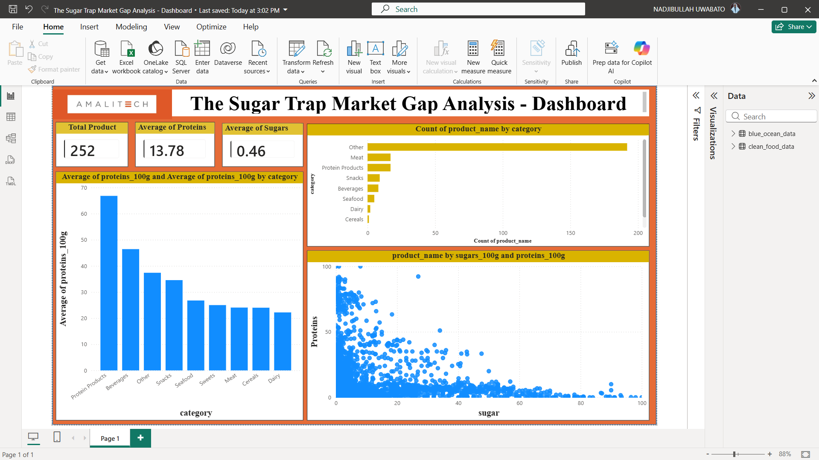
CONCLUSION: DATA-DRIVEN INNOVATION IS THE PATH FORWARD
The "Sugar Trap" is a real market phenomenon, leaving a clear opening for high-protein innovation in the global food landscape.
Validated Market Gap
Data confirms that only 8% of products meet the high-protein, low-sugar criteria, primarily in meat and supplements.
Strategic Opportunity
The functional snack category remains the most viable "Blue Ocean" for new product development.
Competitive Advantage
Early movers can establish brand authority by bridging the gap between health and convenience.
MOVE BEYOND THE RED OCEAN. LEAD THE HEALTHY REVOLUTION.

