Slide 1
Build a RAG Assistant
Answers grounded in your documents
Abdourahman H. Mawlid · Decidata
Hacktoberfest Montréal × AGEEI · 9 October 2026
Notes:
SLIDE 1 - Build a RAG Assistant
TIME: 1 min
SAY
Today we will turn a PDF into an assistant that can answer questions and show its evidence. We will follow one document through the whole process. For each stage, I will explain what it does, why we chose this approach, and what to look for in the application. By the end, you should be able to explain where an answer came from and identify which part of the process to improve.
DO
Show the cover. Keep the application and PDF ready in separate windows. Present in English. Keep the document questions and answers in French.
TRANSITION
Here is how we will work together.
SOURCES
Workshop project README.md.

Slide 2


Abdourahman H. Mawlid
Senior Data Engineer
Founder, Decidata
Polytechnique Montréal
52 min of explanation and practice
8 min of questions
Notes:
SLIDE 2 - Abdourahman H. Mawlid
TIME: 1 min
SAY
I am Abdourahman H. Mawlid, Senior Data Engineer and founder of Decidata. This is a guided workshop. We will alternate between a short explanation and an action in the project. The environment and model endpoints should already be configured. We will spend about fifty-two minutes exploring and practicing, then leave eight minutes for your questions.
DO
Introduce yourself briefly. Explain that participants will use Streamlit and the repository, with no notebook required.
TRANSITION
Let us begin with the kind of information we want to query.
SOURCES
Original speaker slide.

Slide 3
Traditional databases
Structured facts: customers, orders, inventory
Application
SQL / API
Database
Records
& totals
Transactions · stock checks · monthly reporting
“How many orders shipped today?”
The database remains the system of record.
Notes:
SLIDE 3 - Traditional databases
TIME: 1 min
SAY
When information already has a clear structure, a database query is a natural tool. For example, an orders table can tell us how many orders shipped today. Our example today is a privacy policy written in paragraphs. The answer is in the document, but we first need to find the right passage. That is the problem retrieval helps us solve.
DO
Use the orders example briefly. Ask participants to think of a document they regularly search.
TRANSITION
A language model can explain a passage once we give it the relevant text.
SOURCES
Original concept slide.

Slide 4
Why an LLM needs retrieval
A large language model (LLM) can write fluently,
yet miss private documents and recent updates.
Your documents
Question
Retrieval
LLM
+ context
Answer
+ sources
RAG = Retrieval-Augmented Generation
Freshness depends on keeping the source up to date.
Notes:
SLIDE 4 - Why an LLM needs retrieval
TIME: 2 min
SAY
RAG means retrieval-augmented generation. Retrieval finds useful evidence in our documents. Generation uses that evidence to compose an answer. The application sends the question and selected passages to the model. This lets us work with a document without training the model on it. The answer still needs checking because either the search or the generation can make a mistake.
DO
Follow the existing diagram. Ask: where does the information from our PDF enter the process?
TRANSITION
The full workflow has a preparation path and a question path.
SOURCES
rag/pipeline.py
rag/application.py

Slide 5
The RAG pipeline
PREPARE
Documents
Read, clean
+ chunk
Create
vectors
Store in
vector DB
ASK
Question
vector
Find similar
passages
Passages
+ question
LLM answer
+ citations
Indexing imports passages + vectors + page references
Prepare once for the document.
Retrieve and answer for every question.
Notes:
SLIDE 5 - The RAG pipeline
TIME: 3 min
SAY
The top row prepares the document. We read and split it, turn each passage into a vector, and import the passages, vectors and page references into a vector database. That final import is what indexing means in this workshop. A vector is a list of numbers that helps us compare texts by meaning. The bottom row runs for each question. We embed the question, search the stored vectors, and send the retrieved text to the language model. The document vectors can be reused across many questions.
DO
Point to the vector database. Distinguish storage from generation. Ask participants which row runs once for a prepared document and which row runs for every new question.
TRANSITION
Each stage has several possible strategies. Here are the choices we will use today.
SOURCES
rag/corpus.py
rag/chunking.py
rag/pipeline.py
rag/vector_store.py

Slide 6
Choices at each RAG step
Step | Today | Other options
Read | Text + light cleaning | OCR, layout parsing
Chunk | Word windows + overlap | Paragraphs, sections
Embed | Dense multilingual | English-only, domain-tuned
Store | Persistent local Chroma | Managed store, SQL vectors
Retrieve | Cosine similarity, top 3 | Keywords, hybrid search
Answer | Context + citations | Extractive, structured
Check | Source + missing fact | Larger test set, reviewers
06 / 21
Notes:
SLIDE 6 - Choices at each RAG step
TIME: 3 min
SAY
There is no single best configuration for every document. A scan needs OCR, while our PDF already contains text. Chunks can follow a fixed length, paragraphs or document sections. Embeddings should suit the language and subject. Storage can be local or shared. Retrieval can use meaning, exact words, or a combination. Generation can write a cited answer, extract a quotation, or return a fixed structure. We will use the middle column and explain the reason as we reach each stage. These are options we can combine, not exclusive categories.
DO
Spend no more than three minutes on this map. Point to the chosen column. Do not explain every alternative in depth yet.
TRANSITION
First, let us get the same project onto each computer.
SOURCES
Workshop implementation choices.
https://pypdf.readthedocs.io/en/stable/user/extract-text.html
https://huggingface.co/google/embeddinggemma-300m
https://docs.trychroma.com/docs/overview/introduction

Slide 7
Getting the project from GitHub
Before the session: Git + Python 3.12 or 3.13
WINDOWS POWERSHELL
git clone `
https://github.com/Abdourahmandev/RAG_assistant_workshop.git
cd RAG_assistant_workshop
Next: follow README.md to install and configure .env.
Enter your endpoint URLs and token privately.
07 / 21
Notes:
SLIDE 7 - Getting the project from GitHub
TIME: 2 min
SAY
The workshop project is available on GitHub. Before the session, install Git and Python 3.12 or 3.13. Open PowerShell in the folder where you keep your projects. Run git clone with this repository URL, then change into RAG_assistant_workshop. Cloning downloads the code, sample PDF and presentation materials. Follow the README to create the virtual environment and install the dependencies. Copy .env.example to .env and enter your authorized Hugging Face endpoint URLs and token privately. Then start Streamlit using the command in the README. The first processing run creates the embeddings and local database on your computer, so allow time for preparation before the live exercises.
DO
Show the GitHub repository. In PowerShell, demonstrate the clone and cd commands, or show the already cloned folder. Open README.md and point to Windows PowerShell setup. Complete installation before the session. Keep .env closed when presenting. Start Streamlit after configuration.
LOOK FOR
The cloned folder contains app.py, streamlit_app.py, rag/, tests/, the PDF and the workshop materials. Each participant configures .env privately and prepares their own index.
TRANSITION
Now let us locate each RAG responsibility in the cloned project.
SOURCES
https://github.com/Abdourahmandev/RAG_assistant_workshop
README.md
.env.example

Slide 8
The repository at a glance
RAG_assistant_workshop/
Our project
A-6.002.pdf
Source document
streamlit_app.py
The interface we use today
app.py
Terminal alternative
rag/
Shared RAG steps
corpus.py / chunking.py
Read and split
pipeline.py
Embed and retrieve
vector_store.py
Import and search
base_vectorielle/
Saved vector database
Open the project folder. Follow the PDF into rag/.
08 / 21
Notes:
SLIDE 8 - The repository at a glance
TIME: 2 min
SAY
The source PDF is our input. streamlit_app.py is the interface we will use during the workshop. app.py is a terminal alternative. The rag folder contains the shared pipeline, so both interfaces use the same logic. Inside it, corpus reads the document, chunking splits it, pipeline coordinates embedding and retrieval, and vector_store handles storage and search. The local database folder appears after preparation. You only need to recognize these responsibilities today, not read every function.
DO
Open the project folder in the editor. Expand rag/. Point to the PDF, streamlit_app.py and the pipeline modules. Keep .env closed. Then switch to the running Streamlit application.
TRANSITION
Some parts run on this laptop, while the models run on Hugging Face.
SOURCES
Project file inventory.

Slide 9
Two models hosted on Hugging Face
HUGGING FACE INFERENCE ENDPOINTS
EmbeddingGemma 300M
Qwen3 1.7B
Turns text into vectors
for semantic search
Writes an answer using
the retrieved passages
ON THE LAPTOP
PDF reader, Streamlit app and Chroma vector database
09 / 21
Notes:
SLIDE 9 - Two models hosted on Hugging Face
TIME: 2 min
SAY
Both models in this project run on Hugging Face Inference Endpoints. EmbeddingGemma turns document passages and questions into vectors. Qwen writes the final answer using retrieved text. The PDF reader, Streamlit interface and Chroma database run on the laptop. This setup avoids requiring a local GPU for the workshop. A local deployment is another choice when hardware or data constraints call for it. Today, inference requires an internet connection and sends the necessary text to our configured endpoints.
DO
Point to each model and ask which one finds related text and which one writes. If showing the Hugging Face dashboard, show model names and status only. Do not show credentials or spend workshop time creating deployments.
TRANSITION
Our first practical step is to look at the document itself.
SOURCES
https://huggingface.co/google/embeddinggemma-300m
https://huggingface.co/Qwen/Qwen3-1.7B
https://huggingface.co/docs/inference-endpoints/index
rag/config.py

Slide 10

1. Reading the source document
Text extraction + light cleaning
18 pages in French
Why: the PDF already
contains selectable text.
Keep the page references.
IN THE APP
Open the PDF, then select it in Streamlit.
10 / 21
Notes:
SLIDE 10 - 1. Reading the source document
TIME: 3 min
OUR STRATEGY AND REASON
Text extraction and light cleaning. The PDF already contains selectable text. Preserve page references so each passage remains traceable.
SAY
Our source is an eighteen-page privacy policy from Revenu Québec. Reading the PDF means extracting its text while retaining the page it came from. We normalize whitespace and keep the original page references. This PDF has selectable text, so we can use a text extractor. A scanned page would require OCR. Extraction can still damage punctuation or reading order, so checking the original matters. Keeping page references will let us verify the answer later.
DO
Open A-6.002.pdf and select a sentence to show that it contains text. In Streamlit select the same file. Confirm Pages with text is 18. Do not start processing yet.
LOOK FOR
The application recognizes 18 pages with text.
TRANSITION
Next we divide that text into passages the retriever can search.
SOURCES
A-6.002.pdf
rag/corpus.py
https://pypdf.readthedocs.io/en/stable/user/extract-text.html

Slide 11
2. Splitting text into chunks
Fixed word windows with overlap
Chunk | Words included
1 | 1 to 80
2 | 66 to 145
15
shared words
keep context
Why: repeatable boundaries with some shared context.
IN THE APP
Change Words per passage to 120. Observe, then restore 80.
11 / 21
Notes:
SLIDE 11 - 2. Splitting text into chunks
TIME: 4 min
OUR STRATEGY AND REASON
Fixed-size sliding windows: 80 words, 15-word overlap, within one page. This creates simple, repeatable boundaries and retains some context near each boundary. Compare with paragraph, section or semantic chunking.
SAY
A chunk is a short passage we can retrieve independently. We use windows of eighty words. The next window repeats fifteen words from the previous one, which helps retain context near a boundary. Smaller chunks can isolate a fact. Larger chunks can preserve more context but may mix topics. Paragraphs and sections are useful alternatives when the document structure is reliable. Our fixed windows are easy to inspect and give us a simple starting point for this workshop.
DO
Expand Settings in Streamlit. Keep Overlap in words at 15. Change Words per passage from 80 to 120 and observe the passage count change from 110 to 72. Restore 80 before continuing. This preview is local and does not call the embedding endpoint. Do not click Recompute embeddings.
LOOK FOR
80 words gives 110 passages. 120 words gives 72. Restore 80 words and 15 overlap.
TRANSITION
The search engine now needs a numerical representation of every passage.
SOURCES
rag/chunking.py
Local inspect_pdf comparison with the supplied PDF.

Slide 12
3. Turning text into vectors
Dense multilingual embeddings
768
Why: match related wording
in our French document.
numbers per passage
Question and passages
use the same model.
EMBEDDINGGEMMA OUTPUT: FIRST 4 VALUES FROM PAGE 5
[-0.0408, 0.0032, 0.0047, 0.0216, ...]
12 / 21
Notes:
SLIDE 12 - 3. Turning text into vectors
TIME: 3 min
OUR STRATEGY AND REASON
Dense multilingual embeddings with EmbeddingGemma 300M, using 768 dimensions. Use the same model for passages and questions, with their task-specific prefixes. This suits the French corpus and meaning-based retrieval. Embed in batches of 8 and cache completed batches to avoid repeating work. Compare with an English-only or domain-tuned embedding model.
SAY
An embedding is a list of numbers representing text for comparison. Our EmbeddingGemma deployment produces seven hundred and sixty-eight numbers per passage. These displayed values are the first four numbers from the saved vector for the page-five passage. Individual numbers are not readable facts. The model uses the whole vector to help rank related text. We use the same model for the document and the question, with the appropriate input formatting. A multilingual model suits our French document. A specialized model may help with a different domain, but it would need evaluation.
DO
Point to the real vector excerpt on the slide. Ask: which model should also embed the question? Explain that the next preparation action will create or reuse these vectors and store them.
TRANSITION
A useful search record keeps the text and its origin alongside that vector.
SOURCES
https://huggingface.co/google/embeddinggemma-300m
Recorded .rag_cache vector for a-6_002_p0005_0195.
rag/pipeline.py

Slide 13
4. Importing into a vector database
Persistent local Chroma database
Field | What we keep
Passage | Original text from the PDF
Vector | 768 numbers for similarity search
Source | Document name and page 5
Why: reusable search on one workshop laptop.
13 / 21
Notes:
SLIDE 13 - 4. Importing into a vector database
TIME: 3 min
OUR STRATEGY AND REASON
Persistent local Chroma storage for text, vectors and source metadata. The implementation uses an HNSW index with cosine distance. Local storage is convenient for a single workshop laptop and allows reuse. Compare with a managed vector store or SQL database with vector support.
SAY
Indexing imports the prepared records into Chroma. Each record contains the passage text, its embedding and metadata such as the PDF page. The vector helps us find related passages. The text gives the language model evidence to read. The page tells us where to check it. We choose a local persistent database because it is convenient for one laptop and one workshop document. A shared application may need a managed service or a database with vector support. The database stores evidence. The language model still writes the answer.
DO
Point to all three fields. Open the base_vectorielle folder only if useful, without opening or editing the database files. Explain that Start processing completes embedding and database import together.
TRANSITION
We can now run the preparation path in the application.
SOURCES
rag/vector_store.py
https://docs.trychroma.com/docs/overview/introduction

Slide 14
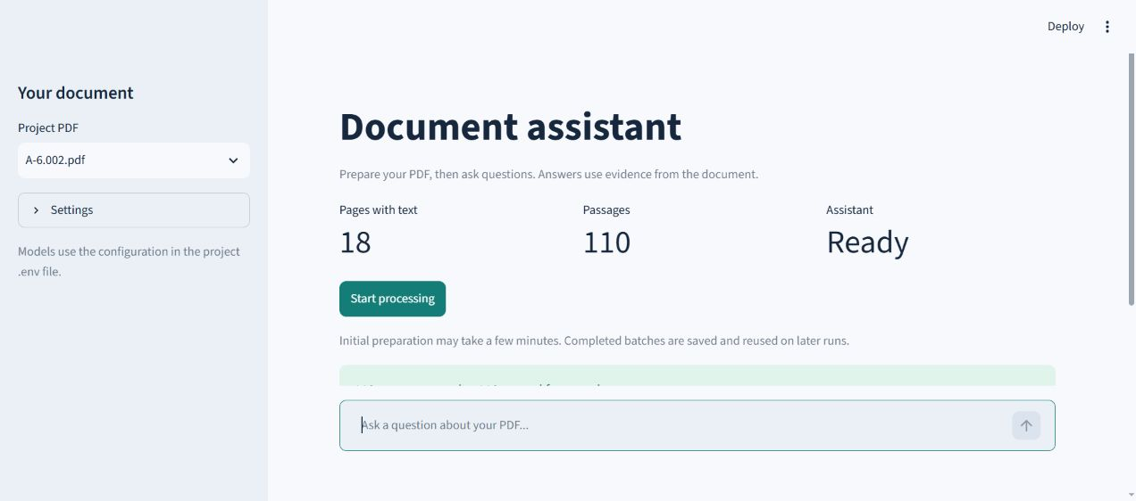
Practice: preparing the document
Click Start processing. Wait for Ready.
14 / 21
Notes:
SLIDE 14 - Practice: preparing the document
TIME: 5 min
SAY
Now we run the top row of the pipeline. Check that the document has eighteen pages and the current settings give one hundred and ten passages. Click Start processing once. The application checks the models, creates missing embeddings, and imports the records into its local database. This laptop already has completed embeddings, so it can reuse them. A new installation will take longer, and an idle hosted model may need time to start. When the assistant says Ready, preparation is complete.
DO
In Streamlit confirm 80 words, overlap 15 and Passages per answer 3. Keep Recompute embeddings unchecked. Click Start processing once. Wait for Ready and 110 passages. If already prepared, explain that the saved preparation is being reused. Do not launch a second server.
LOOK FOR
Assistant: Ready. 110 passages available. A prepared laptop may report 110 reused from cache.
FALLBACK
If the endpoints cannot wake during the session, show the recorded Ready view. Explain that it is a saved demonstration, then continue with the recorded answer and source examples.
TRANSITION
From now on, each question follows the retrieval and answer path.
SOURCES
streamlit_app.py
Recorded application state.

Slide 15
5. Retrieving useful passages
Semantic search using cosine similarity
How often do staff renew confidentiality commitments?
Top 3 sources | Passage topic
Page 5 | Annual renewal of commitments
Page 4 | Confidentiality laws
Page 17 | Destruction and policy changes
Why top 3: short context we can inspect.
15 / 21
Notes:
SLIDE 15 - 5. Retrieving useful passages
TIME: 3 min
OUR STRATEGY AND REASON
Dense semantic retrieval using cosine similarity, with top k = 3. This keeps the evidence short enough to inspect. The implementation has no reranker or confidence threshold. Compare with keyword retrieval, hybrid search, reranking or a different k.
SAY
For a question, we first create its vector and search the stored document vectors. Top three means we return the three highest-ranked passages. It does not mean all three are equally useful or that any answer is guaranteed. These page descriptions come from a recorded run of our French question. Page five contains the annual renewal statement. Page four discusses confidentiality laws. Page seventeen discusses destruction and policy changes. Which one actually answers how often staff renew their commitments? Meaning-based retrieval is a simple starting point. Exact keywords, hybrid search and reranking are alternatives when retrieval misses evidence.
DO
Read the question: À quelle fréquence le personnel renouvelle-t-il ses engagements de confidentialité ? Ask the audience to choose the supporting page before revealing the answer in the application. Accept page 5. Explain that rankings can change with wording or settings.
TRANSITION
The generator receives the selected text and the question together.
SOURCES
Recorded French query from Streamlit.
rag/pipeline.py

Slide 16
6. Writing an answer from evidence
Evidence-grounded prompting with citations
QUESTION
What the user wants to know
EVIDENCE
The three retrieved passages
INSTRUCTIONS
Use the evidence. Cite it. Abstain if missing.
Why: tie each answer to evidence we can check.
16 / 21
Notes:
SLIDE 16 - 6. Writing an answer from evidence
TIME: 2 min
OUR STRATEGY AND REASON
Evidence-grounded prompting with Qwen3 1.7B: a concise French answer, source citations and abstention when evidence is absent. The application uses temperature 0 and disables thinking mode. These choices support a predictable workshop flow, but do not guarantee correctness. Compare with extractive answers or structured output.
SAY
Qwen receives the question, the retrieved passages and instructions. We ask it to answer in French, use only supported information, cite its sources and abstain when evidence is missing. The model does not search the whole PDF at this stage. It sees the context supplied by retrieval. We choose a short cited answer because the audience needs to inspect the source. For other tasks, we might ask for a direct quotation or a structured response. Prompt instructions help, but we still need to verify the output.
DO
Explain the three inputs in plain language. Ask what happens if retrieval does not include the passage with the answer.
TRANSITION
Let us ask the question and inspect the result.
SOURCES
rag/hf_client.py
https://huggingface.co/Qwen/Qwen3-1.7B

Slide 17
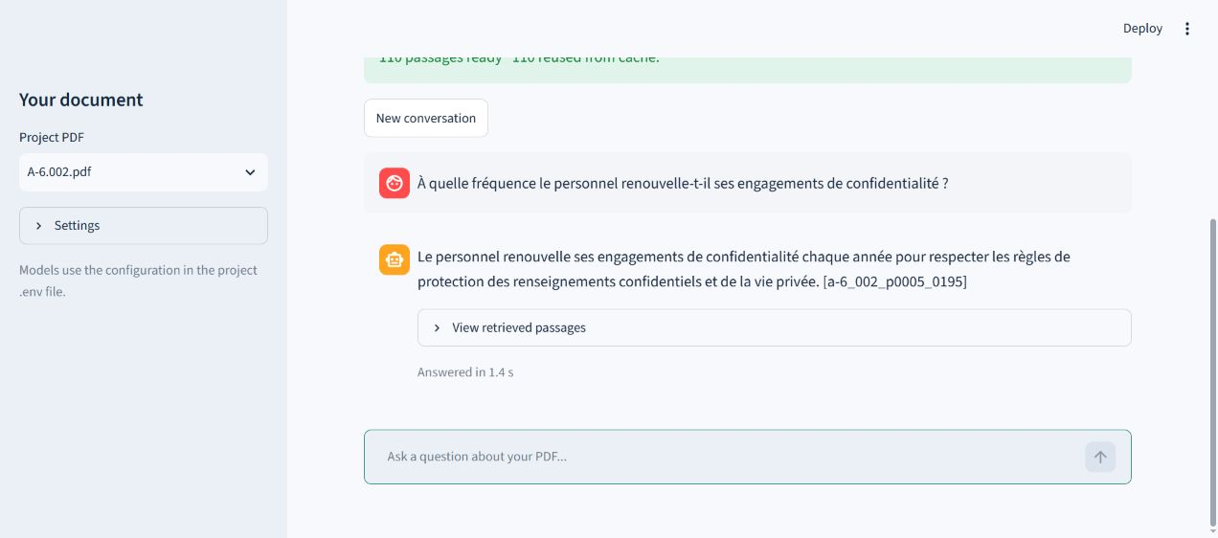
Practice: our first question
Expected fact: chaque année. Then check the citation.
17 / 21
Notes:
SLIDE 17 - Practice: our first question
TIME: 4 min
SAY
Let us ask our prepared assistant how often the staff renew their confidentiality commitments. The French wording is shown here. The expected fact is every year. The application first retrieves passages and then generates the answer. The screenshot records a real exchange from this project. During the live demonstration, your wording may differ, but the factual claim should be supported by the same source. Do not judge the answer only by how fluent it sounds.
DO
Click New conversation if a previous exchange is present. Ask: À quelle fréquence le personnel renouvelle-t-il ses engagements de confidentialité ? Wait for the answer. Look for chaque année and a source citation.
LOOK FOR
An answer in French stating that renewal happens every year, with a citation to the page-five passage.
FALLBACK
If the network is unavailable, state that the displayed screenshot is a recorded response. Continue to the source-checking exercise.
TRANSITION
A citation gives us a place to check. We still need to read it.
SOURCES
Actual Streamlit screenshot.
A-6.002.pdf, page 5.

Slide 18
7. Checking the answer
Human source verification
“Celui-ci signe des engagements
de confidentialité et les
renouvelle chaque année”
5
PDF page
Why: a citation alone cannot prove a claim.
IN THE APP
Open View retrieved passages. Compare with page 5.
18 / 21
Notes:
SLIDE 18 - 7. Checking the answer
TIME: 3 min
OUR STRATEGY AND REASON
Human source verification plus an unsupported-question test. Check that the passage supports the claim and that the assistant abstains when appropriate. This makes the demonstration inspectable. A production evaluation would need more documents, questions and reviewers.
SAY
Page five says that staff sign confidentiality commitments and renew them every year. We compare that source statement with the answer. First, does the cited passage exist? Second, does it support the specific claim? The application displays other retrieved passages too, so find the one actually cited. This check distinguishes a convincing answer from an answer we can justify. The source remains in French so that the live claim and its evidence can be compared directly.
DO
Expand View retrieved passages. Find A-6.002.pdf, page 5. Read chaque année. Open page 5 of the original PDF and compare the statement. Ask a participant to explain why the citation supports the answer.
LOOK FOR
The PDF and the answer agree on annual renewal.
TRANSITION
A useful assistant also needs to recognize when the document cannot answer.
SOURCES
A-6.002.pdf, page 5.
streamlit_app.py

Slide 19
Practice: a missing fact
Quel est le mot de passe du Wi-Fi
de Revenu Québec ?
Je ne trouve pas cette information
dans les documents.
IN THE APP
Start a new conversation. Ask a question outside the PDF.
19 / 21
Notes:
SLIDE 19 - Practice: a missing fact
TIME: 2 min
SAY
We now ask for something the policy does not contain: the Wi-Fi password. Start a new conversation so the example is easy to interpret. The expected response says that the information is not in the documents. This is the right behavior for this question. However, the same refusal can also happen when retrieval fails to find a fact that is present. That is why we test both answerable questions and deliberately unsupported ones.
DO
Click New conversation. Ask: Quel est le mot de passe du Wi-Fi de Revenu Québec ? Verify the French abstention. Confirm that the assistant remains Ready.
LOOK FOR
Je ne trouve pas cette information dans les documents.
TRANSITION
We can also test a retrieval choice without preparing the PDF again.
SOURCES
Recorded Streamlit abstention.
rag/hf_client.py

Slide 20
Practice: three passages or five?
3
5
Shorter context
More evidence to inspect
Same PDF. Same question. Compare the sources.
IN THE APP
Change Passages per answer to 5. Compare, then restore 3.
20 / 21
Notes:
SLIDE 20 - Practice: three passages or five?
TIME: 3 min
SAY
Retrieval depth controls how much evidence reaches the model. Three passages keeps the context short. Five may add a useful passage, but it can also add irrelevant material. We will change only that setting and repeat the same question. We are looking at the retrieved evidence as well as the wording of the answer. More context does not automatically mean a better answer. Changing the number of retrieved passages reuses the existing document vectors.
DO
Start a new conversation and ask the annual-renewal question with Passages per answer set to 3. Inspect the sources. Change it to 5, start a new conversation and repeat the exact question. Compare the sources and supported claim. Restore 3. Do not click Recompute embeddings. Allow this as an optional exercise if startup took too long.
LOOK FOR
The panel shows up to five retrieved passages. No specific improvement is promised. The source-supported fact should stay the same.
TRANSITION
You now have a method for trying a change and checking its effect.
SOURCES
streamlit_app.py
rag/pipeline.py

Slide 21
Your document, your questions
One fact you can verify
One fact the document cannot answer
Find the evidence. Check the claim.
Questions and discussion
21 / 21
Notes:
SLIDE 21 - Your document, your questions
TIME: 8 min
SAY
We have followed the complete RAG workflow: read a document, split it, create vectors, import them into a database, retrieve passages and generate an answer. The final step is checking whether the evidence supports the claim. For your own document, begin with one question you can verify and one question the document cannot answer. When a result is poor, first inspect the retrieved passages. That helps you decide whether to change extraction, chunking, retrieval or the answer instructions. What would you try with your own documents?
DO
Invite questions and discussion. Ask participants to name one setting they would change and how they would judge the result. Keep commands and troubleshooting in the separate presenter guide.
TRANSITION
End the session with the project and guide available to participants.
SOURCES
Workshop learning objectives.

