Slide 1


COURSE PROJECT
Discover Saudi Arabia
An Interactive Cultural Website
Course
Web Technologies, CSC 457
Instructor
Dr. Sultan Alfarhood
Student
Abdullah Alshammari, 443100803
Semester
Second Semester, 1447 H, 2025/2026
King Saud University | College of Computer and Information Sciences | Department of Computer Science

Slide 2
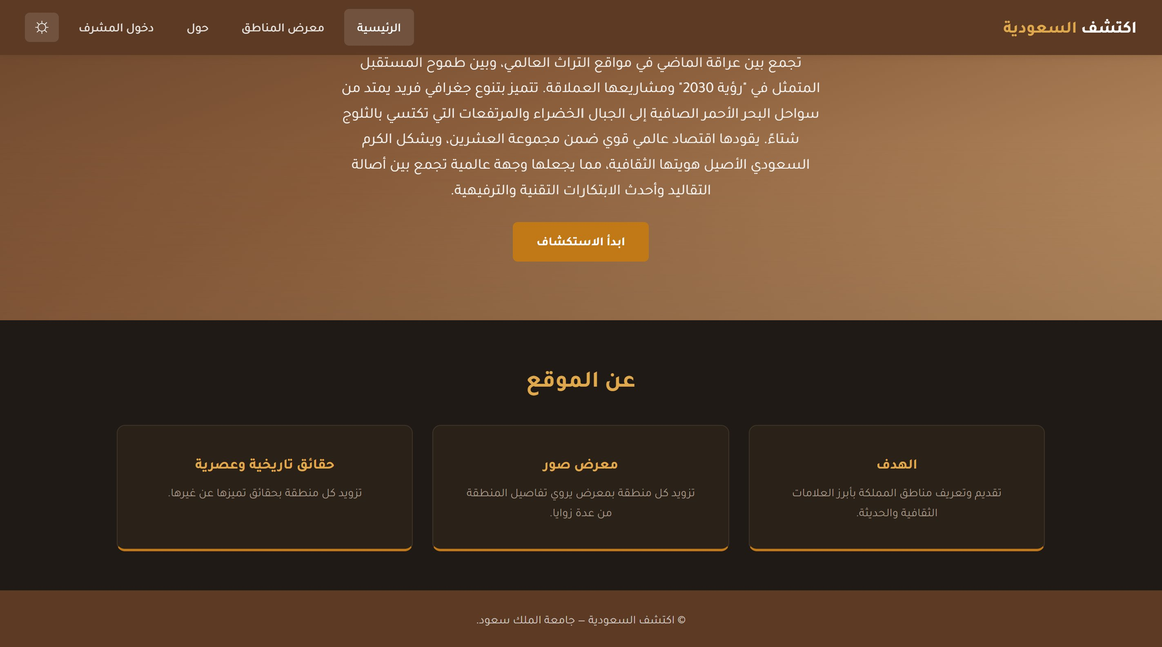



Project Overview
A fully dynamic Arabic cultural website that introduces visitors to the regions, landmarks, and culture of the Kingdom of Saudi Arabia.
Public Side
Home, Gallery, and Details pages with night mode and live filtering.
Admin Side
Session-protected dashboard with full CRUD on the regions database.
The home page (night mode)
Data Layer
MySQL backend over PDO with parameterised queries and bcrypt hashing.
CSC 457 | Discover Saudi Arabia
2

Slide 3





Technology Stack
Built with the four core web technologies plus PHP and MySQL
HTML
CSS
JavaScript
PHP
MySQL
Page structure
Styling & layout
Client interactivity
Server-side logic
Data persistence
Hosting: deployed on InfinityFree at capstone.alshammarii.me
CSC 457 | Discover Saudi Arabia
3

Slide 4








System Architecture
Two-tier structure: public site and protected admin area
PUBLIC SIDE
ADMIN SIDE
index.php (Home)
login.php
gallery.php (Regions)
dashboard.php
MySQL
details.php (Region)
add.php
about.php (About)
admins
update.php / delete.php
regions
CSC 457 | Discover Saudi Arabia
4

Slide 5
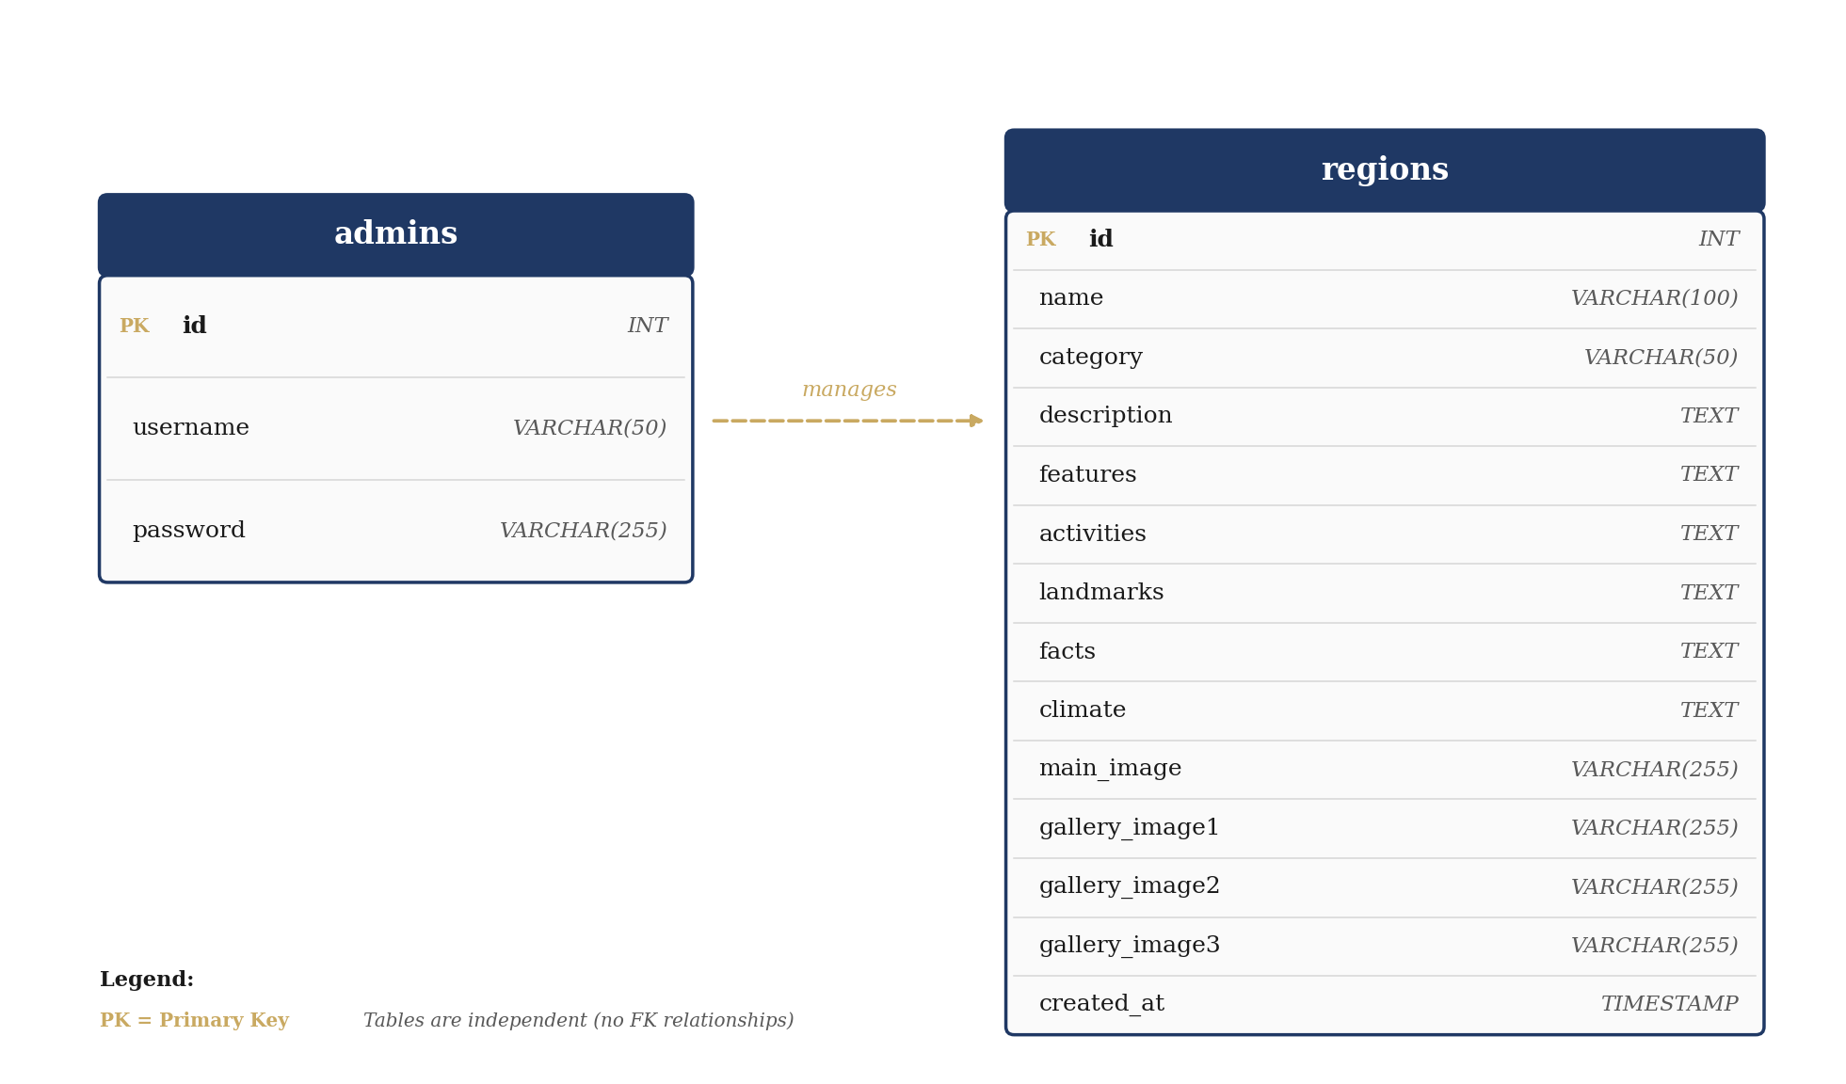
Database Schema
CSC 457 | Discover Saudi Arabia
5

Slide 6
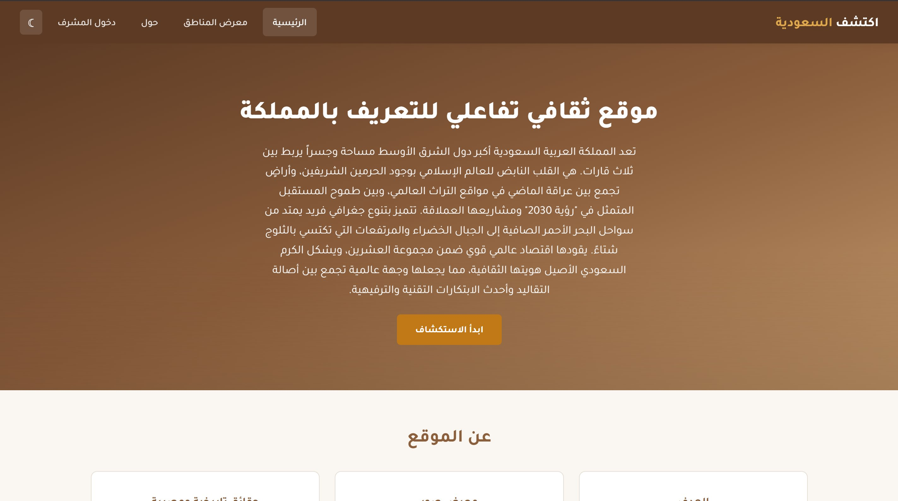
Public Side: Home Page
Standard mode and night mode, toggled with one click
Standard mode (moon icon to toggle)
Night mode (sun icon to toggle back)
Persisted via localStorage: localStorage.setItem('nightMode', isNight)
CSC 457 | Discover Saudi Arabia
6

Slide 7
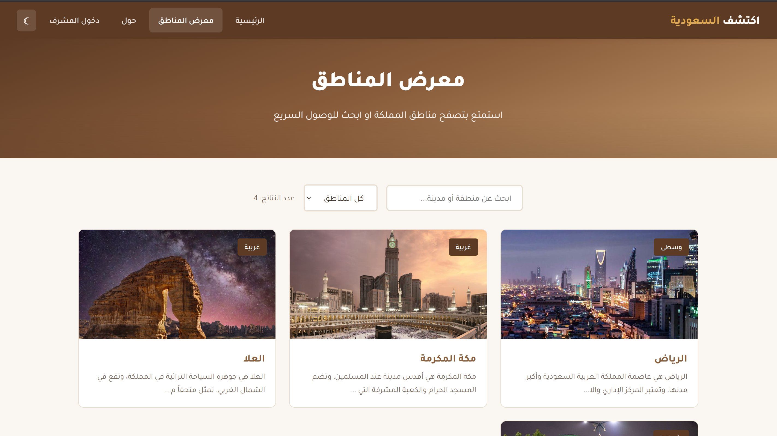



Public Side: Regions Gallery
Live filtering by name and category, with results counter
How filtering works
Free-text search
Reads the data-name attribute on each card and matches the typed query in real time.
Category drop-down
Filters cards by the data-category attribute (central, western, eastern, etc.).
Live results counter
Updates the visible card count after every keystroke and selection change.
CSC 457 | Discover Saudi Arabia
7

Slide 8
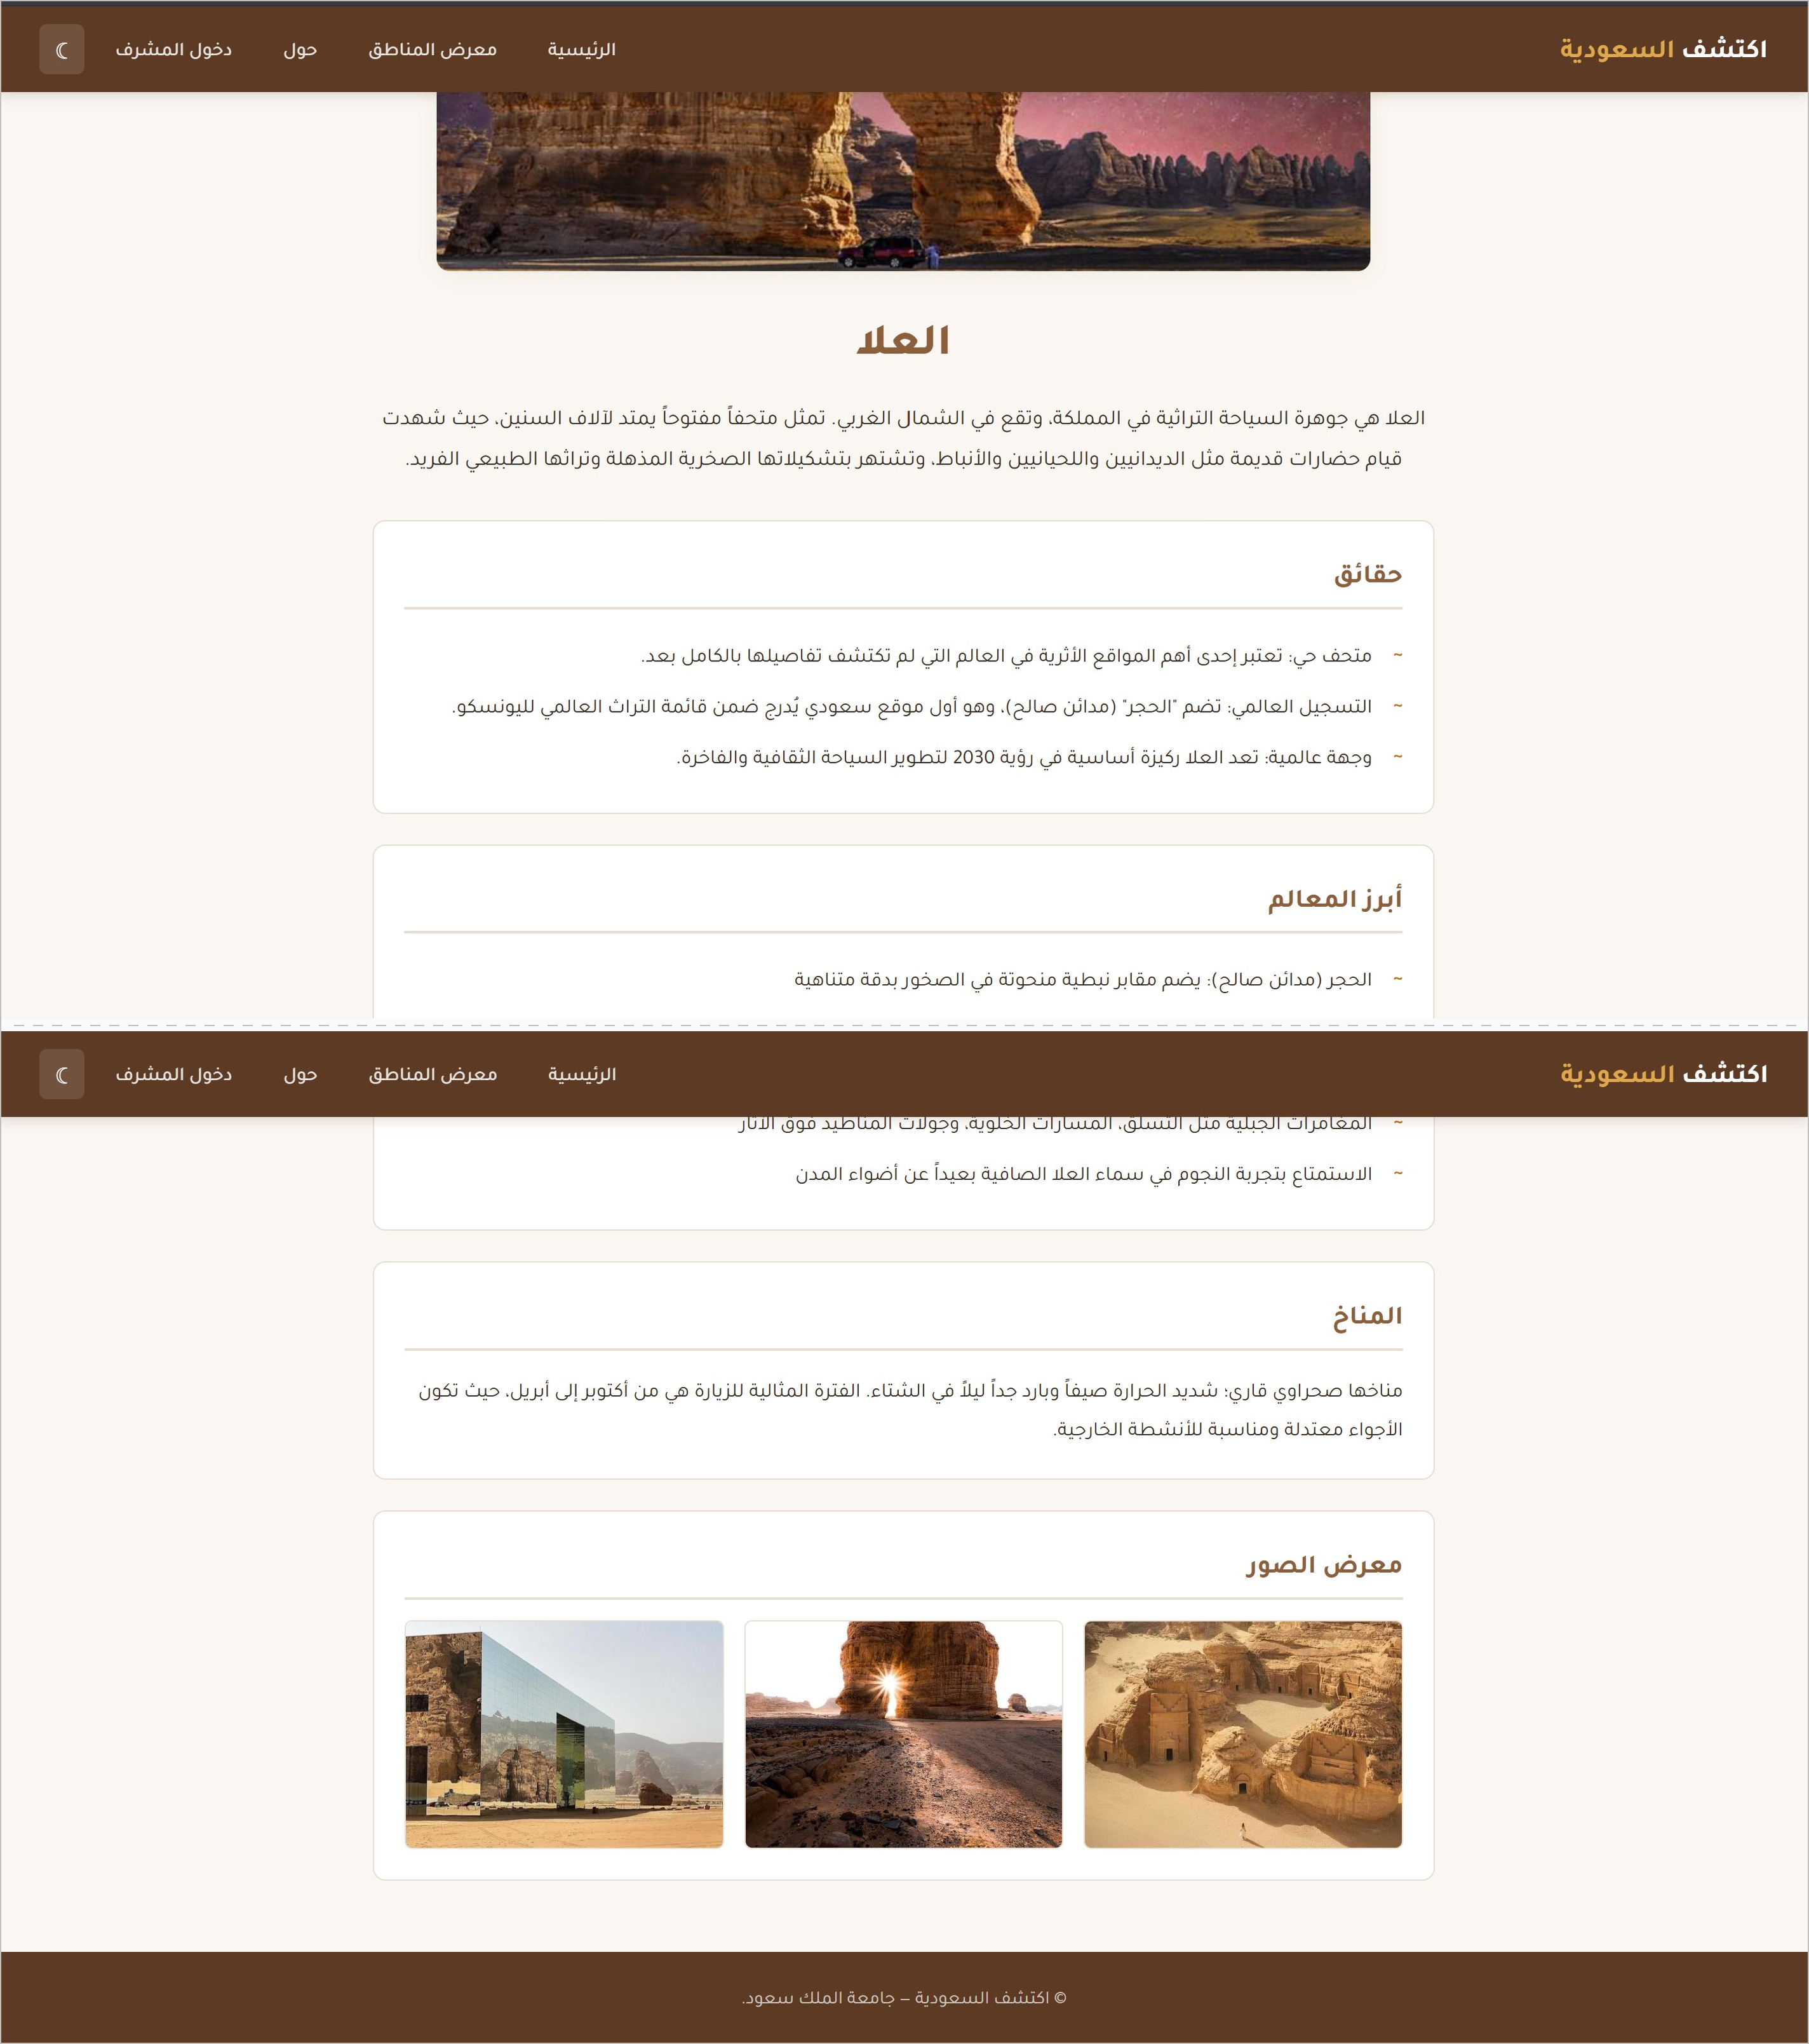
Public Side: Region Details
All region content rendered dynamically from the database
What gets rendered
Hero image · main image
Description · narrative text
Facts · bullet list
Top landmarks · bullet list
Activities · bullet list
Climate · text box
Image gallery · optional images
CSC 457 | Discover Saudi Arabia
8

Slide 9
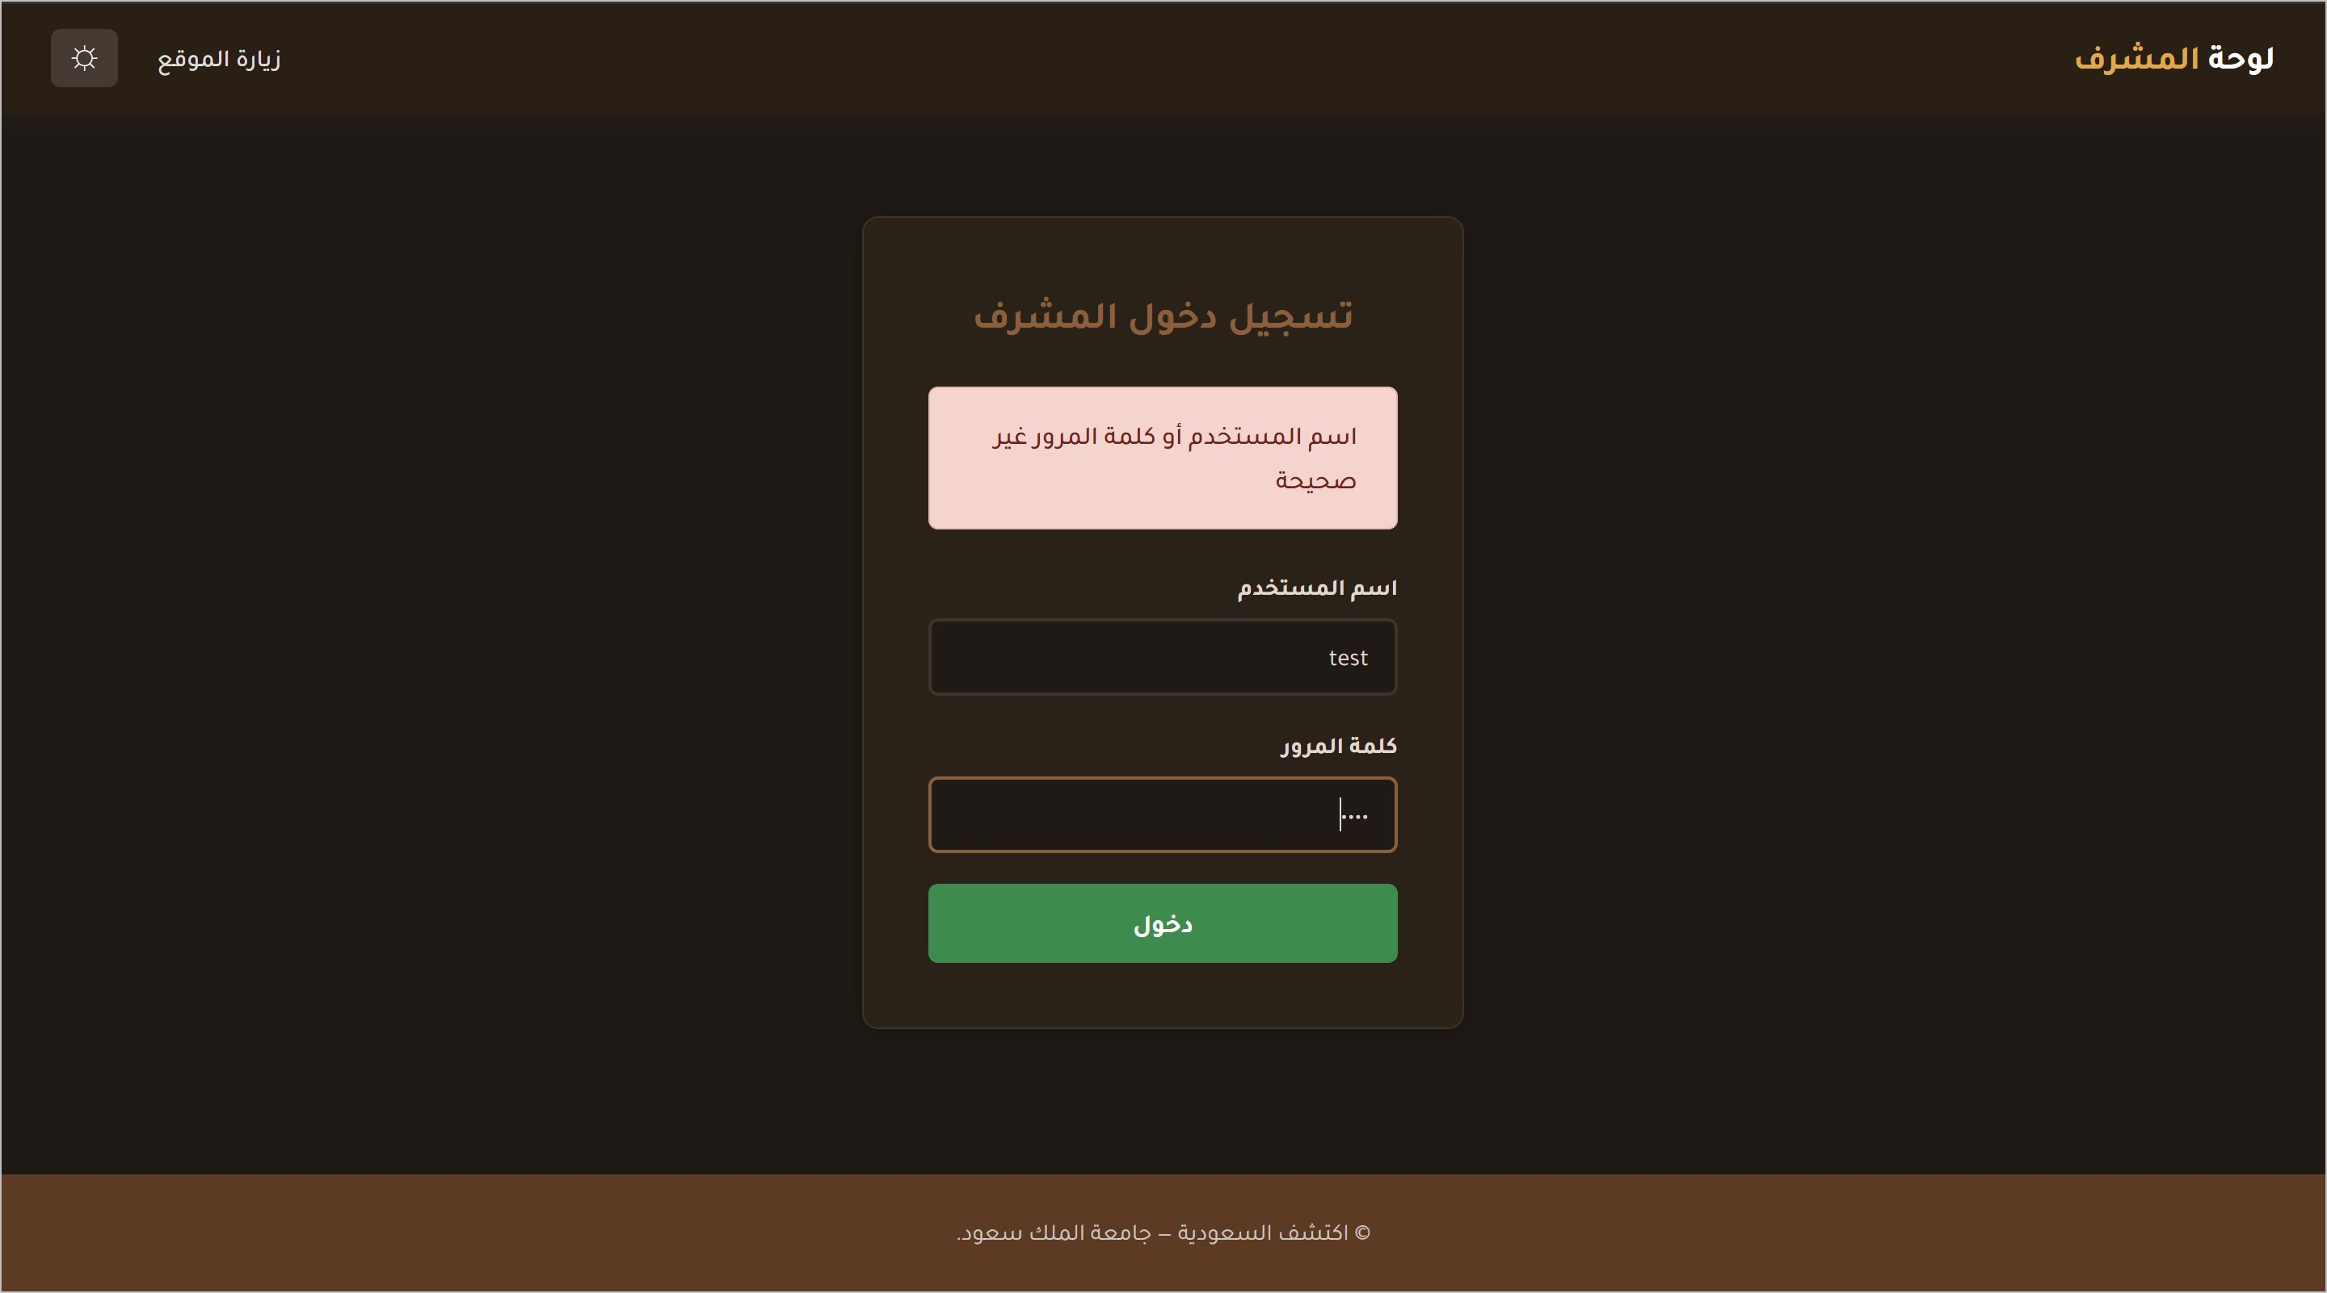



Admin Side: Login & Sessions
PDO prepared statement + bcrypt verification + PHP sessions
login.php
$stmt = $conn->prepare("SELECT * FROM admins WHERE username = ?");
$stmt->execute([$username]);
$admin = $stmt->fetch(PDO::FETCH_ASSOC);
if ($admin && password_verify($password,
$admin['password'])) {
$_SESSION['admin_id'] = $admin['id'];
header("Location: dashboard.php");
}
Failed login: Error renders inside a soft alert.
Parameterised query → no SQL injection
password_verify() → bcrypt safe
auth.php on every protected page
CSC 457 | Discover Saudi Arabia
9

Slide 10
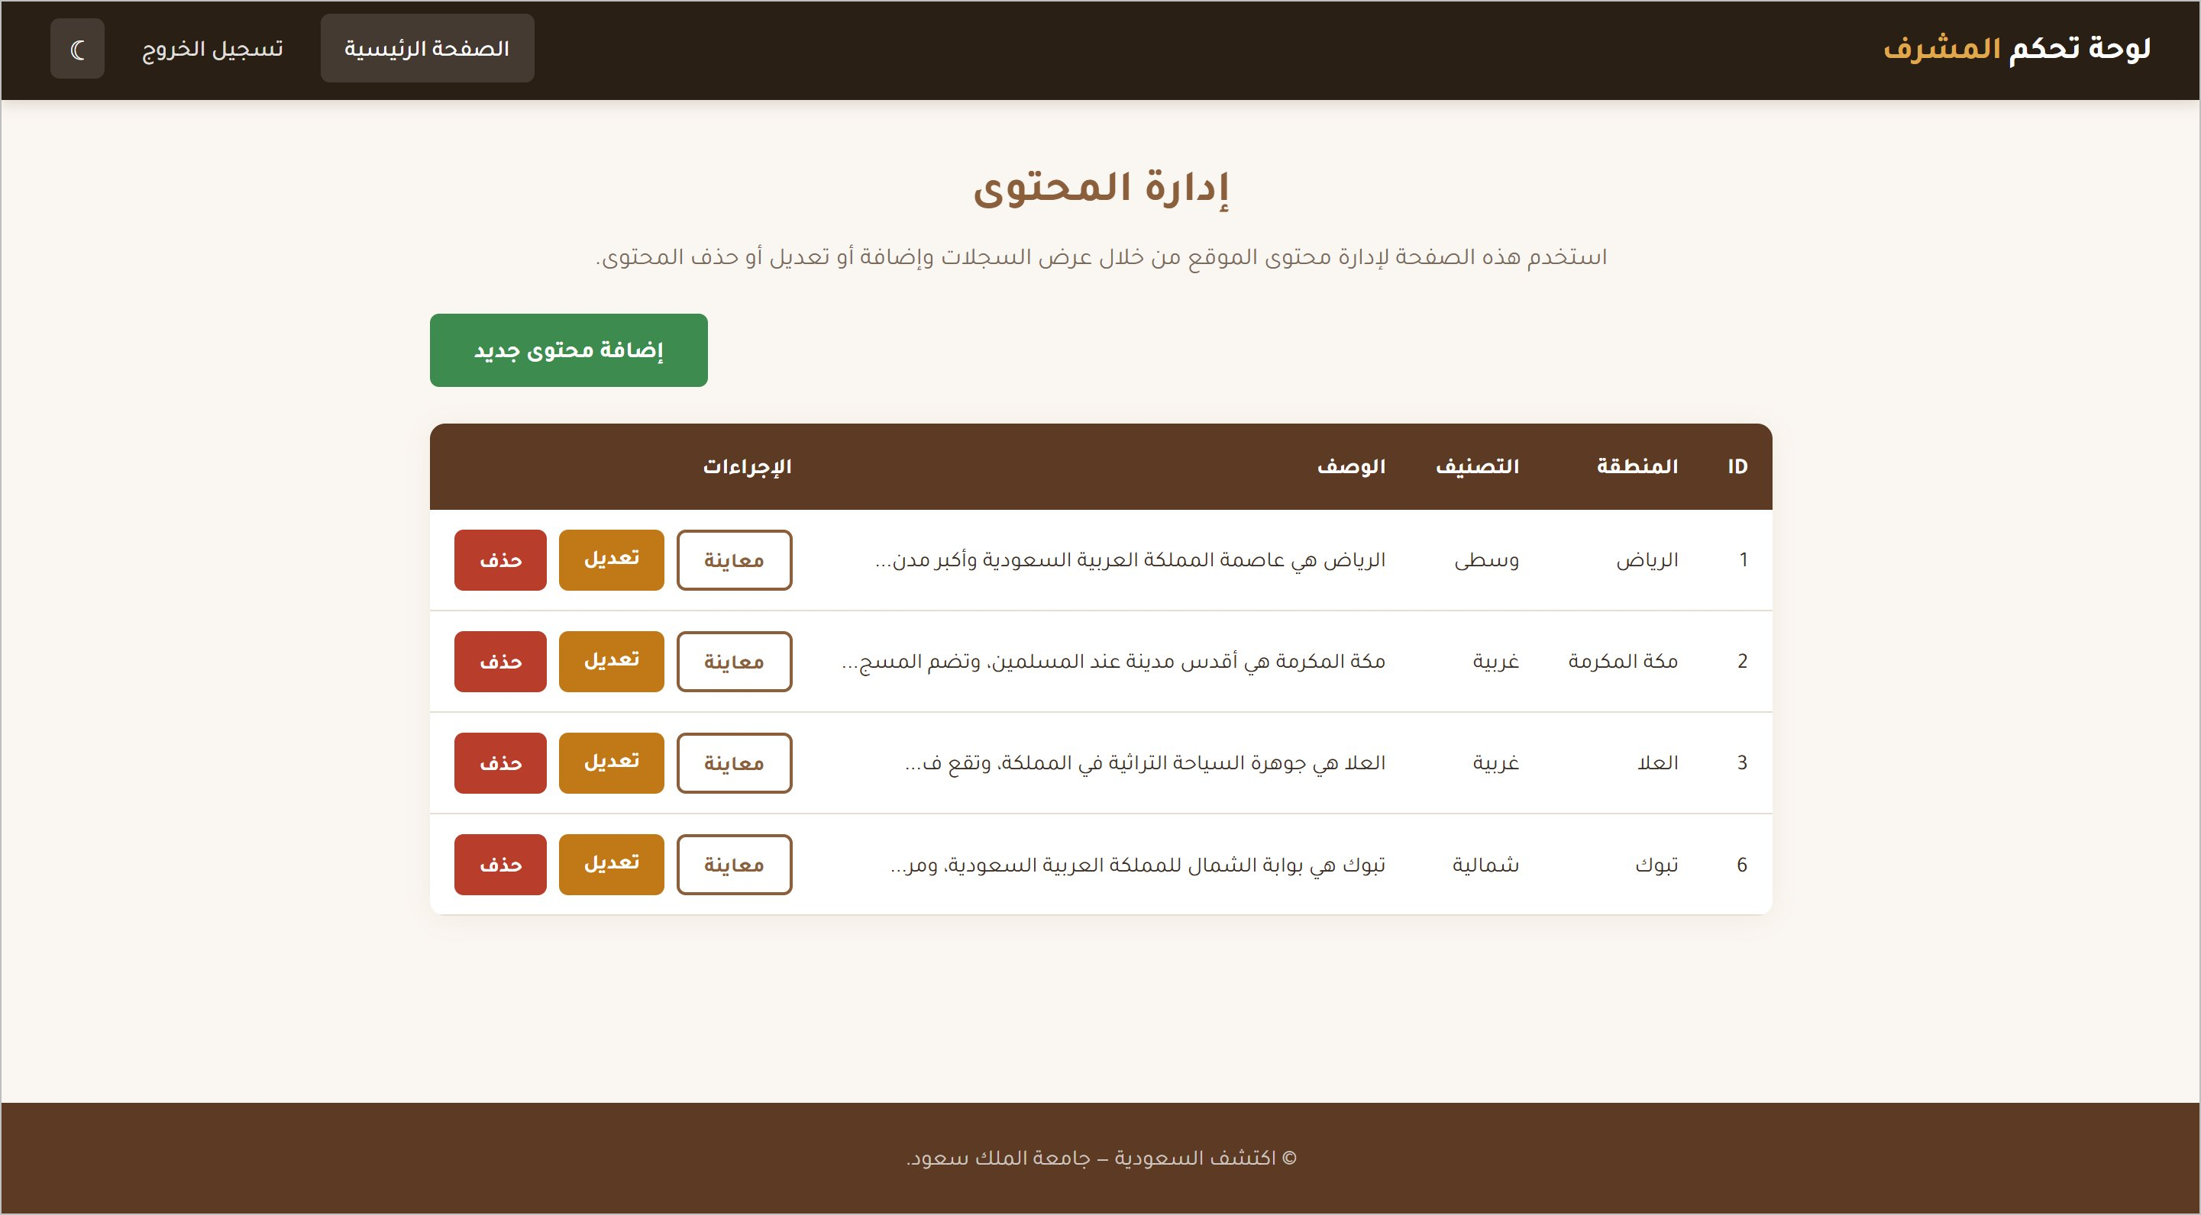



Admin Side: Dashboard & CRUD
Control Panel of regions records
CREATE add.php
validate fields → upload images → INSERT → confirmation message + redirect
READ dashboard.php
auth check → SELECT * FROM regions → render table
UPDATE update.php
load record → pre-fill form → save image → UPDATE → confirmation message
DELETE delete.php
confirm() → unlink images → DELETE
→ confirmation message + redirect
CSC 457 | Discover Saudi Arabia
10

Slide 11
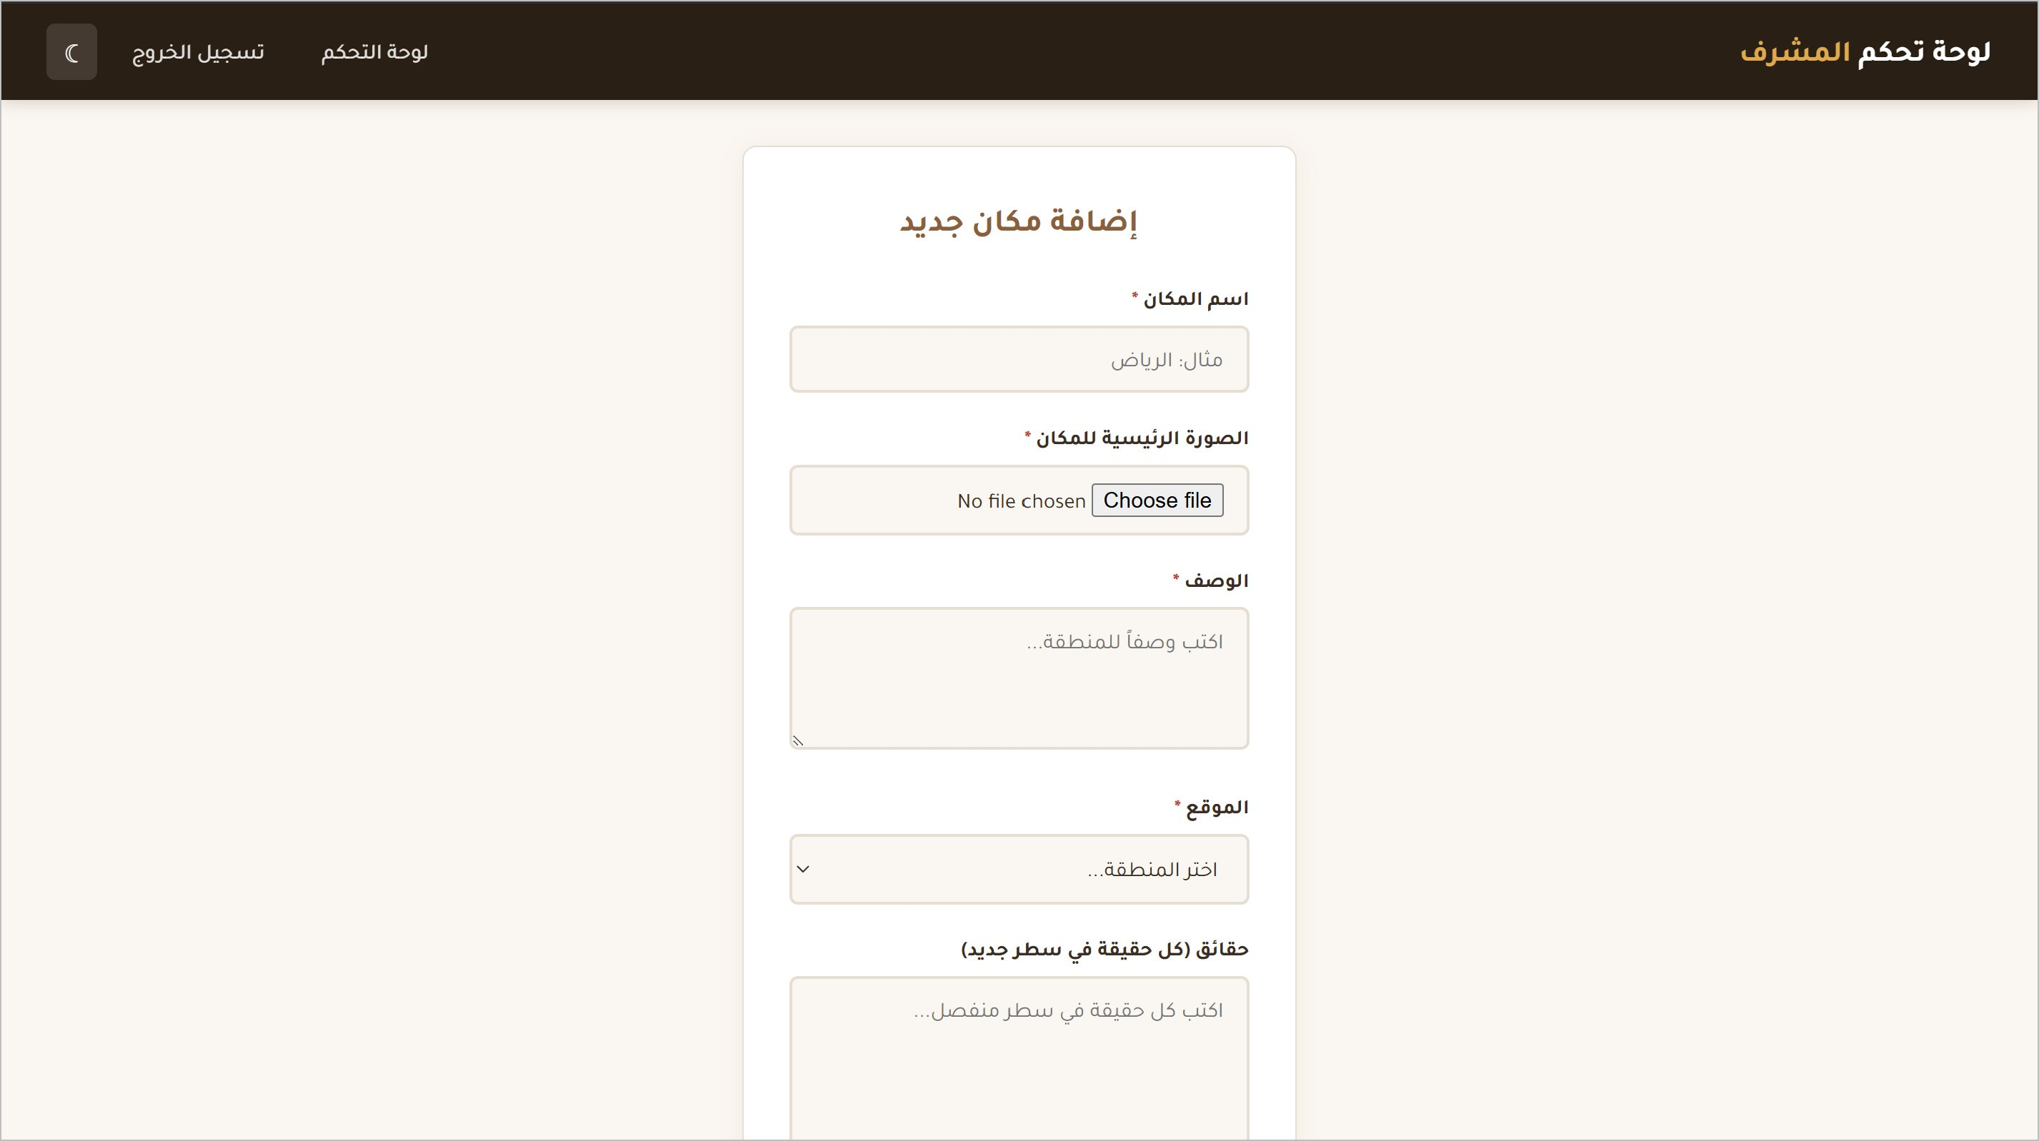
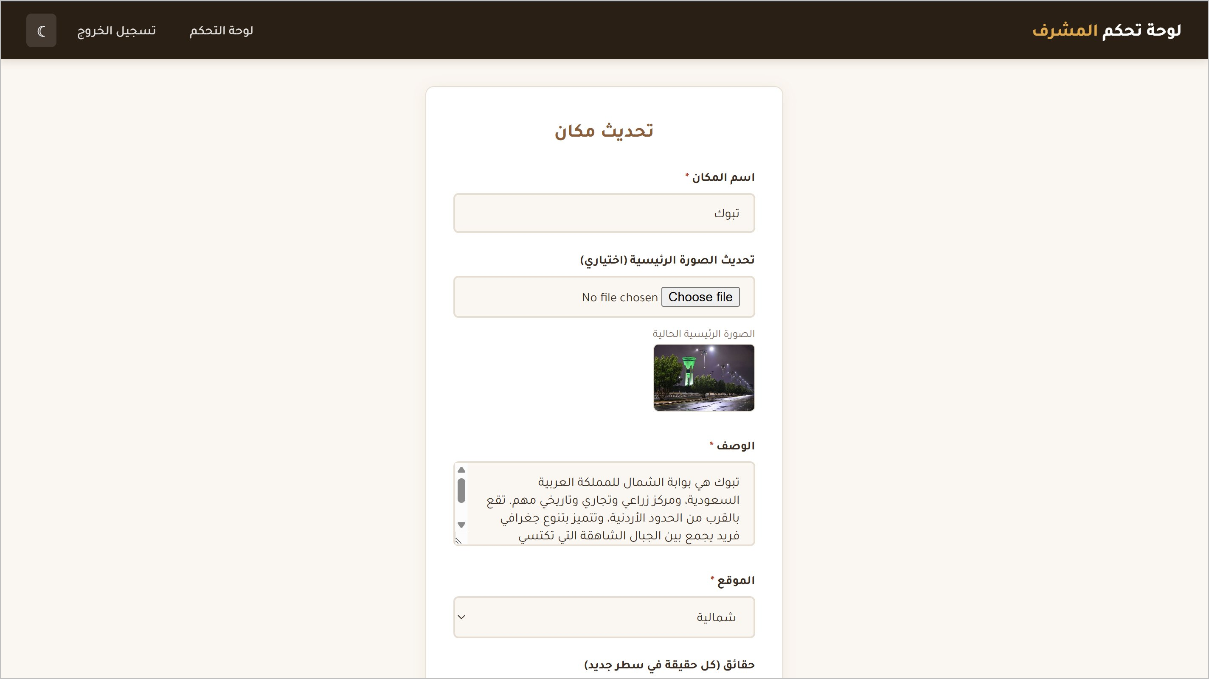

Admin Side: Add and Update Forms
File uploads, image cleanup, JS confirmation before delete
Add Content
Update Content
Delete
add.php
update.php
delete.php
confirm() ✓
unlink() image files
Required fields marked with *.
Form pre-filled from existing record. If no new file is chosen, the old image filename is kept.
JS confirmation dialog before unlinking (deleting) the content from the database.
CSC 457 | Discover Saudi Arabia
11

Slide 12

LIVE DEMO
Discover Saudi Arabia
Live URL
capstone.alshammarii.me
(deployed on InfinityFree)
Thank you
Questions and discussion welcomed.
Abdullah Alshammari, 443100803 · CSC 457 · Dr. Sultan Alfarhood

