Slide 1
PROGRESS FROM SCRATCH TO TILL
ABDU ROUF A
PT2024/039
PROJECT INTERN
DIGITAL UNIVERSITY OF KERALA

Slide 2

PDF PARSING
For Text :
1. PyMuPDF
Code for PyMuPDF
https://github.com/AbduRouf/MATHYPOTHESIS/blob/main/PyMuPDF -
Accuracy Evaluation for PyMuPDF
https://github.com/AbduRouf/MATHYPOTHESIS/blob/main/EVALUATING%20ACCURACY
Result:

Slide 3
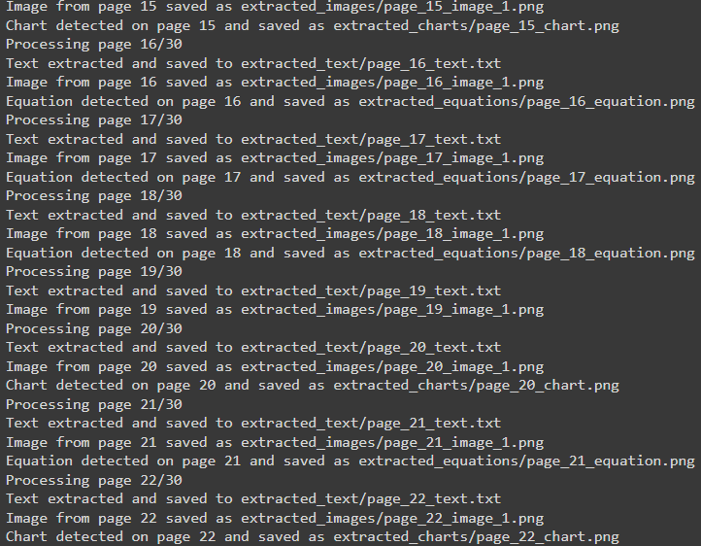
PDF PARSING
2. PyTesseract
Code for pytesseract
https://github.com/AbduRouf/MATHYPOTHESIS/blob/main/pytesseract
Result:

Slide 4
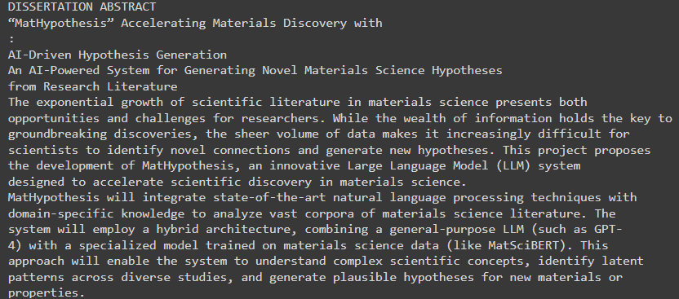
PDF PARSING
3. PDFplumber
Code for pdfplumber
https://github.com/AbduRouf/MATHYPOTHESIS/blob/main/Pdfplumber
Result:

Slide 5
PDF PARSING
4.Pix2Text
An Open-Source Python3 tool for recognizing layouts, tables, math formulas (LaTeX), and text in images, converting them into Markdown format. A free alternative to Mathpix, empowering seamless conversion of visual content into text-based representations. 80+ languages are supported.
Code for Pix2Text
https://github.com/breezedeus/Pix2Text

Slide 6
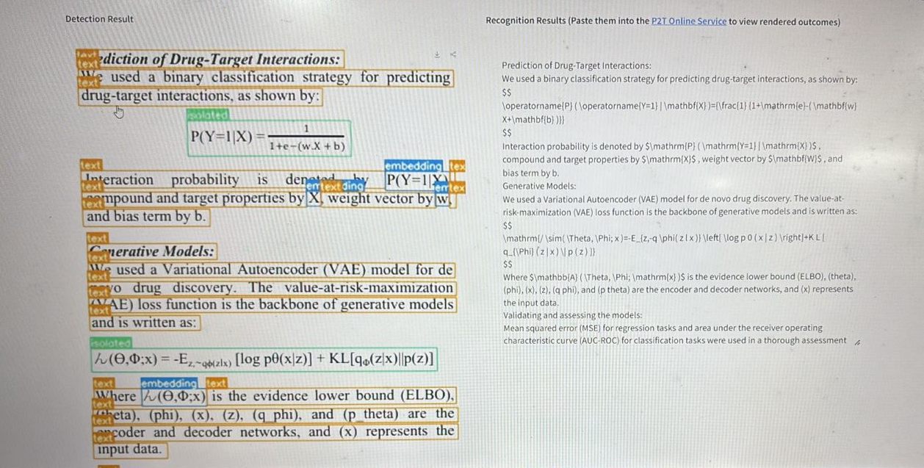
PDF PARSING
Result:

Slide 7
PDF PARSING
5.ChartX and ChartVLM
A Versatile Benchmark and Foundation Model for Complicated Chart Reasoning.
Code for ChartX&ChartVLM
https://github.com/UniModal4Reasoning/ChartVLM/tree/main

Slide 8
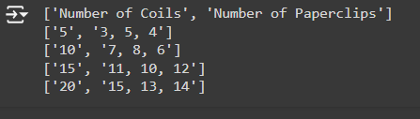
PDF PARSING
6.PDFplumber for Tables
Code for PDFplumber
https://github.com/AbduRouf/MATHYPOTHESIS/blob/main/pdfplumber
Result:

