Slide 1
MATHYPOTHESIS “Accelerating Materials Discovery with AI-Driven Hypothesis Generation”
ABDU ROUF A
PT2024/039
PROJECT INTERN
DIGITAL UNIVERSITY KERALA

Slide 2
PROBLEM STATEMENT
Exponential growth in materials science literature
Information overload for researchers
Difficulty in identifying novel connections
Time-consuming literature review process
Challenge in generating new research directions

Slide 3
SOLUTION
“MatHypothesis” : An innovative AI system which:-
Analyzes vast materials science literature
Identifies patterns across studies
Generates plausible research hypotheses
Ranks hypotheses by novelty and feasibility
Provides transparent reasoning

Slide 4
EXPECTED IMPACT
Accelerated Materials Discovery:
Faster research hypothesis generation
Novel material property predictions
Unexpected relationship identification
Application Areas:
Energy storage solutions
Semiconductor development
Advanced materials research
Sustainable technology

Slide 5
MODULES OF THE PROJECT
PDF PARSING(TO BUILD A EFFICIENT PARSER)
LLM FINETUNING(TO BUILD A COMPUTATIONAL MODEL)

Slide 6
MODULE-I PDF PARSING
Data is an important factor in our project.Hence we need to have a PDF Parser which should be able to:
Fetch every informations from the PDF such as Text,Equations,Figure,Tables etc..
Automatically identifies multiple content types
Extracts information with high precision
Converts complex data into structured formats
Preserves contextual relationships
Enables automated knowledge extraction

Slide 7
EXISTING PDF PARSERS
Drawbacks:
Layout Recognition Problems:
Fails to handle multi-column layouts
Incorrect text flow detection
Lost document structure
2. Mathematical Content Issues:
Poor equation recognition
Mathematical symbol errors
Formula structure loss
Incorrect LaTeX conversion
Visual Element Failures:
Low-quality image extraction
Table structure corruption
Chart data point loss

Slide 8
LITERATURE SURVEY : PDF PARSING TECHNIQUES

Slide 9
PDF PARSING
Based on Text :
PyMuPDF
Code for PyMuPDF
https://github.com/AbduRouf/MATHYPOTHESIS/blob/main/PyMuPDF -
Accuracy Evaluation for PyMuPDF
https://github.com/AbduRouf/MATHYPOTHESIS/blob/main/EVALUATING%20ACCURACY
Advanatages:
Fastest processing speed
Efficient memory usage

Slide 10
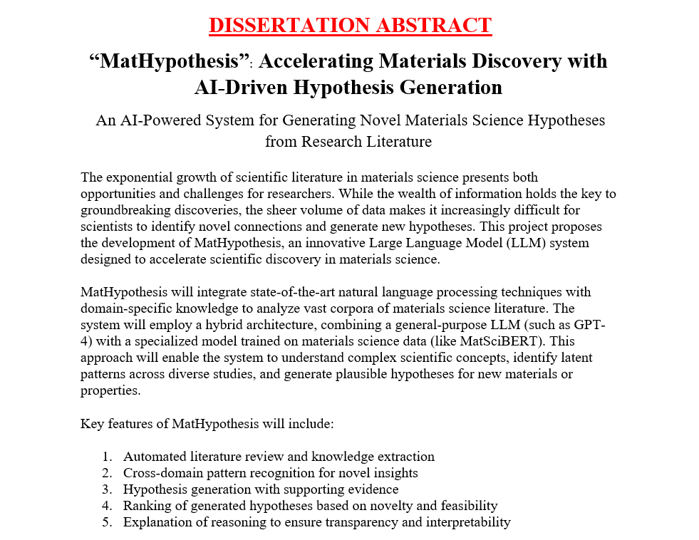
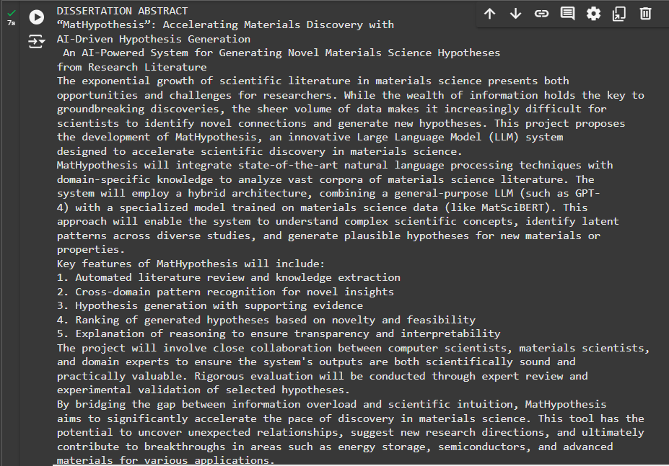

INPUT TEXT(FORMAT-PDF):
OUTPUT:

Slide 11
PDF PARSING
2. PyTesseract
Code for pytesseract
https://github.com/AbduRouf/MATHYPOTHESIS/blob/main/pytesseract
Input PDF File : https://arxiv.org/pdf/2402.12185v1(Source:Arxiv)
Advanatages:
Slowest due to image processing
High computational requirements

Slide 12
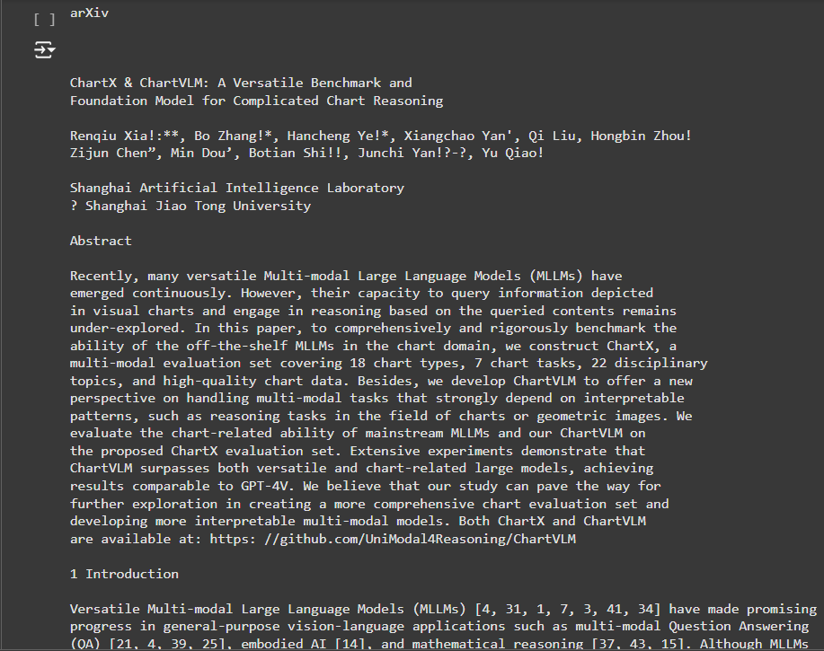
OUTPUT:

Slide 13
PDF PARSING
3. PDFplumber
Code for pdfplumber
https://github.com/AbduRouf/MATHYPOTHESIS/blob/main/Pdfplumber
Advanatages:
Moderate speed
Focuses on accuracy over speed

Slide 14
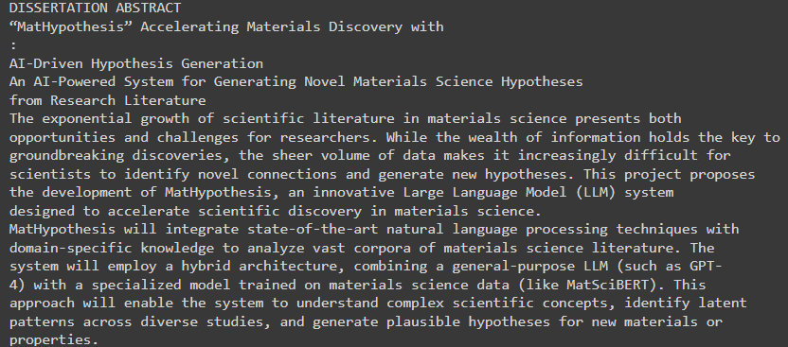
INPUT TEXT(FORMAT-PDF):
OUTPUT:

Slide 15
PDF PARSING
4.Pix2Text
An Open-Source Python3 tool for recognizing layouts, tables, math formulas (LaTeX), and text in images, converting them into Markdown format. A free alternative to Mathpix, empowering seamless conversion of visual content into text-based representations. 80+ languages are supported.
Code for Pix2Text
https://github.com/breezedeus/Pix2Text
Got a positive impact from this tool where we can accurately infer datas such as Text,Equations,Tables,also some meta datas.

Slide 16
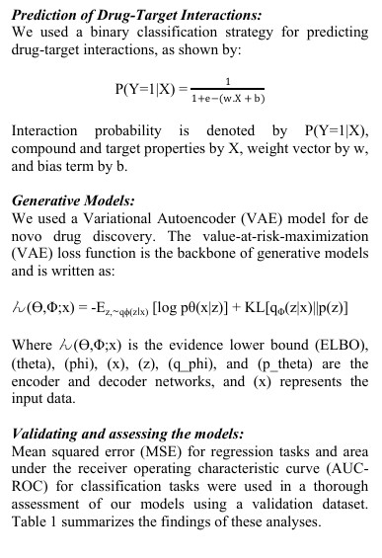
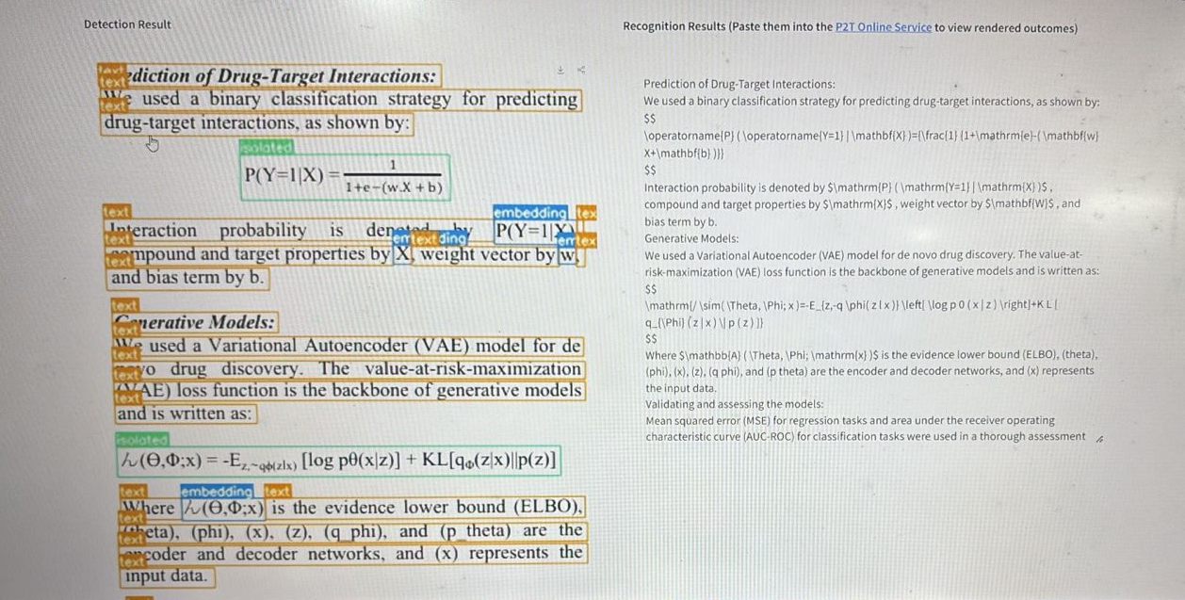
PDF PARSING
INPUT TEXT(FORMAT-PNG):
OUTPUT:

Slide 17
PDF PARSING
5.ChartX and ChartVLM
A Versatile Benchmark and Foundation Model for Complicated Chart Reasoning.
Code for ChartX&ChartVLM
https://github.com/UniModal4Reasoning/ChartVLM/tree/main
OUTPUT:
Cant able to run the inference due to disk issues.

Slide 18
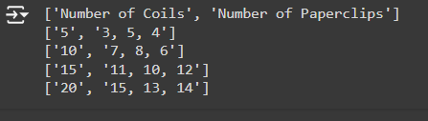
PDF PARSING
6.PDFplumber for Tables
Code for PDFplumber
https://github.com/AbduRouf/MATHYPOTHESIS/blob/main/pdfplumber
Input given in the format of table
OUTPUT:

Slide 19
PDF PARSING
7.Tesseract for Equations
Code for Tesseract OCR for equations
https://github.com/AbduRouf/MATHYPOTHESIS/blob/main/Tesseract%20OCR%20for%20Equattions
Advanatages:
Open-Source & Customizable
Broad Character Support
Extends with tools like SymPy for equation parsing.

Slide 20

PDF PARSING
INPUT TEXT(FORMAT-PNG):
OUTPUT:

Slide 21
PDF PARSING
7.Easy OCR
Code for Easy OCR
https://github.com/AbduRouf/MATHYPOTHESIS/blob/main/Easy%20OCR
Not well suitable for equations

Slide 22
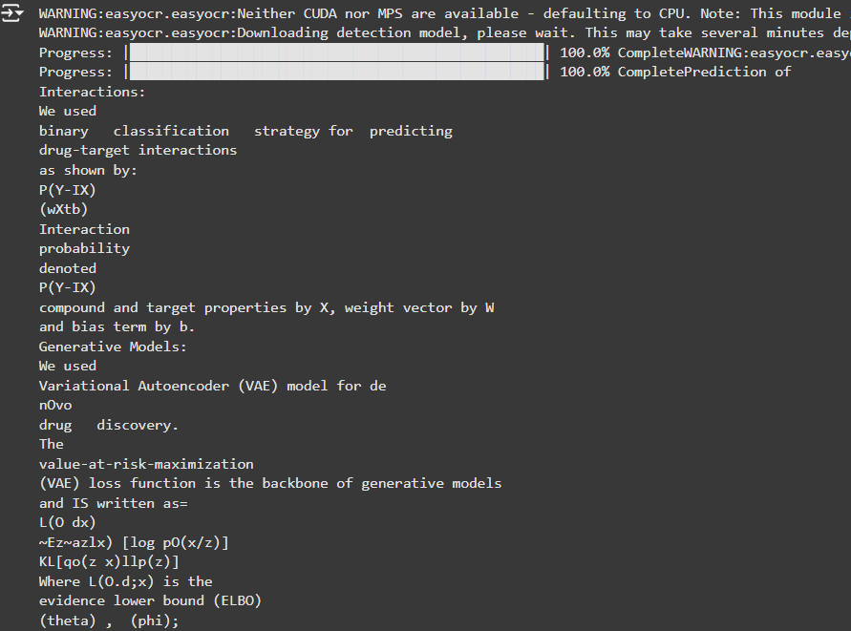
PDF PARSING
INPUT TEXT(FORMAT-PNG):
OUTPUT:

Slide 23
PACKAGE INTEGRATION
From the above experiments Pix2Text shows an accurate fetching of informations from the PDF.
But it only limits to Text,Equations,Table.
We cannot have reasoning from Figures/Graphs
For that we can use ChartVLM,which can able to reason Figures/Graphs
By integrating this two and by coverting them in to a single package, we can have a efficient PDF parsing system as per our literature survey.

Slide 24
FUTURE WORK
After getting an PDF Parsing package,we’ll move to the next module.
Which will intake the data from the parsing package and process using the computational model.
Also from the efficient computation we’ll get our possible hypothesis based on the data and intelligent reasoning.

Slide 25
THANK YOU

