Slide 1
Artificial Intelligence Project

Slide 2
Agenda
Introduction
Team Members
Milestones
Features

Slide 3
Introduction
We aim to create a software to be used in solving directed and undirected graphs using multiple graph solving algorithms such as Breadth first and Depth First while having a simple yet attractive GUI that is both user friendly and delivers the necessary information

Slide 4
Milestones

Slide 5
M1
M2
M3
M4
M5
M6
GUI Planning
GUI Realization
Algorithms Implementation
Major Bug Fixes
Error Handling
Exe Production
Successfully Designed a template for GUI
Developed Working GUI with Pyqt5
Successfully Fixed All Bugs Found During Testing
Successfully Implemented Error Handling in Form of GUI popups
Successfully Produced an exe of the Project using pyinstaller
Successfully Wrote and implemented code for the Required Algorithms

Slide 6
Meet our team
Abdulrahman Ayman 19P6458
Adham Ahmed 19P1250
Osama Ayman 19P1609
AbdulRaouf Monir 19P4442
Osama Ali 19P6937

Slide 7
Features
Simple and User-Friendly GUI
Choosing between Directed and Undirected Graph
Real Time Visualization of Algorithms
Assigning Multiple Goals To a Graph
Producing Search Path, Shortest path and Cost (when found) using a popup after solving each problem

Slide 8
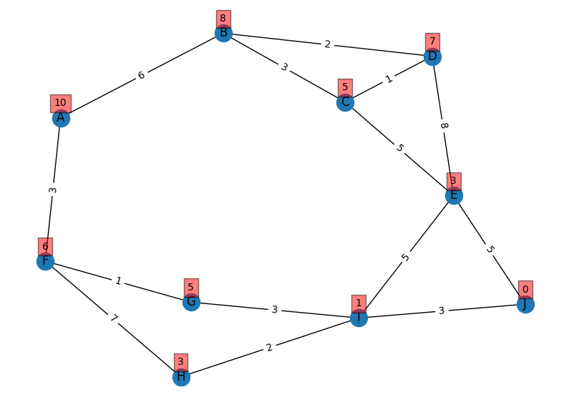
Example: Given The Following Graph:

Slide 9
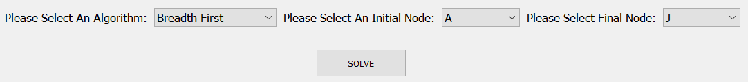
Process:
Our Software lets user choose The Desired Algorithm then the Initial and Goal Nodes, The user the Presses solves the software does its magic and produces the desired solution to the user.

Slide 10
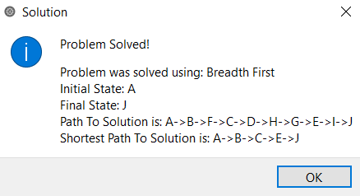
Solution:

Slide 11
Uninformed Search Algorithms

Slide 12
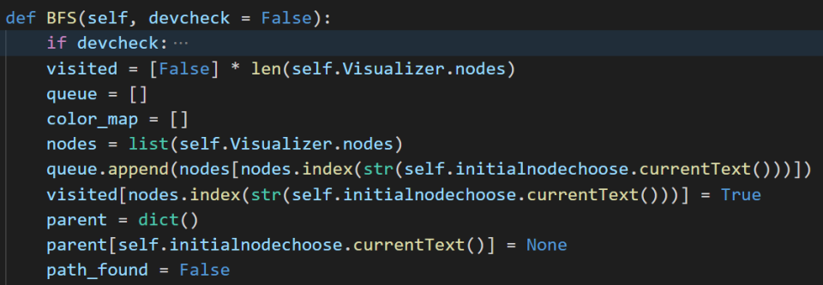
BFS Algorithm

Slide 13
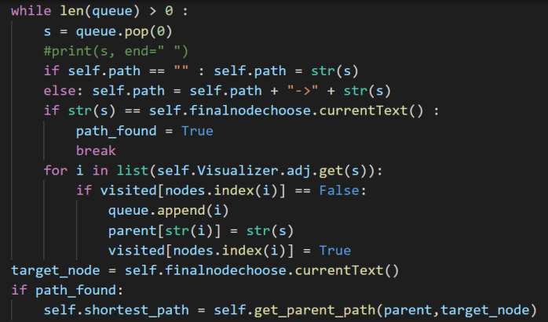
BFS Algorithm

Slide 14
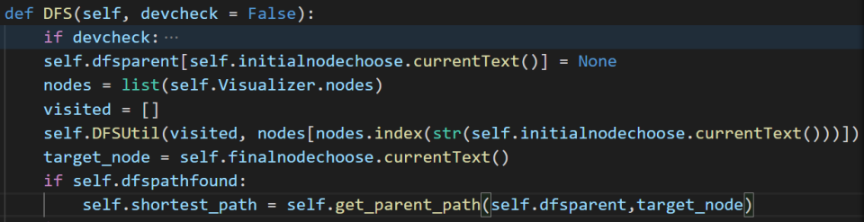
DFS Algorithm

Slide 15
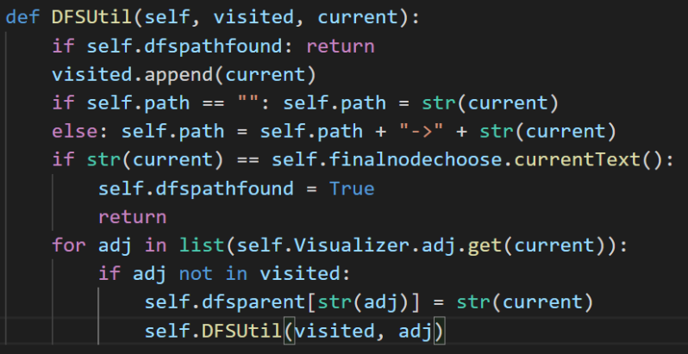
DFS Algorithm

Slide 16
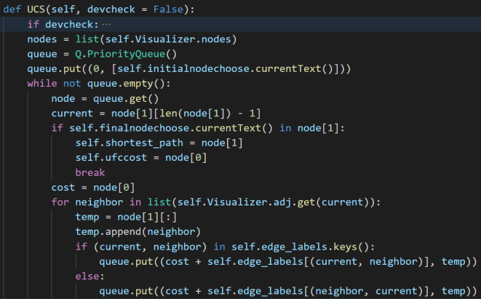
Uniform Cost Search Algorithm

Slide 17
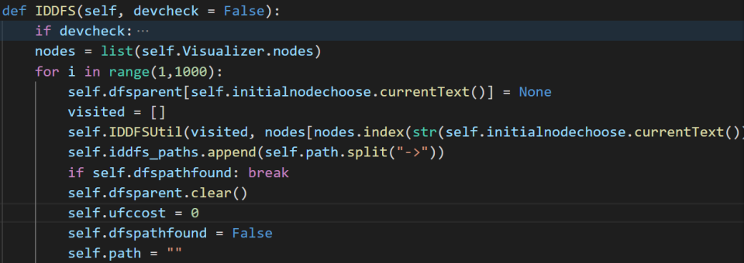
Iterative Deepening

Slide 18
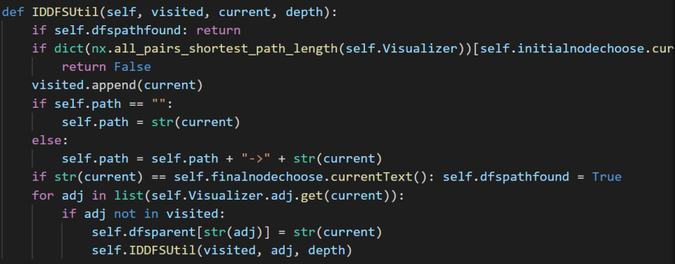
Iterative Deepening

Slide 19
Informed Search Algorithms

Slide 20
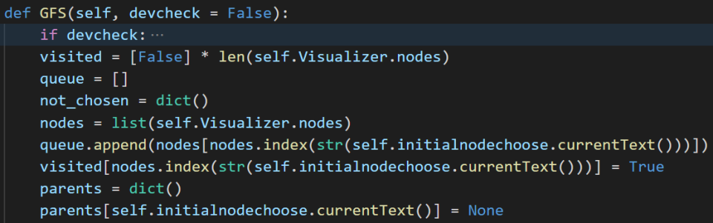
Greedy Algorithm

Slide 21
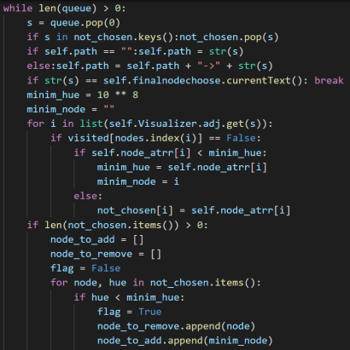
Greedy Algorithm

Slide 22
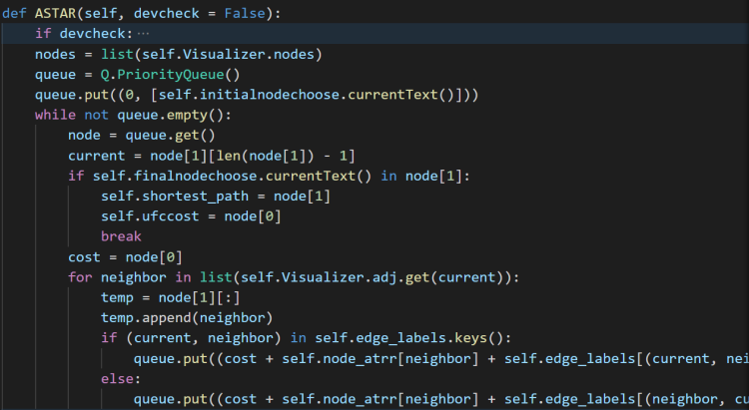
A-star Algorithm

Slide 23
Thank you
officialzerocode@gmail.com

