Slide 1
Tiny Language Compiler
Team 2

Slide 2
Agenda
Introduction
Milestones
Timeline
Features
Summary

Slide 3
Introduction
We aim to create a software application that can compile, and parse code written in tiny language with many features and simple GUI.

Slide 4
Milestones

Slide 5
M1
M2
M3
M4
MILESTONE
MILESTONE
MILESTONE
MILESTONE
Successfully created a working scanner on command line
Successfully created a working parser that outputs a parse tree
Successfully Implemented a simple yet smooth GUI
Successfully made DFA and RegExp deduction

Slide 6
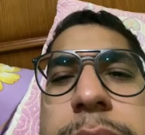
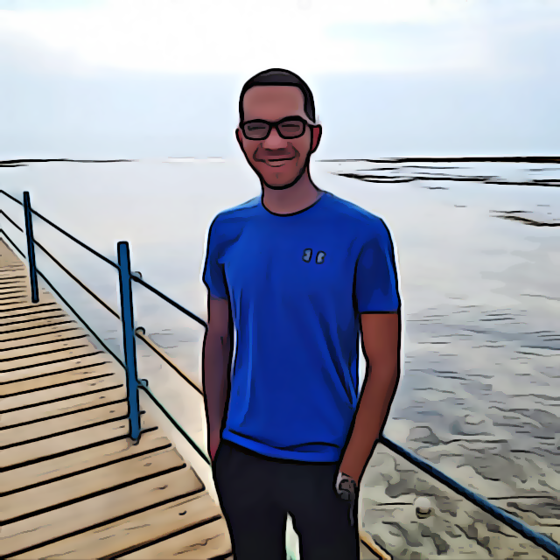


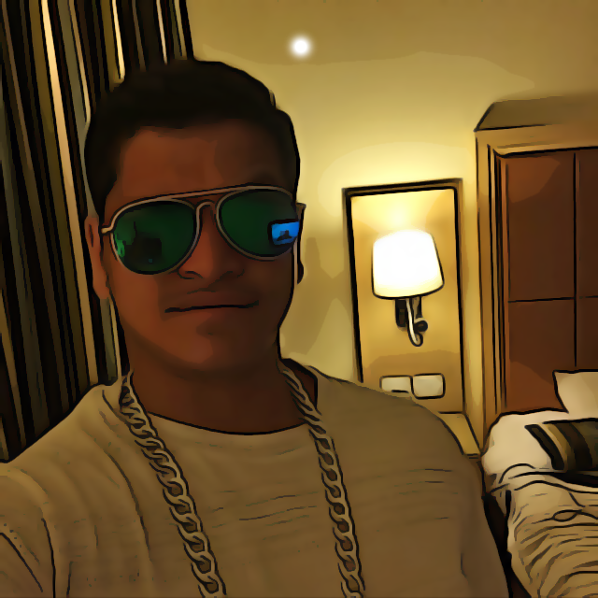


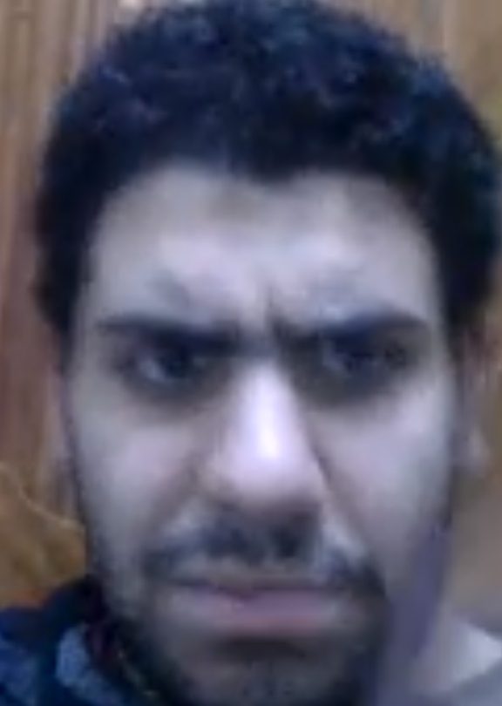

Meet our team
Osama Ali
Adham Ahmed
Osama Ayman
Abdulrahman Ayman
Abdelraof Monir

Slide 7
Timeline
Finished Presentation
March 25/2022
Created Lexer
March 31/2022
Created Parser
April 7/2022
Made DFA and deducted RegExp
April 19/2022

Slide 8
Features
Simple GUI
DFA State Tracking
Table Of Generated Tokens
DFA and RegExp Preview
Live Parse Status

Slide 9
Summary
We think we have created a well-designed software which is both easy to use and provides the necessary features with simple GUI.

Slide 10
Thank you
officialzerocode@gmail.com

