Slide 1
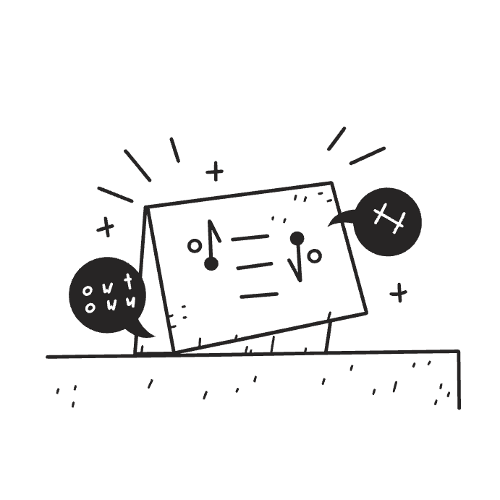
Building a Speech-to-Text & NER Pipeline for Uzbek
Speech-to-text pipeline development. Challenges and solutions. Results and insights.
Docs: link​ | Gradio space: link
by Abduaziz Abdurakhmonov

Slide 2
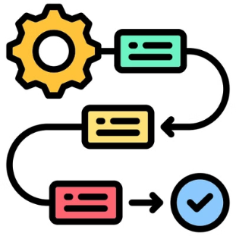
Methodology: A Two-Step Approach
1. Speech-to-Text (STT)
2. Named Entity Recognition (NER)
Dataset: A dataset of 44,000 rows (~70 hours) was used. 40,000 rows were used for training, and 4,000 for testing. Preprocessing steps included noise reduction, volume normalization, and silence trimming.
Dataset: The NER model was trained using 16,000 rows of data, employing BIO tagging for entities (DATE, EVENT, LOC, ORG, PER). Preprocessing included BIO tagging, tokenization, and padding.
Model: Fine-tuning utilized the xlm-roberta-large model with a learning rate of 2e-5 over 6 epochs, leveraging FP16 precision for efficient training.
Model: The openai/whisper-small model was employed. Fine-tuning was performed using a batch size of 16 (train), 16 (eval), a learning rate of 2e-5, and trained for 6000 steps.

Slide 3
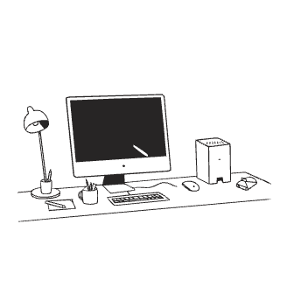
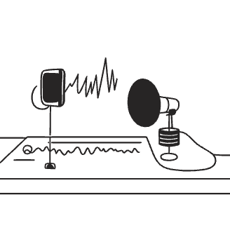
Challenges and Solutions
NER
STT
Class Imbalance: Unequal distribution of entity types skewed model predictions.
Audio Quality: Noise and silence reduced accuracy.
Overfitting: The model overfit the training data, leading to poor generalization.
Resource Limitations: Google Colab's limited resources constrained batch size and training time.
Solutions
Weighted Loss Function: Addressed class imbalance using `compute_class_weight` to improve model fairness.
Early Stopping & Learning Rate Tuning: These techniques mitigated overfitting and improved model stability.
Audio Preprocessing: Noise reduction, silence trimming, and volume normalization improved input data quality.
High-Performance Computing: Migrating to Runpod's A40 GPU accelerated training (reduced time to ~7 hours).
Hyperparameter Optimization: Tuning batch size, learning rate and training steps enhanced model performance.

Slide 4



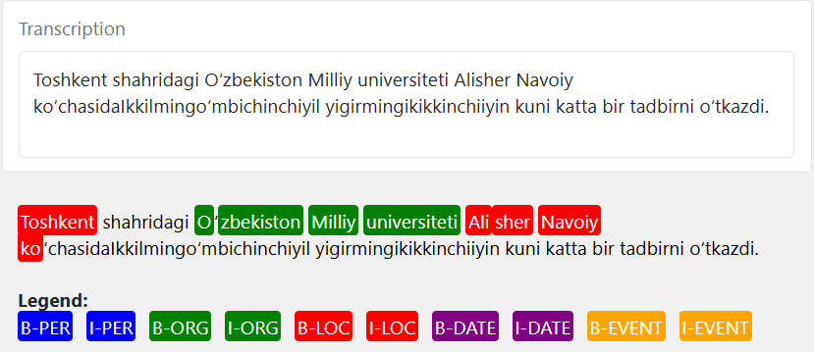
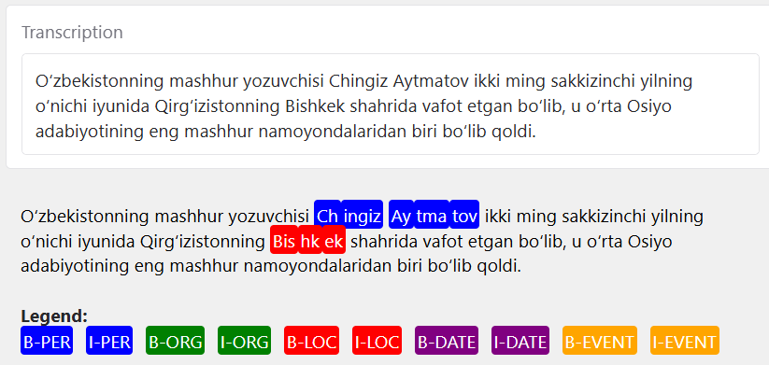
Results and Insights
Named Entity Recognition (NER)
Speech-to-Text (STT)
The NER model performed well in extracting and classifying named entities from Uzbek text, with an overall F1 score of 0.6239. Despite challenges such as class imbalance and overfitting, the model demonstrated significant improvements with targeted fine-tuning.
The STT model successfully transcribed Uzbek speech into text, achieving a Word Error Rate (WER) of 35.8660. Preprocessing techniques like noise reduction and volume normalization were essential in improving transcription accuracy, especially in real-world noisy environments.
Key Metrics:
Key Metrics:
Precision: 62.17%
WER: 35.86%
Recall: 62.62%
Loss: 0.37
F1: 62.39%
Accuracy: 94.93%
Example-1:
Example-2:
Wanna try? Here is gradio space: https://huggingface.co/spaces/abduaziz/stt_ner (running on CPU free)

