Slide 1
FYP Management System
Submitted By: Abdullah Nasir
2021-CS-113
Supervisor: Sir Nazeef Ul Haq
Course: Database Systems
Department: Computer Science
Institute: UET, Lahore

Slide 2
Overview
Acknowledgement
Motivation
Introduction
UI Components
Limitations
Future Work

Slide 3
Acknowledgement
I am grateful to Allah Almighty that He provided me with the strength and power to complete this project in time. I wanted to take a moment to express my gratitude for all of the help and guidance Mr. Nazeef Ul Haq provided me throughout our project. His support was instrumental in helping me achieve my goals and I truly appreciate the time and effort he dedicated to helping me. Your feedback, suggestions, and expertise were invaluable in shaping the final outcome of the project and I am proud of what I was able to accomplish. I look forward to applying these skills in future projects.

Slide 4
Motivation
The main motivation for this project was to help to learn querying data from the database. Simple queries along with complex queries were used to make this project work smoothly. The project was developed in C# .NET Framework using Windows Form and SQL Server Microsoft was integrated as a database. Moreover, PDF reports were generated using iTextSharp (an extension in Microsoft Visual Studio).

Slide 5
Introduction
The management of final year projects is done regularly in every university. Most commonly, this process is done manually where data of students is kept in a register and insertion, modification, and deletion, are done by an attendant. In this final year project management system, the system comprises all the students of the session, and groups are made for a certain project. One student can be working in one and only one group. The evaluations of students are done by an advisory board.

Slide 6
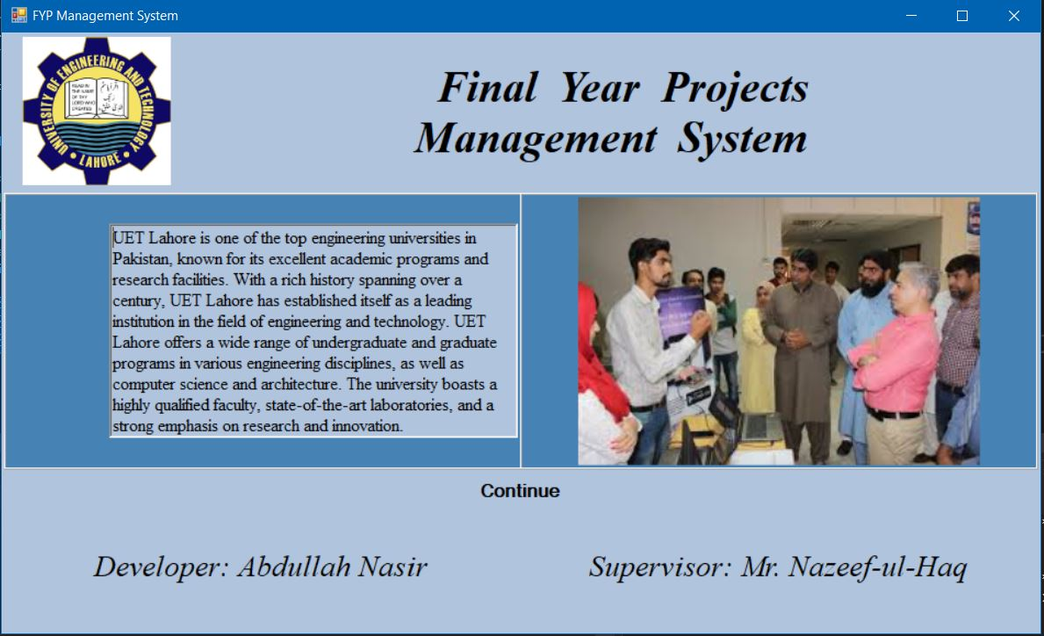
UI Components
Loading Page: This page is added to enhance user experience of the application.

Slide 7
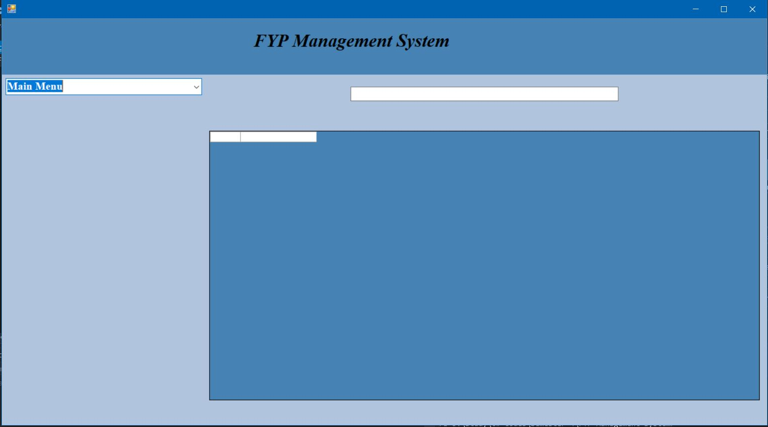
Home Page: This page is the considered the home page of application as all the new processes start from this page.

Slide 8
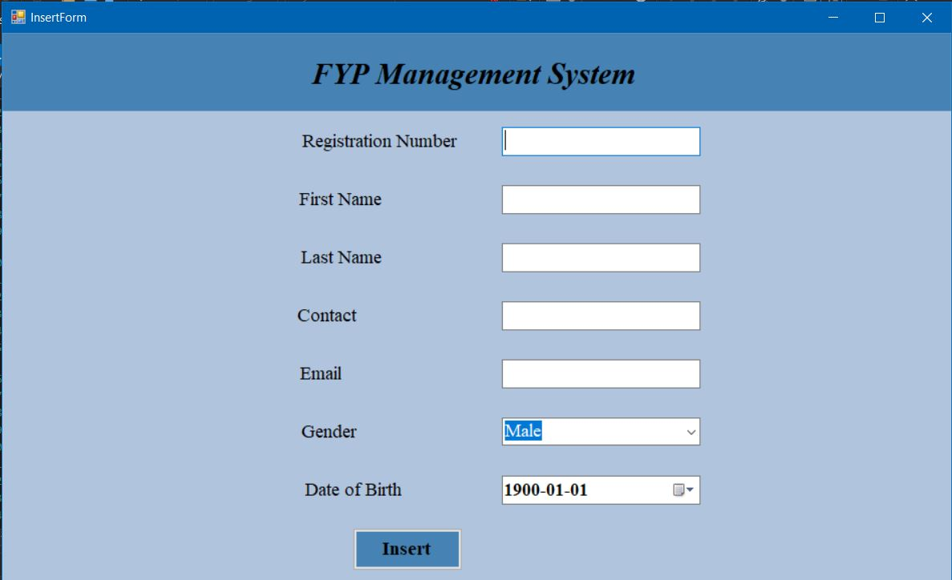
Student Page: This page is used to insert and update students.

Slide 9
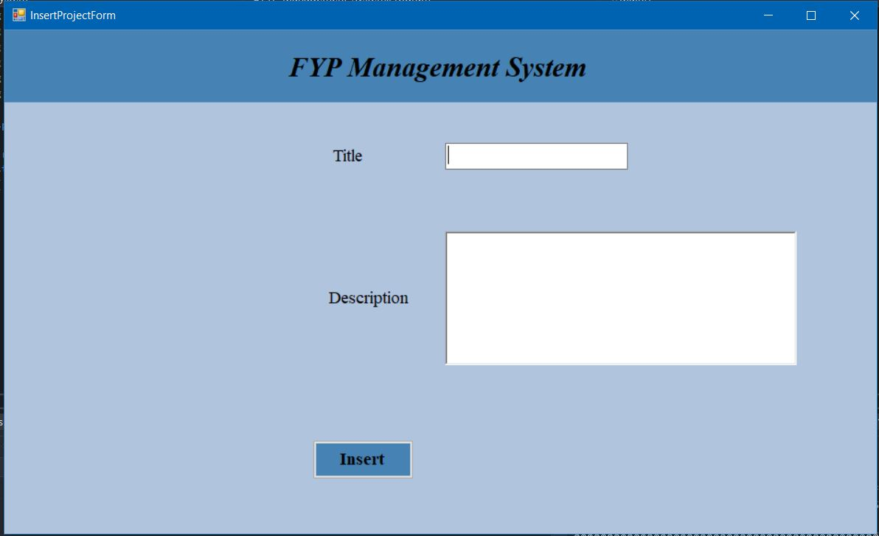
Project Page: This page is used to insert and update projects.

Slide 10
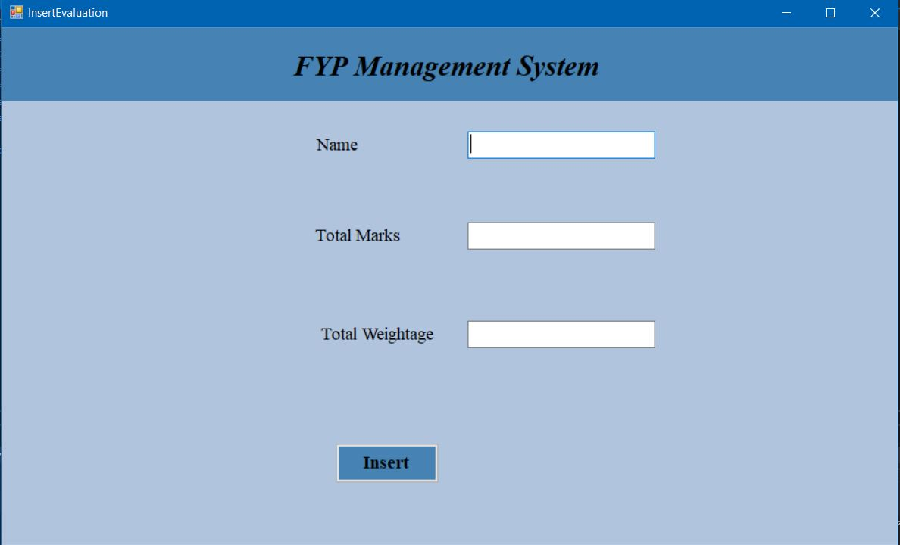
Evaluation Page: This page prompts the user to enter details for the projects of students. Updating of these project details is done here as well.

Slide 11
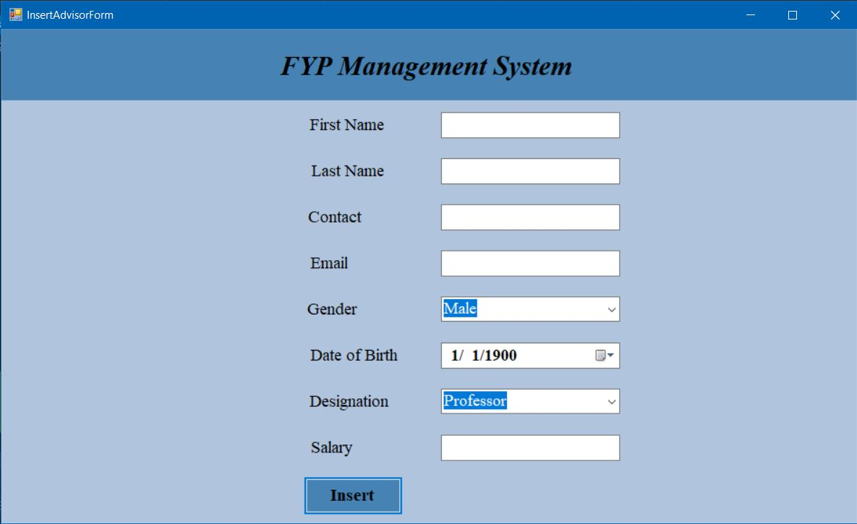
Advisor Page: The page is used to add advisors in the database. Furthermore, modifications in data related to advisors is also done here.

Slide 12
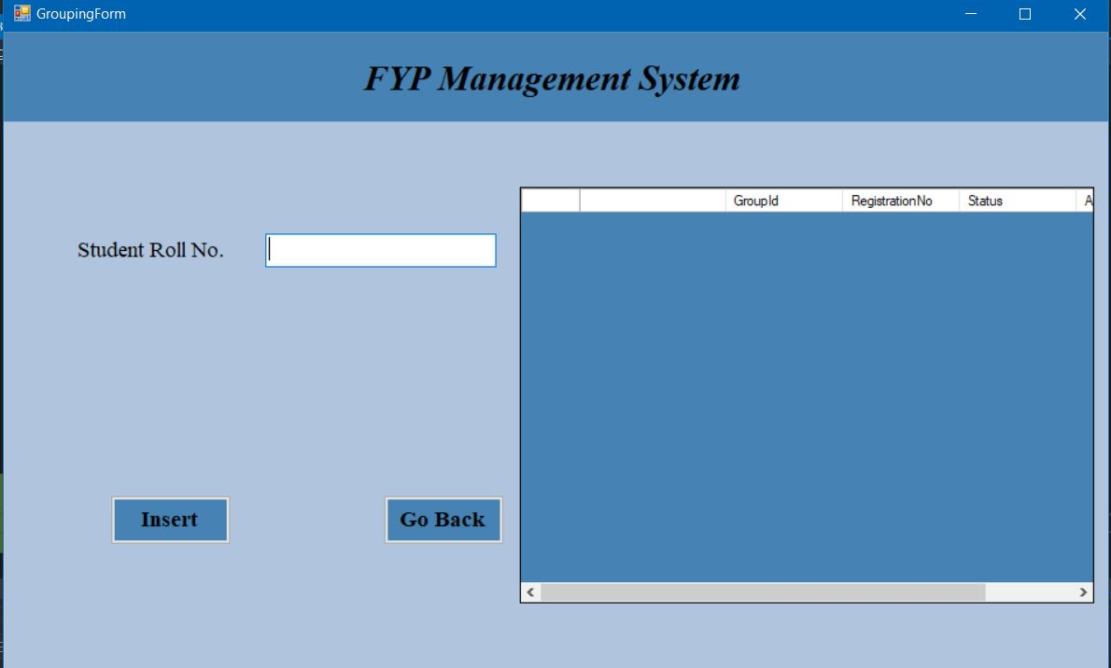
Grouping Page: The page is used to create a new group and add students to it. Moreover it can also be used to enter or remove students from an existing group.

Slide 13
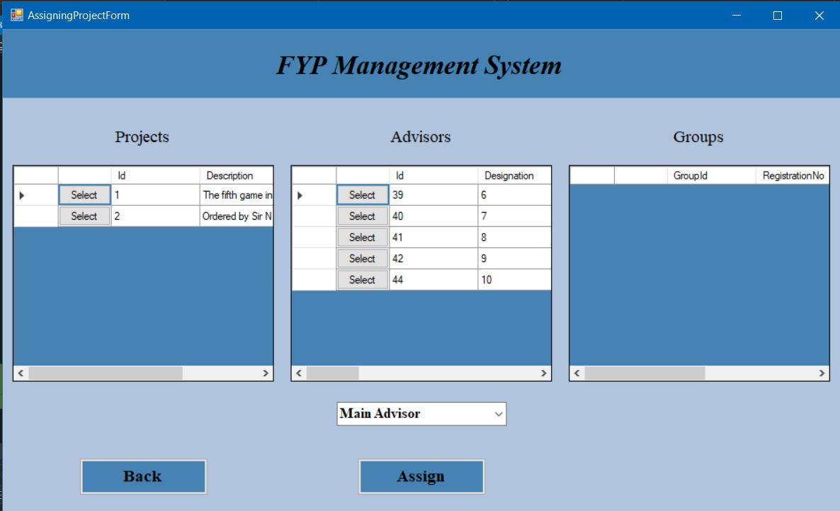
Project Assigning Page: This page is used to assign project to the group and assign advisors to the projects.

Slide 14
Limitation
The application is only oriented towards a single user.
No login is required and thus anyone can access the application, making the data to be insecure.
The code needs to be changed if different reports are required. They are not generated dynamically.

Slide 15
Conclusion
The Final Year Projects Management midterm project for the fulfillment of the Database and Management System Lab was a full package to learn out the practical implementation of the queries. The full power of the project can be revealed if further time is provided. Overall it is a working project with extendibility.

Slide 16
Thank You!
Any Questions?

