Slide 1




GIS-based School site selection in Lahore, Pakistan
Presenter: Muhammad Abdul Aleem

Slide 2
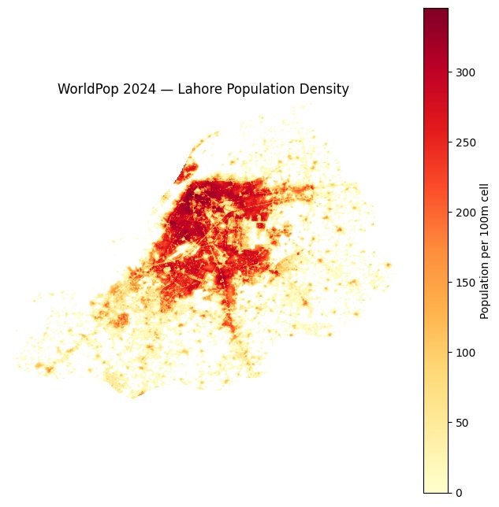


Problem Statement
Growing Demand: Lahore’s 14M+ population strains public schools, creating surging demand for private education — unevenly spread across the city.
Investment Risk: Investors lack data on where demand is high, competition is low, and costs are realistic.
The Consequence: Wrong location = low enrollment, stiff competition, early closure — all preventable with spatial evidence.

Slide 3
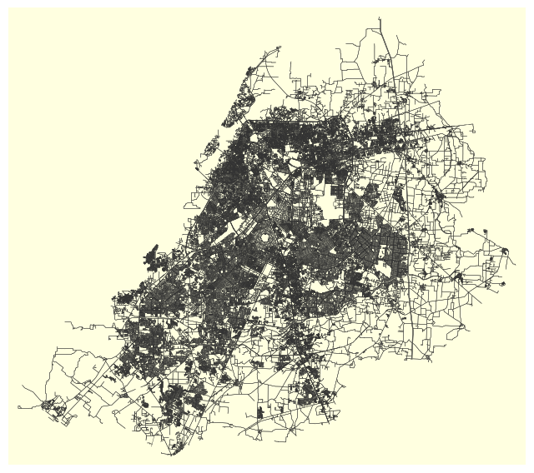
Methodology
Step 1 — Demand Mapping: WorldPop + KDE (1–2 km bandwidth) on OSMnx schools identifies underserved zones with unmet child demand.
Step 2 — MCDA Scoring: OSMnx road travel-time + Zameen.com property rates fed into MCDA to rank candidate sites.
Step 3 — Break-Even Model: Setup costs modelled per site; minimum enrollment to break even calculated.

Slide 4
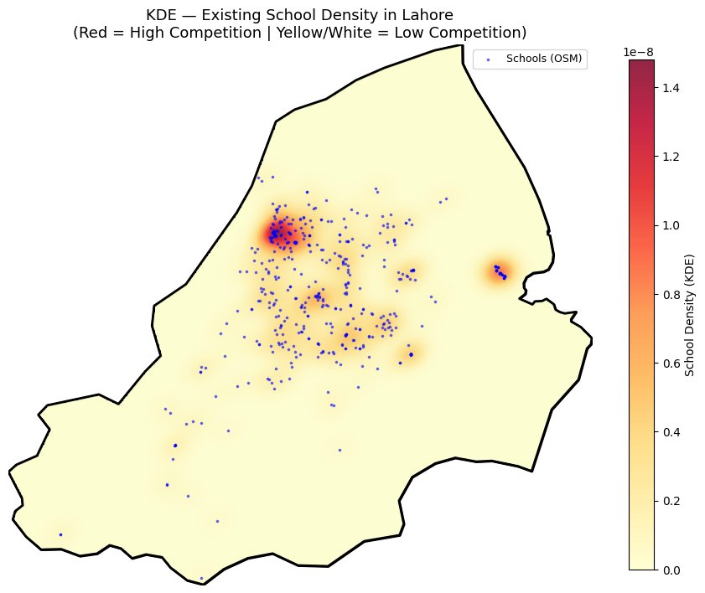
Results/Expected outcomes
Optimal Zoning Map: Ranked, color-coded map of Lahore’s top school investment zones scored by demand gap, accessibility, and cost.
Financial Clarity: Site-by-site cost table + exact break-even enrollment threshold per location.
Confident Decisions: Spatial data distilled into one actionable brief — right location, right budget, right time to invest.

Slide 5
Thank you.

