Slide 1
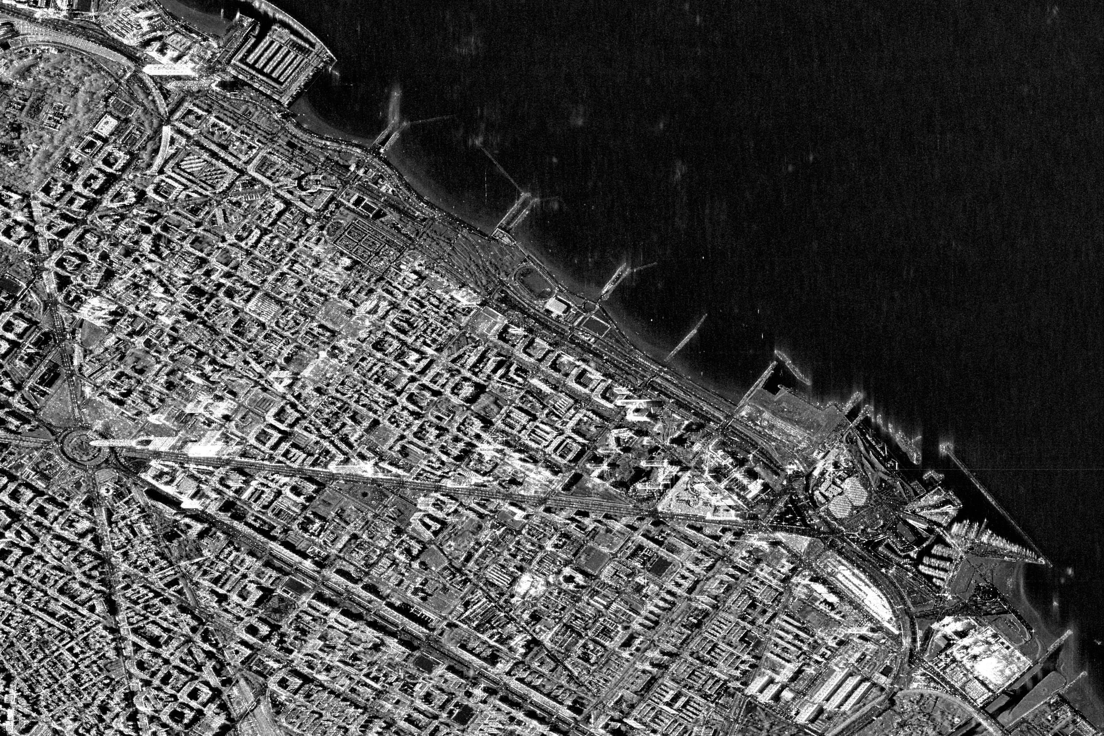
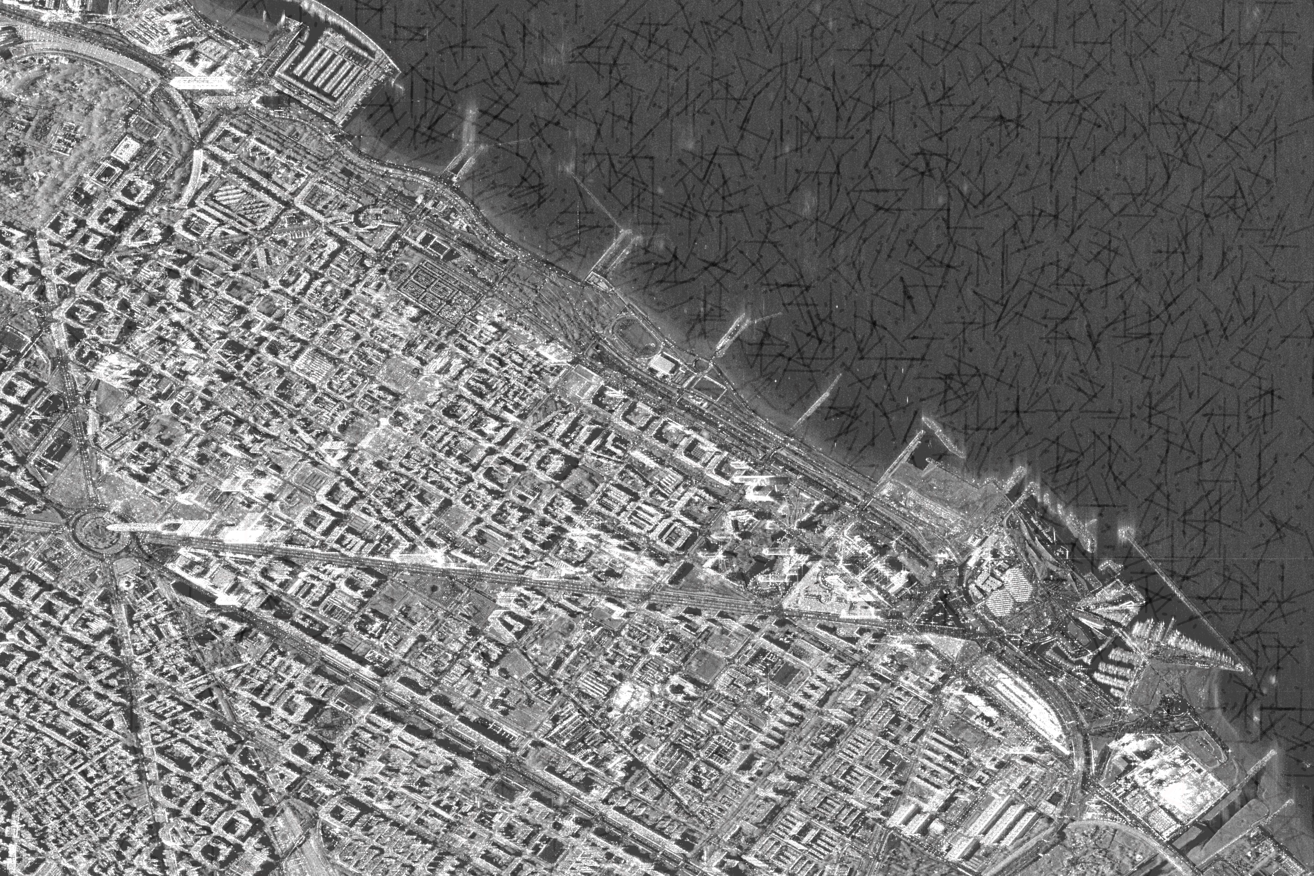
GIS-based School Site Selection in Lahore, Pakistan
Muhammad Abdul Aleem (MSDS25022)
Session: Spring 2026
Supervisor: Course Instructor
Course: Spatial Data Science
1. Introduction
4. Methodology
Lahore is one of Pakistan’s fastest-growing cities with 14M+ residents. Demand for private schooling is rising yet spatially uneven. Investors opening new schools face two critical unknowns: where to locate, and how much capital to invest. This project uses GIS, Kernel Density Estimation, and Multi-Criteria Decision Analysis (MCDA) to spatially identify the most profitable school locations in Lahore using publicly available datasets.
Step 1 — Demand Mapping: Gaussian KDE (σ=5) applied to WorldPop raster to produce child population demand surface. Step 2 — Competition Mapping: KDE (bw=0.15) on 472 school locations produces school density surface. Step 3 — Underserved Zones: Normalized demand minus competition (clipped ≥0) identifies high-opportunity zones. Step 4 — MCDA Scoring: Weighted composite score = 0.35×Population + 0.30×SchoolGap + 0.20×(1−Cost) + 0.15×Accessibility. Step 5 — Break-Even Model: Monthly cost (rent + staff + utilities) divided by fee per student gives minimum enrolment threshold per area.
Fig. 2: KDE population demand surface (left) and underserved zones map (right). Red = high opportunity areas.range vector on ground. Right: An initial PSI solution obtained with IPTA. The dots mark the detected persistent scatterers. Their color represents the estimated deformation in mm/y. The red line shows the extent of an azimuth line whose tomographic inversion is presented in Fig. 5.
2. Problem Statement
Which specific areas of Lahore present the best business opportunity for opening a private school, and what is the estimated investment required to break even? Wrong location choices lead to low enrolment, intense competition, and early closure. Currently no spatial-financial decision framework exists for private school investors in Lahore.
3. Data
5. Results & Discussion
Four open-source datasets were used: (1) WorldPop 2024 gridded population raster at 100m resolution (worldpop.org); (2) 472 school locations from OpenStreetMap via Overpass Turbo; (3) Lahore district boundary from GADM Level 3; (4) OSMnx road network (144,676 nodes, 376,672 edges). Property rental data was manually collected from Zameen.com for 9 areas. Preprocessing: all layers reprojected to UTM Zone 42N (EPSG:32642); WorldPop clipped to Lahore with nodata removal; schools clipped to boundary (486 → 472).
KDE analysis confirms school clustering in central-northern Lahore (Gulberg, Model Town, Johar Town). Southern and western zones (Raiwind, Township, Wapda Town) show high population demand with minimal school coverage — these are primary investment opportunities. MCDA suitability scoring ranks Township and Wapda Town highest (low cost + high demand + low competition). Break-even analysis shows Raiwind requires only 59 students/month vs. 154 for DHA. Recommended investment range: PKR 1.0M–1.5M/year in low-cost zones vs. PKR 4.8M+ in premium areas.
Fig. 1: (Left) 472 existing school locations from OSM — clustered in central Lahore. (Right) Lahore road network — 144,676 nodes, 376,672 edges.
Acknowledgments: Data: WorldPop 2024 (worldpop.org), OpenStreetMap contributors, GADM (gadm.org), Zameen.com. Tools: Python, QGIS, GeoPandas, OSMnx, SciPy.

