Slide 1
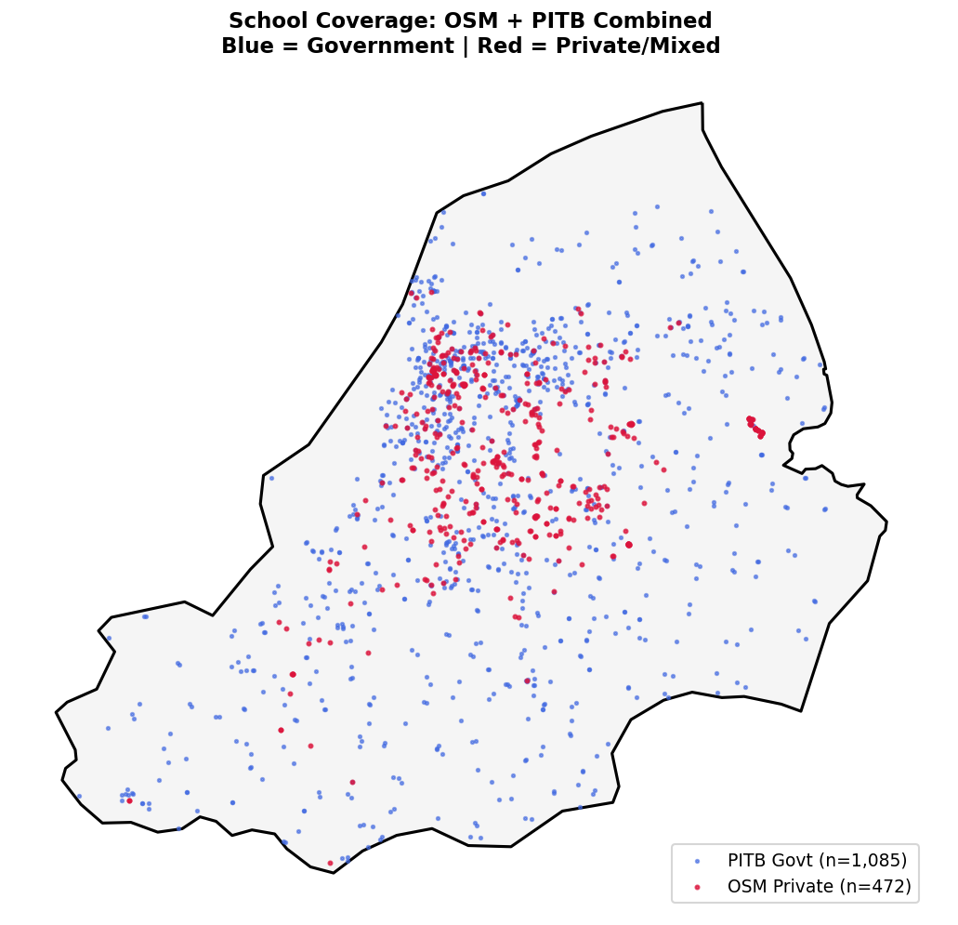
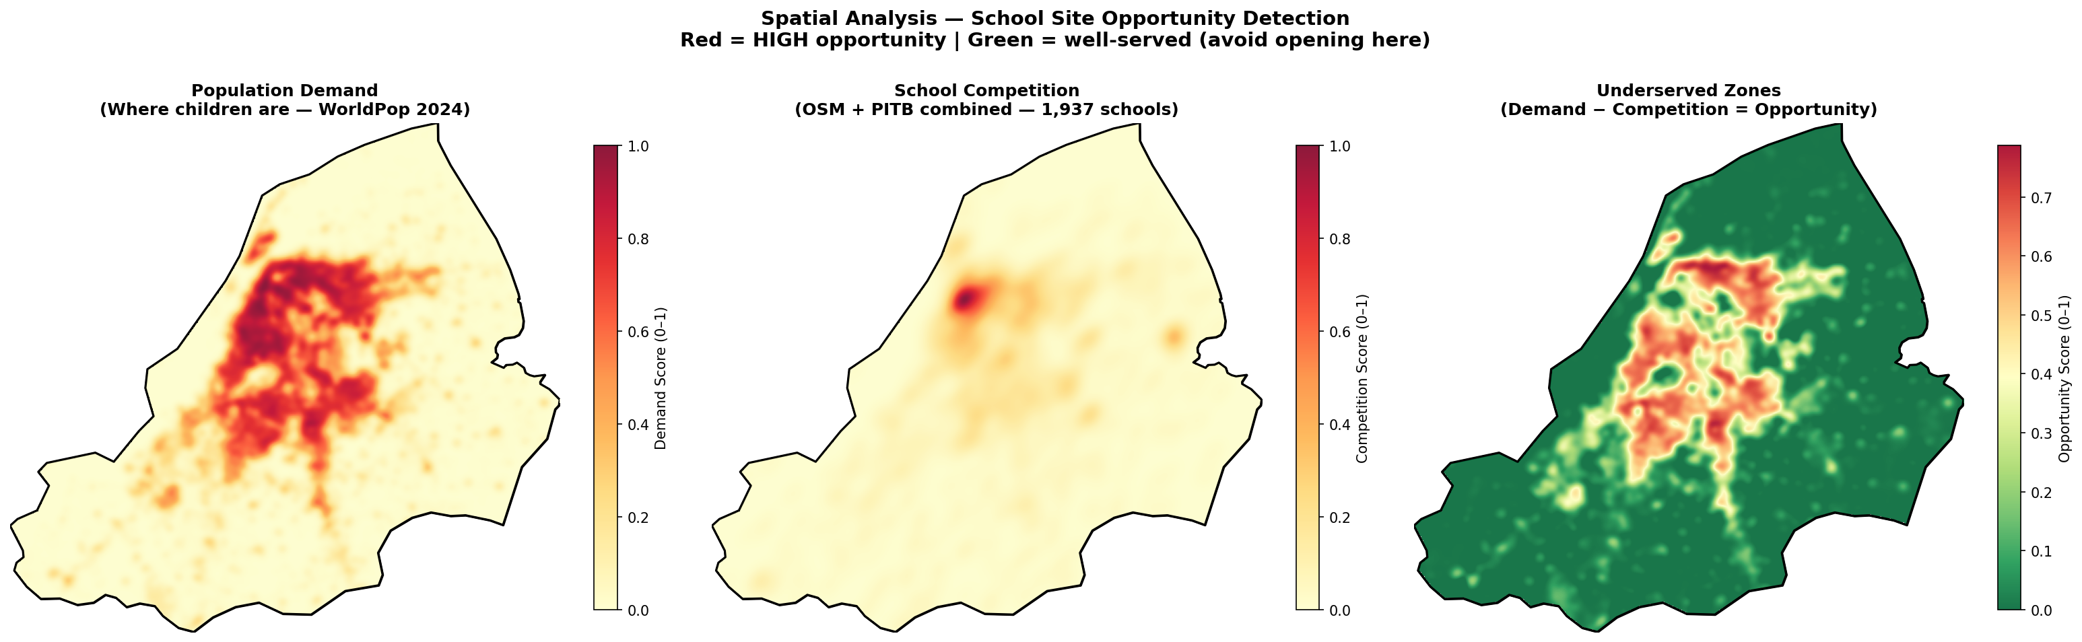
GIS-Based school site selection in Lahore, Pakistan
Muhammad Abdul Aleem (MSDS25022)
Session: Spring 2026
Supervisor: Dr. Adnan Siddique
Course: Spatial Data Science
1. Introduction
4. Methodology
Lahore, Pakistan’s second-largest city with 14M+ residents, faces rapidly growing demand for private schooling. Yet school distribution is highly uneven — dense in central neighbourhoods, almost absent in southern and western zones. Investors who open schools without spatial evidence risk choosing saturated, expensive locations. This project builds a data-driven GIS framework combining Kernel Density Estimation, KD-Tree nearest-school analysis, and Multi-Criteria Decision Analysis (MCDA) to identify the most profitable school locations, with full financial modelling.
Step 1 — KDE Demand Surface: Gaussian filter applied to the WorldPop population raster to produce a smooth child population density heatmap. Step 2 — KDE Competition Surface: Kernel Density Estimation fitted on all 1,937 school locations (OSM + PITB) to map school clustering. Step 3 — KD-Tree School Gap: A scipy cKDTree was built from all school coordinates. For each of 250,000 grid points, the distance to the nearest school was computed — giving a spatially complete gap surface. Step 4 — Property Cost Layer: Commercial rental rates from Zameen.com and Graana.com were spatially interpolated across the full grid using grid data (method=’nearest’) — covers 100% of Lahore with no convex-hull cutoff. Step 5 — Road Accessibility: OSMnx road edge centroids binned onto the grid and smoothed with a Gaussian filter to make an accessibility density surface. Step 6 — MCDA Composite Score: Weighted sum of all four normalized layers: 35% Population + 30% School Gap + 20% Low Cost + 15% Accessibility. Final score normalised 0–1. Step 7 — Break-Even Model: Monthly cost = rent + PKR 250,000 staff + PKR 60,000 fixed costs. Break-even = total monthly cost ÷ PKR 3,000 per student.
Fig. 2: (Left) KDE School Competition Surface — Red = high competition zones. (Right) KDE Population Demand Surface — Red = high child density, high enrolment potential (WorldPop 2024, 100m resolution).
2. Problem Statement
Which specific areas of Lahore present the best business opportunity for opening a new private school? What is the estimated monthly investment, and how many students are needed to break even? Choosing the wrong location leads to low enrolment, intense competition, and early closure.
3. Data
5. Results & Discussion
Four open-source datasets combined with verified property data: • WorldPop 2024: Gridded population raster, 100m resolution • PITB Registry: 1,465 government schools • OpenStreetMap: 472 private/mixed schools • GADM Level 3: Lahore district boundary polygon • OSMnx Roads: 144,676 nodes, 376,672 edges • Zameen.com + Graana.com: Commercial rental rates for 12 areas Preprocessing: All layers reprojected to UTM Zone 42N (EPSG:32642). WorldPop clipped to Lahore boundary. Schools clipped from 486 → 472 (OSM) and from 48,195 → 1,465 (PITB, geographic filter). A shared 500×500 pixel grid was built over Lahore for all analysis layers.
KDE analysis confirms that schools are heavily clustered in central and northern Lahore. The PITB data reveals that government school density is also high in these zones, meaning competition is intense from both private and public sectors. The underserved zone map (population demand minus competition) highlights southern and western Lahore as the highest-opportunity areas: Township, Wapda Town, Raiwind, and Faisal Town show high child population density with minimal school coverage. MCDA suitability scoring (35% population + 30% school gap + 20% cost + 15% access) ranks Township and Wapda Town highest, combining strong spatial demand with low rental costs. Break-Even Results at PKR 3,000/student/month fee: • Raiwind Road: 132 students (PKR 70,000 rent + fixed costs = PKR 395,000/month) • Township: 135 students (PKR 85,000 rent) • Wapda Town: 138 students (PKR 110,000 rent) • DHA Phase 1-5: 187 students (PKR 160,000 rent) • Gulberg: 237 students (PKR 350,000 rent) — high risk Recommendation: A new private school in Township or Wapda Town requires approximately PKR 1.0–1.5M/year in total costs and can achieve profitability with 150 students. Premium zones (Gulberg, DHA) require PKR 4.8M+ and need 200+ students just to break even.
Fig. 1: (Left) 1,937 school locations in Lahore: 472 OSM private schools (red) + 1,465 PITB government schools (blue), clipped to GADM boundary. (Right) Underserved opportunity zones in Lahore (Demand - Competition).
Acknowledgments: Data: WorldPop 2024 (worldpop.org), OpenStreetMap contributors (ODbL), GADM Level 3 (gadm.org), Punjab PITB, Zameen.com, Graana.com. Tools: Python, GeoPandas, Rasterio, OSMnx, SciPy, Matplotlib.

