Slide 1
PART 1
WHAT IS METAVERSE?

Slide 2
HISTORY HINTING ABOUT METAVERSE

Slide 3
Neal Stephenson uses term “METAVERSE” in his novel “Snow Crash” in 1992.

Slide 4
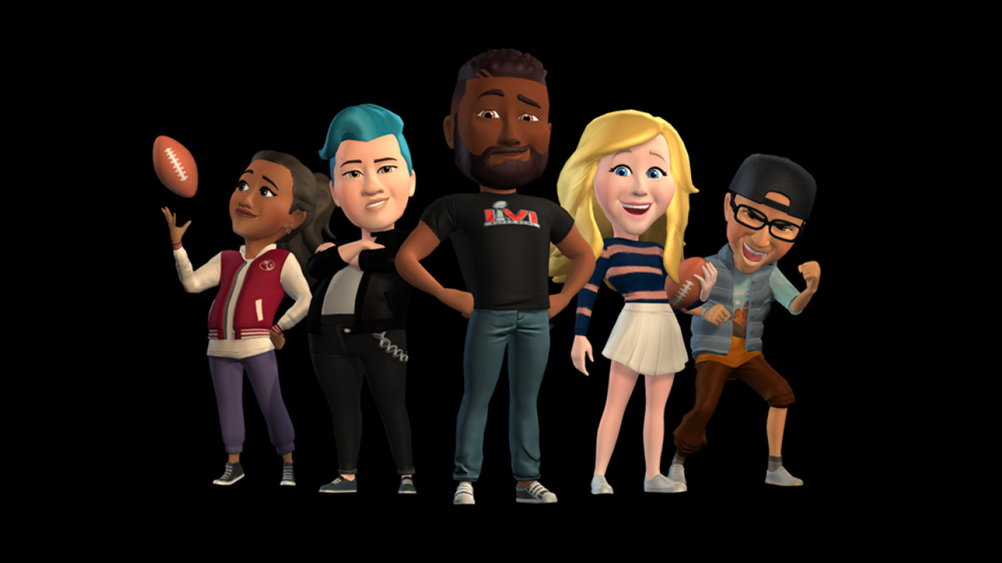
AT ANY GIVEN TIME, THERE WERE ROUGHLY 15 MILLION HUMAN CONTROLLED AVATARS ON THE STREET

Slide 5
William Gibson in1984 uses a term CYBERSPACE which describes an environment of Internet. Like Google, Facebook and Yahoo.

Slide 6
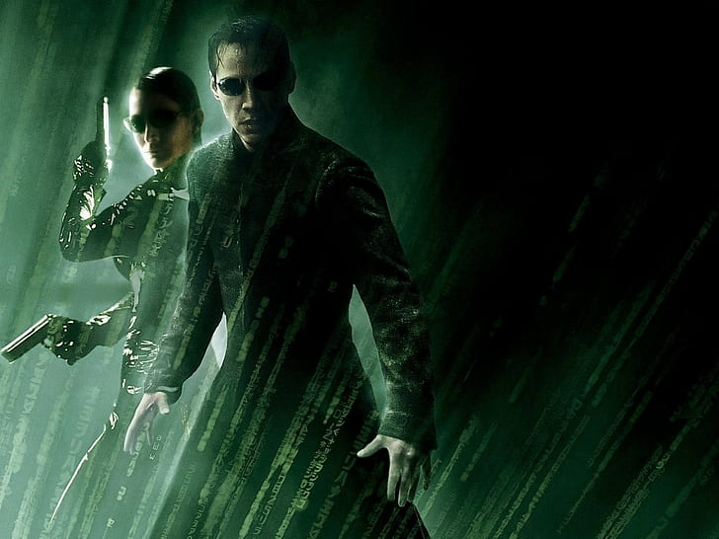
Gibson called the visual abstraction of cyberspace “The Matrix”.
The Matrix movie is released in 1999 in which humanity is connected to 2199 by a simulation.

Slide 7
In 1935, Stanley Weinbaum wrote about VR goggles that gives one sight and sound.

Slide 8
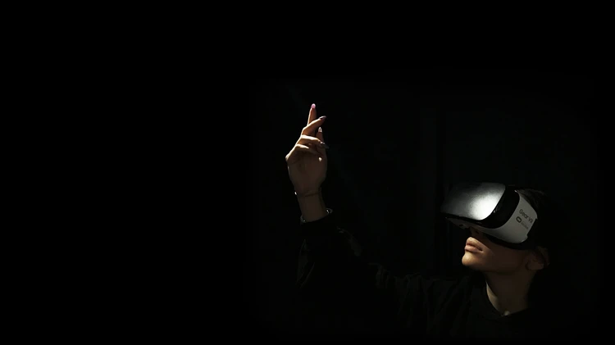
You will be in the story of movie, you speak to avatars and avatars will reply you.

Slide 9
THE COMING FIGHT TO CONTROL TO METAVERSE

Slide 10
In 2016, Tim Sweeny told the reporters,
“This Metaverse is going to be far more pervasive and powerful than anything else. If one central company gains control of this, they will become more powerful than any government and be a God on Earth.”

Slide 11
The Metaverse will also render more acute many of the hard problems of digital existence today, such as data rights, data security, misinformation and radicalization, platform power and regulation, abuse, and user happiness.

Slide 12
TIME FOR DEFINATION

Slide 13
“A massively scaled and interoperable network of real-time rendered 3D virtual worlds that can be experienced synchronously and persistently by an effectively unlimited number of users with an individual sense of presence, and with continuity of data, such as identity, history, entitlements, objects, communications, and payments.”

Slide 14
VIRTUAL WORLDS
For decades, the primary reason to build a virtual world was for a video game, such as The Legend of Zelda or Call of Duty, or as part of a feature film, such as those of Disney’s Pixar or for Warner Bros.’ The Matrix.

Slide 15
3D
3D is necessary not just because it signals something new. Metaverse theorists argue that 3D environments are required in order to make possible the transition of human culture and labor from the physical world to the digital one.

Slide 16
REAL TIME RENDERED
Rendering is the process of generating a 2D or 3D object or environment using a computer program. The goal of this program is to “solve” an equation made up of many different inputs, data, and rules that determine what should be rendered to visualize in real world.

Slide 17
SYNCHRONOUS
We don’t want virtual worlds in the Metaverse to merely persist or respond to us in real time. We also want them to be shared experiences.

Slide 18
PERSISTENCE
The idea of persistence in a virtual world. Almost no current games demonstrate full persistence. Instead, they run for a finite period before resetting part or all of their virtual worlds.

Slide 19
VIDEO GAMES ARE DRIVING
THE NEXT INTERNET

Slide 20
If the Metaverse is indeed a successor to the internet, it might seem odd that its pioneers come from the video gaming industry.

