Slide 1
PSG COLLEGE OF TECHNOLOGY, COIMBATORE - 641 004
DEPARTMENT OF COMPUTER APPLICATIONS • 26MX17 WEB APPLICATION DEVELOPMENT
PSG NEXUS (CHAT-BOT)
Intelligent Role-Based Campus Digital Assistant & Navigation Portal
PROJECT GUIDE:
Ms. J. GOWRI THANGAM
Assistant Professor
Department of Computer Applications
PSG College of Technology
TEAM MEMBERS (TEAM 1):
• LAXMAN B (26MX209)
• KARTHIKEYAN S (26MX110)
• MOHAMED ABDUL BASITH A A (26MX115)

Slide 2
PSG COLLEGE OF TECHNOLOGY • DEPARTMENT OF COMPUTER APPLICATIONS
Acknowledgement
• Dr. N. ILAYARAJA
Head of the Department, Department of Computer Applications, for providing overall guidance, institutional facilities, and motivation.
• Ms. A. KALYANI
MCA Programme Coordinator & Course Coordinator (26MX17 WAD), for curriculum structure, continuous monitoring, and valuable review instructions.
• Ms. J. GOWRI THANGAM
Faculty Project Guide, for consistent technical feedback, review dairy verification, and architecture suggestions.
• FACULTY REVIEW PANEL
Review Panel Members and Department Faculty, for evaluating our Review 1 deliverables and providing constructive suggestions for project enhancement.
26MX17 WEB APPLICATION DEVELOPMENT • REVIEW 1 • TEAM 1 (PSG NEXUS)

Slide 3
PSG COLLEGE OF TECHNOLOGY • DEPARTMENT OF COMPUTER APPLICATIONS
Project Overview
• Interactive Digital Campus Assistant: Seamlessly integrated as an interactive widget on the PSG College website.
• Unified Single-Point Guide: Delivers fast information across syllabi, departments, admissions, fees, hostel rules, and forms.
• Persistent In-Browser Session: Chatbot remains active and remembers conversation history across page navigation using browser sessionStorage.
• Intelligent Autonomous Page Redirection: Automatically navigates users to target pages (e.g., from Home to Online Forms Portal) without resetting the chat.
• Role-Based Access Control (RBAC): Provides tailored assistance for Students, Faculty, Parents, and Visitors while protecting confidential staff records.
• Local Database Persistence: Automatically stores user queries, responses, and roles in local MongoDB Compass (psgnexus_db.conversations) for campus analytics.
26MX17 WEB APPLICATION DEVELOPMENT • REVIEW 1 • TEAM 1 (PSG NEXUS)

Slide 4
PSG COLLEGE OF TECHNOLOGY • DEPARTMENT OF COMPUTER APPLICATIONS
Analysis of the Existing System
EXISTING SYSTEM FEATURES
• Central Information Hub: Publishes circulars, department news, tenders, and events (psgtech.edu).
• Transactional Student Services: Studzone portal allows viewing internal marks and fee payment challans.
• Traditional Menu Navigation: Organized into multi-level dropdown menus and external PDF links.
• Static FAQ & Contact Forms: General contact numbers and grievance emails.
IDENTIFIED MISSING FEATURES
• No Conversational Assistance: Lacks an interactive virtual guide to immediately answer repetitive queries.
• High Information Retrieval Latency: Students must search across multiple sub-pages to locate rules (75% attendance, CAT marks).
• Zero Automated Navigation: Cannot redirect users directly to relevant online forms or syllabus repositories.
• Lack of Cross-Page Continuity: Conventional forms or widgets reset upon clicking another page link.
• Absence of Role-Based Security: Anyone sees static links, but no contextual filtering exists for visitors vs faculty.
26MX17 WEB APPLICATION DEVELOPMENT • REVIEW 1 • TEAM 1 (PSG NEXUS)

Slide 5
PSG COLLEGE OF TECHNOLOGY • DEPARTMENT OF COMPUTER APPLICATIONS
Literature Survey of the Existing System
• 1. Official Institutional Portals (e.g., psgtech.edu)
Standard university websites provide comprehensive information but rely strictly on static hierarchical menus. Studies show students spend substantial time navigating sub-domains to locate routine circulars and syllabus copies.
• 2. Standalone Chatbot Systems in Higher Education
Existing higher education chatbots function mostly as isolated popups on single landing pages. When a user clicks an internal link, the chat context resets, causing communication drop-off and frustration.
• 3. Traditional Contact Forms & Static FAQs
Static FAQ pages fail to address user queries dynamically, and 'Contact Us' forms suffer from delayed response times (24-48 hours) for common procedural questions.
• 4. The Proposed PSG Nexus Approach
Combines a responsive college portal replica with a persistent, bottom-left AI assistant using client-side sessionStorage, automated page redirection, and role-governed document security.
26MX17 WEB APPLICATION DEVELOPMENT • REVIEW 1 • TEAM 1 (PSG NEXUS)

Slide 6
PSG COLLEGE OF TECHNOLOGY • DEPARTMENT OF COMPUTER APPLICATIONS
Tools and Technologies to be Used
FRONTEND & CLIENT UI: HTML5, CSS3, JavaScript (ES6), Bootstrap 5.3
• Responsive replica of psgtech.edu, carousels, cards, floating chatbot widget with animated pulse ring.
SERVER & TEMPLATING: Node.js & Express.js, EJS (Embedded JavaScript)
• Asynchronous server script, modular MVC routing, reusable EJS partials (header.ejs, footer.ejs, chatbot.ejs).
SESSION & PERSISTENCE: Browser sessionStorage & Express Sessions
• Preserves chat history, user role, and active widget state across page reloads without database overhead.
DATABASE & STORAGE: MongoDB (Local Storage) & MongoDB Compass
• Mongoose ODM models storing query text, bot responses, user roles, status, and timestamps in 'psgnexus_db'.
AI / NLP ENGINE: Built-in Campus Knowledge Base & Google GenAI SDK
• 50+ offline PSG Tech topics with keyword scoring; optional Gemini 1.5 Flash API for natural answering.
26MX17 WEB APPLICATION DEVELOPMENT • REVIEW 1 • TEAM 1 (PSG NEXUS)

Slide 7
PSG COLLEGE OF TECHNOLOGY • DEPARTMENT OF COMPUTER APPLICATIONS
Major Entities Involved in the Proposed Project
• STUDENT (26MX Roll No, Dept)
Role & Access: Default active role in PSG Nexus. Accesses attendance criteria (75%), CAT continuous assessment marks, CGPA calculations, syllabus downloads, hostel rules, and online form submissions.
• FACULTY / STAFF (Staff ID)
Role & Access: Elevated administrative privileges. Accesses staff leave application forms, syllabus revision guidelines, and confidential academic council / department meeting records.
• PARENT & PROSPECTIVE STUDENT
Role & Access: Focuses on institutional credentials. Accesses tuition fee structures, TNEA cutoff marks, hostel warden phone numbers, and admission eligibility guidelines.
• VISITOR & ALUMNI
Role & Access: Explores public institutional facts. Accesses campus travel directions, G.R.D. Memorial Library details, NIRF rankings, and alumni network resources (Laudea).
• CAMPUS ADMINISTRATOR
Role & Access: Monitors interaction analytics via MongoDB Compass. Tracks frequently searched student queries to identify information gaps and update circulars.
26MX17 WEB APPLICATION DEVELOPMENT • REVIEW 1 • TEAM 1 (PSG NEXUS)

Slide 8
PSG COLLEGE OF TECHNOLOGY • DEPARTMENT OF COMPUTER APPLICATIONS
Major Functionalities of the System (Review 1 Deliverables)
• 1. Official Website Replica (>90% Match): Replicated top utility bar with news marquee, official logos (75 & 100 yrs), royal blue navigation header (#2B4BAB), hero carousel, portal tiles, and 4-column footer.
• 2. Bottom-Left Assistant Widget: Embedded floating AI launcher in the bottom-left corner with glowing cyber-cyan ring (#38BDF8) and active 'STUDENT' default role.
• 3. Multi-Page Redirection Engine: Automatically redirects users to specific routes (e.g., /forms or /academics) upon verbal request with an animated 2-second countdown.
• 4. Cross-Page Session Continuity: Utilizes browser sessionStorage to keep the chat window open and preserve all conversation history across page navigation.
• 5. Out-of-Scope Boundary Guardrail: Scans incoming queries for non-college topics (movies, cricket, gaming) and responds with polite institutional boundary notices.
• 6. Role-Based Document Access Control (RBAC): Restricts confidential faculty meeting records and staff salary slips when queried by Students, but authorizes them for Faculty.
• 7. Local MongoDB Compass Storage: Asynchronously records all conversations into local MongoDB (psgnexus_db.conversations) with browser endpoint verification.
26MX17 WEB APPLICATION DEVELOPMENT • REVIEW 1 • TEAM 1 (PSG NEXUS)

Slide 9
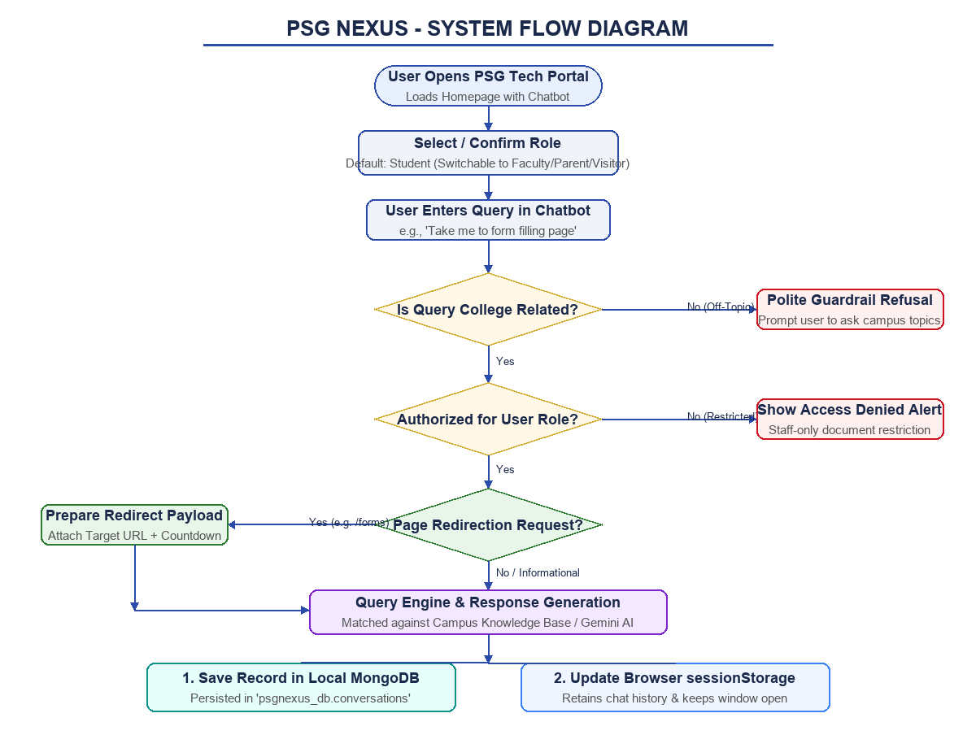
PSG COLLEGE OF TECHNOLOGY • DEPARTMENT OF COMPUTER APPLICATIONS
Work Flow of the Project
WORKFLOW STAGES:
• 1. User Access: Opens portal, launcher toggles chat.
• 2. Role Identification: Default Student role verified.
• 3. Boundary Filtering: Checks if query is college-related.
• 4. Security Check: Evaluates document access permissions.
• 5. Intent Matching: Checks if query requests page navigation.
• 6. Query Answering: Fast lookup via local campus knowledge base or Gemini API.
• 7. Dual Persistence: Writes document to MongoDB & saves state in sessionStorage.
• 8. Smooth Transition: Navigates page with open chat session.
26MX17 WEB APPLICATION DEVELOPMENT • REVIEW 1 • TEAM 1 (PSG NEXUS)

Slide 10
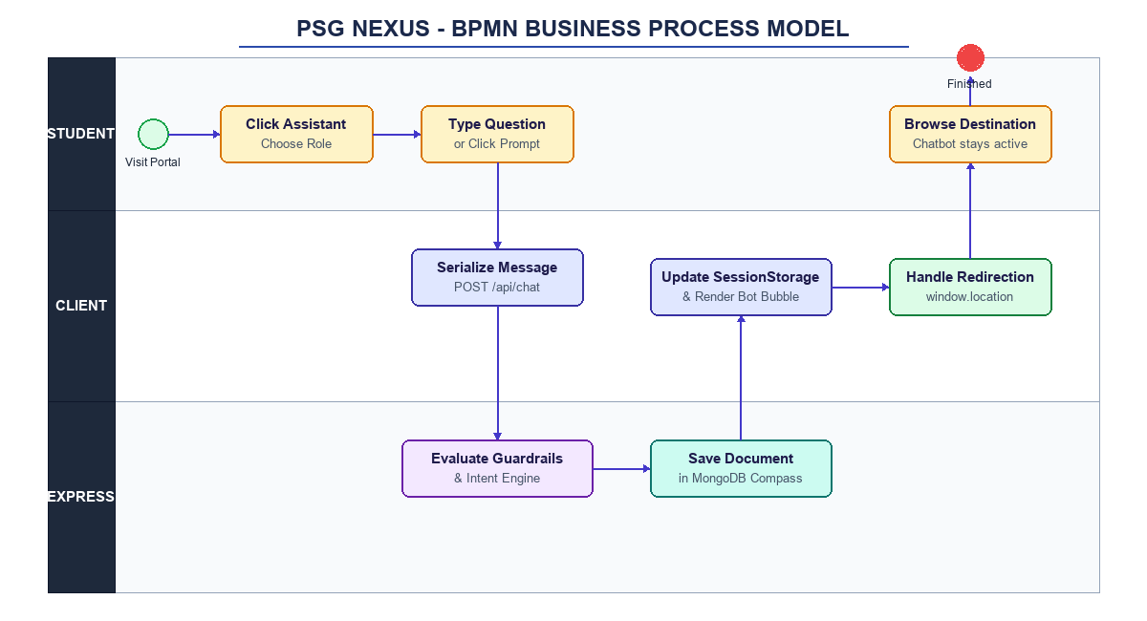
PSG COLLEGE OF TECHNOLOGY • DEPARTMENT OF COMPUTER APPLICATIONS
BPMN Diagram of the Entire Project
3 SWIMLANES:
• User Lane: Interacts with portal, submits queries, and clicks quick prompt chips.
• Client UI Lane: Serializes chat history into sessionStorage and executes redirection timers.
• Express Server Lane: Evaluates guardrails, processes intent, generates answer, and logs to MongoDB.
• End Event: User lands on destination page with active assistant conversation.
26MX17 WEB APPLICATION DEVELOPMENT • REVIEW 1 • TEAM 1 (PSG NEXUS)

Slide 11
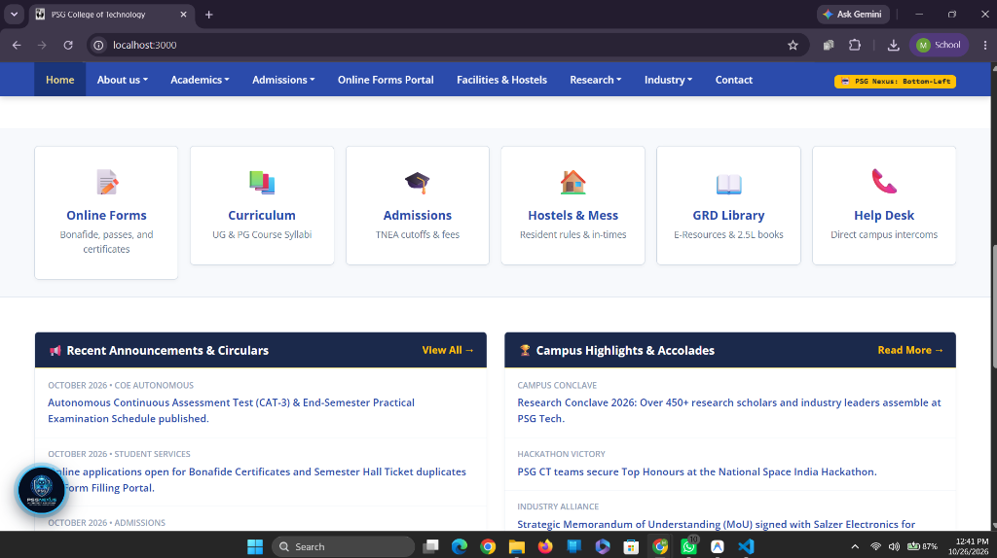
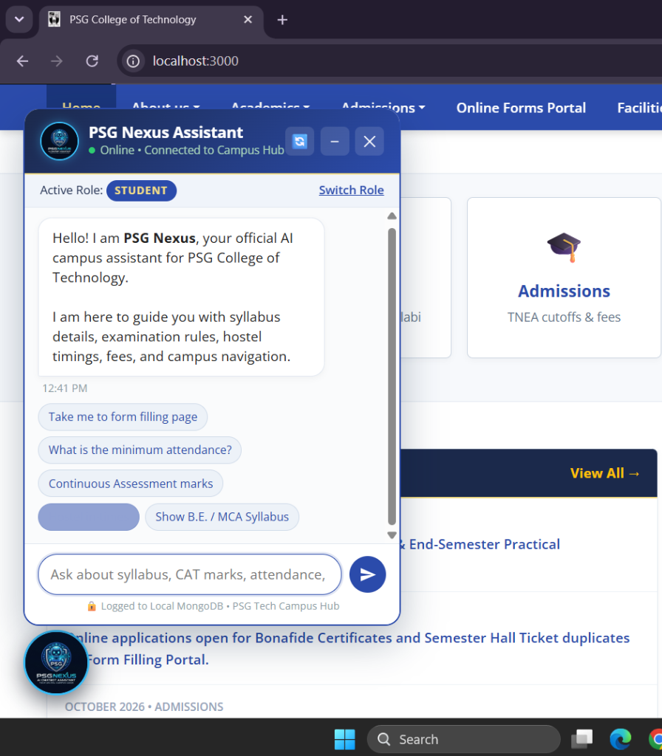
PSG COLLEGE OF TECHNOLOGY • DEPARTMENT OF COMPUTER APPLICATIONS
UI Pages of the Complete Project (Running Prototype)
• Figure A: Official PSG Tech Portal Replica with Bottom-Left Floating Launcher
• Figure B: Interactive Chatbot (Student Role, Quick Chips & Redirection)
26MX17 WEB APPLICATION DEVELOPMENT • REVIEW 1 • TEAM 1 (PSG NEXUS)

Slide 12
PSG COLLEGE OF TECHNOLOGY • DEPARTMENT OF COMPUTER APPLICATIONS
Timeline of the Project (8-Week Work Plan)
• WEEKS 1 - 2: Requirement Gathering & Architecture Design — Analyzed campus workflows, drafted WAD design document, set up Git repository in VS Code.
• WEEK 3: Frontend Replica & EJS Layout Modeling — Built psgtech.edu UI replica, responsive Bootstrap 5 components, and shared EJS partials.
• WEEK 4 (CURRENT): REVIEW 1: 30% Workable Modules Completion — Persistent chatbot widget, auto-redirection engine, sessionStorage state, and local MongoDB Compass logging.
• WEEK 5: Knowledge Base Expansion & AI Optimization — Enhanced local knowledge base with 50+ topics, integrated Gemini 1.5 Flash SDK, and tuned guardrails.
• WEEK 6: Online Services & Digital Certificate Module — Functional Bonafide application, hostel pass generation, and duplicate hall ticket requisition workflow.
• WEEK 7: Testing, Security Auditing & RBAC Hardening — Cross-browser verification, mobile responsiveness testing, and security rule assessment.
• WEEK 8: FINAL REVIEW: Deployment & Documentation — Full platform demonstration, viva evaluation, work diary completion, and repository handoff.
26MX17 WEB APPLICATION DEVELOPMENT • REVIEW 1 • TEAM 1 (PSG NEXUS)

Slide 13
PSG COLLEGE OF TECHNOLOGY • DEPARTMENT OF COMPUTER APPLICATIONS
Conclusion & Review 1 Summary
• Milestone Achieved: Successfully completed 30%+ workable modules for Review 1 strictly adhering to the WAD syllabus.
• Syllabus-Compliant Stack: Built using Node.js, Express.js, EJS templates, Bootstrap 5.3, and local MongoDB Compass without external React overhead.
• Continuous Navigation Solved: Overcame the traditional multi-page reset issue by coupling browser sessionStorage with automated redirection.
• Security & Integrity: Enforced role-based document authorization and strict campus boundary guardrails to protect institutional information.
• Next Steps: Ready to proceed into Week 5 for automated certificate approvals and administrative analytics dashboard.
26MX17 WEB APPLICATION DEVELOPMENT • REVIEW 1 • TEAM 1 (PSG NEXUS)

Slide 14
THANK YOU!
Questions, Feedback & Faculty Suggestions Welcome
PSG NEXUS (CHAT-BOT) • TEAM 1
Laxman B (26MX209) • Karthikeyan S (26MX110) • Mohamed Abdul Basith A A (26MX115)
Guide: Ms. J. Gowri Thangam
Project Repository: https://github.com/Abdul-Basith-AA/psgNEXUS

