Slide 1
Finding difference in images
Thuy Nguyen, Abdulaziz Ismail, Ronalds Upenieks

Slide 2
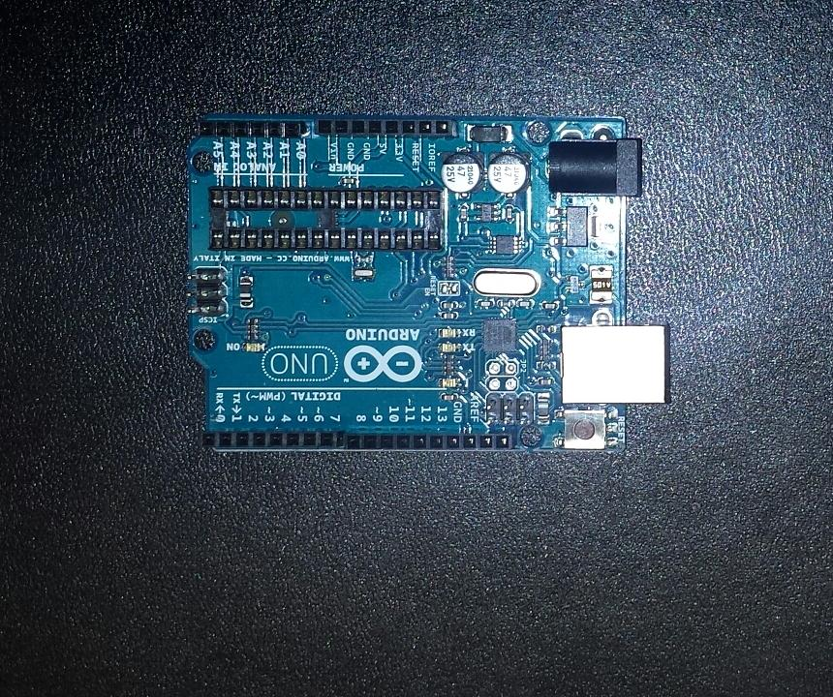
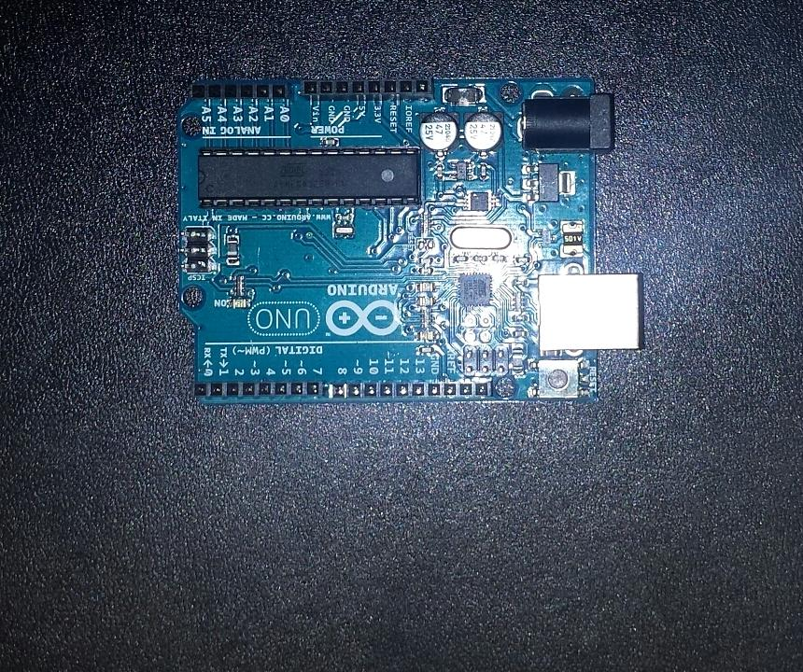
Objective: detect difference between 2 given images

Slide 3
Challenges faced
Flash
Different angle / perspective
Background: mix of differently coloured pixels
Lighting

Slide 5
Solution: background extraction
Background extraction: Manual method
YUV extraction, crop based on outline
Dilate output
Median blur, normalize and apply clahe

Slide 6
Solution: Difference Spotting
Spotting the difference:
Regions of image compared in grayscale
Sum of pixel values averaged
Regions exceeding threshold marked as different

Slide 7
Results
** insert images

