Slide 1
Finding difference in images
Thuy Nguyen, Abdulaziz Ismail, Ronalds Upenieks

Slide 2
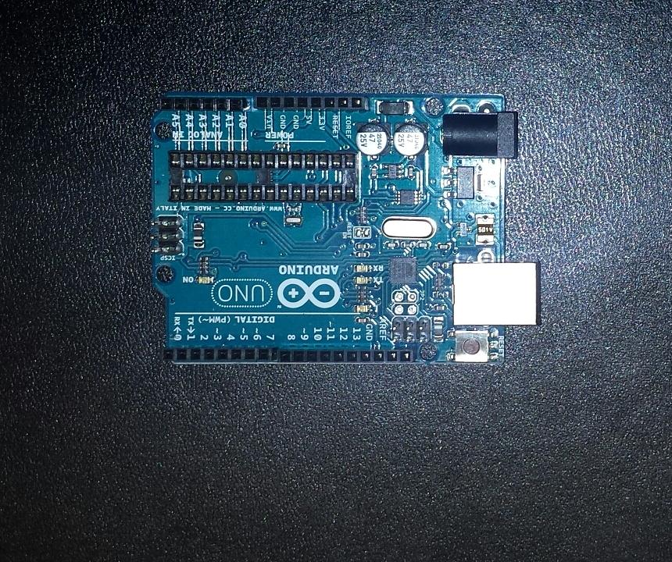
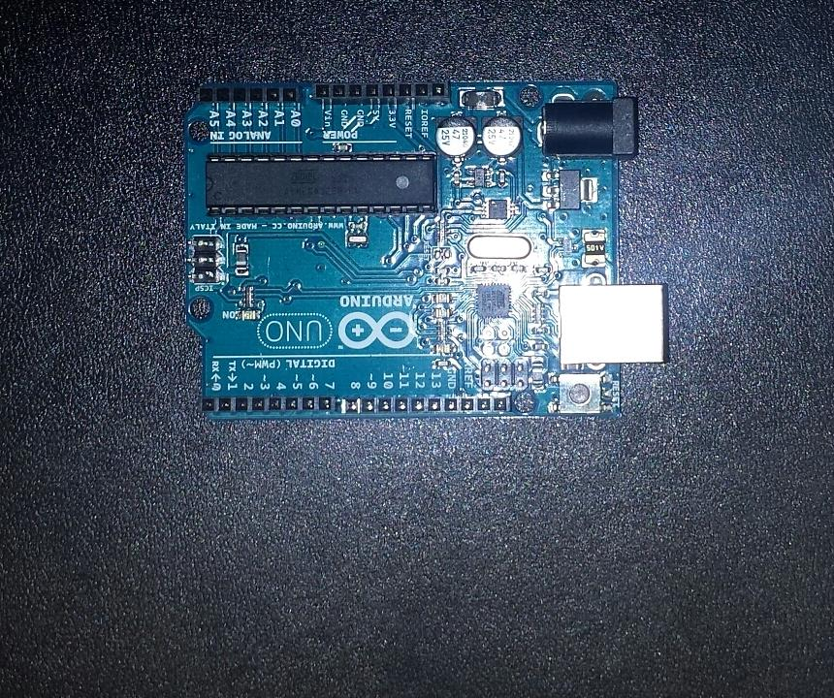
Objective: detect difference between 2 given images

Slide 3
Challenges faced
Flash
Different angle / perspective
Background: mix of differently coloured pixels

Slide 4
Naive approach
Direct pixel comparison
Impossible given challenges mentioned
Possible on more simple images
Notes:
Flash, different angles, different perspective makes direct pixel comparison impossible.

Slide 5


Naive approach
Notes:
Direct pixel comparison possible given the fact that images have the same orientation, perspective and size. This is not the case with our project source images.

Slide 6
Research involved
SSIM – Structural Similarity Index (Difference detection)
OpenCV Grab Cut (ROI Extraction)
Self made algorithms (ROI Extraction, difference detection)

Slide 7
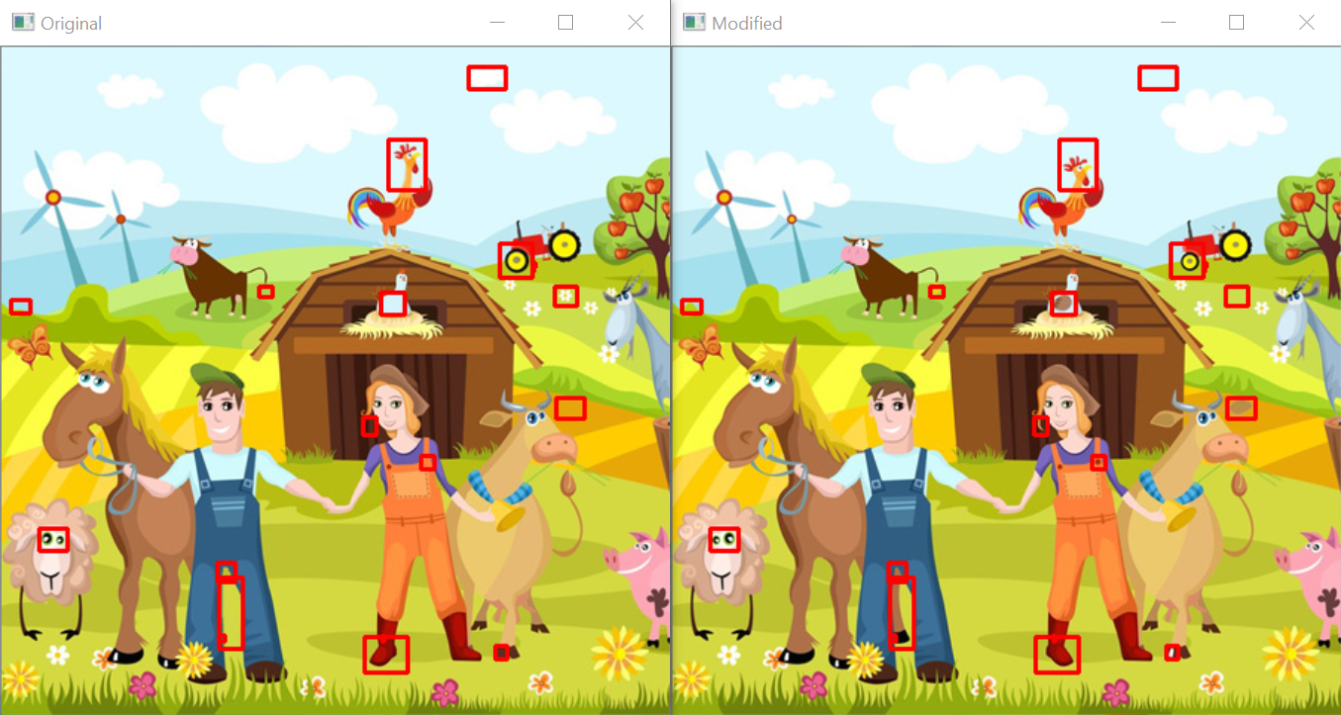
SSIM

Slide 8
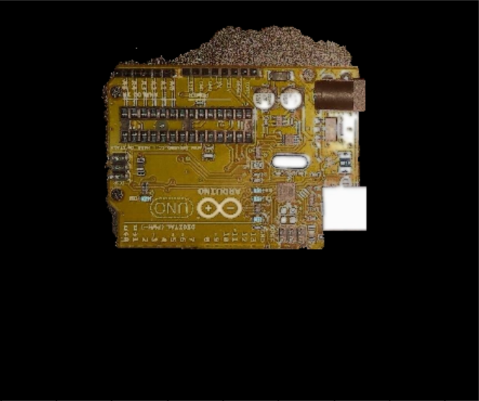
Opencv Grab cut

Slide 9
Solution: background extraction
Background extraction: Manual method
YUV extraction, crop based on outline
Dilate output
Median blur, normalize and apply clahe

Slide 10
Solution: Difference Spotting
Spotting the difference:
Regions of image compared in grayscale
Sum of pixel values averaged
Regions exceeding threshold marked as different

Slide 11
Results
** insert images

