Slide 1

Vel Tech Rangarajan Dr. Sagunthala R&D Institute of Science and Technology
School of Computing
Department of Computer Science and Engineering
10211CS224 / FULL STACK APPLICATION DEVELOPMENT (JAVA)
PROJECT REVIEW : MILESTONE PROJECT – 1
Date: 24-03-2026
Relational Inventory Control & Stock Tracking System
SDG 9 – Industry, Innovation and Infrastructure
Presented By:
D. ABDULKHADARVALI– VTU30308 – 23UECS2059
Courses Handling Faculty:
Mr. S. Manohar
Asst. Professor

Slide 2
INTRODUCTION
Inventory management plays a vital role in businesses to track products, suppliers, and stock levels efficiently. Many small organizations still use manual methods such as notebooks or spreadsheets, which often result in errors and poor stock tracking.
The Relational Inventory Control & Stock Tracking System is designed to automate inventory operations. The system allows users to manage products, suppliers, and stock movements effectively. It also provides real-time analytics through charts and dashboards. This system improves accuracy, saves time, and helps businesses maintain better control over their inventory.
1
2
3
4
5
6
7
8
9

Slide 3
PROBLEM STATEMENT
In many organizations, inventory management is handled manually or using simple tools that lack automation. This leads to inaccurate stock records, delays in updating product information, and difficulty in monitoring stock movements.
Businesses may face problems such as overstocking or running out of products due to poor tracking. There is a need for an automated system that can efficiently manage product details, suppliers, and stock movements while providing real-time insights for better inventory control.
1
2
3
4
5
6
7
8
9

Slide 4
OBJECTIVE(S)
• To design and develop a web-based Relational Inventory Control & Stock Tracking System for managing products, suppliers, and stock transactions.
• To implement a dashboard with graphical analytics and stock alerts to improve inventory monitoring and decision-making.
1
2
3
4
5
6
7
8
9

Slide 5
PROPOSED SYSTEM
The proposed system is a web-based inventory management application that automates the process of tracking products and stock levels.
It allows users to add, update, and delete product information easily.
The system records stock movements such as stock-in and stock-out transactions.
Supplier details can also be managed within the system. The dashboard provides graphical analytics such as bar charts, pie charts, and line charts to visualize stock data.
It also generates alerts when stock levels are low.
This system improves efficiency, accuracy, and decision-making for inventory management.
1
2
3
4
5
6
7
8
9

Slide 6
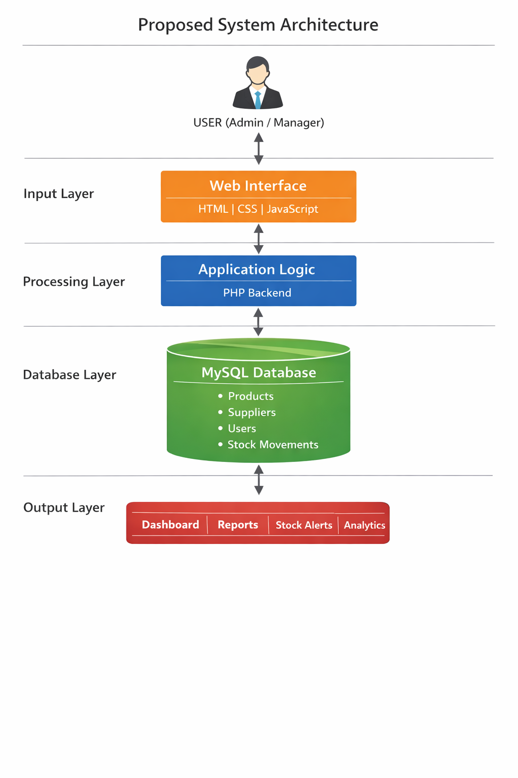
PROPOSED SYSTEM ARCHITECTURE
1
2
3
4
5
6
7
8
9

Slide 7
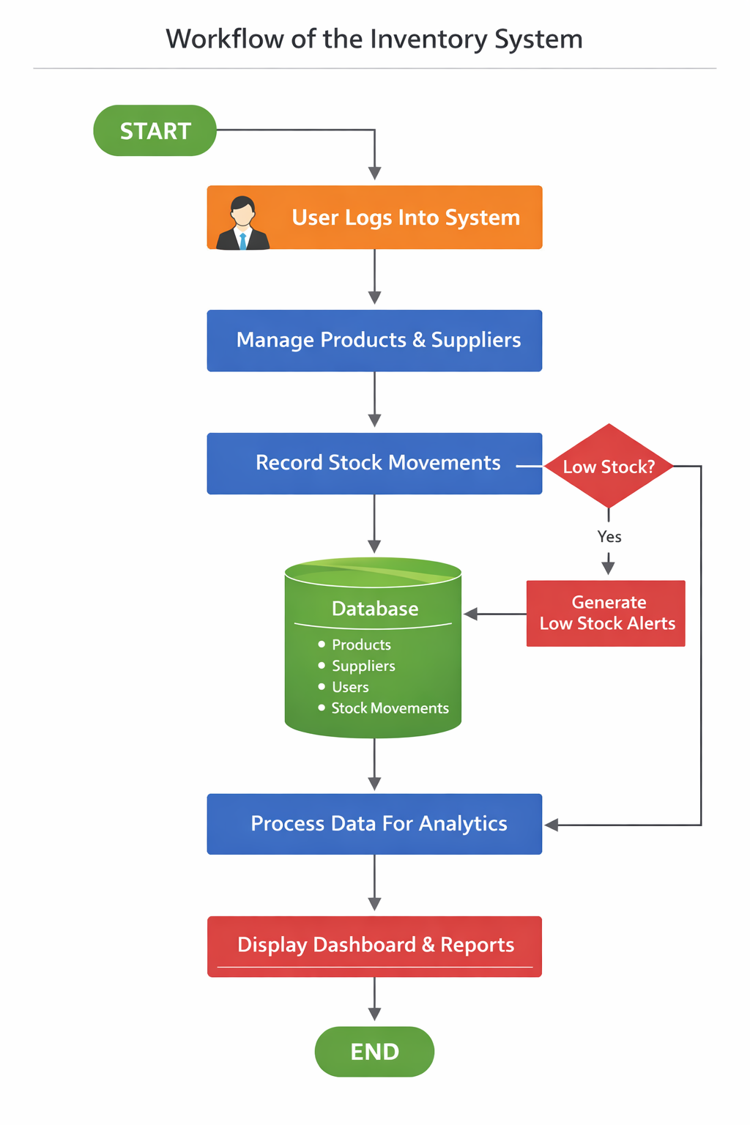
WORKFLOW
1
2
3
4
5
6
7
8
9

Slide 8
TECHNOLOGIES USED
Frontend:
HTML5
CSS3
JavaScript
Backend:
PHP
Database:
MySQL
Tools:
XAMPP, VS Code
Hardware/Software Requirements:
Computer system with minimum 4GB RAM
XAMPP server and modern web browser.
1
2
3
4
5
6
7
8
9

Slide 9
MODULE DESCRIPTION
Module 1: User Authentication Manages user login and session control to provide secure access to the system.
Module 2: Product Management Allows users to add, edit, delete, and view product information including category, supplier, price, and stock.
Module 3: Stock Management Handles stock-in and stock-out transactions and automatically updates product stock levels.
Module 4: Dashboard & Analytics Displays charts, stock statistics, and alerts to help users monitor inventory performance.
1
2
3
4
5
6
7
8
9

Slide 10
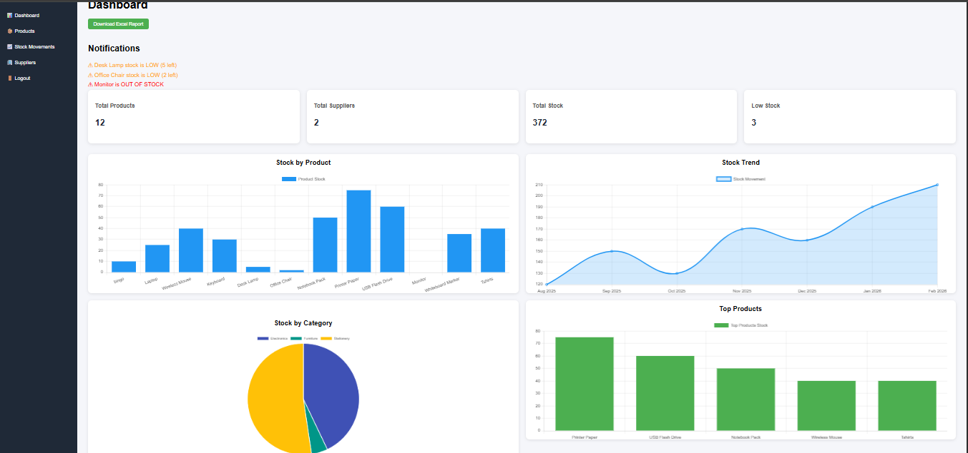
IMPLEMENTATION SCREENSHOTS
Home page:
1
2
3
4
5
6
7
8
9
It displays total products, total stock and some more additional data about products in the form of charts.

Slide 11
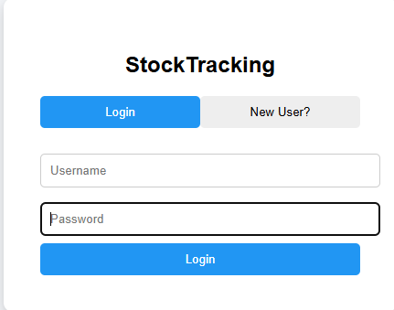
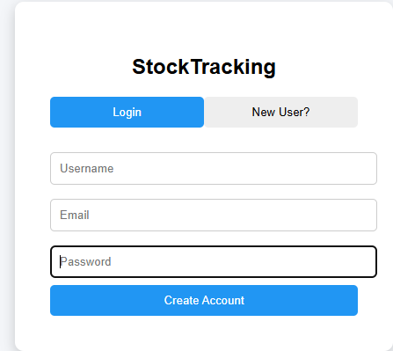
IMPLEMENTATION SCREENSHOTS
Login Page:
Register Page:
1
2
3
4
5
6
7
8(A)
9
Login Page:
Allows users to login and track data continously and monitor stock alerts about products.
Register Page:
Allows users to create new account if it doesn’t exist.

Slide 12
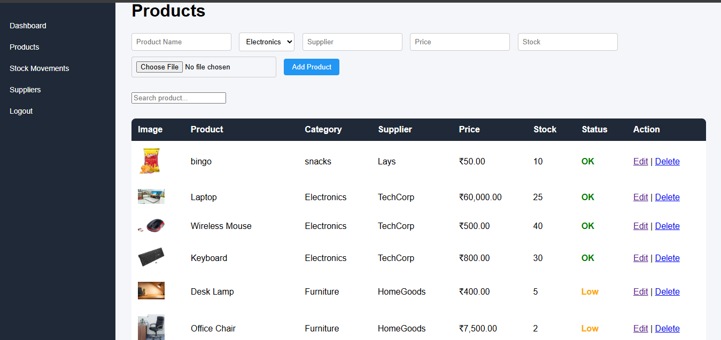
IMPLEMENTATION SCREENSHOTS
Products Page:
1
2
3
4
5
6
7
8(B)
9
It displays all the products or stocks and their availability along with add, edit and delete operations.

Slide 13
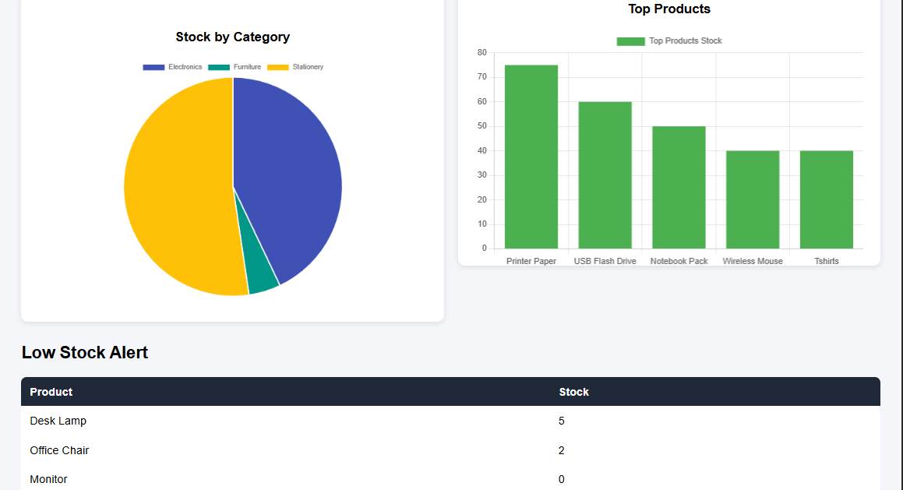
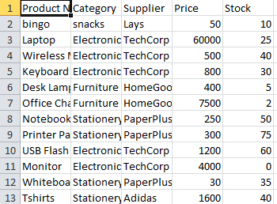
IMPLEMENTATION SCREENSHOTS
Output Page:
1
2
3
4
5
6
7
8(C)
9
It may display in the form of graphs or may download the excel report about the products.

Slide 14
ADVANTAGES & LIMITATIONS
1
Advantages
• Reduces manual inventory management errors • Provides real-time stock monitoring • Easy product and supplier management • Graphical dashboard for better insights
Limitations
• Requires server setup and internet access • Limited scalability for very large enterprise environments • Additional security features may be required for production systems
2
3
4
5
6
7
8
9

Slide 15
Thank you

