Slide 1

DoctorHive:
A Multi-Agent Specialist Consultation System
Presented by: Abdul Moiz Shehzad, Muhammad Fahad Hussain, Reyyan Saeed
Supervisor: Ms. Mariam Nasim
Institution: FAST-NUCES, Lahore
Notes:
1

Slide 2
Table of Contents
1 | Problem Statement & Elaboration
2 | Scope
3 | Foundational Literature
4 | Architecture
5 | Methodology
6 | Goals
7 | Requirements Constraints & Limits
8 | Prototype & Experimental Design
9 | Conclusion & Impact

Slide 3
Problem & Elaboration
Problem: Current medical chatbots produce unreliable, panic-inducing outputs with opaque reasoning and limited expertise.
Unreliable
Limited Specialization
Trust Gap
Single agents make unchecked reasoning errors
No model covers multiple medical fields
Lack of explainability reduces patient confidence
DoctorHive's Solution
A multi-agent system where medical specialists debate and collaborate to reach a reliable, consensus-based diagnosis.
Notes:
2

Slide 4

Scope
In Scope | Out of Scope
Develop Multi-Agent Debate Framework for healthcare queries | Hospital database or EHR integration
Role-based agents: General Physician, Cardiology, Neurology, Ophthalmology | Prescription or treatment generation
Implement debate-ready architecture and testing pipeline | Real-world testing or deployment with patients
Evaluate using simulated medical cases
SDG Alignment: Supports SDG 3 – Good Health & Well-Being through reliable AI healthcare.
Notes:
3

Slide 5
Foundational Literature: Context & Links
Study | Methods / Features | Relevance to DoctorHive | Limitations
Bohr & Memarzadeh (2020) | A review of AI use in healthcare, outlining main opportunities and risks. | Highlight’s reliability and safety needs; basis for DoctorHive’s consensus model. | General overview, lacks methodological depth on MAS.
Chen et al. (2020) | MAS simulations for diagnostics and monitoring. | Foundation for collaborative, distributed agent reasoning. | No integration with emerging AI (e.g., LLMs, deep learning)
Wong et al. (2021) | Review of explainable AI (XAI) techniques. | DoctorHive’s focus on greater explainability and reliability | More clinician-focused.
Hwang & Kesselheim (2022) | Policy review on chatbot ethics and safety. | Supports DoctorHive’s multi-agent safety and reliability approach. | Lacks system-level solutions; overlooks MAS or debate mechanisms.
Lin et al. (2023) | Experimental multi-agent debate framework. | Directly supports DoctorHive’s debate-driven model. | Limited to controlled experiments.
Zhang et al. (2024) | MAS prototype for diagnostic collaboration. | Methodological base for consensus-driven reasoning. | Simulated only
Notes:
Ai has potential in medical but lacks reliability
MAS improve the quality of the diagnostics as compared to single
Explainability matters a lot
Again single chatbot isn’t that reliable
Directly introduced Multi agent debate framework
Proof of concept for multi agent system in medical field with specialized agents.

Slide 6
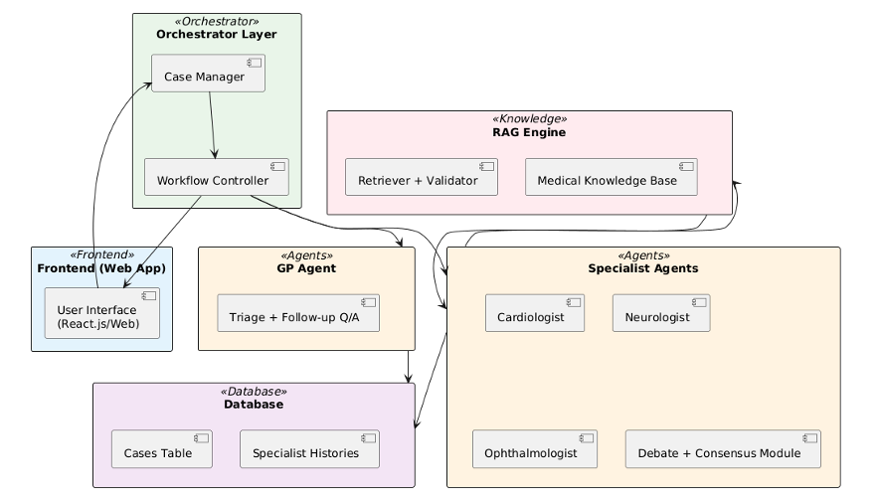
Architecture
Notes:
7

Slide 7
Methodology
1.System & Process
Design: Modular, Layered Architecture (Orchestrator, Agents, RAG, Database).
Agents: LLM-based, Role-Conditioned Specialists.
RAG Grounding: Integrates evidence from a Medical Vector Store to enforce citation and minimize hallucination.
Workflow: Agile, iterative process

Slide 8
2. Debate & Consensus Mechanism
Protocol: Structured debate in successive rounds (Claim, Counterargument, Synthesis).
Consensus: Hybrid voting weighted by evidence strength and majority opinion.
3. Validation & Metrics
Baseline: Comparative testing against Single-Agent LLMs.
Evaluation: Focuses on multiple dimensions beyond accuracy.
Key Metrics: Diagnostic Accuracy, Trust/Interpretability (via surveys), and Performance (latency).

Slide 9
Goals:
Phase 1
Phase 2
Debate mechanism, agents argue and refine diagnoses collaboratively
Phase 3
Consensus mechanism for final diagnosis
Phase 4
Build knowledge base for RAG integration
Phase 5
Test RAG and optimize pipeline
Phase 6
Develop patient-facing web interface
Phase 7
Deployment and performance evaluation
Core specialist agents and orchestration pipeline
Notes:
4

Slide 10
Requirements
1
Modular, scalable multi-agent architecture
2
Transparent logging of each agent's reasoning
Constraints
  Response latency < 10 seconds
  High computation for concurrent agents
Limitations and Mitigation
  Hallucinations: RAG grounding planned
  No real data: Can’t train model
  Advisory use: Supports, not replaces, clinical judgment
Notes:
8

Slide 11

Prototype & Experimental Design
Prototype
Data
Core Functionality: Working pipeline of GP Triage and Specialist Debate.
Design:
Modular architecture ready for Consensus and RAG integration.
Input: Simulated patient cases and curated Medical Knowledge Base.
Storage:
PostgreSQL/pgvector database stores structured data and RAG embeddings.
Deployment Plan
Backend Stack: Python (FastAPI/LangChain) with PostgreSQL.
Frontend Stack: Patient-facing Web Interface via React.js.
Cloud Strategy: Containerized deployment using Docker/Kubernetes on AWS/Google Cloud (Backend) and Vercel (Frontend).
Notes:
9

Slide 12
Conclusion & Impact
Summary
Current Success
Future Impact
DoctorHive builds collaborative, debate-driven AI diagnostics, replacing single-agent reasoning with transparent consensus.
Completed specialist agents, orchestration, and debate modules.
Consensus reasoning, RAG validation, and patient-facing deployment for accessible, trustworthy healthcare AI.
"DoctorHive — a conversation among doctors inside one AI."
Notes:
10

Slide 13


