Slide 1

SpaceX Capstone Project Report
AbdulMujeeb Leasu

Slide 2
Table Of Content
This Presentation goes through the SpaceX Capstone Project. Displaying findings in an explainable way.
Data Collection and Data Wrangling Methodology
Predictive Analysis Methodology
Visualizations
Interactive Folium Map
Explanatory Data Analysis
Dash Dashboard using Plotly
Predictive Analysis (Machine Learning)
Extra Insights

Slide 3
Data Collection
Using Github to gain data from the:
https://github.com/r-spacex/SpaceX-API
Using Pandas to Convert JSON files into a readable DataFrame.
From the Onset difficulties in loading the actual data. Using Webscraping seems to be harder and gives unreliable results.
Preprocessing the data.
Removing the Booster Version ‘Falcon 1’ as we only need ‘Falcon 9’.
Replacing Null values for Payload Mass with the average value.

Slide 4
Data Wrangling
I used Data Wrangling to set up the Data for further analysis
Organising the outcome values by creating a ‘Class’ Series. This Class Series contains values for different types of Landing Outcomes where the bad outcomes are considered 'None ASDS', 'False RTLS', 'False Ocean', 'False ASDS', 'True RTLS’.
I Obtained the percentage of successful lands which yielded a percentage of 66%
Saving the data into a new CSV for further Analysis
Visualizations

Slide 5
Visualizations

Slide 6
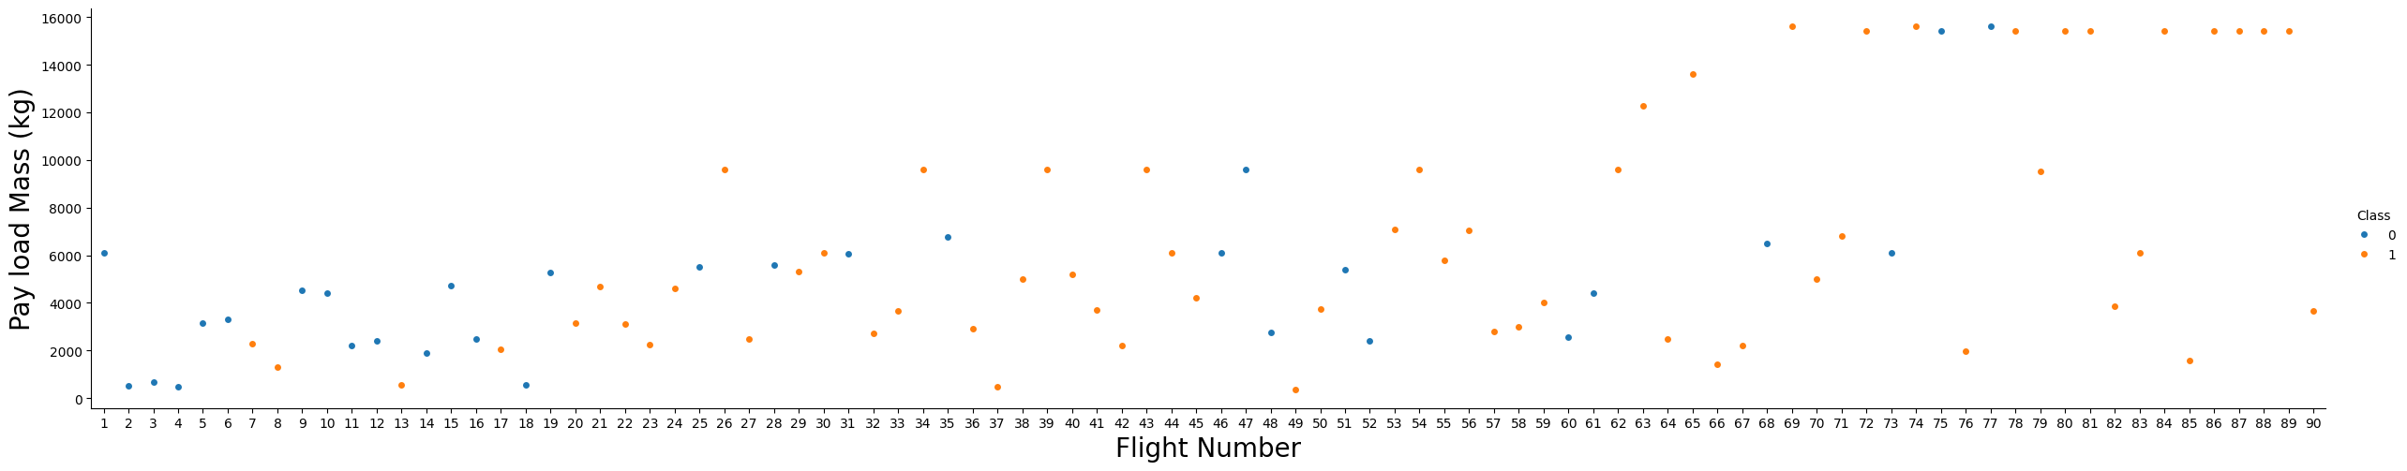
Payload Mass Vs. Flight Number
There seems to be a slight bit of correlation between The payload Mass and Flight Number
This may be due to an increasing amount of confidence and successes as Payload mass is
Higher for later flight numbers.
We can also see a greater number of successes as Flight Number increases as there are more
Data points of Class 1.

Slide 7
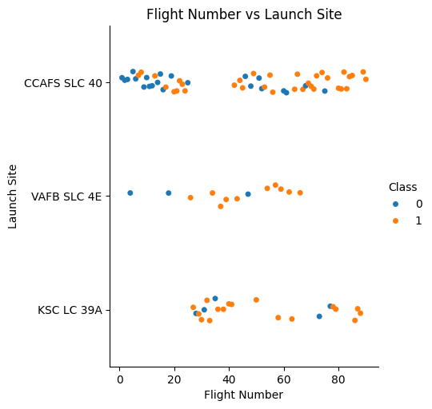
Flight Number Vs Launch Site
CCAFS SLC-40 Launch Site has the
highest number of flights. This seems
to be the main launch site
VAFB SLC 4E has the highest success
to non success ratio
KSC LC 39A. Clearly shows that the flights
Switch to this launch site temporarily
as there a gap between CCAFS SLC 40

Slide 8
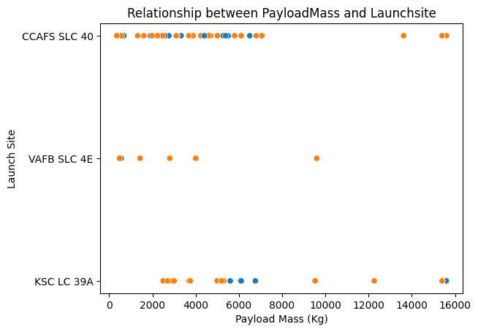
Payload Mass vs LaunchSite
SO orbit level clearly has no good outcomes
While ES-L1, GEO, HEO, SSO have a success rate of 100%

Slide 9
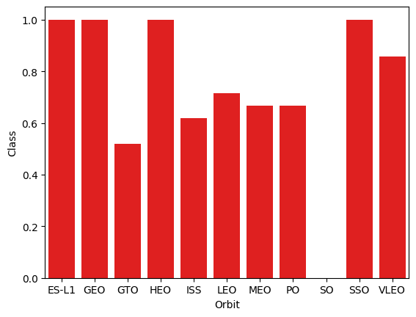
Payload Mass vs LaunchSite
At CCAFS SLC 40. a smaller payload mass is used for most of the launches as there is a clear left skew in the data.
At KSC LC 39A a higher average payload mass is used as oppose to CCAFS
The plot shows that the success rate is over 50%

Slide 10
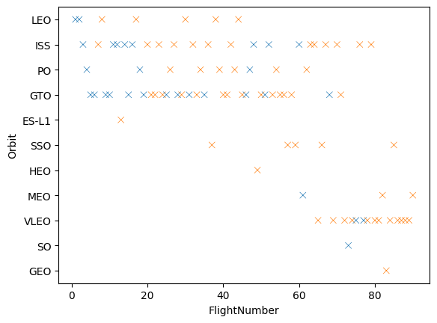
Orbit Distance Vs FlightNumber
There seems to be a greater orbit distance
as the flight number increased. This is probably
due to an increase in confidence. There is also
a greater amount of variables classed as
a success.

Slide 11
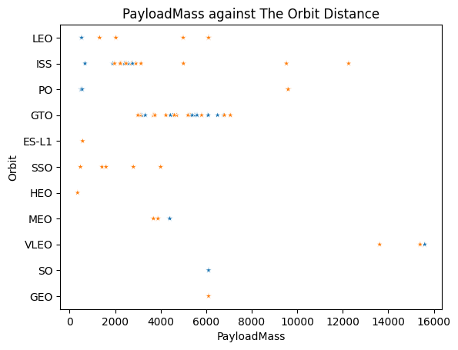
Payload Mass vs Orbit Distance
Greater increase in Payload Mass for further
Orbit distances. GTO has constant values of Payload
Mass compared to other orbit distances.

Slide 12
Folium Maps

Slide 13
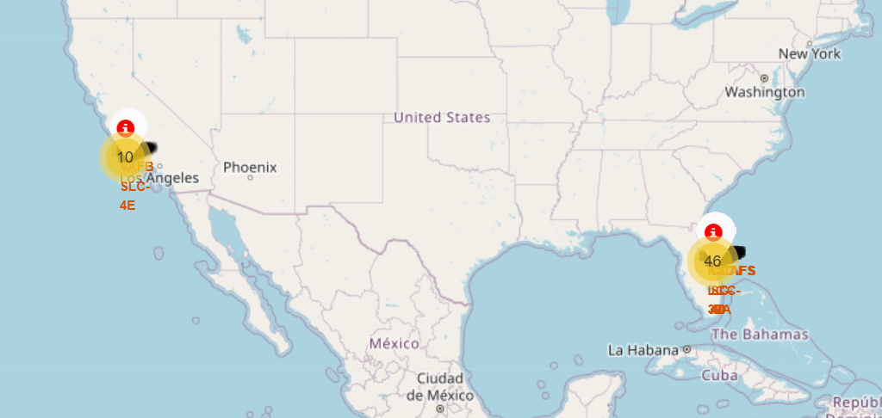
Geographical locations and number of Launches per LaunchSite
More Launches occurred in Florida (56) than in California (10).

Slide 14
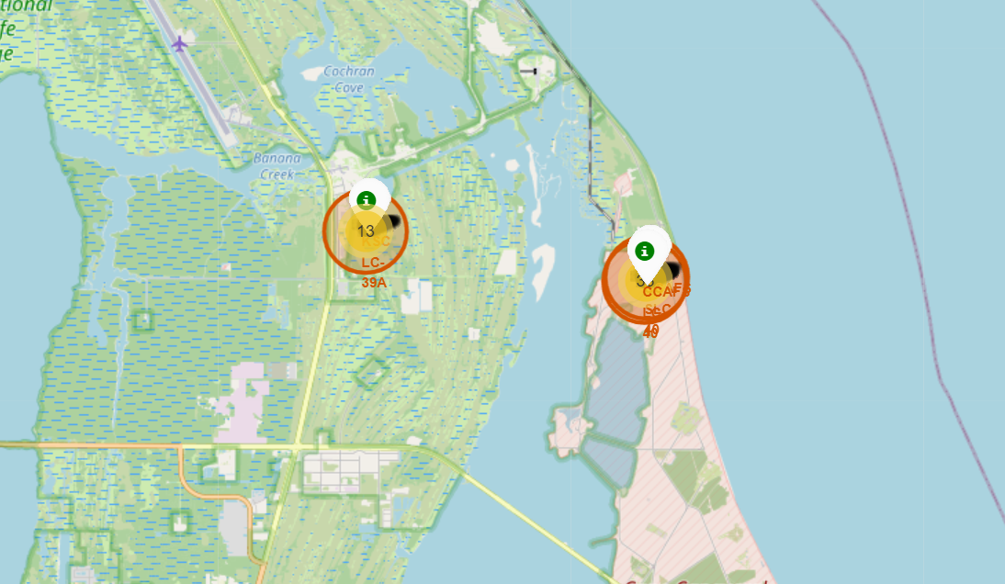
Florida LaunchSites
3 Launch Sites are in close proximity to each other. Showing that CCAFS LC-40 having the most Launches overall

Slide 15
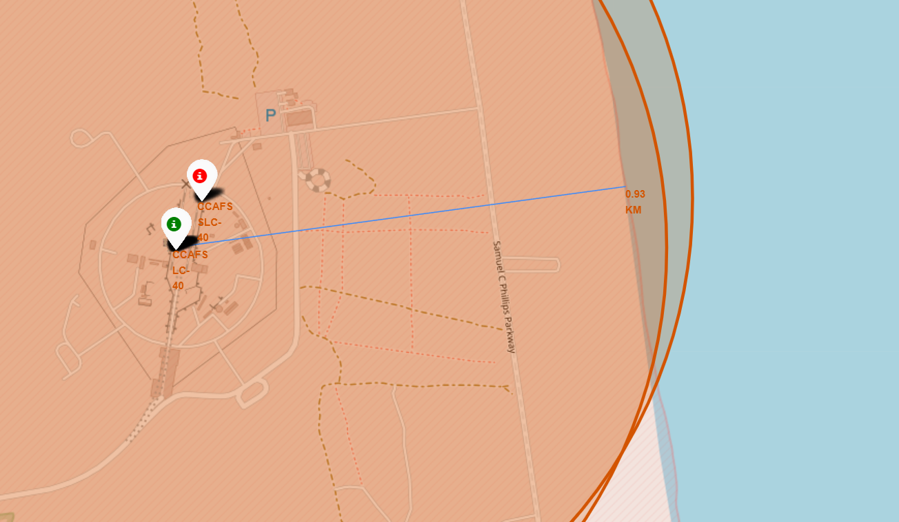
Patterns obtained in selected locations
The map Prior showed that the Launch Sites where in Florida and California. These are located near the coastline.
This is due to the fact that the Stage 1 parts rockets returns down for relanding. The possibility of an unsuccessful rocket landing still exist so it is preferred to launch the rockets near uninhabited areas.
Seen 0.93km proximity with the coastline.
Any other relationships…?

Slide 16
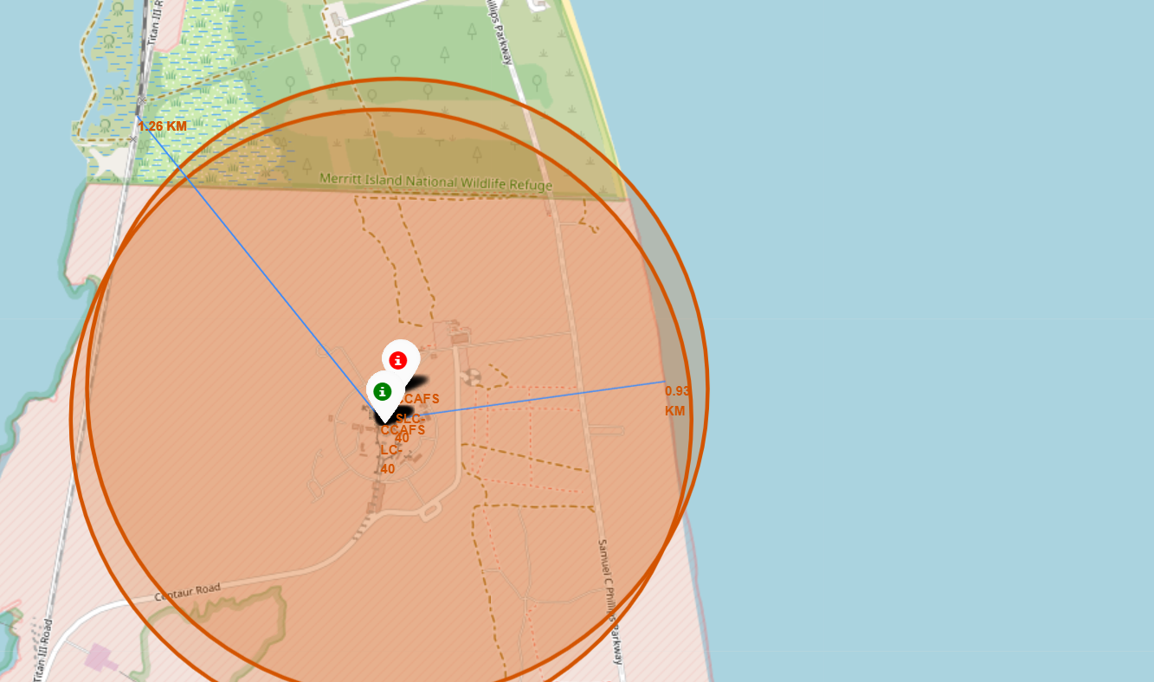
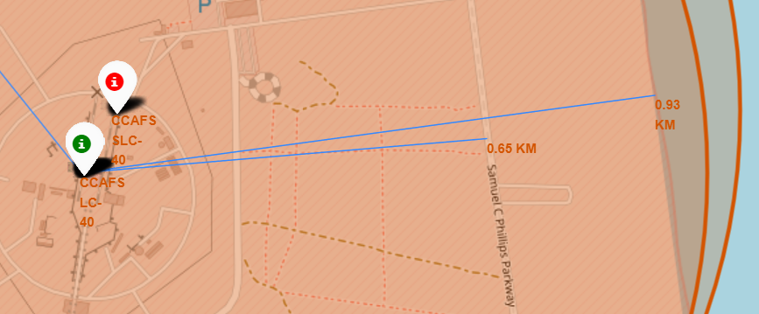
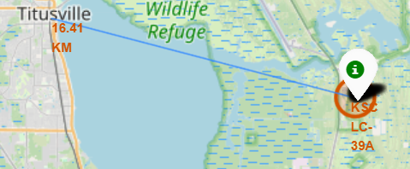

Other
Cities are usually located a far distance away. The closest city away from a Launch Site is 16.41km
This is again due to wanting a launch site away from inhabited areas.
This is also due to the amount of noise created per rocket launch
A highway is located in close proximity to the launch sites.
Used for transporting Rockets etc.
Rail Tracks are also nearby.
Also Used for transportation of materials and rockets.

Slide 17
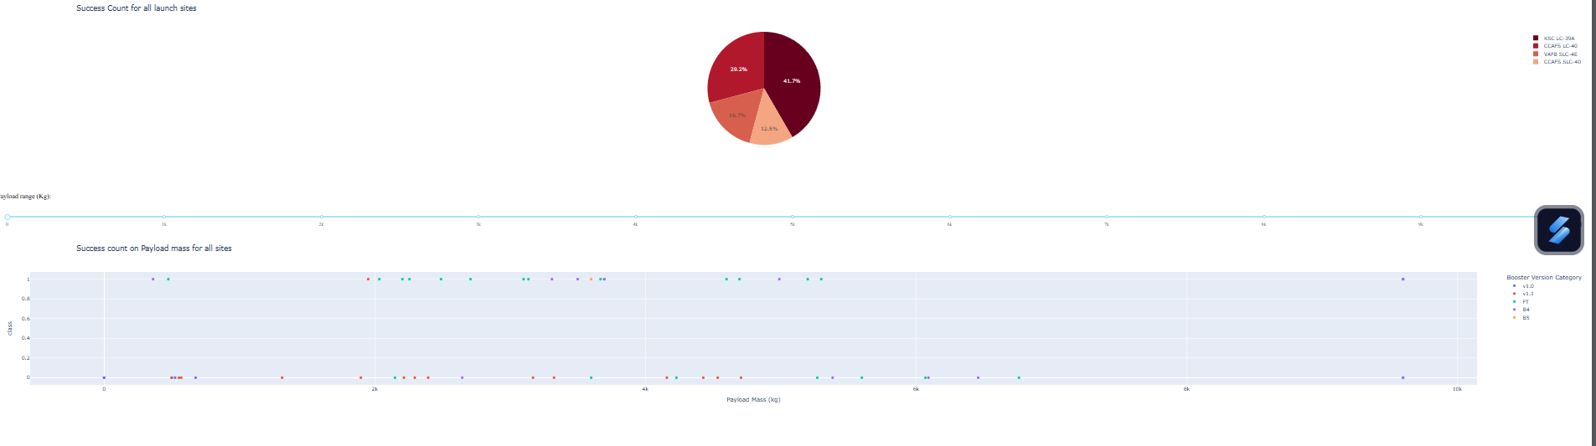
Dash Dashboard
Using an Active Dashboard to display data. This presents the success rates in each site.

Slide 18

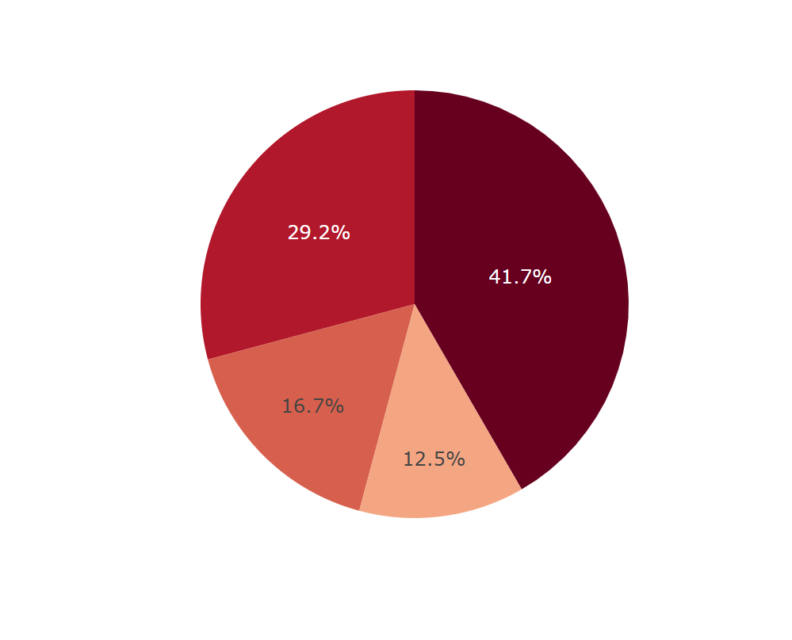
All sites Success rate

Slide 19
Machine Learning

Slide 20

Explanation
Machine learning models are used to predict new pieces of data.
I use multiple models such as Logistic Regression, Decision Trees etc.
Split the data up into Training and Testing data then review the model accuracy to see if the model is suitable.

Slide 21
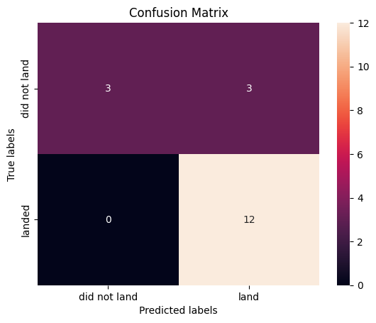
Logistic Regression Model
Using a Logistic Regression to obtain the Accuracy
Test Accuracy Obtained: 83%

Slide 22
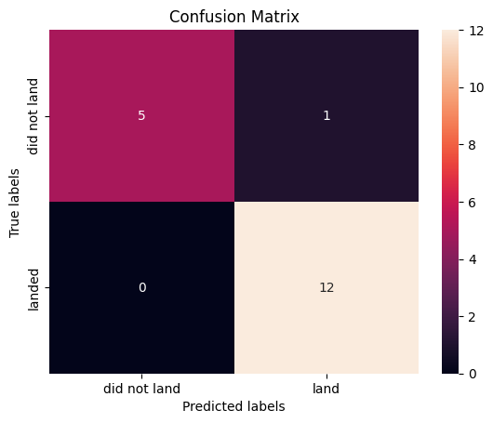
Decision Tree Model
Using Decision Tree to obtain the Accuracy
Test Accuracy Obtained: 94%

Slide 23
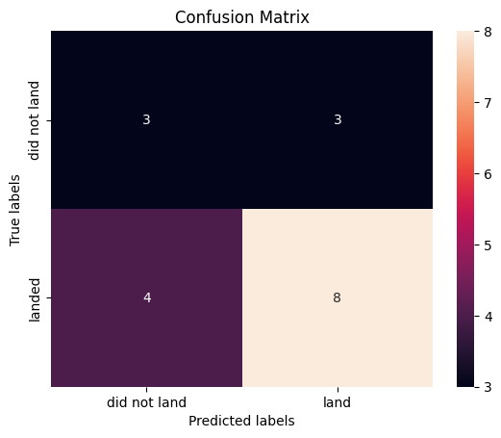
K-Nearest-Neighbors Model
Using KNN to obtain the Accuracy
Test Accuracy Obtained: 61%

Slide 24
Machine Learning Conclusion
The Decision Tree Model Clearly has the highest Accuracy at 94%. This model should be used for predicting outcomes for future flights.
KNN should definitely not be used as the test accuracy is 61% this is very low!
Logistic Regression Model can possibly be used to predict with an accuracy of 83% but should not be used for very large datasets.

Slide 25
Conclusion
In Conclusion the Analysis shows some decent insights. There is a clear upwards trend in successes over the years as SpaceX used new and innovative methods to land there rockets. This has clearly had a profound effect on the price of space exploration as now the expensive Stage 1 of the rocket can be reused.
The Decision tree model can also be used to predict further rocket launches to further increase the success rate.

Slide 26
Credits
IBM Skills Network. This project was done for the Data Science Capstone Project Course on Coursera.
Me Ofcourse ☺
Thank You for going through the course.

