Slide 1

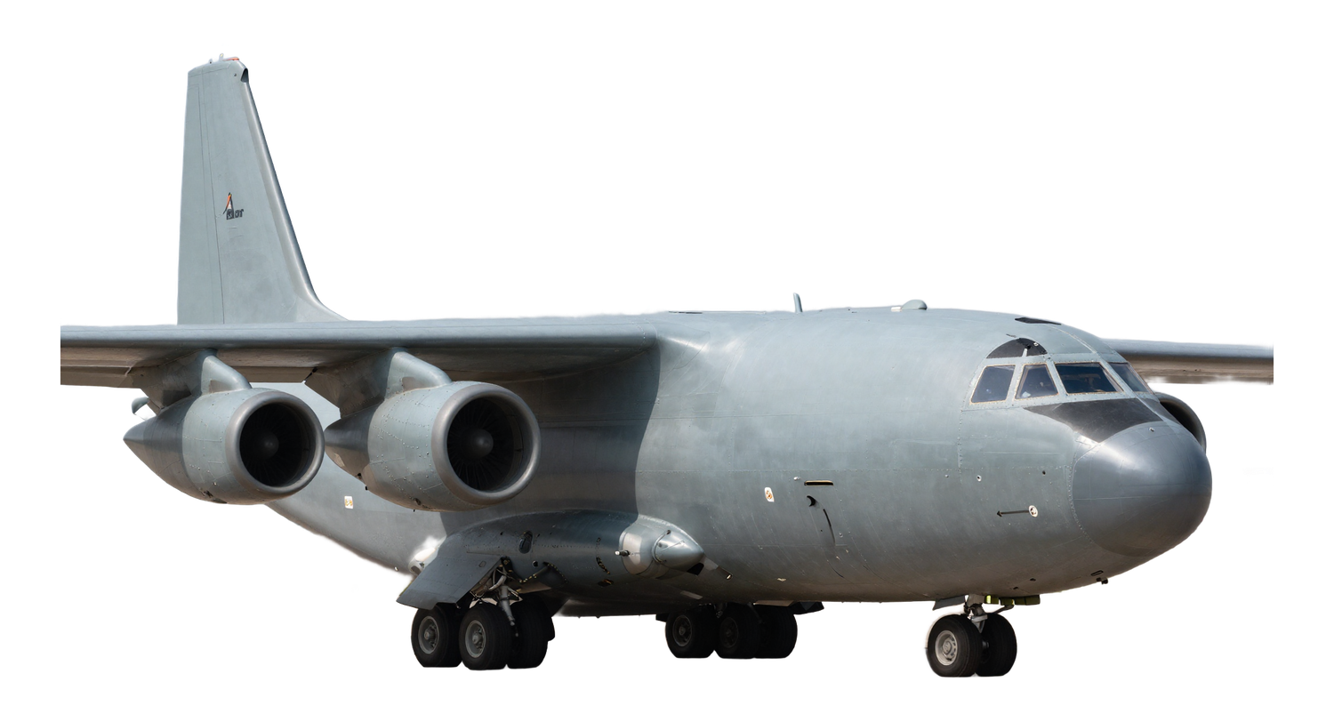
ADVANCED TECHNOLOGIES COMPANY
Provision of Aircraft
Spare Parts & Simulators
The first licensed Saudi company supplying aircraft spare parts, ground support equipment and simulators — from the United States and worldwide.
30+ years
Riyadh, KSA
Civil & military

Slide 2
WHO WE ARE
A professional Saudi team, 30+ years of expertise
A professional Saudi team,
30+ years of expertise
30+
1st
Years of combined experience
Licensed Saudi supplier in its field
3Lines Advanced Technologies is the first licensed Saudi company for supplying aircraft spare parts, ground support equipment and simulators from the United States and all over the world.
Backed by a professional Saudi team with more than 30 years of experience, we serve civil and military aviation with genuine parts, dependable maintenance and world-class technical support.
14
US+
Specialized service lines
Sourcing across the U.S. & worldwide
3lines.com.sa
02

Slide 3
WHAT WE DO
Our Services
Aviation, MRO & ground support
01
02
03
04
Provide Spare Parts
Maintaining & Repairing
Supporting Ground Equipment
Structure & Frame
All original spare parts for civil and military aircraft and supporting equipment.
Experienced engineers and technicians delivering the best maintenance and repair services.
Maintenance and support for aircraft auxiliary equipment to ensure operational readiness.
Maintain and repair structures and tires for safety and optimal performance.
05
06
07
Simulator System Support
Hydraulic & Pneumatic
Generators & UPS
Specialized supporting services for flight and maintenance simulators.
Maintain and repair hydraulic and pneumatic systems efficiently and reliably.
Maintain and repair generators and UPS systems to ensure power continuity.
3lines.com.sa
03

Slide 4
WHAT WE DO
Our Services
Defense, engineering & technology
08
09
10
11
RADAR System
US Government Support
Procurement
Engineering
Military and civilian RADAR project development and management.
World-class US Government support services.
A dedicated team sourcing genuine parts from the U.S. and worldwide.
A dedicated engineering department delivering technical solutions and integration.
12
13
14
AI Solutions
Cybersecurity
English Language Training
Sovereign AI — command centers, document intelligence and operations agents.
Protecting critical systems and data with a sovereign, in-Kingdom approach.
Advanced English language training delivered by highly experienced trainers.
3lines.com.sa
04

Slide 5
SPOTLIGHT — PROCUREMENT
Global sourcing you can rely on
Our procurement team sources genuine parts, equipment and components from trusted OEMs and authorised distributors across the United States and worldwide.
We manage the full cycle — from RFQ to delivery — with transparent pricing, verified authenticity and dependable lead times, so your operations never wait on supply.
Strategic sourcing
Vendor management
Qualifying the right suppliers for every part and program.
Long-term relationships with OEMs and authorised distributors.
Quotations & negotiation
Logistics & expediting
Competitive RFQs with clear pricing and delivery terms.
Export handling, shipping and priority AOG expediting.
AT A GLANCE
OEM & authorised distributors
Transparent pricing & lead times
United States & worldwide supply
Certificates & full traceability
Quality & compliance
Inventory planning
Authenticity checks, certificates of conformity, traceability.
Forecasting and stock planning so critical parts are on hand.
3lines.com.sa
05

Slide 6
TRUSTED BY
Partners & Clients
Working alongside leading aerospace and defense organizations in the Kingdom and worldwide.
CLIENTS
AGREEMENTS
PARTNERS
8 organizations
3 organizations
5 organizations
AirBus
SAMI — Saudi Arabian Military Industries
ARMITE Lubricants
BAE Systems
SAMI AEC — Advanced Electronics
MAC Aerospace Corp.
Amentum
ICS Arabia
SAMI Aerospace
SMSCMC — Maintenance & Supply Chain
OPTOKON Middle East
NPCO
TAM
Wallan Group
Vinnell Arabia
AACC
3lines.com.sa
06

Slide 7
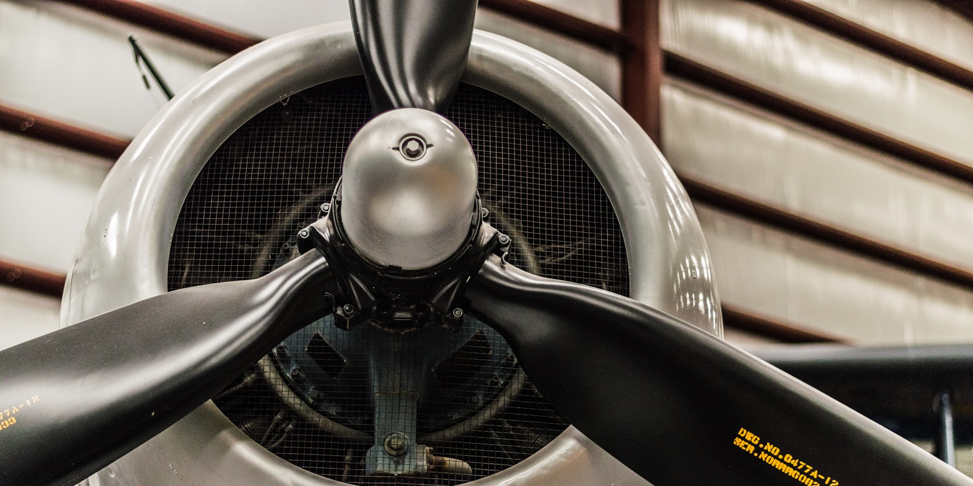
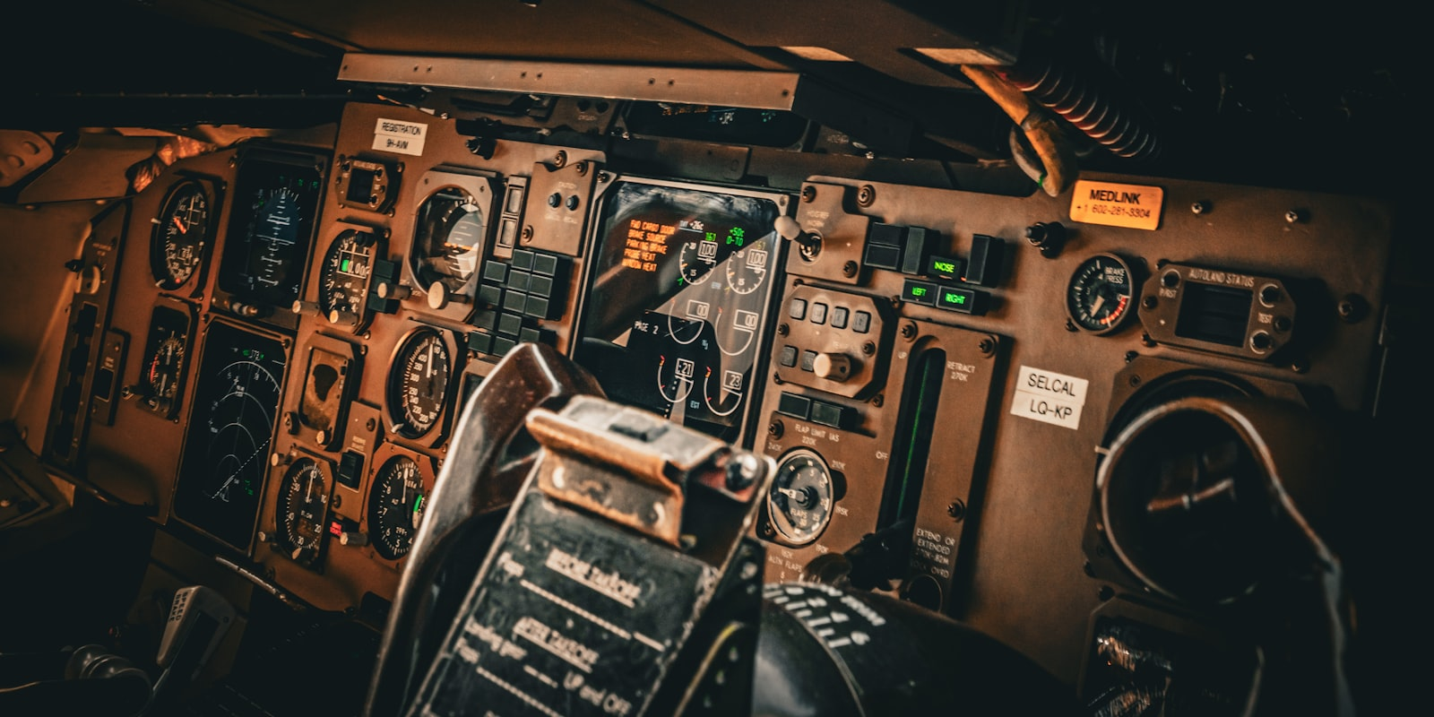
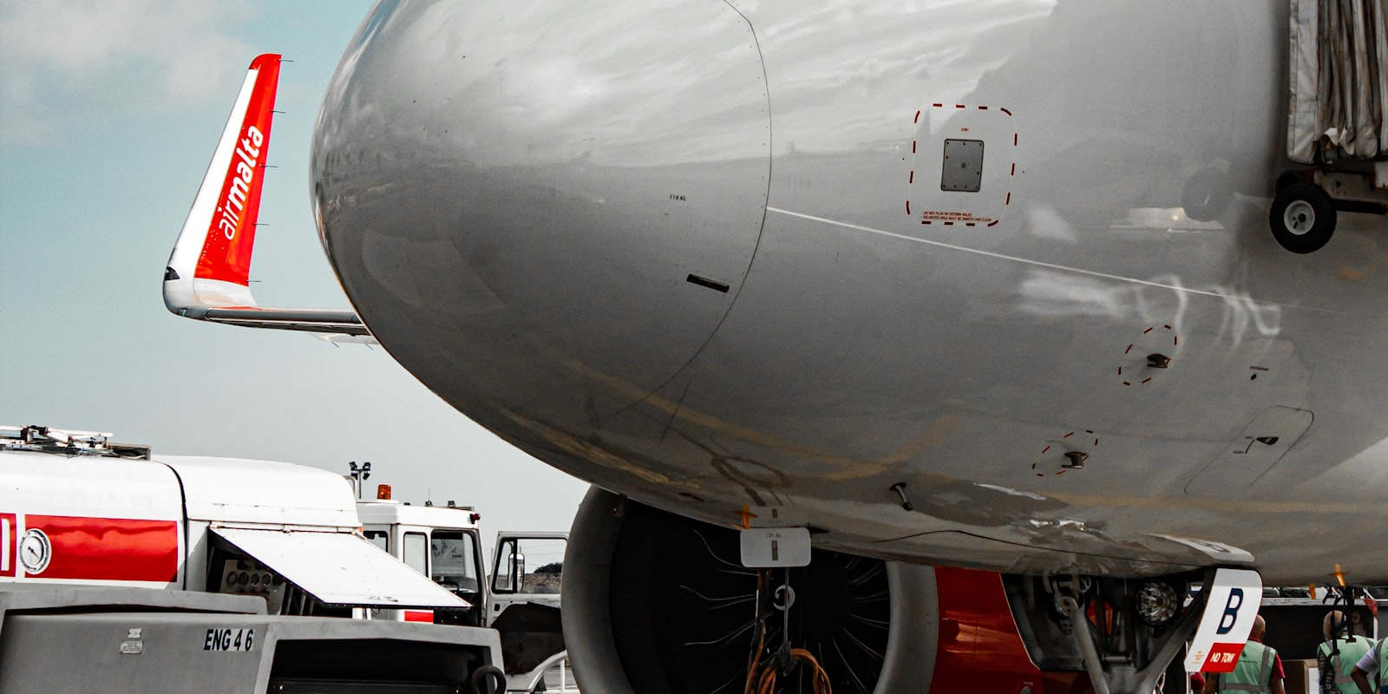

NEWSROOM
Latest News
MAY 2026
APR 2026
MAR 2026
FEB 2026
Expanding Our Aircraft Spare Parts Capabilities
Investing in Advanced Simulator Support
Strengthening Ground Support Equipment
Advancing Radar & Sensor System Support
Growing our inventory and global sourcing network for civil and military aircraft.
Keeping flight and maintenance simulators operating at peak readiness.
Comprehensive maintenance and spare parts for operational readiness on the ground.
Installing, calibrating and maintaining radar systems for surveillance and ATC.
3lines.com.sa
07

Slide 8
SITE MAP
Explore the Site
Every page on 3lines.com.sa/en · also available in العربية · 日本語 · 한국어
SERVICES
14 pages
COMPANY & PAGES
/en/services/…
Home
News
Provide Spare Parts
RADAR System
/en
/en/news
About
Contact
Maintaining & Repairing
US Government Support
/en/about
/en/contact
Partners & Clients
Pages Index
Supporting Ground Equipment
Procurement
/en/partners-and-clients
/en/pages-index
Structure & Frame
Engineering
Simulator System Support
AI Solutions
LEGAL
Hydraulic & Pneumatic
Cybersecurity
Privacy Policy
Terms & Conditions
Cookie Policy
Generators & UPS
English Language Training
/privacy-policy
/terms-and-conditions
/cookie-policy
3lines.com.sa
08

Slide 9
GET IN TOUCH
Let's keep your fleet ready for anything.
HEADQUARTERS
Office 203, 2nd floor, Building #2148
King Abdullah Branch Road, King Faisal Dist.
Riyadh 13215, Saudi Arabia
Talk to our team about spare parts, MRO, ground support, simulators and more.
CR 1010589885
VAT 310407303200003
PHONE
EMAIL
LINKEDIN
+966 11 225 2433
info@3lines.com.sa
linkedin.com/company/3lines
© 2026 3Lines Advanced Technologies Company · 3lines.com.sa

