Slide 1
3 Lines — Company Website
A guided tour of our services, sectors and capabilities
https://3lines.com.sa/en

Slide 2
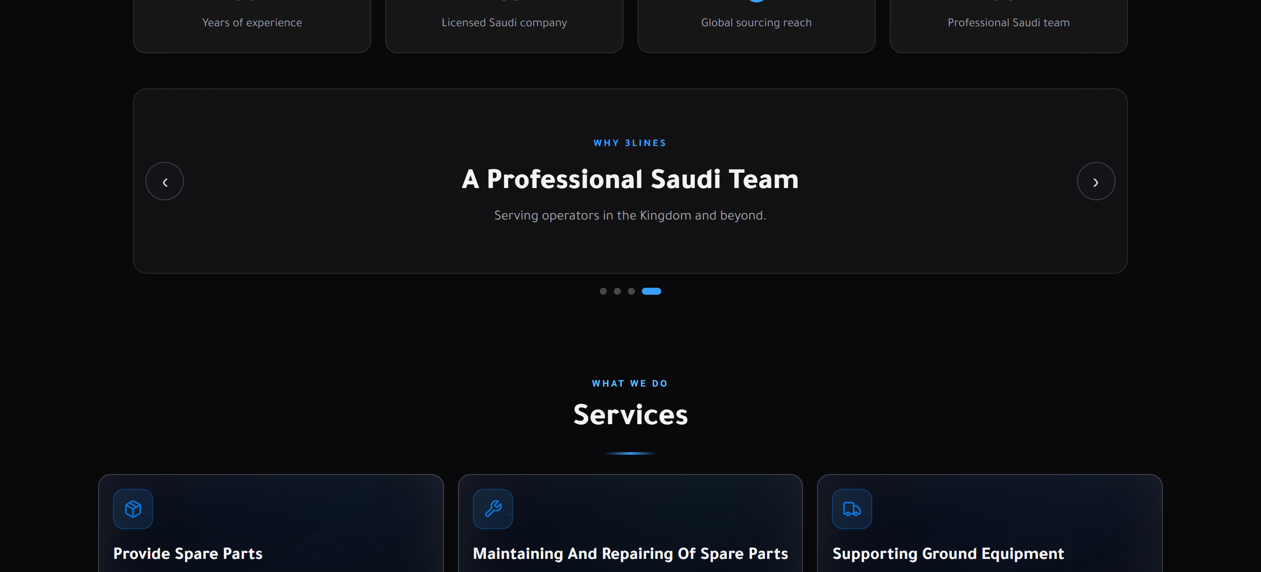
Home
https://3lines.com.sa/en

Slide 3
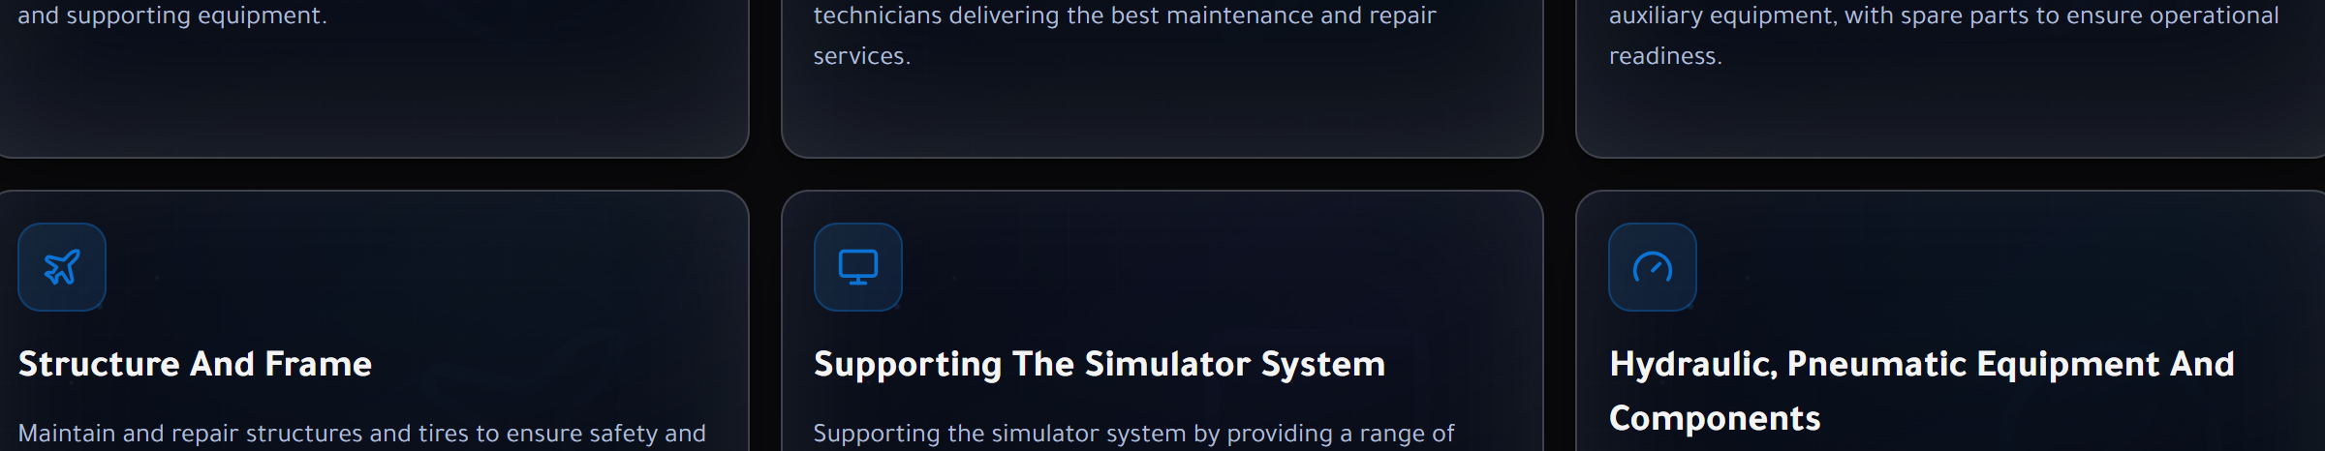
Home
https://3lines.com.sa/en

Slide 4

Home
https://3lines.com.sa/en

Slide 5
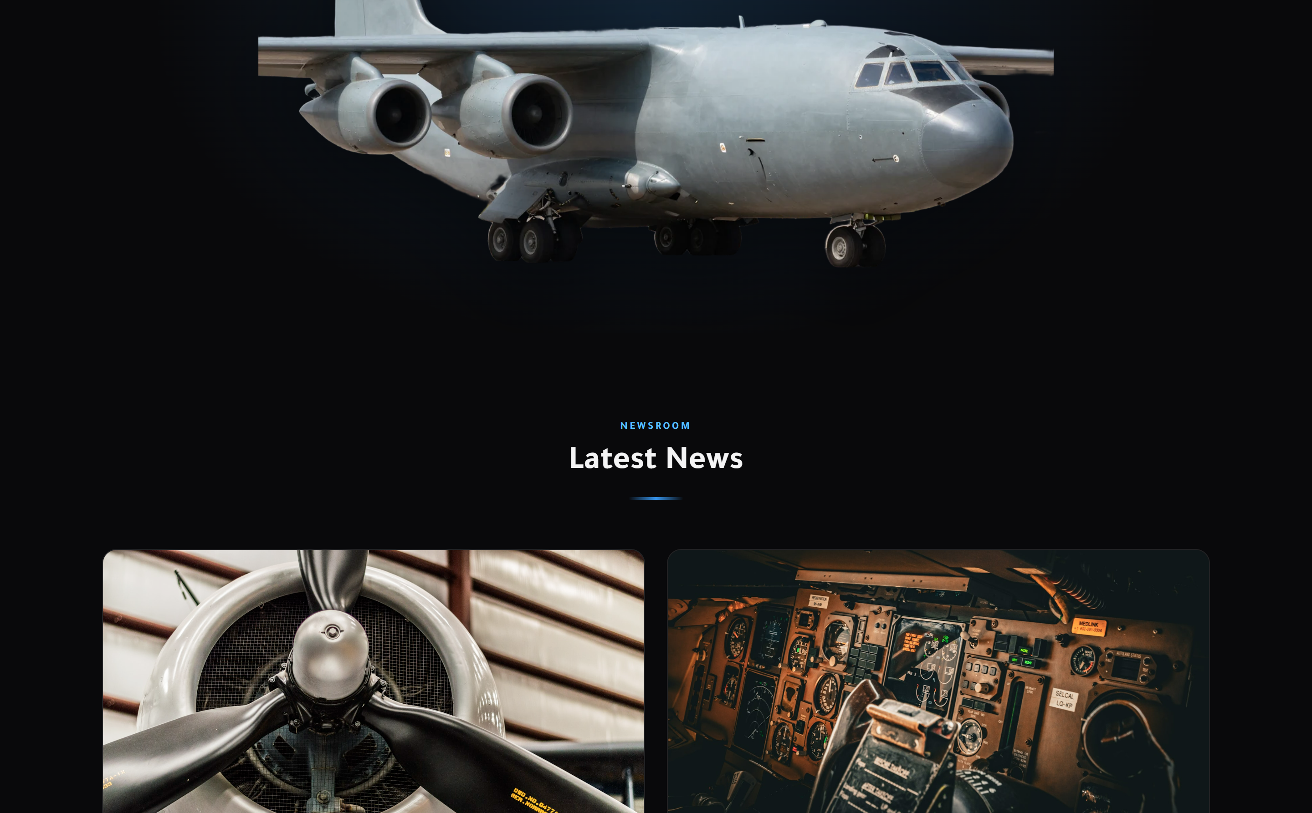
Home
https://3lines.com.sa/en

Slide 6
Home
https://3lines.com.sa/en

Slide 7
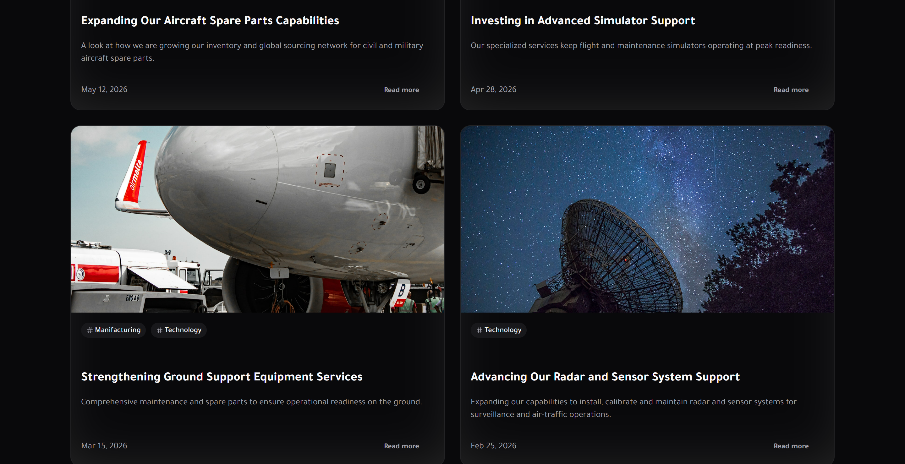
Home
https://3lines.com.sa/en

Slide 8

Home
https://3lines.com.sa/en

Slide 9
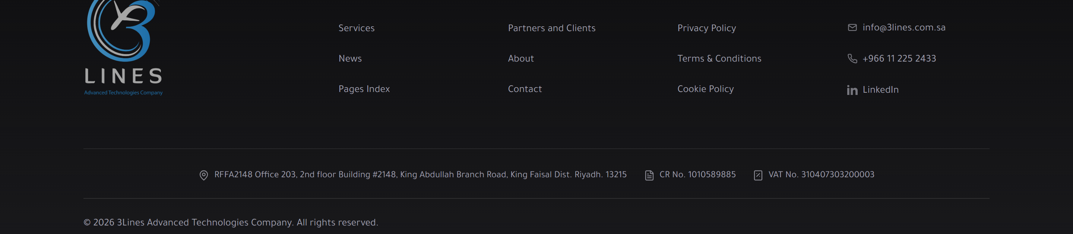
Home
https://3lines.com.sa/en

Slide 10
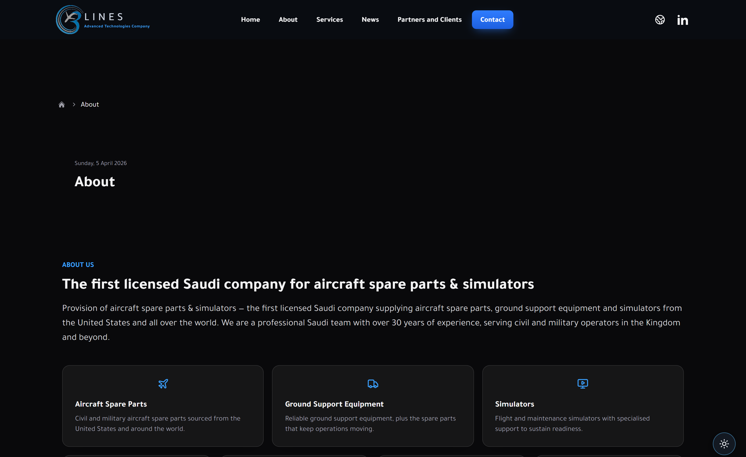
About
https://3lines.com.sa/en

Slide 11

About
https://3lines.com.sa/en

Slide 12
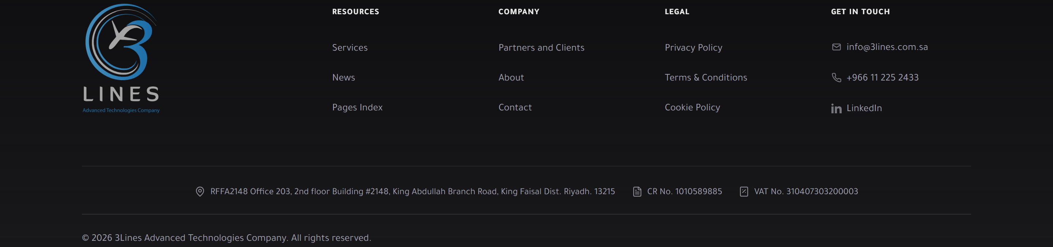
About
https://3lines.com.sa/en

Slide 13
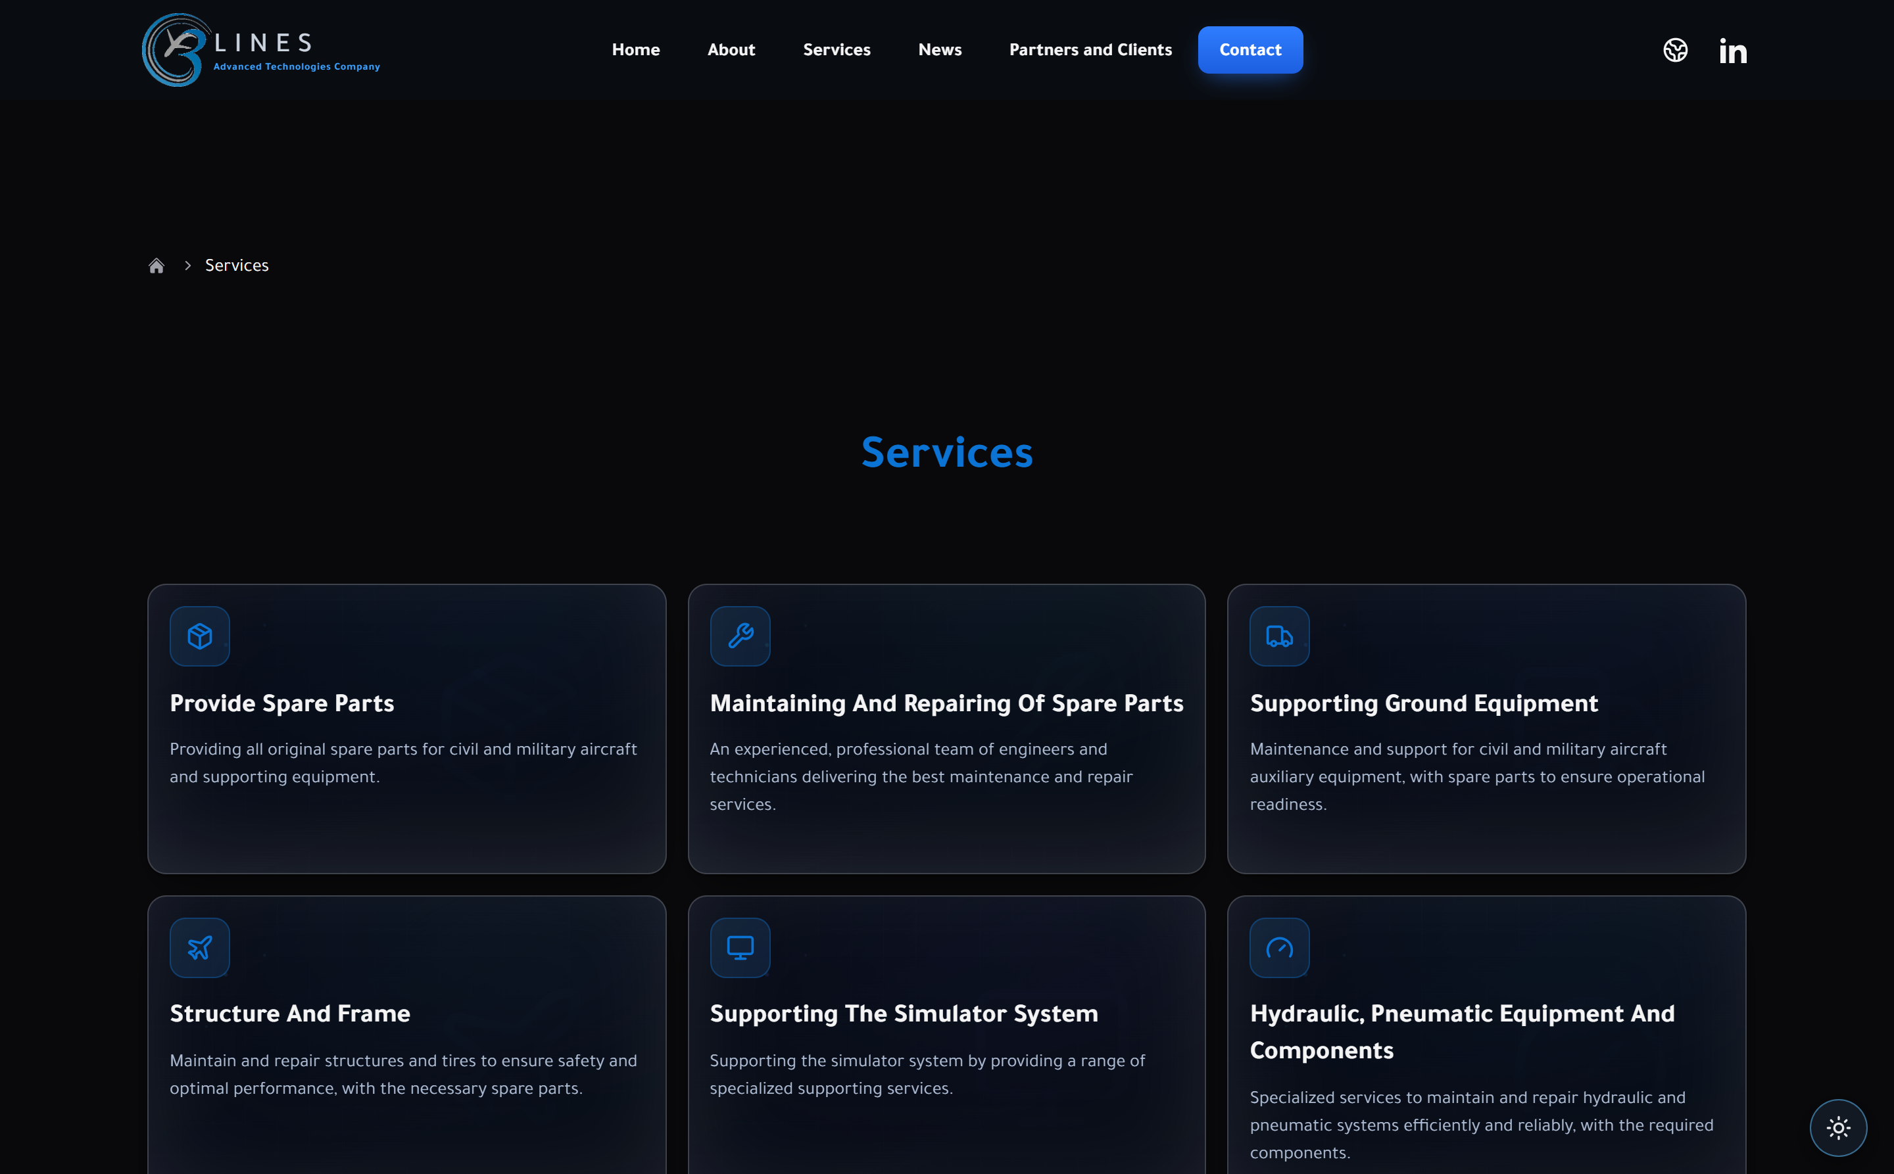
Services
https://3lines.com.sa/en

Slide 14
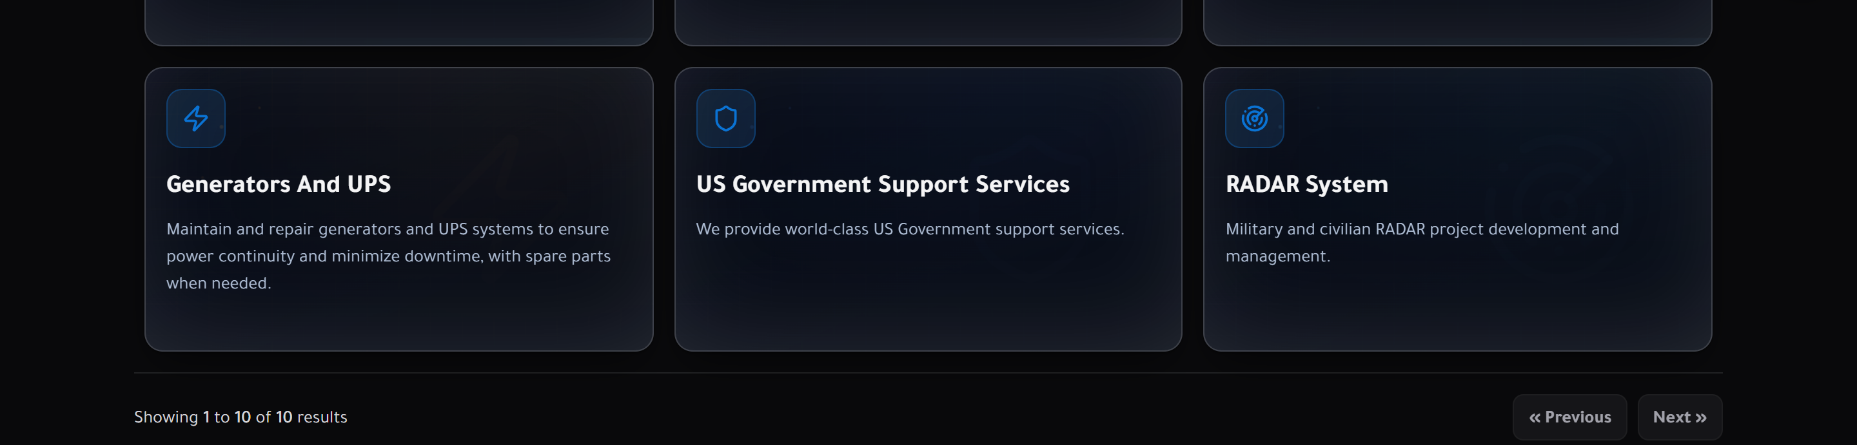
Services
https://3lines.com.sa/en

Slide 15

Services
https://3lines.com.sa/en

Slide 16
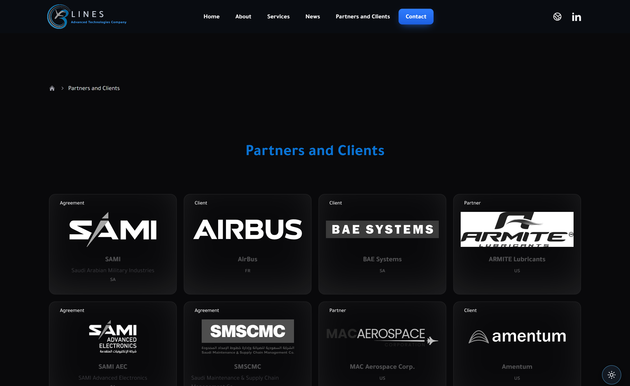
Partners & Clients
https://3lines.com.sa/en

Slide 17
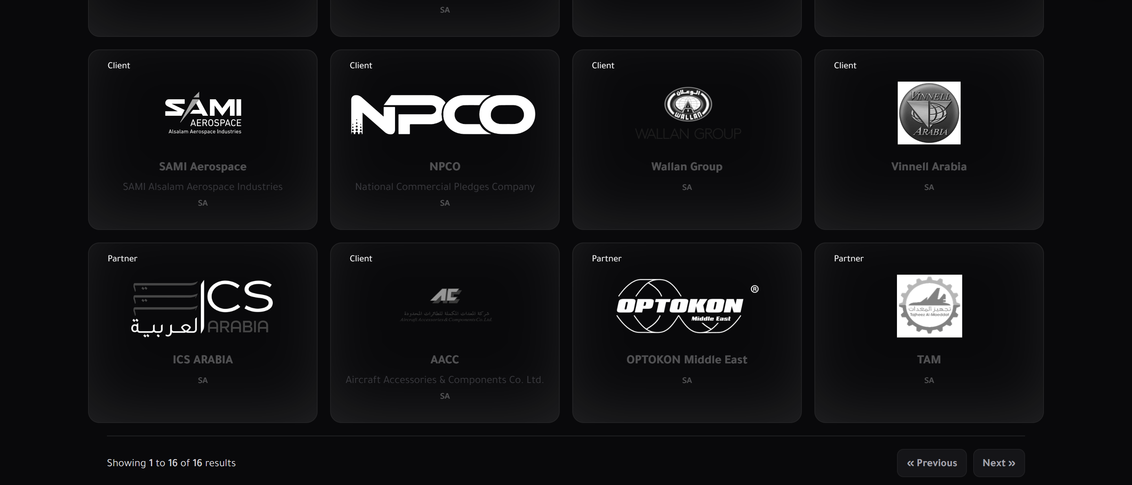
Partners & Clients
https://3lines.com.sa/en

Slide 18

Partners & Clients
https://3lines.com.sa/en

Slide 19
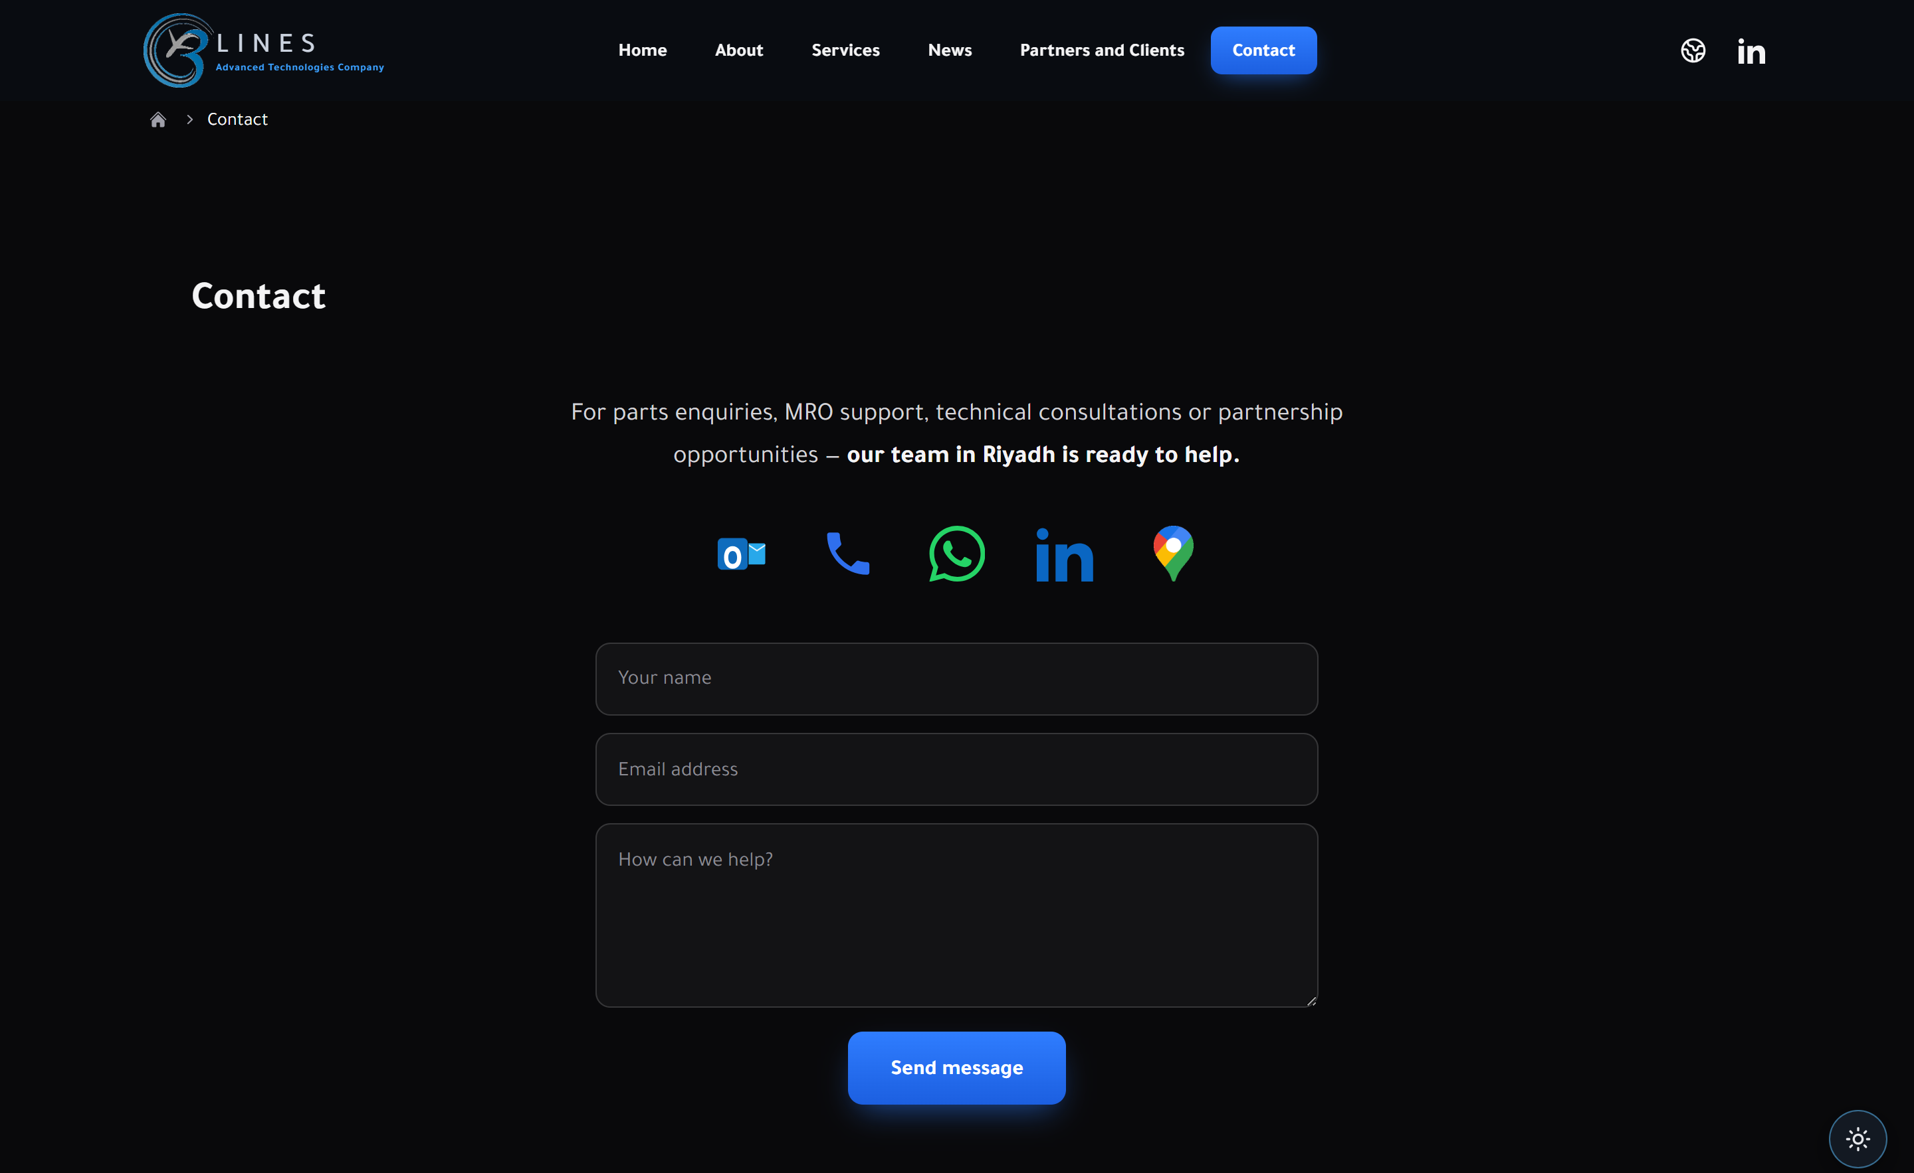
Contact
https://3lines.com.sa/en

Slide 20
Contact
https://3lines.com.sa/en

Slide 21
Contact
https://3lines.com.sa/en

Slide 22
Let's work together
Explore the full, interactive site and get in touch:
https://3lines.com.sa/en
Contact: https://3lines.com.sa/en/contact

