Slide 1
Multi-level Indexes
Because a single-level index is an ordered file, we can create a primary index to the index itself; in this case the original index file is called the first-level index and the index to the index is called the second-level index.
We can repeat the process, creating a third, fourth,… top level until all entries at the top level fit in one disk block.
A multi-level index can be created for any type of first-level index as long as the first-level index consists of more than one disk block.

Slide 2
Multi-level Indexes
Such a multi-level index is a form of a search tree; however, insertion and deletion of new index entries is a severe problem because every level of the index is an ordered file.

Slide 3
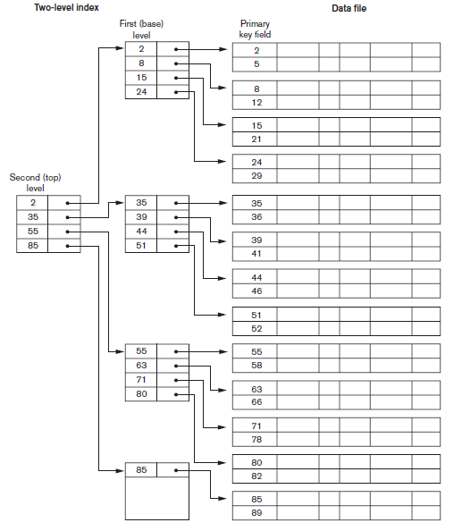
Multilevel Index (Cont.)

Slide 4
Dynamic Multilevel index
To retain the benefits of using multilevel indexing while reducing index insertion and deletion overhead, designers adopt multilevel index that leaves some space in each of its blocks for inserting new entries
This is called dynamic multilevel index and is often implemented by B-trees and B+ trees.

Slide 5
B-Trees
A Tree data structure where each node has a predetermined maximum fan-out p (order)
Terminologies: root node, leaf nodes, internal nodes, parent, children

Slide 6
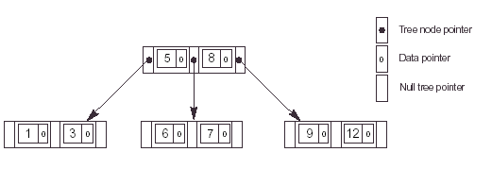
Structure of a Node
K₁
K₂
K_{i-1}
K_{i}
X < K₁
Data
Pointer
K₁ <
X < K₂
Data
Pointer
X >
K_{i}
Left-most
Subtree
Right-most
Subtree

Slide 7
Order of B-Tree
The order of a B-tree is determined by the maximum number of children a node can have. It's calculated based on the size of keys, pointers, and the block size.
Consider a B-tree which has 10 bytes long key. The data pointer and block pointer are 8 byte and 5 byte long respectively. If the block size is 512 bytes, then what is the order of B-tree?

Slide 8
Operations
B-Tree of order 4
  Each node has at most 4 pointers and 3 keys, and at least 2 pointers and 1 key.
Insert: 5, 3, 21, 9, 1, 13, 2, 7, 10, 12, 4, 8

Slide 9
Insert 5, 3, 21
* 5 *
a
* 3 * 5 *
a
* 3 * 5 * 21 *
a

Slide 10
Insert 9
* 9 *
a
b
c
* 3 * 5 *
* 21 *
Node a splits creating 2 children: b and c

Slide 11
Insert 1, 13
* 9 *
a
b
c
* 1 * 3 * 5 *
* 13 * 21 *
Nodes b and c have room to insert more elements

Slide 12
Insert 2
* 3 * 9 *
a
b
d
c
* 1 * 2 *
* 5 *
* 13 * 21 *
Node b has no more room, so it splits creating node d.

Slide 13
Insert 7, 10
* 3 * 9 *
a
b
d
c
* 1 * 2 *
* 5 * 7 *
* 10 * 13 * 21 *
Nodes d and c have room to add more elements

Slide 14
Insert 12
* 3 * 9 * 13 *
a
b
d
c
e
* 1 * 2 *
* 5 * 7 *
* 10 * 12 *
* 21 *
Nodes c must split into nodes c and e

Slide 15
Insert 4
a
* 3 * 9 * 13 *
b
d
c
e
* 1 * 2 *
* 4 * 5 * 7 *
* 10 * 12 *
* 21 *
Node d has room for another element

Slide 16
Insert 8
a
* 9 *
f
g
* 3 * 7 *
* 13 *
b
d
h
c
e
* 1 * 2 *
* 4 * 5 *
* 8 *
* 10 * 12 *
* 21 *
Node d must split into 2 nodes. This causes node a to split into 2 nodes and the tree grows a level.

Slide 17
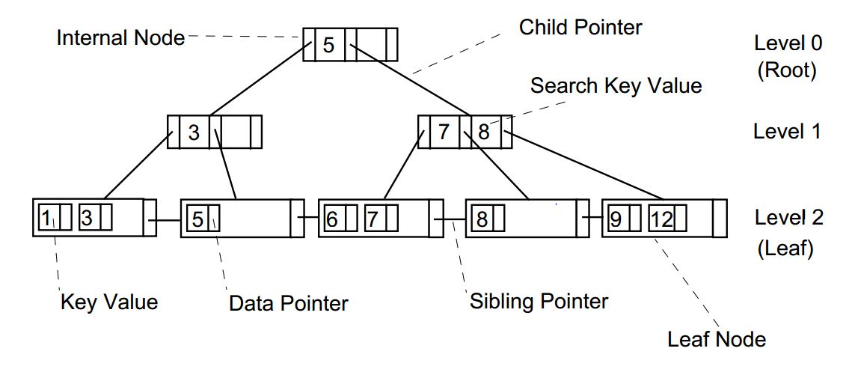
Structure of B+ Tree

Slide 18
Order of B+ tree
Consider a B+ tree in which the search key is 10 bytes long, block size is 512 bytes, record pointer is 8 bytes long and block pointer is 5 bytes long. What is the order of leaf ( max number of key and data pointer pairs) and non leaf node (maximum number of children)?

Slide 19
B+ tree Construction
Construct B+ tree for following data. 30,31,23,32,22,28,24,29, where the order of non leaf and leaf node is 5.

Slide 20
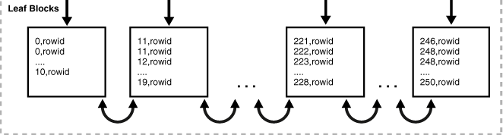
Structure of Leaf Blocks of Index in Oracle
The example shows an index on the department_id column, which is a foreign key column in the employee table.

Slide 21
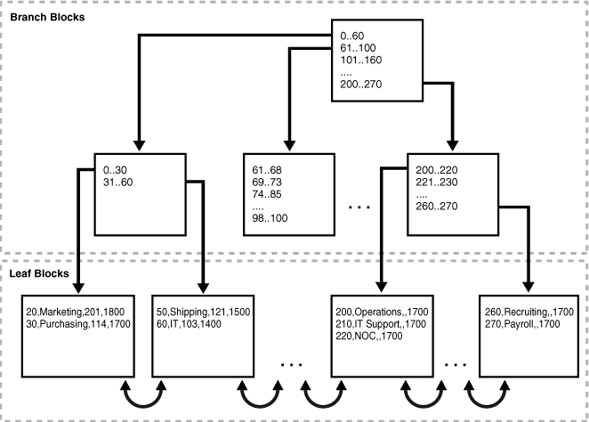
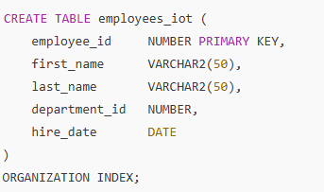
Index-Organized Table (IOT) in Oracle
Structure of an index-organized department table. The leaf blocks contain the rows of the table, ordered sequentially by primary key. For example, the first value in the first leaf block shows a department ID of 20, department name of Marketing, manager ID of 201, and location ID of 1800.

Slide 22
Bitmap Index
A bitmap index for attribute A of relation R is:
  A collection of bit-vectors
  The number of bit-vectors = the number of distinct values of A in R.
  The length of each bit-vector = the cardinality of R.
  The bit-vector for value v has 1 in position i, if the ith record has v in attribute A, and it has 0 there if not.
Records are allocated permanent numbers
There is a mapping between record numbers and record addresses.

Slide 23
Example
Assume relation R with
  2 attributes A and B.
  Attribute A is of type Integer and B is of type String.
  6 records, numbered 1 through 6 as follows:
    A, B
    30, foo
    30, bar
    40, baz
    50, foo
    40, bar
    30, baz
  A bit map for attribute B is:
value | Vector
foo | 100100
bar | 010010
baz | 001001

Slide 24
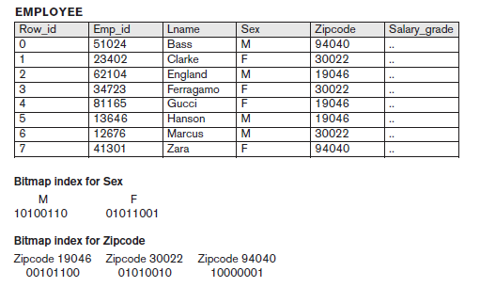
Bitmap Index

