Slide 1
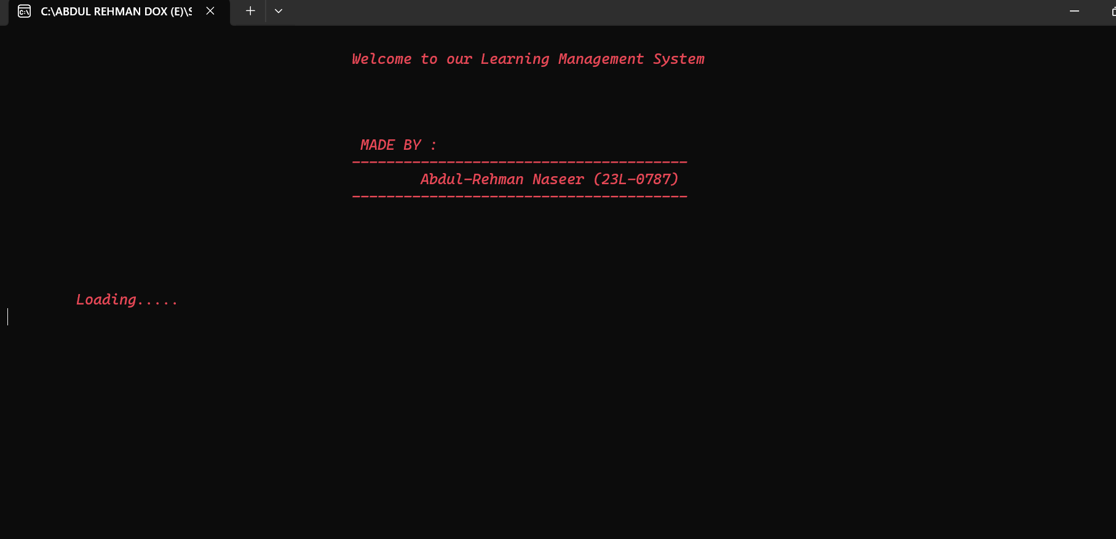
This is the first page you will see when you run the code.
Press any key, such as "Enter," to proceed.

Slide 2
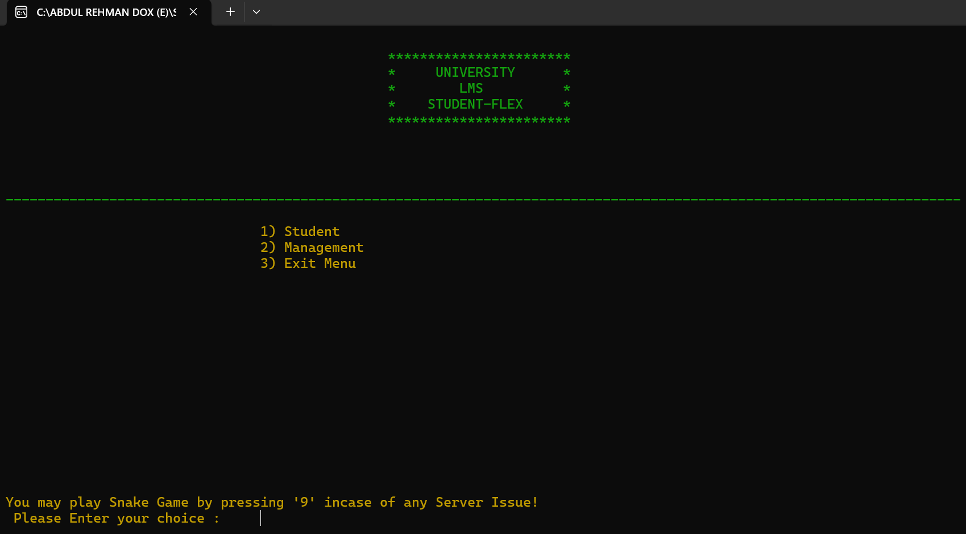
"On this page, you have four options available. You need to select one.

Slide 3
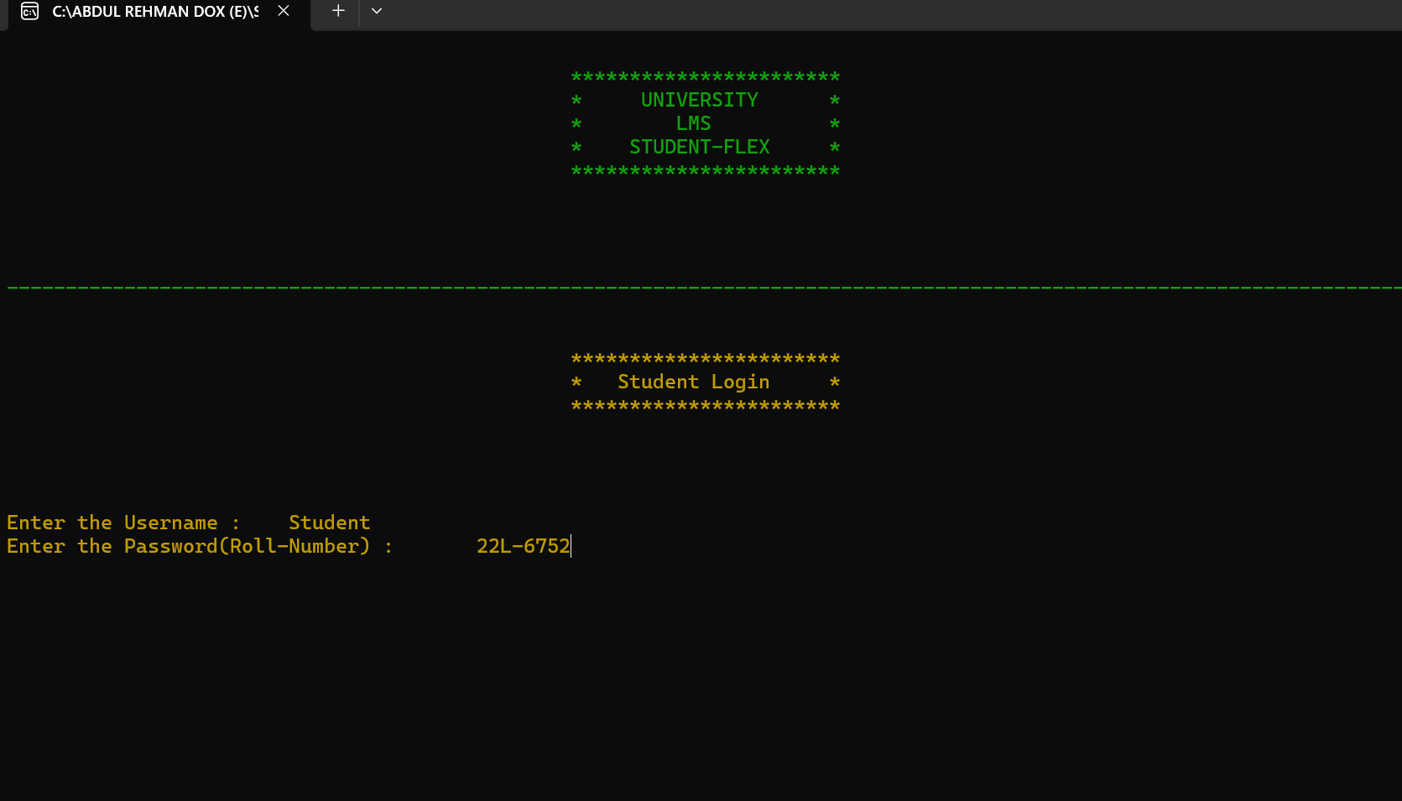
Let's start with the first option: student login. Enter 'Student' as the username and the roll number of any registered student to log in. You can find the roll numbers of registered students in either the test-subjects folder or the students.txt file.

Slide 4
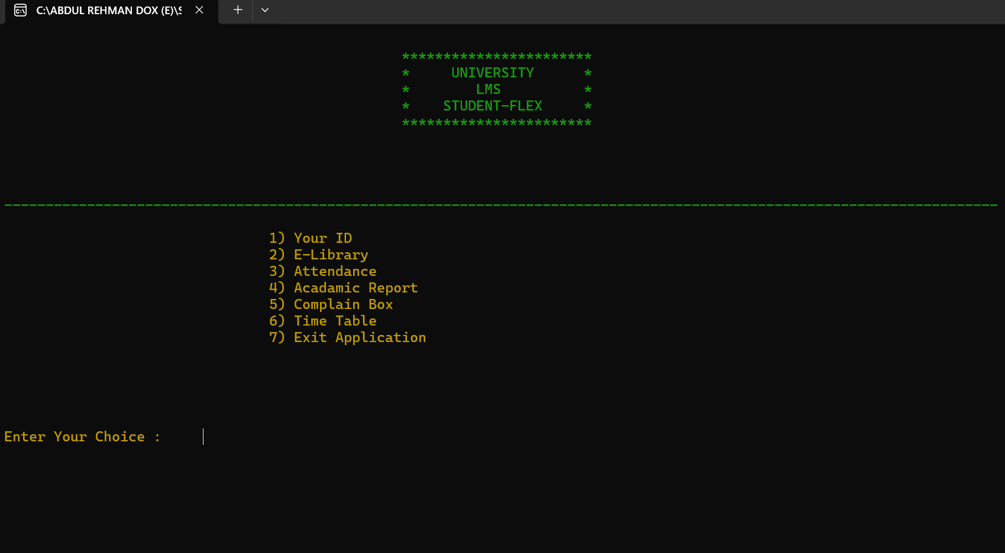
Student Login: Now, you can choose any option from the list Above.

Slide 5
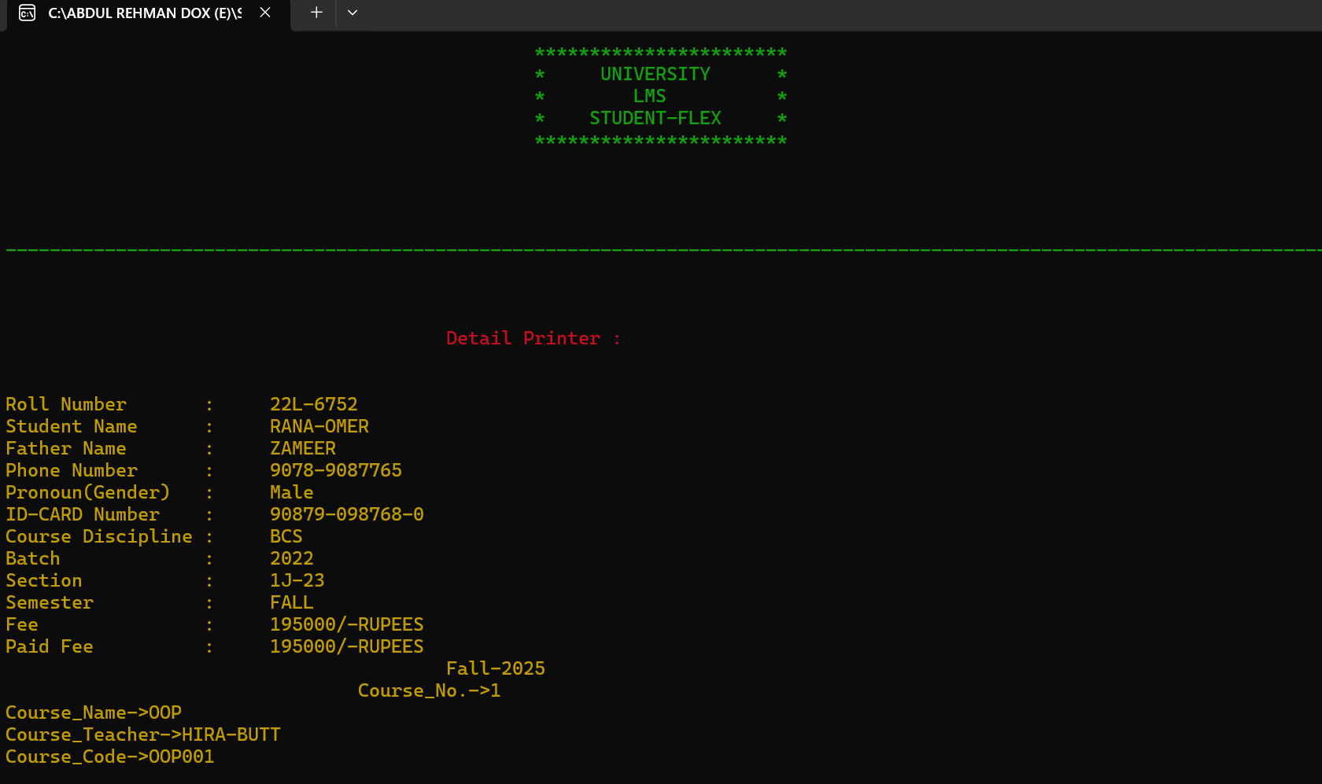
Press any key, such as Enter, to go back.
The first option under Student Login prints all the details of a student listed in the student record file. When using the Print Details option, the whole code requires the ID number (such as a roll number) to print the person's details. This applies to both students and faculty members

Slide 6
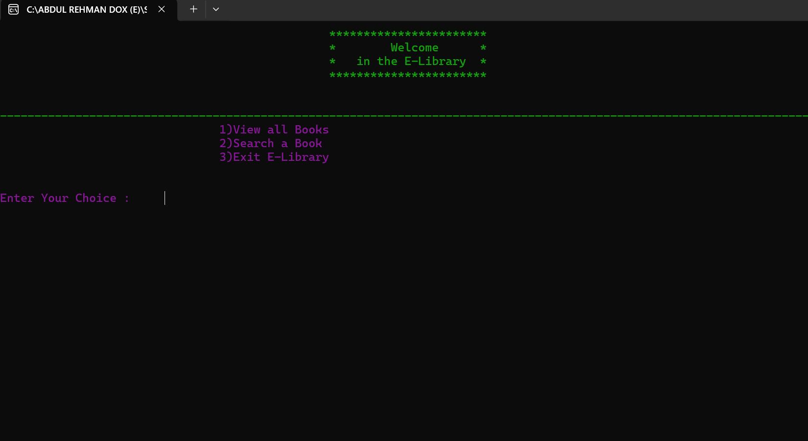
Second Option: E-Library Students have access to the following options:
Press any key, such as Enter, to go back.

Slide 7
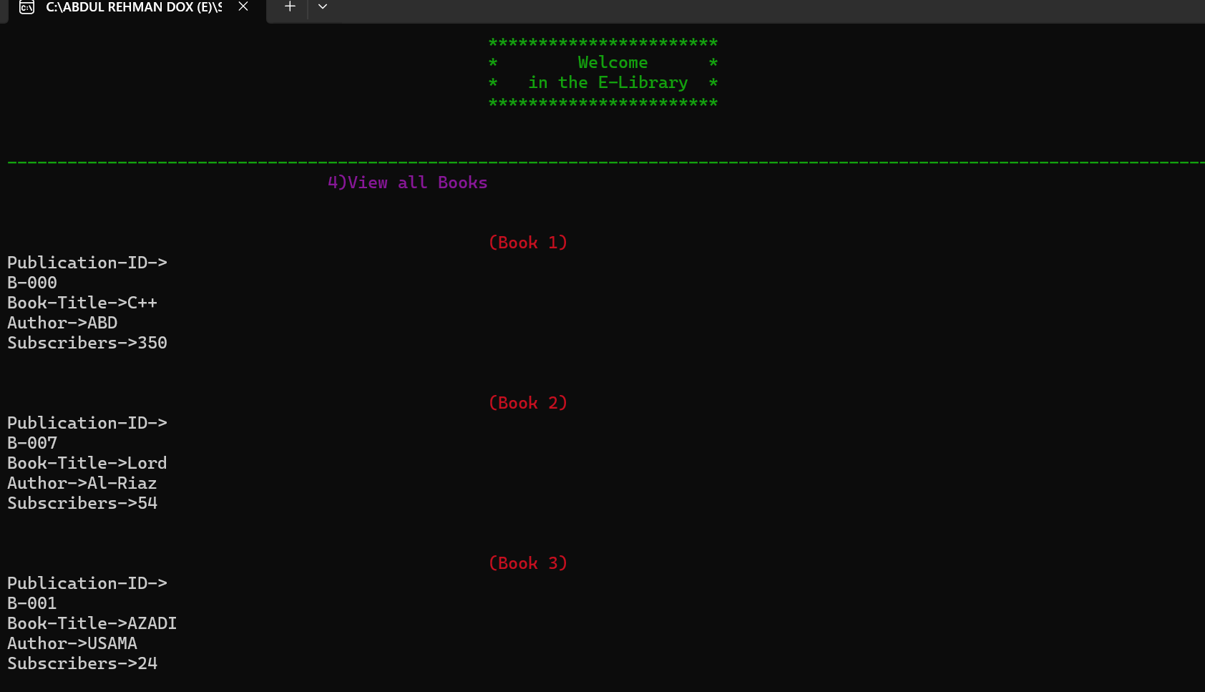
This is the view of a list of all books.
Press any key, such as Enter, to go back.

Slide 8
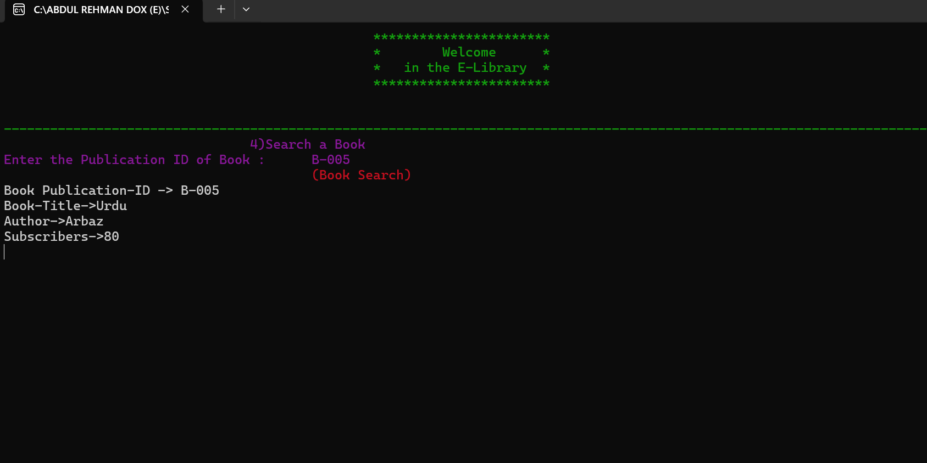
This is the view of the book search system in the E-Library.
Press any key, such as Enter, to go back.

Slide 9
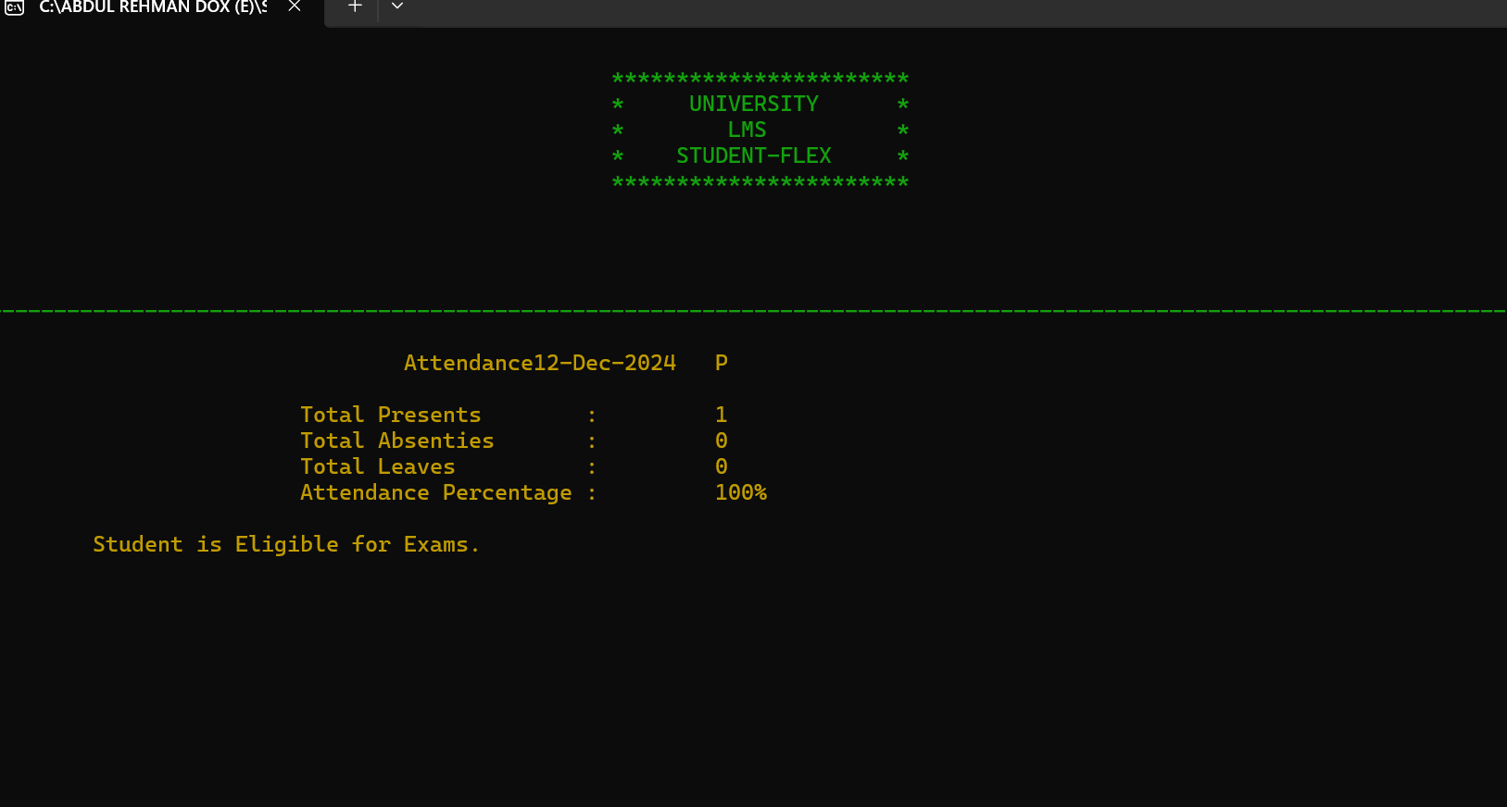
Third Option: Student Login Students can check their attendance.
Press any key, such as Enter, to go back.

Slide 10
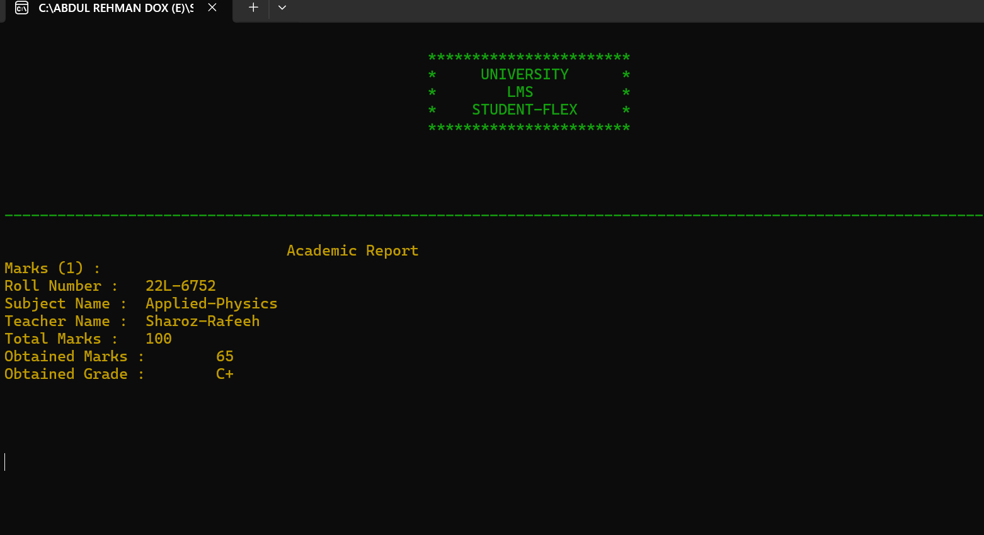
Fourth Option: Academic Report or Result Students can view their academic reports or results.
Press any key, such as Enter, to go back.

Slide 11
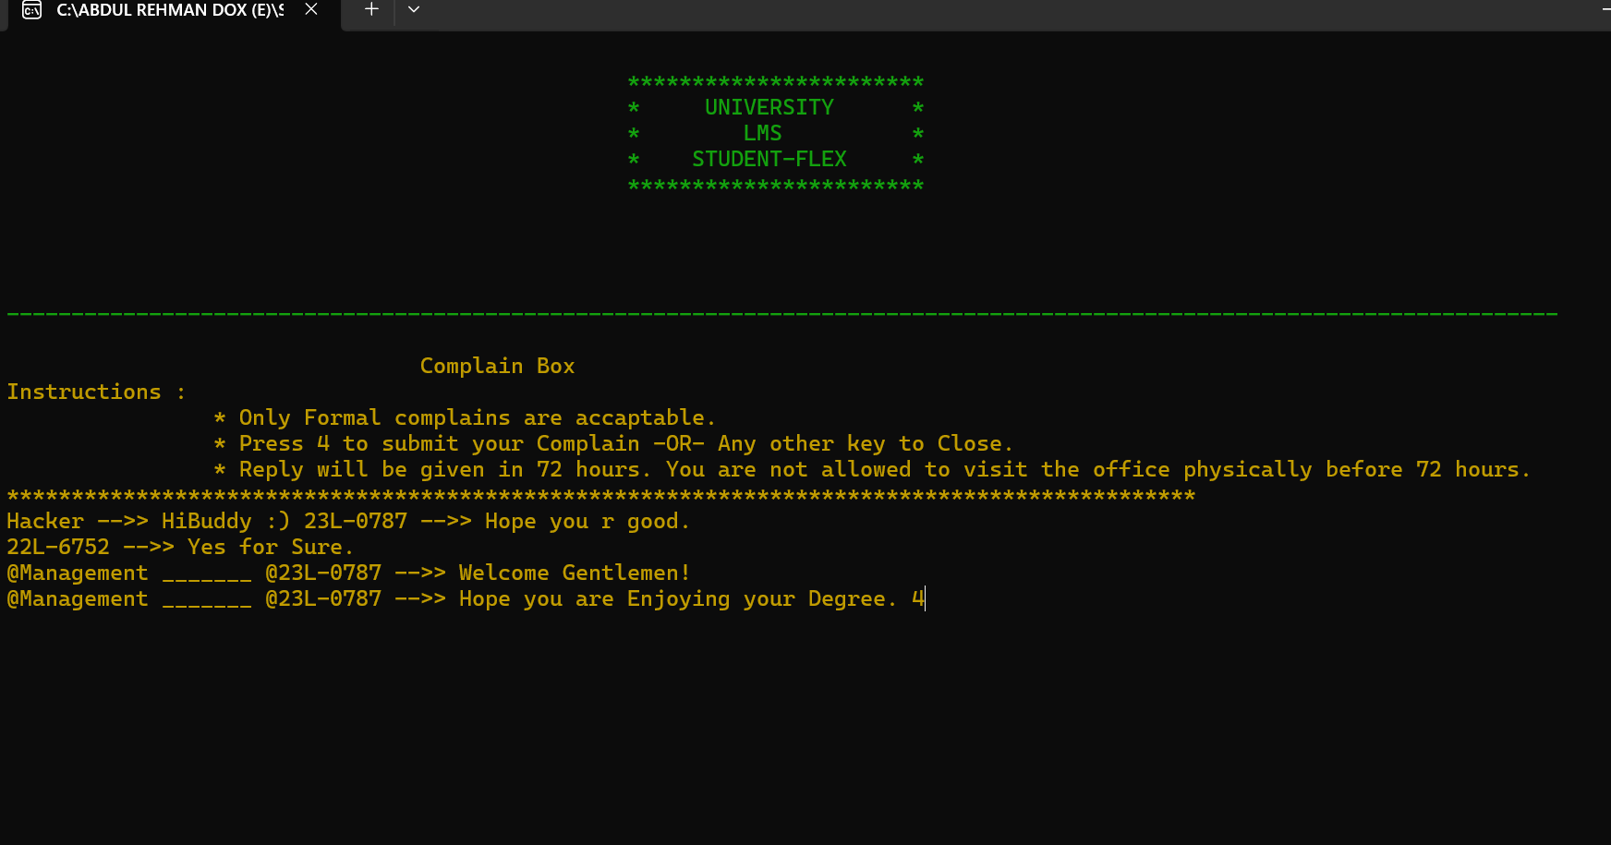
Fifth Option: Comment Box or Report Session Students can use this option to report to the academic office or management Instructions are given clearly

Slide 12
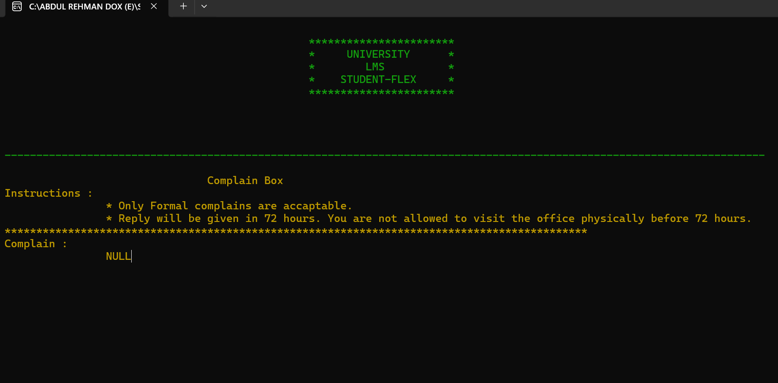
Here's an example of how you might write a comment

Slide 13
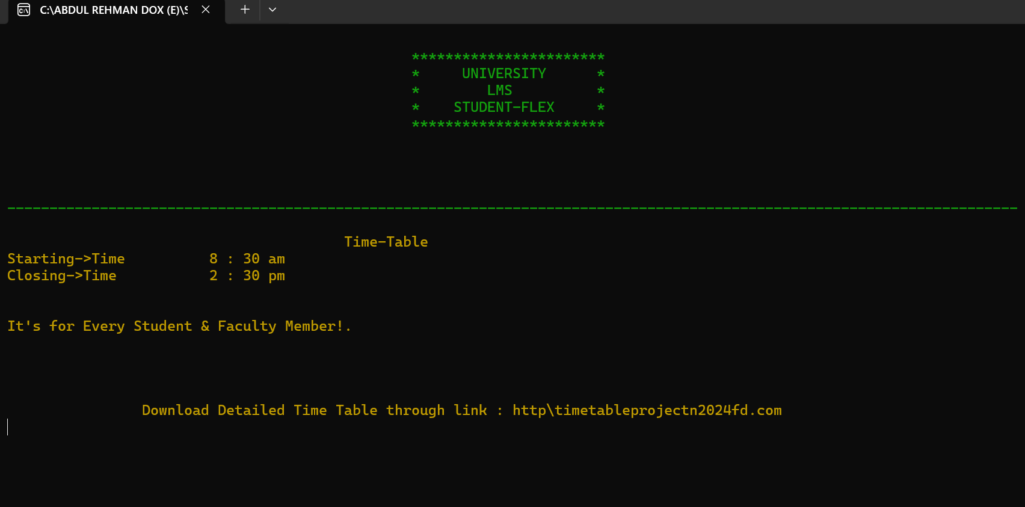
Sixth Option: Time Table Students can view their class schedules and time tables
Press any key, such as Enter, to go back.

Slide 14
Press 7 to exit Student Login and go back.

Slide 15
Now, let's move to the management section by entering 2

Slide 16
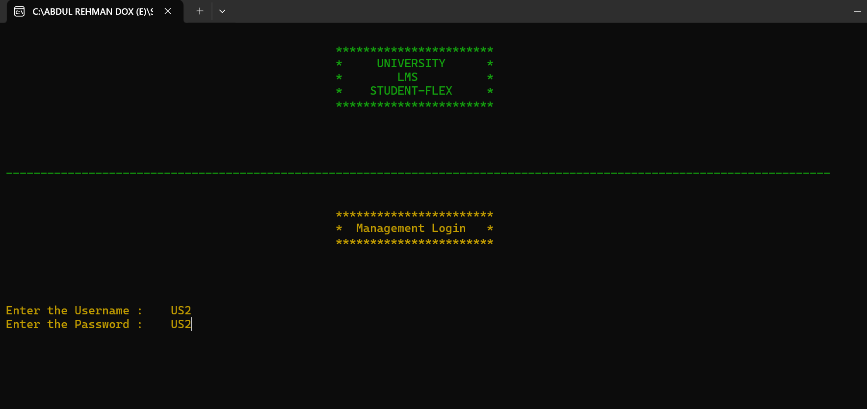
Enter the details as shown in the image to log in to the Management section

Slide 17
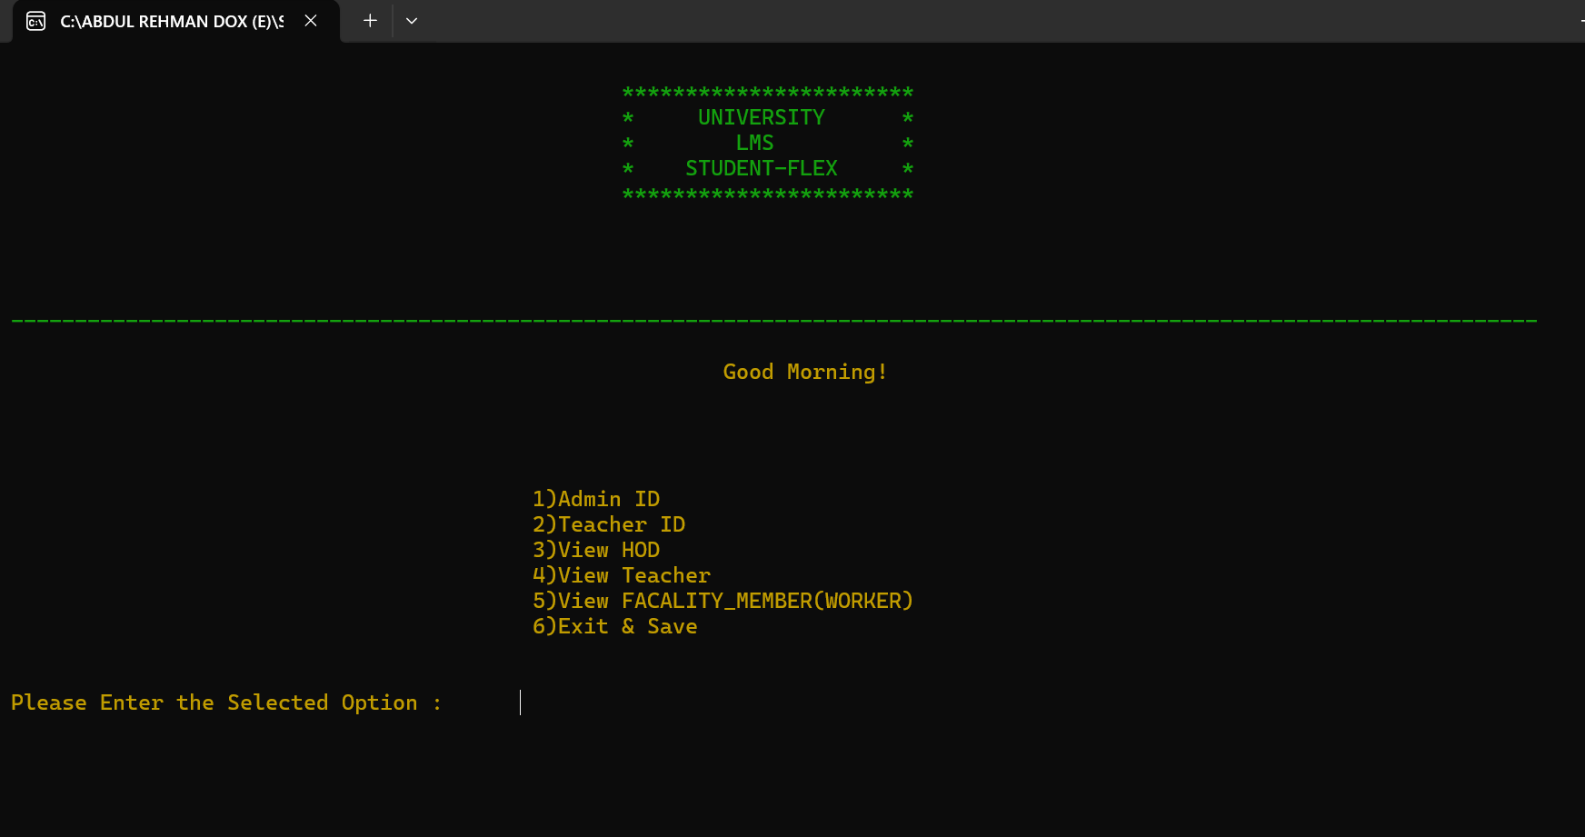
This is the login page for management, featuring easy-to-understand options.

Slide 18
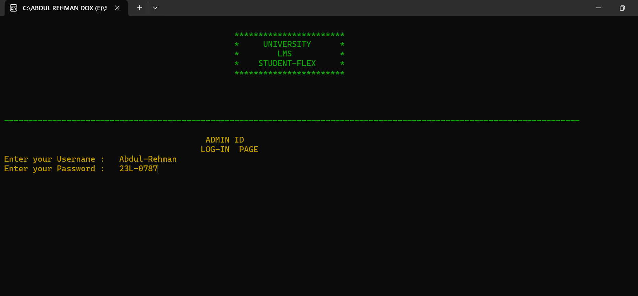
First Option: Admin Login Enter the provided username and password to log in as an administrator.

Slide 19
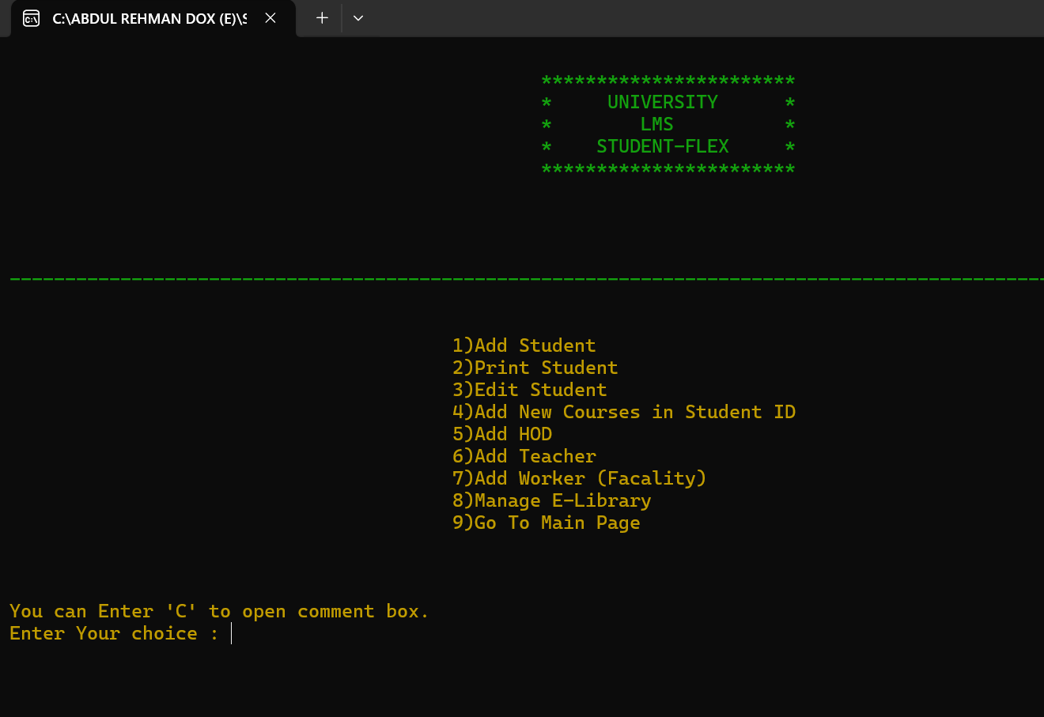
Admin Login Admins have access to all main options. They can add any faculty member or student by simply choosing the option and providing the required information for registration. Additionally, they manage the E-Library and can edit or print old student records for review.

Slide 20
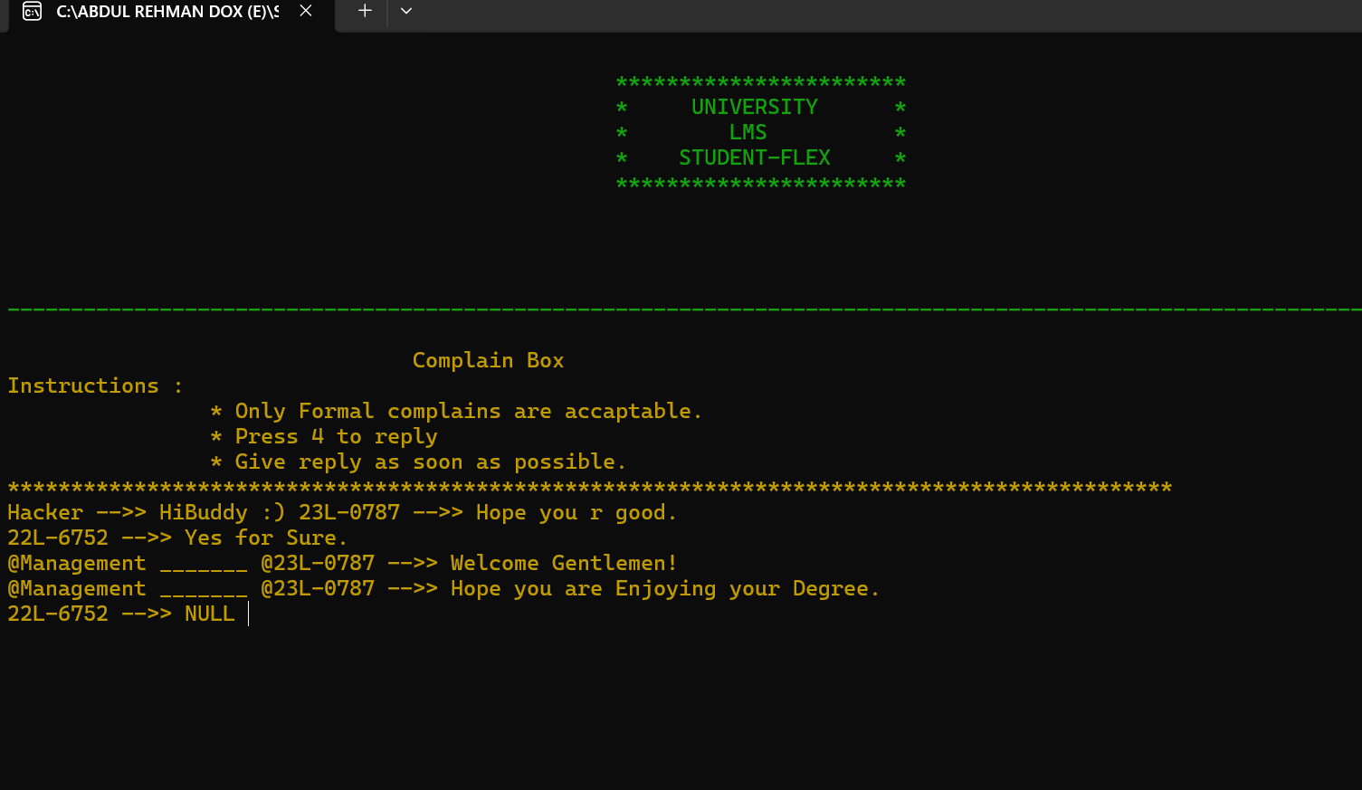
Comment Box By entering 'C', admins can access the comment box to reply to student complaints.

Slide 21
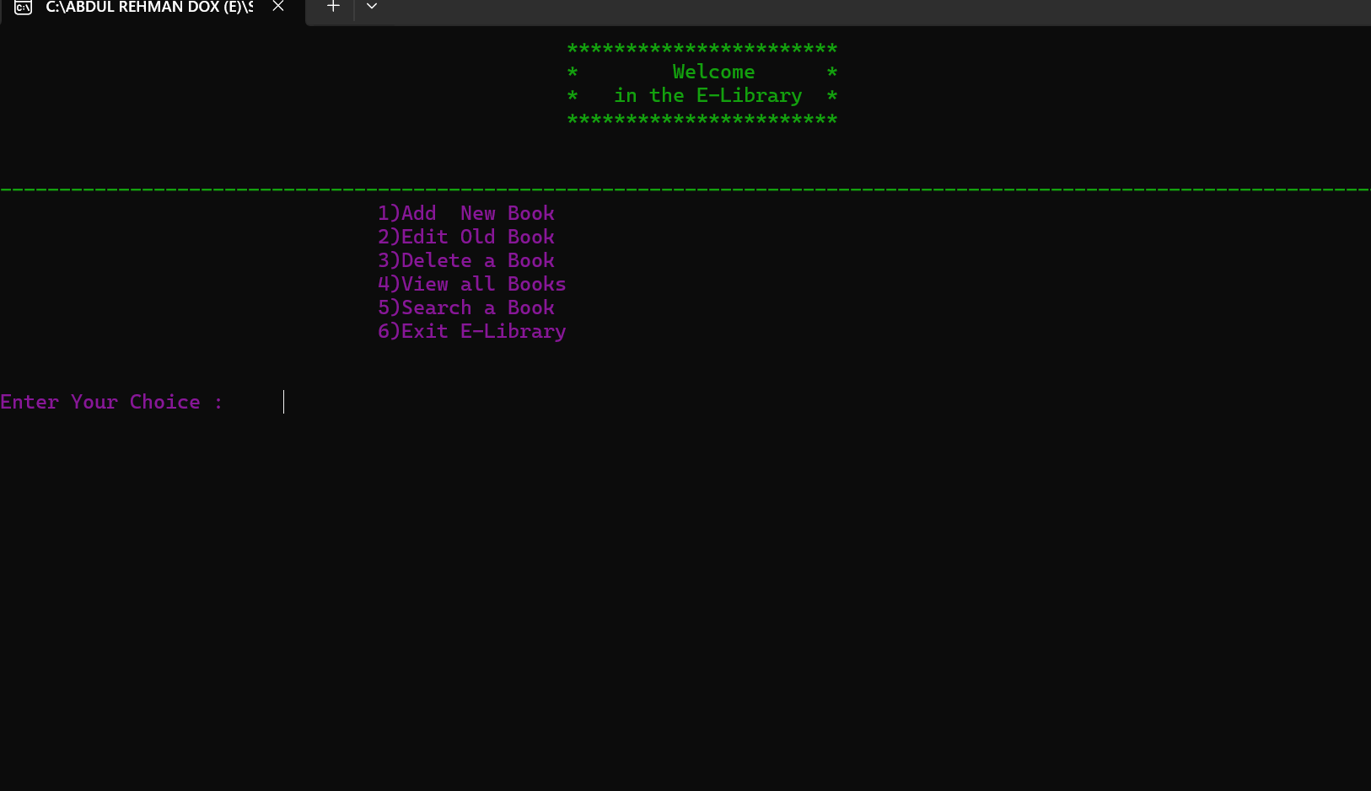
E-Library by Admin Admins can add, edit, or delete any book record.

Slide 22
Press 9 to exit Admin Login and go back.

Slide 23
Now, let's move to the Teacher Log In by entering 2

Slide 24
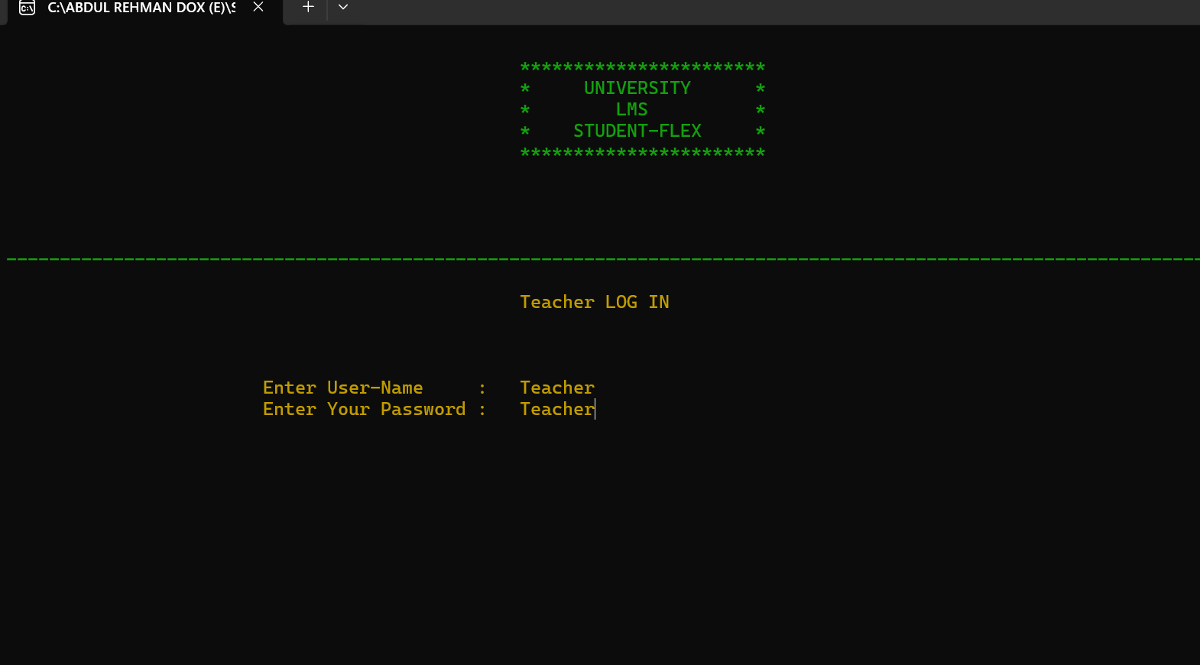
Second Option: Teacher Login Enter the provided username and password to log in as Teacher.

Slide 25
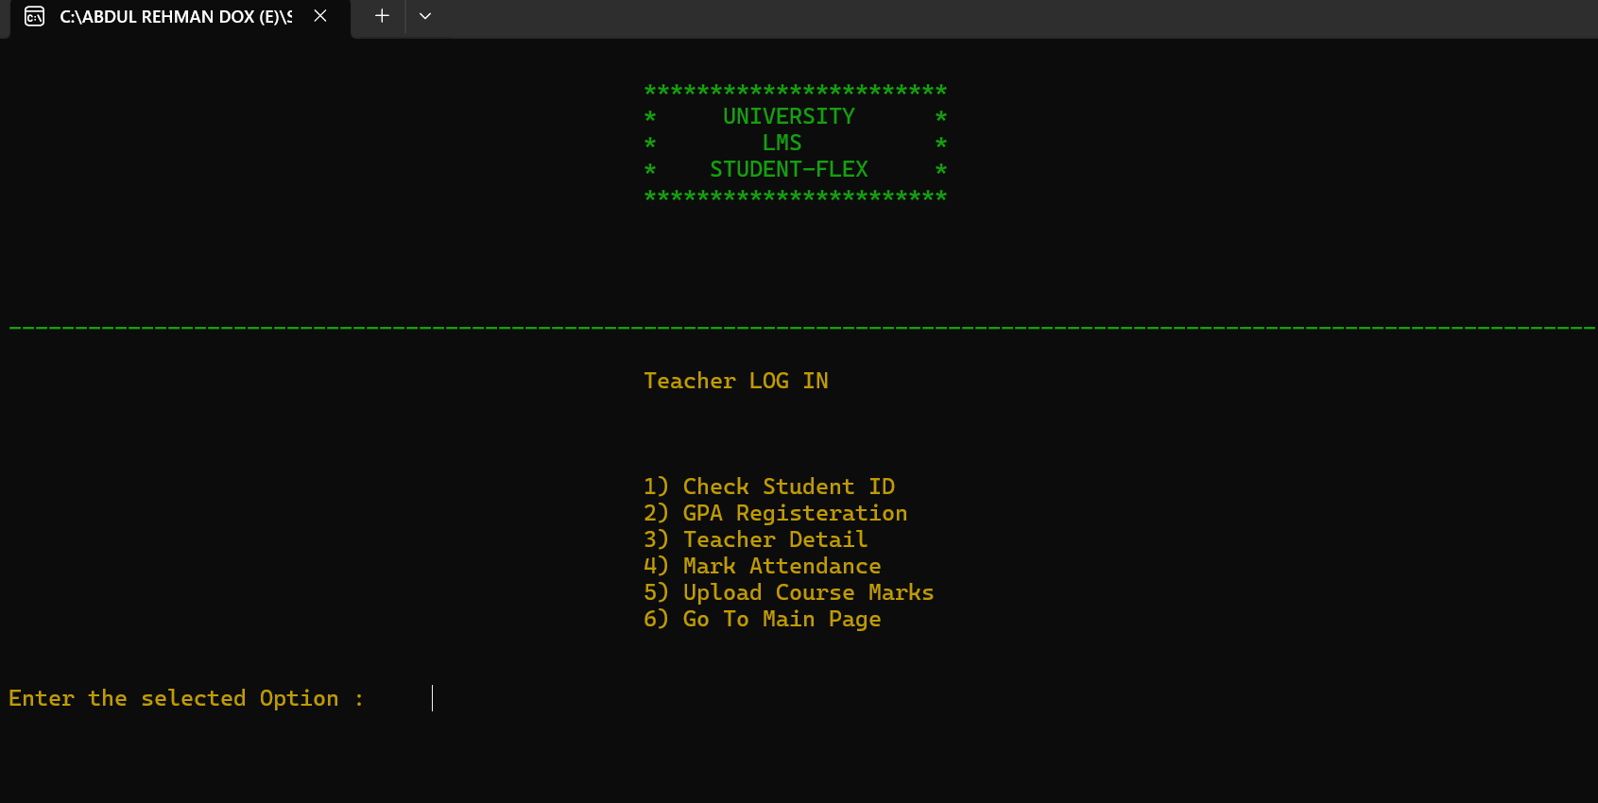
"Teacher Options These are the simple options available for teachers. You can use them very easily—just go with the flow.

Slide 26
The rest of the options are very simple. Just choose 'View Detail' as desired and then enter the ID, as explained in the student detail printer section.

Slide 27
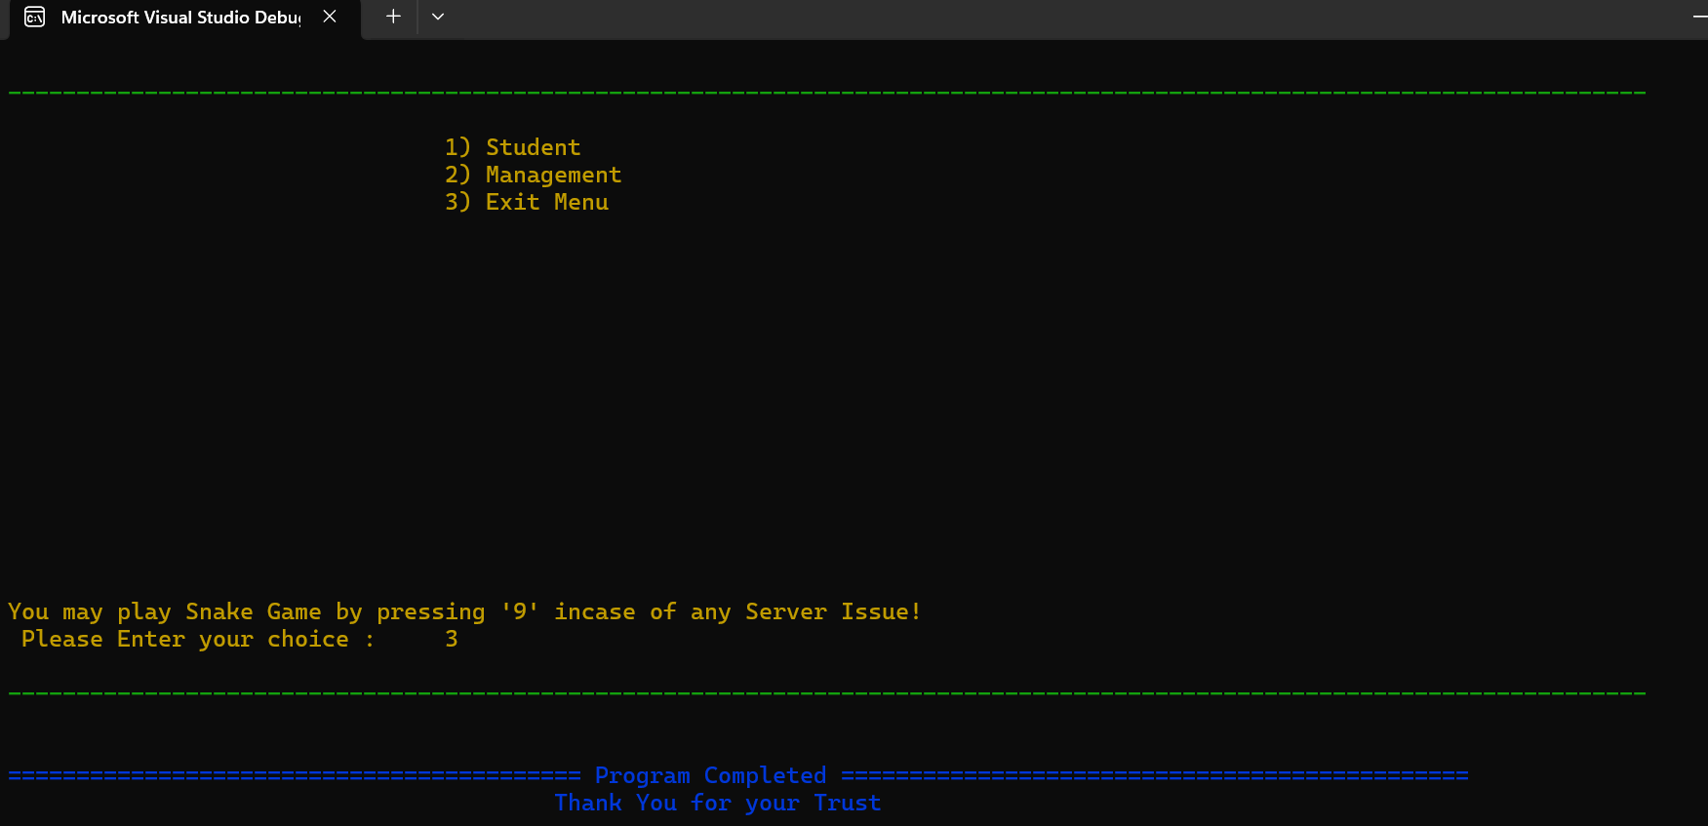
Enter 9 to play a game or 3 to exit, as you prefer. Detailed instructions are provided at each step in the code

Slide 28

Thank you for reaching out to GitHub. My code is designed to be very easy to understand and use. If you have any queries, feel free to contact me via email
abdulrehmannaseer572@gmail.com
l230787@lhr.nu.edu.pk

