Slide 1
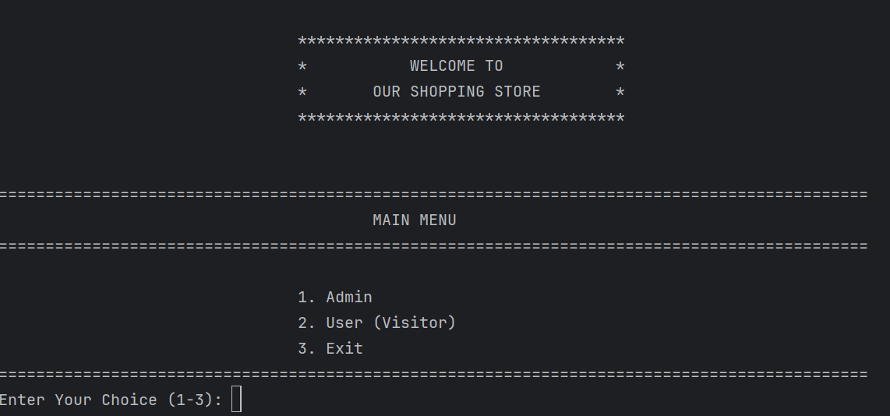

Slide 2
Overview:
This is a shopping store management system implemented in Python using object-oriented programming (OOP) principles. The system has four main components:
1. Product management (Base and Derived classes)
2. User management (Customers)
3. Admin functionality (Owner)
4. Order and payment processing

Slide 3
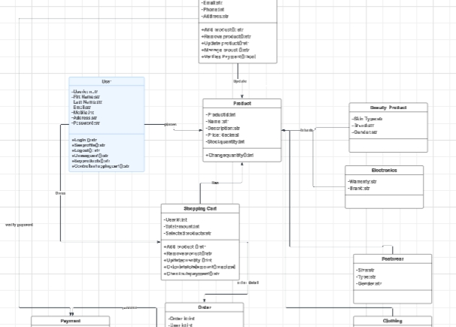
LucidChart Diagram
Visual Representation of Code Structure

Slide 4
1) PRODUCT MANAGEMENT
Base Class (Product)
Contains common attributes for all products (ID, name, description, price, quantity, category, gender).
Provides a string representation of product details.
Derived Classes (Clothing, Electronics, Footwear, Beauty)
Each inherits from Product and adds specialized attributes:
Clothing: Size and material
Electronics: Brand and warranty period
Footwear: Size and shoe type
Beauty: Brand and skin type
Each overrides the string representation to include its specific attributes in product details

Slide 5
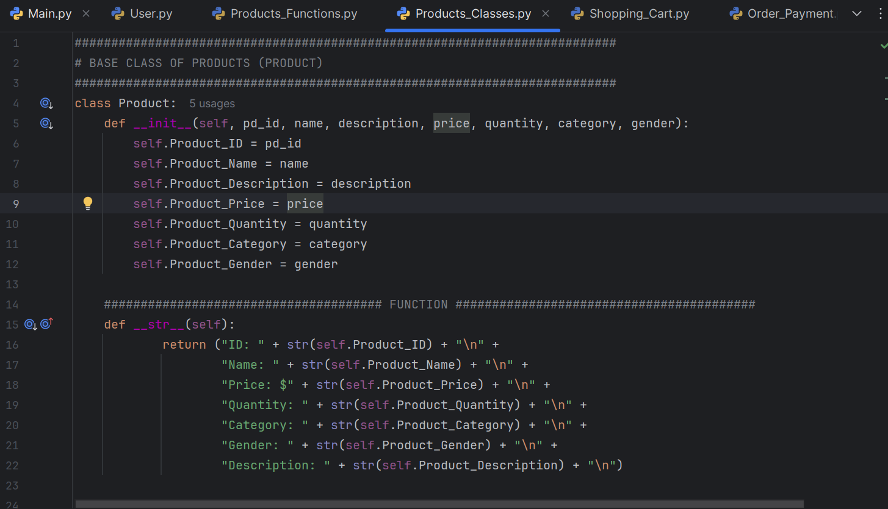
1) Product Management

Slide 6
2) User System
User Class
1) Represents store customers with personal details (name, email, address, etc.)
2) Each user has a ShoppingCart
3) Provides string representation of user details
User Authentication Functions
1) user_sl_menu() - Shows signup/login options
2) sign_up_user() - Handles new user registration with validation
3) user_log_in() - Authenticates existing users
4) Manages shopping cart

Slide 7
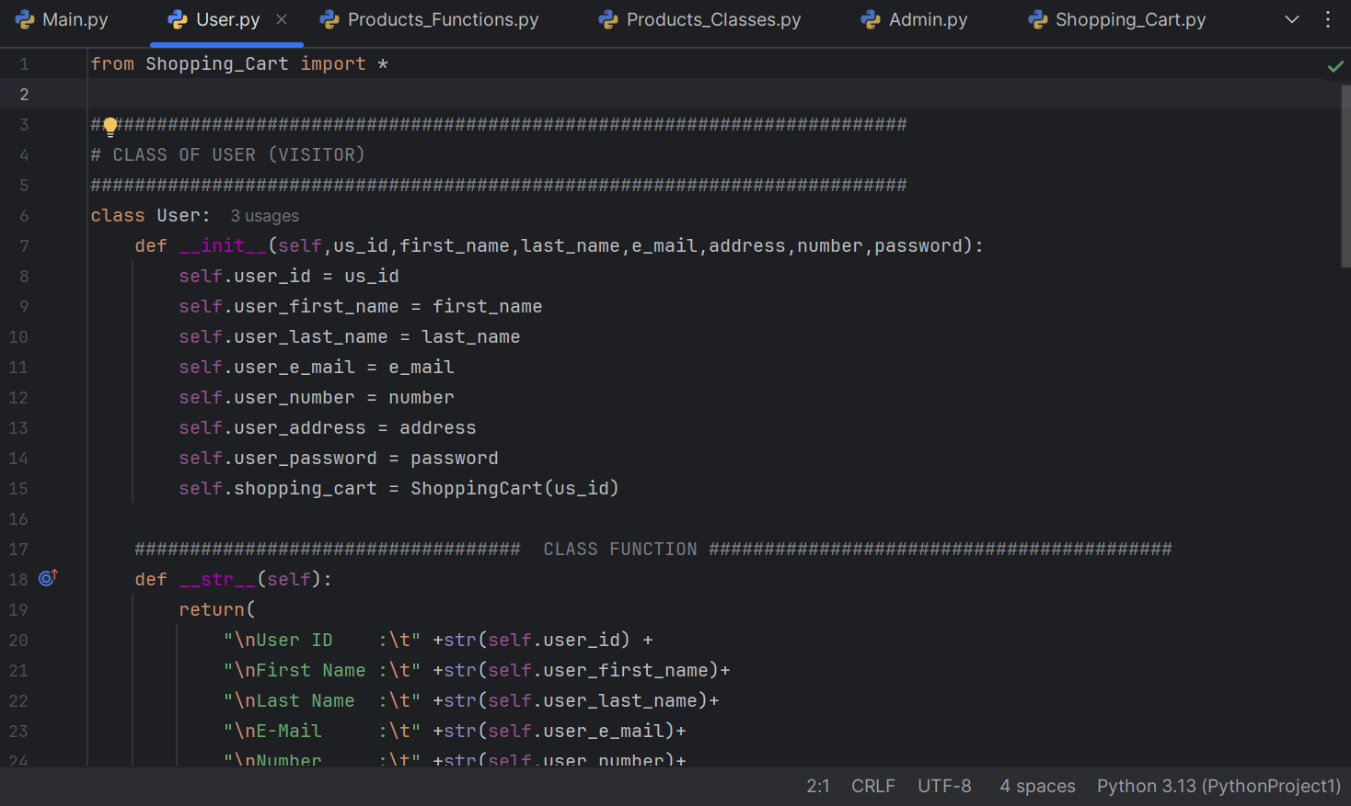
2) User (Customer)

Slide 8
3) Admin System
Admin Class
1) Manages store operations with functions to:
I) Add/edit/delete products
II) View and verify payments
2) Each operation maintains consistency across all product lists

Slide 9
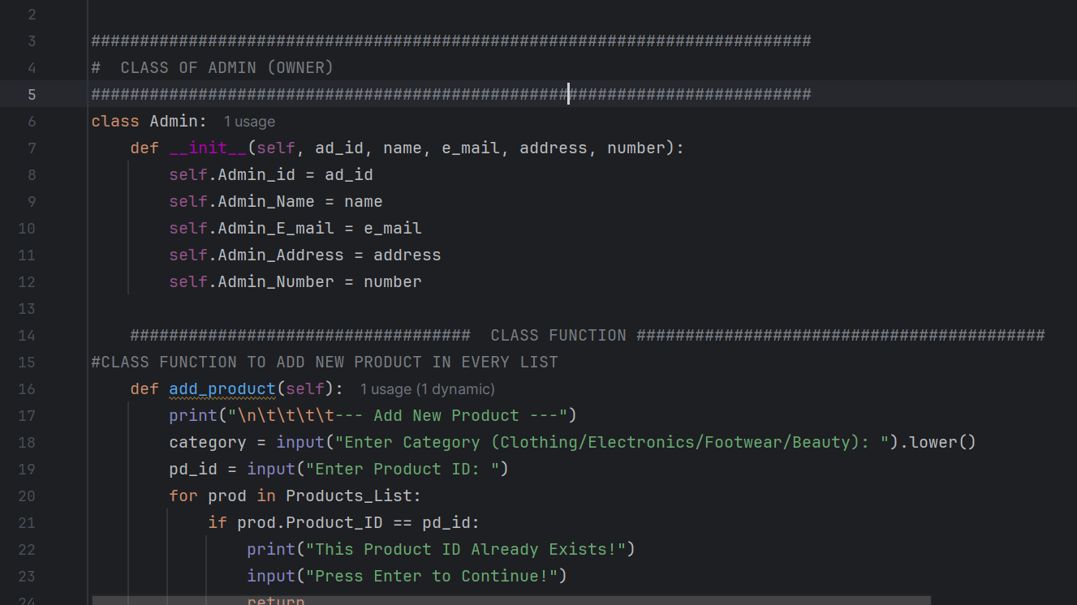
3) Admin (Owner)

Slide 10
4. Order Processing
Order Class
1) Tracks order details (ID, user, amount, shipping address, status)
2) Handles payment creation
Payment Class
1) Manages payment details (method, amount, verification status)
2) Supports different payment methods (credit card, PayPal, etc.)

Slide 11
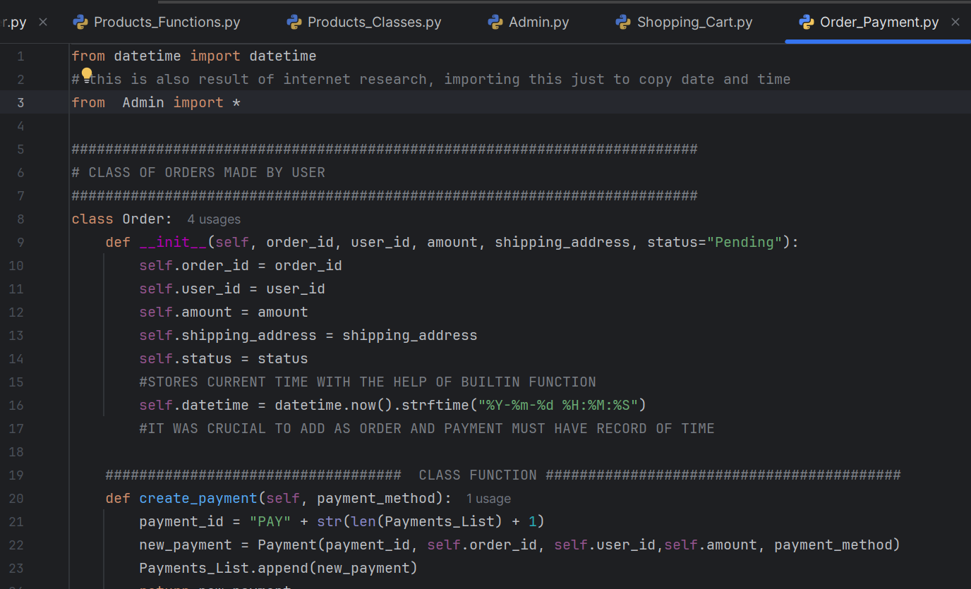
4) Order & Payment Management

Slide 12
Main Program Flow
1) Initializes sample data (products, users, orders)
2) Provides the main menu interface to navigate between admin and user functions
3) Coordinates all system components
Data Structures
The system uses several global lists to manage data:
Products_List - All products
Category-specific lists (Clothing, Electronics, etc.)
User_List - Registered customers
Orders_List - All orders

Slide 13
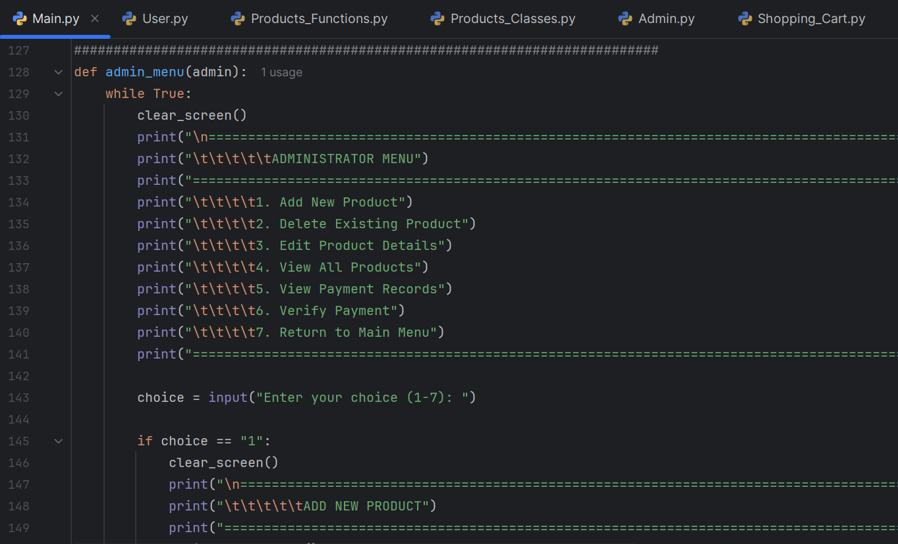
(Main File) Unites All Class with the Help of Menus

Slide 14
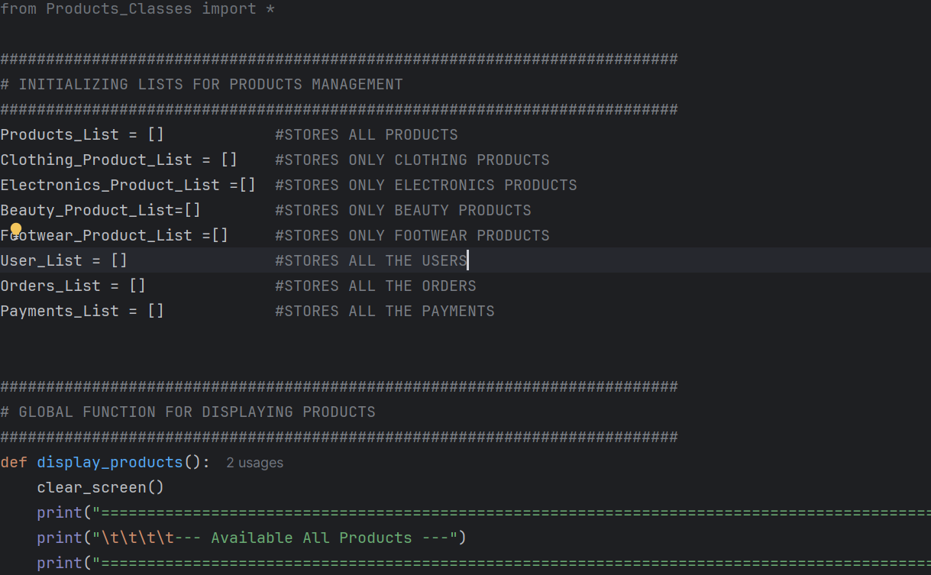
Global Lists

Slide 15
