Slide 1

Introduction to DevOps
Lecture 01
Muhammad Kamran
CSC418 • DevOps for Cloud Computing
1
Notes:
[Sources]
- https://unsplash.com/photos/yd_RKGH_RH4 (photo, Unsplash License)
[/Sources]

Slide 2

THE BASICS
Who is Dev?
Who is Ops?

Slide 3
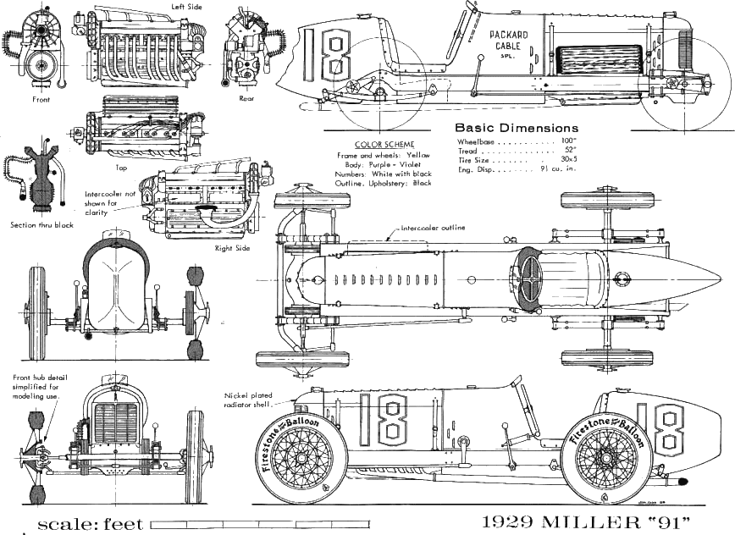

Traditional Development
The Inventors
Create new features and functionality in “dev” environment
Occasionally deliver new product to operators, along with instructions
May incorporate feedback from operators in future deliveries
Rewarded for delivering new features
The inventors are responsible for changing the system

Slide 4


Traditional Operations
The Mechanics
Receive new products from developers to be installed and operated
Expected to keep production systems up and running
Track problems, deployment failures, and system outages
May provide feedback to the inventors for future consideration
Penalized for downtime
The mechanics are responsible for keeping the system in operation

Slide 5

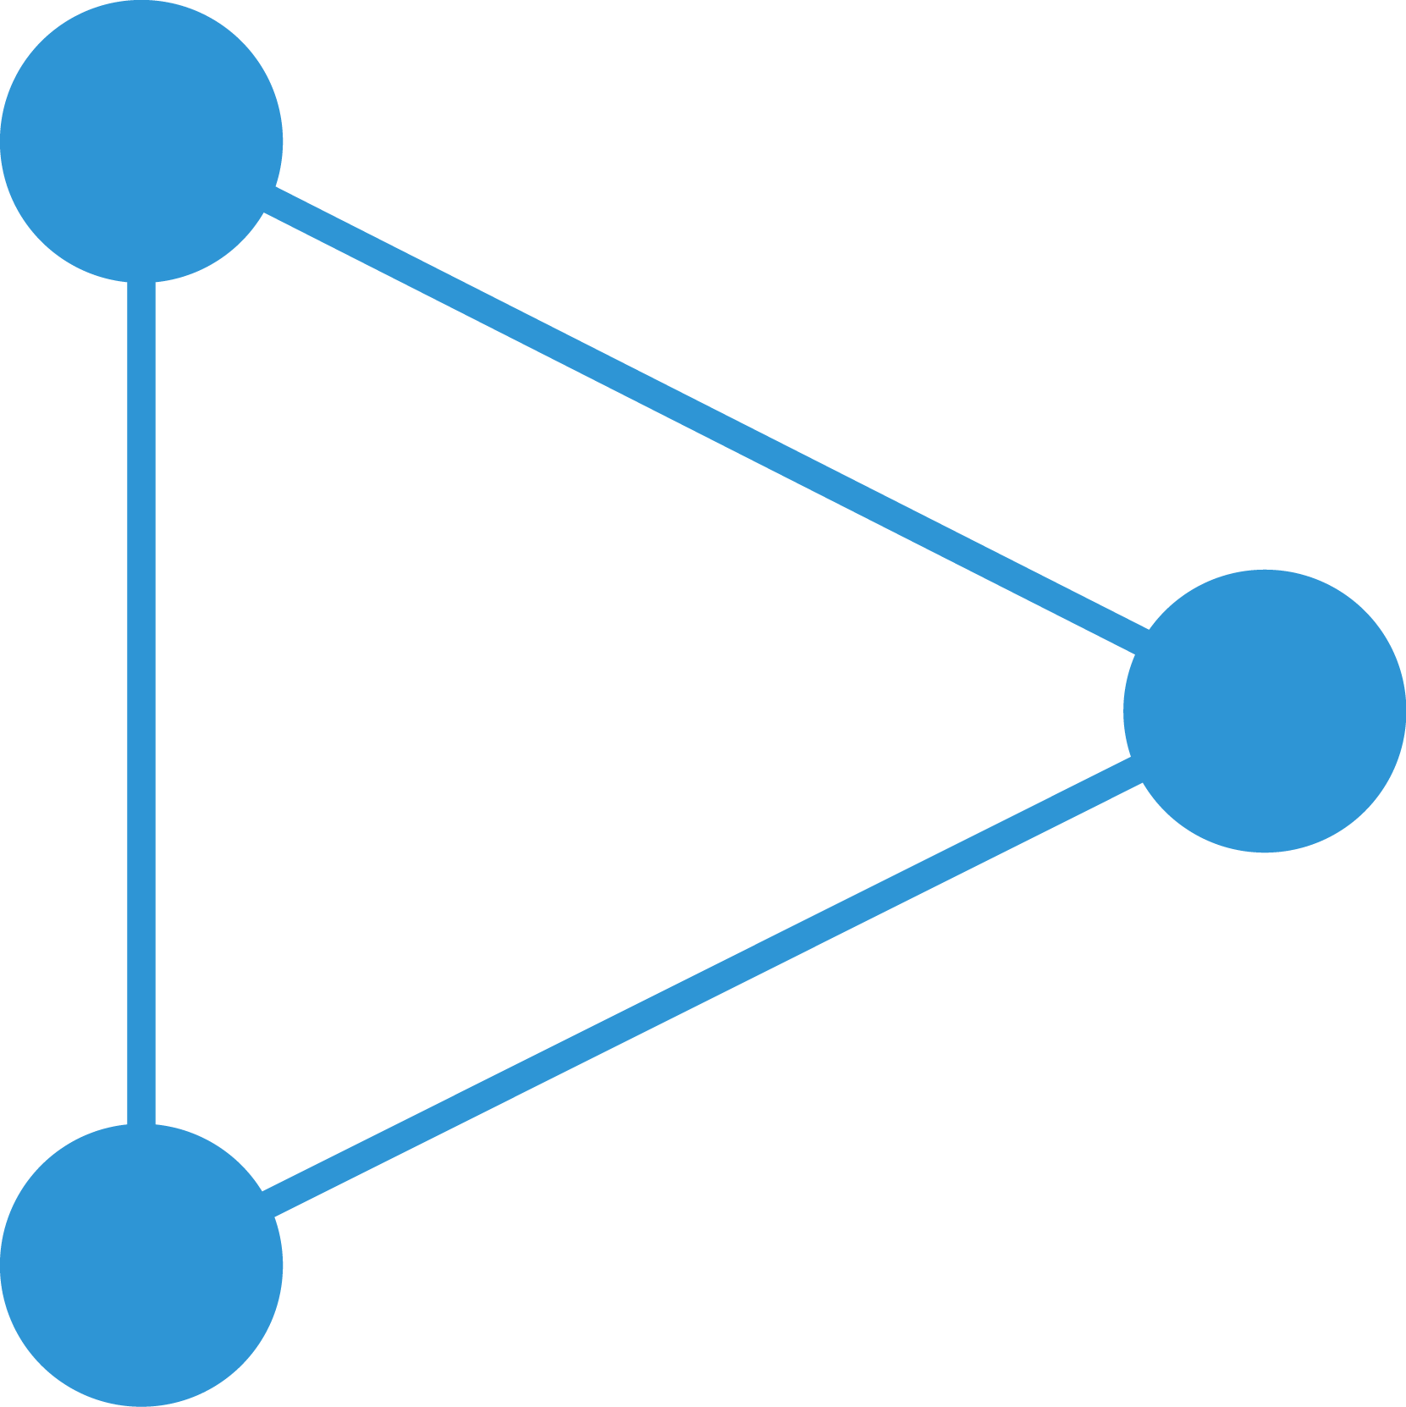
Evolution towards agile/DevOps
DevOps is built on agile principles and provides a platform for greater speed, versatility and agility
Waterfall
Agile
DevOps
Long pre-planned release cycles
Can be difficult to change direction
Business may wait a long time for delivery
Short & frequent releases
More responsive
Business gets new features faster
Testing, risk, impact and recovery time are low
Continuous delivery to business
Highly responsive
Automation reduce risks and improves quality
Greater business alignment & satisfaction
Improved productivity & efficiency

Slide 6
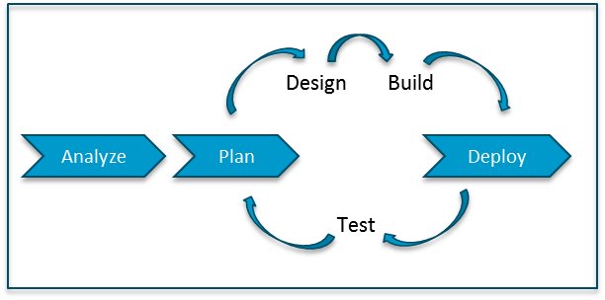
Waterfall vs. Agile Dev Methodologies
Waterfall
Analyze
Plan
Design
Build
Test
Deploy
Agile
Project Timeline
Requirements
Change
Customer
Turnover
Technology
Innovation
Source: http://www.kenwayconsulting.com/agile-or-waterfall-let-the-organization-decide/
Notes:
This slide describes the two most common development methodologies. Waterfall first used in 1956 but more popularized in 1970, and Agile first coined in 2001 and gaining in popularity with the rise of consumer Internet companies and cloud computing. While the sub-phases are generally the same, the difference is one single end-to-end phase for Waterfall compared to smaller phases, called “sprints”, for Agile.
This sprint approach comes from the understanding that
1) all requirements are not known upfront,
2) even if they are known, the requirements will change when you start interacting with users,
3) customers that you start building a product for changing their mind or the need change, and
4) technology comes out at such a new pace that you benefit from using new technologies sooner.

Slide 7

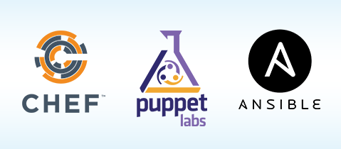


Agile (Dev) + Deploy (Ops) → Automation
DevOps
Continuous
Integration
Continuous
Deployment
Continuous
Integration
Continuous
Deployment
Continuous
Integration
Continuous
Deployment
Notes:
Agile can only succeed and be efficient if automation is used between all the steps in each sprint.
Performing all the processes and hand-offs manually within each sprint actually slows down the overall start-to-finish process.
Thus, Agile has given birth to new cottage industries and vendors providing consulting, training, and tools for these phases.
Continuous Integration is tools and processes that automate the development process of build and test, adding new functionality in small improvements.
Continuous Deployment is tools and processes that enable Operators to quickly and easily push new functionality, often one module at a time on live systems, without big monolithic releases and system downtime.
Some of the more popular Continuous Integration tools for Developers are Jenkins, Hudson, and Bamboo.
Some of the more popular Continuous Deployment tools for Operations are Chef, Puppet, and Ansible.

Slide 8
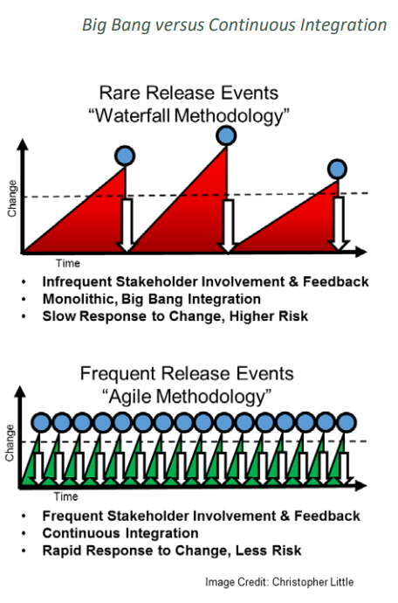
Big Bang vs. Continuous Integration

Slide 9

What problems led to the creation of DevOps?
DevOps implementation has increased the rate of software delivery and revenue for business stakeholders. The following listed reasons are the most considerable ones that led to the creation of DevOps.
  Before DevOps, operation and development teams were working in an isolated environment.
  Testing and Deployment activities mostly were performed in an isolated manner after the design-build step, and they took more time than the actual project completion time.
  Team members usually spend a large amount of time deploying, testing, designing, and building the projects
  Human production errors were deployed during manual code conduction.
  Operations and coding teams generally had different timelines and did not have proper synchronization which results in further delay.

Slide 10

Traditional Development and Operations
DEV
OPS
Notes:
DevOps word in itself is a combination of two words one is Development and other is Operations.
It is neither an application nor a tool; instead, it is just a culture to promote development and Operation process collaboratively.
As a result of DevOps implementation, the speed to deliver applications and services has increased.

Slide 11
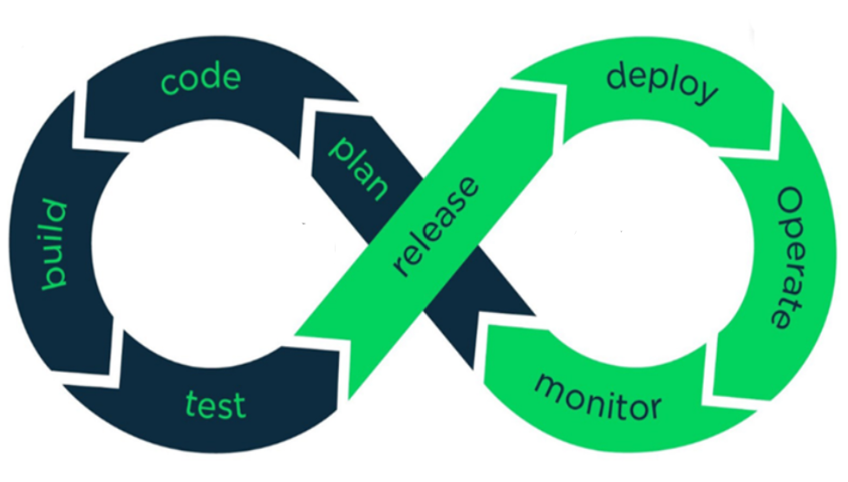
Development
Operations
Notes:
Graphic: https://www.brainvire.com/devops/ (with modifications from AFIT)
DEV/OPS uses automation and monitoring of short dev cycles, frequent deployments and aligns with business operations

Slide 12
What is DevOps
DevOps is a modern approach to software development that brings development and operations teams together to deliver applications faster and more reliably.
Encourages close collaboration between development and operations teams.
Automates build, test, and deployment processes to reduce errors.
Enables faster and more frequent software releases.
Improves system reliability, monitoring, and feedback loops.
https://www.geeksforgeeks.org/devops/introduction-to-devops/

Slide 13
DevOps Stages (Plan)
Convert business needs into clear, testable work (user stories, tasks, acceptance criteria)
Maintain a prioritized backlog and define “Definition of Ready” / “Definition of Done”
Plan for operability early: availability, performance, scalability, logging/metrics needs
Decide release strategy: incremental delivery, MVP slicing, risk reduction
Popular tools: Jira, Azure Boards, Trello; Confluence/Notion/Wikis for documentation
https://www.geeksforgeeks.org/devops/introduction-to-devops/

Slide 14
DevOps Stages (Code)
Build features in small, reviewable changes (frequent commits, pull requests)
Use version control as the system of record (code + configs + pipeline definitions)
Practices: branching strategy, code review, coding standards
“Shift-left” mindset: developers consider deployability + observability while coding
Popular tools: Git; GitHub/GitLab/Bitbucket; pre-commit hooks, linters (ESLint, Pylint)
https://www.geeksforgeeks.org/devops/introduction-to-devops/

Slide 15
DevOps Stages (Build)
Turn source code into immutable artifacts (binaries/packages/container images)
Make builds repeatable (same input → same output) and fast
(cache dependencies)
Embed metadata: version, commit hash, build number (traceability)
Store artifacts centrally for promotion across environments
Popular tools: Jenkins / GitHub Actions / GitLab CI; Maven/Gradle/npm;
https://www.geeksforgeeks.org/devops/introduction-to-devops/

Slide 16
DevOps Stages (Test)
Automate tests to validate changes before they reach production
Typical layers: unit → integration → API/contract → end-to-end/UI
Gate the pipeline with quality checks (coverage thresholds, linting, static analysis)
Prefer isolated test environments for reliability
Popular tools: JUnit/PyTest; Selenium (UI); Postman(API);
SonarQube (quality); test reporting in CI
https://www.geeksforgeeks.org/devops/introduction-to-devops/

Slide 17
DevOps Stages (Deploy)
“Release” = approve/promote a tested artifact as a candidate for deployment
Apply versioning (semantic versioning), generate release notes, tag commits
Introduce controls without slowing flow: lightweight approvals, automated evidence,
audit trails
Use feature flags to decouple “deploy” from “expose to users” (reduce risk)
Popular tools: Jenkins pipelines (promotion stages), GitHub Releases/Tags,
artifact repository promotion
https://www.geeksforgeeks.org/devops/introduction-to-devops/

Slide 18
DevOps Stages (Operate)
Keep services healthy in production: reliability, availability, performance,
cost awareness
Standardize runbooks, on-call processes, incident response,
and rollback procedures
Capacity & resilience: autoscaling policies, backups, safe config management,
secrets handling
Continuous operational work (patching, tuning) is part of the lifecycle
Popular tools: Kubernetes (HPA/Deployments); KMS (secrets); PagerDuty;
https://www.geeksforgeeks.org/devops/introduction-to-devops/
Notes:
KMS (Key management service)
Pager duty: AI first operational platform

Slide 19
DevOps Stages (Monitor/Observability)
Monitor what matters: metrics, logs, traces (and user experience signals)
Define reliability targets using SLIs/SLOs; alert on symptoms, not noise
Dashboards for visibility + alert routing to the right team with actionable context
Monitoring output is a feedback channel to drive fixes, performance work,
and prioritization
Popular tools: Prometheus + Grafana; Nagios;
https://www.geeksforgeeks.org/devops/introduction-to-devops/

Slide 20
Who’s in?
Just about everybody:
Amazon, Microsoft, Google, Facebook, Twitter, yahoo, Adobe,….

Slide 21
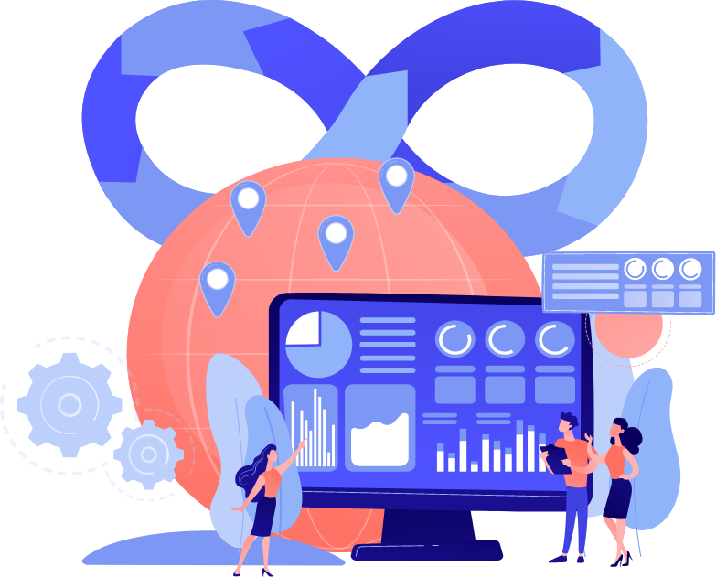
DevOps Global Market Trends
The DevOps market is expected to grow from an estimated $10.4 billion in 2023 to $25.5 billion in 2028.
Source:
https://spacelift.io/blog/devops-statistics

Slide 22

“DevOps is development
and operations collaboration”
“DevOps is treating your infrastructure
as code”
It’s DevOps!
It’s DevOps!
“DevOps
is using automation”
It’s DevOps!
“DevOps
is feature switches”
It’s DevOps!
“DevOps
is small deployments”
“Agile
for Ops?”

Slide 23

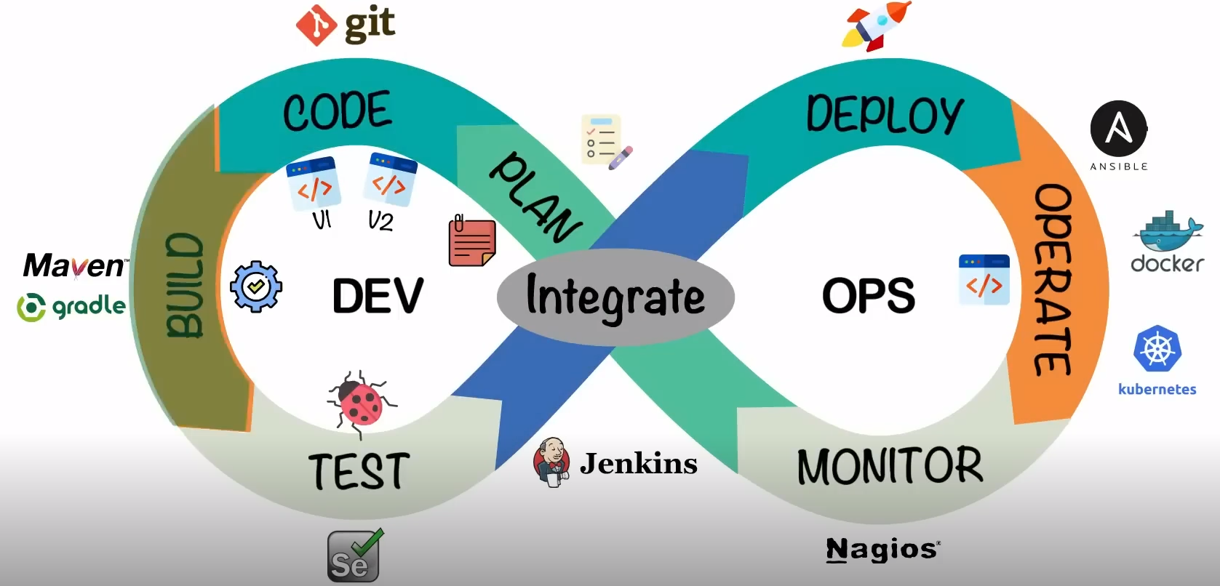
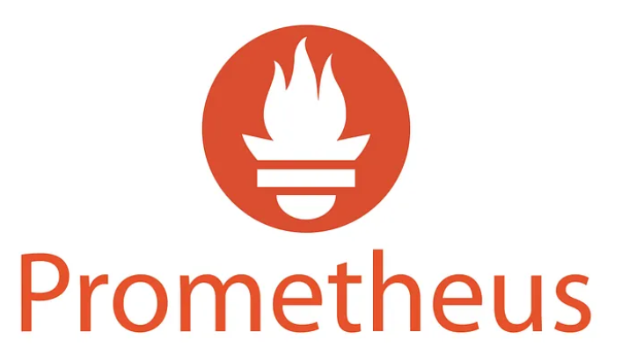
Phases in DevOps Implementation
Source:
https://www.weblineindia.com/blog/all-about-devops-automation/

Slide 24

Yes, you want speed . . .

Slide 25

What you really want is quality at speed!

Slide 26

DevOps culture: CALMS
DevOps succeeds when culture and process change together (tools are secondary).
C
Culture
A
Automation
L
Lean
M
Measurement
S
Sharing
Trust, collaboration, shared outcomes
Pipelines, IaC, repeatability
Small batches, remove waste
Track delivery + reliability
Knowledge, visibility, learning
If you only automate without culture change, you usually just ship problems faster.
8
Notes:
[Sources]
- https://www.atlassian.com/devops/frameworks/calms-framework (CALMS framework)
[/Sources]

Slide 27
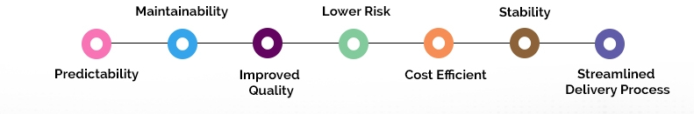
What are the Features of DevOps Implementation?
“DevOps is not a goal but a never-ending process of continual improvement.”
The DevOps offer continuous integration and continuous delivery (CI/CD). It makes the product delivery cycle quicker, and enterprises become able to launch the software timely without compromising its quality.
Following are the factors that will improve as a result of DevOps implementation:
Predictability: DevOps decreases the failure rate of new product releases.
Maintainability: The process improves the overall recovery rate at the time of the release event.
Improved Quality: DevOps improves the quality of product development by incorporating infrastructure issues.
Lower Risk: Security aspects are incorporated in SDLC, and the number of defects gets decreased across the product
Cost Efficient: Cost efficiency is improved due to DevOps which is always an aspiration of every business organization.
Stability: DevOps implementation offers a stable and secure operational state.
Streamlined Delivery Process: As DevOps provides streamlined software delivery, the marketing effort is reduced up to 50%. It happens due to mobile applications and digital platforms.

Slide 28
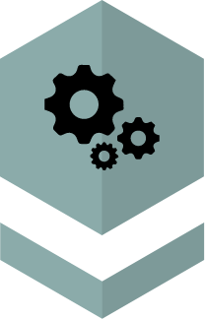


To understand DevOps better you need to know it consists of three fundamental ideas.
Practices and Process
People and Culture
Tools and Techniques
Source:
https://www.weblineindia.com/blog/all-about-devops-automation/

Slide 29
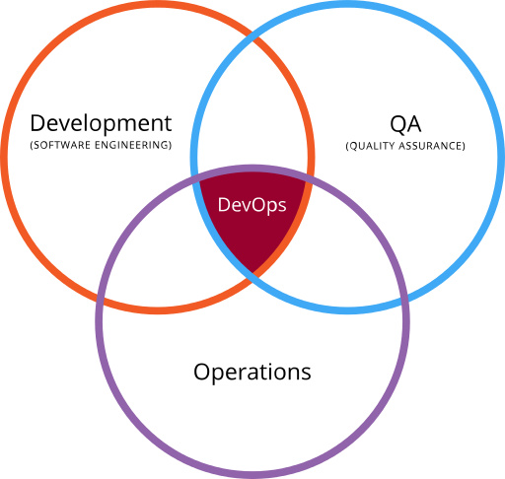
DevOps
DevOps is the intersection of development (software engineering), operations and quality assurance (QA)

Slide 30

What is Automation in DevOps?
Automation in DevOps makes the entire process smooth, and all conventional manual software development barriers become scalable and manageable. Furthermore, it helps to efficiently manage and run an application in the development environment with frequent updates. It also needs strict testing standards.
Source:
https://www.weblineindia.com/blog/all-about-devops-automation/

Slide 31

To sum it up

Slide 32








Benefits of DevOps Automation
Removes Manual Error
Shorter
Development
Cycle
Increases
No.Of
Deliveries
Latency
Removed
Improved
Defect Detection
Reduced
Deployment Failures and Rollbacks
Reduced Time
to Recover Upon Failure
Source:
https://www.weblineindia.com/blog/all-about-devops-automation/

