Slide 1
CSC418 / Week 6
Source control and Git
Notes:
This combined lecture follows syllabus rows 13, 14, and 15. Unit 13 develops the code stage and source-control choices. Unit 14 builds a practical Git model and command workflow. Unit 15 extends the same change into GitHub collaboration, Actions automation, and webhook integration. The presentation uses current online documentation rather than another textbook chapter. Use the supplied scm-actions-demo project for the worked examples. Detailed notes include teaching prompts and expected observations. The final review and extension material can be used for independent study if a single class meeting cannot include every demonstration.
Exact slide examples
Sources
CSC418 syllabus V3.2, units 13–15
../../CSC418_DevOps_Syllabus_V3.2.pdf#page=2
Understanding GitHub Actions
https://docs.github.com/en/actions/get-started/understand-github-actions
Git: About Version Control
https://git-scm.com/book/en/v2/Getting-Started-About-Version-Control
Online references accessed 26 September 2026.

Slide 2
Why source control matters
Recover an earlier state
Identify the version that existed before a regression.
Explain a change
Inspect what changed and the reason recorded with it.
Coordinate contributors
Combine parallel work without relying on renamed folders.
Identify tested input
Tie a CI run and its output to a particular revision.
Notes:
Use a directory named final-final-fixed as the opening analogy. A filename provides a weak description of history and usually says nothing about how two contributors’ work relates. A version-control record can preserve the actual relationship between revisions. For the catalog, ask which exact source revision produced a failed test report. This question links source control to repeatability. Version control records what was committed; it cannot recover a file that was never added or committed merely because that file happened to be in the project folder.
Exact slide examples
Sources
Git: About Version Control
https://git-scm.com/book/en/v2/Getting-Started-About-Version-Control
Git: Viewing Commit History
https://git-scm.com/book/en/v2/Git-Basics-Viewing-the-Commit-History
GitHub Actions: Workflow artifacts
https://docs.github.com/en/actions/concepts/workflows-and-actions/workflow-artifacts
Online references accessed 26 September 2026.

Slide 3
SCM capabilities and team decisions
History and comparison
Store versions and inspect differences between them.
Parallel development
Use branches or other workspace mechanisms to isolate related work.
Integration
Combine changes and resolve conflicts deliberately.
Governance
Agree who may accept a change and what evidence they require.
Notes:
SCM is often used here to mean source-code management. In broader software engineering discussions it can also refer to software configuration management, which includes controlled identification and change of software configuration items. Keep the classroom scope explicit. A tool can represent branches and commits, but the team decides its review policy and release procedure. A repository with unrestricted direct pushes is still version controlled; it simply provides different governance from a repository that requires reviewed pull requests and passing checks.
Exact slide examples
Sources
Git: About Version Control
https://git-scm.com/book/en/v2/Getting-Started-About-Version-Control
Git: Branches in a Nutshell
https://git-scm.com/book/en/v2/Git-Branching-Branches-in-a-Nutshell
GitHub: Rulesets
https://docs.github.com/en/repositories/configuring-branches-and-merges-in-your-repository/managing-rulesets/about-rulesets
Online references accessed 26 September 2026.

Slide 4
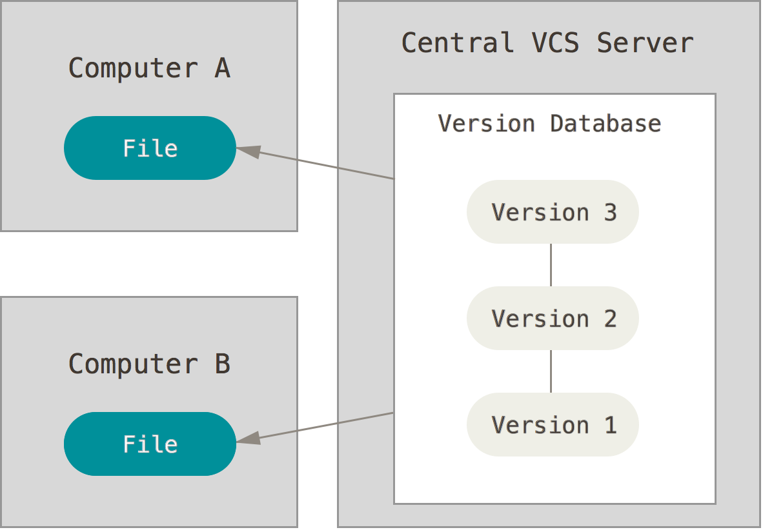
Centralized source control
Central history
The shared server holds the authoritative revision history.
Working copies
Developers edit checked-out files and submit changes to the server.
Operational dependency
Server access matters when recording shared revisions and coordinating changes.
Notes:
The diagram from the online Pro Git documentation illustrates the traditional centralized model. Subversion is a familiar example. A disconnected developer can still edit a working copy, but recording a new central revision requires communicating with the central service. Central administration can simplify access and policy management. Do not say that a centralized system makes editing impossible whenever the network fails. The important distinction is which operations require the shared repository and where recoverable history is stored.
Exact slide examples
Sources
Git: About Version Control
https://git-scm.com/book/en/v2/Getting-Started-About-Version-Control
Online references accessed 26 September 2026.

Slide 5
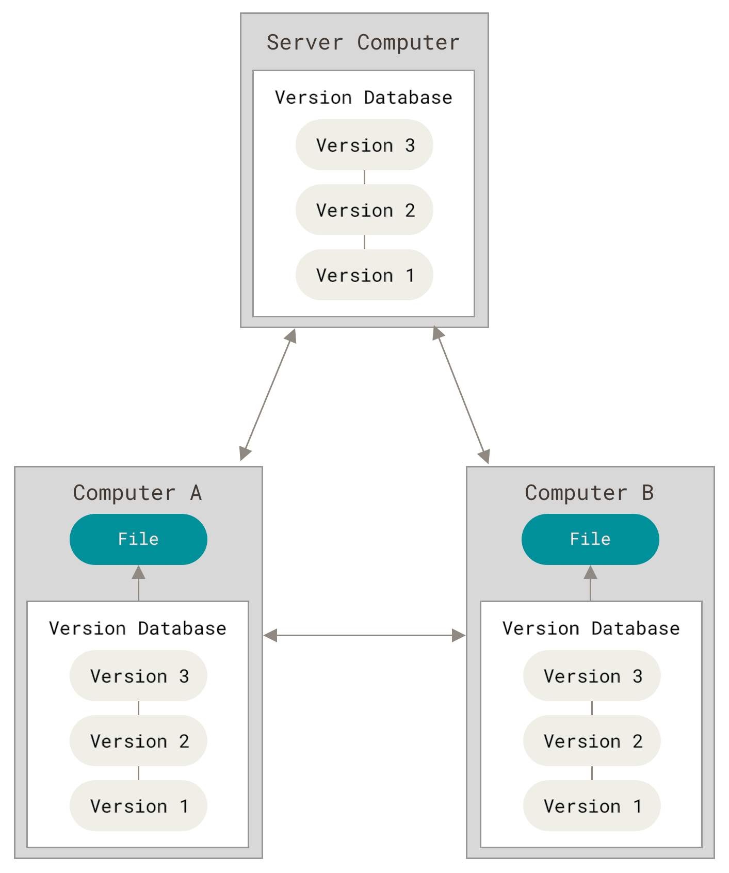
Distributed source control
Local repository
A normal full clone includes project history as well as working files.
Local commits
Developers can record changes and inspect available history offline.
Explicit exchange
Fetch and push synchronize selected history with other repositories.
Git: About Version Control / Sources in notes
Notes:
Git’s distributed model separates recording a local commit from publishing that commit elsewhere. A shared hosting service remains useful, but local history operations do not depend on that service being reachable. Qualify the diagram: shallow clones deliberately limit history, and partial clones may obtain some objects later. A local clone also does not automatically contain hosted issues, pull-request discussions, secrets, or every external large-file object. Those services need their own protection and recovery plans. Ask what continues working when GitHub is temporarily unreachable.
Exact slide examples
Sources
Git: About Version Control
https://git-scm.com/book/en/v2/Getting-Started-About-Version-Control
git fetch reference
https://git-scm.com/docs/git-fetch
git push reference
https://git-scm.com/docs/git-push
Online references accessed 26 September 2026.

Slide 6
Centralized and distributed trade-offs
History location
Centralized systems emphasize server-held history. A full Git clone also stores history locally.
Disconnected work
Git can make local commits offline. Publishing and fetching still require access to another repository.
Administration
A central service can simplify policy. Distributed teams still need permissions and review rules.
Repository size
Local history is useful, but very large repositories may require additional clone and storage strategies.
Notes:
Compare the consequences of each design rather than announcing one universal winner. Ask students to reason about a small connected team, a contributor with intermittent connectivity, and a repository containing large binary assets. For each situation, separate the version-control data model from product features added by a hosting service. Modern products can offer additional mechanisms beyond this introductory comparison. The learning objective is to identify the relevant trade-off and justify a choice using the team’s constraints.
Exact slide examples
Sources
Git: About Version Control
https://git-scm.com/book/en/v2/Getting-Started-About-Version-Control
Git: What is Git?
https://git-scm.com/book/en/v2/Getting-Started-What-is-Git%3F
GitHub: Rulesets
https://docs.github.com/en/repositories/configuring-branches-and-merges-in-your-repository/managing-rulesets/about-rulesets
Online references accessed 26 September 2026.

Slide 7
A shared main branch is a team policy
Distributed storage
Several repositories can contain the same Git commits.
An agreed integration point
The team chooses which repository and branch represent accepted work.
Controlled updates
Reviews and required checks govern changes to that branch.
Explicit release selection
A release identifies the revision that is approved for distribution.
Notes:
A common misconception is that using one GitHub repository makes Git a centralized version-control system. The team can choose a central collaboration point while the underlying tool remains distributed. Distinguish topology from authority: where copies exist is a technical fact, while which copy the team treats as accepted work is a policy. In this lecture, main is the integration branch and a GitHub pull request is the review mechanism. Another organization may choose a different workflow without changing Git’s basic object model.
Exact slide examples
Sources
Git: Working with Remotes
https://git-scm.com/book/en/v2/Git-Basics-Working-with-Remotes
GitHub flow
https://docs.github.com/en/get-started/using-github/github-flow
GitHub: Rulesets
https://docs.github.com/en/repositories/configuring-branches-and-merges-in-your-repository/managing-rulesets/about-rulesets
Git: Tagging
https://git-scm.com/book/en/v2/Git-Basics-Tagging
Online references accessed 26 September 2026.

Slide 8
Git records snapshots and their relationships
A commit identifies a recorded state
It references a tree of tracked content and records metadata and parent relationships.
History forms a graph
Ordinary commits usually have one parent. Merge commits can connect multiple parents.
Commit IDs are content-derived
Changing recorded commit information produces a different identity.
A working folder is only one view
Checking out a revision materializes its files for editing.
Notes:
Explain the snapshot model conceptually without suggesting that Git duplicates every unchanged file for every commit. Git reuses content objects and can compress storage internally. The useful student model is that a commit names a reproducible tracked state with history links. A hash identifies recorded content; it does not by itself prove that the change is correct or that a trustworthy person approved it. Ask students how a CI report can refer to the exact source state even after the branch has moved forward.
Exact slide examples
Sources
Git: What is Git?
https://git-scm.com/book/en/v2/Getting-Started-What-is-Git%3F
Git: Branches in a Nutshell
https://git-scm.com/book/en/v2/Git-Branching-Branches-in-a-Nutshell
Online references accessed 26 September 2026.

Slide 9
Working tree, index, and repository
Working tree
The files currently available for editing.
Index or staging area
The proposed contents of the next commit.
Repository
The recorded commits and Git objects, normally stored under .git.
The normal sequence
Edit files, select changes with git add, then record the staged state with git commit.
Notes:
Demonstrate these three states using a single file. After an edit, the working tree differs from the index. After git add, the index contains the selected content. After git commit, that staged snapshot is recorded. If the file is edited again after staging, the index does not silently adopt the new edit. This explains why a file can have both staged and unstaged changes. The repository and index are local structures; none of these steps requires a push to GitHub.
Exact slide examples
Sources
Git: What is Git?
https://git-scm.com/book/en/v2/Getting-Started-What-is-Git%3F
Git: Recording Changes
https://git-scm.com/book/en/v2/Git-Basics-Recording-Changes-to-the-Repository
Online references accessed 26 September 2026.

Slide 10
Initial setup in the classroom repository
Terminal
git --version
git init -b main
git config user.name "Student Name"
git config user.email "student@example.com"
git config --get user.name
git status
Use a dedicated copy of the supplied project
Run these commands inside scm-actions-demo, not in another course repository.
Identity is commit metadata
The configured name and email do not sign you in to GitHub.
Notes:
Use a current Git installation that supports switch, restore, and init -b. The user name and email examples are classroom placeholders. Students can use their own approved identity, including a GitHub no-reply email if appropriate. These commands use repository-local configuration so they do not change identity for every project on the machine. Point out that --global has a broader scope and should be chosen deliberately. Confirm the current directory before initializing, then inspect status to see the initially untracked project files.
Exact slide examples
Terminal
git --version
git init -b main
git config user.name "Student Name"
git config user.email "student@example.com"
git config --get user.name
git status
Sources
Git: First-Time Git Setup
https://git-scm.com/book/en/v2/Getting-Started-First-Time-Git-Setup
Git: Getting a Git Repository
https://git-scm.com/book/en/v2/Git-Basics-Getting-a-Git-Repository
Online references accessed 26 September 2026.

Slide 11
Starting locally or cloning existing work
Alternative starting commands / replace OWNER and REPOSITORY
git init -b main
git clone https://github.com/OWNER/REPOSITORY.git
git init
Creates a repository in a local directory without contacting a hosting service.
git clone
Copies a repository and normally configures its source as the remote named origin.
Choose the correct starting point
Clone an existing team repository instead of creating an unrelated history for it.
18 / 86
Notes:
The commands shown are alternatives, not a sequence to run inside the same folder. For the supplied package, initialize the copied demo. For an existing GitHub exercise repository, replace OWNER and REPOSITORY with the real assigned names, and clone into a new directory. A normal clone checks out a working branch and records remote information. Mention that shallow or partial options change what is downloaded; the introductory workflow uses a normal clone. Never tell students to invent a remote URL and expect authentication or access to work.
Exact slide examples
Alternative starting commands / replace OWNER and REPOSITORY
git init -b main
git clone https://github.com/OWNER/REPOSITORY.git
Sources
Git: Getting a Git Repository
https://git-scm.com/book/en/v2/Git-Basics-Getting-a-Git-Repository
Git: Working with Remotes
https://git-scm.com/book/en/v2/Git-Basics-Working-with-Remotes
Online references accessed 26 September 2026.

Slide 12
Reading git status
Terminal
git status
git status --short
Untracked
The file exists locally but is not yet selected for version control.
Modified
A tracked file has changes that are not yet staged.
Staged
The index differs from the current commit and is ready to record.
Clean
No reported pending changes in tracked files or ordinary untracked files.
19 / 86
Notes:
Use git status frequently during the demonstration. The short format has two status columns: the first describes the index, and the second describes the working tree. An MM entry is possible after staging a change and editing the same file again. A clean result does not mean ignored files are absent, tests passed, or the local branch has been pushed. Have students predict which state appears after editing, staging, and committing the new mixed-case test.
Exact slide examples
Terminal
git status
git status --short
Sources
Git: Recording Changes
https://git-scm.com/book/en/v2/Git-Basics-Recording-Changes-to-the-Repository
Online references accessed 26 September 2026.

Slide 13
.gitignore and already tracked files
.gitignore excerpt
__pycache__/
*.py[cod]
.venv/
.env
.env.*
!.env.example
reports/
Existing tracking is unchanged
An ignore pattern does not remove an already tracked file.
History is unchanged
Adding a pattern does not erase credentials committed earlier.
24 / 86
Notes:
Open the supplied .gitignore and explain each pattern in terms of the demo’s file lifecycle. The negation for .env.example allows a template while excluding actual environment files. If a generated file was accidentally tracked, git rm --cached can remove it from the next tracked snapshot while keeping the working copy, but students must understand which path they are changing. Do not suggest that this deletes old history. Treat exposed credentials separately from the mechanics of tracking a path.
Exact slide examples
.gitignore excerpt
__pycache__/
*.py[cod]
.venv/
.env
.env.*
!.env.example
reports/
Sources
gitignore reference
https://git-scm.com/docs/gitignore
Git: Recording Changes
https://git-scm.com/book/en/v2/Git-Basics-Recording-Changes-to-the-Repository
Online references accessed 26 September 2026.

Slide 14
Branches and HEAD
Branch
A movable name that identifies the current tip of one line of development.
HEAD
The checked-out position, usually attached to a branch.
A new commit
Advances the current branch to the newly recorded commit.
26 / 86
Notes:
Avoid describing a branch as a separate copied directory. Branches are lightweight references into the commit graph. The working tree changes when a different revision is checked out, subject to Git’s checks for conflicting local changes. A detached HEAD is not automatically a broken repository; it is useful for inspection. However, beginners should create a branch before keeping new development from that position. Have learners use git branch --show-current and the decorated log to connect the abstract terms to visible output.
Exact slide examples
Sources
Git: Branches in a Nutshell
https://git-scm.com/book/en/v2/Git-Branching-Branches-in-a-Nutshell
Online references accessed 26 September 2026.

Slide 15
How a merge conflict arises
Competing changes
Two branches edit overlapping content from a shared starting point.
Git needs a decision
It cannot infer the correct combined meaning from those edits.
The index records an unresolved state
Inspect the affected paths before completing the merge.
Resolution is an engineering task
Choose the intended behavior and test it, rather than merely removing markers.
29 / 86
Notes:
Create a conflict in a disposable repository by having main and a feature branch change the same README line differently. After merging, status identifies the unresolved path and the file may contain conflict markers. Ask which wording preserves the intended documentation. Code conflicts need the same semantic judgment and often additional tests. Start this exercise from a clean working tree so that aborting a merge is easier to reason about. Do not imply that every parallel edit produces a conflict.
Exact slide examples
Sources
Git: Basic Branching and Merging
https://git-scm.com/book/en/v2/Git-Branching-Basic-Branching-and-Merging
Online references accessed 26 September 2026.

Slide 16
Git and GitHub have different roles
Git
Records and exchanges versioned history. It runs locally and can use many hosting services.
GitHub repositories
Host Git data and provide access controls and collaboration features.
Pull requests and issues
Support discussion, review, and coordination around proposed work.
GitHub Actions and webhooks
Connect repository events to automated work and external integrations.
39 / 86
Notes:
Ask students which of the commands they just practiced would work without a GitHub account. Local init, status, add, commit, log, and branch operations do not require GitHub. A pull request is a hosting workflow around Git changes, not another spelling of git pull. The distinction matters when troubleshooting: an authentication problem, a branch protection rule, and a local merge conflict belong to different layers. Use the same feature branch to connect the local Git model to the collaboration interface.
Exact slide examples
Sources
Git: What is Git?
https://git-scm.com/book/en/v2/Getting-Started-What-is-Git%3F
GitHub flow
https://docs.github.com/en/get-started/using-github/github-flow
Understanding GitHub Actions
https://docs.github.com/en/actions/get-started/understand-github-actions
GitHub: About webhooks
https://docs.github.com/en/webhooks/about-webhooks
Online references accessed 26 September 2026.

Slide 17
Repository, branch, fork, and clone
Repository
A project’s versioned history and associated hosting space.
Branch
A line of development inside a repository.
Fork
A separate GitHub repository connected to an upstream repository.
Clone
A local repository copied from another repository for inspection or development.
40 / 86
Notes:
These terms describe different objects. A team member with write access can often work on a branch within the team repository. A contributor without that permission may use a fork and propose a pull request back to the upstream project. Either person can clone the repository locally. Fork visibility and permissions depend on repository and organization settings, so avoid saying that every repository can be forked freely. Ask a student to name the remote URL, local branch, and pull-request base in an example contribution.
Exact slide examples
Sources
GitHub: Forks
https://docs.github.com/en/pull-requests/reference/forks
Git: Getting a Git Repository
https://git-scm.com/book/en/v2/Git-Basics-Getting-a-Git-Repository
GitHub: Pull requests
https://docs.github.com/en/pull-requests/reference/pull-requests
Online references accessed 26 September 2026.

Slide 18
GitHub flow for a focused change
Create a branch
Start from the accepted baseline and keep the change focused.
Commit and push
Publish the proposed work under its feature branch.
Open and review a pull request
Discuss behavior, inspect the diff, and evaluate checks.
Merge and synchronize
Accept the change, then update the local main branch.
42 / 86
Notes:
The lecture uses GitHub flow because it makes the contribution sequence easy to follow. It is a team workflow, not a requirement that all organizations use one branching strategy. After the PR merges, a student can switch to main and pull --ff-only. A short-lived feature branch should not accumulate unrelated tasks while review is in progress. Explain that additional commits pushed to the PR’s head branch update the proposal and can cause checks to run again.
Exact slide examples
Sources
GitHub flow
https://docs.github.com/en/get-started/using-github/github-flow
GitHub: Pull requests
https://docs.github.com/en/pull-requests/reference/pull-requests
git pull reference
https://git-scm.com/docs/git-pull
Online references accessed 26 September 2026.

