Slide 1
Introduction of Virtualization and Linux
Muhammad Kamran
Notes:
Teaching time: about 1 minute.
Introduce this as the combined CSC418 Lecture 5 and Lecture 6 presentation. The first section explains the virtual machine as a cloud resource. The second operates that machine using Linux and relates package installation to the delivery process. Plan approximately two 50-minute meetings. Use a prepared Ubuntu VM for the command demonstrations, because downloading and completing an OS installation can exceed lecture time. The title follows the supplied books. The exact local Verona edition is 2016, first edition, not the 2018 edition named in the syllabus. The content of its second chapter is still usable for environment consistency and package management. Linux utilities and hypervisor types require clearly identified supplementary material.
[Sources]
- CSC418_DevOps_Syllabus_V3.2.pdf, PDF p. 2, Lectures 5 and 6, Unit 2. CLO-2 on PDF p. 1.
- Sehgal, Bhatt and Acken (2020), Cloud Computing with Security: Concepts and Practices, 2nd ed., Chapter 3, "Cloud Computing Pyramid", printed pp. 49–59, PDF pp. 86–96.
- Joakim Verona (2016), Practical DevOps, 1st ed., Chapter 2, "A View from Orbit", printed pp. 9–20, PDF pp. 28–39. The supplied file is the 2016 edition, although the syllabus bibliography lists 2018.
[/Sources]

Slide 2
Roots of cloud computing
Shared infrastructure
Time sharing and virtual machines let several users work on one physical system.
Utility computing
A provider measures consumption and offers computing as a service.
Cloud access
A portal or API hides infrastructure detail and provisions resources on demand.
Virtualization supplies an abstraction that cloud management can use.
03
Notes:
Teaching time: about 2 minutes.
Follow Section 3.1 from mainframes and shared telecommunications infrastructure toward utility computing. A provider can share physical capacity while presenting each tenant with a useful logical environment. Grid computing contributes parallel execution, utility computing contributes metering, and cloud services add convenient provisioning interfaces. These are related ideas rather than interchangeable terms. Avoid the book’s dated statements about current market growth or billing units. A local virtual machine illustrates the resource abstraction, but the local hypervisor alone does not supply all the characteristics of a cloud service. Transition to the service pyramid to locate the VM within the consumer’s responsibilities.
[Sources]
- Sehgal, Bhatt and Acken (2020), Cloud Computing with Security: Concepts and Practices, 2nd ed., Chapter 3, "Cloud Computing Pyramid", printed pp. 49–51, PDF pp. 86–88.
[/Sources]

Slide 3
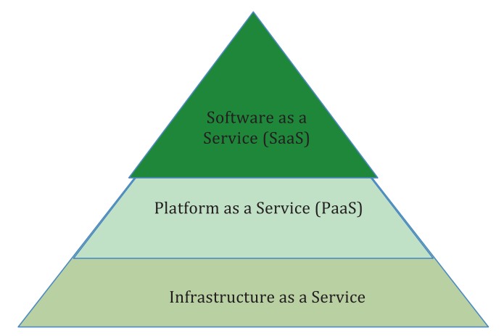
The cloud computing pyramid
SaaS
The consumer uses a provider’s application.
PaaS
The consumer deploys application code to a managed platform.
IaaS
The consumer provisions resources and manages a guest OS.
Figure 3.1: User view of cloud computing services
04
Notes:
Teaching time: about 2 minutes.
Read the pyramid from infrastructure at the base to software at the top. Spell out Infrastructure as a Service, Platform as a Service and Software as a Service. The diagram represents service abstraction, not relative market share or numerical capacity. A Linux virtual machine is a useful way to understand IaaS because the guest operating system remains visible to the consumer. The provider still operates the physical infrastructure. Section 3.1 also revisits public, private, hybrid and community deployments. Mention them briefly as the environment in which the same resource abstraction can operate. Do not treat the book’s additional VPC category as another NIST deployment model. This is an unchanged color extraction of Figure 3.1.
[Sources]
- Sehgal, Bhatt and Acken (2020), Cloud Computing with Security: Concepts and Practices, 2nd ed., Chapter 3, "Cloud Computing Pyramid", printed pp. 50–51, PDF pp. 87–88.
[/Sources]

Slide 4
Cloud characteristics and virtual resources
Characteristic | Connection to a virtual machine
On-demand self-service | A request can trigger VM provisioning.
Resource pooling | Several tenants draw from shared host capacity.
Rapid elasticity | VM capacity can grow or shrink with demand.
Measured service | Usage records support accounting and capacity decisions.
Network access | Clients reach services through standard networks.
05
Notes:
Teaching time: about 2 minutes.
Section 3.2 lists five characteristics. This table connects each characteristic to the VM example as a teaching interpretation. A hypervisor provides mechanisms such as resource allocation, while cloud management adds request handling, policy, monitoring and provisioning. Elasticity still depends on available capacity and application design. The book calls broad network access “ubiquitous network access”; both refer here to access through standard network mechanisms. A VM on a laptop may have network access and shared hardware but lacks the complete service arrangement described by the cloud definition. Keep this as a short recap so most lecture time stays on virtualization.
[Sources]
- Sehgal, Bhatt and Acken (2020), Cloud Computing with Security: Concepts and Practices, 2nd ed., Chapter 3, "Cloud Computing Pyramid", printed pp. 52, PDF pp. 89.
[/Sources]

Slide 5
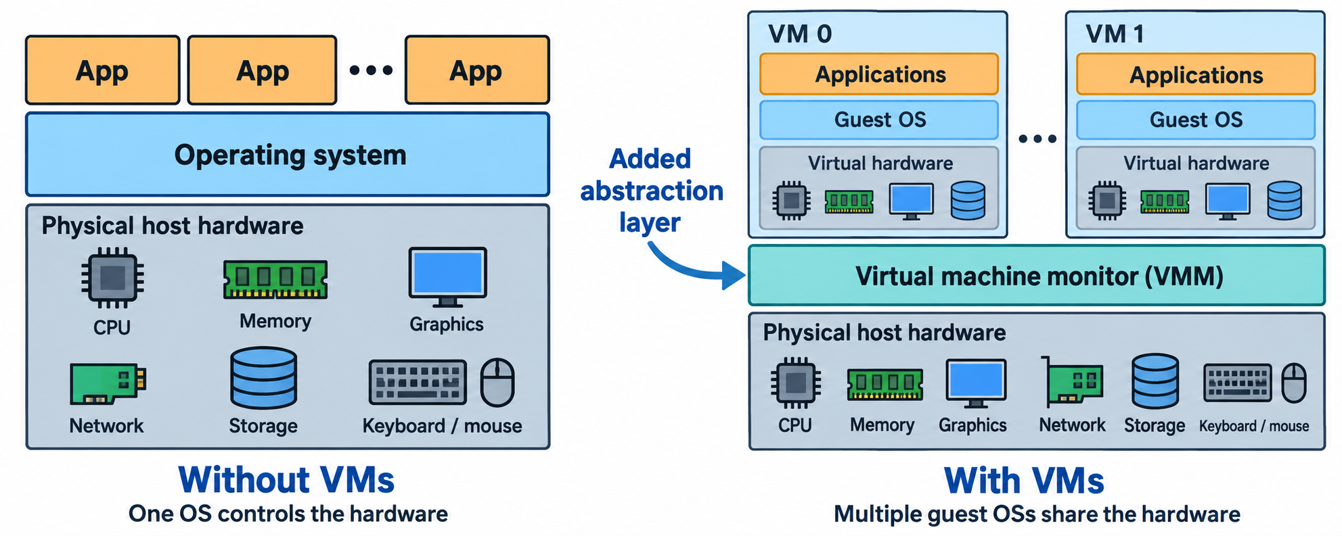
Role of virtualization
Adapted from Figure 3.3: An OS versus a virtualization stack
One operating system manages processes on the left.
On the right, a virtual machine monitor manages guests with their own operating systems.
06
Notes:
Teaching time: about 3 minutes.
Use the colorful adaptation of Figure 3.3 to introduce the exact book vocabulary: virtual machine, virtual machine monitor, hypervisor, guest and tenant. On the left, applications share an OS that controls physical resources. On the right, each VM has its own applications and guest OS, and the VMM mediates access to shared host hardware. The virtual hardware icons within a guest stand for interfaces presented to that guest. They do not mean that an additional physical CPU, network adapter or disk appeared. Windows and Linux guests can coexist on compatible physical hardware. The adaptation replaces small device icons with readable labels while preserving guest grouping, layer order and the arrow pointing to the added VMM layer. It shows a conceptual stack and does not establish every detail of hosted hypervisors.
[Sources]
- Sehgal, Bhatt and Acken (2020), Cloud Computing with Security: Concepts and Practices, 2nd ed., Chapter 3, "Cloud Computing Pyramid", printed pp. 53, PDF pp. 90.
[/Sources]

Slide 6
Virtual CPU
The guest schedules work on vCPUs that use the host’s processing capacity.
Virtual memory
The guest receives a configured memory allocation from the host.
Virtual storage
A virtual disk presents a disk interface backed by host storage.
Virtual network
A virtual adapter connects the guest through a selected network mode.
07
Notes:
Teaching time: about 2 minutes.
Continue the previous subtopic with a blank header. These four resources are the hardware abstraction named in Section 3.3. Explain that the guest sees an apparently complete machine even when physical resources are shared. A vCPU assignment is not necessarily an exclusive physical core. The book notes that even dedicating cores leaves some I/O shared. With local VirtualBox, configured guest RAM is unavailable to other host work while the VM uses it, and a virtual disk is commonly a file on the host. This distinction is essential before selecting VM settings. Additional guest allocations cannot create physical capacity.
[Sources]
- Sehgal, Bhatt and Acken (2020), Cloud Computing with Security: Concepts and Practices, 2nd ed., Chapter 3, "Cloud Computing Pyramid", printed pp. 53–54, PDF pp. 90–91.
- Oracle VirtualBox 7.2 User Guide, Creating a New Virtual Machine. https://docs.oracle.com/en/virtualization/virtualbox/7.2/user/create-vm.html (accessed 12 September 2026).
- Oracle VirtualBox 7.2 User Guide, Virtual Storage. https://docs.oracle.com/en/virtualization/virtualbox/7.2/user/storage.html (accessed 12 September 2026).
[/Sources]

Slide 7
Sharing capacity: the book’s example
Workload | Demand in the example
Company P: drug trial | 1,000 machines continuously for one month.
Studio H: rendering | 1,000 machines during the weekend.
Physical data center | 1,000 physical servers.
Weekend overlap | An additional 1,000 VMs may share the same hardware.
More VMs can increase utilization while slowing competing jobs.
08
Notes:
Teaching time: about 3 minutes.
Preserve the quantities in the book’s worked example. The pharmaceutical company P needs 1,000 machines all month and movie studio H needs 1,000 at weekends. The data center has 1,000 physical servers. Spawning another 1,000 VMs during overlap means presenting 2,000 logical environments, not doubling physical throughput. The text explicitly allows P’s jobs to slow down. The book uses isolation to explain why the tenants can remain separate, but isolation must be maintained and is not an unconditional security guarantee. The practical consequence is that allocation policy needs both capacity information and a performance objective.
[Sources]
- Sehgal, Bhatt and Acken (2020), Cloud Computing with Security: Concepts and Practices, 2nd ed., Chapter 3, "Cloud Computing Pyramid", printed pp. 49–50, PDF pp. 86–87.
[/Sources]

Slide 8
Hypervisors
Virtual machine monitor
A hypervisor presents virtual hardware and controls guest execution.
Resource management
It schedules or allocates processing, memory and device access.
Guest separation
It helps keep each guest’s execution and state separate.
VM lifecycle
Management tools create, start, stop and configure virtual machines.
09
Notes:
Teaching time: about 2 minutes.
The source equates VMM and hypervisor. Compare the levels carefully: an operating system manages processes, while a hypervisor manages virtual machines that may each contain an OS. The management interface that users click is only one part of the system. Separate the engine enforcing resource access from the tools used to configure guests. Guest separation reduces interference but still depends on correct implementation and configuration. Sharing CPU and I/O introduces scheduling and contention, so a VM can behave differently under load. Section 3.3 establishes the role of the hypervisor. The following Type 1 and Type 2 classification is supplementary syllabus coverage from official vendor documentation.
[Sources]
- Sehgal, Bhatt and Acken (2020), Cloud Computing with Security: Concepts and Practices, 2nd ed., Chapter 3, "Cloud Computing Pyramid", printed pp. 53–54, PDF pp. 90–91.
- Red Hat, What is a hypervisor? https://www.redhat.com/en/topics/virtualization/what-is-a-hypervisor (accessed 12 September 2026).
- Oracle VirtualBox 7.2 User Guide, About Oracle VirtualBox. https://docs.oracle.com/en/virtualization/virtualbox/7.2/user/Introduction.html (accessed 12 September 2026).
[/Sources]

Slide 9
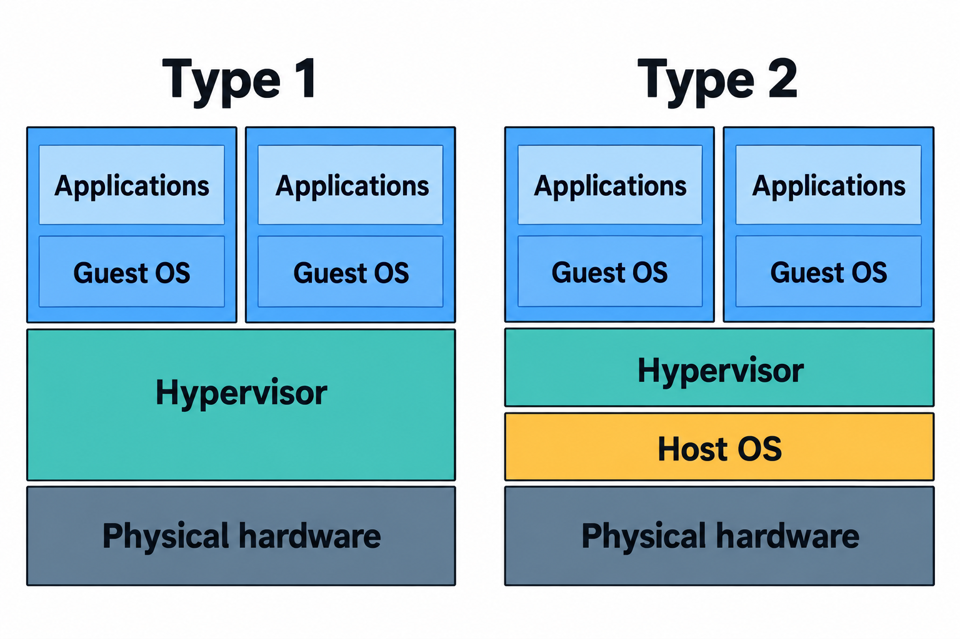
Types of hypervisors
Type 1
Runs directly on physical hardware.
Type 2
Runs as a hosted layer on a conventional host OS.
Both
Run guest operating systems with virtual hardware.
Conceptual illustration based on the hypervisor classification
10
Notes:
Teaching time: about 3 minutes.
Trace the two stacks from bottom to top. The added host OS on the Type 2 side is the central distinction. The schematic is a supplemental conceptual illustration, not Figure 3.3 from Sehgal. Real implementations may use kernel drivers, hardware virtualization and separate management components. This introductory classification therefore describes the architectural role, not every execution path or a universal performance ranking. Both models have physical hardware and guest operating systems. Color reinforces the labels: blue for guests, teal for the hypervisor, amber for the extra host OS and slate for physical hardware. The artwork was generated and reviewed against the stated relationships.
[Sources]
- Red Hat, What is a hypervisor? https://www.redhat.com/en/topics/virtualization/what-is-a-hypervisor (accessed 12 September 2026).
- Sehgal, Bhatt and Acken (2020), Cloud Computing with Security: Concepts and Practices, 2nd ed., Chapter 3, "Cloud Computing Pyramid", printed pp. 53, PDF pp. 90.
[/Sources]

Slide 10
Aspect | Type 1 | Type 2
Typical setting | Dedicated virtualization host | A user’s existing workstation
Examples | VMware ESXi, Microsoft Hyper-V | Oracle VirtualBox, VMware Workstation
Host relationship | Hypervisor controls the hardware | Hypervisor uses a host OS
For this lecture | Explains cloud host architecture | VirtualBox provides the local demo
11
Notes:
Teaching time: about 2 minutes.
Use examples as orientation, not as a product recommendation or benchmark. The Type 1/Type 2 labels do not determine licensing, reliability or performance by themselves. Microsoft Hyper-V remains Type 1 even when the user sees a Windows management environment. KVM is also commonly treated as Type 1 because Linux incorporates the virtualization capability, but it can confuse a first comparison, so leave that detail for explanation rather than adding another row. VirtualBox is a convenient hosted example because students can create a guest alongside their regular desktop system. Product-specific architecture details and supported guests should be checked in the installed product’s documentation.
[Sources]
- Red Hat, What is a hypervisor? https://www.redhat.com/en/topics/virtualization/what-is-a-hypervisor (accessed 12 September 2026).
- Oracle VirtualBox 7.2 User Guide, About Oracle VirtualBox. https://docs.oracle.com/en/virtualization/virtualbox/7.2/user/Introduction.html (accessed 12 September 2026).
[/Sources]

Slide 11
Cloud players and their concerns
Actor | Primary concern
Facility manager | Keep physical infrastructure powered, cooled and available.
Cloud IT or service provider | Use capacity efficiently while protecting service quality.
Cloud customer and enterprise IT | Meet application needs within cost and policy constraints.
End-user | Receive a responsive service and protect personal data.
A busy “noisy neighbor” VM can affect another tenant’s performance.
12
Notes:
Teaching time: about 2 minutes.
Condense Section 3.4 while retaining the different viewpoints. A facility manager operates the physical environment. The cloud IT manager or provider schedules resources, monitors use and plans capacity. The cloud customer may be an application operator whose end-users never interact directly with the cloud provider. Enterprise IT may manage both internal infrastructure and external services. The final consumer evaluates service quality and data protection. The book’s noisy-neighbor example places streaming media next to a database workload that competes for I/O. Separate logical ownership does not eliminate physical contention. Figures 3.4 and 3.5 informed the actor relationships, but this table is an original condensed explanation rather than a numbered figure recreation.
[Sources]
- Sehgal, Bhatt and Acken (2020), Cloud Computing with Security: Concepts and Practices, 2nd ed., Chapter 3, "Cloud Computing Pyramid", printed pp. 54–55, PDF pp. 91–92.
[/Sources]

Slide 12
Cloud data-center considerations
Service levels
Response time, bandwidth and availability need measurable targets.
Migration
Workload demand and sustained utilization affect the value of moving to a cloud.
Performance
Network latency and storage contention can limit an application.
Security
Monitoring and resource controls help detect and contain abnormal behavior.
13
Notes:
Teaching time: about 2 minutes.
Follow Sections 3.5 through 3.5.3. Spell out service-level agreement (SLA) and connect a measurable target to the user’s experience. The historical HPC comparisons in the chapter illustrate a decision method: inspect utilization, costs, communication patterns and storage behavior. Their old instance types, prices and benchmark results do not describe present-day cloud offerings. For security, the useful connection is that providers observe resource behavior and apply controls while maintaining guest isolation. The chapter ends this discussion with the then-current five-function NIST cybersecurity framework. This deck does not teach that historical framework as a current standard, since the requested scope is virtualization and Linux fundamentals.
[Sources]
- Sehgal, Bhatt and Acken (2020), Cloud Computing with Security: Concepts and Practices, 2nd ed., Chapter 3, "Cloud Computing Pyramid", printed pp. 56–58, PDF pp. 93–95.
[/Sources]

Slide 13
Linux operating system introduction
Kernel
Linux manages the system’s processors, memory and device access.
Distribution
A distribution packages the kernel with utilities, libraries and software management.
Examples
Ubuntu, Debian, Fedora and Red Hat Enterprise Linux provide different distributions.
Our guest runs Ubuntu Server. Bash provides the command shell used in the examples.
20
Notes:
Teaching time: about 2 minutes.
Start Lecture 6 by identifying the operating system students have just installed. Use “Linux” carefully: it names the kernel, while everyday use often means the complete distribution. A distribution combines that kernel with user-space tools and package repositories. The kernel release and the distribution release are therefore separate facts, as shown by the verification commands. The server edition can operate through a text console without a graphical desktop. A terminal provides the interaction surface, while a shell interprets command input. Bash is the shell used for the supplementary demonstrations in this deck. Avoid describing Linux itself as a package manager or as a command interpreter.
[Sources]
- Red Hat, What is Linux? https://www.redhat.com/en/topics/linux/what-is-linux (accessed 12 September 2026).
- Ubuntu Desktop documentation, The Linux command line for beginners (Ubuntu 24.04). https://documentation.ubuntu.com/desktop/en/24.04/tutorial/the-linux-command-line-for-beginners/ (accessed 12 September 2026).
[/Sources]

Slide 14
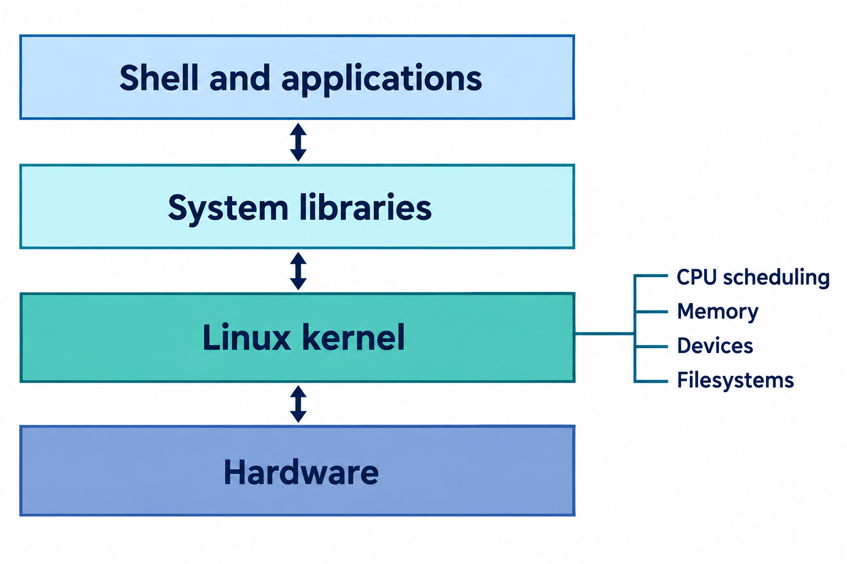
User space
Shells and applications request operating-system services.
Kernel
The kernel coordinates access to system resources.
Inside a VM
The guest kernel uses the virtual hardware supplied to it.
Conceptual illustration based on Linux operating system components
21
Notes:
Teaching time: about 2 minutes.
Trace one shell command through the conceptual components. The shell parses the input and starts a utility, which can use system libraries and system calls to request kernel services. The kernel works through device interfaces. Inside this VM, those interfaces usually represent virtual devices rather than exclusive physical devices. The picture is a simplified teaching model, not a requirement that every program call every layer in exactly the same way. The library layer represents common user-space support. Bidirectional arrows show requests and results. The small list connected to the kernel identifies responsibilities, not additional stack layers. This supplemental illustration was generated for the lecture and checked for these relationships.
[Sources]
- Red Hat, What is Linux? https://www.redhat.com/en/topics/linux/what-is-linux (accessed 12 September 2026).
- Ubuntu Desktop documentation, The Linux command line for beginners (Ubuntu 24.04). https://documentation.ubuntu.com/desktop/en/24.04/tutorial/the-linux-command-line-for-beginners/ (accessed 12 September 2026).
- Sehgal, Bhatt and Acken (2020), Cloud Computing with Security: Concepts and Practices, 2nd ed., Chapter 3, "Cloud Computing Pyramid", printed pp. 53, PDF pp. 90.
[/Sources]

Slide 15
Importance of Linux in DevOps
Similar environments
A Linux development or test VM can resemble a Linux production server.
Repeatable operations
Commands and configuration files make setup steps explicit.
Software management
Package tools install and track the components an environment needs.
Operational visibility
Utilities expose files, processes and resource use during diagnosis.
22
Notes:
Teaching time: about 2 minutes.
Anchor the importance of Linux in Verona’s discussion of developers rather than in unsupported market-share claims. The book recommends similar development and production operating environments where practical. That reduces avoidable differences, but identical platform names do not guarantee identical dependency versions, configuration or data. The command-line examples extend this idea: explicit commands can be inspected, repeated and eventually automated. A VM is one way to provide a disposable production-like environment. Linux is not a requirement for DevOps, and the book also recognizes Windows environments. Use Linux here because it is the syllabus platform and prepares students for later cloud and container demonstrations.
[Sources]
- Joakim Verona (2016), Practical DevOps, 1st ed., Chapter 2, "A View from Orbit", printed pp. 11–12, PDF pp. 30–31. The supplied file is the 2016 edition, although the syllabus bibliography lists 2018.
- CSC418_DevOps_Syllabus_V3.2.pdf, PDF p. 2, Lectures 5 and 6, Unit 2. CLO-2 on PDF p. 1.
- Ubuntu Desktop documentation, The Linux command line for beginners (Ubuntu 24.04). https://documentation.ubuntu.com/desktop/en/24.04/tutorial/the-linux-command-line-for-beginners/ (accessed 12 September 2026).
[/Sources]

Slide 16
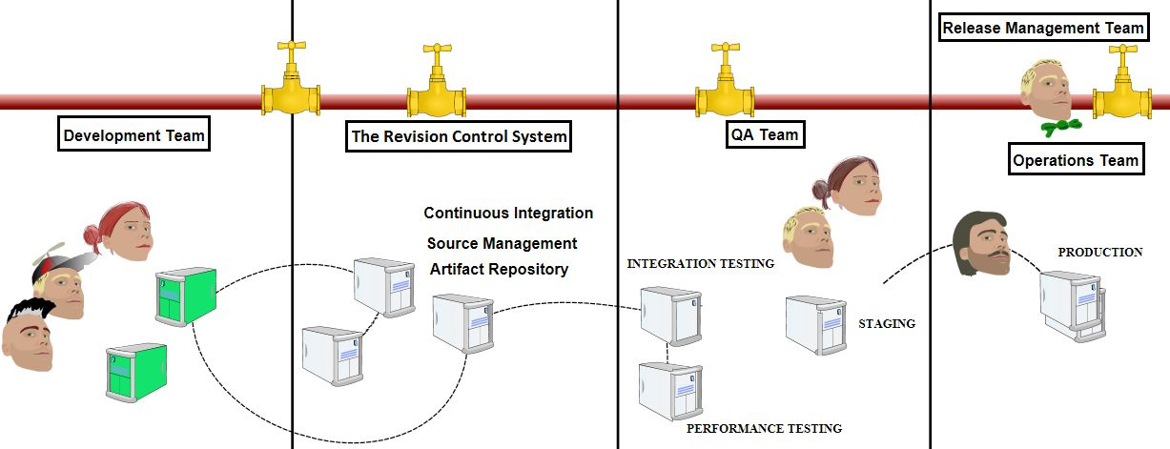
A view of the delivery process
Original unnumbered pipeline illustration, Verona Chapter 2, printed p. 10
Developers change code. Build systems create artifacts that move into test and production environments.
Teams and release decisions coordinate the flow. Linux VMs can host several of these environments.
23
Notes:
Teaching time: about 3 minutes.
Orient students to Verona’s complete pipeline before focusing on commands and package managers. Trace the major areas from development through revision control and continuous integration to testing, staging and production. The drawing is intentionally an overview: the small server labels need not become a list to memorize. The pipe and taps in the book symbolize the flow and human control of delivery. Code repositories retain source and configuration, while artifact repositories retain built deliverables. A package manager retrieves and installs an appropriate binary package in a target environment. Figure numbering is absent in the original, so the caption cites its printed page instead of inventing a figure number. This is the original color figure, extracted unchanged.
[Sources]
- Joakim Verona (2016), Practical DevOps, 1st ed., Chapter 2, "A View from Orbit", printed pp. 9–15, PDF pp. 28–34. The supplied file is the 2016 edition, although the syllabus bibliography lists 2018.
[/Sources]

Slide 17
Development tools and runtime environments
Developer workstation
Test or production runtime
Contains editors, compilers and other development tools.
Contains the software and configuration required to run the application.
Supports local changes and early tests.
Uses consistent installation methods and selected component versions.
A production-like local VM helps expose environment differences earlier.
24
Notes:
Teaching time: about 2 minutes.
Verona distinguishes the developer’s tools from the environment in which the application executes. The book’s examples include a specific JDK and an IDE on the development workstation, while the test and production environment should not automatically inherit every development tool. A local VM can host the application with an operating system and dependency setup resembling the target. External systems may still need substitutes or dedicated integration tests. The goal is relevant consistency, not a claim that all machines contain the same software. This distinction also explains why package lists and versions matter: having “Linux” on both machines does not establish environment equivalence.
[Sources]
- Joakim Verona (2016), Practical DevOps, 1st ed., Chapter 2, "A View from Orbit", printed pp. 11–12, 15–16, PDF pp. 30–31, 34–35. The supplied file is the 2016 edition, although the syllabus bibliography lists 2018.
[/Sources]

Slide 18
Terminal and command syntax
ls -la /etc
# command: ls
# options: -l and -a
# argument: /etc
Command
Names a utility or a shell operation.
Options
Modify how that command behaves.
Arguments
Identify inputs such as a directory or filename.
Commands and paths are case-sensitive. Spaces separate tokens unless quoting groups them.
25
Notes:
Teaching time: about 2 minutes.
Use one actual command before presenting abstractions. ls lists directory entries, -l requests a detailed listing, -a includes entries beginning with a dot, and /etc specifies the target directory. The comment lines are explanations and need not be typed. Shell prompts such as dollar signs are not part of the command. Explain that the terminal receives keystrokes and displays output, whereas the shell parses and executes the command. cd is usually a shell builtin because it changes the shell’s own current directory. These are supplemental Linux examples rather than commands quoted from Verona’s second chapter. Keep later examples in a user-owned demonstration directory.
[Sources]
- Ubuntu Desktop documentation, The Linux command line for beginners (Ubuntu 24.04). https://documentation.ubuntu.com/desktop/en/24.04/tutorial/the-linux-command-line-for-beginners/ (accessed 12 September 2026).
- GNU Coreutils manual. https://www.gnu.org/software/coreutils/manual/coreutils.html (accessed 12 September 2026).
[/Sources]

Slide 19
Paths and filesystem locations
Path | Purpose or meaning
/ | Root of the filesystem tree.
/home/student | An example regular user’s home directory.
/etc | System configuration files.
/var | Changing data such as logs and package state.
/tmp | Temporary files with no guaranteed long-term retention.
Absolute paths begin at /. Relative paths begin at the current working directory.
26
Notes:
Teaching time: about 2 minutes.
The filesystem gives every file a path within one tree. The username student is illustrative and should match the account created during installation. / is the root directory and differs from the root user and the root user’s home directory. A relative filename such as deploy.log changes meaning when the working directory changes. The special name . represents the current directory, .. the parent directory, and ~ usually expands to the current user’s home directory. Introduce these as navigation aids before the next worked sequence. Configuration paths deserve more care than a student-owned directory, and sudo is not necessary for ordinary work in the user’s home.
[Sources]
- Ubuntu Desktop documentation, The Linux command line for beginners (Ubuntu 24.04). https://documentation.ubuntu.com/desktop/en/24.04/tutorial/the-linux-command-line-for-beginners/ (accessed 12 September 2026).
- Supplement: Linux filesystem conventions, hier(7).
[/Sources]

Slide 20
Navigating directories
cd ~
mkdir -p csc418-demo/logs
cd csc418-demo
pwd
ls -la
cd logs
cd ..
Create
mkdir -p creates missing parent directories.
Move
cd changes the current shell’s directory.
Inspect
pwd and ls show where you are and what is present.
If the username is student, pwd displays /home/student/csc418-demo.
27
Notes:
Teaching time: about 3 minutes.
Walk through the commands in sequence using the regular account. The demonstration establishes a single directory that the later file examples reuse. mkdir -p tolerates the existence of the directory and creates missing parents. Running cd logs moves into the child, while cd .. returns to its parent. The given pwd result is explicitly conditional on the username and standard home path, not output captured from the user’s computer. Explain the difference between a directory existing and the shell being inside it. Readability is more important than demonstrating many shortcuts. This sequence is a supplementary worked example authored for the syllabus, and it contains no assessment prompt.
[Sources]
- Ubuntu Desktop documentation, The Linux command line for beginners (Ubuntu 24.04). https://documentation.ubuntu.com/desktop/en/24.04/tutorial/the-linux-command-line-for-beginners/ (accessed 12 September 2026).
- GNU Coreutils manual. https://www.gnu.org/software/coreutils/manual/coreutils.html (accessed 12 September 2026).
[/Sources]

Slide 21
Creating, copying and moving files
printf "INFO start\nERROR build\nINFO end\n" \
> deploy.log
cp deploy.log deploy-copy.log
mv deploy-copy.log logs/previous.log
touch notes.txt
ls logs
rm -i notes.txt
Create
printf writes sample text. touch creates an empty file if it does not exist.
Copy and move
cp makes a copy. mv moves or renames a path.
Remove
rm -i asks before removing this demonstration file.
Run inside ~/csc418-demo. The > operator replaces deploy.log if it already exists.
28
Notes:
Teaching time: about 3 minutes.
This continues the demonstration directory from the previous slide. The fixture contains exactly three lines: INFO start, ERROR build and INFO end. Its values are original teaching data, not book output. printf interprets the backslash-n sequences as line endings. cp duplicates the file, and mv relocates the copy into the logs directory under a new name. touch updates the timestamp if notes.txt already exists. ls logs should show previous.log. rm -i is scoped to the demonstration file and requests confirmation. Standard command-line removal does not use the desktop recycle bin. Do not introduce recursive deletion or broad wildcards in this introductory example.
[Sources]
- GNU Coreutils manual. https://www.gnu.org/software/coreutils/manual/coreutils.html (accessed 12 September 2026).
- Ubuntu Desktop documentation, The Linux command line for beginners (Ubuntu 24.04). https://documentation.ubuntu.com/desktop/en/24.04/tutorial/the-linux-command-line-for-beginners/ (accessed 12 September 2026).
[/Sources]

Slide 22
Reading and searching text
cat deploy.log
head -n 2 deploy.log
tail -n 1 deploy.log
grep "ERROR" deploy.log
wc -l deploy.log
View
cat prints the file. head and tail select its beginning or end.
Filter
grep selects lines matching a pattern.
Count
wc -l counts newline characters.
For our sample file, grep prints ERROR build and wc reports 3 lines.
29
Notes:
Teaching time: about 3 minutes.
Reuse the known three-line fixture so that the output can be explained exactly. cat displays all three lines. head -n 2 displays INFO start and ERROR build. tail -n 1 displays INFO end. grep with this literal-looking pattern selects the single ERROR line. wc -l reports three newline characters and usually includes the filename. The fixture ends every line with a newline, so the count matches the visible line count. Real logs can be large, so a pager such as less is useful for interactive browsing. grep is a separate GNU utility, not part of the Coreutils package. Its regex features are beyond this small example.
[Sources]
- GNU Coreutils manual. https://www.gnu.org/software/coreutils/manual/coreutils.html (accessed 12 September 2026).
- Ubuntu Desktop documentation, The Linux command line for beginners (Ubuntu 24.04). https://documentation.ubuntu.com/desktop/en/24.04/tutorial/the-linux-command-line-for-beginners/ (accessed 12 September 2026).
- GNU grep manual: https://www.gnu.org/software/grep/manual/grep.html. Supplementary worked example.
[/Sources]

Slide 23
Pipes and redirection
grep "ERROR" deploy.log | wc -l
grep "ERROR" deploy.log > errors.txt
cat errors.txt
printf "INFO checked\n" >> deploy.log
Pipe: |
Connects one command’s standard output to the next command’s input.
Replace: >
Writes output to a file, creating or truncating it.
Append: >>
Adds output to the end of a file.
The first command prints 1 for the sample file. The last command makes it four lines long.
30
Notes:
Teaching time: about 3 minutes.
Explain data movement without requiring memorized syntax. In the first command, grep emits the matching ERROR line and wc counts the incoming newline, yielding 1. In the second, the shell directs normal output to errors.txt, replacing any existing contents. cat shows that result. The final command appends one line to deploy.log, so later counts must account for its new four-line state. Standard error remains separate from standard output unless explicitly redirected. A normal pipe connects standard output, not every message. Pipeline exit status has further rules and should not be used here to claim complete failure handling. These examples are newly authored Linux supplements.
[Sources]
- GNU Bash Reference Manual, Pipelines. https://www.gnu.org/software/bash/manual/html_node/Pipelines (accessed 12 September 2026).
- Ubuntu Desktop documentation, The Linux command line for beginners (Ubuntu 24.04). https://documentation.ubuntu.com/desktop/en/24.04/tutorial/the-linux-command-line-for-beginners/ (accessed 12 September 2026).
- GNU Coreutils manual. https://www.gnu.org/software/coreutils/manual/coreutils.html (accessed 12 September 2026).
[/Sources]

Slide 24
Basic process and resource utilities
Command | What it reveals
ps -ef | A snapshot of running processes.
top | An interactive view of processes and resource use.
free -h | Memory usage in readable units.
df -h / | Capacity and free space for the root filesystem.
du -sh logs | Space used by the demonstration logs directory.
A process snapshot or free-space figure needs context before it explains a problem.
31
Notes:
Teaching time: about 2 minutes.
Separate different kinds of observation. ps lists processes at a moment in time. top refreshes a view and can be exited with q. free summarizes memory, whereas df describes filesystem space. du estimates the space used by the selected directory’s contents. A directory’s apparent file sizes and filesystem free space answer different questions. Do not infer a historical performance trend or a root cause from one display. Process control, service management and user administration belong to the following Linux administration lecture. Use these commands as orientation and evidence collection for the VM already created, not as a broad monitoring-tool survey.
[Sources]
- GNU Coreutils manual. https://www.gnu.org/software/coreutils/manual/coreutils.html (accessed 12 September 2026).
- Ubuntu Server command-line cheat sheet: https://ubuntu.com/server/docs/reference/cli-cheatsheet/. Linux manual pages ps(1), top(1), free(1). Supplementary coverage.
[/Sources]

Slide 25
Getting help and using privileges
ls --help
man ls
man apt
# Only the package change needs elevation
sudo apt install tree
Help
--help gives a short reference. man opens a manual page.
Navigation
In a manual pager, / searches and q exits.
Privileges
sudo runs a permitted command with elevated rights.
Use the ordinary account for work in your home directory.
32
Notes:
Teaching time: about 2 minutes.
Show how to recover forgotten syntax rather than expanding the command list indefinitely. man pages may depend on the packages included in the Ubuntu installation. Explain that sudo checks the configured authorization policy and may ask for the user’s password. The terminal normally does not display password characters while typing. It does not make every later command privileged. Ordinary navigation and file work in the user’s own directory require no elevation. The installation line previews the package-management topic and should be run after refreshing repository metadata in the next example. It is not necessary to enable a persistent root shell or change the root password.
[Sources]
- Ubuntu Desktop documentation, The Linux command line for beginners (Ubuntu 24.04). https://documentation.ubuntu.com/desktop/en/24.04/tutorial/the-linux-command-line-for-beginners/ (accessed 12 September 2026).
- Ubuntu Server documentation, Install and manage packages. https://ubuntu.com/server/docs/how-to/software/package-management/ (accessed 12 September 2026).
[/Sources]

Slide 26
Package managers
Package
An installable bundle records software, version information and dependencies.
Repository
A software source provides package files and metadata.
Package manager
The tool resolves required dependencies and performs installation or upgrades.
Installed state
A local database records which package versions and files belong to the system.
33
Notes:
Teaching time: about 2 minutes.
Return explicitly to Verona’s Package managers section, printed pages 14–15. The book explains that binary deliverables can be fetched from repositories and installed with dependencies. Clarify a compressed statement in the text: an artifact repository stores deliverables, while a package manager is the client and associated tooling that installs them. These roles cooperate and should not be treated as literally identical. A repository may serve many versions, and each target machine has its own installed state. The next comparison distinguishes package formats, repository-aware tools and lower-level package databases. The older text’s aptitude/dpkg wording is supplemented with APT for the Ubuntu demonstration.
[Sources]
- Joakim Verona (2016), Practical DevOps, 1st ed., Chapter 2, "A View from Orbit", printed pp. 14–15, PDF pp. 33–34. The supplied file is the 2016 edition, although the syllabus bibliography lists 2018.
- Ubuntu Server documentation, Managing your software. https://ubuntu.com/server/docs/tutorial/managing-software/ (accessed 12 September 2026).
[/Sources]

Slide 27
Linux package-management families
Role | Debian / Ubuntu | Fedora / RHEL family
Package format | .deb | .rpm
Repository-aware tool | APT, commonly apt | DNF, commonly dnf
Lower-level tool | dpkg | rpm
Example installation | sudo apt install tree | sudo dnf install tree
Use the tool for the installed distribution. APT and DNF handle repository dependencies.
34
Notes:
Teaching time: about 2 minutes.
Explain that .deb and .rpm are package formats rather than shell commands. APT and DNF operate with repositories and dependency information. dpkg and rpm work at a lower level and do not themselves provide the same automatic repository dependency retrieval workflow. Verona mentions yum, dnf and aptitude/dpkg. Retain the historical context in the notes while teaching apt for the supplied Ubuntu guest. Command names and available package versions vary by distribution and release, so /etc/os-release is relevant evidence. Show the DNF line as a comparison only. The presenter should run the Ubuntu column in the Ubuntu VM.
[Sources]
- Joakim Verona (2016), Practical DevOps, 1st ed., Chapter 2, "A View from Orbit", printed pp. 14–15, PDF pp. 33–34. The supplied file is the 2016 edition, although the syllabus bibliography lists 2018.
- Ubuntu Server documentation, Install and manage packages. https://ubuntu.com/server/docs/how-to/software/package-management/ (accessed 12 September 2026).
- DNF Command Reference. https://dnf.readthedocs.io/en/stable/command_ref.html (accessed 12 September 2026).
[/Sources]

Slide 28
APT: update, inspect and install
sudo apt update
apt search tree
apt show tree
sudo apt install tree
tree --version
Refresh
update retrieves current repository metadata.
Inspect
search and show identify a package and its details.
Install and verify
install changes installed software. --version confirms the program can run.
Read the proposed transaction before confirming the installation.
35
Notes:
Teaching time: about 3 minutes.
Demonstrate against the configured repositories on the Ubuntu guest. apt update refreshes the local index of available packages; it does not upgrade installed programs. Search output may include packages with tree in their names or descriptions, so apt show tree provides the specific package detail. apt install plans the transaction and requests confirmation when needed. Review its dependency and space information. The exact version and package sizes depend on the release and repository state and are deliberately not hard-coded as expected output. tree --version then checks the executable. For automated scripts Ubuntu recommends apt-get rather than the interactive apt interface. This is an original syllabus example, not the book’s yum upgrade command.
[Sources]
- Ubuntu Server documentation, Install and manage packages. https://ubuntu.com/server/docs/how-to/software/package-management/ (accessed 12 September 2026).
- Ubuntu Server documentation, Managing your software. https://ubuntu.com/server/docs/tutorial/managing-software/ (accessed 12 September 2026).
- Joakim Verona (2016), Practical DevOps, 1st ed., Chapter 2, "A View from Orbit", printed pp. 15, PDF pp. 34. The supplied file is the 2016 edition, although the syllabus bibliography lists 2018.
[/Sources]

Slide 29
dpkg-query -W tree
dpkg -L tree
apt list --upgradable
sudo apt upgrade
Query
Check the installed version and the files owned by the package.
Review
List packages for which the current index offers upgrades.
Upgrade
Apply available upgrades after reviewing the proposed changes.
Repository metadata and the machine’s installed packages are separate kinds of state.
36
Notes:
Teaching time: about 2 minutes.
The header remains blank because this continues the APT workflow. dpkg-query -W tree retrieves the local package record, and dpkg -L tree lists paths registered to that package. The program’s --version result and the package database are complementary evidence. apt list --upgradable uses the index last refreshed by update. apt upgrade changes installed packages and can affect more than the one package used in the demonstration, so the lecture can show the proposed transaction and decline it if a prepared VM must remain unchanged. The slide teaches command semantics and does not instruct the assistant to update the host machine. Environment reproducibility also requires recording distribution and package versions.
[Sources]
- Ubuntu Server documentation, Install and manage packages. https://ubuntu.com/server/docs/how-to/software/package-management/ (accessed 12 September 2026).
- Ubuntu Server documentation, Managing your software. https://ubuntu.com/server/docs/tutorial/managing-software/ (accessed 12 September 2026).
- Debian dpkg-query manual: https://manpages.debian.org/bookworm/dpkg/dpkg-query.1.en.html. Supplementary query command.
[/Sources]

Slide 30
Removing packages
sudo apt remove tree
sudo apt purge tree
Removes the package’s installed software.
Removes the package and its managed configuration.
Can retain package configuration for a later reinstall.
Can still leave user-created data outside package ownership.
Both operations need sudo to change system packages. Review any dependent changes.
37
Notes:
Teaching time: about 2 minutes.
Explain these alternatives without running them consecutively as if they were required workflow steps. In Debian packaging, removal can preserve configuration records, whereas purging also removes package-managed configuration. Neither is a universal deletion of every file a user has ever created with the program. Dependency relationships can affect the proposed transaction, so read the summary. A later apt install may reinstall the package, but that does not recover arbitrary lost user data. Package-management actions are changes to installed state, in contrast to search, show and queries. Keep discussion of unattended upgrades, release upgrades and third-party repository policy for a more advanced session.
[Sources]
- Ubuntu Server documentation, Install and manage packages. https://ubuntu.com/server/docs/how-to/software/package-management/ (accessed 12 September 2026).
- Ubuntu Server documentation, Managing your software. https://ubuntu.com/server/docs/tutorial/managing-software/ (accessed 12 September 2026).
[/Sources]

Slide 31
Test environments, staging and release
Test environments
Install built artifacts using methods that resemble production.
Staging
Validate selected versions before exposing them to real users.
Release control
Human decisions can choose when a tested version advances.
Deployment options
The book describes swapping staging and production or rolling out gradually.
38
Notes:
Teaching time: about 2 minutes.
Resume Verona’s progression after package managers. Test systems consume artifacts from the binary repository. Consistent setup helps avoid errors caused by different installation methods. The book describes staging and production switching roles as a blue-green example, but staging in general does not have to be physically interchangeable with production. Production-like environments can be expensive and may still have important differences. Release management reconciles technical readiness with business timing, so continuous delivery can include a human decision. Rolling deployment is another option discussed by the chapter. These ideas give Linux package operations their delivery context without teaching the later deployment topics in depth.
[Sources]
- Joakim Verona (2016), Practical DevOps, 1st ed., Chapter 2, "A View from Orbit", printed pp. 15–17, PDF pp. 34–36. The supplied file is the 2016 edition, although the syllabus bibliography lists 2018.
[/Sources]

Slide 32
The book’s authentication-change example
1
Develop
Add an authentication role and test the change locally.
2
Build
Git receives the change. The build server tests it and stores an artifact in Nexus.
3
Integrate
Puppet installs the new component in integration test. Regression and QA checks follow.
4
Release
Acceptance checks finish in staging, then a controlled switch promotes the release.
39
Notes:
Teaching time: about 2 minutes.
This is Verona’s worked example from printed pages 18–19, not an exercise or newly invented project. The change adds roles to an authentication system and affects several systems, so it is broken into smaller changes. A local developer environment may lack the LDAP service needed for complete integration testing. After source control and a build, the artifact enters Nexus, then Puppet installs it according to the environment configuration. Automated and manual quality checks precede staging and production. Explain the role of each named tool without providing installation instructions for it. The example illustrates why a prepared runtime, known package state and consistent configuration matter to a successful delivery.
[Sources]
- Joakim Verona (2016), Practical DevOps, 1st ed., Chapter 2, "A View from Orbit", printed pp. 18–19, PDF pp. 37–38. The supplied file is the 2016 edition, although the syllabus bibliography lists 2018.
[/Sources]

Slide 33
Delivery cadence and bottlenecks
Scrum and Kanban
Both benefit from frequent, dependable movement of changes through the pipeline.
Evidence for decisions
Build and test results support automatic or human release decisions.
Common delays
Incompatible data, database changes and dependence on one person can block delivery.
Environment contribution
Consistent machines and package installation remove some avoidable differences.
40
Notes:
Teaching time: about 2 minutes.
Complete the substantive chapter context with the sections on Agile methods and bottlenecks. Preserve Verona’s main point that the pipeline supports different planning methods. Avoid reducing Kanban to a fixed daily cycle or presenting Scrum and Kanban as mutually exclusive. The book’s 15-minute integration-deployment target is an illustrative expectation rather than a universal service-level requirement, so it does not appear as a general rule on the slide. Environment consistency addresses only part of the problem. Database migrations, test data, approvals, coordination and change size can still dominate delivery time. This reinforces that virtualization and Linux utilities are useful tools within a broader DevOps way of working.
[Sources]
- Joakim Verona (2016), Practical DevOps, 1st ed., Chapter 2, "A View from Orbit", printed pp. 17–20, PDF pp. 36–39. The supplied file is the 2016 edition, although the syllabus bibliography lists 2018.
[/Sources]

Slide 34
lecture recap
Virtualization
A hypervisor gives guests virtual hardware while sharing finite physical resources.
VM creation
Configuration, OS installation and verification are separate steps.
Linux utilities
Commands navigate files, inspect text and reveal the guest’s current state.
Package management
Repositories, dependency resolution and installed records support consistent environments.
The Linux VM is the execution environment for the later cloud and DevOps tools.
41
Notes:
Teaching time: about 2 minutes.
Close the combined teaching sequence by connecting the levels. Physical infrastructure supports a hypervisor, the hypervisor supports a guest, Linux manages programs inside that guest, and package tools manage installed software. Linux command utilities provide observable evidence at that guest level. The goal is a coherent explanation of the execution environment, not merely a list of commands. Remind the presenter that Lecture 5 ended at slide 19 and Lecture 6 began at slide 20. The next syllabus lecture extends Linux into user management and administration, while subsequent lectures move to cloud instances and containers. Do not add review questions or exercises, because the user invoked the book-chapter workflow without requesting assessment material.
[Sources]
- CSC418_DevOps_Syllabus_V3.2.pdf, PDF p. 2, Lectures 5 and 6, Unit 2. CLO-2 on PDF p. 1.
- Sehgal, Bhatt and Acken (2020), Cloud Computing with Security: Concepts and Practices, 2nd ed., Chapter 3, "Cloud Computing Pyramid", printed pp. 53–57, PDF pp. 90–94.
- Joakim Verona (2016), Practical DevOps, 1st ed., Chapter 2, "A View from Orbit", printed pp. 11–20, PDF pp. 30–39. The supplied file is the 2016 edition, although the syllabus bibliography lists 2018.
[/Sources]

Slide 35
Supplementary technical references
Oracle VirtualBox 7.2 User Guide
Creating a New Virtual Machine, Virtual Storage, Virtual Networking
Ubuntu Server and Desktop documentation
Basic installation, command-line tutorial, package management
GNU manuals
Coreutils, Bash pipelines and redirection, grep
Red Hat and DNF documentation
Linux components, hypervisor types and RPM-family package tools
These sources supply the Linux and VM procedures beyond the selected chapters.
42
Notes:
Teaching time: about 1 minute.
The syllabus requests Linux utilities, installation and hypervisor types that are not fully taught in the supplied chapters. The supplementary sources provide that missing coverage and verify version-sensitive details. The selected Linux commands are newly authored worked demonstrations. The VirtualBox instructions target the 7.2 workflow and an Ubuntu Server 24.04 LTS example rather than a claim that all versions have the same screens. Full URLs appear below and on the individual teaching slides. All official web sources were consulted on 12 September 2026. This slide precedes the required final book reference slide.
[Sources]
- Red Hat, What is a hypervisor? https://www.redhat.com/en/topics/virtualization/what-is-a-hypervisor (accessed 12 September 2026).
- Oracle VirtualBox 7.2 User Guide, Creating a New Virtual Machine. https://docs.oracle.com/en/virtualization/virtualbox/7.2/user/create-vm.html (accessed 12 September 2026).
- Oracle VirtualBox 7.2 User Guide, Virtual Storage. https://docs.oracle.com/en/virtualization/virtualbox/7.2/user/storage.html (accessed 12 September 2026).
- Oracle VirtualBox 7.2 User Guide, Virtual Networking. https://docs.oracle.com/en/virtualization/virtualbox/7.2/user/networkingdetails.html (accessed 12 September 2026).
- Ubuntu Server documentation, Basic installation. https://ubuntu.com/server/docs/tutorial/basic-installation/ (accessed 12 September 2026).
- Red Hat, What is Linux? https://www.redhat.com/en/topics/linux/what-is-linux (accessed 12 September 2026).
- Ubuntu Desktop documentation, The Linux command line for beginners (Ubuntu 24.04). https://documentation.ubuntu.com/desktop/en/24.04/tutorial/the-linux-command-line-for-beginners/ (accessed 12 September 2026).
- GNU Coreutils manual. https://www.gnu.org/software/coreutils/manual/coreutils.html (accessed 12 September 2026).
- GNU Bash Reference Manual, Pipelines. https://www.gnu.org/software/bash/manual/html_node/Pipelines (accessed 12 September 2026).
- Ubuntu Server documentation, Install and manage packages. https://ubuntu.com/server/docs/how-to/software/package-management/ (accessed 12 September 2026).
- Ubuntu Server documentation, Managing your software. https://ubuntu.com/server/docs/tutorial/managing-software/ (accessed 12 September 2026).
- DNF Command Reference. https://dnf.readthedocs.io/en/stable/command_ref.html (accessed 12 September 2026).
[/Sources]

Slide 36
Book references
Cloud Computing with Security: Concepts and Practices
Naresh Kumar Sehgal, Pramod Chandra P. Bhatt and John M. Acken
Second edition, Springer, 2020
Chapter 3: Cloud Computing Pyramid
Printed pp. 49–59; PDF pp. 86–96
Practical DevOps
Joakim Verona
First edition, Packt Publishing, 2016
Chapter 2: A View from Orbit
Printed pp. 9–20; PDF pp. 28–39
Edition note: the supplied Verona PDF is the 2016 edition. The syllabus bibliography lists 2018.
43
Notes:
Teaching time: about 1 minute.
Final reference slide. Verify edition information directly from the supplied PDFs. Sehgal’s title and copyright pages identify the second edition and Springer 2020. The printed Chapter 3 span is pages 49–59, found at PDF positions 86–96 inclusive, including Points to Ponder and references. The substantive lecture omits the end-of-chapter questions. Verona’s copyright page says first published February 2016, ISBN 978-1-78588-287-6. Its Chapter 2 runs from printed pages 9–20, at PDF positions 28–39. Do not silently label the supplied file as the syllabus’s 2018 edition. No content follows this slide.
[Sources]
- Sehgal, Bhatt and Acken (2020), Cloud Computing with Security: Concepts and Practices, 2nd ed., Chapter 3, "Cloud Computing Pyramid", printed pp. 49–59, PDF pp. 86–96.
- Joakim Verona (2016), Practical DevOps, 1st ed., Chapter 2, "A View from Orbit", printed pp. 9–20, PDF pp. 28–39. The supplied file is the 2016 edition, although the syllabus bibliography lists 2018.
- Sehgal supplied PDF title/copyright pages 1–4; Verona supplied PDF title/copyright pages 2–3.
[/Sources]

