Slide 1
Database Management Systems

Slide 2
Databases
Any collection of data, or information that is specially organized for rapid search and retrieval by a computer.
Databases are structured to facilitate the storage, retrieval, modification, and deletion of data in conjunction with various data-processing operations.
A database management system (DBMS) extracts information from the database in response to queries.

Slide 3
Student Detail
Finance Dept
Course Registration
File
File
File
one file per application
no data sharing
Attendance
Results
File
File
Fee Waver
Assessment
File
File

Slide 4
Student Detail
Finance Dept
Course Registration
File
File
File
cross-application transfers difficult to manage
Attendance
Results
File
File
Fee Waver
Assessment
File
File

Slide 5
Student Detail
Finance Dept
Course Registration
File
File
File
same data , e.g. name & address, stored in many places
Attendance
Results
File
File
Fee Waver
Assessment
File
File

Slide 6
Student Detail
Finance Dept
Course Registration
File
File
File
The solution?
Put all of the data in one place.
Attendance
Results
File
File
Fee Waver
Assessment
File
File

Slide 7
Student Detail
Finance Dept
Course Registration
File
File
File
File
File
Attendance
File
File
File
Results
Fee Waver
Assessment

Slide 8
Student Detail
Finance Dept
Course Registration
DATABASE
INVENTORY
Attendance
Results
ORDER
ENTRY
DESPATCH
Assessment
Fee Waver
A Database Management System (DBMS)

Slide 9
Limitations of File based approach
Separation and isolation of data
Duplication of data (redundancy)
Inconsistencies of data
Example: FYP file, Result Sheets(incase of change in grading, formula change)

Slide 10

So… What is a Database?
Shared Collection of Logically related data designed to meet the information needs of an organization.

Slide 11
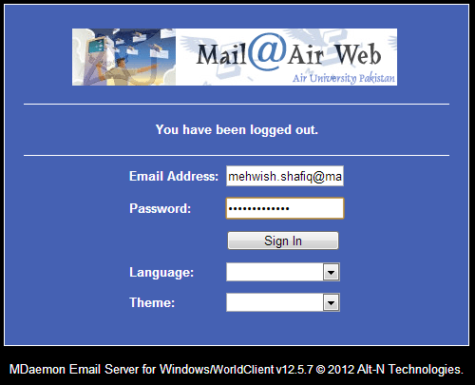

Slide 12
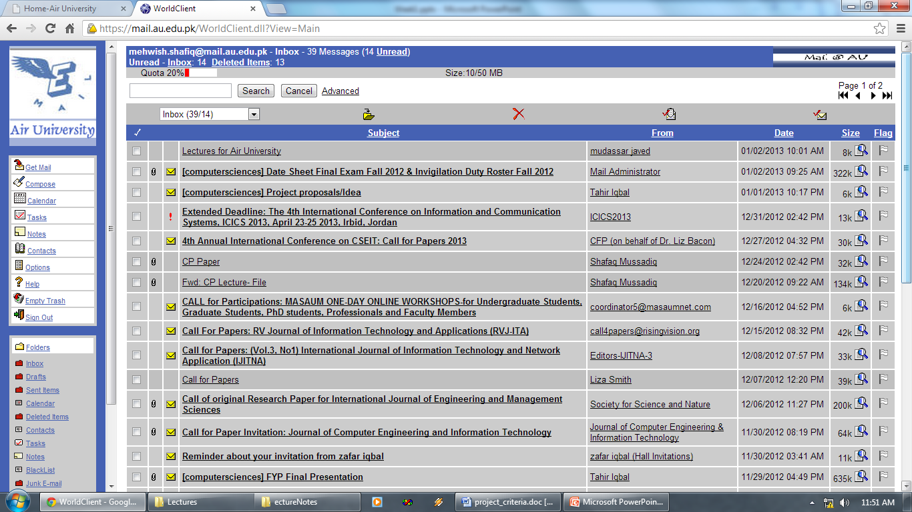

Slide 13
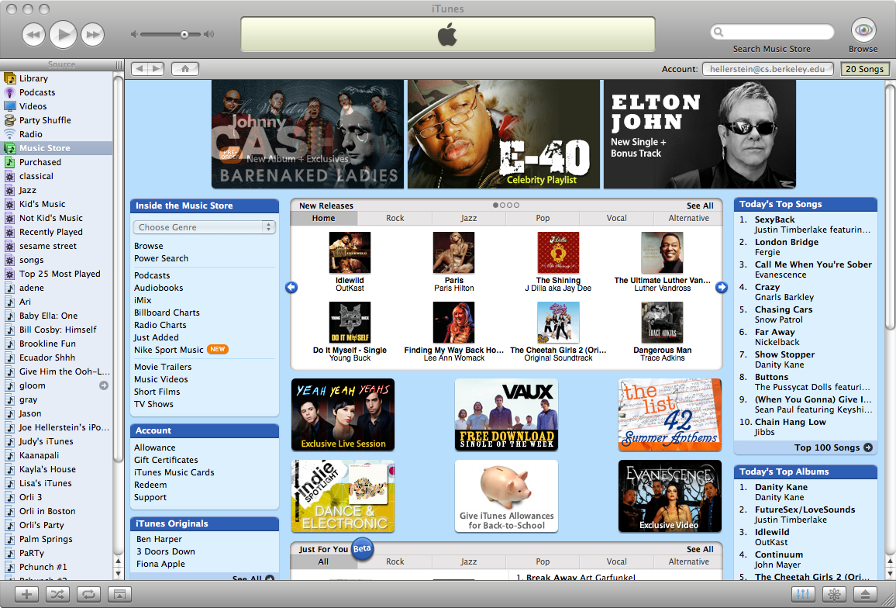

Slide 14

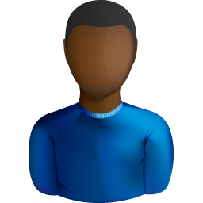
DBMS
Front
End
Back
End
App
User 1
DB
App
User 2

Slide 15
Examples of DB applications
Transactions from ATM
Purchases using your credit / debit card
Using a local library
Studying at university
Booking a holiday at the travel agent

Slide 16
What.. Is a DBMS ?
A software system that enables users to define, create, maintain and control access to database.
A database application program that interacts with database by issuing an appropriate request (SQL statement) to the DBMS.

Slide 17
Who is involved in databases?
Data Administrator (DA)
Database Administrator (DBA)
Database designers
System Programmers
Users (naive and sophisticated)

Slide 18
Database Languages
Data Definition Language (DDL)
Permits specifications of data types, structures and any data constraints.
All specifications are stored in data base.
Data Manipulation Language (DML)
General enquiry facility of data.

Slide 19
Some Major DBMSs
Access
SQL Server
Oracle
Ingres
MySQL
Informix
Sybase

Slide 20
Why study databases?
Linked to many areas of computer science, eg:
Programming languages
Logic
Systems
Many problems left to solve both in implementation and research.

Slide 21
HomeWork
Advantages and Disadvantages of DBMS
https://tutorialink.com/dbms/advantage-and-disadvantages-of-dbms.dbms

