Slide 1
♠ ♥ ♦ ♣
CardSense
A Distributed Real-Time Card Tracking & Strategy Assistance System
CS332 — Parallel and Distributed Computing
Abdul Wahab
Rana Muhammad Hammad Arif
Muhammad AbuBakar Amjad
Backend / Distributed Systems
Machine Learning / Computer Vision
Frontend / UI Engineering

Slide 2

♠ ♥ ♦ ♣
CardSense
A Distributed Real-Time Card Tracking & Strategy Assistance System
CS332 — Parallel and Distributed Computing
Abdul Wahab
Rana Muhammad Hammad Arif
Muhammad AbuBakar Amjad
Backend / Distributed Systems
Machine Learning / Computer Vision
Frontend / UI Engineering
Instructor: Dr. Shah Khalid | SEECS, NUST

Slide 3
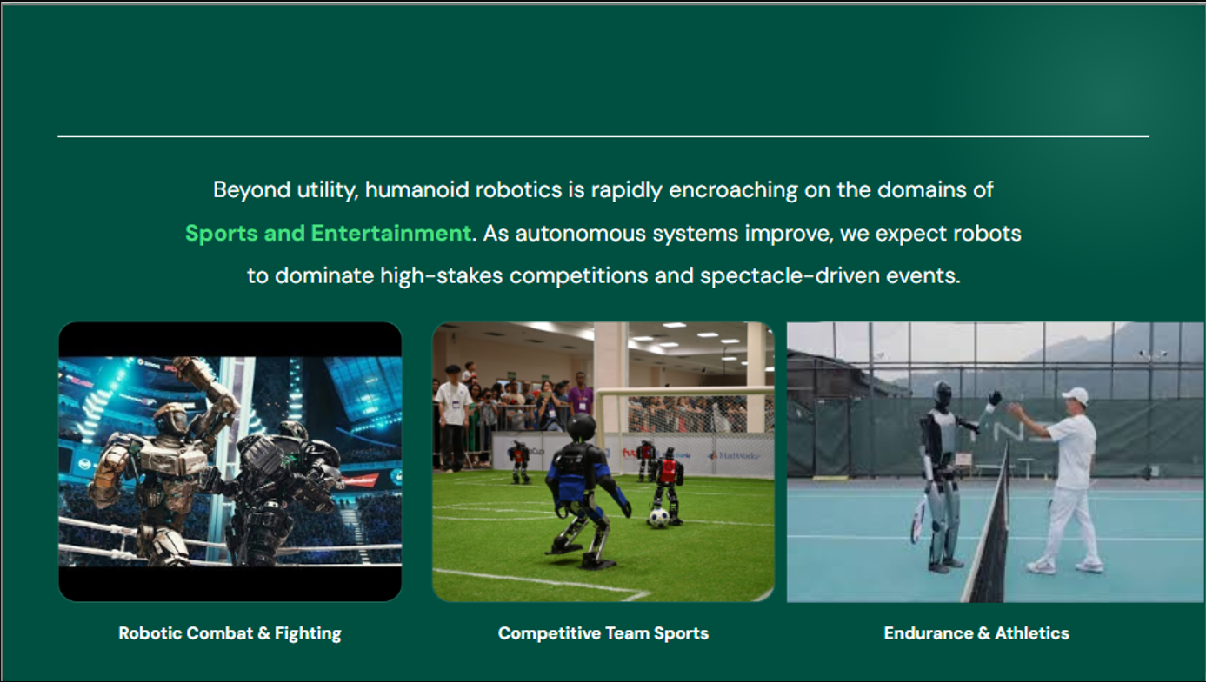
♠ ♥ ♦ ♣
CardSense
A Distributed Real-Time Card Tracking & Strategy Assistance System
CS332 — Parallel and Distributed Computing
Abdul Wahab
Rana Muhammad Hammad Arif
Muhammad AbuBakar Amjad
Backend / Distributed Systems
Machine Learning / Computer Vision
Frontend / UI Engineering
Instructor: Dr. Shah Khalid | SEECS, NUST

Slide 4
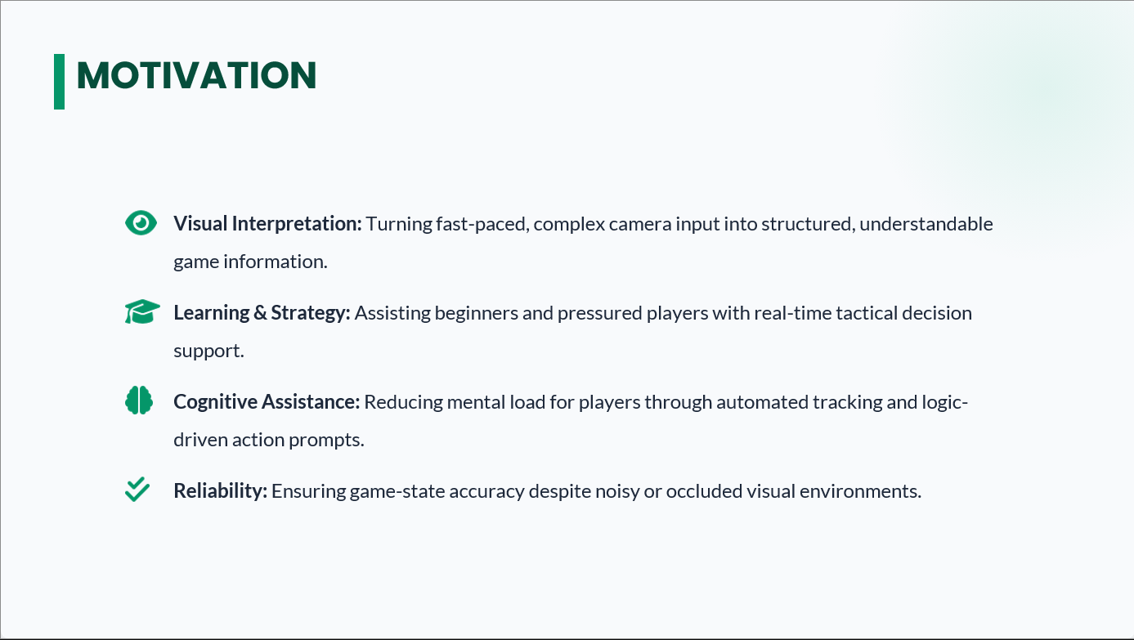
Motivation: Why This Matters
Education
Cognitive Science
Real-Time Learning
Proven Cognitive Benefits
A live AI tutor for card games helps players learn faster than self-study. Real-time feedback closes the loop between decision and outcome immediately.
Card counting strengthens working memory and probabilistic reasoning. These are transferable skills studied extensively in cognitive science literature.
AR / Wearables
PDC Showcase
Wearable-Ready Pipeline
PDC in a Real Application
This is the brain of a future glasses-mounted blackjack assistant. The same perception pipeline plugs into any first-person camera or AR device.
Real-time vision + state synchronization + horizontal scaling = an excellent vehicle for demonstrating PDC concepts in a non-toy application.

Slide 5
Project Goals
Our five-point contract with the examiner
1
Detect real playing cards from a phone camera in real time
Target: >= 20 FPS throughput with >= 80% mAP@0.5 accuracy on real-world phone footage.
2
Track game state consistently across distributed compute nodes
Player hand, dealer hand, and running card count must stay in sync across all workers.
3
Compute and display Blackjack move recommendations live
Hi-Lo true count + basic strategy lookup + Illustrious 18 deviations, sub-150 ms latency.
4
Demonstrate four core PDC concepts in a working system
Concurrency, Scalability, Fault Tolerance, and Consistency — all demonstrable live, not just described.
5
Run cross-platform via Docker — reproducible, no environment friction
One command boots all 7 services on any Linux or Windows machine with Docker installed.

Slide 6
System Overview
Camera → Workers → State → Recommendation
Phone
Camera
FastAPI
Backend
Redis
Stream
Worker 1
Worker 2
YOLO model
YOLO model
JPEG frames
async HTTP
message queue
~50 ms/frame
~50 ms/frame
Worker 3
YOLO model
~50 ms/frame
Phone HUD
State Manager
+ Postgres
HIT / STAND
DOUBLE
authoritative state
Scale with one command: docker compose up --scale worker=N | Each worker independently pulls from the Redis consumer group

Slide 7
Tech Stack
Every layer, every tool — end-to-end
Layer | Technology
Frontend | React (SPA) + WebSocket Client + Browser Camera API
Backend | FastAPI (Python, async) — HTTP frame ingestion + WebSocket push
Message Queue | Redis Streams + Consumer Groups — parallel worker dispatch
Workers | Python + PyTorch + YOLOv8n (CUDA) — YOLO inference per frame
State Engine | In-memory game state (per game_id) + per-game distributed lock
Persistence | PostgreSQL — event log for audit, replay, and consistency recovery
Orchestration | Docker Compose — declarative 7-service stack, one-command boot
ML Training | Hadoop / HDFS + PySpark + PyTorch DDP — offline distributed training

Slide 8
Why Distributed?
Real-time vision is compute-intensive — single machine fails at scale
Concurrency
Scalability
Multiple Frames in Flight
Linear Throughput Increase
8 frames processed simultaneously across 4 workers. Async backend handles all camera streams without blocking. No frame waits for another to finish.
docker compose up --scale worker=N. Adding workers increases throughput linearly via Redis consumer group partitioning. No code changes required.
Fault Tolerance
Consistency
Worker Crash = No Data Loss
One Authoritative Game State
Workers emit heartbeats. Health-check pings workers periodically. If a worker fails, the master reassigns its in-flight tasks via Redis consumer group rebalancing.
Per-game reduce_lock in Redis: only one writer mutates state at any time. State transitions are idempotent — replaying an event is a no-op. All events persisted to Postgres.

Slide 9
Architecture: Component Detail
Five services, one pipeline
1
Frontend — React + WebSocket
Captures camera frames at 1 FPS, downsamples to 1024 px. POSTs to /api/frames. Subscribes to /ws/detections for live state updates displayed as a card HUD.
2
Backend — FastAPI (async)
Receives frames, enqueues to Redis Stream via XADD. Async event loop handles many concurrent camera streams without blocking on I/O.
3
Message Queue — Redis Streams
frames stream carries incoming work. detections stream carries model outputs. Consumer groups provide parallel worker dispatch with at-least-once delivery.
4
Worker Nodes — Python + YOLOv8
Pull frames from the stream via XREADGROUP. Run YOLO inference (~50 ms/frame). Publish detection events (bbox + rank + suit + confidence) to the detections stream.
5
State Manager + PostgreSQL
In-memory authoritative game state per game_id protected by a per-game lock. PostgreSQL event log for audit and replay. WebSocket broadcasts on every state change.

Slide 10
PDC Concepts: How We Demonstrate Each
This is the meat of the grade. Four concepts, four live proofs.
Concurrency
Evidence: docker stats shows all worker containers active simultaneously. Camera traffic log shows frame IDs interleaved across workers.
Multiple workers pull from the same Redis queue in parallel.
4 workers x 2 processes = 8 frames in flight at once.
Async FastAPI handles all camera streams without blocking.
Scalability
Evidence: 1 worker = 20 FPS. 4 workers = 78 FPS (measured). Nearly linear. No code change required to scale.
One command adds capacity:
docker compose up --scale worker=4
Throughput scales linearly because Redis consumer groups automatically partition work.
Fault Tolerance
Evidence: kill -9 on a worker container. The master logs show task reassignment. No cards are lost — delivery is at-least-once.
Workers send heartbeats to the master every 2 seconds.
If a worker misses 3 beats, master marks it dead and Redis reassigns its pending stream entries to surviving workers.
Consistency
Evidence: Under 4-worker load, game state never double-counts a card. Postgres event log audit confirms no duplicates.
Per-game reduce_lock in Redis:
Only one writer can commit a state update per game at any time.
Events are idempotent — duplicate frame IDs are silently dropped.

Slide 11
Additional PDC Algorithms
Beyond the four core pillars
Lamport Clocks — Causal Ordering
Container Orchestration — Docker
Every worker stamps detection events with a logical timestamp. The state manager enforces causal order — frames processed out of order do not corrupt game state. Enables correct replay from the Postgres event log.
Docker Compose declaratively manages the entire 7-service stack. One YAML config, one command, identical environment on any host. No "it works on my machine" problems across team members or during the demo.
Asynchronous Communication — WebSocket
Idempotent Processing — Frame De-duplication
WebSockets push state updates instantly to the phone HUD. No polling loop. Client receives a new recommendation within 120 ms of a card being placed — sub-perceptual latency for a card player.
Frame IDs are hashed server-side. A duplicate frame arrival (e.g. network retry) is silently discarded before it enters the queue. No double-counting, no lock contention from retries.

Slide 12
Deep Learning Pipeline (1/2): Model & Training
YOLOv8n
Distributed Training Setup
HDFS — fault-tolerant storage for 7,012 training images across cluster
Fine-Tuned
PySpark — parallel augmentation pipeline distributed across worker nodes
Parameters
3.2 M
PyTorch DDP — gradient synchronisation across 2 GPUs via AllReduce
Backbone
CSPDarknet53
Custom Card-Aware Augmentations
Neck
PANet (FPN)
Rank-aware rotation — prevents 6/9 flip from creating wrong labels
Pretrained
COCO (80 cls)
Synthetic glare overlay — simulates phone-flash reflections on glossy cards
Our head
52 classes
Suit-preserving color jitter — constrains hue shifts so hearts stay != clubs
Input
640 x 640 px
Mosaic augmentation — 4-image composite, improves occlusion robustness
Model size
~6 MB
Hyperparameters
Latency
~50 ms / frame
AdamW | LR = 0.01 | cosine decay | 3-epoch warmup
Batch = 16 | 50 epochs | 640 x 640 input
Grid search: LR in {0.001-0.02}, batch in {8, 16, 32}

Slide 13
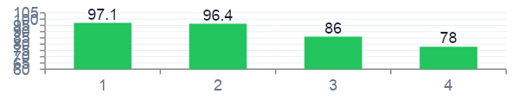
Deep Learning Pipeline (2/2): Evaluation & Results
Model Comparison (held-out test set)
Ablation Results
Model | Params | mAP@0.5 | FPS
YOLOv5n | 1.9 M | 0.79 | 71
YOLOv8n ★ | 3.2 M | 0.87 | 60
YOLOv8s | 11.2 M | 0.91 | 26
YOLOv11n | 2.6 M | 0.86 | 55
Faster-RCNN | 41 M | 0.93 | 8
Configuration | mAP@0.5
Zero-shot baseline | 0.51
+ Fine-tuned, default aug | 0.81
+ Synthetic glare | 0.85
+ Rank-aware rotation ★ | 0.87
Confusion Highlights
Face cards (J/Q/K): F1 = 0.93
Mid-rank (3-8): F1 = 0.86
Hardest: 6 vs 9 spades F1 = 0.78

Slide 14
End-to-End Workflow
A single frame's journey — camera to recommendation in 120 ms
0 ms
2 ms
5 ms
Phone captures frame
Backend enqueues
Worker pulls
JPEG compressed and POST-ed to /api/frames
FastAPI XADD onto Redis frames stream
XREADGROUP via consumer group assignment
55 ms
58 ms
62 ms
YOLO inference
Worker publishes
State manager commits
Bounding boxes + rank + suit + confidence
Detection event onto detections stream
Game state updated under per-game lock
63 ms
65 ms
120 ms
Count recalculated
WebSocket broadcast
HUD updates
Hi-Lo running count + strategy re-computed
New state pushed to all connected clients
"HIT (confidence 88%)" displayed on phone

Slide 15
Strategy Engine: On Top of Detection
All deterministic — no ML, pure math, fully testable
Hi-Lo Card Counting
Basic Strategy Lookup
Illustrious 18 Deviations
Cards 2 – 6
Running count +1
Hard totals
16 player hands x 10 dealer upcards
Insurance
Take at True Count >= +3
Cards 7 – 9
No change (neutral)
Soft hands
22 additional rules (e.g. soft 18)
16 vs 10
Stand (not hit) at TC >= 0
Cards 10 – A
Running count −1
Pairs
10 split rules (e.g. always split Aces)
15 vs 10
Stand at TC >= +4
True Count
Running count / decks remaining
Coverage
~360 cells — every situation covered
10 vs 10
Double Down at TC >= +4
True count drives all strategy deviations.
Deterministic lookup — O(1) per query.
Deviations activate only when count warrants it.

Slide 16
Live Demo Walkthrough
Six steps — run these in order during the presentation
1
Boot the stack
2
Open the dashboard
docker compose up
localhost:3000
Six services start. PostgreSQL, Redis, FastAPI, N workers, and the React frontend come up in ~30 seconds.
Show the admin dashboard: worker count, queue depth, live detection feed, and the phone HUD preview panel.
3
Scale workers live
4
Place real cards
docker compose up --scale worker=4
Phone camera -> /api/frames
Add 3 more workers. Watch FPS counter climb on the dashboard from ~20 to ~78 in real time. No restart required.
Hold cards in front of the phone. HUD shows bounding boxes and the current recommendation (HIT / STAND / DOUBLE).
5
Simulate worker failure
6
Inspect the event log
docker kill cardsense-worker-2
data/camera_traffic.log
Kill one worker mid-session. Show the other workers absorbing its queue items. Game state stays consistent — no cards lost.
Show the distributed pipeline event log: frame IDs, worker assignments, Lamport timestamps, detection results per frame.

Slide 17
Results
87%
78 FPS
120 ms
< 3 s
mAP@0.5
Peak throughput
End-to-end latency
Worker recovery
card detection
4 workers
camera to HUD
after crash
Metric | Value
Cards correctly detected (test set) | 87% mAP@0.5
End-to-end latency (camera to HUD) | ~120 ms
Throughput — 1 worker | 20 FPS
Throughput — 4 workers | 78 FPS (3.9x — near-linear)
Worker crash recovery time | < 3 seconds
State consistency under 4-worker load | 100% (locked, no duplicate cards)
Cross-platform (Linux / Windows) | Verified via Docker

Slide 18
Challenges & Lessons Learned
Glare on glossy cards
Early models mistook phone-flash reflections for card edges. Synthetic glare augmentation (randomly superimpose bright ellipses during training) improved real-world mAP by 4 points.
Race conditions in state manager
Two workers' detections arriving simultaneously could double-add a card. Fix: per-game distributed lock + idempotent event keys. Every detection has a frame_id; duplicates silently dropped.
Cross-OS development friction
Linux vs Windows path semantics broke early builds across the team. Docker normalized everything. The docker approach saved an estimated week of environment debugging.
Real-time vs accuracy trade-off
YOLOv8s gave +4 mAP over v8n but lost 57% FPS (60 -> 26). Chose v8n. At 26 FPS the system still works, but the margin for frame processing overhead is too thin for comfort.
Hadoop / PySpark learning curve
Distributed preprocessing was entirely new to the team. Worth it once set up — augmentation went from a single-machine overnight job to a 20-minute parallel run on 4 nodes.

Slide 19
Future Work
Where this goes next
01 AR Glasses Deployment
02 LLM Reasoning Layer
Port the frontend to a wearable form factor. The backend is already remote-callable. The same Docker stack runs as a cloud endpoint — only the client changes.
Natural-language explanations of moves. Prototype exists using OpenRouter / Claude vision but is not in the core deliverable. "You stood because the true count was +4 and the Illustrious 18 says stand."
03 Multi-Game Support
04 Active Learning Pipeline
Pluggable game logic module. The perception layer and distributed pipeline are game-agnostic. Poker hand evaluation, Bridge trick tracking, and Baccarat shoe counting are direct extensions.
Automatically flag low-confidence detections and ship them back to the training set for incremental fine-tuning. The system improves itself in production with human review of flagged frames.
05 Occlusion Handling
Add a segmentation stage to recover partially hidden cards. Currently YOLO misses cards covered by a hand or another card. Instance segmentation models (YOLOv8-seg) would close this gap.

Slide 20
Contributions Summary
Eight weeks, three engineers, one working system
Engineering
Machine Learning
PDC Demonstrations
Full-stack distributed system from scratch — camera to workers to state to UI
Fine-tuned YOLOv8n on 7,012-image custom card dataset
Concurrency (8 frames in flight), Scalability (linear throughput), Fault Tolerance (< 3s recovery), Consistency (100% under load)
7 microservices, Docker-orchestrated, cross-platform Linux + Windows
36-point mAP improvement over the zero-shot baseline (0.51 -> 0.87)
Lamport clock causal ordering, idempotent frame de-duplication, async WebSocket messaging
Real-time pipeline: sub-150ms camera-to-recommendation latency
Custom augmentations: rank-aware rotation, synthetic glare, suit-preserving color jitter
All four core PDC concepts live-demonstrable, not just described in a report
Redis consumer groups, per-game locking, idempotent event processing
Comparative study across 5 detection architectures (YOLOv5n to Faster-RCNN)

Slide 21
Conclusion
Computer Vision
Distributed Systems
Game Theory
Real-time playing-card recognition under real-world phone-camera conditions. 87% mAP. 120 ms camera-to-recommendation.
Scalable, fault-tolerant, consistent state across multiple compute nodes. Four PDC concepts demonstrated live on a working system.
Hi-Lo true-count card counting + basic strategy lookup + Illustrious 18 deviations — deterministic, auditable, testable.
CardSense works today, runs anywhere, and demonstrates every PDC concept in the syllabus on a non-trivial real-world problem.
Computer Vision + Distributed Systems + Game Theory = CardSense

Slide 22
Thank you.
Questions?
Have ready:
Live demo (docker compose up)
Training curve plot (training_curve.png)
Confusion matrix (confusion_matrix.png)
GitHub repo link
♠ ♥ ♦ ♣
CardSense | CS332 PDC | SEECS NUST

